Slide 1
DIAGNOSIS OF ANEMIA COMPLICATING PREGNANCY

Slide 2
ANEMIA
It is defined as low hemoglobin concentration resulting in a decrease in the oxygen carrying capacity of the blood.
According to WHO hb level < 11 g/dl is considered as anemia during pregnancy.

Slide 3
CDC classification
MODERATE | 7-10.9 g/dl
SEVERE | 4-6.9 g/dl
VERY SEVERE | < 4 g/dl

Slide 4
ICMR
MILD | 10.1-10.9 g/dl
MODERATE | 7.1-10.0 g/dl
SEVERE | 4.1- 7.0 g/dl
VERY SEVERE | < 4 g/dl

Slide 5
Physiological anemia
Due to hematological changes in pregnancy , anemia may manifest and it is called as physiological anemia of pregnancy.
Criteria :-
Hb level is 10 g/dl
Rbc count is 3.2 million/cmm
Pcv is 30%
Peripheral smear is normocytic and normochromic.

Slide 6
Hematological changes
Increase blood volume (50%) to meet the needs of growing uterus , fetus and placenta.
Increase in plasma volume by 30-40% & increase in red cell mass by 20-30%.
This disproportionate increase causes hemodilution of blood. This leads to fall in hemoglobin concentration and hematocrit.

Slide 7
MCV increases minimally due to increased erythropoesis .
MCH and MCHC remains unchanged throughout the pregnancy
WBC count increases but lymphocytes and monocytes remain unchanged.
Platelets fall by 15 % but remain within normal levels.

Slide 8
Pregnancy causes hypercoagulable state due to increase in level of clotting factors 5 , 7 , 8, 10 & 12 . Also increase in vWf & fibrinogen.
There are also changes in the level of anti coagulants . Anti thrombin 3 & protein C remains unchanged
There is 40% decrease in protein S . There is an acquired C protein resistance and inhibition of fibrinolysis as a result of decreased levels of plasminogen activator inhibitor.

Slide 9
Acquired
Iron deficiency anemia
Anemia caused by acute blood loss (bleeding piles , worm infestation)
Anemia of inflammation or malignancy
Megaloblastic anemia
Acquired hemolytic anemia
Aplastic or hypoplastic anemia

Slide 10
Hereditary
Thalassemias
Sickle-cell hemoglobinopathies
Other hemoglobinopathies
Hereditary hemolytic anemias

Slide 11
Clinical features
most women are already anemic at the beginning of pregnancy . They are often asymptomatic and only diagnosed during routine full blood count at booking.
Most cases present in the third trimester when the demand for iron is the greatest.
They present with nonspecific symptoms like fatigue , shortness of breath , weakness and dizziness.

Slide 12
SIGNS
Tachycardia
Pallor of non pigmented areas such as nail beds , palms of the hand , palpebral conjunctiva or the oralmucosa.
Nail changes like koilonychia , platyonychia.
Hair fall
Dysphagia due to long standing anemia leading to plummer winson syndrome.

Slide 13
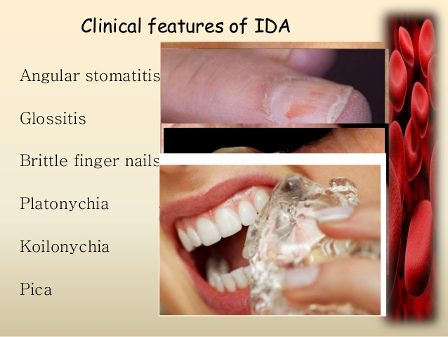

Slide 14
Stages of IDA
Normal , no IDA
Depletion of iron stores
Iron deficient erythropoieisis
Frank IDA

Slide 15
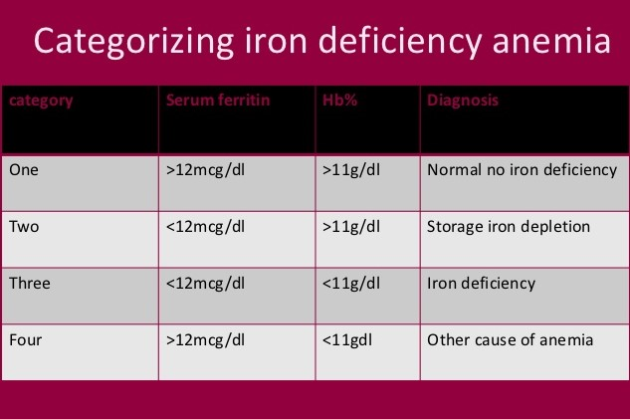

Slide 16
Iron requirement during pregnancy
Total iron requirement – 1000 mg
Daily requirements –
0.8mg In first trimester
4-6 mg/day in second trimester
6-8 mg /day in third triemster

Slide 17
Iron demand
Fetus -300 mg
Placenta – 300mg
Maternal hb mass expansion – 500 mg
Loss via shedding through gut , urine and skin – 200 mg
Loss at delivery- 150 – 200 mg
Lactation – 150 – 200 mg

Slide 18
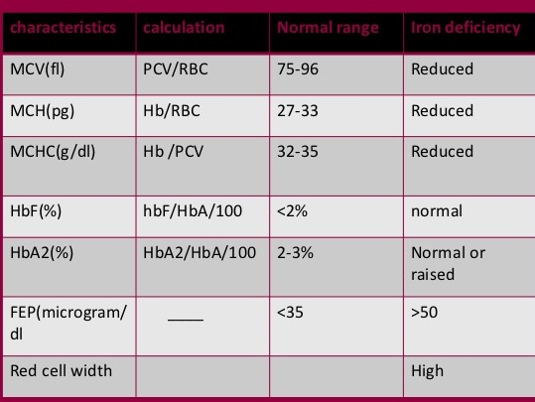
DIAGNOSIS OF IDA

Slide 19
First change is in MCV ( reduced)
Plasma ferritin – normal value is 50-155ug/dl. Any value < 20 indicates deficient iron stores and value <12 indicates complete depletion of iron stores and levels < 50 in early pregnancy is an indication for iron supplementation.
At this point peripheral smear shows abundant , small,well-rounded erythrocytes with pale centres
Along with microcycytic and hypochromia , red cell distribution width increases >15%. It is an indication of presence of a heterogenous red cell population with varying red cell diameters.

Slide 20
Serum iron concentration decreases and is <60ug/dl . Normal level is 60-175 ug/dl.
Serum transferrin level increases with the severity of iron deficiency and is >360ug/dl. Normal level is 200-360 ug/dl.
Decrease in transferrin saturation to <25%. Normal level – 25-60%
A drop In haemoglobin/haematocrit concentration characterises the final stage of IDA.

Slide 21
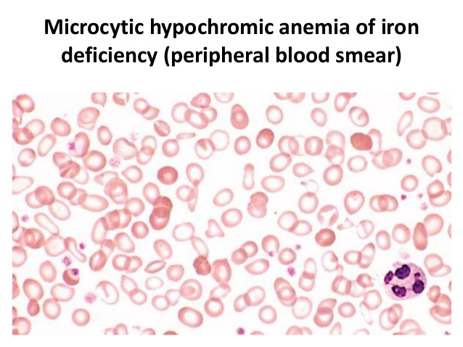
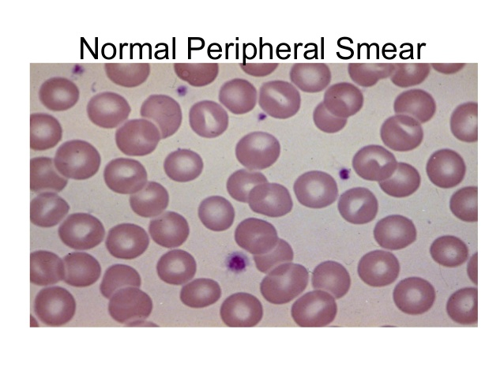

Slide 22
Management of IDA
Dietary modifications
Oral supplementation
Parenteral iron
Blood transfusion
Recombinant erythropoietin.

Slide 23
Oral iron therapy
WHO recommends routine supplementation of iron to all the pregnant women for 6 months and additional for 3 months post partum.
60 mg of elemental iron and 250ug of folic acid tablets
While the GOI , MOH recommends 100 mg of elemental iron and 500 ug of folic acid for 100 days

Slide 24
One tablet of 100-200 mg per day should be given and is sufficient to fulfill the daily needs in pregnancy .
Prophylactic dose is 100 mg per day
Therapeutic dose is 180 mg

Slide 25
DIFFERENT PREPARATIONS AVAILABLE
FERROUS SULPHATE – 300 mg
it has 60 mg of elemental iron , can be given upto 3 times a day . This dose provides 180 mg per day of which 15-25 mg/day is absorbed.
FERROUS GLUCONATE – 320 mg tablet with 36 mg elemental iron
FERROUS FUMARATE – 200 mg tablet with 67 mg of elemental iron .

Slide 26
The increase in hb with oral iron is 0.8 g / dl per week and this is reflected in a significant elevation of the H/H concentration when repeated 2 weeks after initiation of treatment.

Slide 27
Side effects of oral iron therapy
Abdominal cramps , distaste , nausea , vomiting , constipation or diarrhoea.
Disadvantage – intolerance to medication , unpredictable absorption , non compliance.

Slide 28
Parenteral iron preparations
It should be considered from second trimester onwards for women with confirmed iron deficiency who fail to respond to oral iron.
A small test dose should be given deep im due to risk of anaphylaxis
Free iron may result in production of hydroxyl radicals with potential toxicity to tissues .

Slide 29
Total dose infusion
Body weight (kg) x {target hb-pt’s hb}(g/dl) x 0.24 + 500 mg

Slide 30
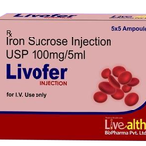
Iron sucrose
Given as infusion .
I ampoule containing 100 mg in 5 ml in 500 ml of NS over 2 hours as slow iv infusion

Slide 31
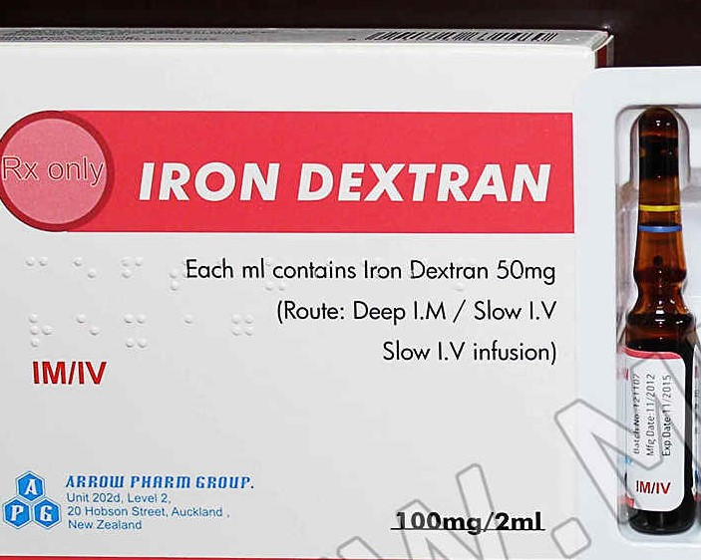
Iron dextran
Can be given direct im using z technique or can be give as slow iv infusion.

Slide 32
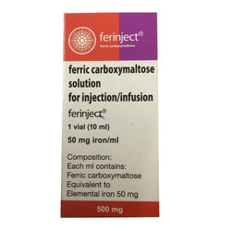
FCM- ferric carboxy maltose
Large doses can be given at once and within short interval that is 1000 mg can be infused over 15 min.

Slide 33
Iron sorbitol citrate
50 mg test dose then 100 mg im

Slide 34
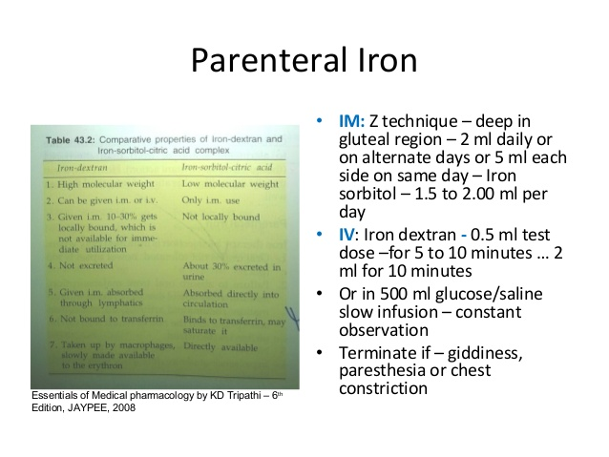

Slide 35
Megaloblastic anemia
Stage 1 – early negative B 12 balance
Stage 2 – vitamin B 12 depletion
Stage 3 – damaged metabolism . Vit B 12 deficient erythropoiesis.
Stage 4 – clinical damage
Pernicious anemia – numbness in hand and feet ; poor muscular coordination ; poor memory ; hallucinations

Slide 36
Folic acid deficiency
Tropical sprue ; pregnancy ; infants born to deficient mothers.
Alcoholics
Patients on medications that affect folic acid absorption eg anti epileptics
Malabsorption syndromes.

Slide 37
Stages of folate depletion and deficiency
Stage 1 – early negative folate balance ( serum depletion)
Stage 2 – negative folate balance ( cell depletion)
Stage 3 – damaged folate metabolism with folate deficient erythropoiesis
Stage 4 – clinical folate deficiency anemia

Slide 38
Investigations
Static test for folate deficiency / B 12 deficiency
Measured in whole blood ( plasma and cells )
and the serum alone
Difference is used to calculate the red blood cell folate concentration
B 12
Measured in serum
High homocysteine levels
Schilling test : radio labelled cobalamin is used to test for B12 malabsorption

Slide 39
Methyl malonic acid measurement can be used along with homocysteine to disinguish between B 12 and folic acid.
High FIGLU in urine is there in folic acid deficiency.
First indication of megaloblastic anemia in pregnancy is elevated MCV. The presence of hypersegmented neutrophils in peripheral smear . This is confirmed by measuring serum and red cell folate.
Serum b 12 level will be low in folic acid deficiency and vice versa but levels below 100 pg /ml is diagnostic of b 12 deficiency.

Slide 40
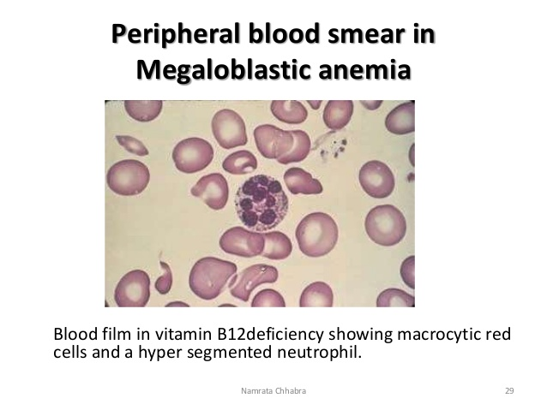
Peripheral smear

Slide 41
treatment
Prophylactic folic acid supplementation for women planning pregnancy – 400 microgram is the daily recommended dose .
Patients on folate antagonist or on anti – epileptic drugs or previous history of neural tube defects should take folic acid in a dose of 5 mg per day , 3 months prior to conception.

Slide 42
Treatment of b12 deficiency is daily B 12 injections.
1000 micrograms of parenteral cyanocobalamin every week for 6 weeks , followed by 1000 ug I M injections every month
The reticulocyte count show response to therapy in 4-6 days and hypersegmentation of neutrophils disappears after 2 weeks.

Slide 43
Hemolytic anemia
2 types
intravascular extravascular
hemolysis hemolysis
-decreased or absent -increase in by
Haptoglobin products of bilirubin.
-Free hb in circulation - fecal & urinary
-meth hb urobilinogen
-Reticulocytosis - inc. unconjugated
bilirubin

Slide 44
Both types will have reticulocytosis
Both will cause bone marrow response – marked erythroid hyperplasia and reticulocytosis.
Immature red blood cells are found in circulation.
Plasma LDH increases as it is from the red cells.

Slide 45
Aplastic anemia
It is a disease in which bone marrow and blood stem cells are damaged in the bone marrow itself
This causes deficiency of all 3 blood cell types rbc , wbc , platelets.
Diagnosis requires bone marrow biopsy
Less than 50 cases reported till now in pregnancy
Serious prognosis and maternal mortality is 30 %.
Treatment – bone marrow transplantation , anti – thymocyte globulin , cyclosporine and high dose corticosteroids.

Slide 46
haemoglobinopathies
Sickel cell anemia
Thalessemias
diagnosis is based on electrophoresis of the different types of haemoglobin present in the blood & peripheral blood pictures .

Slide 47
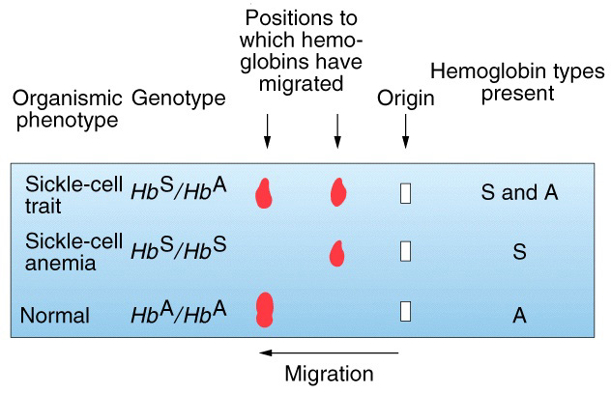
Sickel cell anemia

Slide 48
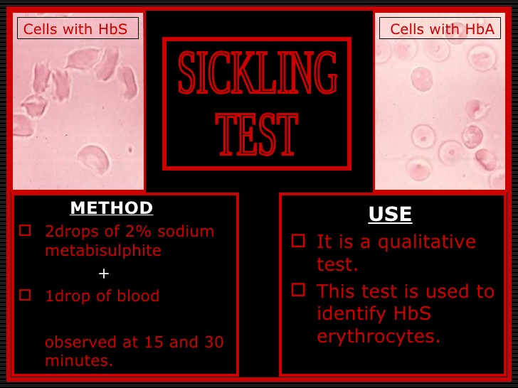
Sickling test

Slide 49
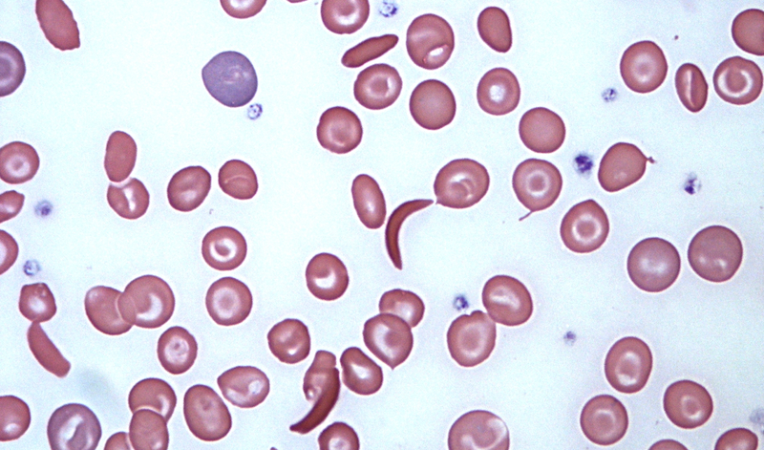

Slide 50
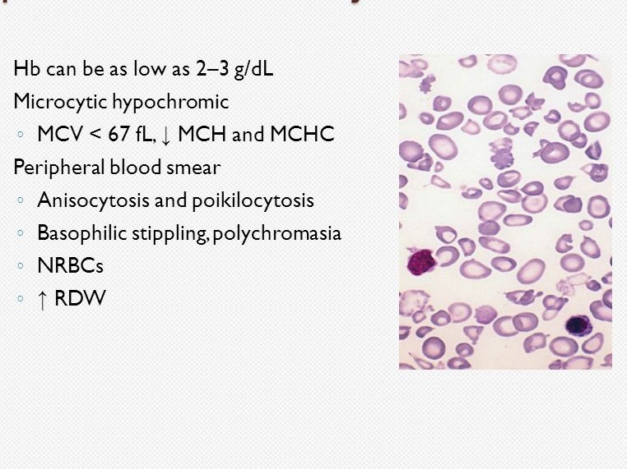
thalessemia

Slide 51
Anemia due to worm infestation
Stool examination for ova and cysts of helminths
Differential blood count will show eosinophilia.
Patients may give history of anal itching specially at night.

Slide 52
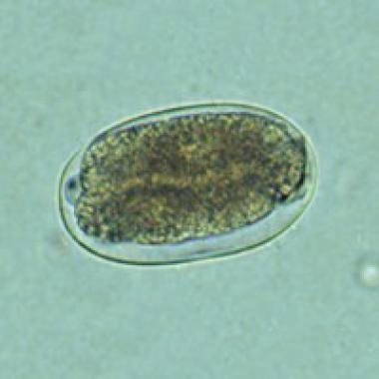
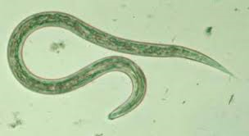

Slide 53


