Slide 1
DYSTOCIA

Slide 2
INTRODUCTION
DEFINITION
CLASSIFICATION
FRIEDMANS CURVE
PARTOGRAM
UTERINE ACTION
TYPES OF PELVIS
FETAL ANOMALIES
CONCLUTION
TAKE HOME MESSAGE
REFERANCES

Slide 3
INTRODUCTION
There are several abnormalities which interfere with the orderly progression to spontaneous delivery
Generally these are referred to as DYSTOCIA
LET US DISCUSS ABOUT THESE ABNORMALITIES IN THIS TOPIC

Slide 4
DEFINITION
Dystocia is defined as difficulty in labour
To understand Dystocia it is necessary to know adout anomalies of expulsive forces which leads to prolonged labour and obstructed labour

Slide 5
CLASSIFICATION
ABNORMLITIES OF POWER
Abnormal uterine action
Insufficient maternal effects
ABNORMALITIES IN PASSAGE
contracted pelvis
CPD
ABNORMALITIES IN PASSANGER
fetal abnormalities
macrosomia
mal position
mal presentation

Slide 6
FRIEADMANS CURVE
IT Is the graphical representation of CERVICAL DILATATION
IT INCLUDES latent phase, active phase
Latent phase __ onset of labour pain to 4cm cervical dilatation
Active phase __ 4cm to complete dilatation of cervix

Slide 7
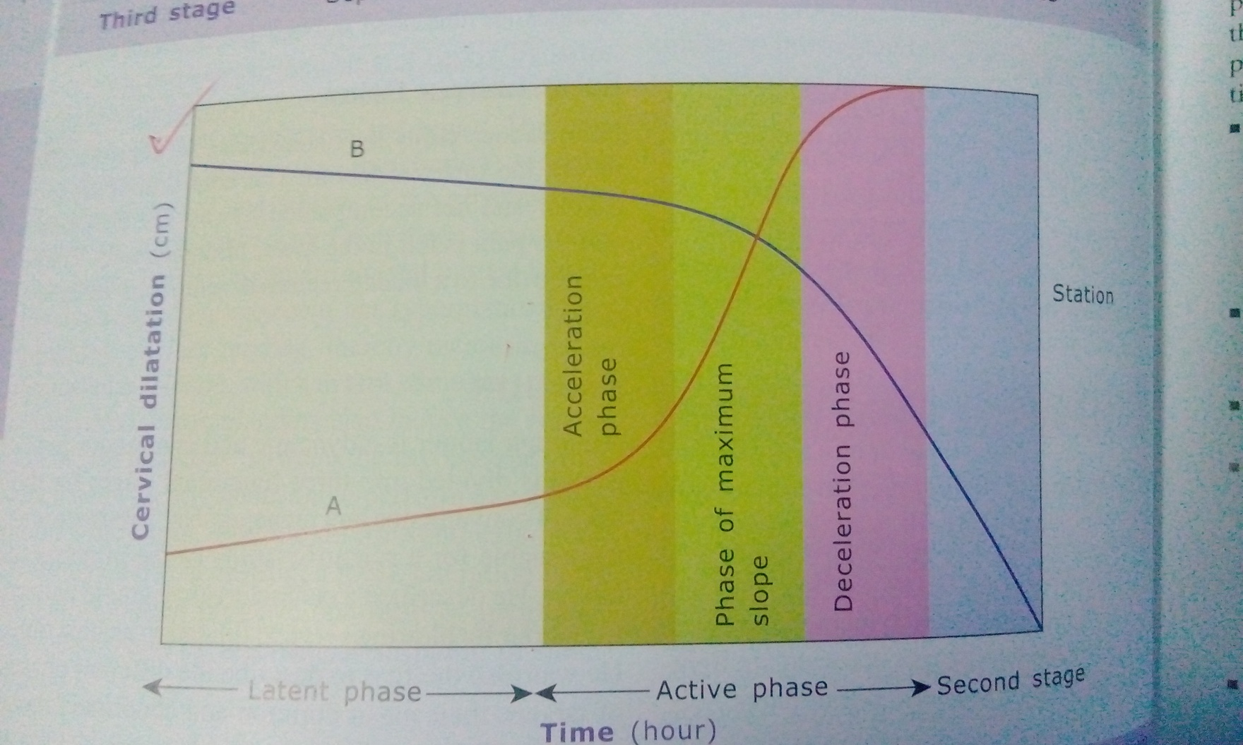

Slide 8
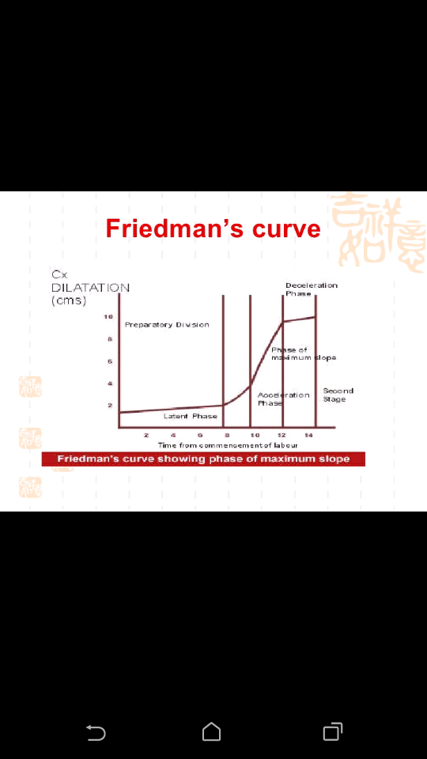

Slide 9
Latent phase
It is concerned with cervical effacement and dilatation upto 3_4cm
6_8 hrs in nullipara
4_6hrs in multipara

Slide 10
Active phase
It extends from 3_4 cm cervical dilatation to complete dilatation of cervix
5hrs in nullipara
3hrs in multipara
The MEAN RATE IN NULLIPARA IS 1.2cm/hr
in MUITIPARA IS 1.5cm/hr
The pattern of cervical dilatation is SIGMOID CURVE
The pattern of FETAL DESCENT IS HYPERBOLIC CURVE

Slide 11
Active phase
Acceleration phase
Decelaration phase
Phase of maximum slope

Slide 12
ACCELARATION PHASE_ cervical ripening and little cervical dilatation 2.5 to 4cm
PHASE OF MAXIMUM SLOPE _4 to 9cm
DECCELARATION PHASE_ 9 TO 10CM

Slide 13
PARTOGRAM
It is the PICTORIAL REPRESENTATION OF PROGRESS OF LABOUR
The main purpose of partogram is to avoid prolonged labour and intervene timely
WHO has developed partogram to improve labour

Slide 14
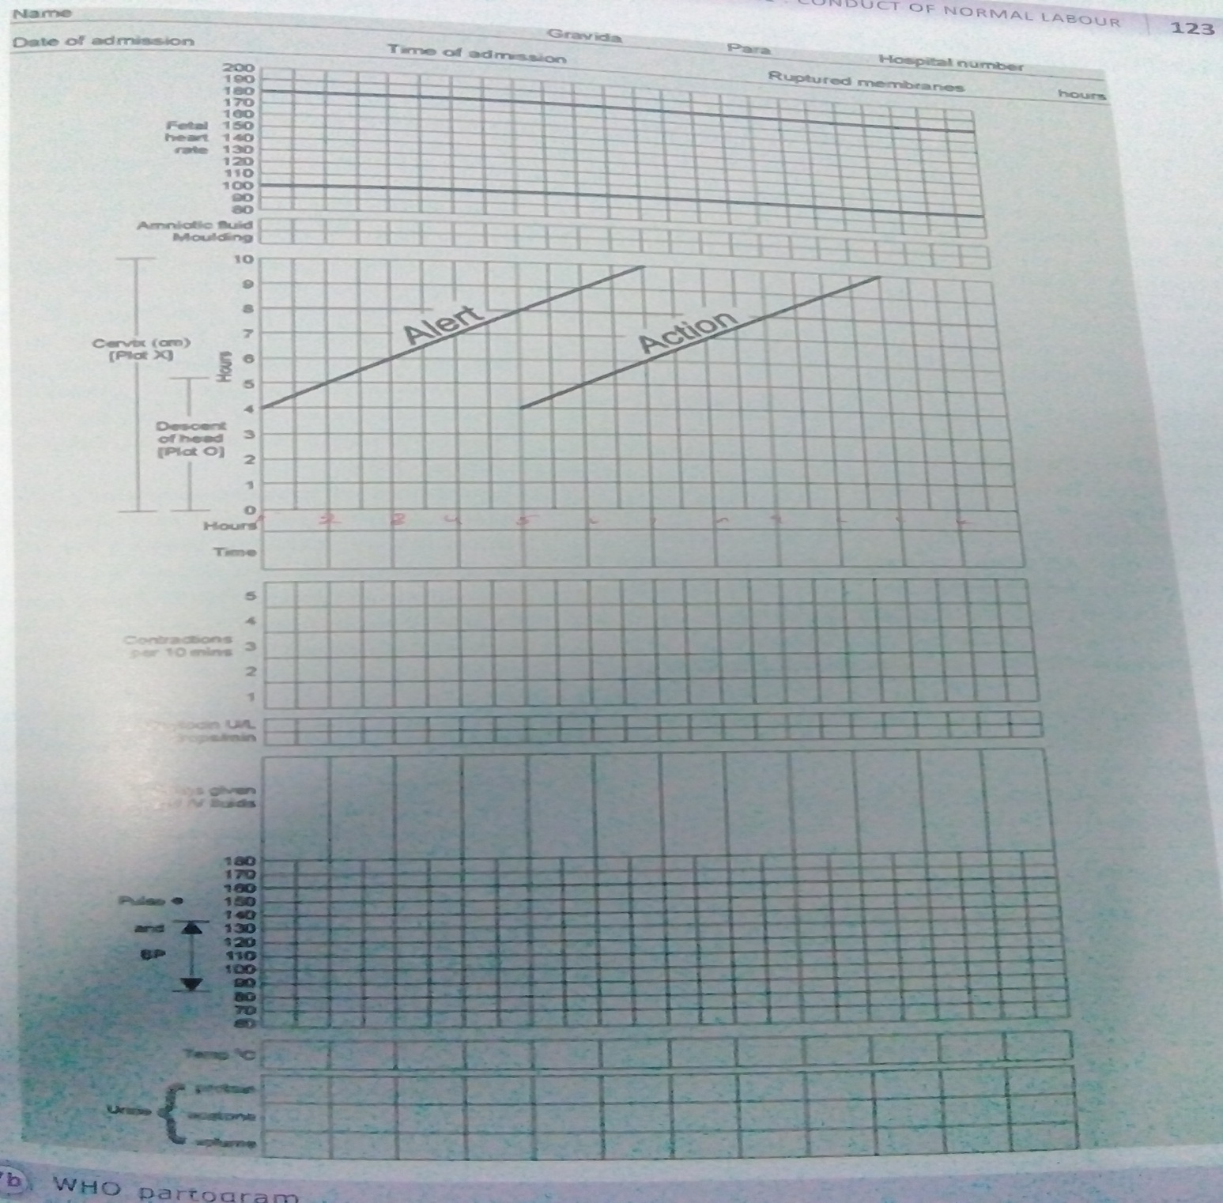

Slide 15
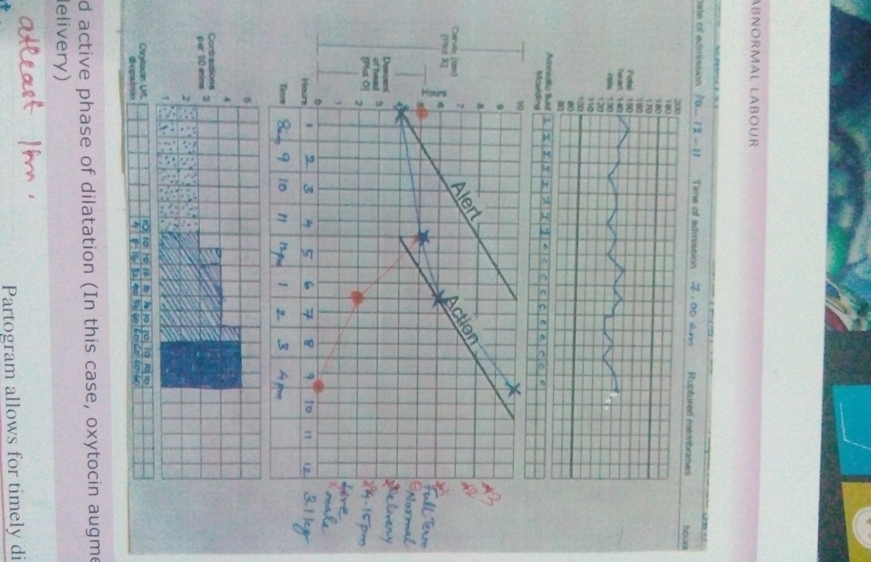

Slide 16
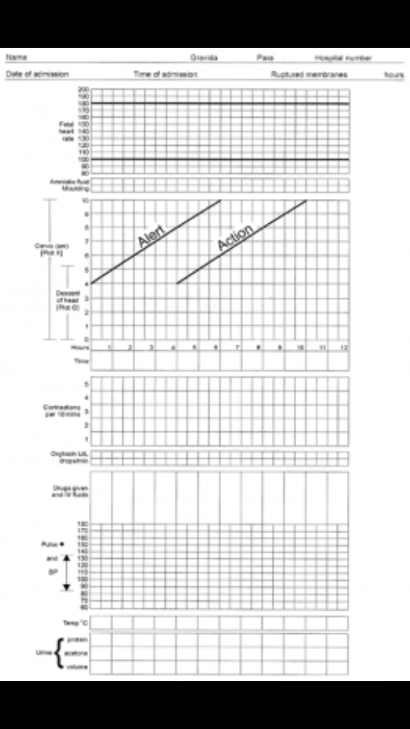

Slide 17
Details of who partogram
Divided into 3 parts
PART 1__deals with maternal data and fetal condition
Patient data:name , age , parity and hospital number
FHR
LIQUOR AMNII RECORDERED as
Intact membrane
Clear liquor
Meconium stained liquor
Blood stained liquor
Absent liquor
Moulding is recorded as +1 ,+2 ,+3 and 0 represents no moulding

Slide 18
PART 2 _ PROGRESS of labour and its middle part
Cervical dilatation in x axis
Situation of head in Y axis
Uterine contractions in 10 min
PART _3 maternal condition and its lower part
Oxytocin
Oral fluids
Drugs given
Blood pressure , pulse and temp
Urine for acetone

Slide 19
Further progress of labour is monitered by abdominal and vaginal examination at 4hrly intervals
In active phase extends from 4 to complete cervical dilatation , labour is expressed to progressed at rate of 1cm cervical dilatation per hour corresponds to ALERT LINE
ACTION LINE drawn 4 cm lateral and parallel to alert line in WHO partograh

Slide 20
If the cervical dilatation is left of alert line then its good cervical dilatation
If it crosses the alert line oxytocin intervention is needed after ruling out mal presentataion and mal position
In peripheral hospital if alert line is crossed it better to shift to higher hospitals
All patients who crosses the action line should be closely monitored
ACTION LINE_ main purpose is to judge whether time taken after crossing the alert line gives satisfactory effects

Slide 21
advantages
All information in one sheet
Low cost measure
Labour DYSTOCIA avoided
Appropriate corrective intervention is taken
Essential for active management of labour
Reduces maternal and perinatal mortality and morbidity

Slide 22
Specific labour abnormalities
Prolonged latent phase
Protracted active phase
Arrest in dilatation
Arrest in descent of labour

Slide 23
Prolonged latent phase
If latent phase lasts >20hrs in nullipara
And more than 14hrs in multipara we called as prolonged latent phase
It does not cause any damage to mother and fetus
Conservative management can be made
Bed rest
Hydration
Analgesia
In majority of cases women may be in false labour
Oxytocin should not be used unnecessarly it leads to CAESAREN SECTION

Slide 24
PROTRACTED ACTIVE PHASE
CERVICAL DILATATION >1.2cm in nullipara
And >1.5cm in multipara
PROTRACTED ACTIVE phase is defined as when cervical dilatation less than ABOVE and is common abnormal pattern seen
Due to mal presentation and mal position and CPD

Slide 25
Arrest due to dilatation
Arrest in cervical dilatation for more than 2 hrs
SAME PATIENT also show protracted active phase and arrest in cervical dilatation
CAUSES
insufficient uterine action __ oxytocin will be effective
CPD , mal presentation may also be the cause
Such cases CAESEAREN SECTION is effective

Slide 26
Arrest in descent of fetal head
Arrest in descent of fetal head atleast >1 hr
Causes
CPD
mal presentation , mal position
Inadequate uterine action
Management
CAESAREAN SECTION

Slide 27
MANAGEMENT
USE OF PARTOGRAM
IF ALERT LINE is crossed shows slow progress of labour , when crossed action line specific action to be taken
Insufficient uterine contraction and mal position is main cause of prolonged labour in NULLIPARA
In MULTIPARA if progress is slow due to CPD or mal presentation
Oxytocin use in multipara , should be caution because of rupture uterus

Slide 28
Iv fluids
Antibiotics to combact infection
Adequate analgesia
If epidural anesthesia avilable it can be given
ARM

Slide 29
Indications to caesarean section
CPD
Mal presentation

Slide 30
Normal uterine action
Normal polarity of uterus means upper segment contracts and lower segment relaxes normally there are two pacemakers situated in the cornua of uterus
These pacemaker generate uterine contractions in co ordinate fashion
Effective uterine contractions starts at cornua and sweeps downwards over the uterus

Slide 31
Normal uterine action increases in duration and frequency so that in active labour the contractions lasts for 30 to 90 seconds and frequency is atleast 3 in 10 minutes
There is differentiation of uterus into two halves upper segment contracts and lower segment passively dilates
FREQUENCY_ number of contraction occuring over a 10 min period
DURATION _ time in seconds where uterine tone is above baseline i.e time between onset and offset of contraction
RELAXATION TIME is the time between end of one contraction and beginning of the next contractions

Slide 32
Measurements of uterine activity
Manual palpation
External tocography _transducer fastened to the maternal abdomen
Cardio tocography
Internal tocography _ intrauterine pressure catheter to record intra amniotic pressure
At the end of first stage contractions usually have
FREQUENCY _ 3-5 IN 10 MIN
AMPLITUDE _>50 mmhg
DURATION about 60 sec

Slide 33
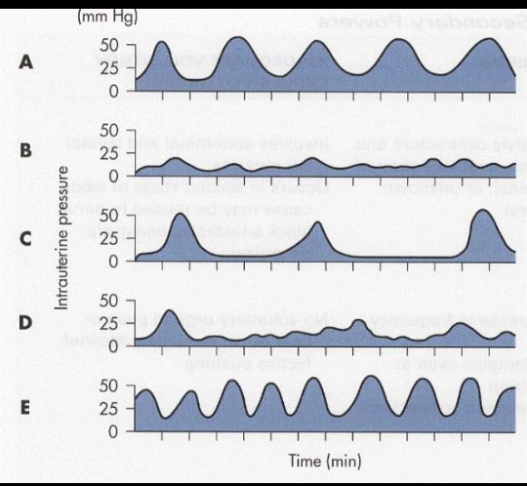

Slide 34
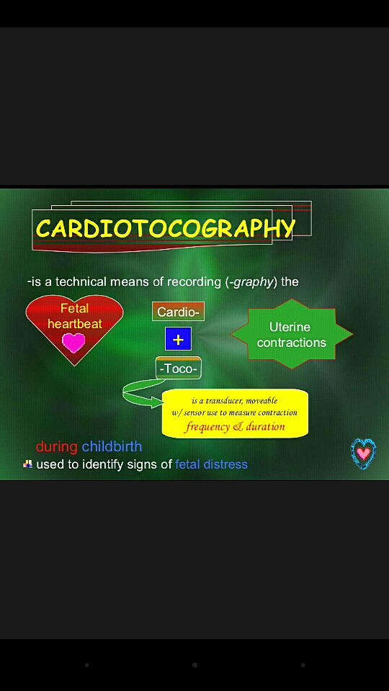

Slide 35
Abnormal uterine action
DEFINITION
any deviation in normal uterine contractions affecting the course of labour is known as abnormal uterine contraction
CLASSIFICATION
Hypotonic uterine contraction
Hypertonic uterine action
Incoordinate uterine action

Slide 36
Hypotonic uterine action
Most cause of prolonged labour is due to hypotonic uterine action
INTERVALS between contractions are LONG<3 in 10 min
DURATION is short <40SEC
INTENSITY is reduced
Intrauterine pressure contraction is below 25mmhg
SLIGHT RISE IN PRESSURE is INSUFFICENT for CERVICAL DILATATION

Slide 37
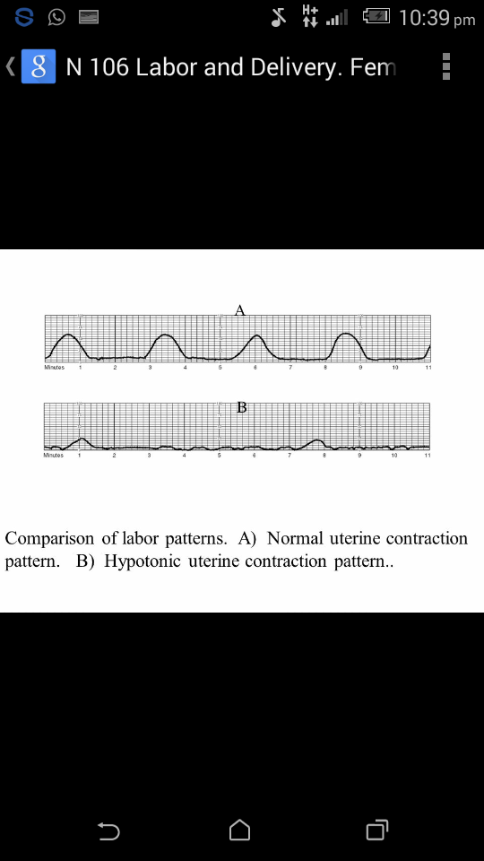

Slide 38
diagnosis
Patient feels less pain during uterine contractions
Hand placed over uterus _less hardening of uterus
Uterine walls are easily indentable at the acme of pain
Uterus becomes relaxed after contractions fetal parts are palpable FHR remains normal
Internal examination reveales
Poor cervical dilatation
Associated presence of contacted pelvis,malposition,malpresentation
Membrane usually remain intact

Slide 39
management
Maternal and fetal distress are unusual
But if membrane ruptured prematurely and labour prolonged __ intrapartum infection will set in and causes increase risk to mother and fetus
MANAGEMENT
Hypotonic inertia is ideal for OXYTOCIN INFUSION in labour
FHR should be monitored
Majarity of cases respond to this line of management and deliver vaginally
Uterine action is ineffective after premature rupture of membrane and OXYTOCIN drip after a resonable interval CESSAREAN SECTION have to be performed

Slide 40
Hypertonic uterine action
Excessive duration and frequency of contractions
IT ps defined as POLYSYSTOLE or TACHYSYSTOLE
The most common cause is excessive use of - oxytocin administration
If remedial action is not taken and dose of oxytocin is increased it will further result in hypertonic uterine activity further increase will result in TETANIC CONTRACTION
Hypertonic activity interferes with blood supply of fetus and cause fetal hypoxia
In this condition prononuced retraction involving whole of uterus upto the level of internal os
There is no physiological intervention between active upper and passive lower uterine segment.
Whole of uterus undergoes tonic muscle spasm with fetus inside

Slide 41
causes
Oxytocin
Prolonged obstructed labour

Slide 42
Hypertonicity due to oxytocin
This is the Commonest cause of hypertonicity
This causion should be exercised when giving these drugs in absence of intrauterine pressure measurements and it should be immediately withheld if FHR becomes reduced
Terbutaline0.25mg is administered as uterine relaxant

Slide 43
Hypertonicity due to prolonged labour
Uterus is in the state of continous contraction and relaxation and no rhythmic contraction of uterine musculature
Upper uterine segment contracts and retracr, while the lower uterine segment expands and dilates
While each contraction upper and lower segment become markedly differentiated due to the retraction of muscle fibers of upper uterine segment and streching of lower uterine segment

Slide 44
Bandls ring
The demarcation between the upper and lower uterine segments becomes very prominent and a well defined ridge known as RETRACTION or BANDLS RING
IT CAN BE MADE OUT BY ABDOMINAL PALPATION
At times round ligament may stand out as tense cords on either side if assistance is not rendered in time the uterus ruptures

Slide 45
Signs and symptoms
Cold and clampy
Anxious and restless
Severe and continuous abdominal pain
Pulse rapid
Temp elevated
Tongue dry
Nausea and vomiting
LOCAL SIGNS
Abdominal palpation_ tender,hard uterus,round ligament is prominent

Slide 46
A definite ring bandls ring may be present,running obliquely or transversly across the uterus,showing demarcation of upper and lower uterine segment
Hard uterus_fetal parts not palpable
FHR _cant be heard
On vaginal examination dry and warm
Presenting part jammed at some portion of pelvic canal
Large caput succedaneum may be present
Cervix edematous,edema of vagina and perineum

Slide 47
Uterus in tonic contraction _if delivery is not completed early UTERINE rupture occurs which leads to death of fetus and risk of mother
Management
Cesarean section in obstructed labour

Slide 48
complications
Fetal distress
Fetal death
Postpartum haemorrhage
Amniotic fluid embolism

Slide 49
INCOORDINATE UTERINE ACTION
Normal contractions start from the cornua of uterus and are propagated down to the body of uterus
Incoordinated uterine contractions have irregular frequency or irregularity in shape of the contractions on a cardiotocograph
Pacemaker appears all over the uterus

Slide 50
Incoordinate uterine action
Abnormal
polarity
Colicky uterus
Spastic lower segment
Constriction ring
Asymmetrical uterine contractions

Slide 51
This contraction force nethier dilates cervix nor pushes the fetus down
Uterine tonus is elevated
Pain is present before,during and after contractions
This result in fetal hypoxia in labour
On CTG the FHR shows reduced variability and late decelarations

Slide 52
Spastic lower segment
IN Uterine contraction
Fundal dominance IS LACKING
Pacemaker do not work in rhythm
The lower segment contractions are stronger
Inadequate RELAXATION inbetween contraction

Slide 53
Symptoms and signs
Patient suffers from severe pain reffered to back
Bladder is distended and often drillng of urine
Abdominal palpation
uterus tender
hardening with pain
palpation of fetal part is difficult
fetal distress appers early

Slide 54
INTERNAL EXAMINATION
cervix is thick,odematous hangs loosely like a curtain
inappropriate dilatation of crevix
absence of membrane
meconium stainned liqour may be there

Slide 55
Inadequate uterine relaxations
Placental insufficiency
Fetal distress

Slide 56
management
No role of oxytocin
Majarity of cases cesarean section is done

Slide 57
Constriction ring
Schroeders ring
Localized myometrial contractions forming a ring of circular muscle fibers of the uterus
It is situvated at the juction of upper and lower uterine segment around the constricted part of the fetus usually around the neck in cephalic presentation
Appear in all stages of labour
It is reversible and complete

Slide 58
causes
Injudious adminstration of oxytocin
Premature rupture of membranes
Premature attempt at instrumental delivery

Slide 59
diagnosis
Ring is not felt per abdomen
It is revealed during first stage in cesarean section , during forceps application in second stage of labour
In third stage it presents as HOUR GLASS CONTRACTION causing retained placenta , when manual removal under general anaesthesia
Uterus never ruptures

Slide 60
treatment
Delivery is by caesarean section

Slide 61
Constriction ring usually passes of by deepening general anaesthesia
Constriction ring usually passes of by deepening general anaesthesia
Otherwise ring has to be cut vertically to deliver the baby
The difficulties is faced during 2nd stage forceps delivary or 3rd stage hour glass contraction overcome by DEEP ANESTHESIA

Slide 62
CERVICAL DYSTOCIA
Progressive cervical dilatation needs an effective stretching force by presenting parts

Slide 63
Causes and types
Insufficient uterine contractions
Malpresentation , malposition
Spasm of cervix
TYPES
primary
secondary

Slide 64
Primary cervical dystocia
Observed during
first birth when external os fails to dilate
rigid cervix
MANAGEMENT
malpresentation , malposition caesarean section is done

Slide 65
Thin rim of cervix is left behind
Rim may be pushed up mannualy during contraction or traction is given by ventose
Duhrssen incision at 2 and 10 o clock position
followed by forceps or ventose extraction is safe and sufficient

Slide 66
Secondary cervical dystocia
Occurs due to excess scaring or rigidity of cervix from effect of previous operation or diseases

Slide 67
Difference between constriction and retraction ring
 | Constricting ring | Retraction ring
nature | Manifestation of localized incoordinate uterine action | End result of tonic uterine contraction and retraction
cause | Irritability of uterus | Followed by obstructed labour
situation | Usually situated at the junction of upper and lower uterine segment but may occur in other places also ONCE FORMED CANT BE ALTERED | Always situated at the junction of upper and lower uterine segment The position PROGRESSIVELY MOVE UPWARDS
stage | Any stage | First and second

Slide 68
Abdominal palpation | Uterus normal and not tender Fetal parts easily felt Ring is not felt Round ligament not felt FHS present | Tense and tender Not easily felt Ring is felt as groove placed obliquely Round ligament tuat and tender FHS absent
Uterine rupture | Absent | Common in multipara
Fetal anoxia | Appear late | Even death are usually early
treatment | Deep anesthesia | Caesarean section

Slide 69
Types of pelvis
As per caldwell and moloy classification
Gynaecoid pelvis
android pelvis
anthrapoid pelvis
platypalloid pelvis

Slide 70
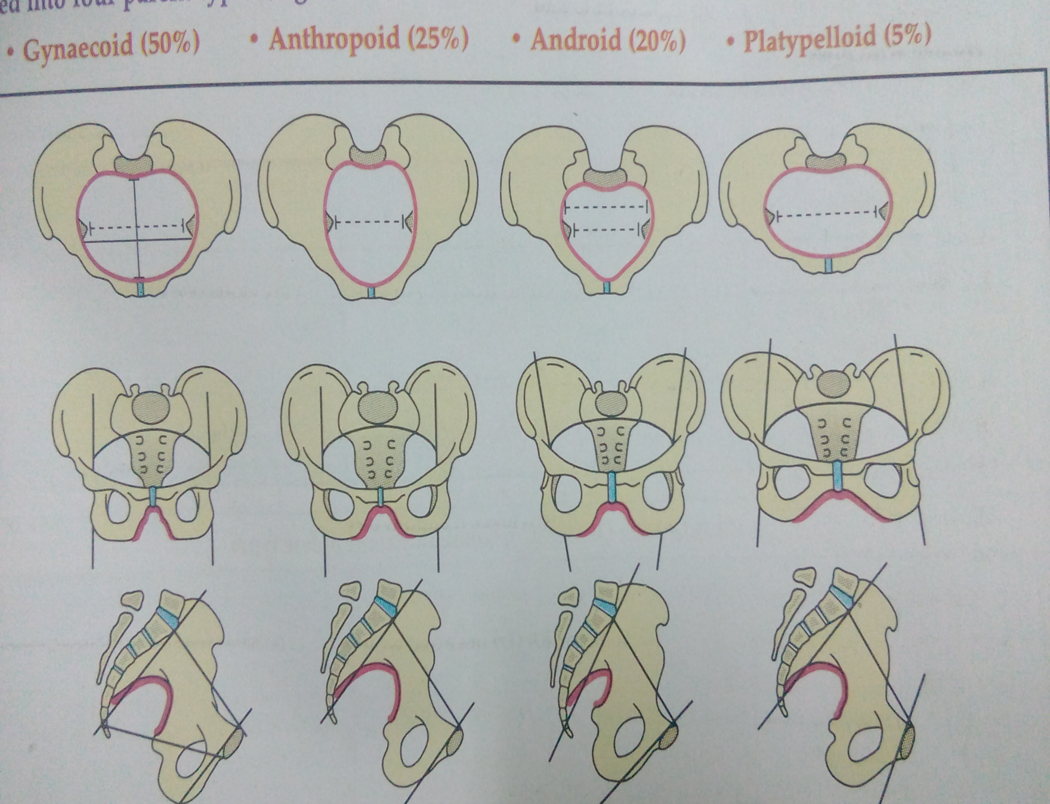

Slide 71
 | GYNAECOID | ANTHROPOID | ANDROID | PLATYPLALLOID
INLET | ROUND | OVAL | TRIANGULAR | TRANSVERSELY OVAL
Anterior and posterior segment | Equal and spacious | Increased with slight narrowing in anterior | Posterior segment short and anterior segment narrow | Both reduced _flat
scarum | >90 Curved from above downward | >90 Long and narrow | <90 Inclined forwards | >90 Inclined posteriorly

Slide 72
CAVITY | SACROSCIATIC NOTCH | Wide and narrow | Wide and shallow | Narrow and deep | Slightly narrow and deep
 | SIDE WALLS | Straight or divergent | Straight or divergent | convergent | divergent

Slide 73
 | ISCHIAL SPINE | Not prominent | Not prominent | prominent | Not prominent
OUTLET | PUBIC ARCH | curved | Long and curved | Long and straight | Short and curved
 | BITUBEROUS DIAMETER | normal | normal | short | wide
 | SUBPUBIC ANGLE | wide | Slightly narrow | narrow | Very wide

Slide 74
INLET position | Occipito anterior/transverse | DOP | OT/OP | OT
Diameter of engagement | Transeverse/oblique | anterioposterior | transverse | transverse
engagement |  |  | difficult | Delayed and difficult
CAVITY Internal rotation | Anterior rotation | Posterior rotation | Deep transverse arrest | Anterior rotation occurs

Slide 75
OULET DELIVERY | normal | Face to pubis | Difficult instrumental delivery | No difficulty

Slide 76
Diameters of female pelvis
INLET
ANTEROPOSTERIOR
Anatomical conjugate 11cm
Obstetric conjugate 10cm
Diagonal conjugate 11.5_12cm
Transverse 13.5cm
Oblique 13cm
OUTLET
Anteroposterior 9.5_11.5cm
Transverse 11cm

Slide 77
Contracted pelvis
DEFINITION
It is defined as any one of essential diameters reduced as to affect the normal mechanism of labour

Slide 78
Types of contracted pelvis
CONTRACTION DUE TO PELVIC INLET
If anteroposterior diameter <10cm
transverse diameter <12cm
diagonal conjugate <11.5cm
When there is inlet contraction , head remains high _mobile head at term in nullipara

Slide 79
Contraction of midpelvis
CONTRACTION OF MIDPELVIS
INTERSPINOUS DIAMETER <10cm
VAGINAL EXAMINATION
prominent ischial spine
convergent side walls
narrow sacrosciatic notch
loss of sacral curvature
MALPRESENTATION occipitoposterior , deep transverse arrest are common

Slide 80
Contraction of pelvic outlet
Intertuberous diameter<8cm
Narrow subpubic arch
Clinically intertuberous diameter does not allow four knuckles
Leads to PROLONGED LABOUR

Slide 81
CAUSES
Diseases of pelvic bone like rickets osteomalacia , new growth and fractures leads to contracted pelvis
DEVELOPMENTAL ANOMALIES
RACHITIC FLAT PELVIS _results if child suffers from rickets nowadays less common because of good vitamin D supplements
NAEGELES PELVIS _due to arrested development of one ala of sacrum

Slide 82
ROBERTS PELVIS _due to arrested development of two ala of sacrum
KYPHOSCOLIOSIS_ the pelvic deformity is usually secondary to tuberculosis or rickets
LOWER LIMB DEFORMITY _dislocation of shoulder , loss of limb

Slide 83
diagnosis
HISTORY
Medical diseases like rickets and tuberculosis can be identified by history itself
Previous difficult vaginal delivery or instrumental delivery
stillbirth

Slide 84
GENERAL EXAMINATION
Short stature
Abnormal waddling gait
Deformities of limbs or spine
ABDOMINAL EXAMINATION
Mobile head in nullipara_CPD_occipitoposterior position
ASSESMENT OF CPD IN MUNROKERR MULLER METHOD
Bimanual examination

Slide 85
Patient is in dorsal position leg flexed and bladder emptied
The left hand grasps head and presses into pelvic brim
The right hand is passed into vagina with aseptic precaution
The THUMB of vaginal hand palpates head over symphysis

Slide 86
By this method relative size of fetal head and maternal pelvis can be guaged
From the desecent of head and maternal pelvis or degree of overidding of head over symphysis a diagnosis of NO DISPROPOTION , MILD DISPROPOTION or MAJOR DISPROPOTION can be made.

Slide 87
Fetal problems leading to dystocia
Fetal macrosomia
Hydrocephalus

Slide 88
Fetal macrosomia
Large fetus
Macroscomia is defined as fetal or neonatal weight exceeding two standared deviations of appropriate normal population or above the 90th centile
Birth weight more than 4000g at term

Slide 89
Risk factors
Maternal diabetes
Previous large baby
Post term pregnancy
Maternal obesity
multiparity

Slide 90
In macrosomia associated with diabetes the shoulders are dispropotionatly large and hence incidence of shoulder dystocia is more compared with similar weight babies born to non diabetic mothers

Slide 91
complications
Maternal
prolonged labour
maternal injuries
increased chance of operative deliveries
FETAL
BIRTH ASPHYXIA
shoulder dystocia leading to erbs palsy
fracture of clavicle
hypoglycaemia

Slide 92
management
Planned caesarean section is especially option in diabetic mothers
If vaginal delivery is allowed , prolonged labour should be avoided by use of partogram

Slide 93
hydrocephalus
Excessive accumulation of cerebrospinal fluid in the ventricles with consequent thinning of brain tissue and enlargement of cranium
It is also associated with other congenital malformations like neural tube defect
Reaccurence rate is5%
It is one of the potential cause of obstructed labour

Slide 94
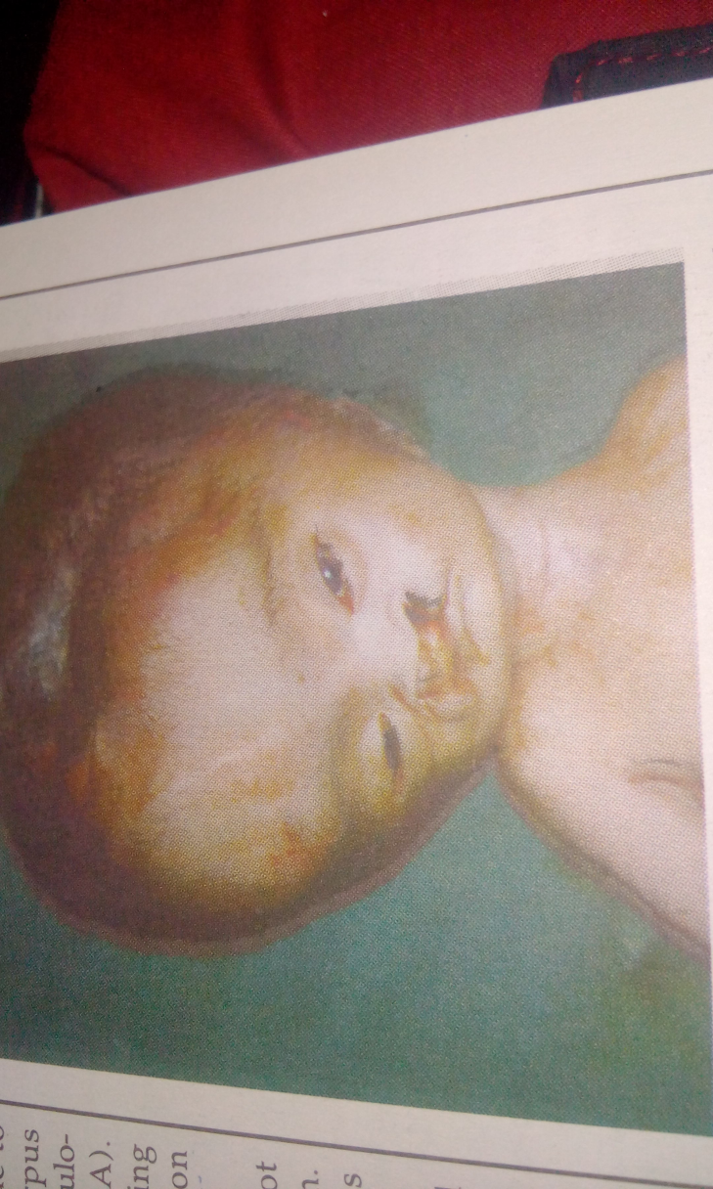

Slide 95


Slide 96
Head felt larger,globular and softer than normal head
Wide sutures and fontelles can be easily made out vaginally
Majority of fetus present as breech

Slide 97
management
Spontaneous delivery is not possible
If fetus is not salvageable cephalocentises can be performed to remove the fluid thereby reducing the head size
If left alone , obstructed labour or rupture uterus
Technique of cephalocentesis varies occurding to presentation
Vertex_transvaginally 3to4cm dilatation through a suture or fontalles using a long 17 guage needle

Slide 98
In case of breech presentation labour allowed to progress upto delivery of trunk and shoulder
Then the needle can be inserted transvaginally into aftercoming head through widended suture lines
Alternative is to perform transabdominally cehalocentesis under ultrasound guidence

Slide 99
Fetal abdomen a cause of dystocia
The main cause of widely distributed fetal bladder is due to urethral stenosis or posterior urethral valves , fetal ascites
Gross enlargement of liver and kidney
All the above findings can be identified sonologically and decision to perform ceaserean section .
If fetus asictes or distended bladder is the case tapping can be done

Slide 100
Take home message
Knowledge of partogram is essential
Crosses ALERT LINE shift the patient to higher hospitals ,if ACTION LINE intervine timely to safeguard the mother and fetus
Constriction ring cant felt abdominally , retraction ring can be felt abdominally
Gynaecoid pelvis is the most common pelvis
In hypotonic uterine contraction __ oxytocin is very effective
In case of fetal anomalies caesarean section is effective

Slide 101
conclusion
Thus by the end of the session we have discussed about abnormalites that causes DYSTOCIA
It is important to know about the PARTOGRAM , when it crosses the ALERT LINE , intervine timely and avoid prolonged ladour
In case of any abnormalities plan for ELECTIVE CAESAREAN SECTION

Slide 102
Thank you

