Slide 1
Gynaecological cancers at a glance
Cervical cancer
          Preventable cancer
Endometrial cancer
          Good cancer
Ovarian cancer
          Killer cancer
Cancer vulva
          Mutilating cancer

Slide 2
Endometrial cancer A current update

Slide 3
Introduction
Endometrial cancer
  Most common gynecologic malignancy in developed countries
  Second most common in developing countries (cervical cancer is more common)
The majority of women with endometrial cancer are diagnosed at an early stage
Distribution of stage at diagnosis is
  Confined to primary site (68%)
  Spread to regional organs and lymph nodes (20%)
  Distant metastases (8%)

Slide 4
Incidence
The incidence of endometrial cancer is very low in India
The highest being observed in Delhi (ASR*=4.3) and Bangalore (ASR=4.2) while in Mumbai it is 2.8 per 100,000¹ vs 25.1 per 100,000 in western world**
Average age of diagnosis of uterine cancer: 60 years
Lifetime risk of developing uterine cancer: 2.6%
*ASR: Age standardized rate
**Ganesh Balasubramanian, S Sushama, B Rasika, et al. Hospital-based Study of Endometrial Cancer Survival in Mumbai, India. Asian Pacific J Cancer Prev, 2013. 14 (2), 977-980
Notes:
Age-standardisation adjusts rates to take into account how many old or young people are in the population being looked at. When rates are age-standardised, you know that differences in the rates over time or between geographical areas do not simply reflect variations in the age structure of the populations. This is important when looking at cancer rates because cancer is a disease that predominantly affects the elderly. So if cancer rates are not age-standardised, a higher rate in one country is likely to reflect the fact that it has a greater proportion of older people.

Slide 5
Classification of Endometrial Carcinomas
Endometrioid adenocarcinoma
  Variants: Villoglandular or papillary, Secretory, With squamous differentiation
Mucinous carcinoma
Papillary serous carcinoma
Clear cell carcinoma
Squamous carcinoma
Undifferentiated carcinoma
Mixed carcinoma

Slide 6
Most common type of uterine cancer: adenocarcinoma of the endometrium
Two histologic categories, which differ in incidence, responsiveness to progesterone and clinical behavior
Type I tumors
Tumors of endometrioid histology that are grade 1 or 2, mucinous carcinoma
80% of endometrial carcinomas
Favorable prognosis
Estrogen-dependent
May be preceded by an intraepithelial neoplasm (atypical and/or complex endometrial hyperplasia)
Type II tumors
Account for 10 to 20% of endometrial carcinomas, but account for more than 50% of all endometrial cancer deaths
Include grade 3 endometrioid tumors as well as tumors of non-endometrioid histology: serous, clear cell, squamous, transitional cell, mesonephric and undifferentiated
Often high grade
Poor prognosis – behave like ovarian cancers
Not clearly associated with estrogen stimulation
A precursor lesion is rarely identified

Slide 7
Etiology
Estrogen
  Estrogen
    Estrogen
      Estrogen
        Estrogen
          Estrogen
Estrogen………………………………………………

Slide 9
Risk factors
HRT
Early menarche & Late menopause
Obesity, DM, HTN
Nulliparity & PCOS
Lynch II
Tamoxifen

Slide 10
Tamoxifen
Tamoxifen (selective estrogen receptor modulator)
In standard doses used in adjuvant treatment of breast cancer, it is known to cause endometrial hyperplasia and polyps, invasive endometrial carcinoma and uterine sarcoma
Causes sub-epithelial stromal hypertrophy, which gives a false impression of thick endometrium on ultrasonography → Poor correlation between endometrial thickness and abnormal pathology → so evaluate only women with AUB
Risk of developing endometrial carcinoma is estimated to be only 1.26 for 1000 patient years after 5 years of tamoxifen intake
ATLAS → ACOG → tamoxifen use may be extended to 10 years
Long-term effects of continuing adjuvant tamoxifen to 10 years versus stopping at 5 years after diagnosis of oestrogen receptor-positive breast cancer: ATLAS, a randomised trial. The Lancet, Volume 381, 2013

Slide 11
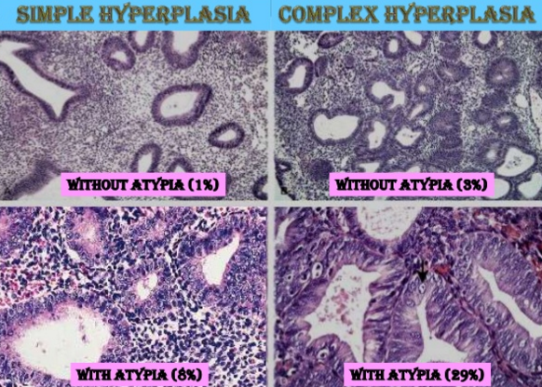
Precursor lesions
Kurman RJ, Kaminski PF, Norris HJ. The behavior of endometrial hyperplasia: a
long term study of “untreated” hyperplasia in 170 patients. Cancer 1985;56:403-412

Slide 12
Lynch II syndrome
<5% of endometrial cancer
Hereditary non polyposis colorectal cancer syndrome (HNPCC)
Autosomal Dominant disorder (Germ line mutation in mismatch repair genes, MLH1, MSH2 & MSH6)
Micro-satellite instability
Colorectal, endometrial, ovarian, gastric, ureter & skin cancer
40-60% life time risk of endometrial and colorectal cancer
Cancer tends to occur in pre-menopausal age (47 yrs vs 60 yrs)

Slide 13
HNPCC
What to do in these patients ???
There are 2 alternatives
  Annual pelvic examination, TVS & EB from the age of 30-35yrs
  OR
  Prophylactic TAH & BSO after completion of child bearing (Preferred alternative)

Slide 14
The Benefits and Risks of Estrogen in HRT
Benefits: helps relieve hot flashes, vaginal dryness and prevents osteoporosis
Unopposed estrogen increases the risk of endometrial hyperplasia and endometrial cancer
  20-50% of women will have developed endometrial hyperplasia after 1 year
  Risk of endometrial cancer is related BOTH to dose and duration of treatment
  Thus, in women taking estrogen alone for 10 years, the incidence of endometrial cancer goes from 1/1000 to 42/1000

Slide 15
Protective factors
Oral contraceptive pills:1 year of use confers 30-50% reduced risk
  Risk reduction is up to 10-20 yrs
  Progestin component has chemo protective role
Progesterone IUCDs confers long term protection
Earlier age of menopause
Smoking

Slide 16
Screening tests
Pap smear
TVS
Endometrial biopsy
  VABRA
  Pipelle

Slide 17
Screening=???...
Disease is not so prevalent and screening test should be acceptable, reproducible, valid (sensitivity) and cost effective
Pap test: Inadequate, Insensitive
Trans vaginal sonography: Too expensive
Endometrial biopsy: Invasive
The current tests can only detect 50% of all cases of Ca endometrium

Slide 18
What to do?
EARLY DIAGNOSIS & TREATMENT

Slide 19
Early diagnosis & prompt treatment has high cure rate
If a lady comes with:
Premenopausal AUB
  25% of the endometrial cancer occurs premenopausally
  5-10% under the age of 40 yrs
Post menopausal bleeding
Abnormal perimenopausal BPV – bloody menopause

Slide 20
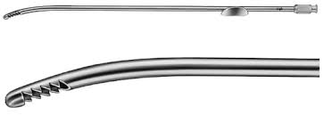
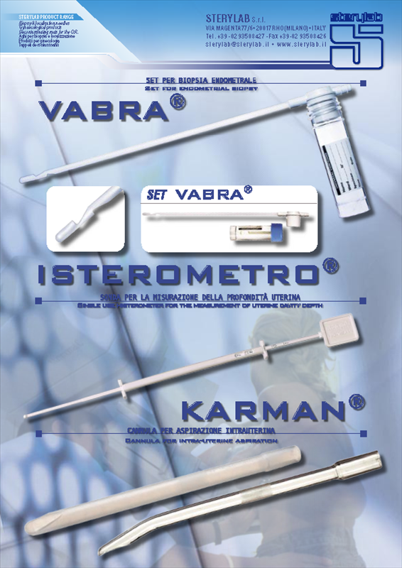
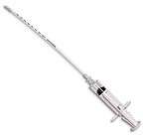
Endometrial biopsy
First step in the evaluation of endometrium → office endometrial biopsy
Novak curette, Pipelle endometrial suction curette and Vabra aspirator
Success of the procedure is affected by → cervical stenosis, alteration of endometrial cavity by submucous fibroids and the size of the lesion itself
In small lesions → the yield of office endometrial biopsy can be increased by combining it with office hysteroscopy
False negative rate: 10% → further evaluation is recommended if the results come back as normal with persistent symptoms or abnormal pelvic imaging
Notes:
Accuracy for diagnosis of endometrial cancer is almost similar among these three (Novak curette: 67–97%, Pipelle endometrial suction curette: 79–94%, Vabra aspirator: 80–98%)

Slide 21
Pre-treatment evaluation (contd….)
Transvaginal ultrasound (TVUS): useful adjunct to office EB in the initial evaluation of endometrial pathology
ET >5 mm: abnormal in PM women
BEWARE: Type II endometrial cancers will have a thin endometrium as these cancers develop in a background of atrophy
Good negative predictive value (99%) but a poor positive predictive value (57%)
Notes:
Morphology of ET: Diffuse endometrial thickness may be due to endometrial hyperplasia or carcinoma and a non-focal blind biopsy is sufficient for diagnosis, whereas, focal endometrial biopsy can be due to lesions like polyps, either benign or malignant, and require hysteroscopic guided biopsy. Other morphological features described by researchers to indicate malignancy are heterogenous and hyperechoic with irregular borders

Slide 22
Pre-treatment evaluation (contd….)
Colour Doppler used along with TVUS
  Broad based lesions with diffuse high level of vascularity indicate malignant lesions and single feeding vessel in the stalk of a focal lesion with low vascularity indicates benign condition like polyps
Sonohysterography: good at detecting benign conditions, but positive predictive value for cancer prediction is very poor (16%)
Hysteroscopy and guided biopsy: useful in small lesions and in tamoxifen induced thick ET
  Concern → dissemination of cancer cells in peritoneal cavity

Slide 23
Initial evaluation of endometrial cancer (NCCN 2016 and ESMO 2013)
Recommended |  | Optional
Clinical and gynaecological examination |  | Genetic counseling in women < 50 years and in those with family history of endometrial cancer and colon cancer
Histopathology of endometrial biopsy |  | Cervix biopsy or MRI in suspected cases of cervical involvement
CBC including platelets |  | CA-125 (optional), MRI, CECT in suspected extra uterine disease
Chest X-ray |  | FDG PET-CT ([18F] 2-Fluoro-2deoxy-D-glucose–positron emission tomography) in suspected distant metastases
Liver function and renal function tests

Slide 24
Imaging in the pre-op workup of endometrial cancer
TVUS, Doppler, CECT, MRI and FDG PET
Helps in determining the need for
  Lymphadenectomy
  Radical hysterectomy
  Pre-operative radiotherapy
To assess for hormonal treatment in women who are desirous of further child-bearing

Slide 25
Accuracy of imaging in work up of endometrial Ca
Imaging modality | Cervical stromal involvement | Myometrial invasion | Distant spread
USG | 69% | 68% | Poor
MRI | 80% | 90% | Good
CECT | 58% | 76% | Good
FDG PET: (Positron emission tomography (PET) with the radioactive glucose analogue 18-2-fluorodeoxy-2-deoxy- d -glucose (18-FDG)): useful in extra-pelvic and nodal metastases

Slide 26


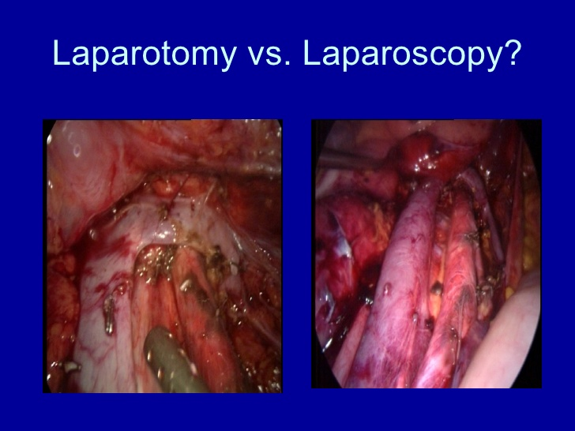


Treatment

Slide 27
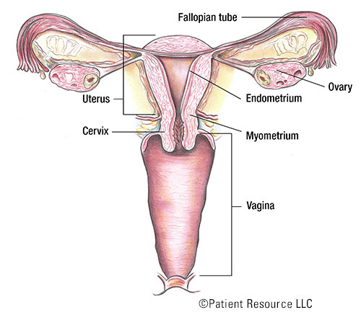
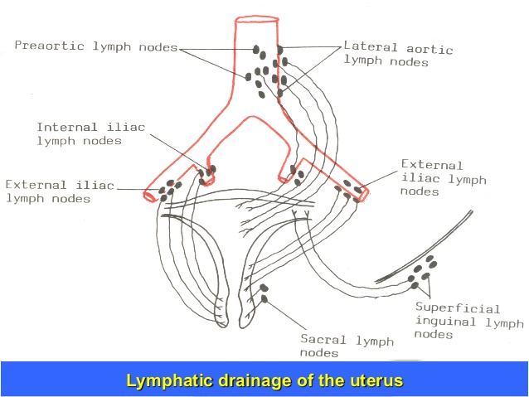
Anatomy of uterus

Slide 28
Surgical staging
Including abdominal exploration, peritoneal cytology, hysterectomy, bilateral salpingo-oophorectomy, and selective pelvic and para-aortic lymphadenectomies
Indications for pelvic and para-aortic lymph node dissection
  Tumour histology clear cell, serous, squamous, or grade 2-3 endometrioid
  Myometrial invasion > 50%
  Isthmus-cervix extension
  Tumor size >2 cm
  Extra-uterine disease

Slide 29
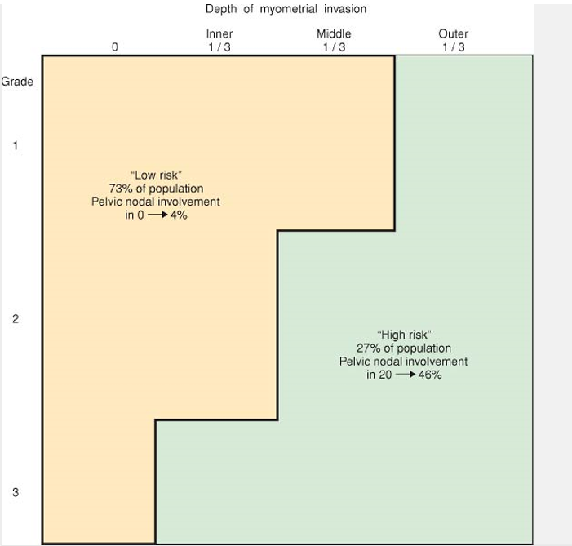
The risk for pelvic lymph node metastasis with grade and depth of myometrial penetration in clinical stage I endometrial cancer

Slide 30
FIGO 2009 staging
Stage I- Tumour confined to corpus uteri
  IA- No or <50% of myometrial invasion
  IB- >50% of myometrial invasion, cervical glandular involvement
Stage II- Tumour invades cervical stroma, but does not extend beyond the uterus
Stage III- Local &/or regional spread of tumour
  IIIA- Serosa of uterus &/or adenexa
  IIIB- Vaginal &/or parametrial involvement
  IIIC- Pelvic (IIIC1) &/ or Para-aortic LN (IIIC2)
Stage IV- Bladder &/or Bowel mucosa (IVA) &/or distant mets (IVB)

Slide 31
Surgical treatment (Laparotomy/Laparoscopy/Robotic)
Stage I
  I A G1–G2
    Hysterectomy with bilateral salpingo-oophorectomy
  I A G3 & I B G1 G2 G3
    Hysterectomy with bilateral salpingo-oophorectomy ± bilateral pelvic & para-aortic lymphadenectomy

Slide 32
Contd….
Stage II: Radical hysterectomy with bilateral salpingo-oophorectomy and bilateral pelvic & para-aortic lymphadenectomy
Stage III: Maximal surgical cytoreduction with a good performance status
Stage IV:
  IV A: Anterior and posterior pelvic exenteration
  IV B: Systemic therapeutical approach with palliative surgery

Slide 33
Vaginal hysterectomy
In selected patients who are
  extremely obese
  have a poor medical status
  for patients with extensive uterovaginal prolapse
Disadvantages: bilateral salpingo-oophorectomy often is technically difficult and abdominal exploration and lymph node sampling cannot be performed
Suitable for patients with low grade IA disease

Slide 34
Prognostic factors
Multiple factors have been identified for high risk of recurrence in apparent early-stage disease:
  Age
  Histological subtype
  Grade 3 histology
  Myometrial invasion ≥50%
  LVSI
Lymph node metastases
Tumour diameter >2 cm
Hormone receptor status
DNA ploidy/proliferative index
Genetic/molecular tumor markers

Slide 35
Risk stratification
Stage I can be subdivided into three risk categories
Low risk: Stage IA (G1 and G2) with endometrioid type
Intermediate risk: Stage IA G3 with endometrioid type, Stage IB (G1 and G2) with endometrioid type
High risk: Stage IB G3 with endometrioid type, all stages with non- endometrioid type

Slide 36
Adjuvant treatment (ESMO guidelines 2013)
Stage I | Low risk | I A G1–G2 | Observation
 | Intermediate risk | IA G3 | Observation or vaginal BT*
 |  | I B G1 G2 | Observation or vaginal BT*
 | High risk | IB G3 | Pelvic RT*
*If negative prognostic factors (LVSI and tumor size>2 cm) → pelvic RT and/or adjunctive chemotherapy could be considered

Slide 37
Stage II | Pelvic RT and vaginal BT
 | If grade 1–2 tumour, myometrial invasion<50%, negative LVSI and complete surgical staging: brachytherapy alone
 | If negative prognostic factor: chemotherapy ± radiation
Stage III–IV | Chemotherapy (Doxorubicin, Platins and Taxols)
 | If positive nodes: sequential radiotherapy
 | If metastatic disease: chemotherapy & RT for palliative treatment

Slide 38
Fertility sparing treatment
Fortunately not a common scenario
  less than 10% of endometrial cancers occur in women less than 40 years
Possible only in well-differentiated early endometrial cancer in the absence of any myometrial invasion or adnexal disease seen on imaging
Progestogens, antiestrogens, GnRHas and aromatase inhibitors
High dose medroxy progesterone acetate (600 mg/day orally) and megesterol acetate (160-320 mg/day orally)
Side-effects: thrombus formation, mood alterations, headaches, weight gain and breast pain and/or tenderness
LNG IUS

Slide 39
Fertility sparing treatment (contd….)
Endometrial sampling 3 monthly → to assess the response to treatment
Response to treatment → 73–81%, but not absolute
Pregnancy rates of 40% and subsequent live birth rates up to 47%
Recurrence rates → 18–40% (follow-up times up to 358 months)
The biggest concern: disease progression while on treatment or after initial response to medical treatment
Women opting for conservative management should be aware that hormonal therapy is not the standard form of management and regular follow up is essential
Gotlieb WH, Beiner ME, Shalmon B, et al. Outcome of fertility-sparing treatment with progestins in young patients with endometrial cancer. Obstetrics and Gynecology. Oct 2003;102(4):718–25.

Slide 40
Estrogen Therapy after Treatment of Endometrial Cancer
Disease confined to uterus
  No evidence that estrogen therapy after apparently successful treatment of endometrial cancer increases the risk for cancer recurrence
Disease beyond uterus
  Topical estrogen for vaginal symptoms
  Symptomatic relief of hot flashes: medroxyprogesterone acetate, 10 mg orally daily or 150 mg intramuscularly every 3 months, or non-hormonal agents such as Peroxotine, Bellergal, clonidine, and venlafaxine

Slide 41
Follow-up after Treatment
History and physical examination remain the most effective methods of follow-up in patients treated for endometrial cancer
Patients should be examined every 3 to 4 months during the first 2 years and every 6 months till 5th year and yearly thereafter for life
Chest x-ray every 12 months
CECT/PET– only if clinically s/o disease recurrence

Slide 42
Survival
The overall 5-year survival rate → 76%
Patients who underwent surgical staging had much better 5-year survival rates than those staged clinically across all stages
  Stage I: 87% versus 54%
  Stage II: 76% versus 41%
  Stage III: 57% versus 23%
  Stage IV: 18% versus 12%

Slide 43

Recurrence

Slide 44
Recurrence
About 1/4th of patients treated for early endometrial cancer develop recurrent disease
More than half of the recurrences develop within 2 years and about 3/4th occur within 3 years of initial treatment
Asymptomatic, vaginal bleeding, pelvic pain, haemoptysis, anorexia, nausea & vomiting, seizures, jaundice

Slide 45
Treatment of recurrence
For central pelvic recurrence, the treatment of choice is surgery or radiation therapy, while for regional pelvic recurrences it is radiation therapy, associated if possible with chemotherapy
High rates of local control: complete response (CR) and a 5-year survival of 50%
Treatment of metastatic disease and relapse: endocrine therapy or cytotoxic chemotherapy
Hormonal therapy is recommended for endometrioid histologies with ER/PR +ve only and involves mainly the use of progestational agents, tamoxifen and aromatase inhibitors

Slide 46
Land mark trials in Endometrial Ca
PORTEC 1 (Post Operative Radiation Therapy in Endometrial Carcinoma)
PORTEC 2: Vaginal brachytherapy versus pelvic external beam radiotherapy
Benedetti Panici
MRC ASTEC trial
Lap 2 trial by GOG: Laparoscopy Compared With Laparotomy
EORTC and MANGO trial: Sequential adjuvant chemotherapy and radiotherapy
PORTEC 3: combined chemotherapy and radiotherapy (ongoing)
Lymphadenectomy in early Endometrial Ca

Slide 47
Controversies in Endometrial Ca
Peritoneal cytology?
Radical hysterectomy?
Omentectomy?
Chemotherapy?

Slide 48
Post test
Question 1
Factor which decreases the risk of endometrial cancer?
Estrogen replacement therapy
Tamoxifen
OC pills
Poly cystic ovarian syndrome
Diabetes

Slide 49
Question 2
A lady is diagnosed with endometrial cancer which is extending to the cervical stroma and her pelvic lymph node biopsy came to be +ve. In which stage you would like to keep her?
a) Stage IA
b) Stage II
c) Stage IIIA
d) Stage IIIC

Slide 50
Question 3
If a lady is diagnosed to have ca endometrium which has spread to the endocervical glands. Under which stage you would like to keep her?
Stage IA
Stage IB
Stage II
Stage IIIA

Slide 51
Question 4
A 50 yr old lady has been diagnosed of having papillary serous carcinoma endometrium and another lady is diagnosed of having mucinous carcinoma. Both are in stage II. Which lady is going to survive more after therapy?

Slide 52
Question 5
What is corpus cancer syndrome?

Slide 53
Question 6
Following surgery for endometrial cancer, adjuvant irradiation improves overall survival. True or false

Slide 54
Question 7
What percentage of endometrial cancers occur in women less than 40 years?

Slide 55
Question 8
What is the dose of medroxy progesterone acetate for fertility sparing treatment of early endometrial cancer?

Slide 56
Question 9
Indications for Pelvic and Para-aortic Lymph node dissection are all EXCEPT
Myometrial invasion >50%
Isthmus-cervix extension
Extra-uterine disease
All the above

Slide 57
Question 10
Progestins can be used as adjuvant treatment after primary surgery for stage 1B Grade 2 endometrial cancer. True or false?

Slide 58
Summary and recommendations
Uterine cancer: most common gynaecologic malignancy in developed countries and second most common in developing countries (cervical cancer is more common)
The majority of uterine cancer are diagnosed at an early stage (68%)
Endometrioid (type I) endometrial carcinoma, the most common type of uterine cancer, typically has a favorable prognosis and is estrogen-responsive
Type II endometrial carcinomas (eg, grade 3 endometrioid carcinoma, carcinosarcoma, serous, clear cell) have a worse prognosis

Slide 59
Contd….
The main risk factor for type I endometrial carcinoma is an excess of endogenous or exogenous estrogen without adequate opposition by a progestin
Office EB and TVS are the first line investigations
Surgery alone is usually curative for women who are at a low risk of disease persistence or recurrence. Women with intermediate- or high-risk disease may benefit from adjuvant therapy
In general, the rate of five-year survival for stage I endometrial carcinoma is approximately 80 to 90 percent, for stage II it is 70 to 80 percent, and for stages III and IV it is 20 to 60 percent

Slide 60
Live as if you were to die tomorrow
Learn as if you were to live forever
Mahatma Gandhi

Slide 61

Thanks for your patient listening!

