Slide 1
FETAL CIRCULATION

Slide 2
The fetal blood moves to and from the placenta at the attachemnt of the umbilical cord.
Fetal DEOXYGENATED blood flows from the fetus to the placenta via TWO UMBILICAL ARTERIES.
OXYGENATED blood flows from the placenta to the fetus via ONE UMBILICAL VEIN.

Slide 3
Differences from the adult circulation
-fetal blood is not oxygenated in the lungs,so major portion of the right ventricular output bypasses the lungs.
-the fetal heart chambers work in parallel not in series as in adult,so brain and heart get more oxygenated blood than the rest of the body
-well oxygenated blood enters the left ventricle which supplies the heart and the brain and less oxygenated blood enters the right ventricle which supplies the rest of the body.

Slide 4
BLOOD FLOW

Slide 5
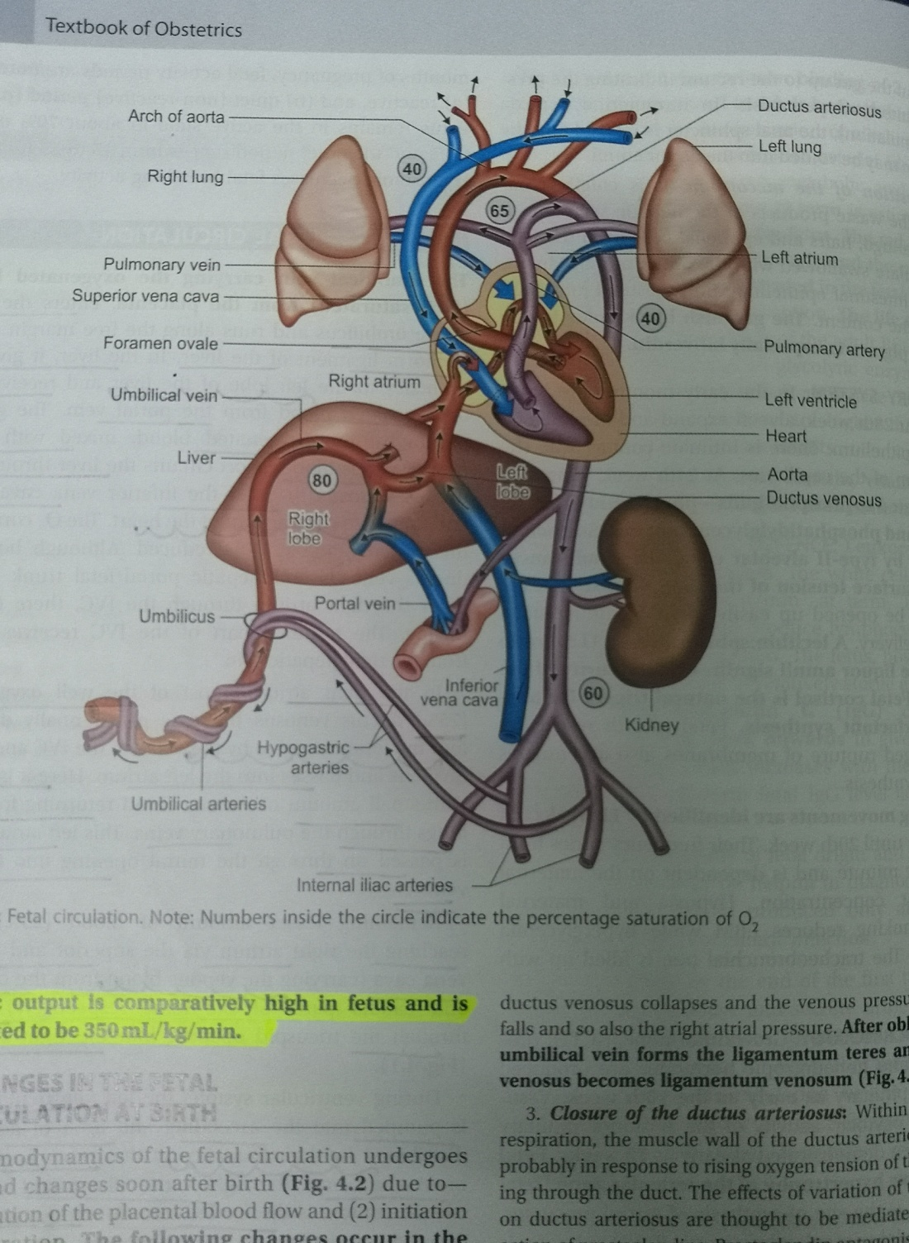
Blood vessels traverse umbilical cord and enter the umbilicus of the fetus(2 umbilical arteries+ 1 umbilical vein}
UMBILICAL VEIN carries oxygenated blood from the placenta,passes directy to the liver.

Slide 6
In the liver,the vein gives two branches DUCTUS VENOSUS- which carries greater part of the blood directly to the INFERIOR VENA CAVA and the PORTAL SINUS which carries blood to the hepatic veins mainly on the left side of the liver where oxygen is extracted.
The deoxygentaed blood from the liver flows back to the inferior vena cava,which also receives LESS OXYGENATED BLOOD from the LOWER PARTS OF THE BODY.

Slide 7
Therefore,
BLOOD FLOWING TO THE FETAL HEART from the INFERIOR VENA CAVA consists of,
-OXYGENATED BLOOD FROM DUCTUS VENOSUS
-DEOXGENATED BLOOD FROM THE LIVER
-DEOXYGENATED BLOOD FROM THE LOWER PARTS OF THE BODY.

Slide 8
From the inferior vena cava,the blood moves to the RIGHT ATRIUM.
From the right atrium the blood moves either to the LEFT ATRIUM OR THE RIGHT VENTRICLE depending on the OXYGEN CONTENT of the blood in the inferior vena
-well oxgenated blood:moves along the medial side of inferior vena cava.
-less oxygenated blood:moves along the lateral side of inferior vena cava.

Slide 9
Once the blood is in the right atrium
THE CRISTA DIVIDENS: shunts the well oxygenated blood from the medial side of the inferior vena cava and ductus venosus through the FORAMEN OVALE to the left heart and then to heart and brain.
Once the tissues extract the oxygen,the less oxygenated blood returns to the right heart through the superior vena cava.

Slide 10
the less well oxygenated blood along the lateral side of the inferior vena cava and the less well oxygenated blood from the brain and upper body enters the right atrium and is deflected through the tricuspid valve to the right ventricle
*as a result the right ventricle is 15-20%less saturated than the blood in the left ventricle.

Slide 11
From the right ventricle,about 90% of the blood exiting the right ventricles ia shunted through DUCTUS ARTERIOSUS TO THE DESCENDING AORTA
Aorta divides into common iliac >internal iliac and external iliac>internal iliacs>two hypogastric arteries>distally become umbilical arteries
PLACENTA, and the circulation continues.

