Slide 1
FETUS IN NORMAL PREGNANCY

Slide 2
The fetus lies inside the uterus in a closed sac filled with liquor amnii.
Periodic examination is needed to know the lie, presentation ,position and attitude

Slide 3
LIE :the lie refers to the relationship of the long axis of the fetus to the long axis of the centralized uterus. The cephalopodalic axis is the longitudinal axis of the fetus.
-most common lie: longitudinal
-others :-transverse
oblique

Slide 4
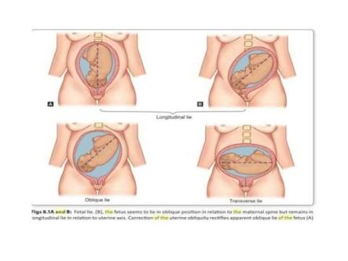

Slide 5
PRESENTATION: the part of the fetus which occupies the lower pole of the uterus and the first to engage in the pelvis when labour starts.
-cephalic
-podalic
-shoulder
-compound

Slide 6
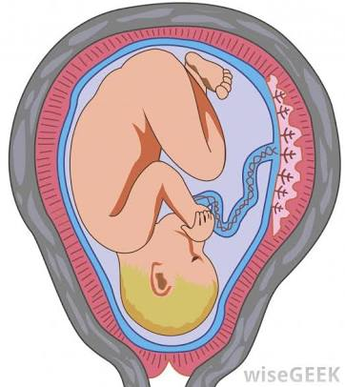
CEPHALIC

Slide 7
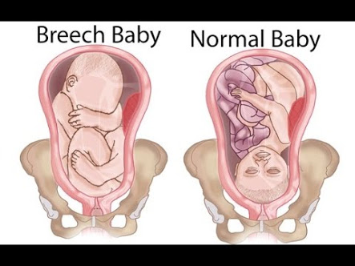
BREECH

Slide 8
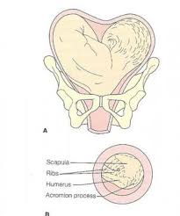
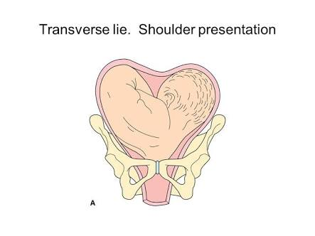
SHOULDER

Slide 9
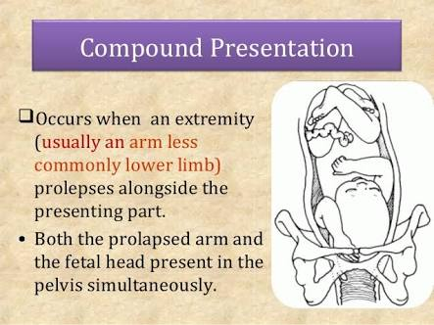

Slide 10
PRESENTING PART: the part of the presentation which overlies the internal os
-felt by the examining finger through the cervical os
cephalic 1.vertex 2.brow 3.face
breech 1.pelvis
shoulder 1.shoulder

Slide 11
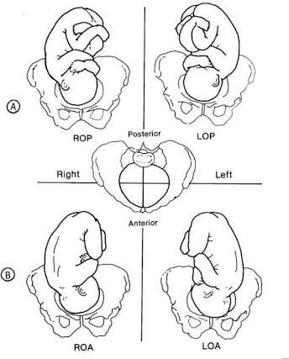
VERTEX
(MOST COMMON)

Slide 12
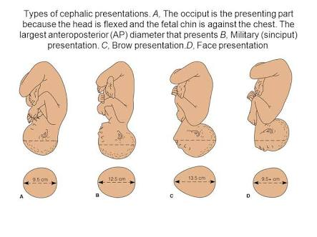
BROW AND FACE

Slide 13
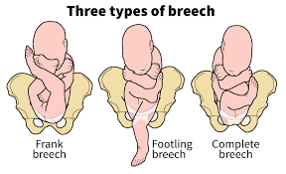

Slide 14
ATTITUDE: it is defined as the relationship of the fetal head to the spine
-relationship of different parts of the fetus to one another
the common attitude are-
flexion,extension,deflexion
THE UNIVERSAL ATTITUDE IS THAT OF UNIVERSAL FLEXION

Slide 15
DENOMINATOR: it is an arbitrary bony fixed point on the presenting part
POSITION: is the relation of an arbitrarily chosen position of the fetal presenting part to the four quadrants of the maternal pelvis
-it is the relation of the denominator to different quadrants of the pelvis

Slide 16
The four quadrants in any plane of the pelvis may be divided into TWO RIGHT QUADRANTS
-the right anterior
-right posterior
TWO LEFT QUADRANTS
-the left anterior
- left posterior

Slide 17
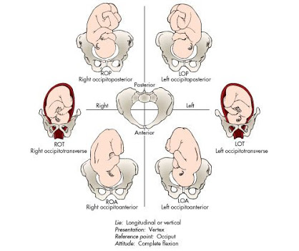
Mc:left occipitoanterior

Slide 18
presentation | Presenting part | denominator
cephalic | vertex | occiput
cephalic | face | Mentum/chin
cephalic | brow | Frontal eminence
breech | pelvis | sacrum
shoulder | shoulder | acromion

Slide 19
FREQUENCY OF PRESENTATIONS AND POSITIONS
Vertex-96% of cases
Breech -3% of cases
Face -0.5% of cases
Shoulder-0.5% of cases
Among VERTEX :the most commonly adopted by the fetus LEFT OCCIPUTOANTERIOR next is RIGHT OCCIPITOANTERIOR

Slide 20
The other positions are right occipitoposterior and left occipitoposterior.

Slide 21
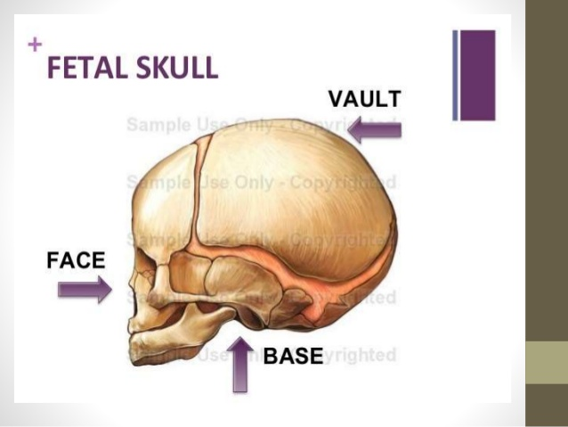

Slide 22
THE FETAL HEAD
THE FETAL SKULL: consists of
-vault
-base
-face
VAULT: two frontal bones two parietal bones occipital bone two temporal bones and the wings of the sphenoid

Slide 23
In between the two bones is a thin piece of membrane ,which is called a SUTURE
When two or more sutures meet there is a wider expanse of membrane ,which is called FONTANELLE
SUTURES:
-frontal -coronal -temporal
-sagittal -lambdoidal

Slide 24
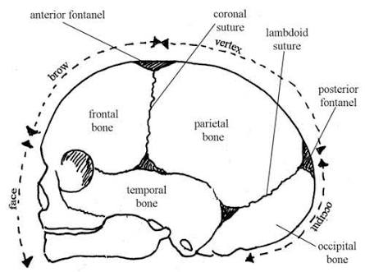

Slide 25
Types of sutures
Importance of the sutures
Types of fontanels
Importance of the fontanels

Slide 26
Diameters of the skull

Slide 27
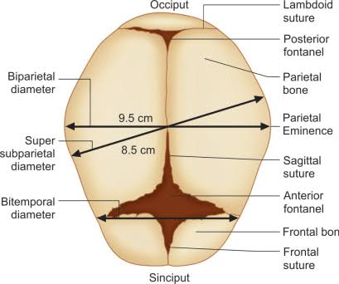

Slide 28
Bi parietal diameter:
-it extends between two parietal eminences
-9.5cm
Super subparietal diameter:
-it extends from a point placed below one parietal eminence to a point placed above the other parietal eminence of the opposite side
-8.5cm

Slide 29
Bitemporal diameter
-it is the distance between the ant inferior ends of the coronal suture
-8cm
Bimastoid diameter
-it is the distance between the tips of the mastoid process
-7.5cm

Slide 30
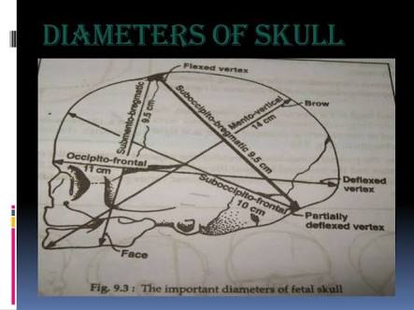

Slide 31
DIAMETERS | MESUREMENTS(CM) | ATTITUDE OF HEAD | PRESENTATION
SUBOCCIPITOBREGMATIC | 9.5 CM | COMPLETE FLEXION | VERTEX
SUBACCIPITOFRONTAL | 10CM | INCOMPLETE FLEXION | VERTEX
OCCIPITOFRONTAL | 11.5CM | MARKED DEFLEXION | VERTEX

Slide 32
MENTO VERTICAL | 14CM | PARTIAL EXTENSION | BROW
SUBMENTO VERTICAL | 11.5CM | INCOMPLETE EXTENSION | FACE
SUBMENTO BREGMATIC | 9.5CM | COMPLETE EXTENSION | FACE

Slide 33
CIRCUMFERENCES
Attitude of head | Plane of engagement | circumferences
Complete flexion | Biparietal suboccipitobregmatic(almost round shape) | 27.5cm
deflexed | Biparietal occipitofrontal(oval shape) | 34cm
Incomplete extension | Biparietal mentovertical(bigger oval shape) | 37.5cm
Complete extension | Biparietal submentobregmatic(almost round shape) | 27.5cm

Slide 34
MOLDING OF FETAL HEAD
It is the alteration of the shape of the forecoming head while passing through the resistant birth passage during labor
-as the fetal skull bones are united only by fibrous tissue ,they can slide and overide each other to accommodate to the shape and size of the maternal pelvis

Slide 35
During normal delivery ,an alteration of 4mm in the skull diameter
MECHANISM: there is compression of the engaging diameter of the head with corresponding elongation of the diameter at right angle to it
Moulding disappears within few hours of birth

Slide 36
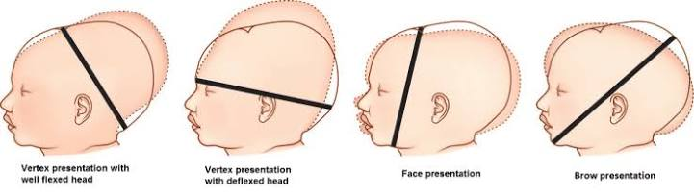

Slide 37
GRADING
-grade1:the bones touching but not overlapping
-grade2:overlapping but easily separated
-grade 3:fixed overlapping

Slide 38
IMPORTANCE
-it enables the head to pass more easily, through the birth canal
-extreme molding as met in disproportion may produce severe intracranial disturbance in the form of tearing tentorium cerebelli or subdural hemorrhage
-shape of molding can be a useful information about the position of the head occupied in the pelvis

Slide 39
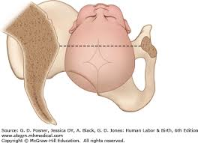
Synclitism and asynclitism

Slide 40
When the BIPARIETAL DIAMETER of the fetal head is parallel to the planes of the pelvis,the head is in SYNCLITISM
The SAGITTAL SUTURE is midway between the front and back of the pelvis. when this relationship does not occur the head is said to be in ASYNCLITISM

Slide 41
ANTERIOR ASYNCLITISM: anterior parietal presentation
POSTERIOR ASYNCLITISM: posterior parietal presentation

Slide 42
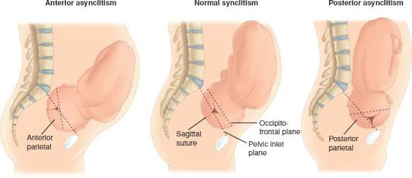

Slide 43
THANK YOU

