Slide 1
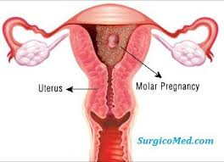
GESTATIONAL TROPHOBLASTIC DISEASE

Slide 2
Gestational Trophoblastic Disease.
The term GESTATIONAL TROPHOBLASTIC DISEASE(GTD) is used to describe a group of tumours derived from Placental trophoblastic tissue.
Trophoblastic tumours may be categorised into three groups:
Benign Hydatiform mole.
Persistent trophoblastic disease/Residual trophoblastic disease.
Choriocarcinoma.

Slide 3
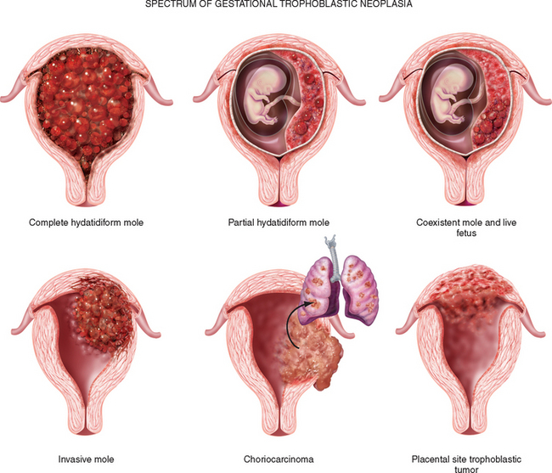

Slide 4
Physiology
Normal trophoblast behaves in many ways like a malignant growth
It locally invades maternal tissue and fragments of it enter the blood stream to lodge in the lungs.
These factors are normally controlled by some maternal factor(immunological)
So,that invasion of uterine wall is limited and any extrauterine deposits are destroyed

Slide 5
Pathogenesis
Trophoblast is made up of tissues which are only 50% maternal.
Paternal contribution is presumably foreign to the host so there must normally also be some mechanism whereby its rejection is prevented.
Occurence of a trophoblastic tumour as the result of a breakdown in what must be a complicated and delicate host-invader balance.

Slide 6
Lack of ability to control trophoblastic activity has 2 possible bases:
An inherent or immunological one,
Malnutrition,
Debility.
Blood group A woman mated with a group A man is at least risk.
Blood group AB is at greatest risk.
GTDs secrete Human Chorionic Gonadotrophin (hCG),which serves as a reliable tumour marker
They have good prognosis.

Slide 7
RISK FACTORS
Maternal age
<20 years
>35 years.
Obstetric history
Previous abortion,
Previous hydatidiform mole.
Menstrual Irregularities
Race(South-east Asia)-Common in Rice eaters.
(12/1000)in India
Vitamin A deficiency.
Use of combined oral contraceptive pills.
Low socio-economic status

Slide 8
Hydatidiform mole.
Proliferation and hydropic degeneration of the chorionic villi give rise to the typical vesicles characteristic of hydatidiform mole.
A hydatidiform mole is a neoplasm of the trophoblast which involves both epithelial layers,cytotrophoblast and syncytiotrophoblast.
Syncytiotrophoblasts are highly differentiated cells and secrete hCG.
Cytotrophoblasts are primitive trophblasts,polygonal in shape with mitotic activity,donot secrete hCG.
Intermediate trophoblasts invade decidua,myometrium and blood vessels,secrete hCG

Slide 9
Clinical features
Patient presents with symptoms (16-18 weeks)
Anaemia,
Large uterus,
Larger theca lutein cysts,
Pre-eclampsia,
Hyperemesis.

Slide 10
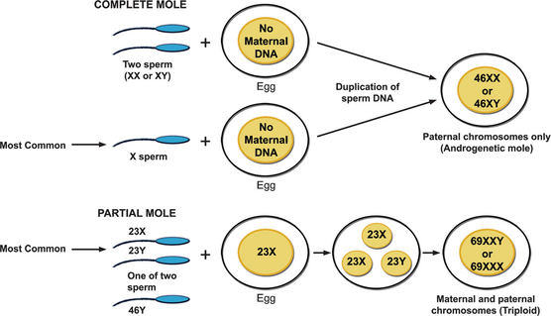

Slide 11
Features | Partial hydatidiform mole | Complete Hydatidiform mole
Karotype | Triploid paternal and maternal origin | 46,XX(90%)MOSTLY PATERNAL ORGIN, 46XY(10%)
PATHOLOGY
FOETUS /AMNION, FETAL VESSELS | PRESENT | ABSENT
HYDROPIC VILLI | Variable often focal | Pronounced,generalised. Diffuse and placenta not present
TROPHOBLASTIC PROLIFERATION | MILD TO MODERATE | MARKED
BETA Hcg | Comparatively low | Very high
MOLE CLINICAL DIAGNOSIS | RARE | COMMON
MALIGNANT SEQUELAE | <5% | 6-36%
UTERUS LARGE FOR DATES | RARE | 30-50%

Slide 12
SYMPTOMS.
VAGINAL BLEEDING: most common symptom.
PASSAGE OF VESICLES: Pathognomonic but occurs rarely.
ANAEMIA is due to prolonged /heavy bleeding.
HYPEREMESIS(30%) & PRECLAMPSIA(1/3 rd)<24 wks due to High levels of hCG
hCG stimulates the thyroid gland and cause elevation of thyroxin levels.(HYPERTHYROIDISM)
Trophoblastic embolisation can occur after evacuation of mole.
Manifests as chest pain,dyspnoea,tachypnoea.(Thyrotoxicosis)
Rales are heard on auscultation
Chest Xray reveals diffuse infiltration.

Slide 13
Signs.
Pallor, febrile
Signs of preclampsia :Elevated Blood Pressure,proteinuria
Signs of hypothyroidism:Tachycardia,
Tremor
Uterus larger than gestation in 70% of women,corresponds to gestation in 15% and is smaller in 20%
Larger uterus is associatedwith markedly elevated levels of hCG.
Doughy consistency.(absence of amniotic fluid)Cx feels soft.
Theca lutein cysts(>6cm) due to stimulation of ovaries by hCG(B/L)
Hydatidiform mole usually leads to abortion between 3rd and 6th months of pregnancy

Slide 14
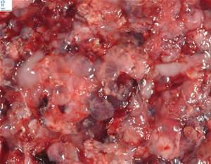
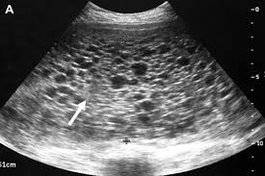
Complete Mole

Slide 15
Morbid Anatomy
Complete hydatidiform :(MACROSCOPIC)
Bunches of grape-like vesicles,
Pearly white in colour and translucent containing watery fluid.
Vesicles vary in size from few millimetres upto 2-3cm in diameter and are attached to the main stalk by thin pedicles
Few haemorrhagic areas seen in between the bunches.
Size of the mole depends on duration of pregnancy and degeneration.
The fetus,amniotic sac and the placenta are absent.

Slide 16
Histology.
Hydropic degeneration and swelling of the villous stroma.
Absence of villous blood vessels.
Proliferation of both epithelia to a varying degree
Vesicles demonstrates irregular proliferation and pleomorphism of epithelial cells whose nuclei are hyperchromatic and actively mitotic
Absence of fetal parts.
Villous structure is well preserved and identifiable that determines the benign nature of the trophoblastic disease

Slide 17
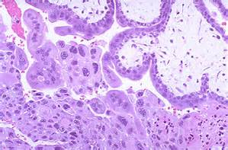
Histology of a complete mole.

Slide 18
PARTIAL MOLE
A PARTIAL MOLE resembles the placenta,but contains a few vesicles on its maternal surface.
A fetus is identifiabe in this case.
One of the twins may be a mole and another a normal fetus.
Fetus often shows gross malformation,IUGR,IUD.
Very few live babies are born through partial mole.
Fetal blood vessels are seen on ulrasound.
Partial mole is diagnosed is at later date than a complete mole around 24-26weeks of pregnancy

Slide 19
It rarely metastasizes and doesnot require prophylactic chenotherapy.,as the level of hCG<10,000IU.
Followup is necessary,as choriocarcinomamay rarely follow a partial mole.
The uterine wall is hypertrophied in a hydatidiform mole as in a pregnancy and is lined by a thick decidua.
Ovaries contain enlarged granulosa lutein cysts in 60% cases,cyst may grow upto maximum size of a fetal head.
Rare complications:
Torsion of this ovarian cysts
Haemorrhage into the cyst necessiating laporotomy.

Slide 20
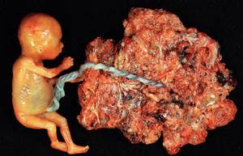
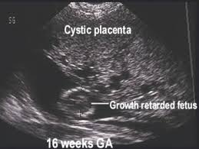
Partial mole

Slide 21
HISTOLOGY
Focal trophoblastic proliferation,
Focal hydropic degeneration and villous oedema,
Presence of foetal tissue,
Triploid karotype.
MOLAR PREGNANCY WITH COEXISTING FOETUS:
One can be a complete mole and the other , a normal foetus
Increased risk of
Spontaneous abortion,
Chromosomal anomalies,
Pre-eclampsia,
Foetal growth restriction

Slide 22
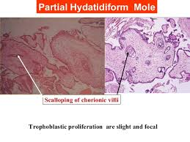
Histology.

Slide 23
Differential diagnosis.
Mistaken dates,
Multiple pregnancy,
Acute hydraminos,
A Fibroid n Pregnancy,
Threatened Abortion.

Slide 24
COMPLICATIONS.
Haemorrhage,
Anaemia,
Thyroid storm- 3%,
Embolization with acute pulmonary insufficiency and coagulation failure,
Uterine Perforation-Spontaneous but more commonly during suction evacuation,
Delayed-Recurrent mole and Choriocarcinoma.

Slide 25
Investigations.
Doppler
Ultrasound,
Serum Beta hCG,
Radioimmunoassay,
Flow Cytometry,
Radiography of chest,
CT scan.

Slide 26
Doppler.
The auscultation of fetal heart by Doppler can rule out a complete molar pregnancy.
Absence of fetal heart goes in favour of a molar pregnancy.
Doppler ultrasound can show abnormal vascularization.

Slide 27
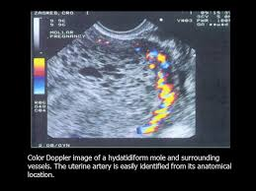

Slide 28
Ultrasound
Complex,echogenic intrauterine contents with cystic spaces,
Known as SNOW STORM Appearence.
Absence of fetal shadow in a complete molar pregnancy.
In Partial mole: the fetus (malformed/IUGR) & Placenta are visualised
Placenta shows scattered cysts.
Followup to see if the granulosa lutein cysts diminish in size and disappear and to detect persistent mole,invasive mle and choriocarcinoma.
Metastasis in Liver can be picked up on ultrasound scan

Slide 29
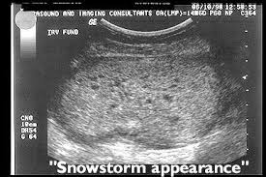

Slide 30
Serum Beta hCG
Serum beta hCG level is very high.
Level more than 40,000mIU/ml determined by RIA
HPL level is low in a molar pregnancy but raised in pulmonary stasis and placental site tumour
Radiography of chest is done to rule out lung metastasis,
CT scan is done for Brain and Liver metastasis.

Slide 31
Other investigations
Determination of ploidy by Flow Cytometry is used in differentiating partial mole(Triploid) from complete mole,which is diploid.
Immunostaining for Protein that is expressed by maternal gene also helps in the diagnosis.

Slide 32
Management.
Haemoglobin should be estimated and packed cells kept ready.
BP must be controlled and precautions taken to manage a thyroid storm.
Suction and evacuvation ia a method of choice.
Packed cells should be ready.
Regional/General Anaesthesia,
Large bore needle for IV access,
Cx dilated to 10-12 mm,
Evacuation with suction cannula(No.10-12Karman cannula)
Oxytocin infusion 20U in 1L of saline.
Uterine Curettage to ensure completion.
Digital exploration of uterine cavity will prevent perforation.

Slide 33
Complications of S&E
Sudden unexplained collapse due to massive DIC.
Pulmonary embolisation leading to acute pulmonary hypertension and cardiac failure.
Hyperthyroidism and CCF seen in 3% cases.
Haemorrhage cause sudden death
Postabortal anaemia and sepsis are not uncommon
Choriocarcinoma develops in 2-10% of cases

Slide 34
Postmolar followup
Serum Beta hCG
48hours after evacuation
Weekly thereafter
Continue till levels<5mIu/ml
Pelvic examination every 2 weeks
Uterine size,
Size of theca lutein cysts
Chest Xray if Beta hCG plateaus or rises,
Contraception till hCG levels normalise
Combined oral pills
DMPA

Slide 35
Followup
Followup for 2 years
Test become negative in about 6-8 weeks(hCG in urine & Serum)
Pt is called for weekly intervals for this test.
3 months in 1st year,
6 months in 2nd year.
Pregnancy avoided for 1 year as pregnancy interfere with the hCG levels.

Slide 36
Contraception.
Barrier methods-Safe
IUCD and progesterone only pills cause irregular bleeding
COC can be given once beta hCG levels remains undetected.
OC pills lower LH and hCG level can cause misinterpretation of results.

Slide 37
Prophylactic chemotherapy.
High risk cases: Young women or Perimenopausal women>40 who refuses hysterectomy.
Urine hCG:
6 weeks:>30,000IU/24 hrs
10weeks:>24,000IU/24 hrs
Serum hCG:
4weeks:>20,000mIU/ml
Over 3 consecutive weeks.
This is to expected to reduce the risk of pulmonary emboli and dissemination.

Slide 38
Prophylactic chemotherapy.
Methotrexate 5 mg 5times a day for 5 days.
3 courses repeated at the interval of 7-10 days,
Provided Hb%,white cell count.
Methotrexate 15mg orally daily for 3 days prior to planned evacuation and 2 days after.
During evacuation 50mg methotrexate IV drip lasting for 3-4 hours.
Actinomycin-D IV 12ug/kg daily for 3days prior to evacuation and 2 days after.

Slide 39
Prophylactic hysterectomy.
Hysterectomy is not recommended today,
It doesnot avoids followup,
It is not often required,
Followup with beta hCG levels is effective.

Slide 40
Recurrent molar pregnancy
Reported in 2% cases
Following 2 molar pregnancies,risk of recurrent mole rises to 28%
Woman with one molar pregnancy faces 20 times the risk of suffering another molar pregnancy and choriocarcinoma.
Pregnancy with her husbad should be avoide(RMP)
IVF with donor sperm is option.

Slide 41
Invasive mole
It is locally invasive but doesnot metastasise
Invasive mole develops after a complete mole /partial mole.
SYMPTOMS:
Vaginal bleeding,
Enlarged Uterus,
Elevated Beta hCG,

Slide 42
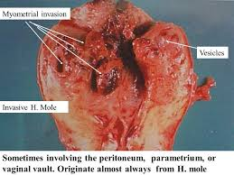
Invasive mole/Chorioadenoma Destruens

Slide 43
Histology
Hydropic villi present.
The proliferating cytotrophoblasts and syncytiotrophoblasts invade the
myometrium,
Serosa,
Vaginal wall,
Uterine Vessels,

Slide 44
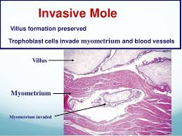

Slide 45
Complications
Uterine Perforation,
Intraperitoneal Haemorrhage,
Profuse Vaginal Bleeding,
Sepsis.(Necrotic tumour tissue)

Slide 46
Placental site Trophoblastic tumour.
Rare tumour.
Develops from Intermediate trophoblasts,
Comprised principally cytotrophoblast
It is locally invasive,
It can metastasise,
Serum hCG levels are not high,
Secretes Human Placental Lactogen in relatio to size of tumour,
Occurs in Reproductive Years,

Slide 47
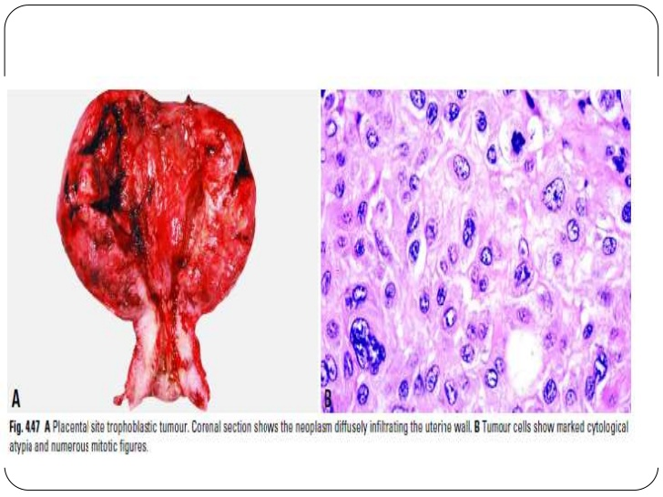

Slide 48
Symptoms and Treatment.
Amennorhoea,
Uterine Enlargment,
Clinical Diagnosis:
Missed Abortion,
RIA for Pregnancy will be Positive.
Curettage leads to Uterine Perforation.
Hysterectomy is the treatment of choice.
Conservative Surgery with Excision of tumour in sporadic cases where preservation of fertility is desired.

Slide 49


