Slide 1

HIV IN PREGNANCY

Slide 2
INTRODUCTION
HUMAN IMMUNODEFICENCY VIRUS(HIV) is a DNA retrovirus belonging to the subfamily of LENTIVIRUS.
INCIDENCE:
According to WHO (2010):
World wide:34 million HIV infected people
16.8 million were women.
3.4 million were children
2.7 million new cases
1.8 million HIV related deaths

Slide 3
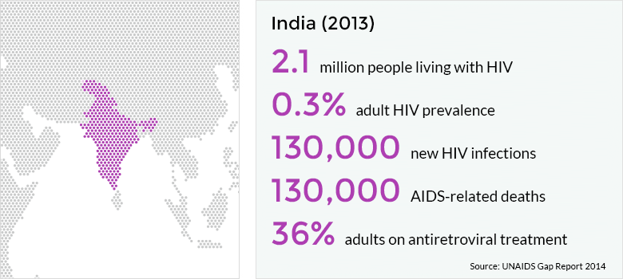
Hiv prevalence in india.
In Antenatal population :
Low <1% in most states
>3% Prevalence in Andra pradesh, karnataka, Tamilnadu,Maharashtra,Manipur, Nagaland,Orissa, Rajasthan.

Slide 4
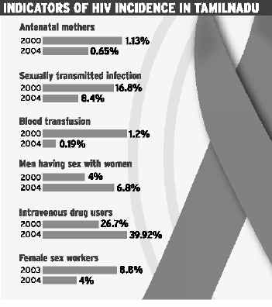
Tamil nadu incidence.

Slide 5
Hiv prevalence rate
Among pregnant women is 0.3%
Vertical Transmission rate to fetus is around 30%
36 wk-labor
<14 wk
14-36 wk
Intrapartum
75 %
uninfected
25 %
infected
4% 16% 50% 30%

Slide 6
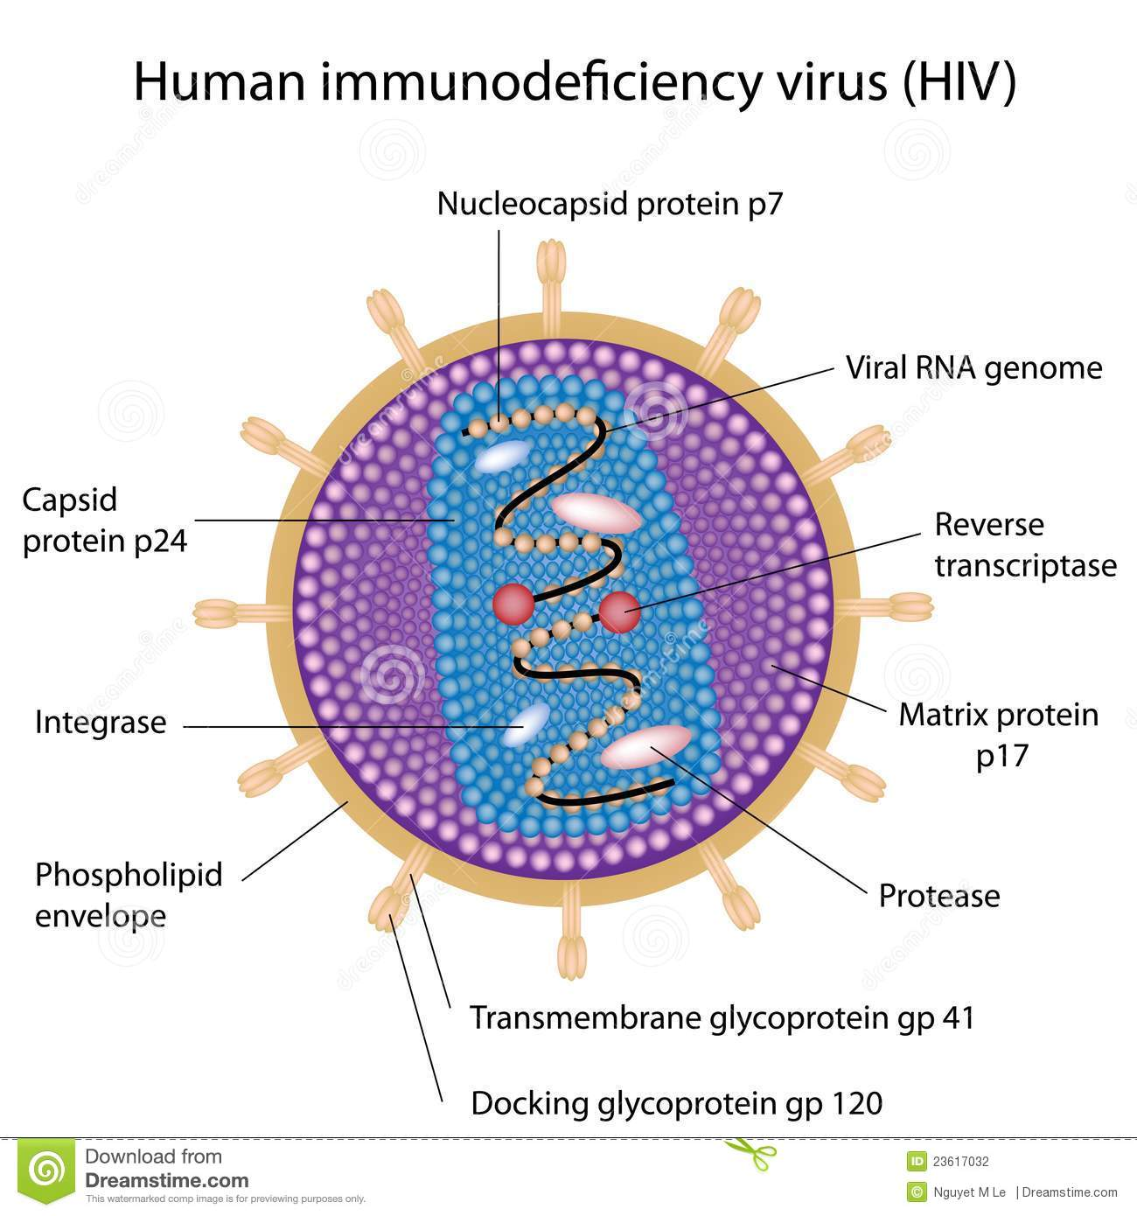
Structure of hiv virus.

Slide 7
Morphology.
HIV is a Spherical enveloped virus about 90-120nm in diameter.
The nucleocapsid has an outer icosahedral shell and an inner cone shaped core enclosing the ribonucleoproteins.
Genome is diploid contains 2 identical copies of single stranded,positive sense RNA genome.
In association with viral RNA is REVERSE TRANSCRIPTASE Enzyme.

Slide 8
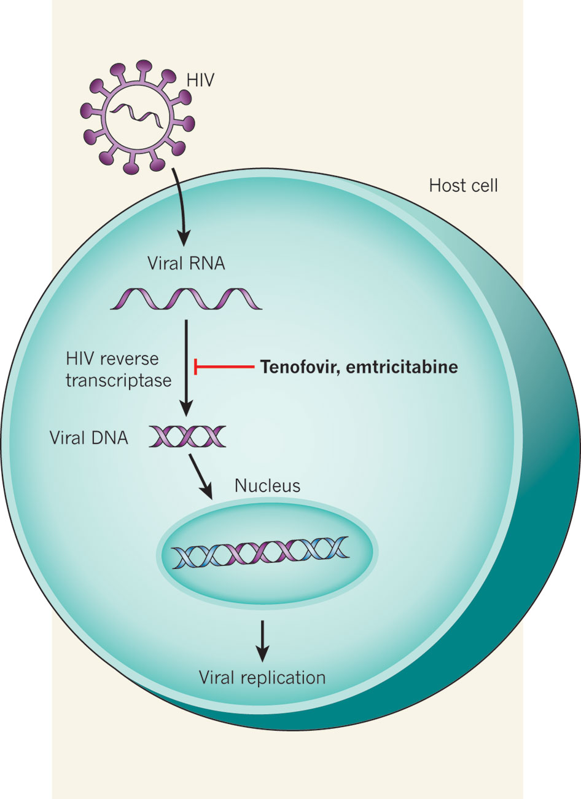
When virus infects a cell, viral RNA is transcribed into sDNAa and then into dDNA(provirus) which is integrated into host cell chromosome

Slide 9
The provirus remain latent for long periods though it influences host cell function.
During viral replication, when the naked virus buds out through host cell membrane,it acquires a lipoprotein envelope,which consists of lipid derived from host cell membrane & glycoproteins which are virus coded.
Virus coded envelope are projecting knoblike spikes on the surface and anchoring transmembrane pedicles
Spikes bind to the CD4 receptors on susceptible host cells
Transmembrane pedicles cause cell fusion.

Slide 10
Viral Attack on CD4
Attachment (First Step)
Surface protein on virus attaches to specific receptor (s) on cell surface
Virus specific receptor is necessary but not sufficient for viruses to infect cells and complete replication cycle

Slide 11
HIV Cell Binding and Entry
CD4 Cell
CCR5
R5 HIV
CCR5
T HELPER CD4 CELL
CD4
CXCR4
CXCR4

Slide 12
CCR5 Natural Ligand - Chemokines
CD4 Cell
CCR5
R5 HIV
CCR5
CD4
Chemokines
Rantes
MIP-1 Beta
MIP-1 Alpha
CXCR4
CXCR4

Slide 13
HIV Cell Binding and Entry
CD4 Cell
CCR5
R4 HIV
CCRCCC5
CD4
CXCR4
CXCR4

Slide 14
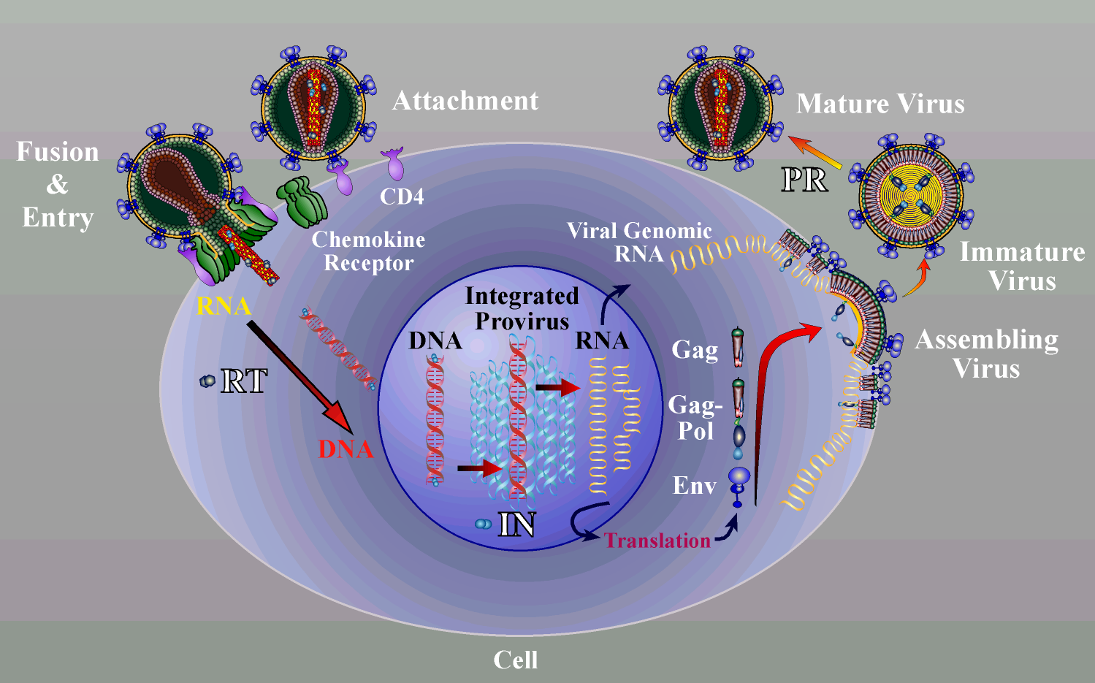
Retro-viral attachment to CCR5

Slide 15
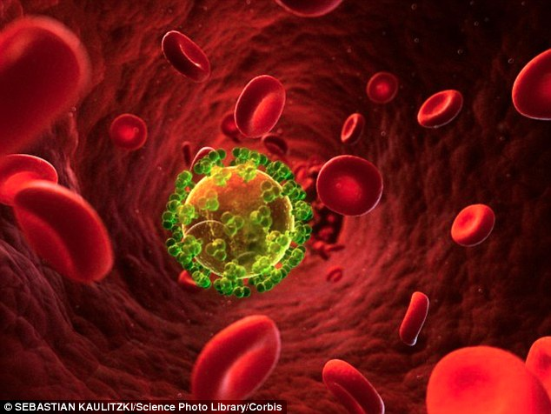
HIV virus in circulation.

Slide 16
Viral Replication
Penetration (Second Step)
Enveloped viruses penetrate cells through fusion of viral envelope with host cell membrane
May or may not involve receptor mediated endocytosis
Non enveloped viruses penetrate by - Receptor mediated endocytosis
Translocation of the virion across the host cell

Slide 17
Viral Replication
Multiplication (Third Step)
Replication of viral RNA occurs
This utilizes the DNA of host nucleus
Invaded CD4 cells genome is altered
They produce thousands of copies of HIV- RNA
Approximately 100 billion new viral particles are produced every day
1-2 billion CD4+T cells die each day

Slide 18
Viral Replication
Destruction (Fourth Step)
CD4 cells are over powered and destroyed
Instead of being defense machinery they
Are the seat of HIV replication
CD4 cells are destroyed – cytolysis
HIV copies are released to attack more CD4

Slide 19
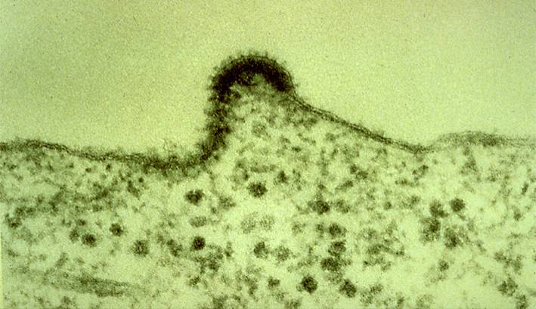
New HIV Budding from CD4

Slide 20
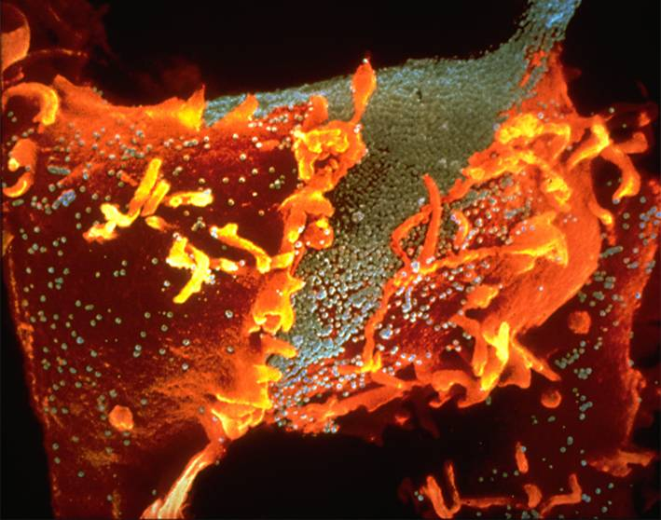
CD4 Cell Destruction

Slide 21
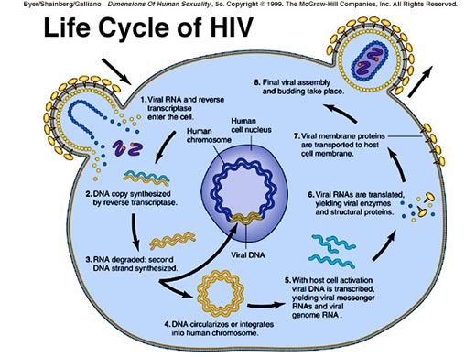
HIV Life Cycle in CD4 Cell

Slide 22
HIV Life Cycle (IN BRIEF)
dinHIV enters the blood stream
Comes in contact with CD4 lymphocytes
RNA transcribed by reverse transcriptase to DNA inside the host cell
Integration of provirus(latent infection)
Release of progeny virions to infect other cells entry, reverse transcription, replication, budding, and maturatiodinnd entry, reverse transcription, replication, budding, and maturation

Slide 23
Portal of Transmission of HIV
HIV is transmitted by
Direct contact with infected blood.
Sexual contact – oral, anal or vaginal.
Direct contact with semen or vaginal and cervical secretions.
Mothers infected with HIV to infants during pregnancy, delivery and breastfeeding.

Slide 24
Infectivity depends on the portal
BBP (Blood and Blood Products) – Nearly 100%
IDU (Intravenous drug users) – 80%
Sexual intercourse – 60% (depends on sex Practices)
MTCT ( Mother To Child Transmission) – 30%

Slide 25
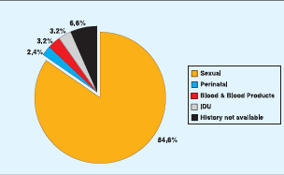
Portal of Entry of HIV - India

Slide 26
Perinatal Transmission of HIV – 30%
HIV infection in pregnancy is an important implication for foetus because of risk of vertical transmission
Antepartum 5-15%
HIV in Mothers with high viral load & Low CD4 count.
Inutero by transplacental spread.
Intrapartum 50-80%
Exposure to Cervico Vaginal secretions
(Infected birth canal)
Postpartum 15-20%
Via Breastfeeding

Slide 27
Sexual mode of Transmission
No of sex partners
Sex without condom
Co existing STI or ulcerative lesions
Vaginal v/s Anal or Oral sex
Ejaculatory v/s non ejaculatory
Receiving partner
Viral load of the infected person
Homosexual/Heterosexual transmission
Female to Male transmission is increasing in
ASIA and AFRICA.

Slide 28
PARENTERAL TRANSMISSION
INTRAVENOUS DRUG ABUSERS
HAEMOPHILIACS.(FACTOR 8 & 9)
RANDOM RECIPIENTS OF BLOOD TRANSFUSION,
TRANSMISSION OF HIV INFECTION TO HEALTH CARE WORKERS
ACCIDENTAL NEEDLE STICK INJURY(SEROCONVERSION IS 0.3%)
EXPOSURE OF NONINTACT SKIN TO INFECTED BLOOD IN LAB ACCIDENTS.

Slide 29
HIV can’t be transmitted by
Coughing,
Sneezing,
Insect bites,
Touching, hugging
Water, food
Public baths
Handshakes
Work or school contact
Using telephones
Sharing cups, glasses, plates, or other utensils

Slide 30
Natural History of HIV
PHASES OF INFECTION:
PRIMARY INFECTION/VIRUS DISSEMINATION/ACUTE RETROVIRAL SYNDROME.
MIDDLE CHRONIC PHASE(Asymptomatic)
CLINICAL AIDS.

Slide 31
CLINICAL FEATURES.
GROUP 1 | ACUTE HIV INFECTION.
GROUP 2 | ASYMPTOMATIC INFECTION
GROUP 3 | PERSISTENT GENERALISED LYMPHADENOPATHY
GROUP 4 SUBGROUP A B C D E | CONSITUTIONAL DISEASE NEUROLOGICAL DISEASE SECONDARY INFECTIONS SECONDARY CANCERS OTHERS.

Slide 32
PRIMARY INFECTION.
Clinical Features
On first exposure, there is a 2-4 week period of intense viral replication before the onset of an immune response and clinical illness.
Acute illness lasts from 1-2 weeks and occurs in 53% to 93% of cases.
Clinical manifestations resolve as antibodies to the virus become detectable in patient serum.
Patients then enter a stage of asymptomatic infection lasting months to years.

Slide 33
Early disease
Time since exposure: Months to years.
CD4 counts :350-500.
HIV RNA: Varies
Often asymptomatic.

Slide 34
Acute retroviral syndrome
Manifests as a flu-like syndrome : Fever, myalgia, weight loss, fatigue, cervical adenopathy, diarrhoea ,vomiting.
Neurological symptoms
HIV in CSF, aseptic meningo-encephalitis
Gastrointestinal symptoms
Mucocutaneous ulceration, pharyngeal edema
Dermatological symptoms : rash, urticaria, etc..,

Slide 35
Chronic infection:phase of clinical latency
Lymph nodes & spleen are sites of continous HIV replication and cell destruction.
Destruction of CD4 cells occur
(1-2*109 CD4 T cells per day)
In this phase virus may solely shift from CD4 receptor to CXCR4 and CCR5 coreceptors
Patients are asymptomatic or develop minor opportunistic infections
Oral candidiasis,
Herpes zoster,
Mycobacterial tuberculosis,

Slide 36
Midrange disease
Time since exposure: Years.
CD4 counts: 200-350
HIV RNA : Varies.
Presents with weight loss, lymphadenopathy, oral thrush, night sweats, diarrhoea.

Slide 37
Clinical aids
AIDS in an adult is defined by existence of atleast 2 major signs assocaited with atleast 1 minor sign, in the absence of known causes of immunosuppression such as cancer or severe malnutrition or other recognised aetiologies.
Major signs:
Weight loss of > 10% for > 1 month.
Chronic diarrhoea for > 1 month.
Prolonged fever for > 1 month (intermittent or constant)

Slide 38
Minor signs:
Persistent cough for > 1 month.
Generalised pruritic dermatitis.
Recurrent herpes zoster.
Oropharyngeal candidiasis.
Chronic progressive and disseminated herpes simplex infection.
Generalised lymphadeopathy.
Presence of Kaposi’s sarcoma or Cryptococcal meningitis is sufficient by themselves for the diagnosis of AIDS.

Slide 39
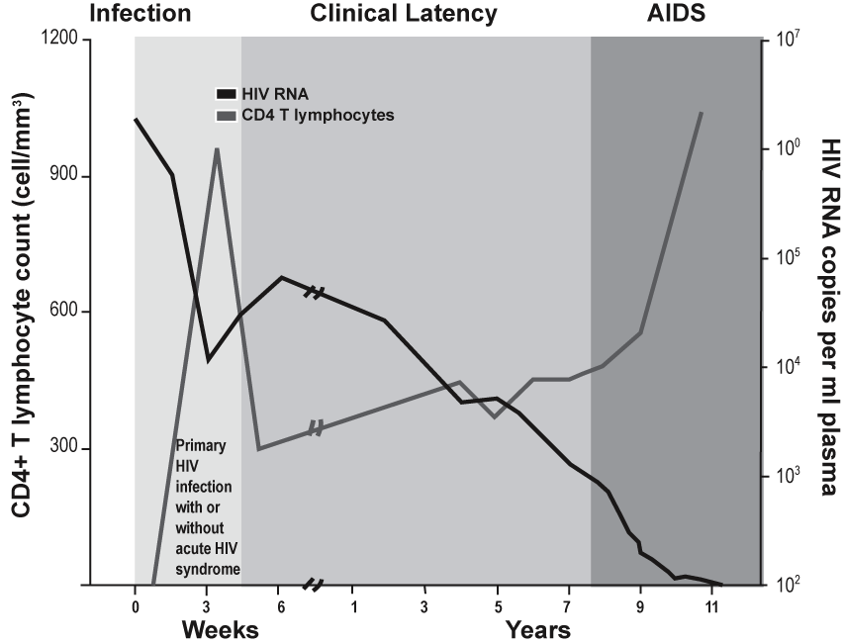

Slide 40
Opportunistic infections
PROTOZOAL & HELMINTHIC INFECTIONS | FUNGAL INFECTIONS | BACTERIAL INFECTIONS | VIRAL INFECTIONS
Cryptosporidosis | Pneumocystosis (Pneumonia/ disseminated infection) | Mycobacteriosis ( atypical MAI) | Cytomegalovirus(Pulmonary,intesinal,retinitis,CNS infections)
Isosporidosis (Enteritis) | Candidiasis(Esophageal,tracheal, pulmonary) | Nocardiosis (Pneumonia, meningitis,disseminated) | Herpes Simplex virus
Toxoplasmosis (Pneumonia/CNS infection) | Cryptococcosis (CNS infection) Coccidiomycosis | Salmonella infetions, disseminated | Varicella zoster virus
 | Histoplasmosis (disseminated) |  | Progressive multifocal leuko encephalopathy

Slide 41
Intimate Friends of HIV
HBV, HBC infections
GBV-C infections
HHV-6 Infections
CMV Infection
Herpes Simplex Virus infections
STI of any kind.

Slide 42
Pregnancy on HIV infection
Pregnancy :
Slightly Immunosuppressive
Minimal effect on CD4 count
Minimal effect on HIV RNA level
Doesnot have significant effect on the clinical or immunological course of hiv infection
Maternal morbidity and mortality not increased

Slide 43
HIV infection on pregnancy
Slightly increase rate :
preterm birth(3.7% risk)
IUGR
PROM(15-25% if ROM>4 hours)
Fetal and neonatal infection
varies from 25-40 percent

Slide 44
Pregnancy Outcome | Relationship to HIV Infection
Spontaneous abortion | Limited data, but evidence of possible increased risk
Stillbirth | No association noted in developed countries; evidence of increased risk in developing countries
Perinatal mortality | No association noted in developed countries, but data limited; evidence of increased risk in developing countries
Newborn mortality | Limited data in developed countries; evidence of increased risk in developing countries

Slide 45
Pregnancy Outcome | Relationship to HIV Infection
Intra-uterine growth retardation | Evidence of possible increased risk
Low birth weight | Evidence of possible increased risk
Preterm delivery | Evidence of possible increased risk, especially w/ more advanced disease
Preclampsia | No data
Gestational diabetes | No data
Amnionitis | Limited data; more recent studies do not suggest an increased risk; some earlier studies found increased histologic placental inflammation, particularly in those with preterm deliveries

Slide 46
Adverse Pregnancy Outcomes and Relationship to HIV Infection (continued
Pregnancy Outcome | Relationship to HIV Infection
Oligohydramnios | Minimal data
Fetal malformation | No evidence of increased risk

Slide 47
DYNAMICS OF PERINATAL HIV TRANSMISSION
Mother to Child transmission is the most common cause of paediatric HIV infections.
15-40% neonates born to non-breast feeding,untreated,HIV infected mothers,gets infected.
TRANSMISSION GESTATIONAL AGE
20% 36Weeks
50% Near Term
30% Intrapartrum
30-50% Breast feeding.

Slide 48
Risk factors
Immunologically /clinically advanced HIV disease in mother,
High Plasma Viral Load,
Maternal injectable drug use during Pregnancy,
Preterm delivery( 4 fold increase in Risk)
Failure to receive ART therapy,
Prolonged Rupture of membranes,
Breast Feeding.

Slide 49
Obstetric risk factors
Risk increases with every hour after membranes rupture,independent of other risk factors.
Co-infection with another STI during pregnanacy.
Chorioamnionitis.
Obstetric Procedures:
Chorionic villus sampling,
Amniocentesis,
ARM
Invasive fetal intrapartrum monitoring.(fetal scalp ph monitoring)

Slide 50
Maternal plasma hiv rna
Perinatal HIV transmission is correlated with maternal plasma HIV RNA burden.
TRANSMISSION RATE | VIRAL COPIES/ML
2% | 1,000
11% | 10,000
40% | 1,00,000

Slide 51
. Maternal plasma HIV RNA level
Most important factor,
HIV RNA viral load > 100000 copies/ml : risk > 30 %
HIV RNA viral load < 400 copies/ml : risk 1 %

Slide 52
However transmission has been observed at all HIV RNA levels including those that were undetectable.
This is due to discordance between viral load in plasma and genital secretions.
Viral load not only determinant to decide need of ART therapy.
NO ASSOCIATION: Maternal Age, Race, Ethnicity, H/O previously infected child.

Slide 53
Intrapartrum transmission
Occur during Labour through maternal-fetal exchange of blood or by contact of the infant’s skin/mucous membrane with maternal blood /secretions during delivery.
HIV-1 and HIV-2
Transmitted through the same routes
Associated with similar opportunistic infections
HIV-1 is more common worldwide
HIV-2 is found primarily in INDIA,West Africa, Mozambique and Angola.

Slide 54
Differences between HIV-1 and HIV-2
HIV-2 is less easily transmitted.
HIV-2 develops more slowly.
HIV-2 cause less severe illness
MTCT is relatively rare with HIV-2.
HHV-6 does not cause AIDS – Helper virus
Women with maternal HSV-2 Antibody have significant 50% increased risk of intrapartrum HIV-1 MTCT.
25% vertical transmission to maternal HSV-2 Co-infection.

Slide 55
PRECONCEPTIONAL COUNSELING.
Effective contraception should be discussed if pregnancy is undesired.
Educate about decreasing high risk sexual behaviours to prevent transmission and to decrease acquisition of other STIs.
Educate about avoidance of drugs that has high teratogenicity (efavirenz).

Slide 56
Regime of ART has to be altered based on the teratogenicity risks.
Maximal suppression of maternal viral load before conception is aimed in women who wish to conceive.
Propylaxis for oppurtunistic infections is provided.
Immunisation is instituted.

Slide 57
Folic acid is administered in higher dose (5mg) in women on cotrimoxazole.
Partner testing and counselling for HIV is done.
Discordant couples are counselled and managed accordingly.

Slide 58
History Taking in Hiv in pregnancy
Antiretroviral drugs
Antiretroviral adherence history
Drug resistence testing
History of oppurtunistic infection
Immunization history (hepatitis A, hepatitis B,Influenza,Pneumococcus)

Slide 59
PHYSICAL EXAMINation
Lymph node enlargement
Oral candidiasis
Hepatomegaly
Splenomegaly
Stigmata of concurrent STI ( syphillis, gonorrhoea, chlamydia, etc.)

Slide 60
Laboratory evaluation
CD4 T cell count , percentage.
Plasma HIV RNA PCR
Complete blood count
Serum creatinine
Liver function tests

Slide 61
Evaluation of comorbid STD
Screening for Syphillis.
Screening for HSV .
Screening for Gonorrhoea and Chlamydia.

Slide 62
Evaluation of need for prophylaxis
Pneumocystis carinii (CD4< 200)
Mycobacterium avium (CD4 < 50)

Slide 63
EVALUATION OF NEED FOR IMMUNISATION
Hepatitis (A&B).
Influenza
Pneumococcus
Others as per ACOG guidelines.

Slide 64
What are the factors that increase mother to child transmission of Hiv?
High HIV RNA PCR viral load
Lower CD4 counts
Unprotected sex with multiple sexual partners
Genital tract infections
Substance abuse
Mode of delivery( vaginal vs caesarean)

Slide 65
Longer duration of rupture of membranes
Obstetric interventions( fetal scalp monitoring , instrumetal deliveries, episiotomy).
Low birth weight baby.
Breast feeding.

Slide 66
PRENATAL HIV SCREENING.
CDC & ACOG recommends HIV screening using an Opt-out approach.
In areas where incidence is 1 per 1000 person years or greater,
Women are at high risk for acquiring HIV(LAST 3 MONTHS)
Injection drug use,
Multiple sexual partners,
Diagnosis of another STI,
A suspected/known HIV-infected sexual partner.
Need repeat testing at 3rd Trimester/at delivery.

Slide 67
References:
MUDALIAR.
IAN DONALD,
WILLIAMS OBSTETERICS,
ROBINNS PATHOLOGY,
BAVEJA MICROBIOLOGY.

Slide 68


Slide 69
Screening is performed using ELISA test with a sensitivity of > 99.9%
A positive ELISA test is confirmed by either Western blot or IFA test.
For acute primary HIV infections, identification of p24 core antigen or viral RNA/DNA is possible.

