Slide 1
HYPERTENSIVE DISORDERS IN PREGNANCY

Slide 2
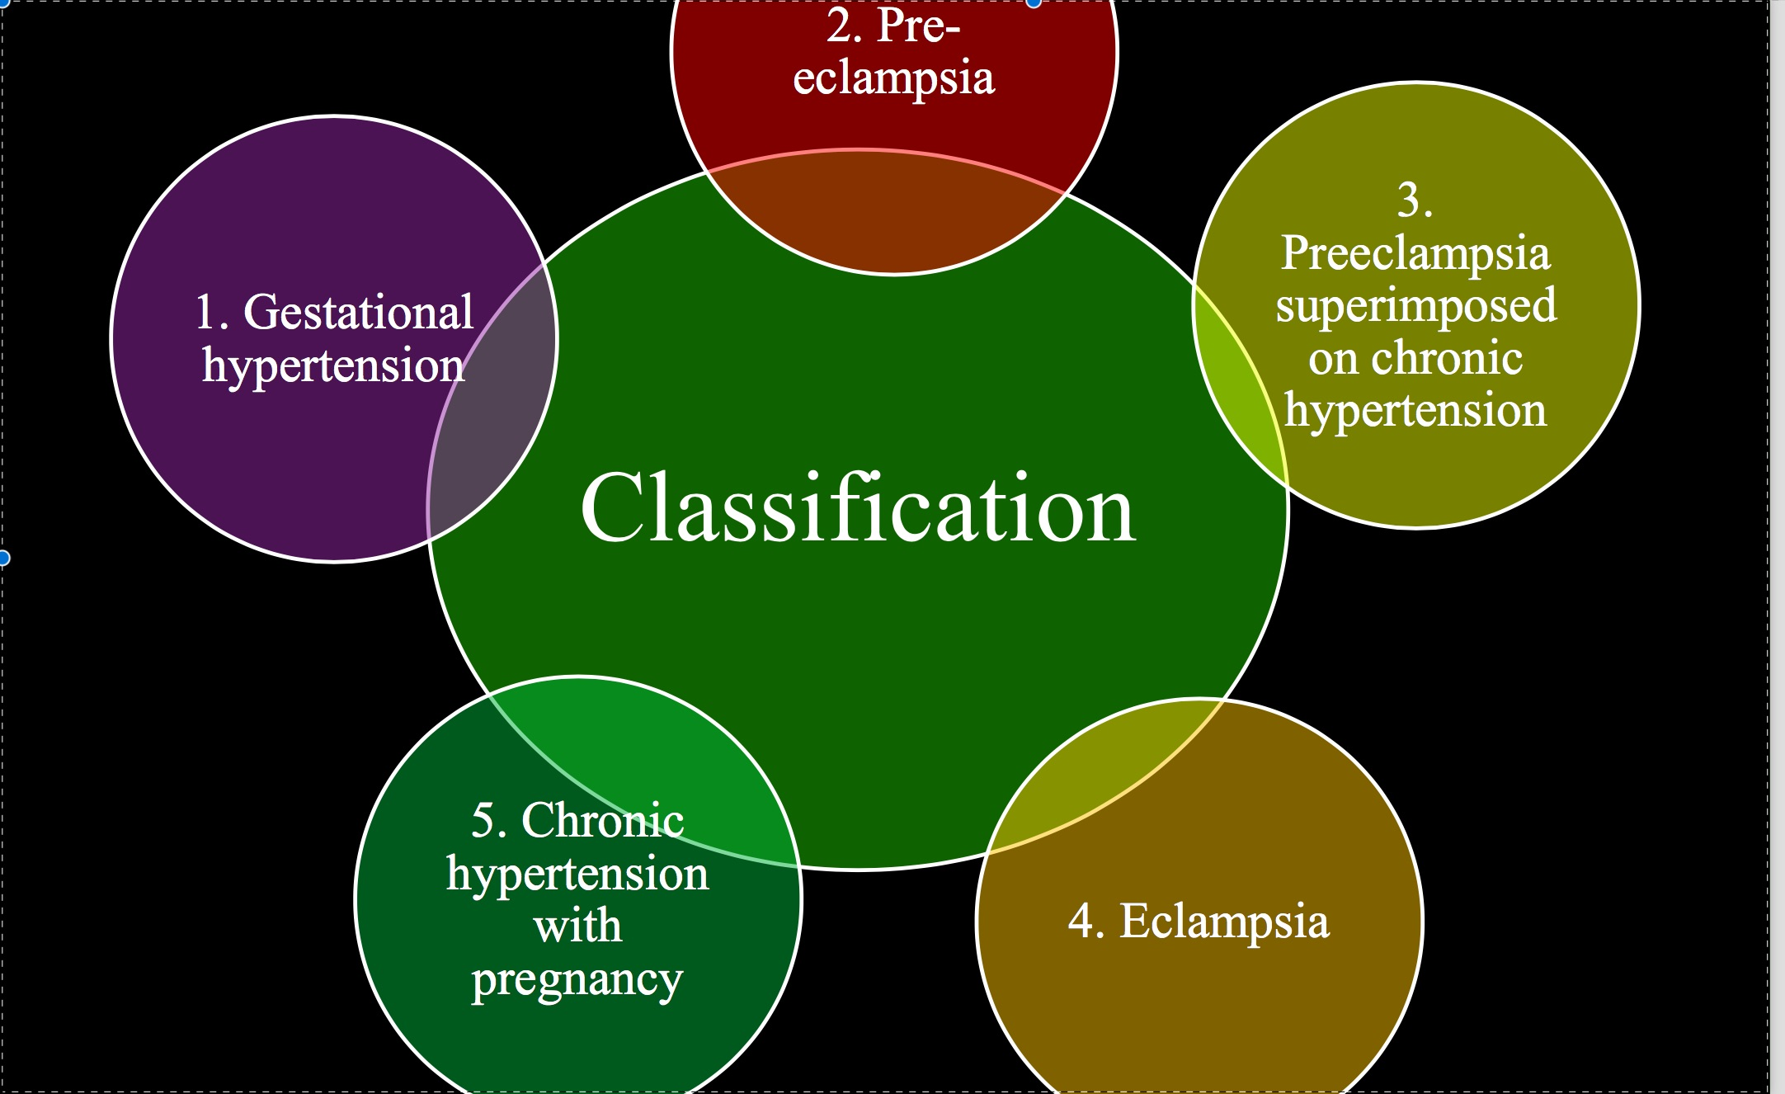

Slide 3
HYPERTENSION IN PREGNANCY
Hypertension in Pregnancy
There are four major types of high blood pressure that may occur during pregnancy:
▪ Pre-eclampsia
▪ Chronic hypertension
▪ Preeclampsia superimposed upon chronic hypertension
▪ Gestational hypertension (also called transient hypertension)

Slide 4
HYPERTENSION IN PREGNANCY
Gestational Hypertension:
▪ Women with gestational hypertension have all of the following:
- Blood pressure ≥140/90 mmHg
- No protein in the urine (proteinuria)
- Are ≥20 weeks pregnant
- No previous history of high blood pressure.

Slide 5
HYPERTENSION IN PREGNANCY
Chronic Hypertension:
▪ Chronic hypertension is defined as a blood pressure ≥140/90 mmHg diagnosed either:
- Before pregnancy
- Before the 20th week of pregnancy
- Or that persists more than 12 weeks after
delivery.

Slide 6
HYPERTENSION IN PREGNANCY
Pre-Eclampsia Superimposed Upon Chronic Hypertension:
▪ This refers to a woman with chronic hypertension who develops signs of pre- eclampsia after the 20th week of pregnancy.

Slide 7
HYPERTENSION IN PREGNANCY
Pre-eclampsia:
A multisystem disorder of unknown cause characterized by BP >140/90, proteinuria, diagnosed after 20weeks of gestation in a previous normotensive and non-proteinuric woman.

Slide 8
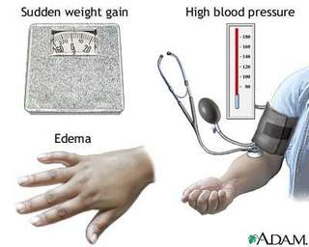

Slide 9
HYPERTENSION IN PREGNANCY
Abnormal trophoblastic invasion of uterine vessels
-In normal implantation, 1st trimester at 10-12w, endovascular trophoblasts invade the decidual layer of the uterus, 2nd trimester 16-18w, invasion of the myometrium occurs with replacement of the spiral arterioles endothelial cells and smooth muscles with trophoblastic cells that results into a low resistance, low pressure and high flow system.
-In Pre-eclampsia this 2nd invasion process fails to occur.

Slide 10
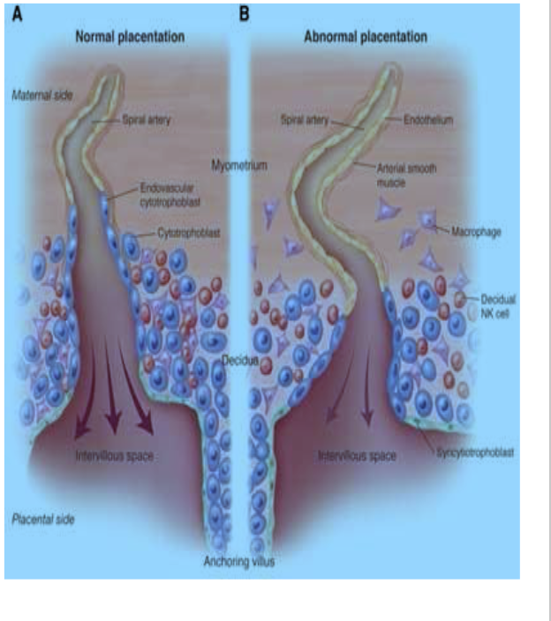

Slide 11
HYPERTENSION IN PREGNANCY
Immunological factors
-Presence of HLA(Human Leukocyte Antigen) on surface of trophoblastic cells activates uterine NK cells—diffuse activation of maternal leukocytes. Circulating activated leukocytes—endothelial dysfuction
Endothelial dysfunction and vasospasms
-Activated leukocytes release IL-6, TNF alpha that brings about oxidative stress, endothelial damage, increased capillary permeability, coagulation and vasospasms due to low NO and PGEI₂ formation and release of TXA₂ from aggregating platelets

Slide 12
HYPERTENSION IN PREGNANCY
Dietary factors
-Lack of Calcium, Zinc and Magnesium
Genetic factors
- 1st degree relative history of pre-eclampsia are at risk of the disease

Slide 13
HYPERTENSION IN PREGNANCY
Risk factors
Maternal personal risk factors
-Age less than 18 or above 35 years
-Black race
-Null parity
-New paternity
-Inter pregnancy interval less than 2 years or more than 10 years
-Family history of pre-eclampsia (1st degree relative)
-Previous history of pre-eclampsia
-BMI more than 30

Slide 14
HYPERTENSION IN PREGNANCY
Maternal medical risk factors
-Chronic hypertension
-Renal diseases
-DM
-Obesity
-SLE
-Antiphospholipid syndrome
Fetal or placenta risk factors
-Multiple gestation
-Trophoblastic gestation disease

Slide 15
HYPERTENSION IN PREGNANCY
Pathophysiology
Pre-eclampsia is a multisystem disorder therefore multiple body systems are affected
Central Nervous System
-Cerebral edema, capillary thrombosis, infarction and intraventricular or
parenchyma hemorrhage may occur
-Clinically: Headache, blurred vision (edema), blindness (ischemia, edema of occipital lobe), convulsions

Slide 16
HYPERTENSION IN PREGNANCY
Cardiovascular system
-Increased after load due to vasospasms
-Capillary leakage due to endothelial dysfunction and low oncotic pressure
-Clinically: features of heart failure due to L V failure
Respiratory sytem
-Pulmonary edema

Slide 17
HYPERTENSION IN PREGNANCY
Gatrointestinal system:
Subcapsular hematoma in the liver due to periportal hemorrhage -Injury to hepatic cells due to ischemia occurs—elevated liver enzymes -Clinically: RUQ pain or epigastric pain
Genital urinary system
-Decreased GFR due to renal artery vasospasms, ATN -Clinically: Oliguria
Hematopoiteic system
-Hemoconcentration due to fluid extravasation into tissues -Coagulation—platelets activation
-Erythrocyte destruction that may lead into hemoglobinemia and hemoglobinuria

Slide 18
HYPERTENSION IN PREGNANCY
Classification of pre-eclampsia
Two clinical types exists
Mild pre-eclampsia
-BP SBP more than 140-160 or DBP more than 90-110
-Proteinuria more than 0.3gm per 24hours urine collection or
- Deep stick 1+

Slide 19
HYPERTENSION IN PREGNANCY
Severe pre-eclampsia
-BP SBP more than 160 or DBP more than 110
-Proteinuria more than 5gm per 24hours urine sample or Deep stick 3+
-Headache
-Blurred vision
-Epigastric or RUQ pain
-PE and cyanosis
-Oliguria (urine output less than 500ml per 24hours) or anuria less than 50ml per 24hours
-Elevated liver enzymes
-Thromocytopenia less than 10,000per mm³
-Oligohydromnios
-IUGR

Slide 20
HYPERTENSION IN PREGNANCY
Investigations
                Total Blood Count
                Hematocrit
                Platelet- reduced
                Coagulation profile (PT, aPTT)
                WBC may increase due to liver damage
                LFT and RFT
                Increased uric acid and creatinine

Slide 21
HYPERTENSION IN PREGNANCY
INVESTIGATION
                Raised ALAT and ASAT
                24hrs urine for proteins
                Serum lactate dehydrogenase(LDH)
                Biophysical test-
                Poor placental perfusion Oligohydramnios
                Fetal movement
                CTG with deceleration
                Obstetric USS (R/O IUGR)

Slide 22
HYPERTENSION IN PREGNANCY
Management
Depends on maternal and fetal condition, GA and severity of pre-eclampsia
Definitive management is delivery of the fetus and placenta
Mild pre eclampsia
-If GA less than 37w allows pregnancy to continue with close monitoring
of symptom worsening, weekly or 2x BPP, daily assessment of fetal kicks
Severe pre-eclampsia
-Delivery indicated regardless of GA
-For GA less than 34w: dexamethasone 6mg IM 12hourly for 48hours -Prophylaxis for eclampsia should be given

Slide 23
HYPERTENSION IN PREGNANCY
Loading dose 13g
-4g IV with 200mls NS or RL (10-15mins)
-4.5g (9mls of 50% solution) IM each buttock with 2% lignocaine 1ml
Maintanance 4.5g with 2% lignocaine 1ml alternate buttocks until 24hours postpartum
Before a loading dose check RR should be above 16bpm, reflex and urine output (acceptable above 30ml per hour)
Incase of toxicity, calcium gluconate 1g IV slowly (10mls of 10% calcium gluconate)

Slide 24
HYPERTENSION IN PREGNANCY
Management
Hypertension
-ALPHA METHYL DOPA 250-500mg BD-TDS
-Nifedipine 10-20mg BD
-For severe pre-eclampsia give hydralazine 40mg in 500mls of RL slowly 8hourly or
-Labetolol 10mg IV STAT if no lowering in BP in 10minutes give 20mg STAT
-Monitor BP 4hourly

Slide 25
HYPERTENSION IN PREGNANCY
Eclampsia
Generalised tonic-clonic convulsion in a pre-eclamptic woman without any other attributable cause ..
-The exact mechanism unknown
-But it has been related to cerebral irritation as a result of brain hypoxia and edema
Eclamptic fits have 4 stages
◦ Premonitory phase
-Loss of consciousness
-Twitching of facial, tongue and limb
◦ Tonicphase
-tonic spasms; opisthotonus, limbs flexed, clenched fist, cessation of respiration
◦ Clonic phase
-Repititive contraction and relaxation of voluntary muscles, tongue bite
◦ Coma phase
-Patient goes into deep sleep

Slide 26
HYPERTENSION IN PREGNANCY
Differentials
                Epilepsy
                Hypertension encephalopathy
                Hypoglycemia
                Cerebral malaria
                Meningitis
                HIV encephalopathy
                Brain Mass

Slide 27
HYPERTENSION IN PREGNANCY
Management
ABC
Position the mother in LT lateral position-risk of aspiration
Use of side rails or lie the mother down to avoid risk of falling from bed—
injuries
Give loading dose of magnesium sulphate 13g—see pre-eclampsia
Maintenance dose 4.5g—see pre-eclampsia
HTN: Hydralazine 40mg in 500ml of RL slowly 8hourly stop with DBP=90. Aim SBP 140-160 and DBP 90-100
Deliver the fetus and placenta after 8-12hours
Mode of delivery depends on: Fetal well being, fetal presentation and Bishop score

Slide 28
THANK YOU

Slide 29
HYPERTENSION IN PREGNANCY
Complications
Maternal
Neurological decifit
Cardiopulmonary arrest
Pulmonary edema
Aspiration pneumonia
AKI
Abrupto placenta
DIC
Fetal complications
IUGR
Prematurity
Fetal death

Slide 30
HYPERTENSION IN PREGNANCY
DRUGS
Magnesium Sulphate
-Act as calcium antagonist, the sulphate binds with calcium forming insoluble calcium sulphate—reduced calcium influx into neurons and other cells.
-SE: Depressed reflexes, Respiratory depression, depressed cardiac function, hypocalcemia, hypophosphotemia,
Methyl DOPA-Aldomet
-Centrally acting anti-hypertensive drug
-Competitive inhibitor of the enzyme DOPA decarboxylase that converts L-DOPA into Dopamine a precursor of adrenaline and noradrenaline
-Selective agonist of alpha 2 receptors in the brain stem, upon activation it blocks sympathetic outflow
SE: Headache, dizziness, hypotension, bradychardia, dry mouth, parkinsonism

Slide 31
HYPERTENSION IN PREGNANCY
DRUGS
Hydralazine
-Vasodilator anti-hypertensive drugs
-SE: Headache, dizziness, tachychardia, palpitation, fluid retention  Dexamethasone
-Steroids
-Speed up morphological development of type 1 and 2 pneumocytes in the
lungs
-Type 1 pneumocytes are responsible for gaseous exchange in the lungs
-Type II pneumocytes are responsible for production and secretion of surfactant

