Slide 1
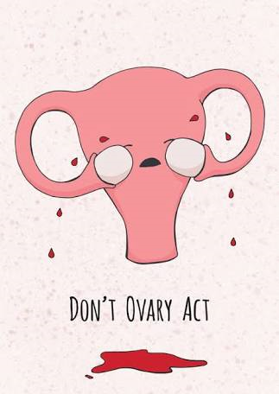
Heavy menstrual blood loss

Slide 2
Normal Menstrual Cycle
Menstration is a cyclic physiological phenomena
starting at the age of Menarche (10-12years) till establishment of Menopause (45-55 yrs).
It is regulated by hypothalmo-pituitary- ovarian hormones secreted in pulsatile and cyclic pattern.
Also influenced by endometrial response top these (E& P ) hormones and coagulation cascade.
Cycle lenghth-21-35 days , mean menstrual blood loss -30-40 ml , duration of bleeding (period0---2-8 days.

Slide 3
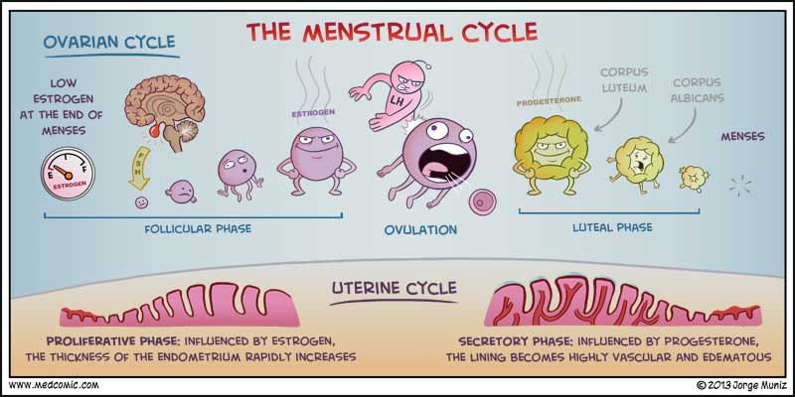

Slide 4
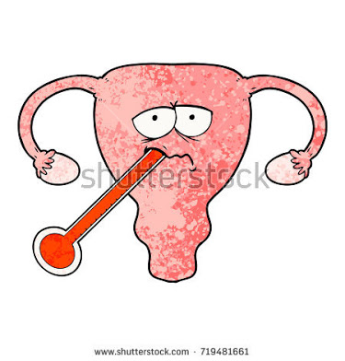
Definitions
Menorrhagia: heavy menstrual bleeding (>80 mL)
Metrorrhagia: bleeding between periods
Polymenorrhea: bleeding that occurs more often than every 21 days
Oligomenorrhea: bleeding that occurs less frequently than every 35 days
Notes:
Older classification/definitions:
Menorrhagia – heavy menstrual bleeding, is defined as menstrual blood loss >80 mL. Definition is for research purposes; use patient perception in practice
Metrorrhagia – bleeding between periods.
Polymenorrhea – bleeding that occurs more often than q21 days
Oligomenorrhea - bleeding that occurs less frequently than q35 days

Slide 5
Volume of blood flow is assessed by number of pads / tampons used whether the pads are fully/ partially soaked , presence of clots. It can be better assessed by pictorial charts--
Pad Area Soaked | 1st day | 2nd Day | 3rd Day | 4th Day | 5th day | 6th Day | 7th Day
X 1 |  |  |  | // | / | /
X 5 |  | /// | //
X20 | ///
Total Points | 89(<1oo)- | Normal | blood | Loss
Tampons soaked X1 |  |  | // | // | / | /
x 5 |  | ///
D X 15 Total Points | ////// 111 Excessive blood loss

Slide 6
Classification of DUB
1. Anovulatory –
Metropathia Haemprrhagica.
Threshold Bleeding.
2.Ovulatory ---
Idiopathic ovulatory Menorrhagia.
Luteal Phase Defect.

Slide 7
Anovulatory DUB
In some adolescent girls and perimenopausal women, Ovarian follicles develop(FSH Stimulation) and produce estrogen in variable amount leading to proliferation of endometrium .
Dominant follicle may not develop due to insufficient LH surge – no ovulation—no development of corpus Luteum ---no progesterone --- no secretary changes in endometrium ; estrogen still secreted by follicles (granulosa cells) .
Unopposed estrogenic Stimulation and some time hyper ( super threshold ) level of estrogen results in over growth of endometrium(hyperplasia) ----resulting in prolonged cycle and increased blood loss during period.

Slide 8
Anovulatory DUB
When endometrium over grow s its blood supply , lack of progesterone causes decrease PGE2 vasodilators initially and Avascular necrosis of functional endometrium occur , endometrium is shed off Lack of vasoconstrictors--- PGf2a and thromboxane results in excessive blood loss which is pain less and prolonged for 20-30days (As irregular shedding of endometrium continues for such a long time ).
Persistent Follicles under go the formation of follicular cysts.

Slide 9

Anovlatory DUB Metropathia Hamorrhagica
Accounts for 80% of DUB; at Pubertal and perimenopausal age ,Patient has variable period of amenorrhoea followed by prolong, heavy , painless bleeding .
Prolonged Un opposed Estrogen
Proliferative Endometrium
Simple Hyperplasia
Complex Hyperplasia
Complex Hyperplasia with Atypia
Adenocarcinoma

Slide 10
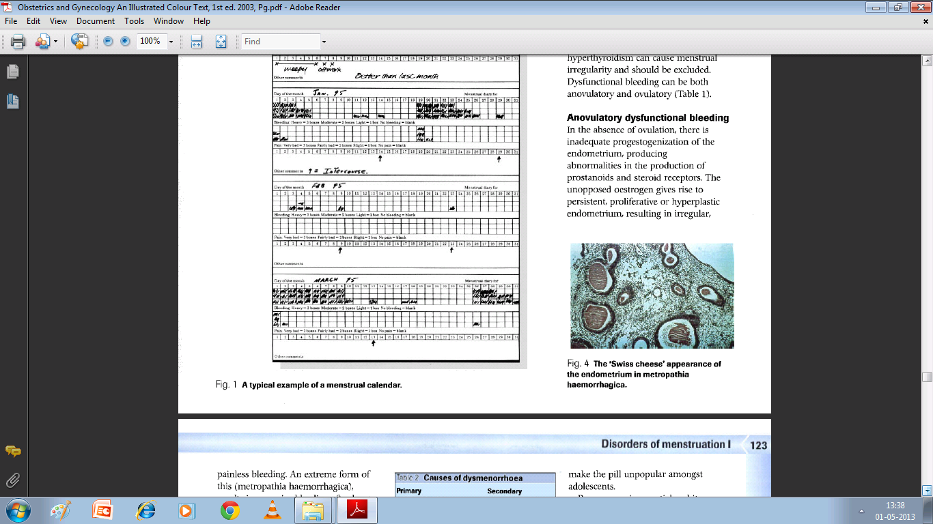
Metropathia Haemorrhagica

Slide 11
Threshold Bleeding
This is often seen in peri menopausal women . There is insufficient development of ovarian follicles resulting in low estrogen level not able to sustain endometrium or trigger LH surge ( no ovulation ).
Such women can have prolonged and excessive bleeding due to absence of progesterone and lack of PGF2a and thomboxane.
Bleeding PV in these women can be controlled with cyclic E2 + P Combination Therapy as both are at low level .

Slide 12
Luteal Phase Defect
In adequate Functioning of corpus luteum can result in--
-- in sufficient and erratic production of Progesterone. As well as alteration in the ratio of PGE : PGF
--resulting in irregular and patchy secretory changes in the endometrium .
Both pathophysiological deficit leads to irregular ripening and or irregular shedding
of endometrium .

Slide 13

Ovulatory DUB
More common in women of reproductive age group (21-40 years ) .
Accounts for 20% cases of DUB.
Patient usually present Cyclic excessive bleeding / premenstrual spotting.
Periods are associated with Pain .

Slide 14
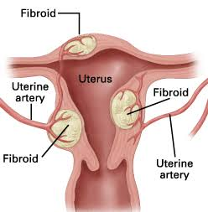
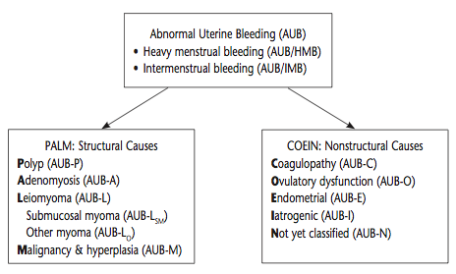
Classification: PALM-COEIN¹
International Federation of Gynecology and Obstetrics, 2011
Notes:
Prior definitions had some gray areas.
A new classification system known by acronym “PALM-COIEIN” was introduced by FIGO (Int’l Federation of Gynecology & Obstetrics) in 2011, to create universal nomenclature system to describe uterine bleeding abnormalities in reproductive-aged women; ACOG supports adopting PALM-COEIN classification/nomenclature to standardize terminology used to describe AUB
Classifies by: bleeding pattern & etiology
“Dysfunctional uterine bleeding” is a term that was often used synonomously with AUB in literature but meant AUB for which no cause was identifiable; article recommends discontinuing use of the term.
In diagram above:
Coagulopathy: ex) von Willebrand
Ovulatory: unopposed estrogen, typically endocrinopathy (PCOS)
-So first steps are is determining acute vs. chronic
-Acute AUB: episode of heavy bleeding that is sufficient amount to require immediate intervention to prevent further blood loss (clinician’s judgment); can be spontaneous or in context of chronic AUB
-chronic AUB = AUB present for most of prior 6 months

Slide 15
History Taking In DUB
Age
Age at menarche.
Parity.
Menstrual History—regularity, frequency, duration of bleeding , Volume of blood loss.
Post coital bleeding ?
Dysmenorrhoea – spasmodic / congestive .
Dyspareunia.
O.H.---fertility / infertility/ gravidity / parity etc.
Associated Vaginal Discharge .
Rescent Abortion / delivery / ectopic pregnancy .
IUCD insertion , ocs, hormone therapy/ drugs.
Symptoms of thyroid disease.
Symptoms of any bleeding disorder.

Slide 16

Examination
General Physical .
Pallor.
thyroid.
BMI .
Signs of PCOD .
Speculum Examination.
PV examination --- uterine, position, size. Shape surface , consistency ,tenderness and mobility .
Furnaces for any anneal mass /tenderness/ indurations

Slide 17

INVESTIGATIONS

Slide 18
Laboratory Tests→ HB , T/DLC, BT. CT, PT , PPT, platelets count , ESR, Fasting Blood Sugar,,T3-T4- TSH.– to know degree of anemia, to exclude coagulation disorders and leukemia's, Diabetes and thyroid disorders.
TVS /abdominal USG –to exclude Genital tract lesions like fibroids, endometrial thickening , endometriosis, PCOD , polyps , IUCD pregnancy related conditions anneal mass etc .
Soon Historiography– intra cavity lesions like polyp fibroid .
.

Slide 19

Dilatation Curettage--- Endometrial sampling for HPR--- type of endometrial ; secretary , LPD, proliferative / hyperplasia , inflammation like tuberculosis and precancerous or cancer lesion .
Hysteroscopy---diagnostic as wells therapeutic use in IUCD sub mucous fibroid , polyps .

Slide 20
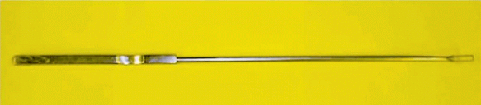
Endometrial curette

Slide 21
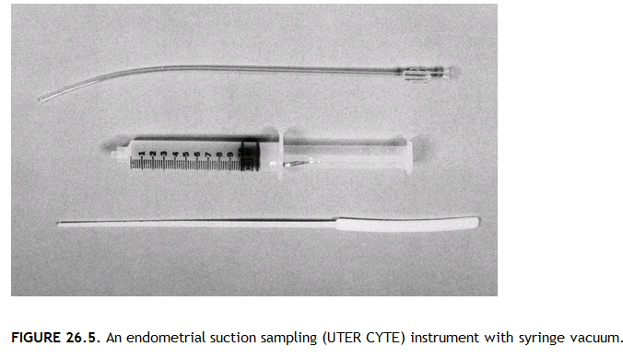

Slide 22
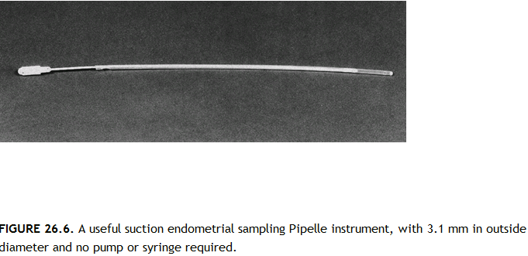

Slide 23
Differential Diagnosis—Adolescent---DUB
Differential Diagnosis | Symptoms and signs | Investigations
Bleeding Disorder s | previous history Present | BT, CT , Platelet count , PT APTT
Thyroid dysfunction PCOD (hormonal disorder but ovarian enlargement can be detected ) | Thyroid enlargement ,Resident of Goiter endemic area, clinical symptoms and signs present. Obesity, Acne , hirsutism,Acanthyosis etc | T3 , T4 and TSH profile. USG, FSH/LH ratio ,serum prolactn and SerumE2 level on day 2 of menses.

Slide 24
Differential diagnosis in Reproductive Age Group
Differential diagnosis | Symptoms & Signs | Investigations
Evacuation of vascicular mole, Post Abortal Bleeding , ch. Ectopic ,Post delivery bleeding , retained IUCD | H/o recent abortion , missed period , delivery/ insertion of IUCD / Medical abortion Pill | urine Pregnancy test, USG
Fibroid Uterus | Menorrhagia/ Poly menorrhagia , congestive dysmenorrhea , irregular enlarged uterus but not tender. | USG
Endometriosis/ Adenomyoma | Menorrhagia/ Poly menorrhea , cutting pain during menses / coital pain ,Infertility. Enlarged (Localized in adenomyoma) RV RF Fixed and tender uterus and adenexa/ mass. | USG
Chronic PID | Poly menorrhagia, congestve dysmenorrhoea,leucorrhea chronic pain in lowe abdomen and sacral region. Tender uterus , fixed / restricted mobility , adnexal thickening and tenderness | USG

Slide 25
Differential Diagnosis In Perimenopausal Age Group
Differential Diagnosis | Symptoms And Signs | Investigations
Fibroid Uterus Adenomyosis | Multipara, menorrhagia , congestive dysmenorrhea Uterus bossed and irregularly Enlarged firm to hard and not tender. Menorrhagia, multipara , congestive dysmenorrhoea . Uterus regularly enlarged soft and tender | USG USG
Endometrial Carcinoma | Nullipara, obese , hypertensive , delyed menopause , diabetic , family history +/_ , PCOD , Irregular /freuent cycles | Fractional Curretage and endometrial HP Examination

Slide 26
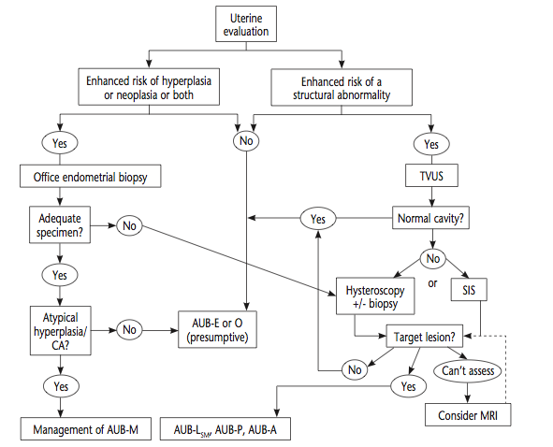
Uterine Evaluation¹
Notes:
Uterine evaluation. Guided by the medical history and other elements of the clinical situation, such as patient age, presence of an apparent chronic ovulatory disorder, or presence of other risk factors for endometrial hyperplasia or malignancy.
If increased risk, endometrial biopsy is probably warranted
If risk of structural anomaly, particularly if previous medical therapy has been unsuccessful, evaluation of the uterus should TVUS. Unless the ultrasound image indicates a normal endometrial cavity, it will be necessary to use either or both hys- teroscopy and sonohysterography to determine whether target lesions are present.
If inconclusive or virginal: MRI may be of value, if available.
Abbreviations: AUB, abnormal uterine bleeding; AUB-P, polyp; AUB-A, adenomyosis; AUB-LSM, leiomyoma submucosal; AUB- M, malignancy and hyperplasia; AUB-O, ovulatory dysfunction; AUB-E, endometrial; CA, carcinoma; MRI, magnetic resonance imag- ing; SIS, sonohysterography; TVUS, transvaginal ultrasonography. Reprinted from Munro MG. Abnormal Uterine Bleeding. Cambridge: Cambridge University Press; 2010.^p4^p7

Slide 27
Management
Medical management should be initial treatment for most patients
Need for surgery is based on various factors (stability of patient, severity of bleed, contraindications to med management, underlying cause)
Type of surgery dependent on above + desire for future fertility
Long term maintenance therapy after acute bleed is controlled
Notes:
Studies are limited for treatments of acute AUB

Slide 28
Management Continued
Determine acute vs. chronic
If acute, signs of hypovolemia/hemodynamic instability?
If yes, IV access with 1 to 2 large bore IV; prepare for transfusion and clotting factor replacement
Once stable, evaluate etiology (PALM-COEIN)
Determine Treatment

Slide 29
Medical Management
Conjugated Equine Estrogen
Combined OCPs
Medroxyprogesterone Acetate
Tranexamic Acid
Long term therapy: levonorgesterel IUD, OCPs, progestin (PO or IM); unopposed estrogen should not be used long term
Treatments differ for pts with bleeding disorders
Ex: desmopressin can help in vWF disease, etc
Avoid NSAIDs
Notes:
“-Conjugated equine estrogren: 25 mg IV q4–6 hours for 24 hours.
Contraindications: include, but are not limited, to breast cancer, active or past venous thrombosis or arterial thromboembolic disease, and liver dysfunction or disease. The agent should be used with caution in patients with cardiovascular or thromboembolic risk factors.
[this is the only US FDA approved treatment for acute AUB]
-Combined oral contraceptives: Monophasic combined oral contraceptive that contains 35 micrograms of ethinyl estradiol TID for 7 days.
Contraindications : include, but are not limited to, cigarette smoking (in women aged 35 years or older), hypertension, history of deep vein thrombosis or pulmonary embolism, known thromboembolic disorders, cerebrovascular disease, ischemic heart disease, migraine with aura, current or past breast cancer, severe liver disease, diabetes with vascular involvement, valvular heart disease with complications, andmajor surgery with prolonged immobilization.
-Medroxyprogesterone acetate: 20 PO TID for 7 days.
Contraindications: include, but are not limited to, active or past deep vein thrombosis or pulmonary embolism, active or recent arterial thromboembolic disease, current or past breast cancer, and impaired liver function or liver disease.
Tranexamic acid: 1.3g PO or 10 mg/kg IV (maximum 600 mg/dose) TID for 5 days (q8 hours )
Contraindications: include, but are not limited to, acquired impaired color vision and current thrombotic or thromboembolic disease. The agent should be used with caution in patients with a history of thrombosis (because of uncertain thrombotic risks), and concomitant administration of combined oral contraceptives needs to be carefully considered”
*Citation for ACOG chart

Slide 30
Surgical Management Options
D&C
Endometrial Ablation
Uterine Artery Embolization
Hysterectomy
Notes:
D&C vs hysterectomy based on desire for future fertility
-Consider endometrial ablation only when other modalities have failed/contraindicated, endometrial/uterine cancer is not the cause of AUB, and woman does not have plans for future childbearing

Slide 31
References
Practice bulletin no. 128: diagnosis of abnormal uterine bleeding in reproductive-aged women. Obstet Gynecol. 2012 Jul;120(1):197-206. doi: 10.1097/AOG.0b013e318262e320.
Committee Opinion no 557: management of acute abnormal uterine bleeding in nonpregnant reproductive-aged women. Obstet Gynecol. 2013 Apr;121(4):891-6. doi: 10.1097/01.AOG.0000428646.67925.9a.

Slide 32
MKSAP Questions
1) A 35 year old female is evaluated for a 5 month history of heavy menstrual bleeding. She has been menstruating for the last 8 days and is still going through 10 pads or more daily with frequent clots. She has fatigue but no dizziness. She and her husband would like to conceive a 2nd child next year. She does not smoke.
Vitals: Afebrile, BP 138/71, HR 80. Neg orthostasis. Pelvic exam: moderate amount of blood in vaginal vault.
Pelvic u/s shows a large submucosal fibroid. Hb 10.5. You consult ob/gyn for a myomectomy, scheduled in 2 weeks.
Which of the following is the most appropriate next step in management?
Levonorgestrel IUD (Mirena)
IV estrogen
Estrogen-progesterin oral contraceptive
Re-evaluate in 2 weeks

Slide 33
Question 1: Answer
Correct Answer: C) Estrogen-progestin OCP
Estrogen-progestin OCP and IUD are effective treatments for heavy menstrual bleeding. Estrogen/progestin OCP is the better choice as pt is planning to conceive in the near future. Pt also does not have any contraindications to estrogen.
IV Estrogen (B) would be appropriate if pt was orthostatic or dizzy from blood loss. PE and DVT are complications of IV estrogen.
Monitoring (D) is not appropriate given her significant, ongoing blood loss.

Slide 34
Question 2
49 year old women presents to your primary care clinic with a 3 day history of heavy menstrual bleeding. She denies dysmenorrhea but reports that her menstruation cycle have been increasingly irregular over the past couple years. She is not sexually active and had a bilateral tubal ligation 10 years ago. Her physical exam demonstrated normal vital signs, no signs of hypovolemia, no bruises. Pelvic exam was unremarkable for tenderness, nodularities, or abnormal size uterus. Cervix was normal with blood in the os. Pregnancy test is negative and pap smear was performed.
Which of the following is the most appropriate next step in management of this patient?
Endometrial biopsy
Measure serum LH and FSH
Pelvic U/S
Oral contraceptives

Slide 35

THANK YOU

