Slide 1
INDUCTION OF LABOUR

Slide 2
DEFINITION
It is defined as artificial initiation of uterine contractions , prior to their spontaneous onset beyond the period of fetal viability.

Slide 3
AUGMENTATION OF LABOUR
It is stimulation of spontaneous contractions that are considered inadequate because of failure of cervical dilatation and descent of fetus.

Slide 4
METHODS OF INDUCTION
Non pharmacological methods
Pharmacological methods
Surgical methods

Slide 5
INTRODUCTION
It has 2 components
Cervical ripening
stimulation of uterine contraction to achieve dilatation of cervix and descent of the fetus.
The main aim is vaginal delivery
Method of induction depends upon the favourability of the cervix.

Slide 6
ELECTIVE INDUCTION
ADVANTAGES
DISADVANTAGES
Relives anxiety for continuing the pregnancy further.
Benefits both maternal & fetal where continuing the pregnancy might pose many problems.
Allows women to plan for her delivery.
Increases the risk of caesarean section or instrumental vaginal delivery.
Increases the perinatal morbidity in the form of fetal distress , birth asphyxia , increased release of meconium.
Greater use of epidural analgesia , & pain perception in labour.

Slide 7
PRE REQUISITIES
Fetal lie & presentation is suitable.
Fetal maturity confirmed
Placental localisation using USG
Informed consent & risk of induction should be explained to the mother
If does not progress chances of cesarean section should be explained to the mother.

Slide 8
MODIFIED BISHOP SCORE
CERVICAL FEATURE |  | PELVIC SCORE
 | 0 | 1 | 2 | 3
DILATATION OF CERVIX | <1cm | 1-2cm | 2-4cm | >4cm
LENGTH OF CERVIX | 4cm | 2-4cm | 1-2 cm | <1 cm
STATION OF PRESENTING PART | -3cm | -2cm | -1/0 cm | +1/+2 cm
CONSISTENCY OF CERVIX | firm | average | soft
POSITION OF CERVIX | posterior | Mid/posterior | anterior

Slide 9
0-5 unfavourable
6-13 favourable
When elective induction was performed when the score is ≥ 9 , there was a high chance of vaginal delivery and duration of labour was <4hrs.

Slide 10
NON PHARMACOLOGICAL METHODS
Herbal compounds , sexual intercourse , castor oil , breast stimulation , hot bath , acupuncture , acupressure , transcutaneous nerve stimulation.
Mechanical devices __ exerting pressure into the cervical canal , which stimulate the release of local hormones prostaglandins .

Slide 11
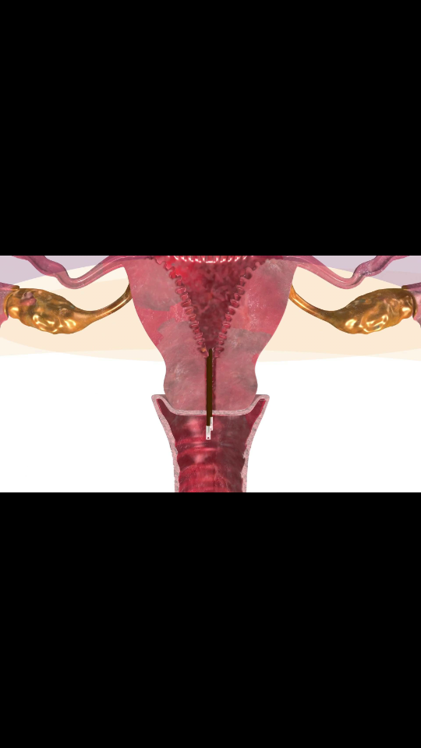
HYGROSCOPIC DEVICE
Hygroscopic devices like laminaria , dilapan absorb water from the endocervix and local tissues & swells up , thereby gradually dilating the cervix.
Dilators are of low cost.
Used for cervical ripening before induction of labour.
Placement generally required speculum and positioning of women on an table which can be uncomfortable.

Slide 12
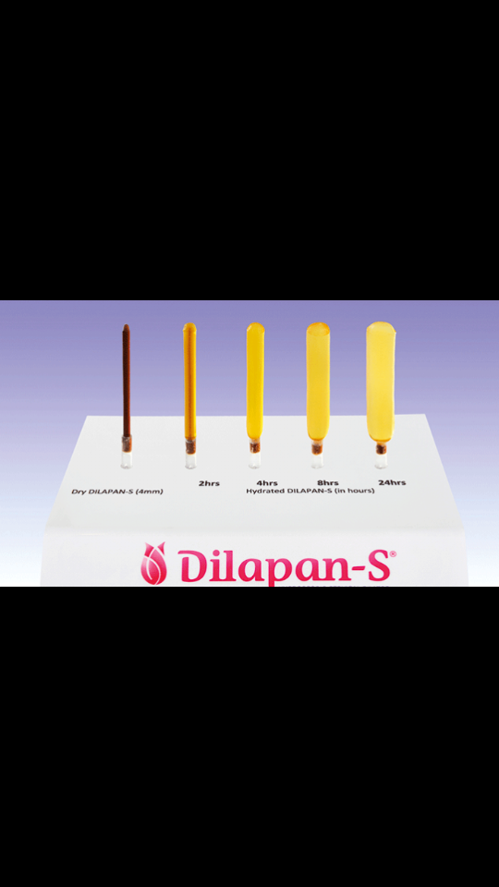

Slide 13
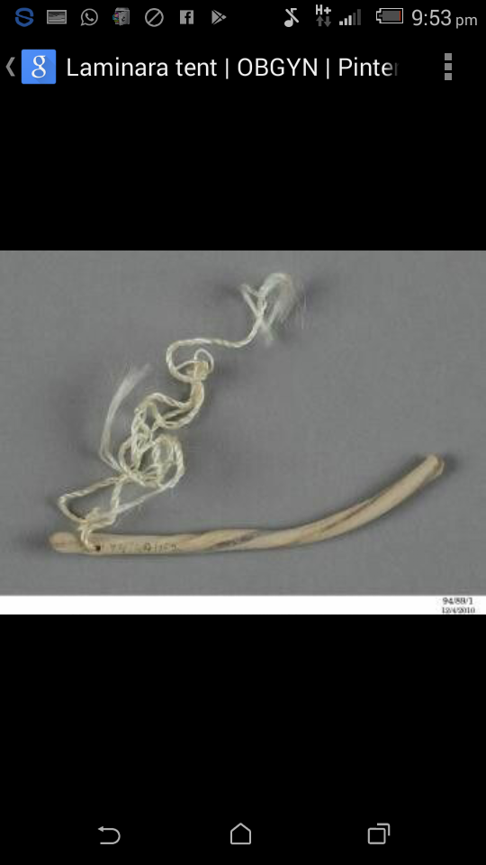
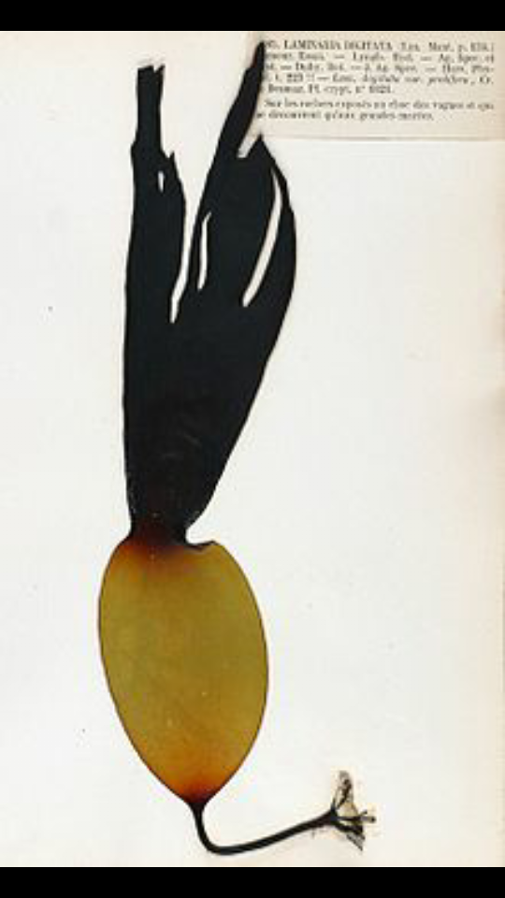

Slide 14
EXTRAAMNIOTIC SALINE INFUSION
It is used in unfavourable cervix.
Foleys catheter is placed through the internal os and downward tension is created by taping the catheter to the thigh .
Extra amniotic saline infusion through the catheter into the space b/w internal os & placental membranes.
Higher rate of delivery within 24 hrs with mechanical technique.

Slide 15
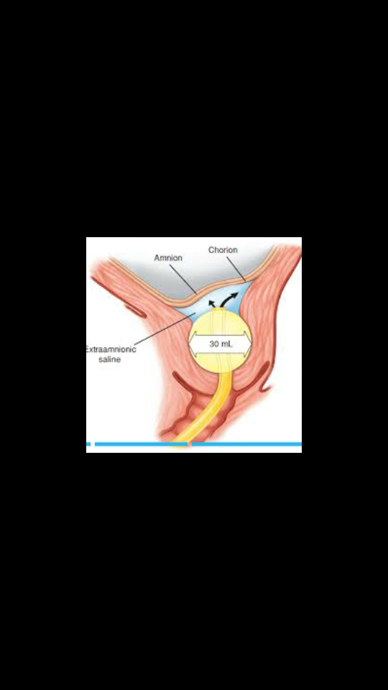

Slide 16
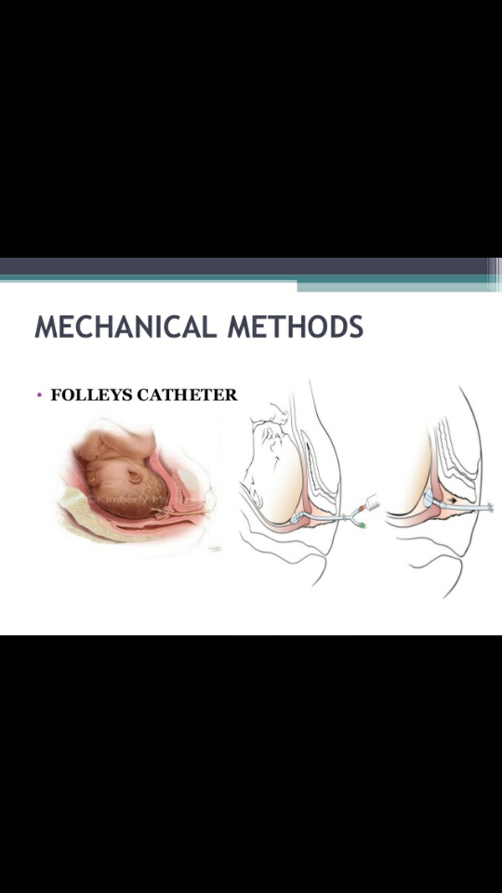
TRANSCERVICAL CATHETER
Under USG guidance / blind insertion
Foleys catheter inserted through the cervical os
Balloon at the level of the internal os & inflate with 30 ml of saline which cause dilatation of the cervix . Foleys catheter used along with intravenous oxytocin infusion.

Slide 17
ADVANTAGES & RISK
Out patient
No need for FHR monitoring.
Reduced risk of hyperstimulation
Reduced risk of meconium stained liquor
No adverse effect on neonatal outcome.
Risk
bleeding
infection
placental separation

Slide 18
PHARMACOLOGICAL METHODS
2 components
Oxytocin
Prostaglandins
Used for ripening the cervix
Other pharmacological methods currently under investigations are mifepristone, oestrogens , corticosteroids , relaxin , and hyluronidase.

Slide 19
OXYTOCIN
Being peptide it is inactive orally.
It is administered as im or iv routes rarely by intranasal spray.
Half life is 6 min
Pregnant uterus and placenta elaborate a special enzyme __ oxytocinase which can be detected in maternal plasma. Hence half life is reduced towards term.

Slide 20
continued
As pregnancy progress , the number of receptors in uterus increases markedly 100 folds at 32 weeks , 300 folds at onset of labour.
Oxytocin alone is a poor choice for induction with an unfavourable cervix.
low dose infusion is as effective as the high dose regimen with less side effects.(hyperstimulation & precipitate labour)

Slide 21
REGIMEN | STARTING DOSE (mU/ml) | INCREMENTAL INCREASE mU/min | DOSE INTERVAL min | MAXIMUM DOSE(mU/min)
LOW DOSE | 0.5_1 | 1 | 30_40 | 20
 | 1-2 | 2 | 15 | 40
HIGH DOSE | 6 | 6,3,1 | 15_40 | 42

Slide 22
RCOG GUIDELINESS FOR INDUCTION OF LABOUR
TIME AFTER STARTING | OXYTOCIN DOSE | VOLUME INFUSED ML/HR
MIN | MU/MIN | Dilution 30IU oxytocin in 500ml of normal saline | Dilution 10IU oxytocin in 500 ml normal saline
0 | 1 | 1 | 3
30 | 2 | 2 | 6
60 | 4 | 4 | 12
90 | 8 | 8 | 24
120 | 12 | 12 | 36
150 | 16 | 16 | 48
180 | 20 | 20 | 60
210 | 24 | 24 | 72
240 | 28 | 28 | 84
270 | 32 | 32 | 96

Slide 23
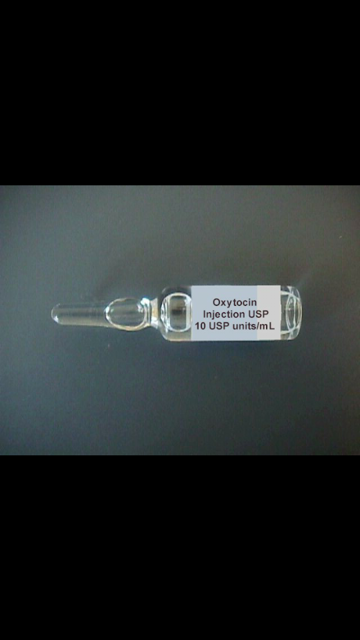
5 U of oxytocin in 500 ml RL solution.
Infusion is commenced at a rate of 1_2 mIU/min.
Gradually increased every 30 minutes till good contractions are achieved (3 contractions in 10 min lasting for 45 seconds)
In high dose regimen ,infusion is started at 6mIU/min.

Slide 24
DURATION
As it takes 20_30 minutes for the administered drug to reach the steady state level , it is unnecessary & potentially harmful to increase dose at very frequent intervals.
Adequate uterine contractions can usually be achieved at a dose of 10_12mIU/min.
Maximum dose of infusion in induction of labour is 20mIU/min although upto 32 mIU/min.

Slide 25
OXYTOCIN INFUSION USING A DRIP SET FOR INDUCTION
TIME SINCE INDUCTION (min) | OXYTOCIN DRIP RATE DROPS/MIN | DOSE OF OXYTOCIN (mIU/ml) | TOTAL VOLUME INFUSED(ML)
00 | 2U/500ML 10 | 2 | 0
30 | 20 | 4 | 15
60 | 30 | 6 | 45
90 | 40 | 8 | 90
120 | 50 | 10 | 150
150 | 60 | 12 | 225
180 | 4U/500ML) 40 | 16 | 315
210 | 50 | 20 | 3755

Slide 26
The danger of uterine rupture is minimal in primi but it is maximum in multi.
But asphyxia of baby is a potential complication.
We should aim to maintain the lowest dosage consistent with regular contractions lasting about 40 seconds every 3 minutes.

Slide 27
Once painful contraction starts, we should monitor
The intensity and the frequency of contractions,
Fetal heart rate and maternal pulse for every half an hour and maternal BP for every 4 hourly.

Slide 28
An ARM is performed once there is adequate contractions, cervix is 3 cm dilated.ARM with oxytocin infusion for induction is likely to be successful.
Once membrane has been ruptured , there is no turning back& if the patient does not progress , caesarean section is inevitable.
When induction is not very urgent , if patient fails to go into labour after 6 hrs one can discontinue the oxytocin drip & restart in next morning.

Slide 29
Oxytocin drip should be kept running right through the third stage of labour & preferably for atleast an hour or 2 hrs following twin delivery to prevent atonic haemorrhage.
Discontinue __when contractions become more than 5 in 10 min
contractions lasts longer for 60 _70 seconds
FHR pattern become reassuring.

Slide 30
SIDE EFFECTS
Water intoxication_ 20mU/min or more oxytocin is infused along with appreciable amount of fluids , water intoxication may lead to convulsions , coma , and even death.
Maternal hyponatremia _ prolonged use of intravenous oxytocin in high doses owing to antidiuretic nature of oxytocin.
So the dose of oxytocin & volume of fluid infused should be limited.

Slide 31
PROSTAGLANDINS
It is a derivative of prostanoic acid.
It has a property of acting as local hormones.
PGE2 & PGF2α which have significant effect on the uterus are used for induction of labour and abortion.
PGE1 has found to be equally effective recently.

Slide 32
Karim and his colleagues in uganda in 1966 noted PGF2α in human amniotic fluid & maternal venous blood in variable amount during labour.
Early studies of induction used IV infusion of prostaglandin ___painful phlebitis , vomiting , diahorrea.
But now both intravaginal or intracevical PGE2 have been more successful in achieving vaginal delivery within 24 hrs when compared to oxytocin , alone or with amniotomy
Now available as vaginal gel , intracervical gel , vaginal inserts , vaginal tablets &suppositories.

Slide 33
SIDE EFFECTS
Vomiting
Diahorrea
Abdominal cramps
Fever
Dizziness
Headache
Caution must be exercised in administering prostaglandins in patients with compromised cvs , renal , hepatic function , asthmatics & those with glaucoma , raised intraoccular pressure

Slide 34
VAGINAL INSERT
Dinoprostone is available as a 10 mg vaginal tablet which is inserted high up into the vagina and left for 12 hrs , even the pt can be allowed to walk after 2 hrs.
The insert must be removed when the patient goes into an active labour or after 12 hrs and before starting oxytocin infusion.
It is more expensive.
Its efficacy is similar to PGE2 gel and misoprostol.
Incidence of hyperstimulation & cesarean rates are same as gel.

Slide 35
PGE2 GEL
It should be administered near the labour ward.
Patient __recumbent for atleast 30 minutes after administration.
FHR monitoring.
Oxytocin should not be started within 6 hrs of PGE2 administration to avoid hyperstimulation.

Slide 36
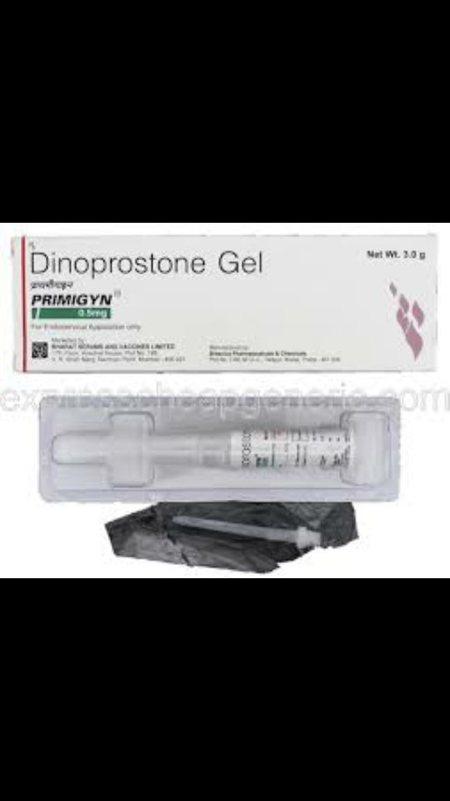

Slide 37
Intracervical PGE2 gel preparation has been widely used .
Its usage for cervical ripening is widespread ACOG 2009.
The gel is available as 2.5ml preload syringe for intracervical application.
It contains 0.5 mg of Dinoprostone.

Slide 38
PROCEDURE
Women in dorso-lithotomy position , cervix is exposed.
The tip of the cannula , which is attached to prefilled syringe , is inserted gently into the internal os.
The gel is then instilled into the cervix.
Patient in recumbent position for next 30 minutes
The dose may be repeated for every 6 hrs
Maximum dose of 1.5mg of Dinoprostone (3 doses or 7.5 ml of gel) within 24 hour period.
It is good clinical practice to assess the state of cervix before next dose is instilled

Slide 39
ADVANTAGES
Ripen the cervix
Induce the labour and reduce the risk of failed induction.
40% do not need further induction.
Reduction in cesarean section rate
Reduction in risk of cervix remaining unfavourable /unchanged at 24-48 hrs.
Reduction in use of epidural analgesia.

Slide 40
PGE1 (MISOPROSTOL)
It is cheap
Stored at room temperature
Oral __ peak plasma levels in 10-15 min, with the half life of 20-40 min.
Bioavailability is 3 times greater when administered vaginally than oral administration.
It is useful in inducing labour & abortion.
Side effects _ hyperstimulation , meconium stained liquor , uterine rupture .It can be reduced by lowering the dose of misoprostol.

Slide 41
MISOPROSTOL
VAGINAL
ORAL
Doses ranging from 25mcg 3-6 hrly , 50 mcg 4th hrly , 100mcg 6-12th hrly .
More effective than oxytocin or prostaglandin.
According to ACOG guidelines use of 25mcg of misoprostol is a initial dose for cervical ripening.
Frequency of administration should not be more than every 3-6hrs
Oxytocin should not be administered < 4hrs after last misoprostol dose.
Oral 50mcg , 100mcg is as effective as vaginal misoprostol.
For women with ruptured membrane it has similar efficacy to oxytocin.

Slide 42
Higher doses
Increased risk of uterine tachysystole
FHR decelerations.
Occurrence of meconium stained liquor was more common.
Other routes are buccal , sublingual applications.

Slide 43
DOSAGE REGIMEN FOR PROSTAGLANDINS
REGIMEN | DOSAGE AND REGIMEN
PGE2 vaginal tablet | 3mg can be repeated after 6_8 hrs if required
PGE2 vaginal gel | primi 2mg; multi 1mg can be repeated after 6 hrs if required
PGE2 vaginal insert | 10 mg , released at 0.3 mg/hr for 12 hrs.

Slide 44
PGE2 intracervical gel | 0.5 mg, can be repeated after 6 hrs if required max dose 1.5 kg
Vaginal misoprostol | 25 µg 4_6 hrly; max 6 doses
Oral misoprostol | 50 µg 4 hrly ; max 12 doses

Slide 45
PREPARATION | INSTRUCTION FOR USE AND STORAGE
PGE2 VAGINAL TAB | Remain lying for 30 mins after administration.
PGE2 VAGINAL GEL | Store in ref 2-8 degree calicoes
PGE2 VAGINAL INSERT | Supine for 2 hrs after insertion, remove at onset of active labour or 12 hrs or hyperstimulation occurs Stored in -10-20 degree calicoes Warming before insertion is not required
PGE2 INTRACERVICAL GEL | Supine for 15 mins after administration
VAGINAL MISOPROSTOL | Available as 100 µg tablet. no Need refrigeration Store below 30 degree c

Slide 46
SURGICAL METHODS
Sweeping of membranes
Artificial rupture of membrane or amniotomy

Slide 47
SWEEPING OF MEMBRANES
Sweeping of membranes as routine at term reduced the chance of pregnancy progressing beyond 41 weeks.
No associated increase in maternal and fetal infection.
Maternal discomfort, side effects like bleeding and risk of irregular contractions.

Slide 48
ARTIFICIAL RUPTURE OF MEMBRANE
Simple method
No maternal discomfort
Prolongation of latent phase of labour after ARM beyond 12 to 18 hrs it is indication for cesarean section.
Procedure
FHR monitoring
Cord prolapse , severe bleeding following amniotomy is rare.

Slide 49
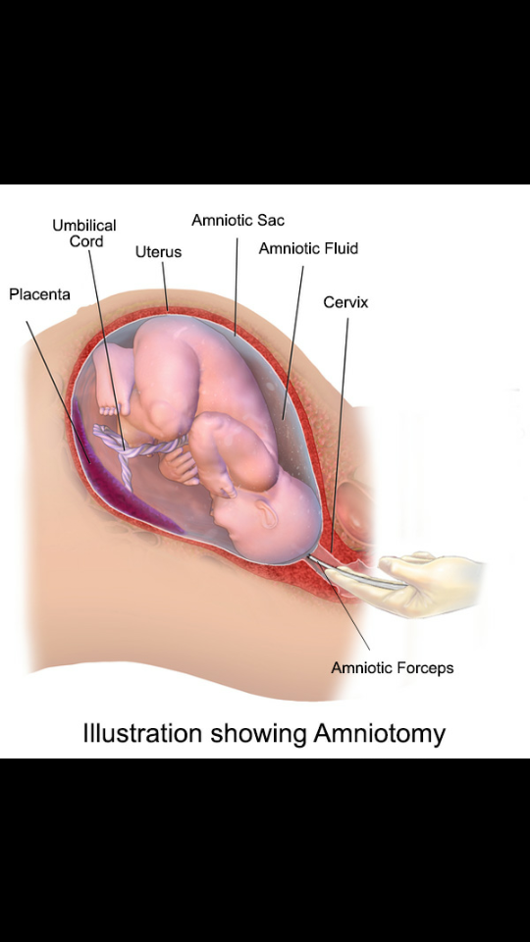

Slide 50
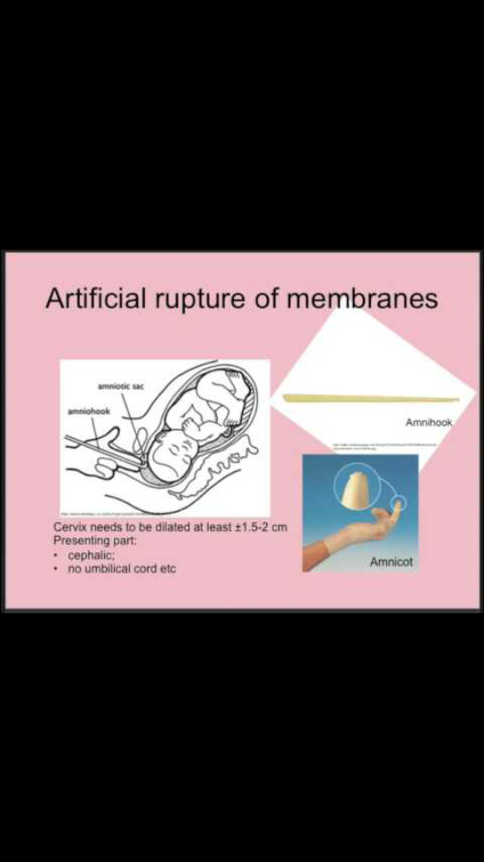

Slide 51
Sometimes after rupture of membrane meconium stained liquor is obtained
Further evidence of fetal distress , indication for cesarean delivery.

Slide 52
Occasionally, fetal hand may be felt along the side of head during surgical induction.
It should be pushed out of reach provided the head settles well into the cervix.
If it is not possible to pass the finger through the cervix such case are not suitable for surgical induction.

Slide 53
RISK OF INDUCTION
Uterine hyperstimulation
Uterine rupture
Failed induction
Prematurity
Sepsis
Partial placental detachment and bloody tap
Accidental haemorrhage
Fetal pneumonia
Cord prolapse
Amniotic fluid embolism
Neonatal jaundice

Slide 54
UTERINE HYPERSTIMULATION
Overstimulation of uterine activity is an inherent risk when uterus is artificially stimulated.
Tachysystole
Hyper tonus
Hyper tonus__ inadequate fetal perfusion of fetoplacental circulation results in fetal hypoxia.
Incidence is 1-5 %

Slide 55
Hyperstimulation without FHR changes
Oxytocin infusion is reduced or stopped
Remaining prostaglandin preparation is removed
Close monitoring until uterine activity returns to normal.
Hyperstimulation with FHR changes
Infusion stopped
Oxygen facemask
Iv infusion of RL
If hyperstimulation persists ,inj . terbutaline 0.5 mg is given subcutaneous
If hyperstimulation Still persists and there is evidence of fetal compromise, plan for caesarean section.

Slide 56
UTERINE RUPTURE
scar dehiscence & uterine rupture is reported in women with previous cesarean scar particularly after induction with prostaglandin more so with misoprostol.
Misoprostol should be avoided in women with previous cesarean section.
Greater caution to be taken while inducing labour in multipara.

Slide 57
FAILED INDUCTION/
1-6% of induced patients require cesarean section __ failure of uterus to contract.
A timeframe needs to be set , usually 24-48 hrs after adequate induction.
Even after 2 doses of PGE2 gel within 24 hrs & 12 hrs of oxytocin infusion according to acog

Slide 58
PREMATURITY
miscalculation of date of delivery
Inaccurate history of menstrual cycle and last period & induction of presumed POSTMATURITY resulting in prematurity.
So reconfirm with the dating scan.

Slide 59
SEPSIS
Is negligible as long as the amniotic sac is intact.
When membrane are ruptured risk of intrauterine infection.
Baby can also acquire active infection or infection which may remain latent for many weeks after birth.
When fetus is dead in utero, surgical induction is best avoided due to intrauterine infection.

Slide 60
PARTIAL PLACENTAL DETACHMENT AND BLOODY TAP
Placenta is sited low in the uterus surgical induction may provoke antepartum haemorrhage
If bleeding is uncontrollable caesarean section is indicated
Bloody tap __rupture of vase prevail or fetal blood vessels which traverse the lower uterine segment below the presenting part.

Slide 61
Important to know whether it is maternal or baby blood.
Fetal haemoglobin is more resistant to denaturation by alkali than adult blood.
These include apt , ogita , loendersloot_5 -7 min.
Bloody tap + bradycardia _ cesarean section.

Slide 62
FETAL PNEUMONIA
prolonged retention of fetus in utero with ruptured membranes , particularly in association with prolonged labour.
Fetal anoxia+ inevitable presence of meconium with it __deep inspiratory efforts on baby __ fetal pneumonia.
Broad spectrum antibiotics is given prophylactically in women with PPROM.

Slide 63
AMNIOTIC FLUID EMBOLISM
it can occur either at amniotomy or after few hrs later.
amniotic fluid squeezed into a maternal sinus through a rent in membrane.

Slide 64
NEONATAL JAUNDICE
Large volume of electrolytes + diureteric effect of oxytocin __ neonatal and maternal hyponatremia & decreased osmolality.
This results in osmotic fragility of the erythrocytes in the infants resulting in haemolysis and hyperbilliribinemia.
5% glucose instead of RL for oxytocin infusion reduces the risk of neonatal hyperbillirubinemia.

Slide 65
Recommended methods of induction of labour as per RCOG JULY 2008
Membrane sweeping
Prior to formal induction of labour, women should be offered a vaginal examination for membrane sweeping.
At the 40 and 41 week antenatal visits, nulliparous women should be offered a vaginal examination for membrane sweeping.
At the 41 week antenatal visit, parous women should be offered a vaginal examination for membrane sweeping.
Pharmacological methods
Vaginal prostaglandin E2 (PGE2) is the preferred method of induction of labour, unless there are specific clinical reasons for not using it (in particular, the risk of uterine hyperstimulation).
• one cycle of vaginal PGE2 tablets or gel: one dose, followed by a second dose after 6 hours if labour is not established (up to a maximum of two doses)
• one cycle of vaginal PGE2 controlled release pessary: one dose over 24 hours.

Slide 66
Misoprostol should only be offered as a method of induction of labour to women who have intrauterine fetal death .
Mifepristone should only be offered as a method of induction of labour to women who have intrauterine fetal death .
Methods that are not recommended for induction of labour
Pharmacological methods
• oral PGE2
• intravenous PGE2
• extra-amniotic PGE2
• intracervical PGE2
• intravenous oxytocin alone
• corticosteroids
• vaginal nitric oxide donors.
oestrogen

Slide 67
Surgical methods
Amniotomy, alone or with oxytocin, should not be used as a primary method of induction of labour unless there are specific clinical reasons for not using vaginal PGE2, in particular the risk of uterine hyperstimulation.
Mechanical methods
Mechanical procedures (balloon catheters and laminaria tents) should not be used routinely for induction of labour.

Slide 68
THANK YOU

