Slide 1
MTP UPDATES.

Slide 2

FOGSI GUIDELINES.

Slide 3
Women seeking Medical methods of Abortion.
Option of MMA should be given to all women coming to a health facility seeking termination of pregnancy upto 7 weeks of gestation (49 days from the first day of last menstrual period in women with regular cycles of appxmtly 28 days)
Selection criteria:
Acceptibility of minimum three follow up visits.
Ability to understand the instructions and give informed consent.
Agrees for vaccum aspiration procedure,if failure or excessive bleeding occurs.
Support from family or others.
Consent of guardian in case of minor as per MTP act 1971.
Easy access to appropriate health care facility in an emergency.

Slide 4
DRUGS USED.
Drug controller General of India approved the use of Mifepristone(April 2002) and Misoprostol(December 2006) for termination of pregnancy upto 49 weeks of gestation.
In december 2008,
Mifepristone+Misoprostol(1 tab of Mifepristone 200 mg and 4 tab of misoprostol 200mcg each)
Combipack was approved by the central drugs Standard control organisation,Directorate General of Health services for the MTP for upto 63 days gestation.

Slide 5
Mifepristone. (RU-486)
History:
Commonly called RU-486.
Invented in 1980.
RU is the initials of pharmaceutical company(Roussel-ulcaf)
486 is a random laboratory serial number.
MOA:
Anti-progesterone,blocks the progesterone receptors in the endometrium and decidua causing necrosis of uterine lining and detachement of implanted embryo.
Causes cervical softening,increased production of prostaglandins,causing uterine contractions,It senstizes the uterus to the effect of prostaglandins.

Slide 6
More effective in early pregnancy when progesteroe is present in lower concentrations due to the limited production by the corpus luteum.
DOSAGE:
200mg orally on day 1 (first visit)
When used with prostaglandins,complete abortion rate is 95-99%
Side effects:
Nausea,
Vomiting,
Fatigue,
Diarrhoea.

Slide 7
Misoprostol
it is a synthetic prostaglandin E1 analogue.
In december 2006,Drug controller of India approved its use in gynaecological indications:
Cervical ripening,
Prevention of PPH.
Mifepristone for early abortions upto 7 weeks.
MOA:
It binds to myometrial cells causing strong uterine contractions , cervical softening and dilatation.
This leads to expulsion of conceptus from the uterus.

Slide 8
Dosage:
dose is dependent on gestational age and route of administration
Approved protocol in India :
400mcg given orally or vaginally on day 3(Second visit)for gestation period upto 49 days
800mcg sublingually or vaginally for gestation period upto 63 days.
Depending upon women,clinician’s decision,even misoprostol on day 2 or 3 may be tried to reduce one follow up visit.

Slide 9
Advantages
It is economical and stable at room temperature.
It gets absorbed fairly well in gastrointestinal tract and vaginal mucosa.
Through vaginal route,it has lesser side effects,is absorbed slowly and is effective for a longer time bypasses first pass metabolism.
It has fewer side effects as compared to other prostaglandins
Being selective for PGE1 receptors,it has no significant effect on bronchi and blood vessels.
S/E:
Nausea,
Vomiting,
Diarrhoea,
Fever(sometimes with shivering).

Slide 10
Contraindications of MMA
Ectopic pregnancy either confirmed or suspected.
Allergy,
Current use of long term corticosteroid
Uncontrolled seizure disorder
Anemia(Hb<8gm%)
Haemorrhagic disorder,
Current anticoagulant therapy,
Uncontrolled hypertension,BP>160/100,
Inherited porphyria.

Slide 11
Special precautions
Pregnancy with fibroid big symptomatic fibroids encroaching on endometrial cavity can have bleeding and may interfere with uterine contractility.
Bronchial asthma-PGs other than misoprostol shouldnot be used.
Misoprostol is a weak bronchodilator.
Intrauterine device in place(remove before giving mifepristone).
If on ATT drugs,efficacy of the drugs may decrease and there are more chances of failure requiring surgical abortion.

Slide 12
Pschyo-social situations
Women unable to take responsibility for her condition.
Language or comprehension barrier,
Inablity to give informed consent.
Anxious women wanting quick abortion.
Not willing for VA abortion in case of failure.

Slide 13
Effectiveness .
CONDITION | EFFECTIVENESS
Complete Abortion | 95-99%
Heavy bleeding requiring vaccum aspiration | 1-2%
Incomplete abortion requiring other methods of evacuation | 1-2%
Heavy bleeding requiring blood transfusion | 0.1-0.2%

Slide 14
Failure
It could be due to
Heavy bleeding/Haemorrhage
True drug failure/Continuing pregnancy.
Sometimes it’s clinician /women’s decision.
Heavy bleeding:Blood loss is estimated taking into account the number of normally used average sized pads soaked at a given time.if indicated,VA is done as soon as possibe.
True drug failure is presence of gestational cardiac activity 2 weeks after Mifepristone and Misoprostol administration leading to continuing pregnancy.This has to be terminated by VA

Slide 15
Incomplete abortion.
Women have a persistent gestation sac without cardiac activity 2 weeks after the Misoprostol administration.This is called Incomplete abortion.
Sometimes,gestation sac is expelled but women keep bleeding due to blood clots/decidual bits in the uterine activity.
This can be managed conservatively as mostly it is expelled spontaneously.
But if bleeding is profuse,VA may have to be done.
SAFETY:
Using Mifepristone and Misoprostol is a safe method to terminate pregnancy as long as the woman doesnot not have any contraindications for its use.

Slide 16
Advantages.
Abortion can be offered at an early stage.
Potentially , more private,similar to a natural miscarriage.
Less invasive than VA.
No instruments are used.
No anaesthesia.

Slide 17
Limitations.
At least three clinic visits required.
Takes longer than VA,mean duration of bleeding being 9.5 days.
Unpredictable outcome: may end in complete/incomplete abortion/ continued pregnacy.
Possibility of side effects of drugs.
Risk of fetal malformation if pregnancy continues.

Slide 18
VA vs MMA procedure.
FEATURES | VACCUM ASPIRATION | MEDICAL METHODS OF ABORTION.
TECHNIQUE USED | Uterine contents evacuated through a cannula attached to vaccumsource(manual/electric) | Uterine evacuation with drugs(mife&Miso), a non surgical method.
GESTATION LIMIT OF THE TECHNIQUE | Can be used upto 12 weeks of pregnancy | Can be used upto 7 weeks of pregnancy.
EFFECTIVENESS | More than 98% effective | 93-98% effective
TIME TAKEN FOR THE PROCEDURE COMPLETION | 5-15 MIN | May take 9-16 days
POC check | POC are examined and confirmed immediately | POC may be expelled at home
NUMBER OF VISITS FOR THE PROCEDURE | One visit | Require minimum 3 visits
FOLLOW UP VISIT | Not mandatory | Must to ensure completion

Slide 19
FEATURES | VACCUM ASPIRATION | MEDICAL METHODS OF ABORTION
ANAESTHESIA USED | Local Anaesthesia & oral analgesics | Oral pain control medication
PROCEDURE DONE BY | Health care provider | Process similar to a miscarriage.
RISK OF CERVICAL AND UTERINE INJURY | possible but rare | No risk of injury to cervix and uterus since no instrumentation is done.
POST PROCEDURE BLEEDING | Minimal | Post medication bleeding usually heavy
POST PROCEDURE PAIN | For a very short period | Pain could be intense and prolonged
HOSPITAL STAY | Few hours | Few hours on each visit.

Slide 20
FEATURES | VACCUM ASPIRATION | MEDICAL METHODS OF ABORTION.
RISK OF FETAL MALFORMATION | None | Potential risk exists.
COST INVOLVED | Cost effective as lesser sources required and lesser hospital stay | Cost of the drug used is still high to be affordable by all women
ACCEPTABILITY TO WOMEN | Lower levels of pain medication. Done in OPD settings. Women awake during procedure. Noiseless procedure with MVA. | Non invasive technology More private. Close to natural miscarriage. No hospital stay.
INVOLVEMENT OF MALE PARTNER | Not allowed in the procedure room | Male partner could be fully involved in the whole process
TISSUES SAMPLES FOR | 82% effective | Not relevant.

Slide 21
APPROACH OF MTP

Slide 22
Steps taken during the preparation of a woman for MMA.
Provide counselling to the woman and obtain informed consent.
Perform clinical assessment including medical history and physical examination.
Discuss her contraceptive needs and services required.
Confirm her access to emergency health care services if required.

Slide 23
General Counselling.
Tell her about all the methods available for abortion and how each method differs from the other.
Ask about her existing knowledge and belief about abortion options.
Discuss her contraceptive needs and counsel her accordingly for a regular contraceptive after abortion.
If she choses MMA then inform her that she will have to sign a written consent for termination of pregnancy using medical methods.

Slide 24
Method specific counselling/Basic Information.
It is non invasive and non surgical.
The process is similar to miscarriage
She needs to make a minimum of 3 visits to the facility
She has to follow a definite drug protocol
She may have vaginal bleeding for 9-16 days.
She has to stay within the accessible limits of the appropriate health care facility.
She has to be told about the side effects of the drugs,i.e;she may experience nausea,vomiting,diarrhoea,etc;
Potential teratogenic effect on the fetus,if pregnancy continues.
Contact phone number and address to be given to her for emergency.
Signs and symptoms of when to seek care for emergenices.
Avoid intercourse to prevent infection/use of barrier methods.

Slide 25
MEDICAL HISTORY
Record the complete history of the woman including
Menstrual h/o,
Obstetric H/0,
Rule out all contraindications.

Slide 26
Physical examination.
Check for Pallor,
Blood Pressure,
Cardiovascular and respiratory system for any abnormality,
PELVIC EXAMINATION:
Confirm the period of gestation,
Rule out ectopic pregnancy,if possible
Identify any fibroids to take precautionary measures
Look for any infection.

Slide 27
Investigations.
RECOMMENDED:
Haemoglobin,
Complete Urine Examination,
ABO Rh.
OPTIONAL:
Ultrasound is done only if:
Women is unsure of LMP/she has irregular periods and/or the uterine size and menstrual dates donot match.
There is suspicion of ectopic pregnancy or fibroid during P/V examination.

Slide 28
Who recommendations

Slide 29
PROTOCOL FOR MMA.
VISIT | DAY | DRUGS USED
FIRST | ONE | 200mg Mifepristone orally Anti-D if Rh negative.
SECOND | TWO OR THREE | For gestation upto 49 days(7 weeks) 400mcg Misoprostol orally or vaginally After 7 weeks oral miso should not be used. For gestation upto 63 days(9 weeks) 800mcg Misoprostol sublingually/vaginally Analgesics Home administration by the woman may be tried in some cases.
Third | 14 or 15 days | Confirm and ensure completion of procedure Contraceptives

Slide 30
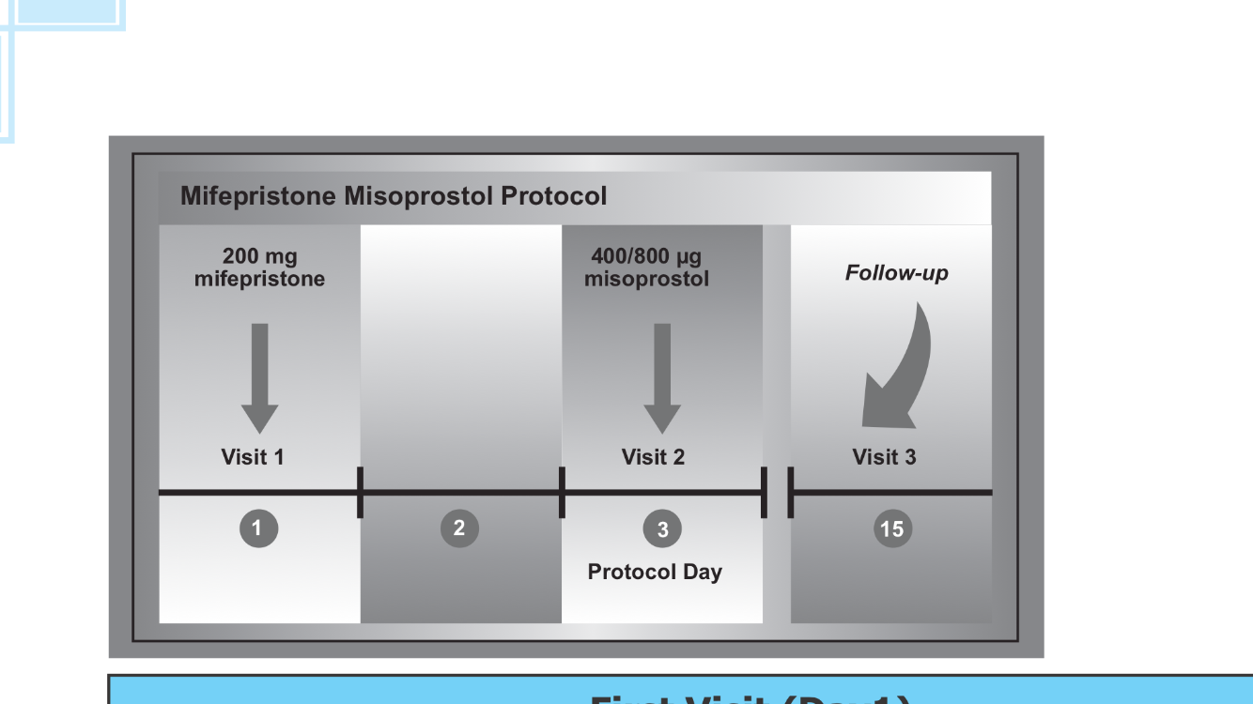

Slide 31
For pregnancies of GA between 9 and 12 weeks(62-84 days)
200 mg Mifepristone administered orally followed by 36-48 hours later by 800ug misoprostol administered vaginally.
Subsequent misoprostol doses should be 400mcg administered either vaginally or sublingually,every 3 hours upto four further doses,until expulsion of the products of conception.
For pregnancies of gestational age over 12 weeks(84 days).
200 mg mifepristone administered orally followed 36 to 48 hours later by repeated doses of Misoprostol.

Slide 32
Recommended methods of abortion of GA over 12 to 14 weeks.
Dilatation and evacuation (D&E) and medical methods(mifepristone & misoprostol,misoprostol alone) are both recommended methods for abortion for gestation over 12 to 14 weeks.
Facilities should offer at leat one,and preferably both methods,if possible,depending on provider experience and the availability of training.

Slide 33
For pregnancies of gestational age over 12 weeks & 24 weeks.
Initial misoprostol dose following oral mifepristone administration may be either 800ug administered vaginally or 400ug administered orally.
Subsequent misoprostol doses should be 400ug,administered either vaginally or sublingually ,every 3 hours upto four further doses.
For pregnancies beyond 24 weeks,
Dose of misoprostol should be reduced,dur to greater sensitivity of the uterus to prostaglandins,but the lack of clinical studies precludes specific dosing recommendations.

Slide 34
When mifepristone is not avialable.
For pregnancies of gestational age upto 12 weeks (84 days)
800ug misoprostol administered vaginally or sublingual routes.
Upto 3 repeated doses of 800ug an be administered at intervals of atleast 3 hours,but for no longer than 12 hours.
For pregnancies of GA over 12 weeks.(84 days).
400ug Misoprostol administered vaginally or sublingually,repeated every 3 hours for upto 5 doses.
For pregnancies beyound 24 weeks,
Dose of misoprostol should be reduced.

Slide 35
Recommendations for surgical abortion.
Vacuum aspiration is the recommended technique for pregnancies upto 12 to 14 weeks of gestation.
The procedure should not be routinely completed by sharp curettage.
If D&C is still practised,should be replaced by vacuum aspiration.

Slide 36
Recommendations for care preceding induced abortion.
CERVICAL PREPARATION:
Prior to surgical abortion,cervical preparation has to be done.
Is recommended for all women between 12 to 14 weeks of gestation.
Any one of these methods before surgical abortion in the first trimester :
Oral mifepristone 200mg(24 to 48 hours prior),
Misoprostol 400ug administered sublingually,2 to 3 hours prior to the procedure.
Misoprostol 400ug administered vaginally 3 hours prior tothe procedure.
Laminaria placed intracervically 6 to 24 hours proir to the preocedure.
Recommended methods of cervical preparation prior to D&E after 14 weeks of gestation aremosmotic dilators or misoprostol.

Slide 37
Recommendations for post abortion.
Contraception,
Followup,
Incomplete abortion.

Slide 38
Contraception.
Any hormonal contraception at the time of surgical abortion
.
Following medical abortion IUD may be inserted when it is reasonably certain that the women is no longer pregnant.

Slide 39
Follow up
No need for medical need for a routine follow up visit following uncomplicated surgical abortion or medical using mifepristone followed by misoprostol.
However women should be advised that additional services are available to them if needed or desired.

Slide 40
Incomplete abortion.
If uterine size at the time of treatment is equivalent to a pregnancy of gestational age13 weeks or less,either vacuum aspiration or treatment with misoprostol recommended for women with incomplete abortion.
The recommended regimen :
Misoprostol is a single dose given either sublingually(400ug) or orally(600ug).

Slide 41
MTP act.
Conditions under which pregnancy may be terminated.
Who can perform /provided abortion services.
Sites where abortion service can be provided.
Documentation and records for abortion services.
Punishments for violation of the MTP act.

Slide 42
Legal provider.
In case RMP,who was registered in a state medical register immediately before the commencement of the act,experience in OBG for a period not less than 3 years.
In case of RMP,who was registered in a State Medical register after the commencement of act
Has completed 6 months of house surgerncy in OBG.
Has experience at any hospital for a period of not less than one year in practice of OBG.
Holds a postgraguate degree or diploma in OBG.
Assisted an RMP in the performance of 25 cases of which atleast 5 have been performed independently,in a hospital established or maintained by the government or a training institute approved by Govt.
This training will enable RMP to do only first trimester MTP.

Slide 43
Site /Place where a pregnancy may be terminated.
Hospital established or maintained by the Government or a place approved by the government or the District Level Committee(DLC) headed by the Chief Medical Officer(CMO) or District Health Officer(DHO)
AS per National guidelines,
Pregnancy can be terminated at Government facilities upto:
8 weeks of gestation at Primary Health centre(PHC)
12 weeks of gestation at Community Health centre or 24x7 PHC,
20 weeks of gestation at District Hospital and above facilities.

Slide 44
DLC may approve a private place to conduct:
Terminations upto 12 weeks or
Terminations upto 20 weeks.
In case of emergency ,any pregnancy may be terminated by an RMP to save the life of the woman at an unapproved place.
In case of termination of early pregnancy upto 7 weks using a combination of mifepristone with misoprostol,the RMP can prescribe the drugs at his clinic /her clinic provided he/ she has access to a place approved for terminating pregnancy under the MTP act.

Slide 45
Conditions under which pregnancy can be terminated.
Continuation of the pregnancy would involve a risk to the life of the pregnant woman or it may cause grave injury to her physical or mental health.
Substantial risk that the child if born would be seriously handicapped due to physical or mental abnormalities.
Pregnancy is caused by rape (Presumed to constitute grave injury to mental health).
Pregnancy is caused due to failure of contraceptive in married woman or her husband (presumed to constitute grave injury to her mental health)

Slide 46
Documentations.
CERTIFICATE OF APPROVAL:
FORM B:
The certificate of approval for a ‘private’place issued by the DLC chaired by the CMO shall be conspicuously displayed such that it is easily visible to visitors.
All government facilities are by default approved to provide services and therfore donot need a certificate of approval.

Slide 47
FORM B - Certificate of approval.
( See sub-rule (6) of rule 5 )
The place described below is hereby approved for the purpose of the Medical termination of Pregnancy Act, 1971 ( 34 of 1971).
AS READ WITHIN UPTO-------------WEEKS
Name of the Place
Address and other descriptions
Name of the owner
Place :
Date :
to the Government of the ______________________________

Slide 48
FORM I.
Opinion form for each MTP done must be duly filled with reason for termination and signature with date within 3 hours of termination of pregnancy.
OPINION OF THE SECOND RMP:
In case of second trimester abortions must also be recorded either at the time of admission or within 3 hours of termination of pregnancy.

Slide 49
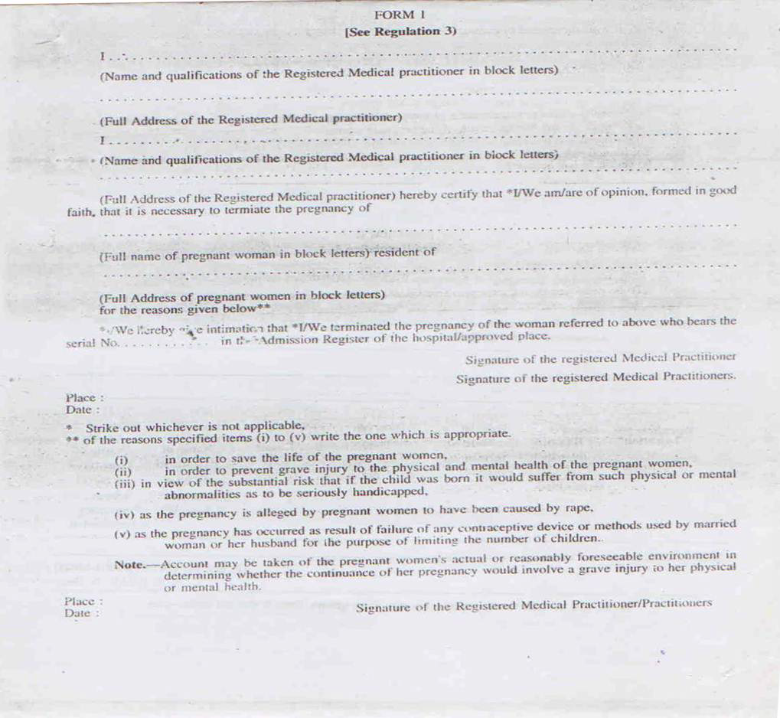

Slide 50
FORM 11
Reporting Format-A monthly statement of all MTPs done must be sent to CMO on this format.
This should include both surgical and medical methods of abortion

Slide 51
FORM 111
Admission register-All MTPs conducted at the facility must be recorded in the confidential admission register maintained at the facility for each calendar year.
Is a confidential document and is not open to inspection by any person except under authority of law.
To kept in a safe custody.
Preserved for a period of 5 years from the date of last entry.
There is no requirement for recording sex of the abortus in the Admission Register or any other records.

Slide 52
FORM C
Consent Form: consent of only woman is required if she is of and above 18years.
Only in case of a minor,/mentally ill woman of any age group,her guardian’s consent is required.
Information about termination of pregnancy must be sent in a sealed envelope to the CMO the same day or the next working day.
Consent from husband/parent/guardian is not required for seeking an abortion from a woman who is of or above 18 years of age and who is not mentally ill.
Additional documentation of age proof is not required in addition to Form C.

Slide 53
FORM C (See rule 9) I __________________________________________________________________
daughter / wife of ___________________________________________ aged about
_________ years at present residing at _________________________________ (state the permanent address) do hereby give my consent to termination of my pregnancy at
___________________________________________________ (state the name of place where pregnancy is to be terminated ) Place________________ Date ________________ Signature / Thumb impression ____________________ (to be filled in by guardian where the woman is mentally ill person or minor)
(to be filled in by guardian where the woman is mentally ill person or minor) I ______________________________________________________________ son / daughter / wife of _______________________________________ aged about ___________ years at present residing at (Permanent address) _________________________________________ do hereby give my consent to the termination of the pregnancy of my ward _________________________________ who is a minor / mentally ill person at ________________________________________________________________ ( place of termination of pregnancy) Place _____________________ Date _____________________ Signature / Thumb impression ________

Slide 54
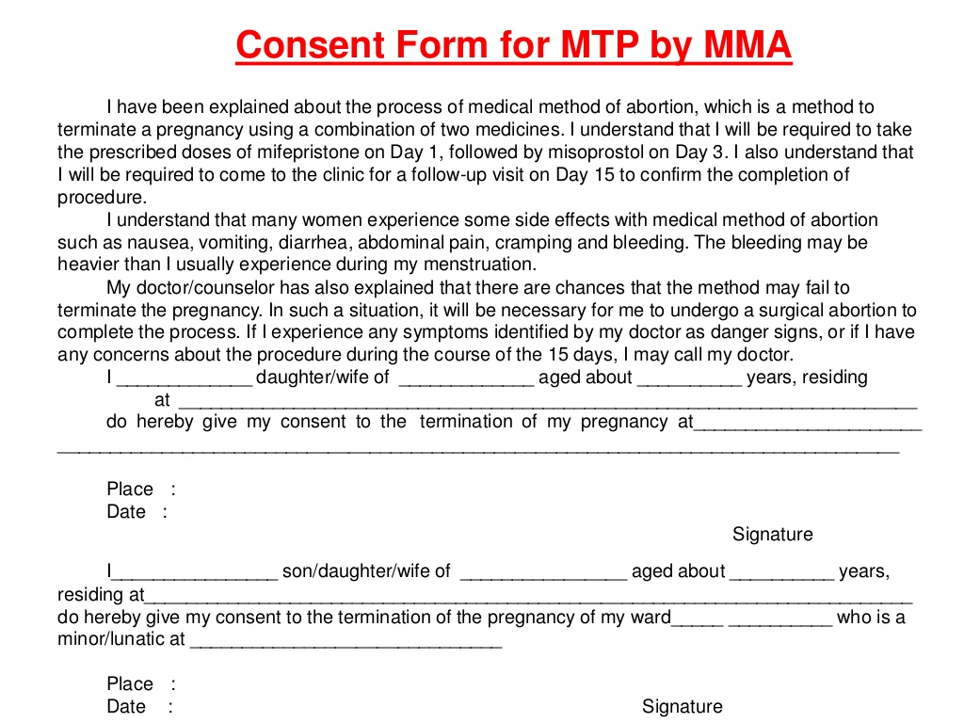

Slide 55
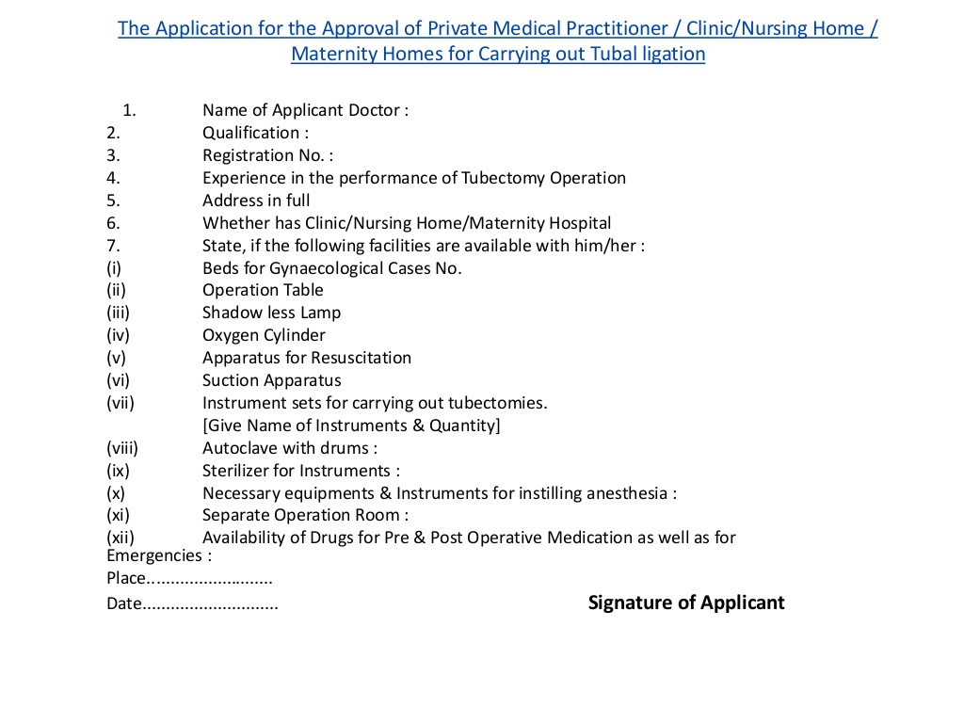

Slide 56
PC&PNDT ACT.
The PNDT act,1994 amended and renamed as the PC&PNDT act in 2003 was enacted with following objectives.
To provide for the prohibition of sex selection,before or after conception.
For regulation of prenatal diagnostic techniques for the purpose of detecting genetic abnormalities or metabolic disorders or chromosomal abnormalities or certain congential malformations or sex-linked disorders.
For the prevention of their misuse for sex determination.

Slide 57
PC&PNDT ACT,2014.
SIX MONTHS training in USG title” the Fundamentals in Abdomen –Pelvic Ultrasonography”.
Level One : for MBBS doctors from an institutuion notified by the State Health Medical Education department.
The period of training for obtaining a certificate of training is 300 hours.
Gynaecologist with a postgraduate degree/diploma and radiologists with a Pg diploma/degree need not undergoe this training,
Medical practitioners already using USG(even before ammendment) are exempt from training but have to undergo a competency based assessment no later than January 2017.

Slide 58
MTP ACT.
MTP act in India came into existence in 1971 based on recommendations of the Shah Committee.
This act was amended in 2003 to facilitate better implementation and increase access for women especially in private health sector.
However 38 years after the implementation of a liberal MTP act,unsafe abortions still continue to outnumber safe and legal abortions in the country contributing to the total maternal deaths in India.
The Ministry of Health and Family welfare(MOFHW) decided to examine the MTP act and amends it to enable increased access to safe abortion services in the country.

Slide 59
MTP(AMENDMENT)BILL,2014.
MTP ACT 1971,hereafter referred as Principal act.
“Registered medical practitioners”,the words by “Registered health care providers” shall be substituted.
A practitioner who passes
A) any recognized medical qualification of Ayurvedha,Unani or Siddha whose name as has been entered in the Central Register or State Register of Indian Medicine.
B)A nurse or auxillary nurse midwife who possesses any recognized qualification in general nursing or auxillary nurse midwifery who has been enrolled in the Indian Nurses Register or the State Register.

Slide 60
Pregnancy can be terminated by RHC provider.
On request of a woman,where the length of the pregnancy doesnot exceed 12 weeks.
Where the length of pregnancy exceeds 12 weeks but doesnot exceed 12 weeks
Where the length of pregnancy exceeds 20 weeks but doesnot exceed 24 weeks and the woman fall in one of the categories:
If such health care provider is of the opinion formed in good faith that
A) the continuance of the pregnancy would involve a risk to the life of the pregnant woman or of grave injury to her physical or mental health
B) there is substantial risk that if the child were born it suffer from serious physical or mental abnormalities.

Slide 61
Explanation
Where any pregnancy is alleged by the pregnant woman to have been caused by rape,the anguish caused by such pregnancy shall be presumed to constitute a grave injury to the mental health of the pregnant woman.
Where any pregnancy occurs as a result of failure of any device or method used by any woman or her partner for the purpose of limiting the number of children or preventing pregnancy,the anguish caused by such pregnancy may be presumed to constitute a grave injury to the mental health of the pregnant women.
Length of pregnancy shall not apply to the termination of apregnancy is necessitated by the diagnosis of any substantial foetal abnormalities as may be prescribed.

Slide 62
Punishment
No registered health care provider shall reveal the name and other particulars of a woman whose pregnancy has been terminated under this act.
.
Termination of pregnancy by aperson who is not registered health care provider shall be an offence punishable with rigorous imprisonment for a term which shall not be less than 2years but which may extend to seven years.
Whoever terminates any pregnancy in aplace other than a place mentioned shall be punishable with rigorous imprisonment for a term which shall not be less than 2 years but which may extend to seven years.
Any person being owner of the place which is not approved shall be punishable with rigorous imprisonment for a term which shall not be less than 2 years but may extend to seven years.

Slide 63
Proposed amendments.
The proposed amendments to the MTP Act are currently with the Ministry of Health and Family Welfare,Government of India are awaiting final approval for further process.
The proposed amendments to the MTP Act are primarily based on incresing the availabilty of safe and legal abortion services for women in the country.
The recommendations can be broadly classified into the following”
Expanding base of legal abortion providers,
Increasing access to legal abortion services for women,
Increasing the upper gestational limit for legal MTPs.
Increasing clarity of the MTP law.

Slide 64
Expanding the base of legal abortion providers.
Including Medical Practitioners with Bachelor’s degree in Unani,Ayurveda or Homeopathy.
These categories of practitioners have OBGYN training and abortion services as a part of their undergraduate curriculum.
It is recommended to include nurses with three and half year’s degree and registered with the Nursing Council of India,into the base of legal providers for medical methods of abortion only.
The training requirement,gestation period limits and any limitation on abortion technologies to be used by the new provider categories would be described in the Rules.

Slide 65
Increasing access to legal abortion services for women.
The group made the following recommendations to remove some operational barriers in the current law that limit access to safe and legal abortion services.
Remove the requirement for provider’s opinion for first trimester abortions.
Reduce the condition of requirement of the opinion of two services providers for second trimester pregnancies to one service provider only,as this seen as hindrance in access to safe abortion services by women in situations where 2 providers are not available.

Slide 66
Cont...
Extend the indication of contraception failure to include unmarried women also.
Distinguish between training for medical and surgical methods of MTP.
Since the training required to provide only medical methods of abortion is significantly less than surgical abortions,it has been recommended to distinguish between the two trainings.
This would enable more providers to be appropriately trained,thereby ensuing safe MTP services.

Slide 67
Increasing the upper gestation limit for legal MTP services.
This recommendation has been keeping in mind the latest technological and medical advancements which have made late abortions safer than before.
It has been recommended to allow termination of pregnancy where necessitated by the diagnosis of any of the substantial foetal abnormalities.
Modalities like definition ”substantial foetal abnormalities”, list of foetal abnormalities,diagnostic modalities,record keeping and others will be enumerated in n notification issued by the government.

Slide 68
Increasing clarity on the MTP act.
the expert group has also taken this opportunity to recommend the addition of some clauses to make the Act more comprehensive and Clear.
For this purpose,it has been recommended to add definitions of following terms:
Abortion,
Medical termination of pregnancy.
Methods of abortion.
It has been recommended which clearly states that only the consent of a woman is required for an MTP procedure.
This is suggested to address the common practice of insisting on consent of or notice to the woman’s husband/partner or of conditionay providing abortion services on the condition of acceptance of contraception

Slide 69
It has been recommended to replace the term :Registered medical Practitioner” with “Registered service Provider”.
This would cover by bringing in Paramedics(Nurses),also Unani,Ayurvedic and Homeopathic Practitioners as legitimate providers of abortion service.this would also avoid confusion since RMP also commonly refers to a ‘rural medical practitioner’/

Slide 70

+

