Slide 1
MEDICAL TERMINATION OF PREGNANCY

Slide 2
After viability, the foetus in utero is protected by law in most countries and accorded the rights of an individual human being.

Slide 3
Definition
The Indian Act permits the willful termination of pregnancy before the age of fetal viability (20 weeks of gestation) for well defined indications.
It has to be performed by recognized medical practitioners in a recognised place approved by the competent authority under the act.
MTP service is available in India as a health
measure to avoid criminal abortion and not as a
contraceptive technique.

Slide 4
Incidence
Total number of abortions performed globally is about 46 million anually
Of that, 26 million are done in countries where abortion is legal.
In India, 6.7 million MTPs take place, in which 40% are unplanned and 25% are unwanted.
40 to 50 % of abortions are unsafe MTPs done by less qualified persons.

Slide 5
MTP ACT

Slide 6
In India, the medical termination of pregnancy (MTP) Act was passed by parliament in 1971 and came into force on 1st April, 1972.
The Act liberalized the abortion laws as a family welfare and health measure to ensure better health and prevent risks to the lives of women from the hazards of criminal abortion.

Slide 7
The law specifies
The indications of grounds on which pregnancy may be terminated.
The persons who are permitted to perform this procedure
The place where such terminations can be performed

Slide 8
Grounds for performing MTP
Medical grounds
Where continuation of pregnancy is likely to:
Endanger the life of the pregnant women
Cause grievous injury to her physical and /or mental health, as in cases of severe hypertension, cardiac disease, diabetes, psychiatric illnesses, genital and breast cancer.

Slide 9
Eugenic grounds
risk of the child being born with serious physical or mental abnormalities.
Examples:
Hereditary disorders, chromosomal/ structural anomalies
Teratogenic drugs
Radiation exposure of >10rad in early pregnancy
Rh-isoimmunization
Maternal rubella posing risk of anomalies in the fetus.

Slide 10
Humanitarian grounds
When the pregnancy is caused by rape, or incest.

Slide 11
Social grounds
In the actual or reasonably foreseeable future, her environment (social, economic) might lead to risk of injury to her health
Pregnancy resulting from failure of contraceptive device or method

Slide 12
The Persons who can Perform the MTP
The Act provides safeguards to the mother by authorizing only a registered medical practitioner having:
Diploma or postgraduate degree in obstetrics and gynaecology
One has assisted atleast 25 MTP in authorized center & having a degree.
One has got 6months of house surgeon training in obstetrics & gynaecology

Slide 13
The Place for Performing MTP
A hospital established and maintained by the government.
A place recognized and approved by the government, under this Act.

Slide 14
Indian MTP act
Ensure proper case selection
Essential investigations should be performed
(Hb%, urine routine, blood grouping & typing, USG)
One medical practitioner’s opinion for I trimester, two’s for II trimester
To be performed by a recognized medical practitioner in a recognized place
Documents to be maintained- Form I, Form II, admission register.

Slide 15
Implications of the MTP Act
In countries with liberal abortion laws, maternal morbidity and mortality have declined, and women have been motivated to accept birth control measures.

Slide 16
Deaths due to illegal abortions are 500/1 lakh.
It is due to haemorrhage, sepsis, embolism, etc
Repeated abortions are not conducive to a woman’s health, hence MTP should not be considered as a birth control measure, and should not replace prevailing methods of contraception.

Slide 17
Even in the best of circumstances, there is a small inherent risk in the procedure of MTP.
This should serve as a warning that MTP can never be as safe as efficient contraception.
The woman undergoing MTP should be educated to accept contraception.

Slide 18
METHODS OF MTP

Slide 19
FIRST TRIMESTER MTP upto 12wks
MEDICAL
SURGICAL
Menstrual regulation
Vacuum aspiration
Dilatation & suction evacuation

Slide 20
Medical methods:
Permissible upto 9wks of gestation (63days).
Prostaglandins
Mifepristone
Methotrexate
Tamoxifen
Acting singly, they are not effective as used in combination.

Slide 21
Written consent for MTP is required
Blood grouping RH typing
Hb%
USG- to confirm intrauterine pregnancy

Slide 22
Prostaglandins:
Prostaglandin injections (PGF2α)- Carboprost 250mcg given im every 3 hours up to a maximum of 10 doses has been found to be effective in initiating the process of abortion
Mechanism of action:
Causes strong uterine contractions and causes expulsion of fetus.

Slide 23
Not been popular in first trimester because:
High incidence of incomplete abortion(20%) requiring surgical intervention to complete the procedure
High rate of side effects (nausea, vomiting, diarrhoea, fever, cramping abdominal pain, bronchospasm)

Slide 24
Mifepristone/ RU 486:
Roussel Uclaf 486, invented in France 1980.
Synthetic steroid, derivative of 19-nortestosterone
Antiprogestogenic effect
Antiglucocorticoid and weak antiandrogenic action

Slide 25
Mechanism of action:
Competing with progesterone receptors
Reduces the endometrial glandular activity and increases stromal action
Accelerates degenerative changes Sloughing of endometrium
Prevents implantation of the fertilized ovum through luteolysis
It also causes uterine contractions
Softens & slightly dilates the cervix.
Causes incomplete abortion in 10-20% cases.
Effective in only 83%.

Slide 26
Mifepristone & Misoprostol
Effective upto 63days
Highly succesful when used within 49days
PROTOCOL:
Day 1: 200mg oral RU-486
Day 3: misoprostol- 400mcg orally/ 800mcg vaginally
Day 14: followup to confirm abortion has occured. If not surgical MTP is done.

Slide 27
Complete abortion- 95%
Incomplete abortion- 4%
Continuation of pregnancy- 1%

Slide 28
Contraindications
IUCD in situ
Suspected ectopic pregnancy
Hypertension, anemia, glaucoma, cardiac disease, smoker, asthmatic
A women on anticoagulant and glucocorticoid therapy
Previous uterine scar
lactating women
Gestation period should not exceed 63days (preferably 49 days)

Slide 29
Advantages
Easy administration
Avoids hospitalization

Slide 30
Complications
Adrenal failure
Headache, malaise, skin rash, fever
Failure to abort -1%
Misoprostol causes Mobious syndrome in the fetus (congenital facial palsy, limb defects, bladder extrophy, hydrocephalus). Therefore termination is strongly recommended if medical termination fails.

Slide 31
Takes longer time for termination and longer follow up for 2 weeks is necessary
Surgery is required in case of failure or incomplete
The subsequent menstruation may be delayed by 10-14 days
Sublingual misoprostol is effective but side effects are more than oral & vaginal.
if vomiting occurs soon after oral misoprostol, repeat the dose/ vaginal pessary is safe.

Slide 32
Methotrexate & Misoprostol
Day 1: MTX 50mg/m2 im (before 56days of gestation)
Day 7: Misoprostol 800mcg vaginally, repeated after 24hrs if it fails.
Less expensive but takes longer time.
Complete abortion occurs in 92%.
USG is done to confirm failure & suction evacuation is to be done.

Slide 33
Tamoxifen & Misoprostol
Tamoxifen 20 mg bd for 4 days followed by misoprostol has also been tried and the results have been found to be comparable to Methotrexate-Misoprostol.

Slide 34
EPOSTANE
Progesterone blocking agent
200mcg 6hrly for 7days

Slide 35
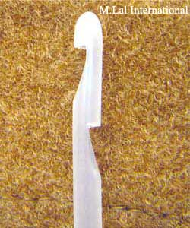
SURGICAL METHODS Menstrual regulation
Aspiration of the contents of the uterine cavity by means of a plastic cannula (Karman’s cannula)

Slide 36
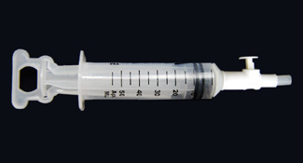
It has a plastic 50 ml syringe
Capable of creating vacuum over 650 mmHg
Simple thumb-operated pressure control valve and piston locking handle
Independent of electricity, portable and washable

Slide 37
It can be done in an OP clinic and is the efficient and easy way of MTP.
Carried out effectively within 42 days of the LMP
A paracervical local anaesthetic block or preoperative sedative alone usually suffices
In an apprehensive patient, GA with IV Thiopentone sodium may be necessary

Slide 38
After introducing the post. Vaginal speculum, ant.lip of cervix held with vulsellum.
Cervix is gently dilated
Karmans cannula is then inserted & attached to 50ml syringe.
The canula is rotated, pushed in and out with gentle strokes.
Operator should examine the aspirated tissue.

Slide 39
Complications
Anaesthetic complications
Haemorrhage
Cervical laceration
Perforation
Infection
Failure to evacuate

Slide 40
FAILURE TO EVACUATE leads to continuation of pregnancy (0.5-2%)
Too early pregnancy
Ectopic pregnancy
Bicornuate uterus. (aspiration carried out in non pregnant horn)
Preoperative USG is useful in preventing this complications.
Contraindications:
Advanced pregnancy
Local pelvic inflammation

Slide 41
Vacuum aspiration
Effective upto 12wks
Procedure may be MVA/ EVA, done in OT & is similar to menstrual regulation.
After the dilatation of the cervix, suction cannula / karman’s cannula of appropriate size (diameter corresponding to the wks of gestation) is introduced into the uterine cavity.
A standard negative suction of 650mmHg is applied and the products are aspirated

Slide 42
After the completion of the procedure:
A grating sensation is felt all around the uterine cavity
No further tissue is aspirated
Internal os begins begins to grip the Karman cannula
Blood-stained froth
Time taken for the procedure: 5-15min
Failure rate- very low. <1%

Slide 43
In case of large uterus of 10-12 weeks or nulliparous cervix, priming the cervix with prostaglandin gel or suppository at least 4 hours earlier helps to soften the cervix.
Undue force is avoided during cervical dilatation.
200-400 mcg misoprostol pessary is inserted in the vagina.

Slide 44
Complications
Cervical tear
Lacerations
Injury to the internal os leading to incompetent cervix
Perforation,
Synechiae(asherman’s syndrome)
Predisposes to placenta accreta in future pregnancy

Slide 45
Mortality- <2/1,00,000 procedures
Nonimmunized Rh negative mothers must receive 100mcg of anti-D immunoglogulin after undergoing MTP.

Slide 46
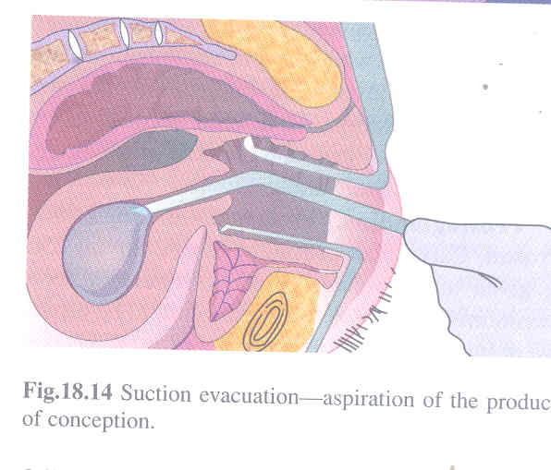
Dilatation & Suction Evacuation
It is a procedure in which the products of conception are sucked out from the uterine cavity with the help of a cannula fitted to a suction apparatus.
Dilatation of cervix with laminaria tents, prostaglandin gel or pessary is done prior to evacuation.

Slide 47
Advantages:
Ideal for termination of therapeutic indications.
Can be done as outdoor procedure under paracervical block. Hazards of GA are absent.
Chance of uterine perforation is less espicially with plastic cannula.
Blood loss is minimal

Slide 48
Drawbacks:
Not suitable for bigger size of uterus
Chance of retained products is more
Requires electicity to operate
Machine is costly

Slide 49
SECOND TRIMESTER MTP (13-20wks)
MEDICAL
Intrauterine instillation of drugs
SURGICAL
Dilatation & evacuation
Aspirotomy
Hysterotomy

Slide 50
MEDICAL METHODS
Intrauterine instillation of drugs
Extra amniotic- 0.1%ethacridine lactate
Intra amniotic- 20%hypertonic saline
- 40%hyperosmotic urea
Intracervical- cerviprime gel

Slide 51
Ethacridine Lactate
Foley catheter introduced transcervically into extraovular space after steadying the anterior lip of cervix
Bulb of Foley inflated with distilled water to seal the internal os
Ethacridine lactate 0.1% prepared solution is instilled into extraovular space 10ml/week gestation up to max 150ml
Uterine activity begins within 12 to 18 hours

Slide 52
Induction-abortion interval is 24-36hrs
In cases of failure for 72hours reinstillation of ethacridine lactate or other method of MTP can be tried
About 30% of abortions may be incomplete and require oxytocin infusion or occasional blunt curettage
Supplementation of prostaglandin hastens the procedure

Slide 53
Intra amniotic instillation of 20%hypertonic saline
Preliminary amniocentesis with 15cm, 18G needle
Amount of saline to be instilled is calculated as numb. Of weeks of gestion multiplied by 10ml
Infused at the rate of 10ml/min.

Slide 54
Mechanism of action:
Necrosis of amniotic epithelium & decidua
Prostaglandins are released
Excites uterine contractions & results in expulsion of fetus
Success rate- 90-95%
Contraindications:
Severe anaemia, cardiovascular, renal diseases

Slide 55
Complications
Minor:
Fever, Headache, Nausea, Vomiting, Abdominal pain
Cervical tear, laceration
Retained products
infection

Slide 56
Hypernatremia
Cardiovascular collapse- intravascular injection
Pulonary edema
Cerebral edema
Renal failure
DIC
Death- 5/1000 instillations

Slide 57
Intraamniotic instillation of hyperosmotic urea
40% urea solution- 80g urea in 200ml distilled water.
Combination with PGF2α, syntocinon drip is effective. Reduces induction-abortion interval- 13hrs.

Slide 58
Prostaglandins
Prostaglandin injections (PGF2α)- 250mcg given im every 3 hours up to a maximum of 10 doses
Success rate is 90% in 36hrs

Slide 59
Misoprostol (PGE1):
400-800mcg vaginally at an interval of 3-4hrs
600mcg vaginally followed by 200mcg orally every 3hrs
400mcg sublingually every 3hrs for max of 5doses.
100% success rate
Induction abortion interval: 11-12hrs

Slide 60
Prostaglandin analogues:
Gemeprost (PGE1)
1mg vaginal pessary every 3-6hrs for 5doses in 24hrs has got 90% success
Induction-abortion interval: 14-18hrs
Dinoprostone (PGE2)
20mg vaginal suppository every 3-4hrs for 4-6doses.
When used with osmotic dilators, the mean induction-abortion interval is 17hrs

Slide 61
Mifepristone & Misoprostol
4OOmcg vaginal misoprostol 3 hourly for 5 doses
(or)
200-600mcg vaginal misoprostol 12hourly
200mg of oral Mifepristone
600mcg of vaginal Misoprostol
after 36-48 hours
Success rate is 97%
Induction-abortion interval: 6.5hrs

Slide 62
SURGICAL METHODS Dilatation & evacuation
Deliberate dilatation of the cervix followed by evacuation of the uterine contents by vacuum or aspirotomy with ovum forceps.
Can be done upto 16wks.
Cervical dilatation
Rupture membranes & aspirate amniotic fluid with suction
Remove placenta with forceps/suction
Sharp curettage performed.

Slide 63
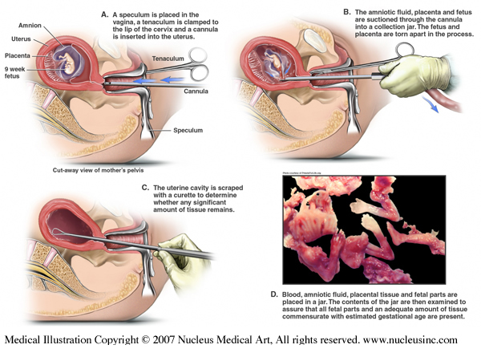

Slide 64
Procedure is completed when
All of fetus is identified in gross examination
Placenta identified
Uterus decreases in size
Minimal vaginal bleeding
No additional tissue obtained in curettage

Slide 65
Complications
Haemorrhage
Cervical tear
Lacerations
Uterine perforation
Incomplete evacuation
Infection
Procedure can be done under ultrasound guidance to reduce the complications.

Slide 66
Aspirotomy
Suction aspiration of liquor amnii with large bore suction cannula
Fetus is dismembered, crushed and extracted through the cervix with aspirotomy forceps.
Extracted mass is assembled to ensure that the fetus has completely extracted.
Throughout procedure – oxytocin infusion is kept running to reduce risk of uterine perforation & bleeding.
Procedure is safe with reduced blood loss

Slide 67
Hysterotomy
Operative procedure of extracting products of conception out of the uterus before viability (28wks) through abdominal route.
Indications:
Failed MTP
Cases where D&E cannot be done - Fibroid in LUS, uterine anomalies, pt with placenta accreta/ percreta

Slide 68
Complications
Immediate
Anaesthetic complications
Hemorrhage & shock
Peritonitis
Intestinal obstruction
Remote
Menstrual abnormality- menorrhagia, irregular periods
Scar endometriosis
Scar rupture in subsequent pregnancy

Slide 69
Nonimmunized Rh negative mothers must receive 100mcg of anti-D immunoglogulin within 72hrs of abortion.

Slide 70
Late sequelae of MTP
PID
Ectopic pregnancy following PID
Infertility caused by tubal damage and blockage
Incompetent os following trauma to cervix
Adherent placenta in subsequent pregnancy
Asherman syndrome
Rh-isoimmunization if anti- D is not administered after MTP to non-immunized Rh –ve mothers
Psychiatric disorders

Slide 71


