Slide 1
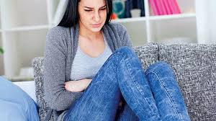
PHYSIOLOGY OF MENSTRUATION AND OVULATION
.

Slide 2
MENSTRUAL CYCLE.
MENSTRUATION:It is the end point in the cascade of events starting at hypothalamus and ending in the uterus.
Mean duration of cycle : 28 days.(21-35 days)
Average duration of menses: 3 -5 days.
Estimated blood loss: 50 ml.
Menstrual rhythm depends on the H-P-O function.
Amount of blood loss depends upon uterine condition

Slide 3
Physiology of H-P-O Axis.
HYPOTHALAMUS:
Located at the base of the brain
Connected to pituitary gland,thalamus,pons and limbic system
Secretes : Gonadotrophin-releasing hormone(GnRH) & all releasing hormones
Dopamine(inhibitor of prolactin)
Controlled by: Hormonal feed back,
Neurotransmitters
Endorphin: endogenous opiod,is a neuropeptide that increase prolactin and inhibit GnRH secretion,
It is an important mediator in hypothalamic amenorrhoea.

Slide 4
Hypothalamus secretes GnRH in a pulsatile fashion
GnRH activity is first evident at puberty.
Follicular phase GnRH pulses occur hourly
Luteal phase GnRH pulses occur every 90 minutes.
Loss of pulsatility:down regulation of pituitary receptors cause decreased secretion of gonadotrophins
Release of GnRH is modulated by –ve feedback by steroids,gonadotropins.

Slide 5
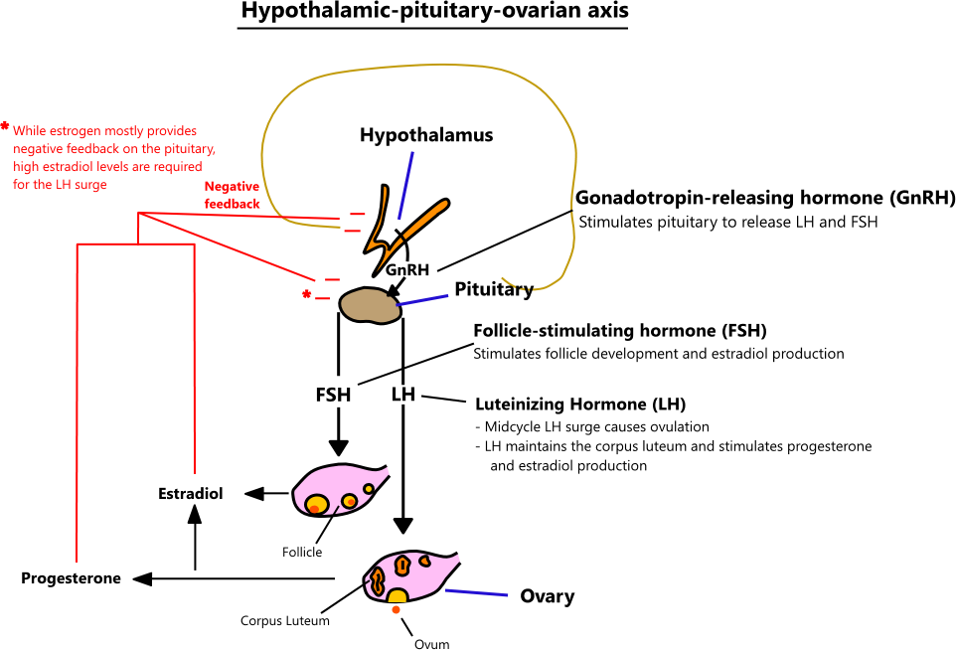

Slide 6
GnRH
Peptide hormone secreted by arcuate nucleus of hypothalamus.
Low amplitude, high frequency stimulate FSH.
High amplitude,low frequency stimulate LH.
DOWNREGULATION:
Administered continuously,suppression of Gonadotropin secretion
UPREGULATION:
Intermittent or Pulsatile administration cause release of gonadotrophins.

Slide 7
PITUITARY GLAND.
Connected to the hypothalamus by a stalk
Anterior:Adenohypophysis
Posterior:Neurohypophysis
Adenohypophysis secretes gonadotrophins
LH
FSH
PROLACTIN(Mammotrophs)

Slide 8
FSH
Glycoprotein
Suppressed by oestrogen and inhibin.
Two peak levels during menstrual cycle:
Follicular phase(6th day)
Preovulatory phase (12th day)
Functions:
Recruitment of follicles,
Follicular growth,
Acts on granulosa cells(increase in no ,LH receptors ,aromatase activity)

Slide 9
LH
Glycoprotein.
Stimulated by GnRH and high level of estrogen.
Suppressed by moderate level of estrogen.
Present in low levels throughout menstrual cycle.
Peak level: 24-36 hours before ovulation.
Functions:
Triggers ovulation,
Stimulates androgen production by theca cells,
Stimulates synthesis of progesterone by corpus luteum.

Slide 10
PROLACTIN
Polypeptide hormone.
Controls milk secretion by breast.
Under inhibitory control of the hypothalamus
Inhibited by dopamine
Stimulated by
TRH
Vasopressin,
Vasoactive intestinal peptides,
Endogenous opioids.

Slide 11
Menstrual cycle.
Consists of
Ovarian cycle.
Follicular phase,
Luteal phase.
Endometrial cycle.
Proliferative phase,
Secretory phase.

Slide 12
Ovarian cycle.
Morphology of the ovary:
Cortex
Medulla.
Cortex: Specialised stroma in which the primordial follicles are embedded
Primordial germ cells develops into oocytes by meiotic division
Surrounded by a layer of granulosa cells called PRIMORDIAL FOLLICLES.

Slide 13
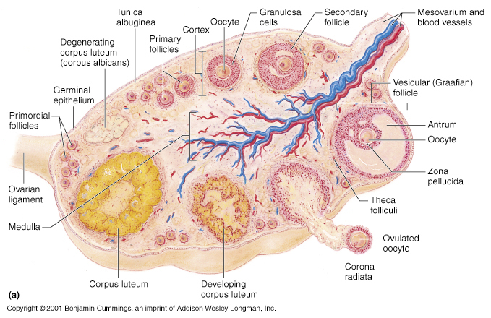

Slide 14
Stages of follicular development
PRIMORDIAL FOLLICLE
single layer of flattened granulosa cells.
PRIMARY FOLLICLE:
cuboidal granulosa cells,
increase in no of granulosa cells,
pseudostratification,
formation of Zona Pellucida,

Slide 15
SECONDARY FOLLICLE
Preantral follicle
Increase in no of granulosa cells,
Stromal differentiation into theca cells,
Formation of theca externa and theca interna.
TERTIARY FOLLICLE:
Antral follicle,
Collection of fluid in the follicle,
Rapid increase in size,
Formation of cumulus oophorus,
Formation of graffian follicle.

Slide 16
AGE | FOLLICLES
20 Weeks of gestation | 6-7 million
Birth | 1 million
Reproductive age group | 400 primordial follicles ovulate
Menopause | Stroma with very few follicles.

Slide 17
Ovarian cycle.
Follicular phase:
Oestrogen is the predominant hormone produced during follicular phase.
Oestrogen is formed by aromatisation of androgens by the enzyme aromatase in the ovary.
Oestrogen begn to rise day 7 to 8.
Reaches peak on day 12.
Falls after ovulation
Rise again to reach a second peak during luteal phase.

Slide 18
Oestrogen.
Steroid hormone
Synthesis by granulosa cells.
Predominant hormone of follicular phase.
Inhibit FSH
Trigger LH surge
Oestradiol,oestrone,oestriol.
Site of production:
Ovary:
Mainly oestradiol,
Small amount of oestrone.
Adipose Tissue: Oestrone.
Foetal Liver: Oestriol.

Slide 19
Clinical significance:
Rise in oestrogen levels during the follicular phase is used for monitoring follicular growth and timing of administration of HCG during ovulation induction.
Hormone | Follicular | ovulation | Luteal phase
Oestradiol | 30-200pg/ml | 200-600pg/ml | 30-200pg/ml

Slide 20
Ovulation
Ovulation is the process of release of an oocyte from the ovarian follicle
14 days prior to the first day of next menstrual cycle.
Process is trigerred by mid cycle LH surge
LH surge causes:
Completion of first meiotic division.
Extrusion of first polar body.
Inflammatory reaction in the follicle.
Release of prostaglandins and cytokines
Perforation of follicular wall
Pickup of oocyte by fimbriae

Slide 21
Symptoms of Ovulation
Unilateral abdominal pain,
Mastalgia,
Spotting associated with ovulation,
Cervical mucus symptoms,
Nipple discharge,
Premenstrual tension: Irritability,anger,Intolerabilit,sense of Bloatness.
Dysmenorrhoea (Spassmodic)

Slide 22
Signs of Ovulation.
Increased Basal Body Temperature
BBT decreases by ½ degree F
Temperature increases above preovulatory level from ½ to 1 degree F
Progesterone :Thermogenic Effect.
Plasma level of progesterones in

Slide 23
LUTEAL PHASE.
LUTEAL PHASE extends from the time of formation of corpus luteum to the onset of menses(luteolysis),usuallly 14 days in length.
Formation of corpus luteum:
GF collapses after ovulation
Granulosa & theca cells become yellow due to deposition of lipids and lutein pigment it is called LUTEINISATION.
Remaining Graffian follicle is Corpus luteum.

Slide 24
CORPUS LUTEUM.
CORPUS LUTEUM secretes oestrogen,inhibin A and large amounts of progesterone.
Prepares the endometrium for nidation.
CL attains size of 2 cm by day 21.
In case of pregnancy,hCG secreted by trophoblasts prevents luteolysis and the corpus luteum continue to function till 10-12 weeks

Slide 25
LUTEOLYSIS:
Degeneartion of the corpus luteum which takes place in the luteal phase unless pregnancy occurs.
Blood supply decreases,hormone production ceases,cells become fibrotic and the structure is called corpus albicans.

Slide 26
Progesterone .
Steroid hormone
Synthesised by theca cells
High levels in luteal phase peak levels by
day 22.
Low levels indicate anovuation
Prepares endometrium for implantation
Site of production:
Ovary
Adrenal glands

Slide 27
Measurement of midluteal progesterone is used as a test for ovulation.
hormone | follicular | luteal
progesterone | .06-3ng/dl | 4.5-20ng/ml

Slide 28
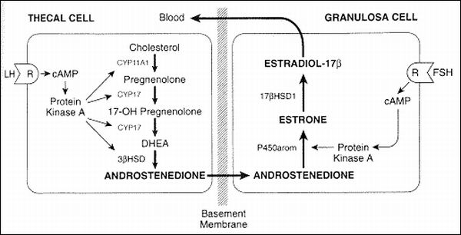
Two cell two gonadotrophin theory

Slide 29
Granulosa cells | Theca cells
Have FSH receptors | Have LH receptors
Have aromatase | Donot have aromatase
Cannot synthesise androgens | Can synthesise androgens.

Slide 30
Granulosa cells have FSH receptors.
Theca cells have LH receptors.
Under effect of LH throughout follicular phase of cycle,the theca cells synthesise androstenedione.
Androgen is transported to granulosa cells where,under the effect of FSH, aromatisation of androgens to estrogens take place.
Granulosa cells lack the enzymes for synthesis of androgens from cholestrol.

Slide 31
 | Oestrogens | Progesterone
Uterus | Myohyperplasia | Myohyperplasia Increased contractility.
endometrium | Growth,vascularisation, proliferative changes | Landular secretion, Secretory endometrium.
Cervix | Increases secretions, Mucous thin,elastic | Reduces secretions Mucous thick,non elastic
Vagina | Superficial keratinised cells Deposition of glycogen | Intermediate cells
Breasts | Growth of stroma and duct | Growth of alveoli

Slide 32
Regulation of ovarian functions by growth factors.
GROWTH FACTORS | FUNCTIONS
Insulin Growth Factors(IGF-1,IGF-2) | Stimulate gonodatrophins induced steroidogenesis.
Transforming Growth Factor(TGF) Epidermal Growth Factor(EGF) | Granulosa cell proliferation and differentitation.
Interleukin-1 | Antigonadotrophic activity Controls luteinisation of granulosa cells.

Slide 33
Inhibin,activin,follistatin.
Peptides
Produced by ovary
Have endocrine and paracrine functions.
Inhibin:two forms A and B
Inhibits FSH
Stimulates ovarian androgen production.
Activin : stimulates FSH release
Aromatase activity.
Progesterone synthesis
Follistatin:binds activin,inhibts FSH,accelerates oocyte maturation.

Slide 34
Endometrial changes in menstrual cycle.
Endometrium is divided into
Superficial functional layer.(2/3rd)
Stratum functionalis
Consists of 2 zones:
Superficial:Stratum Compactum.
Deep:Stratum Spongiosum
Responsive to hormones and undergoes cyclical changes
Deep basal layer(1/3)
Stratum basalis
Source of endometrial regeneration.

Slide 35
Proliferative phase.
Extends from day 1 to 14 in a 28 day cycle.
Duration of follicular phase may vry depending on the cycle length.
During menstruation the entire functional layer is shed.
Under the influence of oestrogens,
Regeneration of the lining cells,glands,and stroma

Slide 36
Higher level of mitotic activity.
Glands : elongated and the linings cells are low columnar
Endometrium is only 1-2 mm thick increases to 12mm just before ovulation.
By late follicular phase,lining cells undergo pseudostratification,glands appear tubular and dilated

Slide 37
Secretory phase.
Extends from day15 to day 28 in a 28 day cycle.
Duration of secretory phase is constant and doesnot vary even if the cycle length varies.
Progesterone acts on endoetrium which is already primed with oestrogens.
Glands:secretions in the form of subnuclear vacoules in the cells lining the glands.
This is considered to be an indication of ovulation.

Slide 38
Glands:tortuous,cork screw shaped.(Saw toothed)
Stroma:oedmatous and leucocytic infiltration.
Spiral arteries elongate and have a coiled appearence.
Day 21:division of compact and spongy layer becomes distinct

Slide 39
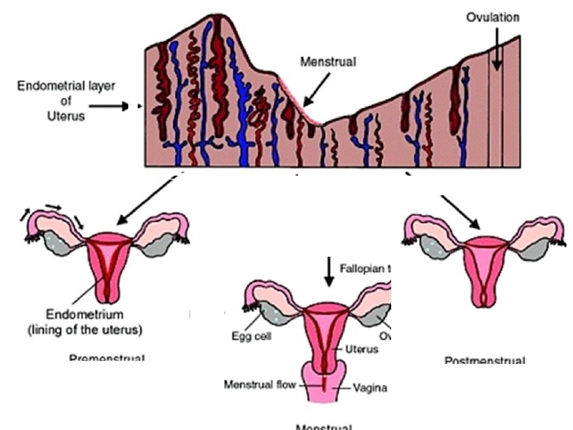

Slide 40
Menstruation
Demise of corpus luteum,levels of oestrogen and progesterone fall.
There is local production of PGF2 alpha causing vasospasm of the spiral arteries,endometrial ischaemia and tissue destruction.

Slide 41
Endometrium breaks down and functional layer is shed and expelled by myometrial contraction.
The degeneration and shedding proceed rapidly during first two days.
PGF2Alpha & thromboxane :vasoconstrictors.
PGE2 and PGI2:Vasodilators
Imbalance in prostaglandins causes AUB.

Slide 42
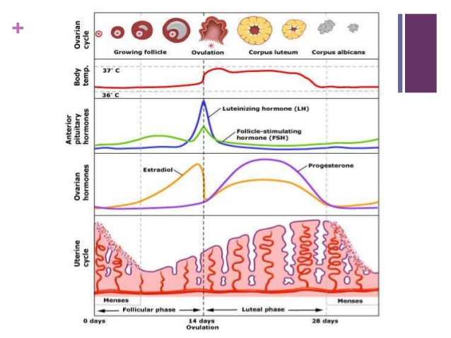

Slide 43
Cervical cycle.(follicular phase)
Under the influence of oestrogen glands secrete mucus which will strech into threadsmeasuring >6.5cm and even 10-15 cm.at the time of ovulation.
This property is “SPINNBARKEIT”basis of the thread test for oestrogen in circulation.
Cervical mucous absorbs water and salts when allowed to dry.deposits crystals of sodium chloride and potassium chloridewhich suggests of fern pattern

Slide 44
Ovulation:
Secretion is profuse that may be noticeable as vaginal discharge.
This property is due to low protein content.
Easy penetration by spermatoza.
Luteal phase:
Mucus become more viscous forms a more secure cervical plug.
Loses its ability to strech without breaking and resists penetration by spermatozoa.
Due to increase in amount of protein in mucus,
Presence of phospholipids.

Slide 45
Vaginal cycle.
Oestrogenic smear: large cornified epithelial cells with pyknotic nuclei.
Luteal phase: increased desquammation many of them have rolled edges,presence of leucocytes.
MATURATION INDEX:percentage of superficial,intermediate and parabasal cells in a vaginal smear is used as a measure of levels of hormones in circulation.

Slide 46


