Slide 1
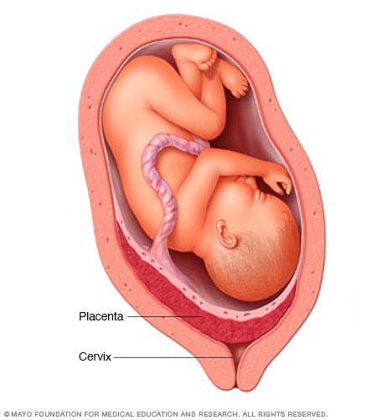
PLACENTA PRAEVIA

Slide 2
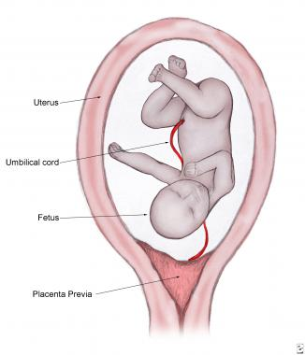
PLACENTA PRAEVIA
Placenta is implanted partially or completely over the lower uterine segment and adjacent to the internal os.

Slide 3
INCIDENCE:
1/3rd cases of APH
O.5-1% amongst hospital deliveries
80% cases found to be multiparous women
Incidence is increased beyond the age of 35

Slide 4
HIGH RISK FACTORS:
Multiparity
Maternal age >35years
H/o prev.LSCS, myomectomy, hysterotomy
Prior curettage
Placental size(twins) and abnormality(succenturiate lobe)
Smoking

Slide 5
ETIOLOGY
DROPPING DOWN THEORY:
Fertilized ovum drops down and implanted in the lower segment.
Causes:
Failure of zona pellucida to disappear in time
Poor decidual reaction in upper uterine segment

Slide 6
DEFECTIVE DECIDUA:
It results in spreading of chorionic villi over a wide area in uterine wall to get nourishment. During this process, the placenta becomes membranous, encroaches onto the lower segment.
Such a placenta praevia may invade underlying decidua or myometrium to cause placenta accreta, increta or percreta

Slide 7
PERSISTENCE OF CHORIONIC ACTIVITY in decidua capsularis and its subsequent development into capsular placenta which comes in contact with decidua vera of lower segment can explain the formation of lesser degrees of placenta praevia.
BIG SURFACE AREA OF PLACENTA as in TWINS may encroach onto the lower segment.

Slide 8
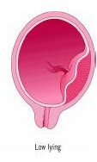
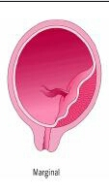
TYPES
TYPE I – LOW LYING:
Major part of the plaenta is attached to the upper segment and only the lower margin encroaches the lower segment but not upto the os.
TYPE II – MARGINAL:
Placenta reaches the margin of the internal os.

Slide 9
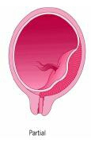
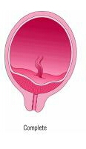
TYPE III – INCOMPLETE/ PARTIAL CENTRAL:
Placenta covers the internall os partially.
(covers the internal os when closed, but does not entirely when fully dilated)
TYPE IV – CENTRAL/TOTAL:
Placenta completely covers the internal os even after it is fully dilated.

Slide 10
CLINICAL CLASSIFICATION
The types are graded into:
MILD DEGREE:
TYPE I and II anterior
MAJOR DEGREE:
TYPE II posterior, III, IV

Slide 11
DANGEROUS PLACENTA PRAEVIA – TYPE II POSTERIOR PLACENTA PRAEVIA
Because of curved birth canal, major thickness (app 2.5cm) of placenta overlies the sacral promontory, thereby diminishing the AP diameter of inlet and prevents the engagement of presenting part.

Slide 12
If vaginal delivery is allowed, placenta is more likely to be compressed which may produce fetal anoxia or even death.
More chance of cord compression, cord prolapse.

Slide 13
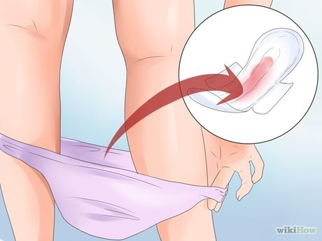
CLINICAL FEATURES
SYMPTOMS:
The ONLY SYMPTOM of placenta praevia is VAGINAL BLEEDING.
CLASSICAL FEATURES:
Unprovoked (sudden onset),
Painless,
Causeless,
Recurrent.

Slide 14
1/3rd of patients have their first episode of bleeding before 30wks.
>50% of patients present with bleeding before 36wks.
In majority of cases bleeding occurs before 38wks.
In about 5% cases it occurs for the first time during labour.

Slide 15
CAUSE OF BLEEDING:
Placental growth slows down in later months and lower segment progressively dilates
The inelastic placenta is sheared off from the wall of lower segment
Opening up of uteroplacental vessels
Episode of bleeding

Slide 16
Bleeding is said to be INEVITABLE. (physiological phenomenon which leads to the seperation of placenta)
However, placental seperation may be provoked by trauma, vaginal examination, coitus, external version or during high rupture of membranes
Blood is almost always MATERNAL, although fetal blood may escape from the torn villi

Slide 17


