Slide 1
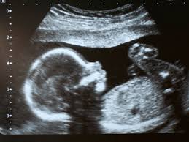
PRENATAL DIAGNOSIS.

Slide 2
PRENATAL DIAGNOSIS
Prenatal diagnosis is the science of identifying malformations, disruptions, chromosomal abnormalities, and other genetic syndromes in the fetus.
It encompasses:
routine screening tests for
Aneuploidy ,
Neural tube defects,
Invasive diagnostic tests such as
Chorionic villus sampling,
Amniocentesis.
Specialised sonography and other fetal imaging techniques.

Slide 3
goals
Accurate information regarding short & long term prognosis.
Recurrence Risk.
Potential Therapy
Improve counselling and optimize outcomes.

Slide 4
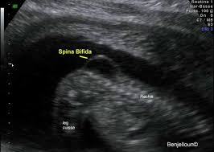
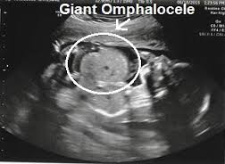
Common mechanism of birth defects
Malformation:An abnormality “Programmed” in development,regardless of whether a precise genetic etiology is known.
Eg;Spina bifida & Omphalocele.

Slide 5
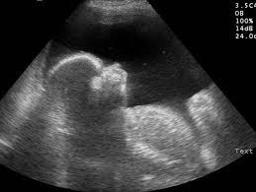
Deformation.
Deformation:Fetus develops abnormally because of extrinsic mechanical factors imposed by the uterine development
Eg;Limb contractures develop with oligohydraminos from bilateral renal agenesis.

Slide 6
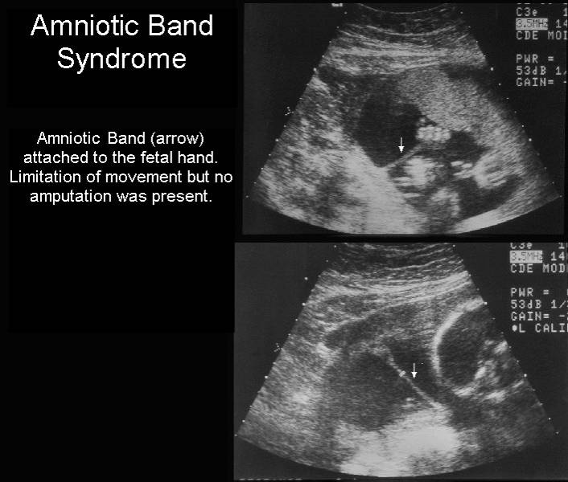
disruption
Disruption:Severe change in the form/function that occurs when genetically normal tissue is modified as the result of a specific insult
Eg;Limb-reduction defect:damage from amniotic band

Slide 7
Causes of birth defects.
Congential defects may be anatomical or functional.
Cause of these defects may be present prior to conception or may occur due to post-conception exposure.
The common preconception causes and the percentage of newborns affected are as follows:
Chromosomal abnormalities -0.2%
Single Gene defects -0.4%
Multifactorial -0.7%
Unknowm -0.6%
Teratogens -0.1%

Slide 8
Most common birth defects
Congential Heart Disease (CHD),
Neural Tube Defects (NTD),
Haemoglobinopathies(Sickle cell anaemia,Thalassaemia),
Downs syndrome,
Glucose-6-phosphate dehydrogenase(G6PD)deficiency,
These all constitute about 25% of all birth defects.

Slide 9
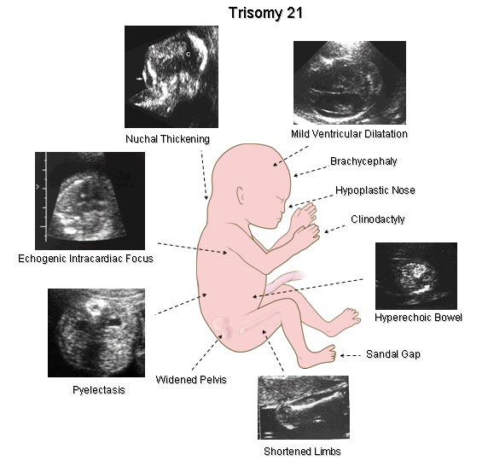

Slide 10
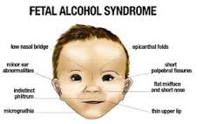
Preconception causes:Difficult to avoid.
Postconception causes:
Maternal Alcohol exposure,
Congential Infections(Syphilis and Rubella)
Iodine deficiency.

Slide 11
Indications of prenatal diagnosis
Increased risk for fetal chromosomal abormalities
based on advanced age,
Previous Pregnancy affected by fetal chromosomal abnormality,
If either of the couple is known carrier of a balanced translocation.

Slide 12
Family H/O known genetic condition ,
(or) if the couple is a known carrier of a gene mutation.
Either of the couple affected by a congential abnormality such as congential cardiac defects.
Previous H/O a Pregnancy affected by congential anomalies.
Family H/O congential defects such as congential cardiac abnormalities,neural tube defects,renal and CNS anomalies

Slide 13
Maternal Medical conditions-Diabetes Mellitus, Autoimmune diseases, hypertension, hypothyroidism, epilepsy , Psychiatric disorders ,
thrombophilia,asthma.
Abnormal serum screen.
Abnormal Ultrasound findings,including ‘Soft Markers’.
Exposure to smoking,drugs and alcohol .
Medications that may be teratogenic-anticonvuslants, chemotherapeutic agents.
Congential Infections-Rubella,Cytomegalovirus,ChickenPox and Syphilis.

Slide 14
Multiple Gestation.
Artificial Reproductive Techniques (ART),
Exposure to X-rays,radioactive substances.
Lead Exposure through intake of specific lead containing Ayurvedic medication.
Fetal Lead exposure increases the risks for Low Birth weight, developmental delay, reduced intelligence and behavioural problems increasing the risk for Gestational Hypertension and Spontaneous abortion in the Pregnant women.
Uncontrolled hypothyroidism in early pregnancy can affect neurologic outcome of fetus.

Slide 15
Non invasive techniques
Prenatal Ultrasound.
Maternal Serum Biochemical Markers.

Slide 16
PRENATAL ULTRASOUND.
INTRODUCTION:
The detection rate ranges from 15 to 85% depending on the structure affected.
Routine ultrasound screening at 16-20week gestation,only 40% major anomalies were detected,compared to 27% were screened for indications.
DETECTION OF STRUCTURAL ANOMALIES IN THE FIRST TRIMESTER:
Nuchal Translucency,
Nasal Bone,
Soft Markers on a genetic Ultrasound

Slide 17
Detection of structural anomalies
First trimester USG can be performed via transabdominal or transvaginal approach.
When performed between 12 to 13 weeks gestation,many of the fetal anatomical structures can be visualised.
2D USG in 1st trimester:Fetal Head,face,abdominal wall ,limbs,stomach,bladder,kidneys,spine and Heart.
Only Transabdominal approach success is 33%
Only Transvaginal Approach Success is 86-95%
3D Usg<2D Usg in evaluating the fetal anatomy in the 1st trimester.

Slide 18
Nuchal translucency
Nicolaides first reported the use of Fetal Nuchal translucency measurement in 1st trimester, as a marker for fetal chromosomal abnormalities.
The Incidence of chromosomal anomalies was 35% in fetus that had a NT of 3-8mm.
Risk of chromosomal abnormalities increases with increasing NT thickness and decreases when the NT is<3 mm.

Slide 19
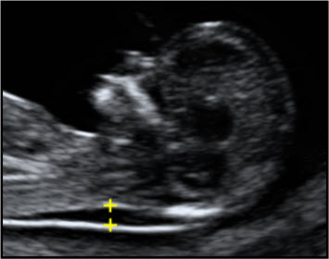
Nt scan

Slide 20
This is the maximum thickness of the subcutaneous translucent area between the skin and soft tissue overlying the fetal skin at the back of the neck.
It is measured in Sagittal plane,when the Crown-Rump length measures between 38 and 84 mm .
Criteria :11-14 weeks.
When NT is increased,the risk for aneuploidy and various structural anomalies including Heart defects is significantly elevated.

Slide 21
Guideliness for nt measurement
The margins of NT edges must be clear enough for proper caliper placement.
The fetus must be in midsaggital plane.
The image must be magnified so that it filled by the fetal head,neck and upper thorax.
The fetal neck must be in a neutral position ,not flexed and not hyperextended.
The amnion must be seen as seperate from the NT line
Electron calipers must be used to perform the measurement.
The Calipers must be placed perpendicular to the long axis of the fetus.

Slide 22
The + Calipers must be placed on the inner borders of the nuchal space with none of the horizontal crossbar itself protuding into the space.
The measurement must be Obtained at the widest space of the NT.
(From the American Institute Of Ultrasound in Medicine,2013)

Slide 23
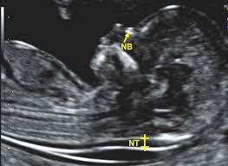

Slide 24
NT as an isolated marker,NT detects 64 to 70 Percent of fetus with Down syndrome at a false positive rate of 5%,maximal senstivity at 11 weeks.
Increased NT thickness is also associated with other aneuploidies ,genetic syndrome,and various birth defects,especially fetal cardiac anomalies.
If NT measurement is 3.5mm or greater,the patient should be offered targeted sonography,with or without fetal echocardiography,in addition to fetal karotyping.
In US,training,credentialing and monitoring are available through the Nuchal Translucency Quality Review.

Slide 25
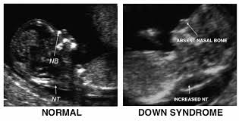

Slide 26
Nasal bone.
In 1866,Langdon Down noted that a common characteristic of patients with Trisomy 21 is a small nose.
Sonographic studies at 11-24weeks of gestation reported that approximately 65% of trisomy 21 fetuses have absent or short nasalbone.
When nasal bone was added to the 1st trimester screening,
Detection rate for Trisomy 21 was 91%
100% for Trisomy 18,13.

Slide 27
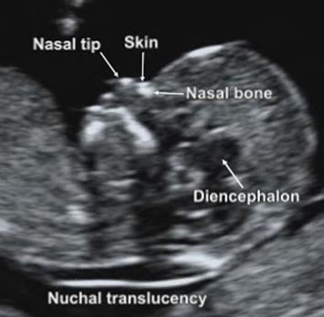

Slide 28
criteria
Fetus occupies most of the image.
There may be 45Degree angle of insonation
With the fetal profile will be well defined in the mid saggital plane,
With the tip of nose and third and fourth ventricles visible,
The nasal bone brightness be greater than or equal to that of the overlying skin

Slide 29
SOFT MARKERS ON A GENETIC usg
Second trimester genetic USG (18-22Weeks),therefore remains the gold standard for a complete survey of fetal anatomy in the unselected Pregnant women.
Chromosomal anomalies occur in 0.36% of all births after 20 weeks and in 0.1-0.2% of live births,
Down syndrome being the most common.
In addition to the soft markers,fetus with Down syndrome are often documented to have other major malformations.
Congential Heart Disease,
Duodenal Atresia.

Slide 30
SOFT MARKERS | DOWN SYNDROME | UNAFFECTED PREGNANCIES
NUCHAL THICKNESS>/6MM | 18% | 0.37%
Echogenic intracardiac intraventricular focus | 28% | 4.5%
Marked Echogenic Bowel,as bright as bone | 3.6% | 0.15%
Moderate echogenic bowel | 11% | 0.36%
Ventriculomegaly | 5.6% | 0.22%
Pyelectasis>/3mm | 7.3% | 1.3%
Short Femur<0.91MoM | 29% | 6.6%
Short Humerus<0.89MoM | 12% | 2.3%
Major Malformation | 8.5% | 0.49%
No Ultrasound Markers | 36% | 87%

Slide 31
Detection of any of the above markers increases the possibility of fetal chromosomal abnormality.
This is helpful in modifying the risk based on maternal age and Serum Screen and in counselling the patient for amniocentesis.
Women with a high a Prior risk of Down Syndrome because of their age should consider amniocentesis even if the ultrasound is normal.

Slide 32
Soft markers & increASED RISK OF DOWN SYNDROME
SOFT MARKER ON ULTRASOUND | LIKELIHOOD RATIO
Short Nasal Bone | X83
Thickened Nuchal Fold | X17
Echogenic Intracardiac Focus | X2.8
True Echogenic Bowel | X6.1
Pyelectasis | X1.9
Short Humerus | X7.5
Short Femur | X2.7
Isolated Single Umblical Artery | 1Fold

Slide 33
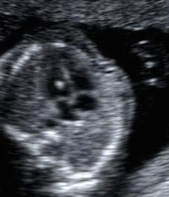
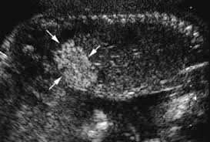
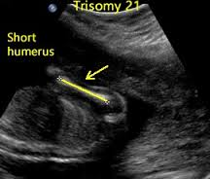
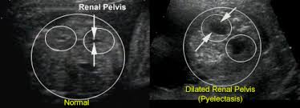
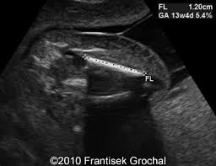
Soft tissue markers

Slide 34
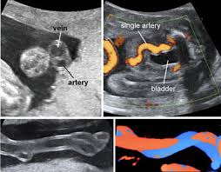

Slide 35
Maternal serum biomarkers
Depending upon on the gestational age at pregnancy booking,testing options that can be offered include:
STRATEGY | ANALYTES | DETECTION RATE(%)
Combined Screen(11-13 weeks): | NT+Serum PAPP-A,Beta hCG | 79-89%
Triple Test: | MSAFP,hCG or free Beta hCG,uE3. | 61-70%
Quadruple Test:. | MSAFP,hCG , or free Beta hCG,uE3,inhbin | 74-81%
Integrated Screen: | First trimester screen and Quad Test,results withhelduntil quad | 94-96%
NT scan | NT alone | 64-70%

Slide 36
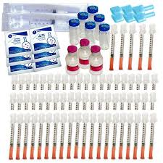
Hcg and papp-a
In singelton Pregnancy with maternal serum hCG of>/4.0Mom had significantly increased risk of spontaneous miscarriage,SGA,PIH,Preterm delivery.
In Twin gestations using higher cutoff,when hCG was >/5.0Mom
First Trimester measurement of maternal serum free B-hCG and PAPP-A when combined with fetal NT will detect about 90% of fetus with trisomy for a 5% false Positive rate.

Slide 37
Second trimester screening
Maternal Serum Alpha-1-fetoproteins (MSAFP):
Alpha fetoprotein is a single chain glycoprotein containing 590 amino acids,
Mol.weight:67,000-74,000 Daltons,
It was first identified in the human fetal serum in 1956
It is the major Protein in the amniotic fluid and the serum of the human fetus,mostly synthesised in the yolk sac and fetal liver and to a small extent i fetal gut.

Slide 38
Elevated msafp
Underestimated gestational age,
Multifetal gestation,
Open spine defects,
Open neural tube defects:
Encephalocele,
Gastroschisis,
Omphalocele,
Umblical cord cysts,
Limb body wall defect/Amniotic band syndrome.
Impendening Fetal death.

Slide 39
Severely elevated MSAFP levels>8MoM are also found to be associated with
Finnish Nephrosis,
Placental chorioangioma,
Fetomaternal haemorrhage,
Sacrococcygeal teratoma
Others:
Cystic hygroma,
Esophageal or intestinal obstrution,
Liver necrosis,
Clocal exstrophy,
Osteogenesis Imperfecta,
Pilonidal cyst,
Placental intervillous thrombosis,

Slide 40
Placental abruption,
Oligohydraminos,
Preeclampsia,
Fetal Growth restriction,
Maternal hepatoma/teratoma,
Renal anomalies-Polycystic kidney, renal agenesis, congential nephrosis, Urinary tract Obstruction.
LOW LEVELS:
Obesity,
Diabetes Mellitus,
Trisomies 21 or 18,
Gestational trophoblastic disease,
Overestimated gestational age,
Fetal death.

Slide 41
Low maternal S.estriol levels
Maternal S.estriol level <0.25 MoM associated with 2 uncommon but important conditions.
Smith-Lemili-Opitz syndrome is AR
Mutation in 7-dehydrocholestrol reductase gene
Associated with CNS,heart,Kidney,Extremity anomalies with ambiguous genitilia,FGR.
STEROID SULFTASE DEFICIENCY:
X linked ichthyosis
Contiguous gene deletion syndrome
Associated with kallmann syndrome, chrondodysplasia punctata, mental retardation

Slide 42
Second trimester screening
Triple test:
Low maternal serum AFP levels-0.07MoM,
Higher hCG Levels-2.0MoM,
Lower unconjugated estriol levels=0.8MoM,
Detect 61-70% of Down syndrome cases.
Levels of all 3 markers are decreased in trisomy 18.
Levels of a fourth marker:Dimeric Inhibin alpha-1.8MoM
Trisomy detection rate is 80%

Slide 43
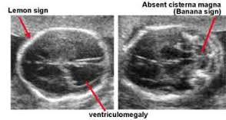
Targeted sonography.
In second trimester fetuses with open spina bifida:
Lemon sign:Frontal Bone Scalloping(BPD)
Banana sign:anterior curvature of the cerebellum with effacement of the cisterna magna.
Small biparietal diameter and ventriculomegaly also noted.
Transverse and saggital images of spine taken to know the size and location of spinal defects.

Slide 44
Combined 1st and 2nd trimester screening.
Integrated screening:
NT measurement + serum analysis,
GA:11-14 weeks
Plus quadruple markers at 15-20 weeks of GA.
Highest Downs syndrome detection rate:94-96%
False Positive rate 5%

Slide 45
Sequential screening
Discloses the results of 1st trimester screening results to women at highest risk,who are then offered invasive testing with CVS/Amniocentesis.
STEPWISE SCREENING:
Women with 1st trimester screen results that confer risk for Down syndrome above a particular threshold are offered invasive testing,and the remaining women receive 2nd trimester screening.
Threshold is set as 1%(70% of Down syndrome pregnancies)
Detection rate:95%

Slide 46
Contingent screening
Women are divided into high,moderate,low risk groups,
Highest risk – Invasive testing.
Moderate risk- undergo 2nd trimester screening,
Remaining who are at low risk needs no further testing.
Detection rate :88-94%
Both integrated and sequential screening require coordination between provider and laboratory to ensure that second sample is obtained during appropriate gestational age linked to 1st trimester results.

Slide 47
STEPWISE SCREEN:First trimester screen + Quadruple test.(risk is 1 in 30 or less on combined)
1% offered diagnostic test after first trimester screen
99%Proceed to Quad test,results withheld until Quad test is completed
CONTIGENT SCREEN:First trimester Screen + Quad Test(risk is 1 in 30-1500 on combined)
1%offered diagnostic test after 1st trimester screen
15% Proceed to Quad Test,results withheld until Quad test is completed
84% have no additional test after 1st trimester screen.

Slide 48


