Slide 1

Physiology of Menstruation
Presented by Dr.Vinitha.K
Chairperson-Dr.Roopesh(associate professor)Dept. of OBG

Slide 2
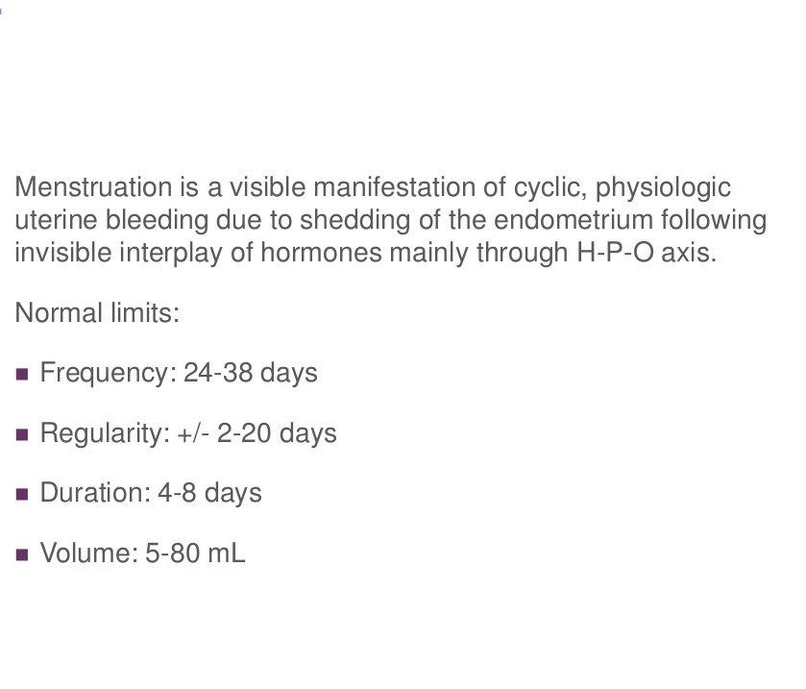

Slide 3
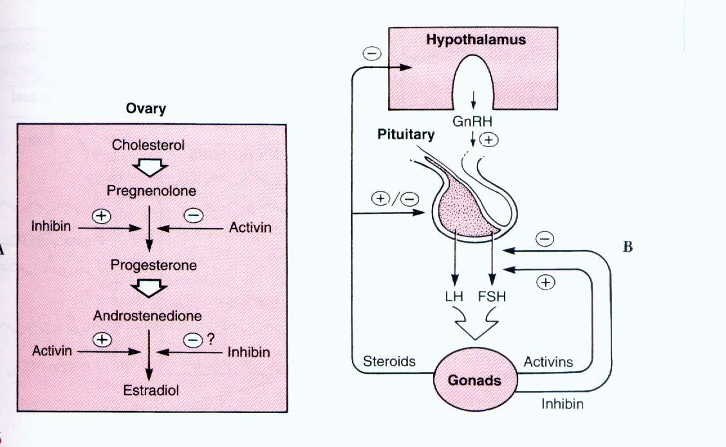
Hypothalamo pituitary ovarian axis

Slide 4
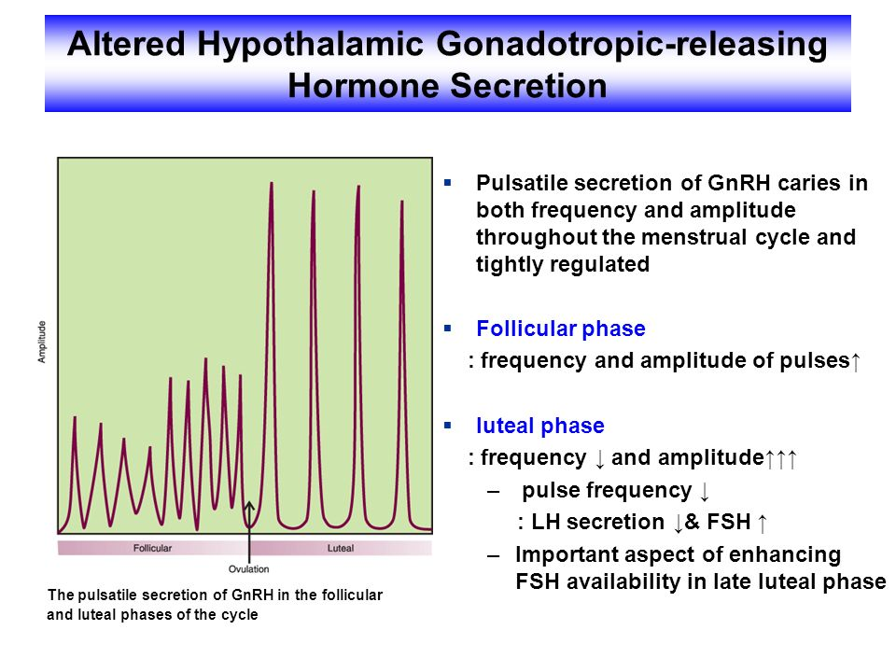
Cont.

Slide 5
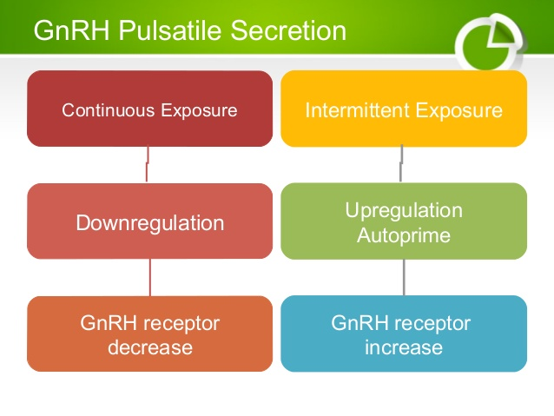

Slide 6
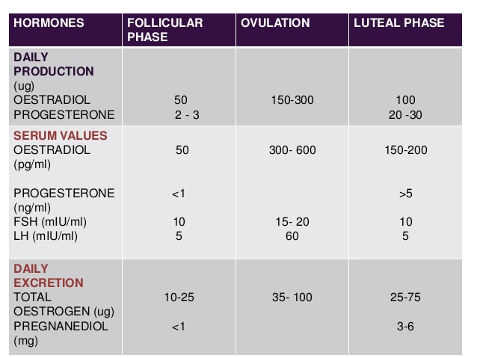

Slide 7
Inhibin ,Activin and Follistatin
This family of peptides is synthesized by granulosa cells in response to FSH and secreted in to the follicular fluid and ovarian veins
Inhibin is an important inhibitor of FSH secretion
Activin stimulates FSH release in the pituitary and augments action in the ovary
Follistatin suppresses FSH activity by binding to activin

Slide 8
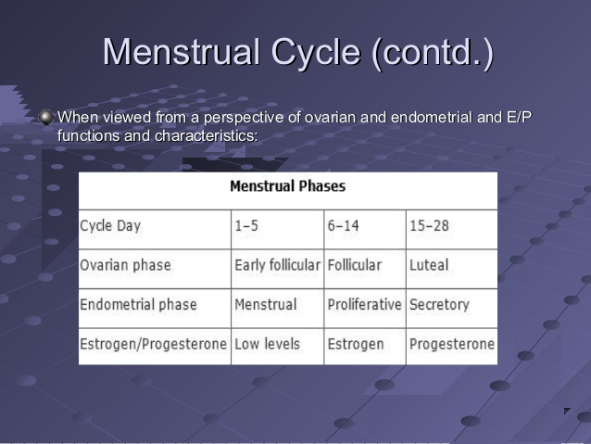

Slide 9
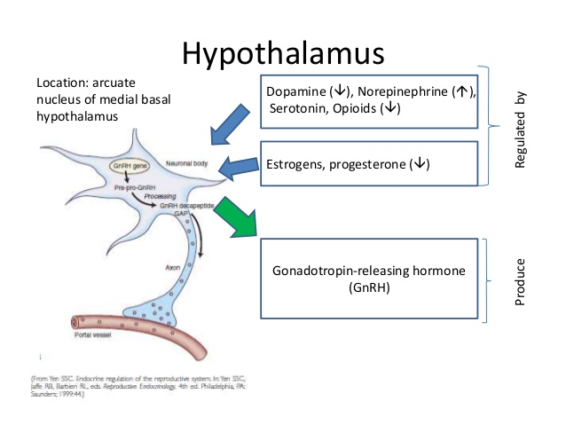

Slide 10
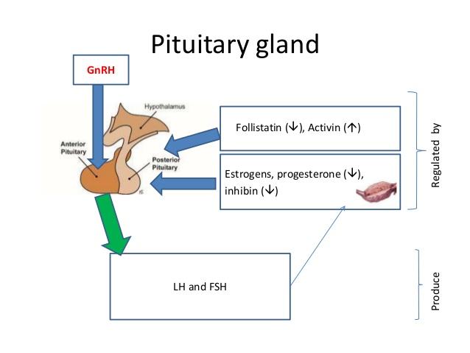

Slide 11
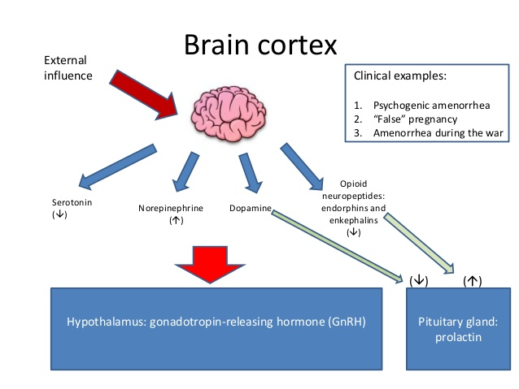

Slide 12
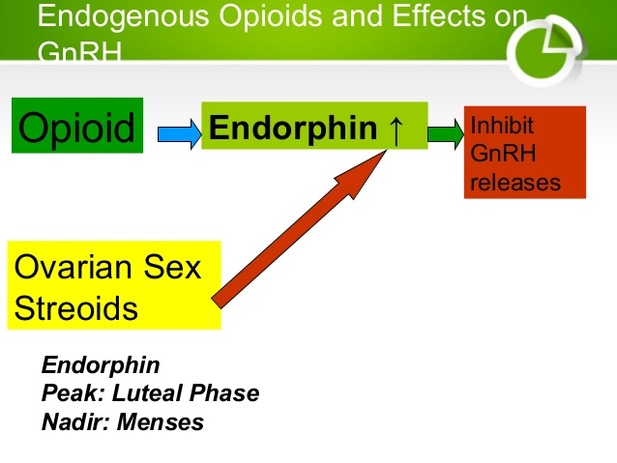

Slide 13
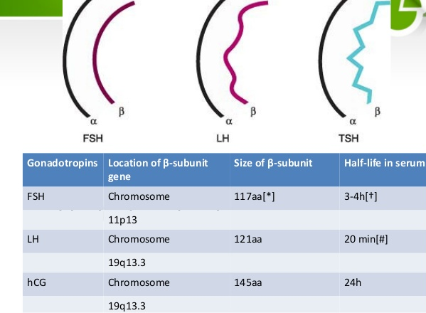

Slide 14
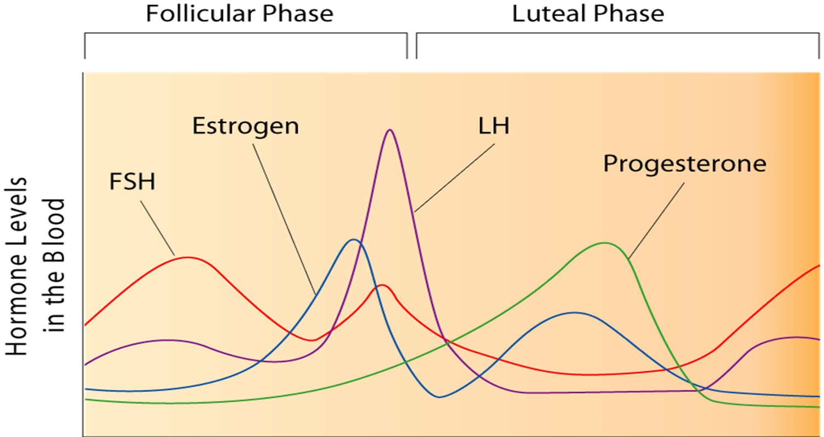
Hormone levels

Slide 15
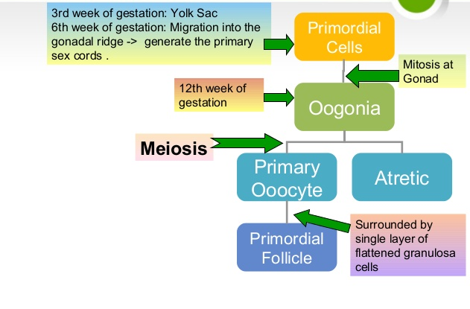

Slide 16
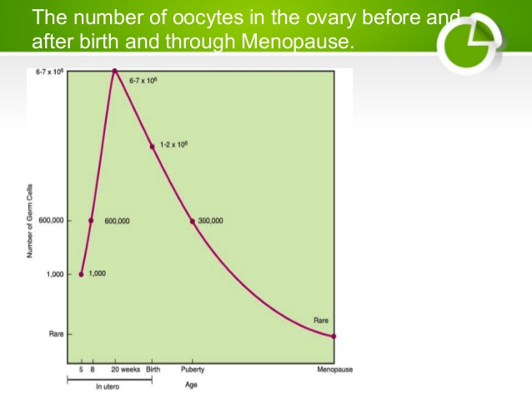
NUMBER OF OOCYTES AT BIRTH

Slide 17
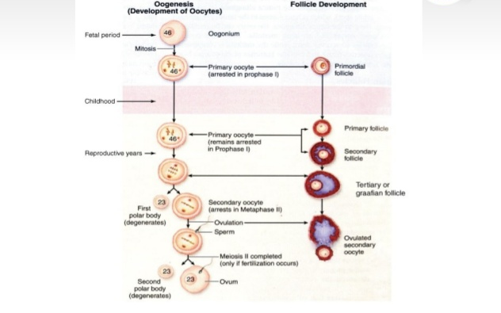

Slide 18
Phases of menstruation
The ovarian cycle
The uterine cycle
The ovarian cycle consist of
The follicular phase
The luteal phase
The uterine cycle consist of
The proliferative phase
The secretory phase

Slide 19
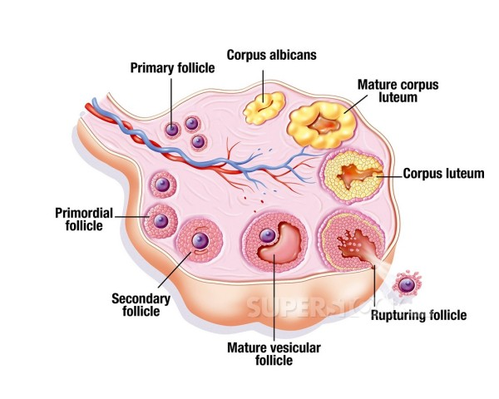
THE OVARIAN CYCLE

Slide 20
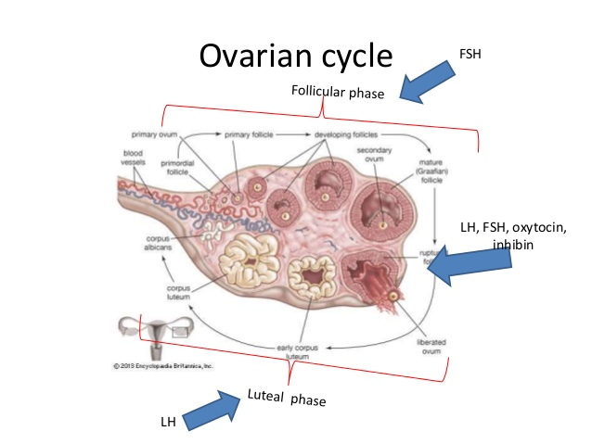

Slide 21
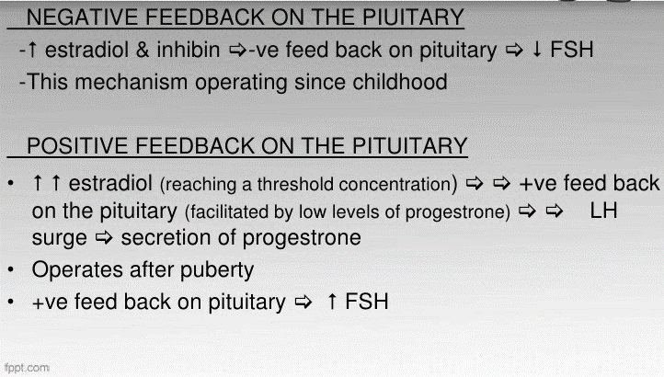

Slide 22
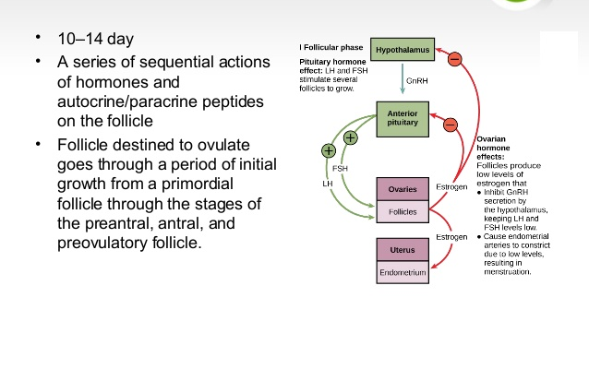
FOLLICULAR PHASE

Slide 23
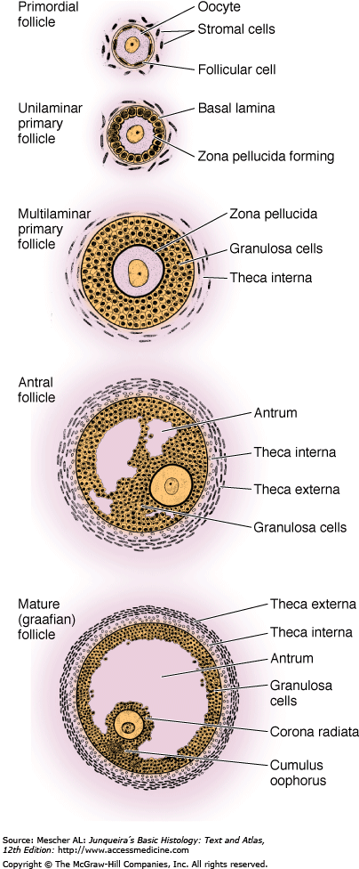
The follicular phase
Primordial follicle
Originates in the endoderm
Migrate to the genital ridge at 5 to 6 weeks
Attains maximum at 16 to 20 weeks of gestation i.e around 7 million.
At birth it is around 2 million
At puberty it is around 0.3 to 0.5 million
Only 400 to 500 follicles ovulate during a woman’s reproductive years

Slide 24
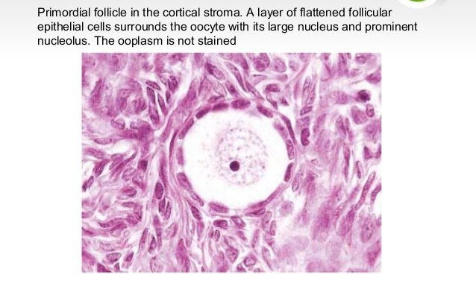
Primordial follicle

Slide 25
Primordial follicle is non growing and consists of an oocyte ,arrested in diplotene stage of meiotic prophase ,surrounded by a single layer of spindle shaped granulosa cells
The initial recruitement and growth of primordial follicles is gonadotropin independent
The total durationof time to achieve pre ovulatory status is approximately 85 days
First visible signs of development are
Increase in the size of oocyte
Granulosa cells becoming cuboidal

Slide 26
Preantral follicle
Oocyte enlarges and is surrounded by a membrane ,the zona pellucida
The granulosa cells undergo a multilayer proliferation as the theca layer continues to organise from the surrounding stroma
The primodial follicle produces more of estrogens than androgens or progestins

Slide 27
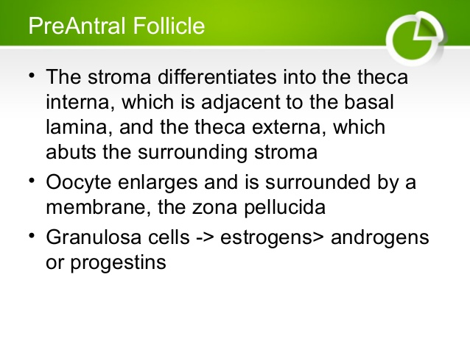

Slide 28
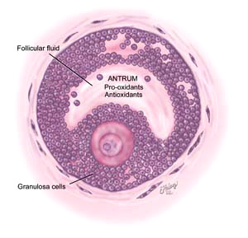
The Antral follicle
Under the influence of estrogen and FSH there is an increase in the production of follicular fluid
Oocyte and the surrounding granulosa cells are nurtured in this follicular fluid
The granulosa cells surrounding the Oocyte are known as cumulus oophorus

Slide 29
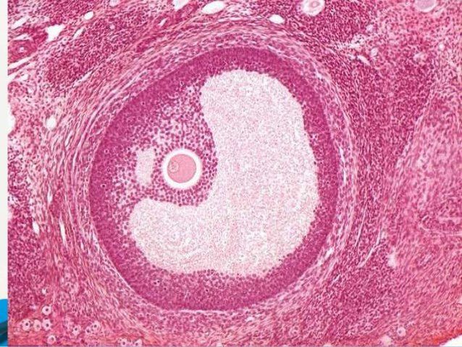
Fully matured graafian follicle

Slide 30
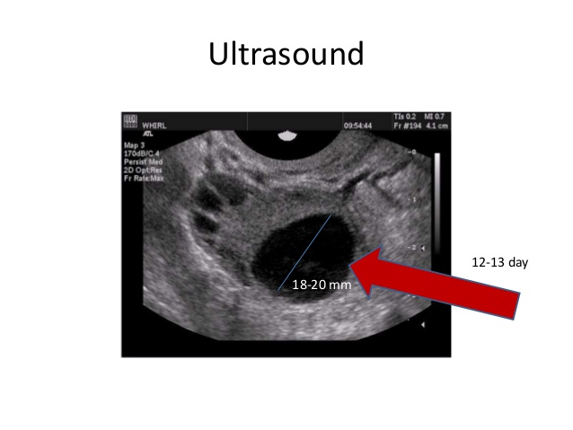

Slide 31
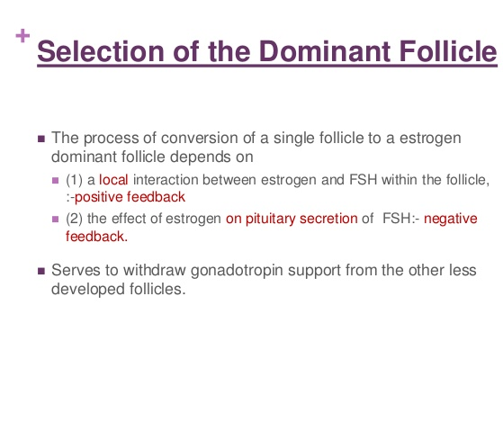

Slide 32
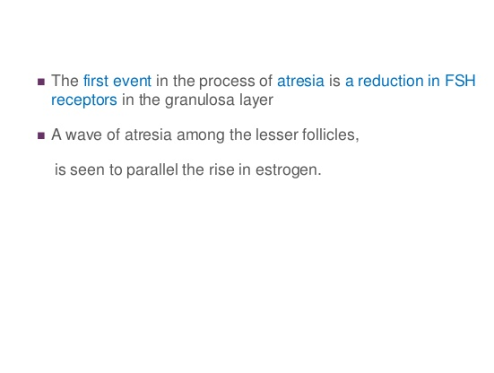

Slide 33
The two cell,two –gonadotropin system
In human preantral follicles
LH receptors are present only on the theca cells
FHS receptors are present only on the granulosa cells
LH stimulates theca cells to produce androgens that can then be converted through FHS –induced aromatization to estrogens in the granulosa cells
The aromatase activity of the granulosa cells is more than thecal cells

Slide 34
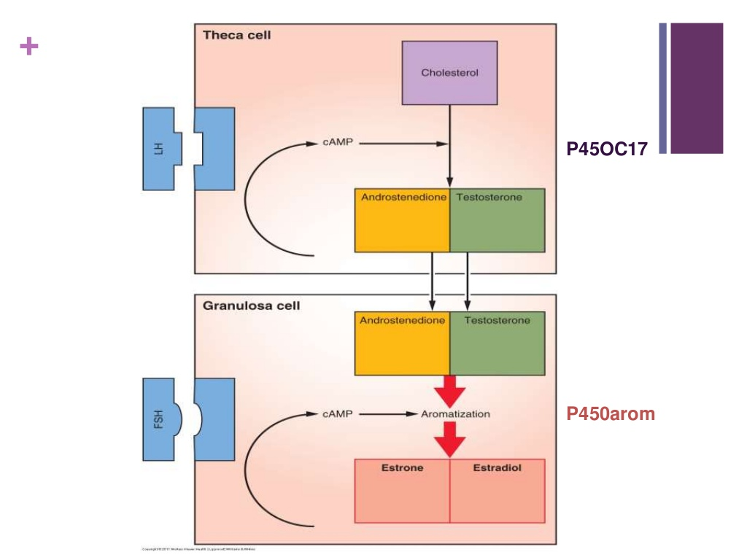

Slide 35
The Preovulatory Follicle
Granulosa cells in the preovulatory follicle enlarge and acquire lipid inclusions
Theca becomes vacuolated and richly vascular,giving the preovulatory follicle a hyperemic appearance
The Oocyte proceeds in meiosis approaching completion of its reduction division
Approaching maturity the preovulatory follicle produces increasing amounts of estrogen
Estrogen peaks approximately 24 to 36 hours prior to ovulation

Slide 36
LH surge
The onset of the LH surge occurs when the peak levels of estradiol are achieved
In providing the ovulatory stimulates to the selected follicles ,the LH surge seals the fate of the remaining follicles with their lower estrogen and FSH content by further increasing androgen superiority
LH promotes Luteinization of the granulosa in the dominant follicle ,resulting in the production of progesterone

Slide 37
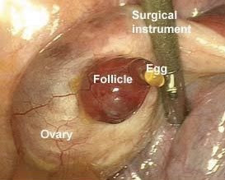
OVULATION
The dominant follicle protrudes from the ovarian cortex
Gentle release of the oocyte surrounded by the cumulus granulosa cells

Slide 38
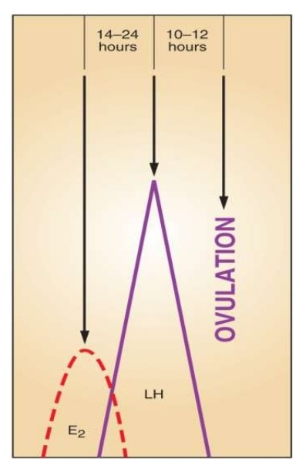
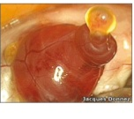
Ovulation
A thresh hold of LH concentration must be maintained for at least 14 to 27 hours in order for full maturation of the Oocyte to occur
Usually LH surge lasts for 48 to 50 hrs

Slide 39
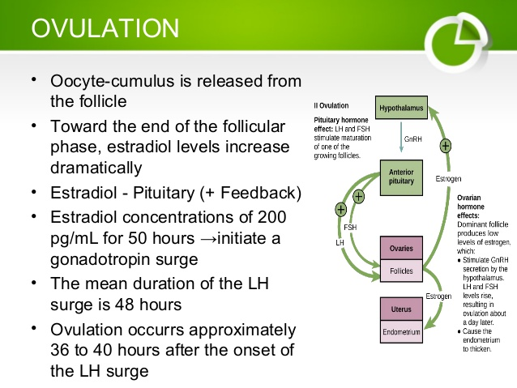

Slide 40
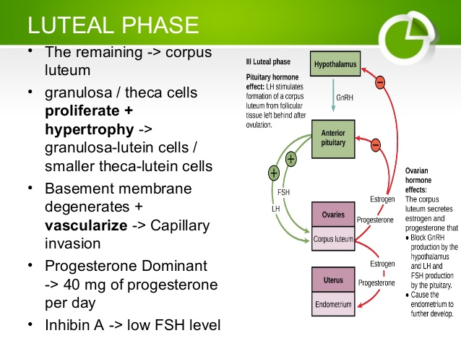

Slide 41
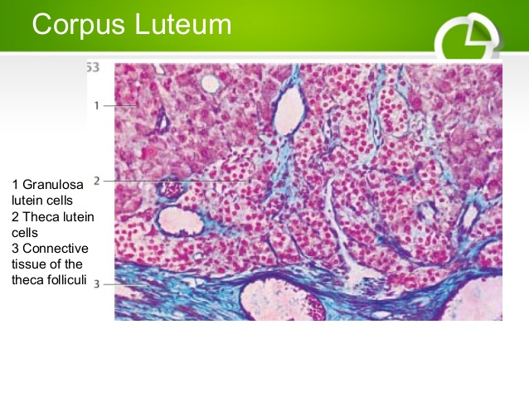

Slide 42
Mechanisms of follicular rupture
1-  Follicular pressure
Changes in composition of the antral fluid   colloid osmotic pressure
2- Enzymatic rupture of the follicular wall
LH & FSH  granulosa cells  production of plasminogen activator   plasmin   fibrinolytic activity  breakdown of Follicular wall LH   prostglandin E   plasminogen activator   PG F2α   lysosomes under follicular wall

Slide 43
LH ,FSH,Progesterone ,growth factors
Plaminogen activator synthesis(granulosa & theca cells)
Ovulation
Collagenase
Disrupts follicular wall
Plasminogen →Plasmin

Slide 44
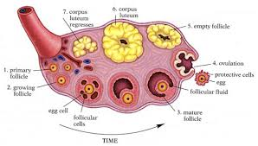
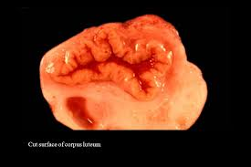
Luteal Phase
Proliferation
Vascularisation
Maturation
regression

Slide 45
Luteinization and Corpus luteum
Granulosa cells increase in size and assume a characteristic vacuolated appearance with the accumulation of a yellow pigment ,lutein
Theca lutein cells may differentiate from the surrounding theca and stroma to become part of the corpus luteum
The leukocytes in the corpus luteum secrete cytolytic enzymes , prostaglandins and growth factors involved in angiogenesis, steroidogenesis, and luteolysis

Slide 46
Angiogenesis
Vasculariszation of the granulosa layer is essential to allow LDL-cholesterol to reach the luteal cells to provide sufficient substrate for progesterone

Slide 47
Corpus luteal demise
Corpus luteum rapidly declines 9 to 11 days after ovulation
The regression of luteal cells in induced by the estradiol produced by the corpus luteum
This action of estrogen is mediated by nitric oxide
The final signal for luteolysis ,however is Prostaglandin F2 alpha produced within the ovary in response to the locally synthesized luteal estrogen

Slide 48
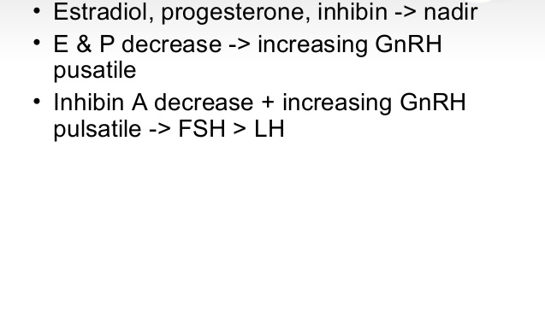

Slide 49
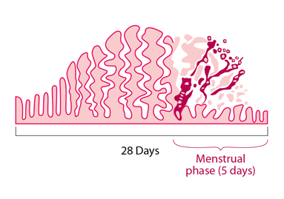
UTERINE CYCLE

Slide 50
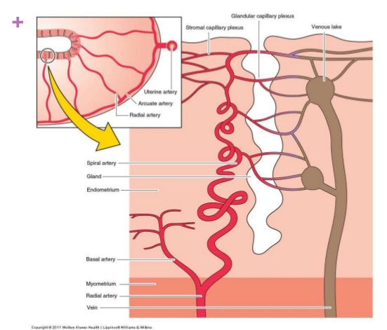

Slide 51
LAYERS OF ENDOMETRIUM
1-Basal layer of the enometrium
-Adjacent to the myometrium
-Unresponsive to hormonal stimulation
-Remains intact throughout the menstrual cycle
2-Functional layer of the endometrium
Composed of two layers:
-zona compacta  superficial
-Spongiosum layer

Slide 52
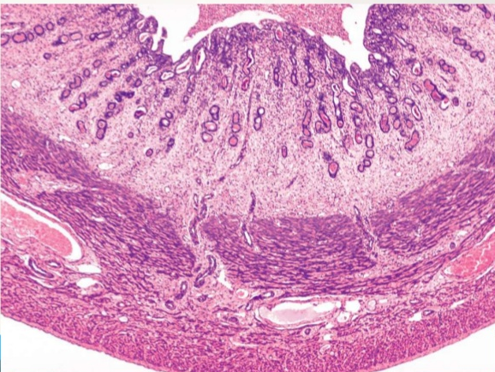
HISTOLOGY OF ENDOMETRIUM

Slide 53
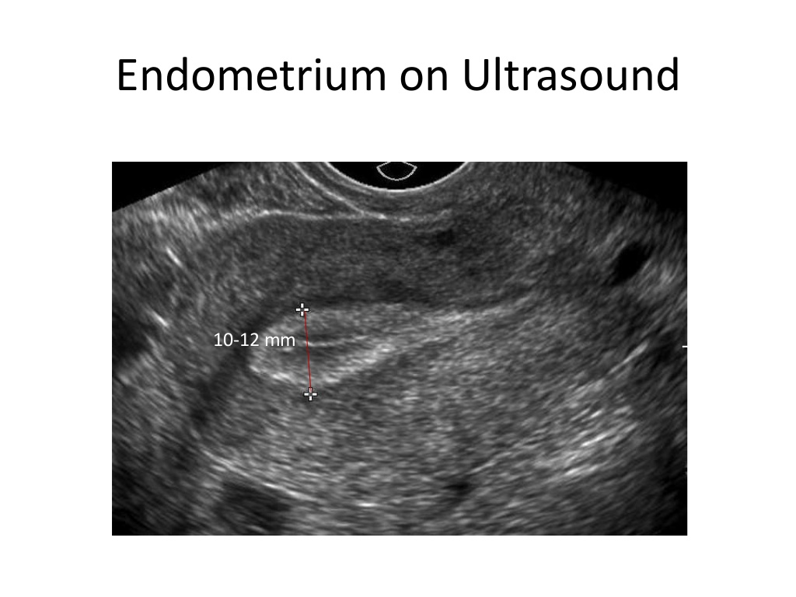

Slide 54
Uterine cycle
The changes in the endometrium can be categorized in to 5 phases
The menstrual endometrium
The proliferative phase
The secretory phase
Preparation for implantation
The phase of endometrial breakdown

Slide 55
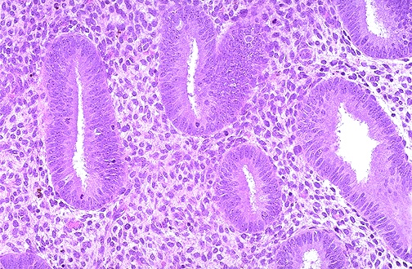
The proliferative Phase
The Glands:
Narrow and tubular ,lined by low columnar epithelium cells
Mitoses
Pseudostratification
A continuous epithelial lining facing the endometrial cavity is formed

Slide 56
Cont.,
All the tissue components demonstrates proliferation , which peaks on days 8 to 10 of the cycle ,corresponding to peak estradiol levels in the circulation and maximal estrogen receptor concentration in the endometrium
Changes are most intense in the functionalis layer in the upper two thirds of the uterus , the usual site of blastocyst implantation

Slide 57
Cont.,
The endometrium grows from approximately 0.5 mm to 3.5mm x 5mm in size
An important feature of this estrogen dominant phase of endometrial growth is the increase in ciliated and microvillous cells

Slide 58
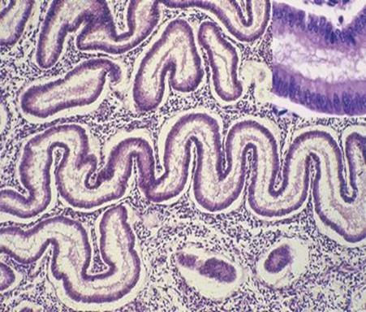
The tissue components continue to display growth , but confinement in a fixed structure leads to progressive tortuosity of glands and intensified coiling of the spiral vessels
The peak secretory level is reached 7 days after the midcycle gonadotropin surge

Slide 59
The Secretory phase
The endometrium demonstrates a combined reaction to estrogen and progesteron activity
Epithelial proliferation ceases 3 days after ovulation
Total endometrial height is fixed at roughly its preovulatory extent(5 to 6 mm) despite continued availability of estrogen
This limitation is due to the progesterone interfernce with estrogen receptors

Slide 60
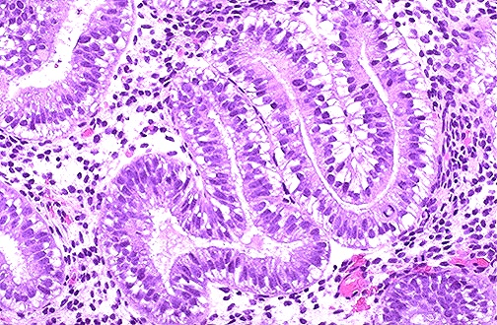
The first histologic sign that ovulation has occurred is the appearance of subnuclear intracytoplasmic glycogen vacuoles in the glandular epithelium on 17th -18th day of the cycle

Slide 61
Implantation Phase
By 13 days postovulation , the endometrium has differentiated into three distinct zones
1/4th of the tissue is the unchanged basalis , straight vessels and spindle shaped stroma
The midportion is the stratum spongiosum,loose edematous stroma with tightly coiled spiral vessels and dilated glandular ribbons
The superfical layer of the endometrium called the stratum compactum , which has become large and polyhedral stromal cells forming a compact layer
The subepithelial capillaries and spiral vessels are engorged

Slide 62
At the time of Implantation ,On 21-22nd day of the cycle , the predominant morphologic feature is edema of the endometrial stroma , due to increase in permeability under the influence of the steroid

Slide 63
Endometrial breakdown
In the absence of fertilization , implantation and the consequent lack of hCG from the trophoblast , the fixed lifespan of the corpus luteum is completed and estrogen and progesterone levels decreases
The most prominent immediate effect of this hormone withdrawal is shrinking of the tissue height and spiral arteriole vasomotor responses

Slide 64
The following vascular sequence occurs
With shrinkage of height , blood flow within the spiral vessels diminishes, venous drainage is decreased and vasodilation occurs
Spiral arterioles undergo rythmic vasoconstriction and relaxation
Each successive spasm is more prolonged and profound, leading eventually to endometrial blanching
Within 24 hrs immediately preceding menstruation, these reaction lead to endometrial ischemia and stasis

Slide 65
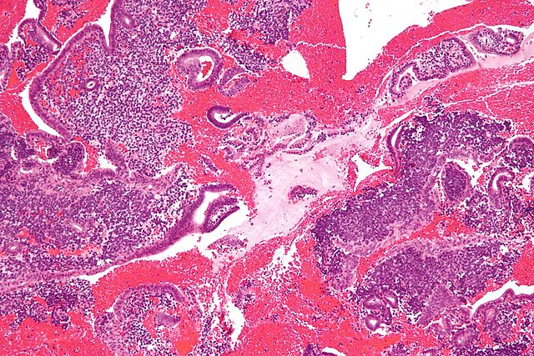
Menstrual endometrium

Slide 66
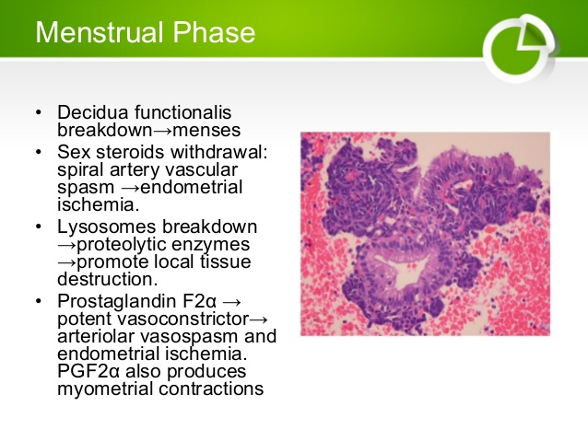

Slide 67
Endometrial tissue breakdown also involves release of enzymes and matrix metalloproteinases:
Collagenases that degrade interstitial and basement membrane collagens
Gelatinases degrade collagens

Slide 68
Control of blood loss
Constriction of spiral arteries, mediated by the perivascular cells, myofibroblasts that surround the spiral arteries
Myofibroblasts respond to progesterone withdrawal
Thrombin generation in the basal endometrium in response to extravasation of blood is essential for hemostasis
The basalis endometrium remains during mensus, and repair takes place from this layer

Slide 69
A natural cleavage point exists between basalis and spongiosum and once breached ,spongiosum collapses
The process is initiated in the fundus and extends throughout the uterus

Slide 70
With in 13 hrs , the endometrial height shrinks from 4 mm to 1.25mm
The menstrual flow stops as a result of combined effects of
Prolonged vasoconstriction of the radial arteries and the spiral arteries in the basalis
Vascular stasis
Estrogen –induced healing
In Contrast to postpartum bleeding , myometrial contractions are not important for control of menstrual bleeding

Slide 71
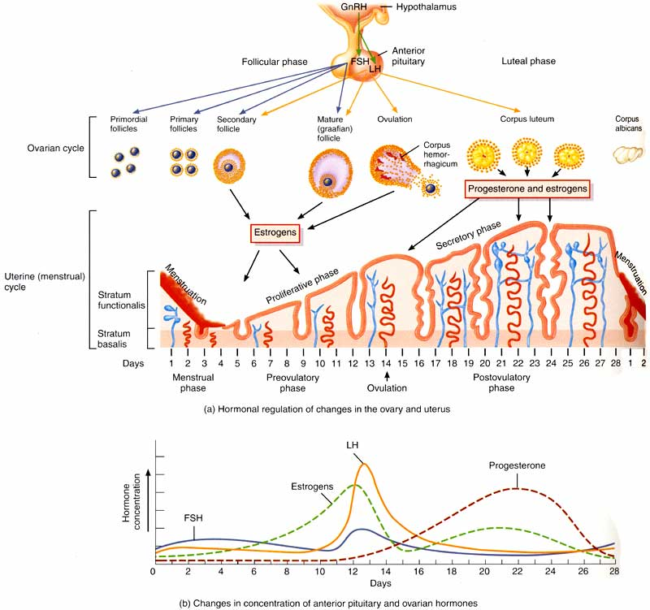

Slide 72
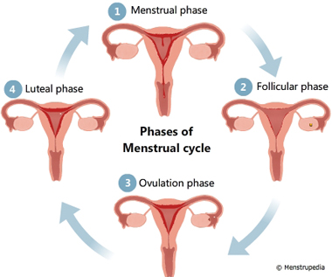
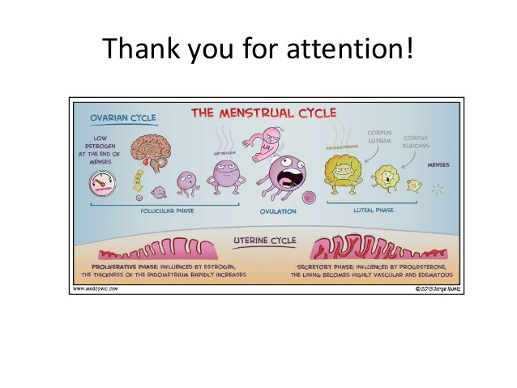
THANK YOU
Thank You

