Slide 1
INDUCTION OF LABOUR

Slide 2
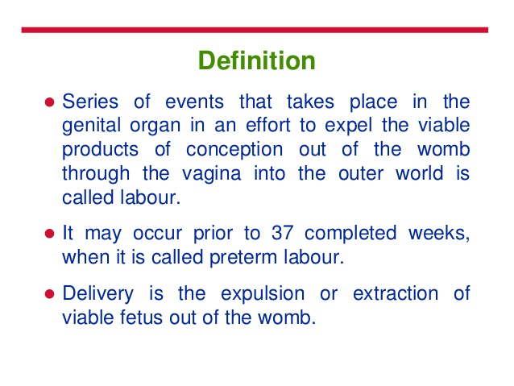
LABOUR

Slide 3
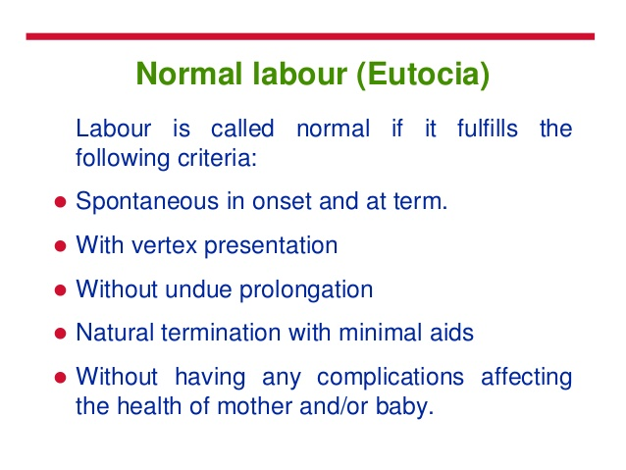

Slide 4
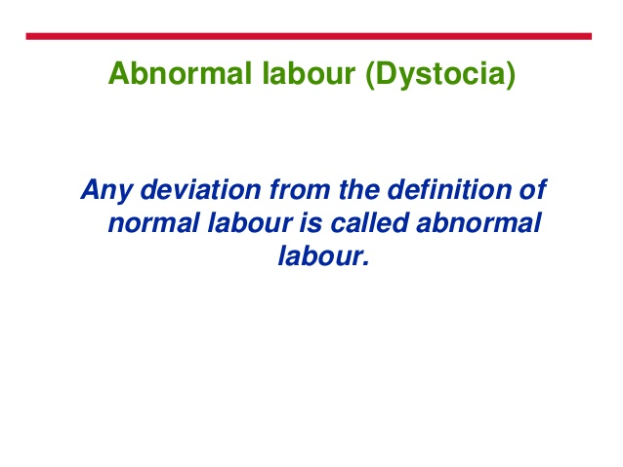

Slide 5
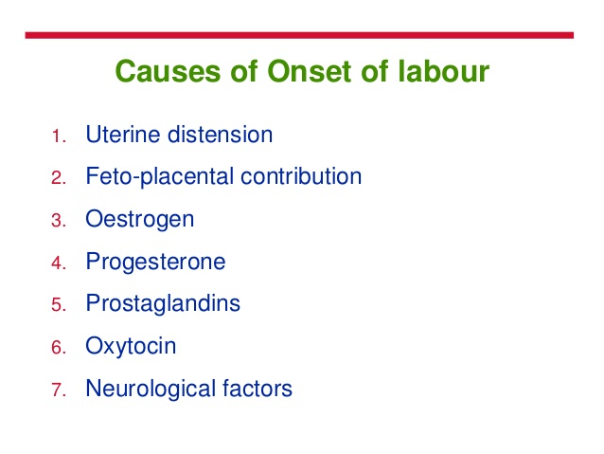

Slide 6
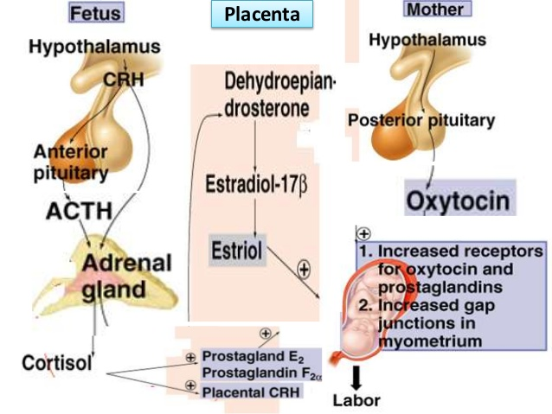

Slide 7
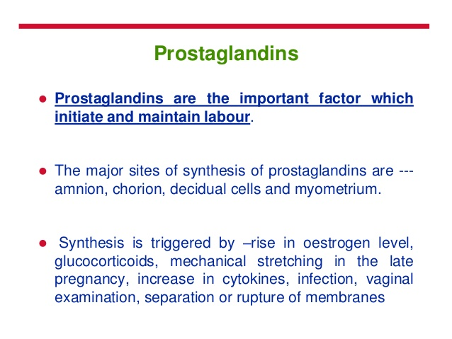

Slide 8
OXYTOCIN
Oxytocin receptors are increased in the uterus with onset of labour.
Oxytocin receptors are maximal at the fundus.
Oxytocin promotes release of prostaglandins from the decidua
Vaginal examination and amniotomy cause rise in maternal plasma oxytocin level [FERGUSAN REFLUX ]

Slide 9
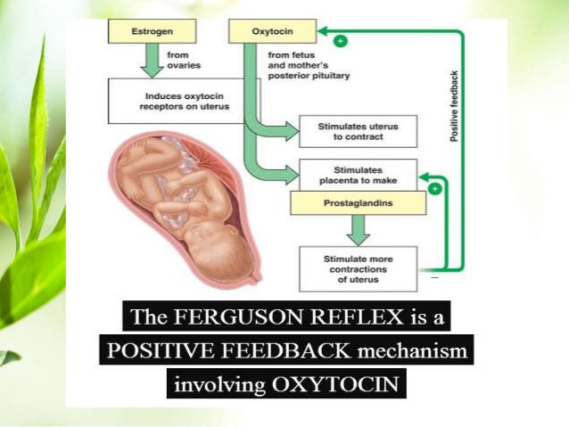

Slide 10
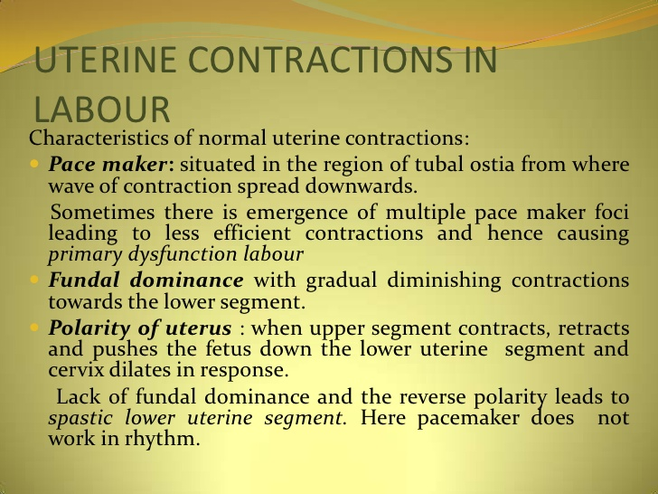

Slide 11
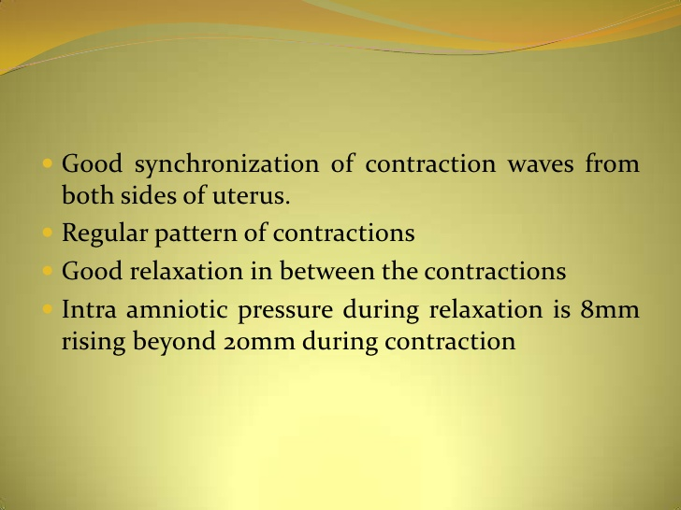

Slide 12
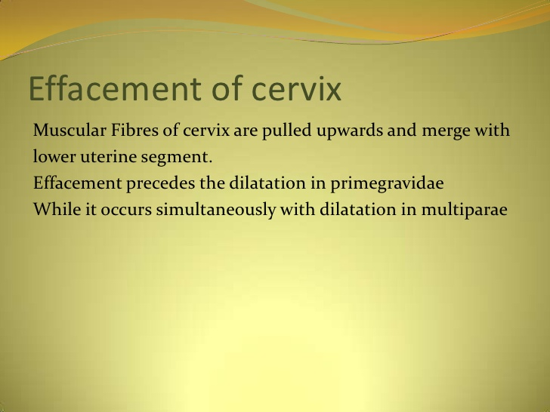
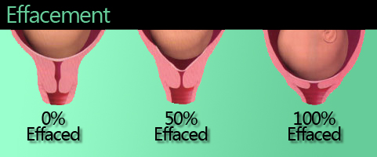

Slide 13
WHAT IS INDUCTION OF LABOUR
IT IS THE INITIATION OF UTERINE CONTRACTIONS AFTER PERIOD OF VIABILITY BY ANY METHOD [MEDICAL,SURGICAL OR COMBINED] FOR PURPOSE OF VAGINAL DELIVERY.

Slide 14
INDICATIONS FOR INDUCTION OF LABOUR
A. Maternal indications:
1. Obstetrical indications:
Post dated or post term pregnancy
Ante partum hemorrhage
Red-cell alloimmunisation
Previous unexplained still birth at term
Oligohydromnios
Premature rupture of membranes
2. Medical indications:
Chronic nephritis superimposed acute nephritis and failure
Hypertension ; pre eclampsia ;eclampsia
Diabetes

Slide 15
B. Fetal indications:
Placental insuffiency
IUGR
Postdatism
Rh isoimmunisation
Previous unexplained still births
Deteriorating antenatal tests for fetal wellbeing.
Intrauterine fetal death
Congenital fetal malformations

Slide 16
CONTRA INDICATIONS OF INDUCTION OF LABOUR
CONTRACTED PELVIS AND CPD
MALPRESENTATION – TRANSVERSE LIE
PREVIOUS CLASSICAL CAESEREAN SECTION
PREVIOUS MYOMECTOMY ENTERING ENDOMETRIAL CAVITY
ACTIVE GENITAL HERPES INFECTION
PELVIC TUMOUR OCCUPYING PELVIS
UMBLICAL CORD PROLAPSE
CERVICAL CARCINOMA
UTEROPLACENTAL FACTORS – VASA PREVIA ; PLACENTA PREVIA

Slide 17
FACTORS TO ASSESS PRIOR TO INDUCTION
MATERNAL
CONFIRM INDICATION
EXCLUDE CONTRAINDICATION
ASSESS BISHOP SCORE
ASSESS PELVIC ADEQUACY
FETAL
ENSURE FETAL GESTATIONAL AGE
ENSURE FETAL PRESENTATION
CONFIRM FETAL WELLBEING

Slide 18
The semi-quantitative clinical scoring system described by Bishop in 1964 is the one most widely employed to assess favorability of cervix prior to induction.
The score uses the cervical dilatation, effacement, consistency, position, and the station of the presenting part.
parameter | 0 | 1 | 2 | 3
position | posterior | intermediate | anterior | -
consistency | firm | intermediate | soft | -
effacement | 0 to 30% | 40 to 50% | 60 to 70% | ≥80%
dilatation | <1cm | 1 to 2 cms | 2 to 4cms | > 4 cms
Foetalstation | - 3 | - 2 | - 1, 0 | + 1 to + 2
Score < 5 is unfavourable and score > 5 is favourable for Induction

Slide 19
The modified Bishop score by Calder:
Calder modified the original Bishop score in 1974, which is known as the modified Bishop score and is currently used by most obstetric units..
He replaced the ‘effacement of cervix’ denoted as percentage in the original score with length of cervix in centimeters, which is having more reproducibility and reliability than original Bishop score.
parameter | 0 | 1 | 2 | 3
position | posterior | Anterior/mid |  | -
consistency | firm | intermediate | soft | -
Length of cx | 4cm | 2 - 4cms | 1 - 2cm | <1cm
dilatation | <1cm | 1 to 2 cms | 2 to 4cms | > 4 cms
Foetalstation | - 3 | - 2 | - 1, 0 | + 1 to + 2
Modified bishop score:
0 – 5 unfavourable ; 6 – 12 favourable
Maximum possible score would be 12, at which point , of course delivery would be just about imminent.

Slide 20
Who definition of induction of labour
Induction of labour implies the artificial initiation of contractions prior to their spontaneous onset beyond period of fetal viabilty.it is indicated when benefits of termination outweigh those of continuing pregnancy.

Slide 21
When induction of labour may be appropriate as per who guidelines
Induction of labour is recommended for women who are known with certainty to have reached 41 weeks (>40 weeks + 7 days) of gestation.
Induction of labour is not recommended in women with an uncomplicated pregnancy at gestational age less than 41 weeks.
Induction of labour at term is not recommended for suspected fetal macrosomia.
Induction of labour is recommended for women with prelabour rupture of membranes at term.
For induction of labour in women with an uncomplicated twin pregnancy at or near term, no recommendation was made as there was insufficient evidence to issue a recommendation.

Slide 22
Methods of induction of labour as per who july 2008
If prostaglandins are not available, intravenous oxytocin alone should be used for induction of labour.
2.Amniotomy alone is not recommended for induction of labour.
3. In the third trimester, in women with a dead or an anomalous fetus, oral or vaginal misoprostol are recommended for induction of labour.

Slide 23
July 23, 2009 — On July 21, the American College of Obstetricians and Gynecologists (ACOG) issued revised guidelines on when and how to induce labor in pregnant women.
The goal of labor induction is to stimulate uterine contractions before the spontaneous onset of labor, resulting in vaginal delivery.
The benefits of labor induction must be weighed against the potential maternal and fetal risks associated with this procedure.
When the benefits of expeditious delivery are greater than the risks of continuing the pregnancy, inducing labor can be justified as a therapeutic intervention.

Slide 24
Indications for Labor Induction acc to ACOG
gestational or chronic hypertension,
Preeclampsia/ eclampsia
diabetes
premature rupture of membranes
severe fetal growth restriction
postterm pregnancy
Contraindications to labor induction acc to ACOG
transverse fetal position,
umbilical cord prolapse,
active genital herpes infection,
placenta previa,
a history of previous myomectomy.

Slide 25
When labor induction is deemed necessary, the gestational age of the fetus should be determined to be at least 39 weeks, or there must be evidence of fetal lung maturity.
The first step in labor induction is cervical ripening using drugs or mechanical cervical dilators to dilate the cervix sufficiently before labor is induced. The next step is to induce labor using oxytocin, membrane stripping, rupture of the amniotic membrane.

Slide 26
Specific clinical recommendations and conclusions,as per acog all based on good and consistent scientific evidence (level A), are as follows:
Regardless of Bishop score, the most efficient method of labor induction before 28 weeks of gestation appears to be vaginal misoprostol. However, infusion of high-dose oxytocin is also an acceptable option.

Slide 27
THANK YOU

