Slide 1
SELECTIVE ESTROGEN RECEPTOR MODULATOR

Slide 2
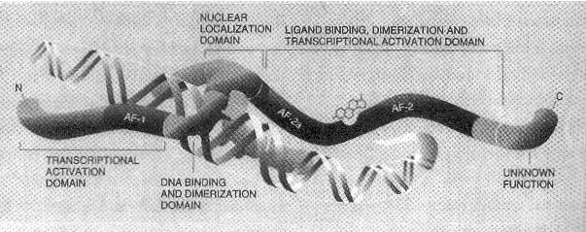
SELECTIVE ESTROGEN RECEPTOR MODULATOR
Class of drugs that act on the oestrogen receptor (ER).
Action is different in various tissues, thereby granting the possibility to selectively inhibit or stimulate estrogen-like action in various tissues.

Slide 3
DISTRIBUTION OF RECEPTORS
α & β -CNS, blood vessels, bone, heart, breast, ovary, uterus, testes, prostate
α - Liver
β - Lungs, kidney, bladder, intestines
NORMAL CELLULAR FUNCTIONS
Estrogen binds to ER
Transcription factor synthesis
Cell proliferation

Slide 4
Estrogenic compounds span a spectrum of activity ranging from:
Full agonists (agonistic in all tissues) such as the natural endogenous hormone estradiol
Mixed agonists/antagonistics (agonistic in some tissues while antagonistic in others) such as tamoxifen (a SERM).
Pure antagonists (antagonistic in all tissues) such as fulvestrant.

Slide 5
HISTORY
The term SERM was introduced to describe compounds that have a combination of estrogen agonist, partial agonist, or antagonist activities depending on the tissue.

Slide 6
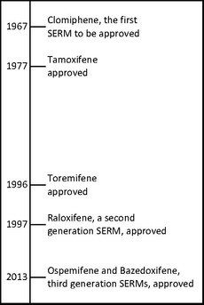
Timeline of approval of SERM

Slide 7
MECHANISM OF ACTION
SERMs produce estrogenic or anti estrogenic effects depending on the specific tissue in question as well as the percentage of intrinsic activity (IA) of the SERM.
SERM with high IA -mostly estrogenic effects -chlorotrianisene .
SERM with low IA -mostly antiestrogenic effects -ethamoxytriphetol
SERMs like clomifene and tamoxifen -more in the middle in their IA and their balance of estrogenic and antiestrogenic actions in comparison.

Slide 8
SERM act on the estrogen receptor (ER), which is an intracellular ligand-dependent transcriptional activator and belongs to the nuclear receptor family.
Two different subtypes of ER have been identified, ERα and Erβ.
ERα is considered the main medium where estrogen signals are transduced at the transcriptional level and is the predominant ER in the female reproductive tract and mammary glands
ERβ is primarily in vascular endothelial cells, bone, and male prostate tissue.
ERα and ERβ concentration are known to be different in tissues during development, aging or disease state.
Many characteristics are similar between these two types such as size (~600 and 530 amino acids) and structure.
ERα and ERβ share approximately 97% of the amino-acid sequence identity in the DNA-binding domain and about 56% in the ligand-binding domain.
The main difference of the ligand-binding domains is determined by Leu-384 and Met-421 in ERα, which are replaced by Met-336 and Ile-373, respectively, in ERβ.[The variation is greater on the N-terminus between ERα and ERβ.

Slide 9
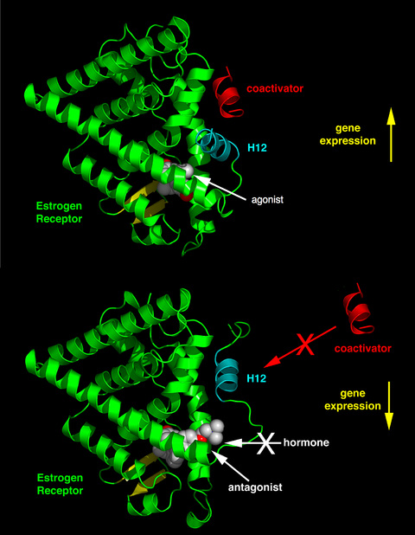

Slide 10
The agonistic or antagonistic activity causes varied structural changes of the receptors, results in activation or repression of the estrogen target genes.
SERMs interact with receptors by diffusing into cells and there binding to ERα or ERβ subunits, which results in dimerization and structural changes of the receptors.
This makes it easier for the SERMs to interact with estrogen response elements which leads to the activation of estrogen-inducible genes and mediating the estrogen effects
High levels of cellular proliferation correlate well with a high ERα:ERβ ratio, but repression of cellular proliferation correlates to ERβ being dominant over ERα.
The ratio of ERs in neoplastic and normal breast tissue could be important when considering chemoprevention with SERMs.

Slide 11
CLOMIPHENE
Clomifene is a SERM that acts by causing the release of gonadotrophin by the hypothalamus.
MOA: Clomifene inhibits estrogen receptors in the hypothalamus, inhibiting negative feedback of estrogen on gonadotropin release, leading to up-regulation of the hypothalamic–pituitary–gonadal axis.
Used in treatment of infertility due to anovulation or oligoovulation.
ART
In male hypogonadism as an alternative to testosterone replacement therapy.

Slide 12
Adverse Effects:
Reversible ovarian enlargement.
Visual symptoms (blurred vision, double vision, floaters, light sensitivity, scotomata)
Headaches
vasomotor flushes (or hot flashes)
abnormal uterine bleeding and/or abdominal discomfort.
high blood level of triglycerides
liver inflammation
reversible baldness and/or ovarian hyperstimulation syndrome
Clomifene can lead to multiple ovulation

Slide 13
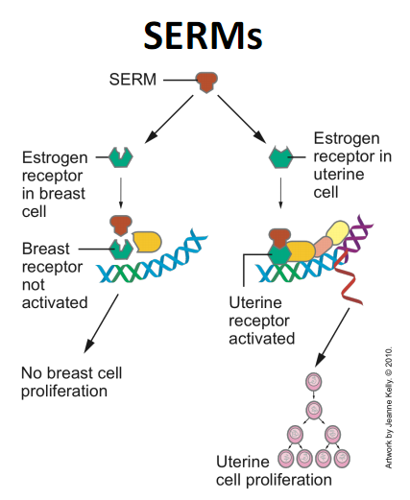
TAMOXIFEN
Tamoxifen is a first-line hormonal treatment of ER-positive metastatic breast cancer.

Slide 14
It is used for breast cancer risk reduction in women at high risk, and as adjuvant treatment of axillary node-negative and node-positive, ductal carcinoma in situ.
Tamoxifen treatment is also useful in the treatment of bone density and in postmenopausal women.
Adverse effects include hot flushes and more serious is two to three times higher relative risk of developing endometrial cancer

Slide 15
TOREMIFENE
A chlorinated tamoxifen derivative, causes fewer DNA adducts in liver than seen with tamoxifen in and was developed to avoid hepatic carcinomas.
It is used as endocrine therapy in women with ER/PR-positive stage 4 or recurrent metastatic breast cancer and has demonstrated similar efficacy compared to tamoxifen as adjuvant treatment of breast cancer and in the treatment of metastatic breast cancer.

Slide 16
RALOXIFENE
Raloxifene is used for prevention and treatment of postmenopausal osteoporosis and breast cancer prevention in high-risk postmenopausal women with osteoporosis.
Less potent than estrogen for the treatment of osteoporosis.
It is associated with an acceptable endometrial profile and has not demonstrated tamoxifen-like effects in the uterus
Adverse effects - venous thromboembolism and vasomotor symptoms, including hot flushes.

Slide 17
OSPEMIFENE
Ospemifene is an analogous metabolite of toremifene.
Not a hepatocarcinogen and therefore ospemifene would also be a safer SERM than tamoxifen.
It is used for the treatment of moderate to severe dyspareunia, a symptom of vulvar and vaginal atrophy associated with menopause.

Slide 18
BAZEDOXIFENE
Bazedoxifene is used as treatment for osteoporosis in postmenopausal women at increased risk of fracture.
It has been shown to be relatively safe and well tolerated.
It shows no breast or endometrial stimulation.
The advantage of bazedoxifene over raloxifene is that it increases endothelial nitric oxide synthase activity and does not antagonize the effect of 17β-estradiol on vasomotor symptoms.

Slide 19
CLINICAL USES OF SERMs
SERMs are used as treatment for various estrogen related diseases.
Ovulatory dysfunction in the management of infertility
Treatment and prevention of postmenopausal osteoporosis.
Treatment and reduction in risk of breast cancer
Treatment of dyspareunia due to menopause.
SERM is also used in combination with conjugated estrogens indicated for the treatment of estrogen deficiency symptoms, and vasomotor symptoms associated with menopause.

Slide 20
Name | Uses | Effects/location
Clomifene | ovulation induction in anovulation | antagonist at hypothalamus
ormeloxifene | contraception | agonist at bone; antagonist at breast and uterus
Raloxifene | osteoporosis, breast cancer | agonist at bone; antagonist at breast and uterus
Tamoxifen | breast cancer | agonist at bone and uterus, antagonist at breast
Toremifene | breast cancer
Lasofoxifene | osteoporosis, breast cancer, vaginal atrophy | agonist at the bone, antagonist at breast and uterus
Ospemifene | vaginal atrophy, dyspareunia | agonist at the bone, antagonist at breast and uterus

Slide 21
SERMs may cause some serious side effects, including blood clots, stroke, and endometrial cancer.
abnormal vaginal bleeding or discharge
pain or pressure in the pelvis
leg swelling or tenderness
chest pain
shortness of breath
weakness, tingling, or numbness in your face, arm, or leg
sudden difficulty seeing
dizziness
sudden severe headache
The most common side effects of SERMs are:
fatigue
hot flashes
night sweats
vaginal discharge
mood swings

Slide 22
CONTRA INDICATIONS
Anticoagulant therapy,
Chemotherapy,
Stroke ,thromboembolic disease.
Endometrial cancer, endometrial hyperplasia, uterine cancer.
Bone marrow suppression, leukopenia, neutropenia, thrombocytopenia.
Cataracts, visual disturbance

Slide 23
THANK YOU

