Slide 1
AMNIOTIC FLUID

Slide 2
Introduction
• Amniotic fluid serves several roles during pregnancy.
• It creates a physical space for fetal movement, which is necessary for normal musculoskeletal development.
• It permits fetal swallowing—essential for gastrointestinal tract development, and fetal breathing—necessary for lung development.

Slide 3
Amniotic fluid guards against umbilical cord compression and protects the fetus from trauma.
Thermoregulation of fetus.
Reservoir of fluids and nutrients to fetus.
Prevents infection by antibacterial properties.

Slide 4
Physiology of amniotic fluid
First trimester
-It is ultra filtrate of maternal plasma.
During the early second trimester, transfer of water and other small molecules takes place across the amnion—transmembranous flow, across the fetal vessels on placental surface—intramembranous flow, and across fetal skin.
Water transport across the fetal skin continues until keratinization occurs at 22 to 25 weeks.

Slide 5
With advancing gestation, four pathways play a major role in amnionic fluid volume regulation
First, fetal urination is the primary amnionic fluid source by the second half of pregnancy.
By term, fetal urine production may exceed 1 liter per day.
Fetal urine osmolality is significantly hypotonic.
The osmolality of maternal and fetal plasma is approximately 280 mOsm/mL, whereas that of amnionic fluid is about 260 mOsm/L.

Slide 6
The hypotonicity of amnionic fluid— accounts for significant intramembranous fluid transfer across and into fetal vessels on the placental surface, and thus into the fetus.
This transfer reaches 400 mL per day and is a second regulator of fluid volume

Slide 7
An important third source of amnionic fluid regulation is the respiratory tract.
Approximately 350 mL of lung fluid is produced daily late in gestation, and half of this is immediately swallowed.
Last, fetal swallowing is the primary mechanism for amnionic fluid resorption and averages 500 to 1000 mL per day

Slide 8
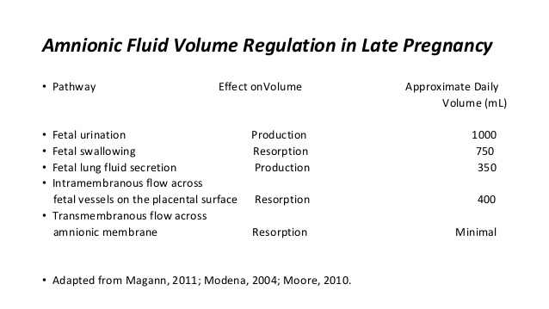

Slide 9
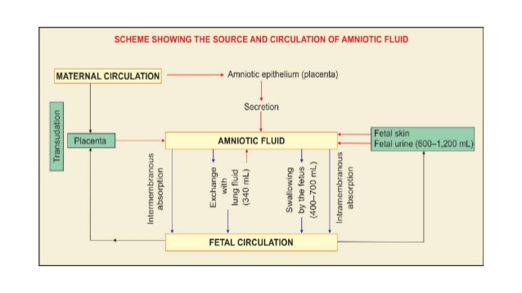

Slide 10
Amniotic fluid
at 10 weeks – 25 ml
At 20 weeks - 400ml
At 28 weeks - 800 – 1000 ml
Plateaus near term
Declines at 42 weeks to 400 ml

Slide 11
Characteristics of amniotic fluid
Water content and osmolality:
at first trimester, amniotic fluid has an electrolyte composition and osmolality similar to that of fetal and maternal blood.
As fetal urine begins to enter the amniotic cavity, amniotic fluid osmolality decreases.
At term it contains 99% water.
The osmolality, sodium, urea and creatinine is not significantly different from the maternal serum

Slide 12
Colour:
In early pregnancy, it is colorless but near term it becomes pale straw colored due to the presence of exfoliated lanugo and epidermal cells from the fetal skin.
It may look turbid due to the presence of vernix caseosa.

Slide 13
Abnormal color has got clinical significance
• Meconium stained (green) is suggestive of fetal distress.
• Depending upon the degree and duration of the distress, it may be thin or thick or pea souped (thick with flakes).
• Thick with presence of flakes suggests chronic fetal distress.

Slide 14
Golden color in Rh incompatibility is due to excessive hemolysis of the fetal RBC and production of excess bilirubin.
Greenish yellow (saffron) in post maturity.
Dark colored in concealed accidental hemorrhage is due to contamination of blood.
Dark brown (tobacco juice) amniotic fluid is found in IUD.

Slide 15
Constituents of the fluid
In early pregnancy , amniotic fluid is an ultra filtrate of maternal plasma.
By the beginning of second trimester , it contains:
a- Organic, inorganic and cellular constituent.
b- It contains traces of steroid and non-steroid hormones.
c- It’s mildly bacteriostatic.

Slide 16
Organic constituents –
• Proteins-0.3 mg/dl
• Glucose- 20mg/dl
• Urea- 30 mg/dl
• Non protein nitrogen-30mg/dl
• Uric acid – 4 mg/dl
• Creatinine -2 mg/dl
• Lipids- 50 mg/ dl
• Hormones- insulin , prolactin, renin
Inorganic constituents - Na, K, Cl
Suspended particles - Lanugo, Desqamated fetal skin cells, vernix caseosa, shedded amniotic cells, cells from the respiratory tract, GIT Genitourinary tract

Slide 17
Measurement
The dye-dilution method involves injection of a small quantity of a dye such as aminohippurate into the amnionic cavity under sonographic guidance.
The amnionic fluid is then sampled to determine the dye concentration and hence to calculate the fluid volume in which it was diluted.

Slide 18
Ultrasound measurements include either the single deepest vertical fluid pocket or the sum of the deepest vertical pockets from each of four equal uterine quadrants—the amnionic fluid index.

Slide 19
Single Deepest Pocket
• This is also called the maximum vertical pocket.
• In the sagittal plane, the largest vertical pocket of fluid is identified.
• The fluid pocket should not contain fetal parts or loops of umbilical cord.
• The normal range for single deepest pocket that is most commonly used is 2 to 8 cm, with values above and below this indicating hydramnios and oligohydramnios, respectively.

Slide 20
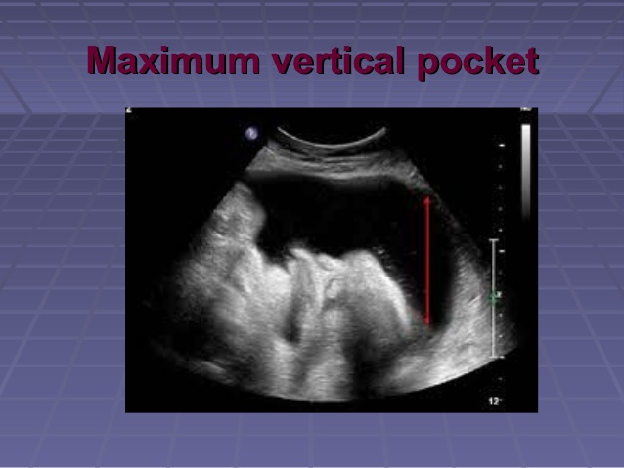

Slide 21
Amnionic Fluid Index (AFI)
it remains one of the most commonly used methods of amnionic fluid volume assessment.
The uterus is divided into four equal quadrants—the right- and left- upper and lower quadrants, respectively.
The AFI is the sum of the single deepest pocket from each quadrant.
Normal range is 5 – 24 cm.

Slide 22
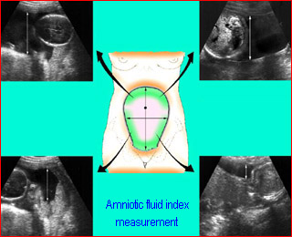

Slide 23
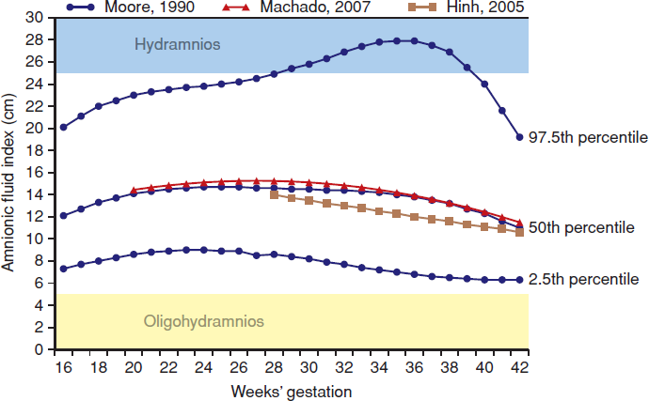

Slide 24
Amniotic fluid testing
Chromosome and DNA analysis
Biochemistry
Fetal infections
Rh disease and other alloimmunisation
Lung maturity
Chorioamnionitis
Fetal therapy-decompression severe polyhydramnios

Slide 25
APPLIED PHYSIOLOGY

Slide 26
Oligohydroamnios:
• This is an abnormally decreased amount of amnionic fluid.
• INCIDENCE: 1 to 2 percent of pregnancies.
• When no measurable pocket of amnionic fluid is identified, the term anhydramnios is used.
• The sonographic diagnosis of oligohydramnios is usually based on an AFI ≤ 5 cm or on a single deepest pocket of amnionic fluid ≤ 2 cm (American College of Obstetricians and Gynecologists, 2012).

Slide 27
Causes
1- Preterm premature rupture of membrane
2- Post maturity
3- Placental insufficiency or intrauterine growth restriction.
4- Fetal causes: reduced or absent fetal urine output.
• This is in turn is the consequence of an abnormality in fetal urinary tract like:
• - Renal agenesis.
• - Bladder outlet obstruction.
• - Renal dysplasia
• - Polycystic or multicystic kidney disease

Slide 28
Cont…
• Fetal chromosomal anomalies
• Intrauterine infections
• Drugs- PG inhibitors, ACE inhibitors
• Amnion nodosum-failure of secretion by the cells of the amnion

Slide 29
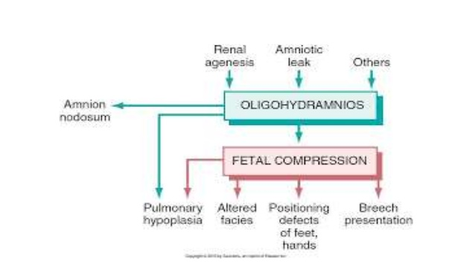

Slide 30
complications
▪ Midtrimester PROM often leads to pulmonary hypoplasia, fetal compression syndrome, and amniotic band syndrome.
▪ AFV is an important predictor of fetal well-being in pregnancies beyond 40 weeks' gestation
▪ AFV is a predictor of the fetal tolerance of labor,

Slide 31
If there is bilateral renal agenesis, the resulting anhydramnios leads to limb contractures, a distinctively compressed face, and death from pulmonary hypoplasia
• When this combination of abnormalities results from renal agenesis, it is called Potter syndrome.

Slide 32
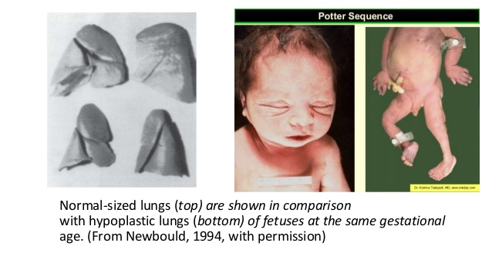

Slide 33
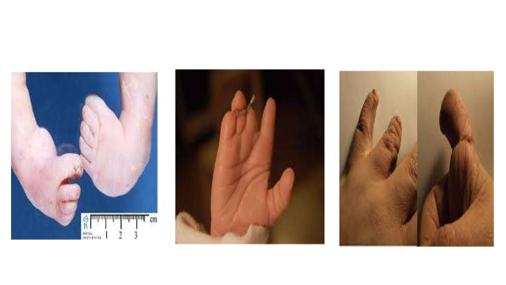

Slide 34
Pregnancy Outcomes
Fetal stillbirth
Fetal growth restriction,
Non reassuring heart rate pattern
Meconium aspiration syndrome
Women with oligohydramnios had a twofold increased risk for cesarean delivery for fetal distress.

Slide 35
Diagnosis
1) Uterine size is much smaller than the period of amenorrhea
2) Less fetal movements
3) The uterus is “full of fetus” because of scanty liquor
4) Malpresentation (breech) is common
5) Evidences of intrauterine growth retardation of the fetus
6) Sonographic diagnosis

Slide 36
L – Arginine
• L-arginine increases uteroplacental blood flow through nitric oxide mediated dilatation of vessels thereby increasing the supply of nutrients to the fetus aiding its growth.
Oral therapy with 3 g of Arginine daily results in accelerated fetal weight gain and improved biophysical profile and prolonging pregnancy complicated with pre-eclampsia & Oligohydramnios.

Slide 37
Polyhydramnios
Definition :
It means excessive amniotic fluid, more than 2 litres.
By ultrasound the vertical diameter of the largest pocket of amniotic fluid measure 8 cm or more, or the amniotic fluid index (AFI) is 25 cm or more.
Incidence : 1 – 2 % of all pregnancies.

Slide 38
It can be classified into :
1- Mild single deepest pocket 8 – 9.9 c.m./ AFI is 25 to 29.9 cm
2- Moderate : single deepest pocket 10 -11.9 c.m./ AFI 30 to 34.9 cm
3- Severe : single deepest pocket ≥ 12 c.m./ AFI> 35 cm

Slide 39
CAUSES
▪ Maternal hyperglycemia
▪ GIT anomalies(obstructive)
▫ Esophageal atresia
▫ Tracheoesophageal fistula
▫ Duodenal atresia
▪ Nonimmune hydrops
▪ CNS anomalies
▫ Anencephaly
▫ Open spina bifida
▪ Thoracic malformations
▫ Diaphragmatic hernia ,fetal neck masses
▪ Congenital infections -Syphilis

Slide 40
CLINICAL TYPES
•Depending on the rapidity of onset, hydramnios may be:
•(a) Chronic (most common) — onset is insidious taking few weeks.
•(b) Acute (extremely rare) — onset is sudden, within few days.

Slide 41
Signs
•Patient may be dyspnoic at rest
•Pedal Oedema
•Evidence of PIH
Abdominal examination
Inspection
•Abdomen is markedly enlarged globular with fullness in flanks

Slide 42
Palpation:
•Height of uterus is more than the corresponding periods of amenorrhoea
•Abdominal girth is more
•Fetal parts cannot be well defined external ballotment is more easily elicited
•Malpresentations are more common and presenting part is usually high up
•Fluid thrill is present
Auscultation
•Fetal heart sounds are not heard distinctly

Slide 43
Complication :
A) During Pregnancy :
1- Abortion
2- Preterm labour
3- Premature rupture of membranes
4- Cord prolapse.
5- Placental abruption
6- Malpresentation
7- Nonengagement of the presenting part
8- Pressure symptoms : as dyspnea, palpitation and edema of lower limbs.

Slide 44
B) During Labour :
Postpartum hemorrhage due to : - Uterine atony due to overdistension of the uterus
C) During Purperium : The uterus may take a longer time to involute (subinvolution).

Slide 45
MANAGEMENT
Large volume amniocentesis termed amnioreduction is required in certain cases.
App 1000 – 1500 ml of amniotic fluid is aspirated over 30 minutes depending on severity of hydramnios and gestational age .
Goal is to restore the upper normal range.

Slide 46
THANK YOU

