Slide 1

OBSTETRIC ANALGESIA & ANAESTHESIA

Slide 2

PHARMACOLOGICAL METHODS
The following factors are important to control the dose of the analgesics.
PAIN THRESHOLD: Varies from patient to patient. Some patients may experience severe pain though uterine contractions are relatively weak.
PARITY: Multiparous women need less analgesia.
MATURITY OF THE FETUS: Minimal doses of drugs are indicated while the fetus is thought to be premature to avoid neonatal asphyxia.

Slide 3
PHARMACOLOGICAL METHODS
Inhalational agents
Systemic opioids
Regional anaesthetic techniques
Neuraxial techniques
Alternate regional techniques

Slide 4

INHALATIONAL AGENTS
Administration of sub anaesthetic concentrations of inhaled anaesthetics to relieve pain during labour.
Mother remains awake and with her protective laryngeal reflexes intact.
Used in first and second stages of labour either alone or as a supplement to parental analgesia.
Useful in patients where other techniques are contraindicated.

Slide 5
The only inhalational agent that has survived the test of time is ENTONOX (50% nitrous oxide, 50% oxygen)
Other agents that have been tried are sevoflurane, isoflurane and enflurane which are volatile anaesthetic agents.

Slide 6
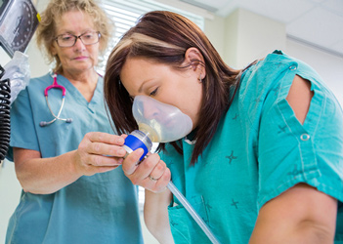
ENTONOX
It has a rapid onset and recovery due to low blood solubility of nitrous oxide.
It can be self administered through a demand value via a face mask or mouth piece from a piped or cylinder supply.
Inhalation by slow and deep breaths should begin from the beginning of uterine contraction and should continue until the contraction ends.

Slide 7
Uses:
Does not interfere with uterine activity and neonatal APGAR scores.
Disadvantages:
30 - 40% of mothers report no benifit.
Not found to be a potent labour analgesic

Slide 8
ISOFLURANE, SEVOFLURANE:
Use of these drugs are limited by
Onset of drowsiness
Unpleasant odour
High cost
Associated undesirable uterine relaxation
When used in higher concentrations it leads to unconsciousness, loss of reflexes and aspiraton

Slide 9
Parental opioids
Used when epidural analgesia is unavailable or contraindicated
Widely used opioids are:
Pethidine
Fentanyl
Remifentanil
Morphine
Diamorphine

Slide 10
Choice of the drug used for pain relief depends on the onset, duration of action and lipid solubility(how much of the drug crosses the placenta to cause fetal respiratory depression)

Slide 11
Pethidine
Strong sedative but less analgesic efficacy
Used in first stage of labour
Route of administration | Dose | Onset of action | Duration
IM | 50-100 mg | 40-45 min | 2-3 hrs
IV | 25-50mg | 5-10 min | ”

Slide 12
Pethidine crosses the placenta by passive diffusion and reaches the fetal circulation within 90 sec after IV dose.
Fetal and maternal concentrations equilibriate within 6 min

Slide 13
Neonatal complications relate to total dose administered and dose-to-delivery interval
Maximal fetal uptake of pethidine occurs in
2-3 hrs of maternal administration.
Infants born within this interval have an increased risk of respiratory depression.
Its active metabolite (norpethidine) is associated with respiratory depression upto 5-6 days after birth and neuro behavioural changes.

Slide 14
Side effects to mother:
Nausea
Vomiting
Delayed gastric emptying
Ineffective analgesia, sedation, dose to be repeated every 4-6hrly.
Dysphoria
Contraindicated in hepatic disease because of its active metabolite which has a long half life

Slide 15
Fentanyl
Highly lipid soluble synthetic opioid.
It has a rapid onset of action with short duration of action with no major metabolites.
Route of admintration | Dose | Onset of action | Peak effect | duration
IM | 50-100µg | 7-8 min | 30 min | 1-2 hrs
IV | 25-50µg | 10 sec | 3-5 min | 30-60 mins

Slide 16
Advantages:
Less maternal nausea and vomiting
It readily crosses the placenta but shows no effect on APGAR score, neurobehavioral scores

Slide 17
Remifentanil
Ultra short acting synthetic potent opioid.
It has a rapid onset of action, readily metabolised by plasma and tissue esterases to an inactive metabolite.
Readily crosses the placenta but extensively metabolised by the fetus.
Bolus doses of 0.5µg/kg with lock out interval of 2 min without a base line infusion has shown to be highly patient acceptable without significant side effects.

Slide 18
The half life is 4 min and it makes a typical modern day ‘off and on’ drug.
The metabolism is unaffected by hepato or renal dysfunction. Hence it is favourable in liver(cholestasis, HELLP syndrome) or renal disease.

Slide 19
Morphine
Route of administration | Dose | Onset of action | Duration
IM | 5-10mg | 60-120min | 5-6hrs
IV | 1-2mg | 10-20min | 2-3 hrs
Twilight sleep
Not recommended as it causes excessive sedation.
Morphine can cross the placenta leading to prolonged respiratory depression.

Slide 20
Diamorphine
Heroin 5-7.5mg
Semi synthetic opiate produced by acetylation of morphine

Slide 21
Opioid antagonist
Used to reverse the respiratory depression induced by opioid narcotics.
Naloxone:
Mother-0.4mgIV
Neonate-0.1ml/kg IM/IV

Slide 22
Diazepam
Diazepam
5-10mg IM
Well tolerated by the patient
Does not produce vomiting
Helps in dilatation of cervix
Disadvantages:
Loss of beat to beat variability
neonatal hypotonia
hypothermia

Slide 23
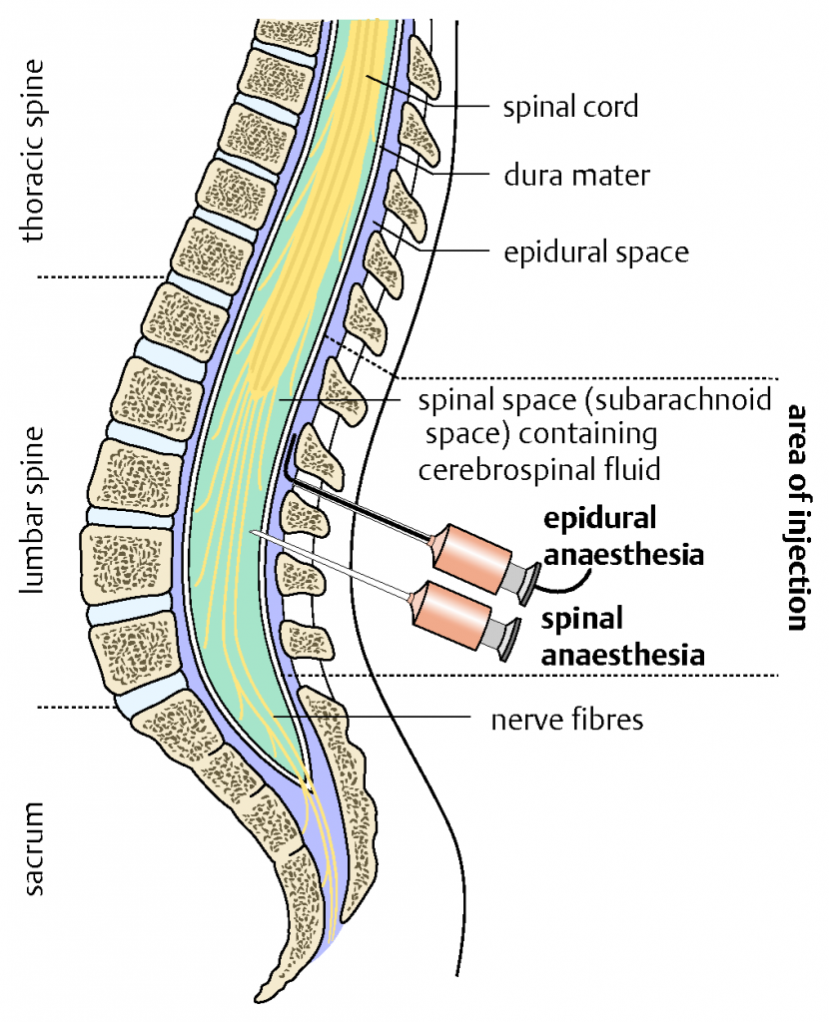
Regional anaesthetic techniques
NEURAXIAL TECHNIQUES:
Epidural analgesia
Spinal analgesia
Combined spinal-epidural analgesia

Slide 24
Neuraxial techniques
Indications:
Maternal request
Hypertensive disorders of pregnancy
Multiple pregnancy
TOLAC
VBAC
Comorbid medical disorders

Slide 25
Contraindications:
Allergy to local anaesthetic
Coagulopathy and thrombocytopenia
Neurological diseases
Spinal deformity
hypovolaemia
Local infection
Systemic sepsis
Inadequate facilities and staff
Maternal refusal

Slide 26
Basic prerequisites:
Informed consent
Pre anaesthetic assessment-examination of back
Availability of resuscitation equipment
Emergency drugs
Maternal and fetal monitering
Correction of hypovolaemia

Slide 27
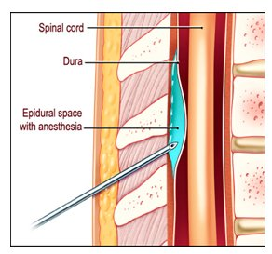
Epidural analgesia
Procedure:
Lumbar puncture is made between L2 and L3 with epidural needle.
When epidural space is ensured, a plastic catheter is passed through the epidural needle for continuous epidural analgesia.

Slide 28
A local anasthetic agent is injected into the epidural space to block only sensory impulses while maintaining normal motor power .
Full dose is given after a test dose, when there is no toxicity.

Slide 29
For complete analgesia in normal delivery, a block from T10-S5 dermatomes is needed.
For caesarean delivery, a block from T4-S1 is needed.

Slide 30
Drugs used for epidural labour analgesia are local anasthetic agents (bupivacaine, levobupivacaine, ropivacaine) mixed with opioids(fentanyl, sufentanil).
The volume of epidural dose required is 15-20ml given during initiation and maintenance of epidural block.
Concentrations of drugs recommended are: bupivacaine 0.0625%-0.1%
fentanyl 2µg/ml

Slide 31
Epidural analgesia can decrease beat-to-beat variability, can cause transient bradycardia, especially with intrathecal opioids.
Epidural analgesia has no effect on APGAR score

Slide 32
Epidural - Instrumental delivery & caesarean section
Epidural is associated with higher incidence of instrumental vaginal delivery.
Prolonged 2nd stage of labour
Fetal malposition
Loss of bearing down reflex & urge to push
Epidural analgesia does not increase the incidence of caesarean sections.

Slide 33
Advantages :
The patient is awake and can enjoy the birth time
Lowered risk of maternal aspiration
Repeated doses can be given through the epidural catheter.
Full anaesthesia can be achieved in case if emergency caesarean delivery is needed.
New born APGAR score is generally good
Pain relief in the post partum period associated with episiotomy/caesarean section can be provided with the epidural catheter.

Slide 34
Complications:
Maternal hypotension
Post dural puncture headache
Pain at the insertion site/Backache
Injury to nerves, convulsions, pyrexia
Urinary retention

Slide 35
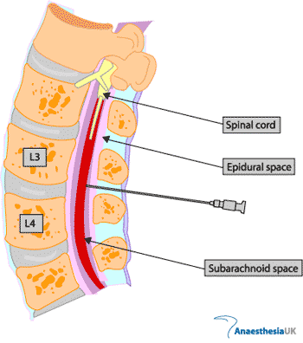
Spinal analgesia
Injection of local anaesthetic agent into the subarachnoid space of L3-L4.

Slide 36
For normal delivery with episiotomy, outlet forceps, ventouse delivery- block should extend from T10-S1.
For caesarean delivery, level of sensory block should be upto T4 dermatome.

Slide 37
Drugs used are:
Hyperbaric bupivacaine-10-12mg
Lignocaine-50-70mg
Addition of fentanyl (to enhance the onset of the block) or morphine (to improve pain control) may be done.
Advantages:
Technique is not difficult
Less fetal hypoxia(unless their is hypotension)

Slide 38
Disadvantages:
Hypotension
Postspinal headache
Failed block
Total spinal-due to excessive dose
Chemical meningitis
Nerve injury/ transient or permanent paralysis
Urinary retention/bladder dysfunction

Slide 39
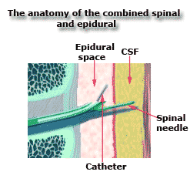
Combined spinal-epidural analgesia
Done by needle through needle technique.
Epidural needle is first placed in the epidural space.
Spinal needle is introduced through the epidural needle into the subarachnoid space.

Slide 40
A single bolus of 1ml 0.25% bupivacaine with 25µg fentanyl is injected into subarachnoid space.
Spinal needle is then withdrawn.

Slide 41
An epidural catheter is thus sited for repeated doses of anaesthetic drug
This method gives rapid and effective analgesia during labour and caeserean delivery.

Slide 42
Regional anaesthetic techniques
ALTERNATE REGIONAL ANALGESIA TECHNIQUES:
Paracervical block
Pudendal block
Perineal infiltration

Slide 43
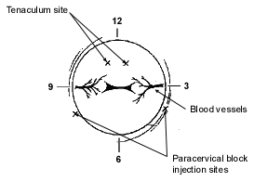
PARACERVICAL BLOCK
Effective method of pain relief in the 1st stage of labour.
Following antiseptic safeguards, a long needle is passed into the lateral fornix, at 3 & 9 o’clock positions.
5-10ml 1% lignocaine with adrenaline is injected at the site of the cervix.
Procedure is repeated on the other side

Slide 44
Sheathed paracervical needle:
A specially constructed guard tube is used.
A needle is inserted through the tube and is of such a length that it protrudes not more than 7mm beyond its tip.

Slide 45
Uses:
Provides complete pain relief in the 1st stage of labour in 80% of patients.
Removes the desire to bear down earlier.
Complications:
Fetal bradycardia
Acidosis

Slide 46
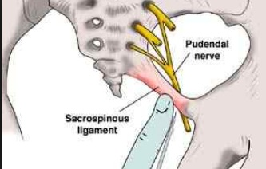
PUDENDAL NERVE BLOCK
It can be given by a transvaginal or transperineal approach.
TRANSVAGINAL ROUTE
commonly preferred as it is less painful & more accurate than transperineal route.
Index and middle fingers of one hand are introduced into the vagina. Finger tips are placed on the tip of the ischial spine of one side.

Slide 47
20ml syringe with 20ml of 1% lignocaine with 22G spinal needle is taken and needle is passed along the groove of the fingers and guided to pierce the vaginal wall on the apex of ischial spine & thereafter to push a little to pierce the sacrospinous ligament just above the ischial spine tip.

Slide 48
After aspirating to exclude blood, 10ml of the solution is injected.
Procedure is repeated on the other side by changing the hands.

Slide 49
TRANSPERINEAL ROUTE:
More painful and less accurate than transvaginal route.
Used only when the presenting part is so low
Skin is infiltrated with local anaesthetic halfway between the anus and ischial tuberosity.

Slide 50
With one index finger in the vagina, the ischial spine is palpated & 10cm spinal needle is advanced through the infiltrated skin and guided towards the ischial spine & sacrospinous ligament.
Aspiration & infiltration around the pudendal nerve follows.

Slide 51
Uses:
Relieves pain during 2nd stage of labour
Vaginal breech delivery
Forceps delivery

Slide 52
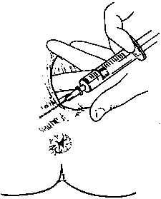
PERINEAL INFILTRATION
FOR EPISIOTOMY:
A 10ml syringe with a fine needle
& 8-10ml lignocaine are required.
The perineum on the proposed episiotomy site is infiltrated in a fan wise manner, starting from the middle of the fourchette.
Each time prior to infiltration, aspiration to exclude blood is mandatory.
Episiotomy is to be done 2-5min following infiltration.

Slide 53
FOR OUTLET FORCEPS/ VENTOUSE:
(PERINEAL AND LABIAL INFILTRATION)
20ml syringe, a long fine needle & 20ml 1% lignocaine are required.
Needle is inserted just posterior to introitus. 10ml of solution is infiltrated in a fanwise manner on both sides of the midline as for episiotomy.

Slide 54
The needle is then directed anteriorly along each side of the vulva as far as the anterior third to block the genital branch of
genito-femoral & ilio-inguinal nerve.
5ml is required to block each side.

Slide 55
Complications of alternative regional analgesic techniques are:
Hematoma
Vasovagal syncope
Local anaesthetic toxicity
Parametrial, subgluteal abscess
Laceration of vaginal mucosa
Fetal bradycardia (intravascular injection)
Needle stick injury to the surgeon

Slide 56
Local anaesthesia for caesarean delivery
Rarely used where regional block is inadequate
The skin is infiltrated along the line of incision with diluted solution of 2%lignocaine with NS.
The subcutaneous fatty layer, rectus sheath, muscle layers are infiltrated as the layers are seen during operation.
Peritoneum is then opened.
UV fold is infiltrated, then incised & uterus is exposed.

Slide 57
Uterus is relatively insensitive to incision but can be infiltrated with 10-15ml before incision.
Operation should be done slowly for the drug to become effective.
Once the infant has been delivered, mother should be given IV morphine.

Slide 58
General anaesthesia for caesarean section
100% oxygen is administered by tight mask for 3min.
Induction of anaesthesia is done with thiopentone sodium 200-250mg (4mg/kg) as 2.5% solution IV, followed by suxamethonium 100mg.
Cricoid pressure is applied by the assistant as consciousness is lost. Patient is intubated with a cuffed ET & cuff is inflated.

Slide 59
Anaesthesia is maintained with 50% nitrous oxide, 50% oxygen & a trace of 0.5% halothane.
Relaxation is maintained with nondepolarising muscle relaxant. (vercuronium bromide 4mg)
After delivery of the baby, nitrous oxide concentration should be increased to 70% & opioids are injected IV to supplement anaesthesia

Slide 60
At the conclusion of surgery, muscle relaxation is reversed with standard doses of neostigmine and atropine/ glycopyrolate.
ET is removed only when laryngeal reflexes have returned and spontaneous respiration has resumed.
Analgesia in the postoperative period is given in the form of NSAID

Slide 61
Complications:
Time interval between uterine incision and delivery is related to fetal hypoxia & acidosis
Longer the exposure to general anaesthetic before delivery, the more depressed is the APGAR score
Uterine contractility may be diminished
Aspiration of gastric contents
Chemical pneumonitis, atelectasis, bronchoneumonia
Delayed gastric emptying

Slide 62


