Slide 1
CERVICAL INTRAEPITHELIAL NEOPLASIA

Slide 2
WHO in 1975 classified, the CIN into three categories correlating with former grading of dysplasia – CIN 1,2,3 & CIS.
Grading to be done according to the thickness occupied by the undifferentiated cells.

Slide 3
BETHESDA SYSTEM
classified cytological abnormalities of premalignant lesions into 3 categories for squamous metaplasia –
a. Atypical Squamous Cells (ASC)
b. Low Grade Squamous Intraepithelial Lesion (LSIL)
c. High Grade Squamous Intraepithelial Lesion (HSIL)
LSIL includes, CIN 1 and the changes of HPV (Koilocytic Atypia)

Slide 4
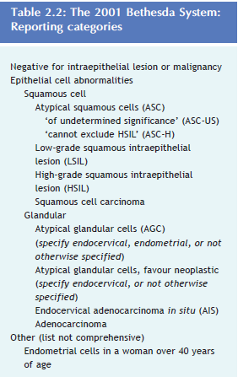

Slide 5
DYSPLASIA | CIN | Limit of Histological changes | Bethesda
MILD | CIN 1 | Basal 1/3rd | LSIL
MODERATE | CIN 2 | Basal ½ to 2/3rd | HSIL
SEVERE | CIN 3 | Whole thickness except 1 or 2 layers
CIS | CIN 3 | Whole thickness

Slide 6
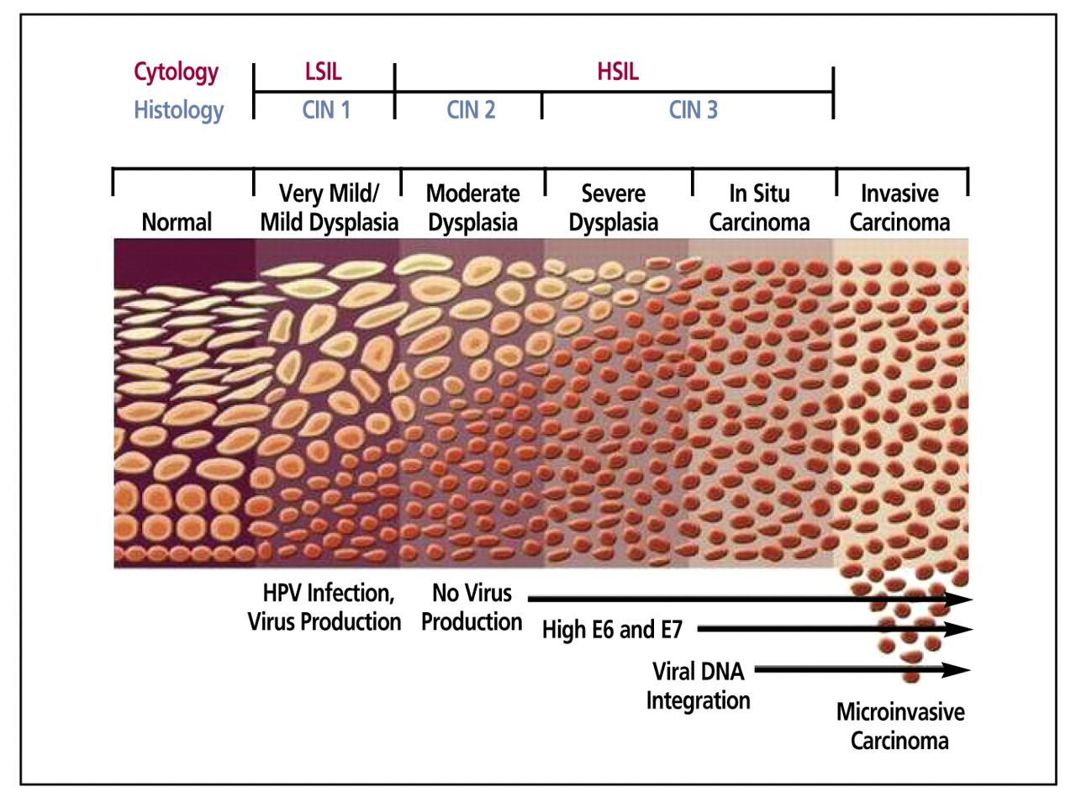

Slide 7
RISK FACTORS FOR
CIN & CERVICAL CANCER
INFECTION – HPV (16, 18, 31, 33), HIV, CHLAMYDIA
EARLY FIRST COITUS
STD
EARLY 1ST PREGNANCY
TOO MANY & TOO FREQUENT BIRTHS
LOW SOCIOECONOMIC STATUS
MULTIPLE PARTNERS
IMMUNOSUPRESSION
OCP USERS
SMOKING

Slide 8
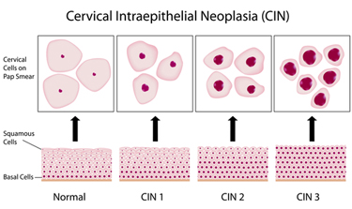

Slide 9

WHEN IS A FEMALE MOST
LIKELY TO DEVELOP CIN ?
CIN is most likely to develop during menarche or after pregnancy, when metaplasia is most active.
After menopause, little chances of metaplasia remain, from de novo HPV.

Slide 10
In majority cases, infection clears in about 9-15 months.
Small proportion of women exposed, have persistent infection & further progress to CIN 2/3/CIS.
Usually, HPV infection doesn’t persist.
NOT ALL HPV LEAD TO CIN, but, ALL CIN ARE PRECEEDED WITH HPV INFECTION

Slide 11
CERVICAL EPITHELIUM | CIN 1 | CIN 2 | CIN 3 / CIS
Regression to normal (%) | 60 | 40 | 30
Persistence (%) | 30 | 35 | 50
Progression to CIN 3 / CIS (%) | 10 | 20 | -
Progression to invasion (%) | <1 | 5 | 20

Slide 12
SCREENING
PAP Test
Colposcopy
HPV – DNA detection
(PCR, Southern Blot Assay, Hybrid Capture)

Slide 13
PAPANICOLAOU TEST
A standardized method of reporting cytology findings defined under THE BETHESDA III SYSTEM (2001).
According to this system, potentially premalignant squamous lesions fall into three categories:
Atypical Squamous Cells (ASC)
(ii) Low-grade Squamous Intraepithelial Lesions (LSIL)
(iii) High-grade Squamous Intraepithelial Lesions (HSIL).
The ASC category is subdivided into two categories:
those of Unknown Significance (ASCUS),
and
those in which High-grade Lesions must be excluded (ASC-H).

Slide 14
Low-grade squamous intraepithelial lesions include CIN 1 (mild dysplasia) and the changes of HPV, termed Koilocytotic Atypia.
The HSIL category includes CIN 2 and CIN 3 (moderate dysplasia, severe dysplasia, and carcinoma in situ).

Slide 15
THE 2001 BETHESDA SYSTEM
SPECIMEN TYPE
Indicate conventional smear (Pap smear) vs. Liquid-based Preparation vs. Other
B. SPECIMEN ADEQUACY
Satisfactory for evaluation
(describe presence or absence of endocervical/transformation zone component and any other quality indicators, e.g., partially obscuring blood, inflammation, etc)
Unsatisfactory for evaluation
Specimen rejected/not processed
Specimen processed and examined, but unsatisfactory for evaluation of epithelial abnormality

Slide 16
C. INTERPRETATION/RESULT
NEGATIVE FOR INTRAEPITHELIAL LESION OR MALIGNANCY
(when there is no cellular evidence of neoplasia, state this in the General Categorization above and/or in the Interpretation/Result section of the report, whether or not there are organisms or other non-neoplastic findings)
Organisms
Trichomonas vaginalis
Fungal organisms morphologically consistent with Candida spp
Shift in flora suggestive of bacterial vaginosis
Bacteria morphologically consistent with Actinomyces spp
Cellular changes consistent with Herpes simplex virus

Slide 17
Other non-neoplastic findings
Reactive cellular changes associated with:
Inflammation (includes typ
Radiation
Intrauterine contraceptive device (IUD)
Glandular cells status post hysterectomy
Atrophy
2. OTHER
Endometrial cells (in a woman >= 40 years of age) (Specify if ‘negative for squamous intraepithelial lesion’)
3. OTHER MALIGNANT NEOPLASMS (specify)

Slide 18
4. EPITHELIAL CELL ABNORMALITIES
Squamous cell
Atypical squamous cells
Of undetermined significance (ASC-US)
Cannot exclude HSIL (ASC-H)
Low grade squamous intraepithelial lesion (LSIL)
HPV/mild dysplasia/CIN 1
High grade squamous intraepithelial lesion (HSIL)
Encompassing: moderate and severe dysplasia, CIS; CIN 2 and CIN 3
With features suspicious for invasion (if invasion is suspected)
Squamous cell carcinoma

Slide 19

Glandular cell
Atypical
Endocervical cells,
Endometrial cells,
Glandular cells,
Atypical
Endocervical cells, favor neoplastic
Glandular cells, favor neoplastic
Endocervical adenocarcinoma in situ
Adenocarcinoma
Endocervical
Endometrial
Extrauterine
Not otherwise Specified (NOS)

Slide 20
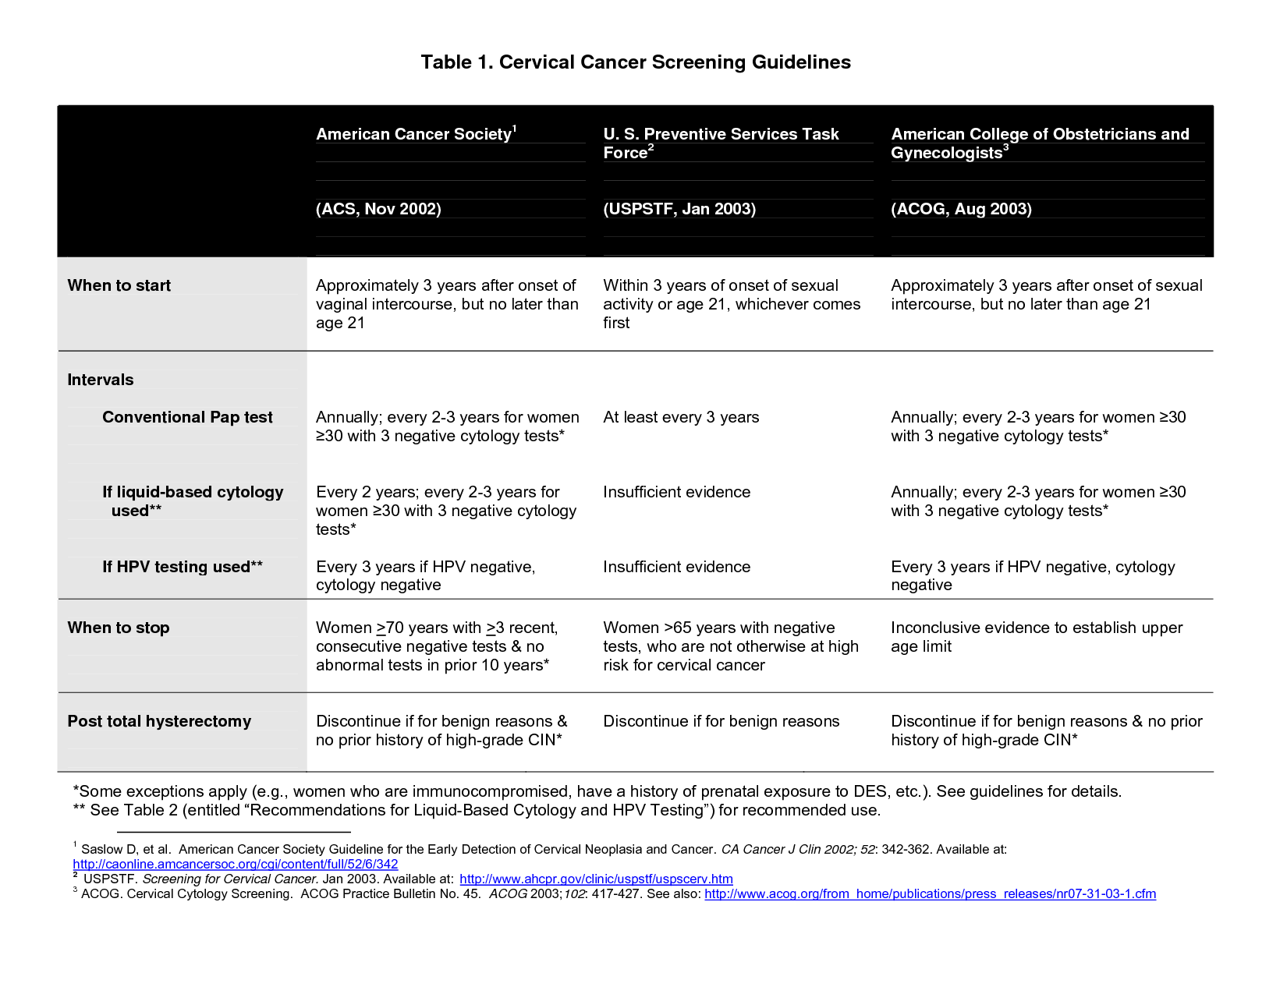

Slide 21
DIAGNOSTIC MODALITIES
Exfoliative Cytology
HPV – DNA Testing
Visual Inspection with Acetic Acid
Colposcopy
Cervicography
Endo cervical Curettage & Biopsy (with / without colposcopy)
Diagnostic Conisation

Slide 22
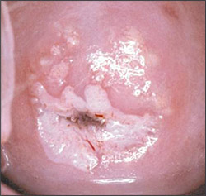
Visual Inspection with Acetic Acid (VIA)
5% acetic acid is applied to the cervix with a large cotton swab and left for 30-60 seconds, after which the cervix is visually examined with the colposcope.
Pre-cancerous lesions, with a higher ratio of intracellular proteins, turn white when combined with acetic acid.
Normal cervices without any precancerous lesions, do not change color.

Slide 23
COLPOSCOPY
A colposcope is used to identify visible clues suggestive of abnormal tissue.
It functions as a lit binocular microscope to magnify the view of the cervix, vagina, and vulvar surface.
Low power (2x to 6x) may be used to obtain a general impression of the surface architecture.
Medium (8x to 15x) and high (15x to 25x) powers are utilized to evaluate the vagina and cervix.

Slide 24
The higher powers are often necessary to identify certain
vascular patterns that may indicate the presence of more
advanced pre-cancerous or cancerous lesions.
Various light filters are available to highlight different aspects of the surface of the cervix.
Acetic acid solution and Iodine solution (Lugol's or Schiller's)
are applied to the surface to improve visualization of abnormal
areas.

Slide 25
Colposcopy is performed in dorsal lithotomy position
A speculum is placed in the vagina after the vulva is examined for any suspicious lesions.
3-5 percent acetic acid is applied to the cervix using cotton swabs.
Areas of aceto-whiteness correlate with higher nuclear density.
Areas of the cervix which turn white after the application of acetic acid or have an abnormal vascular pattern are often considered for biopsy.
If no lesions are visible, an iodine solution may be applied to the cervix to help highlight areas of abnormality.

Slide 26
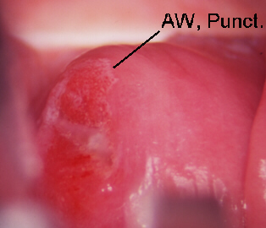
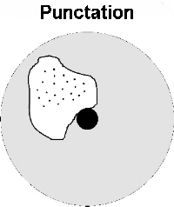
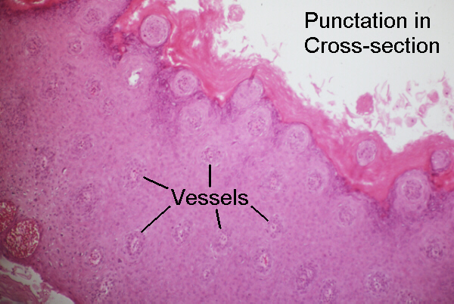
Punctation - A stippled appearance to capillaries seen end-on, often found within acetowhite area appearing as fine to coarse red dots.

Slide 27
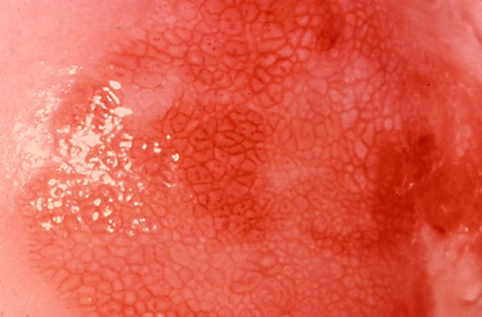
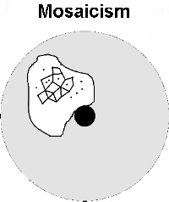
Mosaicism - An abnormal pattern of small blood vessels suggesting a confluence of "tile" or "chickenwire" reddish borders.

Slide 28
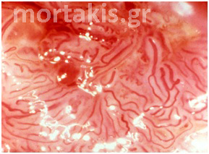
Leukoplakia (hyperkeratosis) - Typically an elevated, white plaque seen prior to the application of acetic acid.
Abnormal blood vessels - Atypical, irregular vessels with abrupt courses and patterns, often appearing as commas, corkscrews, or spaghetti.

Slide 29
OTHER COLPOSCOPIC FINDINGS
Vaginocervicitis - Cervicitis may cause abnormal Pap smears and make colposcopic assessment more difficult. Many authorities recommend treatment before biopsy when a STD is strongly suspected.
Traumatic erosion - most commonly caused by speculum insertion and over vigorous Pap smears but can also result from such irritants as tampons, diaphragms, and intercourse.
Atrophic epithelium - Atrophic vaginal or cervical epithelium may also cause abnormal Papanicolaou smears. Colposcopists will often prescribe estrogen for 2 to 4 weeks before a colposcopy in order to "normalize" the epithelium before the examination. This is generally felt to be safe even if dysplasia or cancer is present because the duration of therapy is short and these lesions do not express any more estrogen receptors than a normal cervix.
Nabothian cysts - They are areas of mucus producing epithelium that are "roofed over" with squamous epithelium. They do not require any treatment. They provide markers for the transformation zone since they are in squamous areas but are remnants of columnar epithelium.

Slide 30
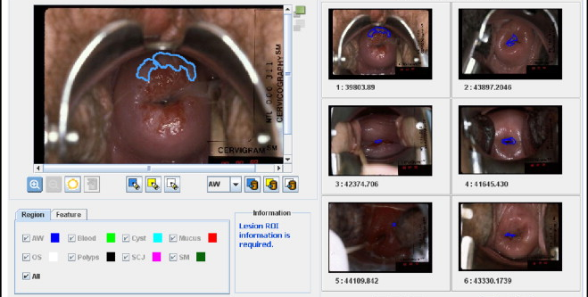
CERVICOGRAPHY
Photographs of the cervix and submitted to an expert for opinion

Slide 31
CERVICAL CONIZATION
Refers to an excision of a cone-shaped sample of tissue from the cervix.
Conization may be used either for diagnostic purposes as part of a biopsy, or for therapeutic purposes to remove pre-cancerous cells.
Types include:
Cold Knife Conization (CKC).
Loop Electrical Excision Procedure (LEEP).
.

Slide 32
COLD KNIFE CONIZATION
Surgical procedure to remove the cervical transformation zone including cevical lesion
Require G.A or reginal anaesthesia.
Prefered for high grade CIN extending deep into the endocervical canal, for endocervical glandular disease.
Patient selection, Ideal for patient older than 35yrs with CIN3 & CIS and patient with risk of invasive cancer.

Slide 33
LEEP(Loop Electro surgical Excision Procedure)
Excision Performed by wire loop cautery
Simultaneously cuts and coagulate the tissue.
Can be used for high grade cervical lesion including those that extend into endocervical canal
Under colposcopy guidence

Slide 34
Side effects –
Cervical Stenosis
Incompetent Os
Hematometra
Adjacent tissue trauma

Slide 35
ABLATION OF
LOCAL LESION
FOLLOWING CRITERIA TO BE FULFILLED –
Entire lesion should be visualized within the TZ.
No evidence of Microinvasion or Invasion.
No endocervical glandular involvement.
No discrepency b/w Biopsy, Cytology & Colposcopy report.

Slide 36
CRYOSURGERY
Principle is crystallization of intracellular water at temperatures of
-90º C.
Uses Nitrous Oxide or CO₂
Depth of tissue destruction = 5 mm
DOUBLE FREEZE TECHNIQUE
(Freeze-Thaw-Freeze)
INDICATED ; CIN persist for 24 months or CIN2
Small lesion
Ectocervical localisation only
Negative for Endo cervical sample

Slide 37
ELECTRODIATHERMY
8-10 mm depths destroyed.
Using a unipolar electrode.
General Anaesthesia.

Slide 38
LASER ABLATION
Depth = 7 mm
Method of choice when CIN extends onto vaginal fornices.
Done through colposcopic guidance
Destroy epithelium by vaporisation.

Slide 39
HYSTERECTOMY
CIN lesion associted with other gynaecological problems like prolapse, fibroid, PID, endometriosis.
Extension into vagina.
Persistent dyskaryotic smear even after treatment.
High grade CIN in elderly women.
Patients with CIN 3
Poor follow up compliance.
Cancer Phobia.
REMOVE VAGINAL CUFF IF LESION EXTENDS TO FORNICES

Slide 40
MANAGEMENT
GUIDELINES
The American Society for Colposcopy & Cervical Pathology (ASCCP) Guidelines developed in 2001, revised in April 2013, define the guideline algorithms.

Slide 41
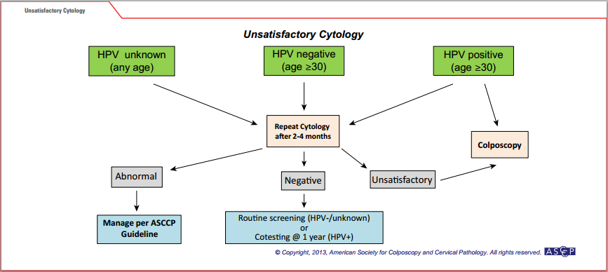

Slide 42
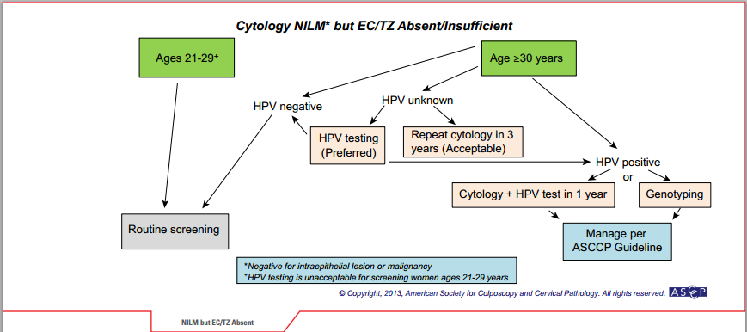

Slide 43
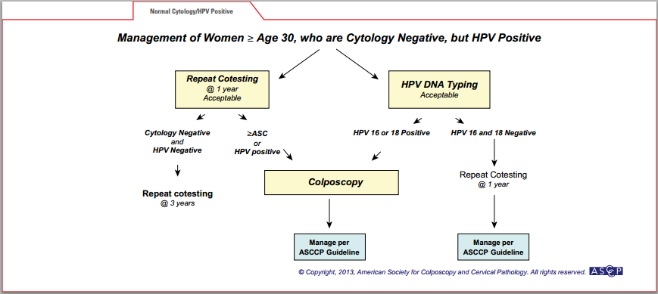

Slide 44
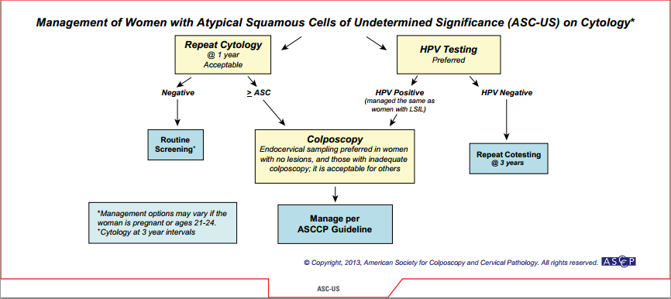

Slide 45
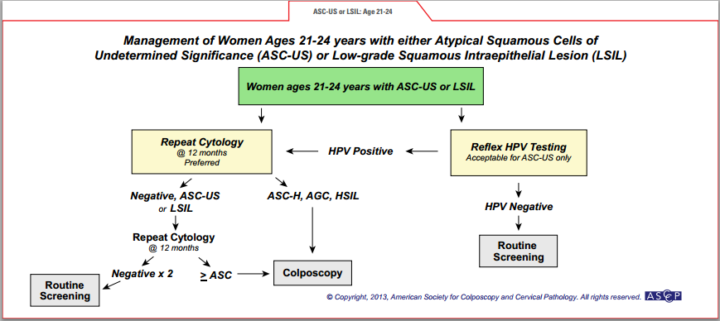

Slide 46
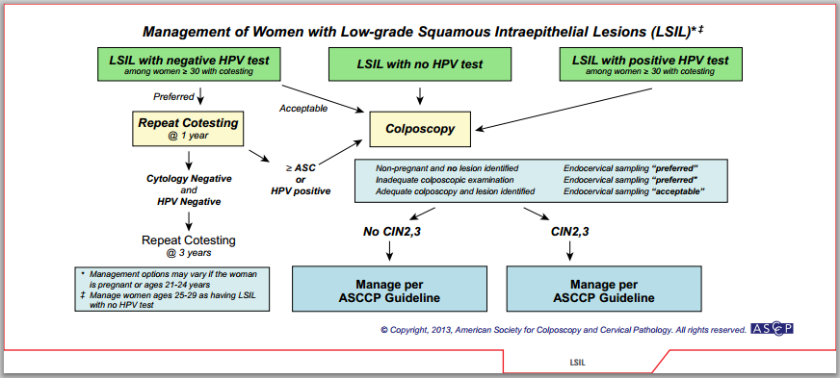

Slide 47
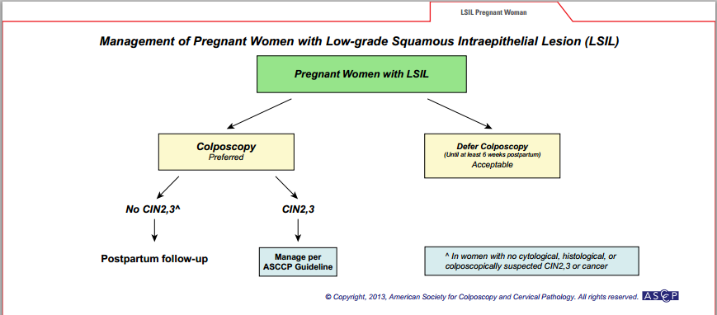

Slide 48
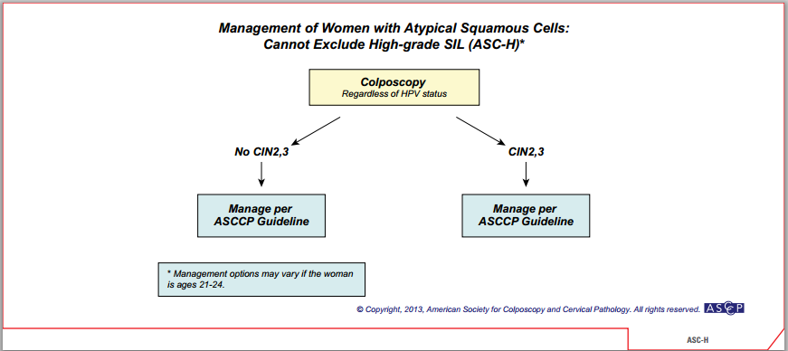

Slide 49
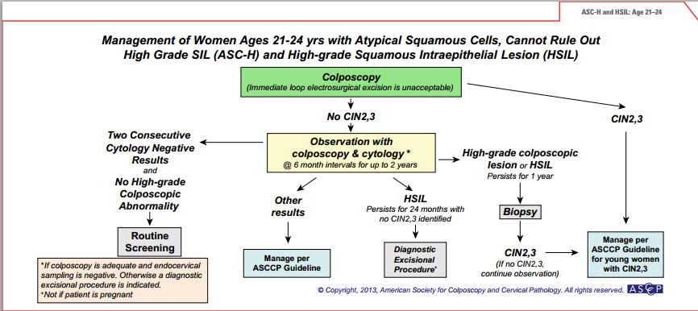

Slide 50
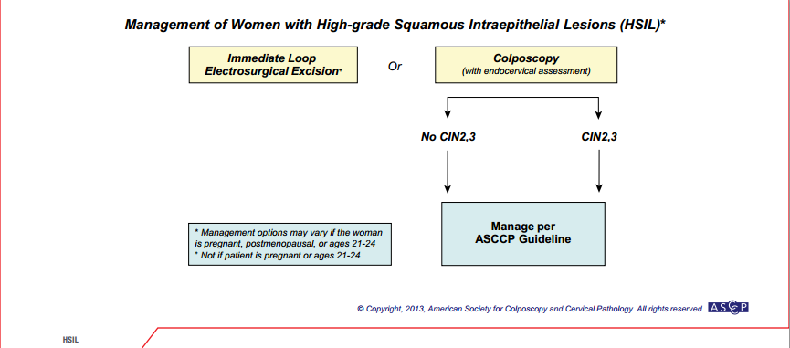

Slide 51
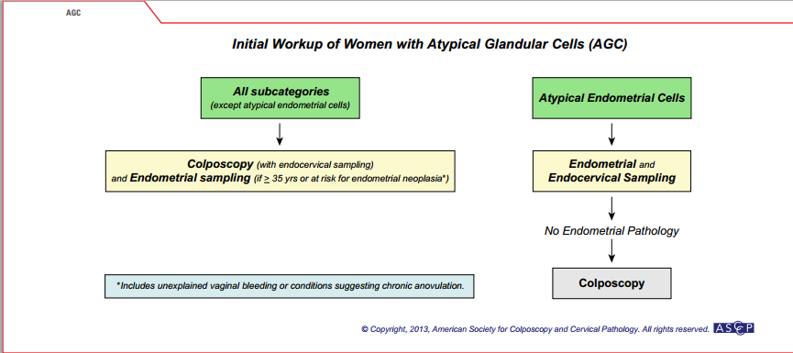

Slide 52
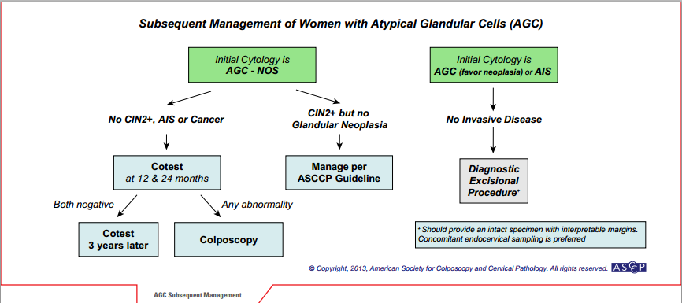

Slide 53
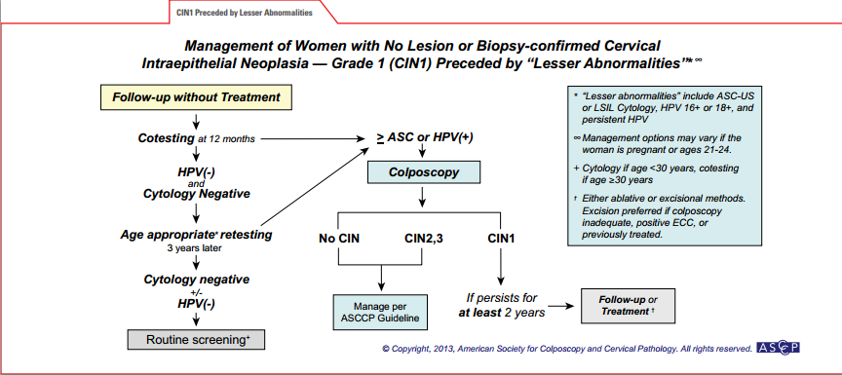

Slide 54
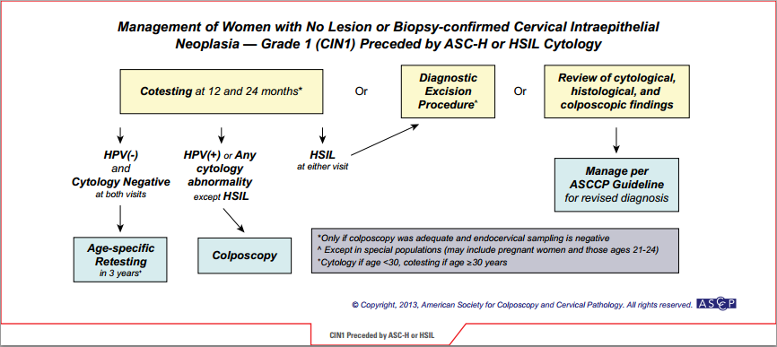

Slide 55
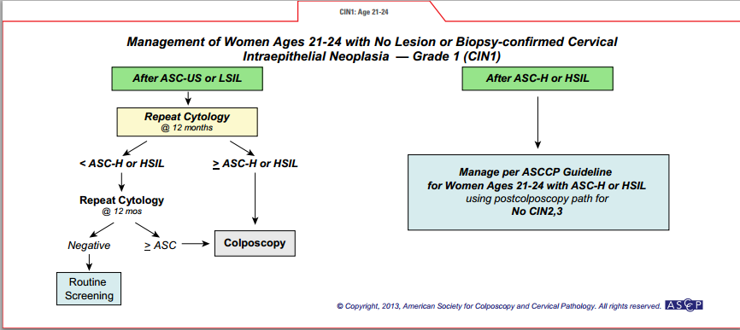

Slide 56
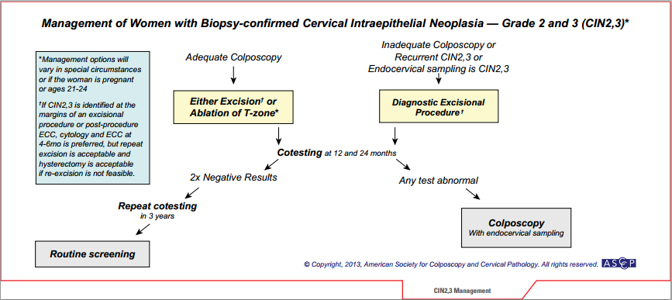

Slide 57
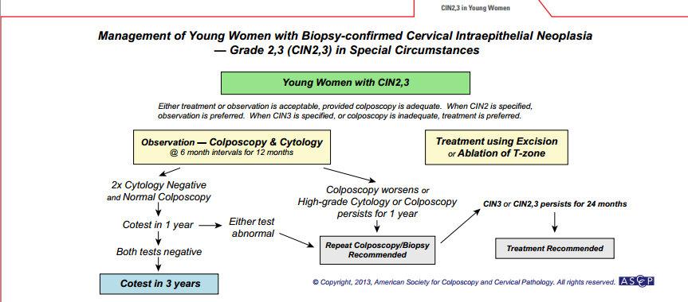

Slide 58
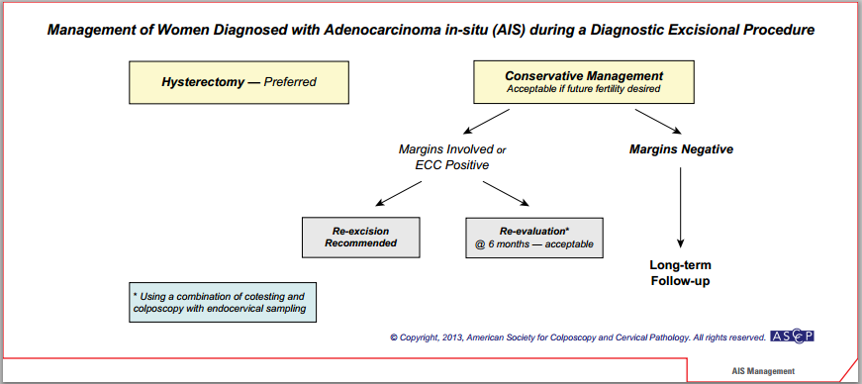

Slide 59
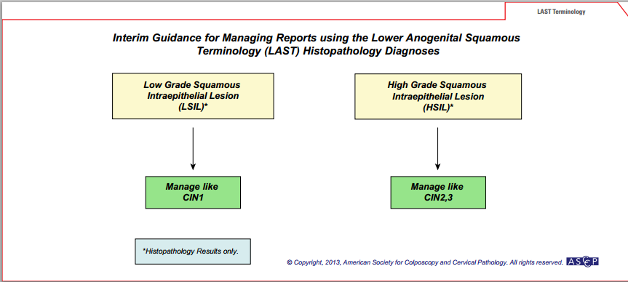

Slide 60
THANK YOU

