Slide 1
Combined Oral
Contraceptives

Slide 2
1st Clinical trials of COC were described by John Charles Rock & Goodwin Pincus with approval of marketing in USA in 1960.
Within 5 years it was used by 30 millions women all over the world.
At the moment , COC is used by over
100 million women worldwide.

Slide 3
Combined Oral Contraceptives ( COC )
Commonly known as the “ Pill “
Widely Accepted & Most Effective Reversible method of Fertility Control.
In 1951, India was the 1st country in world to introduce COC in National programme of Family Planning.

Slide 4
COC : Estrogen + Progestogen
Estrogen :
2 types : - Ethinyl Estradiol ( EE )
- Mestranol ( Not used )

Slide 5
PROGESTOGENS : ( 4 Groups )
1 ) Norethisterone Group : ( 1st generation Pills )
Moderate Androgenic property ….
Norethisterone,
Norethisterone Acetate ,
Ethiynoidal diacetate ,
Lynestrenol
2 ) Norgestrel : ( 2nd generation pills )
Strong Progestogenic & Androgenic property….

Slide 6
3 ) 19 – nor testosterone derivatives :
( 3rd generation pills )
Anti ovulatory function by suppressing Gonadotropin…
Desogestrel,
Gestodene,
Norgestimate.
4 ) Spironolactone analogue :
Antiandrogenic & Anti mineralocorticoid …
Drosperinone ( DRSP )

Slide 7
Types of COC

Slide 8
1) Monophasic
Contains Estrogen & Progesterone in same amount in Each pill .
Divided in 2 subgroups :
- Low dose pills : EE 30 – 35 microgm
- Very low dose pills : EE 15 – 25 microgm.
Mala - N
dl – NGL 0.15 mg
EE 0.03 mg
Mala - D
l – NGL 0.15 mg
EE 0.03 mg

Slide 9
2 ) Multiphasic
Contains low or variable amounts of E and P in 2 ( biphasic ) or 3 ( triphasic ) phases of cycles.
Biphasic : constant E E – 35 micro gram
progestogens : low in first 10 days
higher in next 11 days .
NOT POPULAR – MORE FAILURE RATE .
NOT AVAILABLE IN INDIA.

Slide 10
Triphasic :
Triquilar –
- 0.03 EE +0.5mg l-norgestrel (1 - 6)
- 0.03 EE +0.75mg l-norgestrel (7-11)
- 0.03 EE +0.125mg l-norgestrel (12 - 21)
Total monthly intake – 0.68mg EE +1.92mg progesterone
Adv. - high efficacy rates
- few side effects
- less break through bleeding
- does not affect s.cholesterol & LIPIDS
Disadv. – high pregnancy rates if errors in pill intake .

Slide 11
Mechanism of action:
1 ) Inhibition of Ovulation :
both hormones act on Hypothalamo pituitary axis , suppress release of FSH & LH from Ant. Pituitary.
E – inhibits FSH.
P – inhibits preovulatory LH Surge , less effect on FSH.

Slide 12
2 ) Endometrial Hyperplasia :
stromal oedema , decidual reaction & regression of glands making endometrium nonreceptive to embryo.
3 ) Cervical mucus :
- thick , viscid , scanty .
- impaired sperm transport & penetration.
4 ) May affect tubal motility & alter tubal transport.

Slide 13
Selection of the patient
Detail history ( headache , migraine , etc…)
Thorough general examination
( Breast , blood pressure… )
Pelvic examination to exclude cervical pathology.
Cervical cytology
Rule out any other contraindications.

Slide 14
Checklist for Prescribing COC…
Last menstrual period, rule out pregnancy
Less than 6 months postpartum & lactating?
Age, Cigarette smoking, h/o migraine
Known case of diabetes or hypertension
History of stroke, MI or thrombosis
h/o jaundice/ liver disease
h/o breast/ genital tract malignancies
h/o drug intake: Antitubercular, antiepileptic

Slide 15
Administration
New User :
- 1st day of Cycle .
- Daily 1 tab. Preferably at night for consecutive 21 days.
- Continued for 21 days and then 7 days break ( with iron tablets) .
- Next pack of Pill should be started on 8th day , IRRESPECTIVE OF BLEEDING ( same day of the week , pill finished ).
- Simple Regimen of “ 3 WEEKS ON & 1 WEEK OFF “
- No break between packs.
Can start pill up to 5 days of bleeding with extra precaution with condom for next 7 days.

Slide 16
Missed Tablets :
1 missed – Take 2 tablets next day .
2 or 3 missed – Take 2 tablets on two consecutive days and
continue the rest of the pack.
+
Another Contraceptive for 1 week.

Slide 17
Lactating Women – Progestogen only pills /
Combined pills after 6 months
Non Lactating Women – Combined oral pills after 3 to 6
weeks or after menstruation
Amenorrhea : At any time after excluding pregnancy + barrier method for 7 days.

Slide 18
Follow up …
Examined after 3 months , then after
6 months and then yearly .
Ask for any symptoms.
Examination for breast , pelvis, BP & weight & cervical cytology.

Slide 19
Effectiveness…
Failure rate : 0.1% Failure rate are mainly due to missed pills.

Slide 20
How long can be continued …???
In properly selected patient without any risk factor , benefits are more , and so can be continued up to age of 50 with careful monitoring. Offers dual advantage of Contraception and HRT.
For spacing of birth : 3 – 5 years.

Slide 21
Advantages
Prevention of pregnancy India - MMR 1per 57 i.e. 400 in 1,00,000 2/5th of these deaths can be prevented by use of OCs
Cyclical Stabilisation - Great social advantage. Withdrawal bleeding is predictable & postponed safely by taking more low dose pills contineously .

Slide 22
Cure of Menstrual Disorders
Dysmenorrhoea & Ovulation pain By inhibiting ovulation & production of PG.
b) Menorrhagia & Metrorrhagia - Norgestrel High dose oral pills more
useful.
Protection against Cancer
a) Endometrial cancer- Reduction by 50 %
effect persists for 15 yrs.
b) Ovarian Cancer – Reduction by 40 %
effect persists for 10 yrs.
c) Choriocarcinoma – Indirect prevention by preventing pregnancy.

Slide 23
Protection against benign tumors
1) Fibrocystic and Fibroadenomatous disease
2) Ovarion Functional Cysts
1) Follicular Cyst – 50 %
2) Corpus Luteum Cyst – 80 %
3) Fibroid Uterus - Reduction by 30%
Low Dose OC’s reduce fibroid ( WHO 1996)

Slide 24
Protection against diseases
1) Ectopic Pregnancy
2) PID
3) Anaemia and Malnutrition
4) Endometriosis
5) Acne and Hirsutism
6) DUB
7) Osteoporosis
Simplicity and Attractiveness
No Affection on Future fertility ( 3 months )

Slide 25
Emergency Contraception…
1) Yuzpe regimen –
0.1mg EE + 1 mg dl-Norgestrel
1st dose Within 72 Hrs of Contact
Repeated after 12 Hrs.
2) Ovral
1st dose 2 tablets within 72 hrs.
2nd dose 2 tablets after 12 hrs.
3) Overal – L
1ST dose 4 tablets within 72 hrs.
2nd dose 4 tablets after 12 hrs.

Slide 26
Emergency Contraception…
Plan B : Single dose of 1.5mg of LNG taken 72 hours of intercourse,defined by WHO as the best regimen(Effective even upto 5 days after inter course)

Slide 27
Minor Side Effects…
Nausea, Vomiting and Lack of appetite
Break through bleeding
Menorrhagia and irregular bleeding
Oligomenorrhoea and Amenorrhoea
Breast changes – Heaviness and Tenderness
Vaginal Discharge – Cx erosion, dysplasia causes leucorrhoea
Headache and Migraine
Wt. Gain
Psychosexual Trouble – Depression, Loss of Libido
Others - Leg Cramps, Dimness of Vision

Slide 28
Major Side Effects…
Cardiovascular Diseases
1) MI – Increased Risk in heavy smokers
2) Ischaemic Stroke - 1.5 times more
3) Haemorrhagic Stroke – double risk
4) Venous Thromboembolism – Risk increases with age, recent surgery and thrombophilia
Hypertension - In women more than 35 Yrs.
Carcinogenecity
1) Breast Cancer
2) Cervical Cancer

Slide 29
Absolute Contraindications…
(WHO Category IV)
Migraine, with focal Neurological Symptoms
Pregnancy and breast feeding ( 6 Months)
Severe Hypertension
Complicated valvular heart disease
D.M. with vascular complications
Active hepatitis, liver tumors
Major Surgery
Prolonged Immobilization .

Slide 30
Indications of Withdrawal :
Severe migraine
Visual or speech disturbances
Sudden chest pain
Unexplained fainting attack or acute vertigo
Severe leg cramps
Excessive weight gain
Severe depression
Prior to surgery ( Atleast 6 weeks )
Patient wants pregnancy

Slide 31
PROGESTERONE
ONLY
PILL (POP)
(OR)
MINIPILLS

Slide 32
POP/MINI PILLS
Natural progesterone- destroyed by digestive system when consumed orally
ALL oral contraceptives contains
progestin, synthetic form of
progesterone

Slide 33
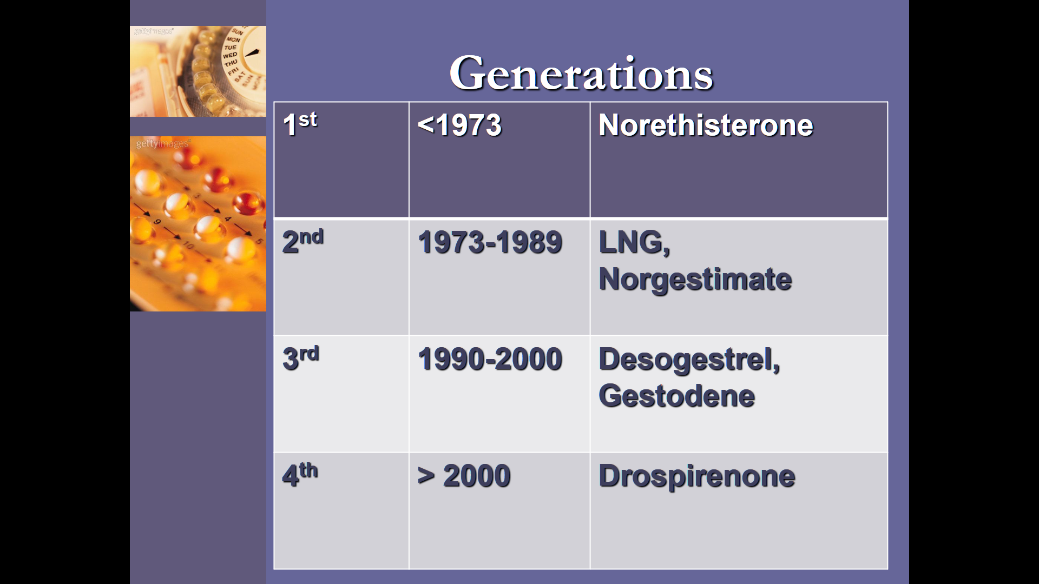

Slide 34
Composition
The low-dose POP (norethisterone 350 mcg, norgestrel 75 mcg or LNG 30 mcg) have been introduced to avoid the side effects of oestrogen in the combined pills.
The tablet is taken daily without a break.

Slide 35
The pill should be started within 5–7 days of the menstruation and taken at the same time within 3 hours on either side of the fixed time each day
If this regime is not observed any day, the woman continues with POP but observes extra precaution for 48 hours.

Slide 36
Cerazette
Cerazette contains 75 mcg desogestrel

Slide 37
MODE OF ACTION
Cerazette suppresses ovulation in 97–100%, whereas other progesterone only pills suppress ovulation in only 40%.
It forms a thick plug of mucus in the cervical canal and acts as a barrier to sperms.
It increases tubal peristalsis and fertilized egg reaches the uterine cavity too early for implantation

Slide 38
advantages over other POPs
Stringent time compliance not necessary, as it suppresses ovulation in 97%, through pituitary hormone suppression.
No androgenic effects like acne.
No ectopic pregnancy, no effect on carbohydrate or lipid metabolism.
Failure rate only 0.21 per 100 woman years. It acts through metabolite etonogestrel which binds to progesterone receptors

Slide 39
COMPLICATIONS
Deep venous thrombosis
Pulmonary embolism
Breast cancer
Liver disease

Slide 40
LACTATING WOMEN
No major side effects and it is well suited for lactating women; some progestogens, in fact, increase milk secretion.

Slide 41
SIDE EFFECTS OF POP PILLS
weight gain
irregular menstrual bleeding
depression
breast cancer
thromboembolism

