Slide 1
CONDUCT OF NORMAL LABOUR

Slide 2
LABOUR
Series of events that takes place in the genital organs in an effort to expel the viable products of conception(fetus,placenta,and the membranes) out of the womb through the vagina into the outer world is called labour
Is characterized by the presence of regular uterine contractions with effacement and dilatation of cervix and fetal descent

Slide 3
CRITERIA FOR LABOUR
Spontaneous in onset and at term
Vertex presentation
Without undue prolongation
Natural termination with minimal aids
Without any complication affecting the health of the mother or the fetus

Slide 4
CONDUCT OF NORMAL LABOUR
Labor events have got great psychological, emotional,and social impact to the women and her family
Management of normal labor aims at maximal observation with minimal active intervention

Slide 5
PREREQUIST
Aseptic precaution to be taken during vaginal examination and during conduct of labor
Parts prepared,vulva&perineum is washed liberally with soap and water and then with 10%dettol solution
Women should take a shower, wear laundered gown &stay mobile
Through out labor she is given continued encouragement and emotional support.

Slide 6
VAGINAL EXAMINATION IN LABOUR
First vaginal examination should be done by a senior doctor to be more reliable and informative
Done with the patient lying in supine position
Gloved middle and index finger of right hand smeared liberally with antiseptic cream like cetavlon are introduced into the vagina after separating the labia by the two fingers of left hand
Complete examination is done before fingers are withdrawn
p/v examination should be restricted to a minimum

Slide 7
PROGRESS OF LABOUR
Judged periodically by noting the dilatation of cervix and descent of the head in relation to the spine
when rupture of membranes occur, exclude cord prolapse especially when the head is not engaged
When there is full dilatation of cervix,occurs with bearing down efforts the beginning of second stage of labor starts

Slide 8
MANAGEMENT OF FIRST STAGE
GENERAL
Bowel enema with soap and water
REST AND AMBULATION
Pt need not be confined to bed..while in bed avoid dorsal supine position to avoid aortocaval compression
If membranes are intact allow ambulation it prevent aortocaval compression and encourages descent of head
Sothat it reduces the duration of labor,need of analgesia and improve maternal comfort
But if the labor is monitored electronically or if under epidural analgesia,pt should be in bed

Slide 9
DIET
Clear fluids
BLADDER CARE
Encourage to pass urine by herself
If in last trimester catheterization can be done with strict aseptic precautions

Slide 10
RELIEF OF PAIN
Commonly used is pethidine 50-100mg in active phase of labor. can be repeated after 4 hrs
Pethidine crosses the placenta so should not be given if delivery is anticipated within 2 hrs

Slide 11
ASSESSMENT OF PROGRESS OF LABOUR
PARTOGRAM
PR-Recorded every 30 min
BP-Recorded every 1hr-arrow
TEMP-Recorded every 2 hrs
U/O-volume,protein,acetone
Any drug given is recorded in partograph

Slide 12
PARTOGRAM
ABDOMINAL PALPATION
Uterine contraction-regarding the frequency, intensity and duration is assessed
Number of contraction in 10 minutes and duration of each contraction in seconds are recorded in partograph
<20sec mild
20-40sec moderate
>40sec strong

Slide 13
PARTOGRAM
PELVIC GRIP
There is gradual disappearance of poles of head(sinciput and occiput)
Abdominal palpation-for descent of fetal head in term of fifths felt above the brim is used
FHR location is shifted downward and medially

Slide 14
PARTOGRAM
ASSESS THE FETAL WELL BEING
FHR- Rhythm and intensity is noted
every 1/2 hr in 1st stage
every 15minutes in 2nd stage
FHR should be monitor in between the contractions for one full minute
In case of obesity and polyhydraminios- doppler ultra sonic cardiography&uterine contraction by tocography

Slide 15
VAGINAL EXAMINATION
Dilatation of cervix in centimeters
Note the position of head and degree of flexion
Note the station of head in relation to the ischial spines
Membranes are ruptured or intact(if ruptured see the color of the liquor )
Degree of moulding of head
Caput formation

Slide 16
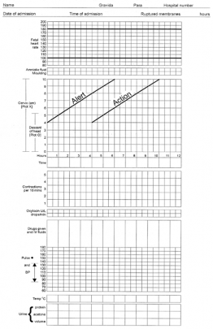

Slide 17
EVIDENCE OF FETAL DISTRESS
METHODS OF FETAL MONITORING
Clinical method
FHR<110/MIN and >160/min-is fetal distress
Biophysical profile
Biochemical method

Slide 18
MANAGEMENT OF SECOND STAGE
Transition from first to second stage is evidenced by the following features
Increased intensity of uterine contractions
Bearing down efforts
Urge to push/defaecate with the descent of the presenting part
Complete dilatation of cervix on p/v examination

Slide 19
2 STAGE OF LABOUR
AIM
To assist in natural expulsion of fetus slowly and steadily
To prevent perineal injuries
GENERAL MEASURES
Pt should be in bed
FHR-is recorded at every 5 min
Inhalation analgesia in the form of N2O+O2
P/V done at the beginning

Slide 20
2 STAGE OF LABOUR
PREPARING FOR DELIVERY
Dorsal position with 15 degree left lateral tilt is preferred to avoid aortocaval compression to facilitate pushing effort
3C should be remembered
clean hands
clean surface
clean cutting and ligation of cord
If bladder is full-cathetrise

Slide 21
2 STAGE OF LABOUR
Next comes the
Delivery of head
Delivery of shoulder
Delivery of trunk

Slide 22
DELIVERY OF HEAD
Pt is encouraged for bearing down efforts during uterine contraction
It facilitates the descent of head
When the scalp is visible for about5cm in diameter,flexion of the head is maintained during contraction
At this stage,the max diameter of the head(biparietal diameter)streches the vulval outlet without any recession of head even after the contraction is over is called crowing of the head

Slide 23
DELIVERY OF HEAD
When perineum is fully stretched -it threatens to tear
Episiotomy is done-after infiltration with 10ml of 1%lignocaine
Episiotomy should be done selectively and not as a routine

Slide 24
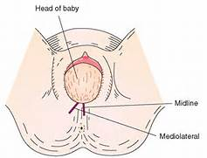
EPISIOTOMY

Slide 25
DELIVERY OF HEAD
Delivery of the head is allowed with proper perineal support
Neck is then palpated to exclude the presence of any loop of cord
If loose enough, it is slipped over head or over the shoulders as the baby is being born
If cord is tight-cut in between 2 kochers forceps placed 1 inch apart

Slide 26
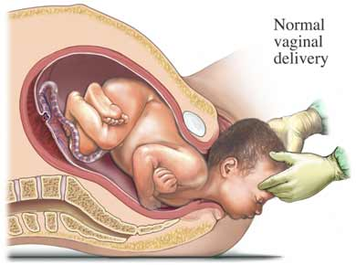
DELIVERY OF HEAD

Slide 27
  PREVENTION OF PERINEAL LACERATION
Spontaneous forcible delivery of head to be avoided-ask the pt not to bear down during contractions
Deliver the head in between contractions
To perform timely episiotomy
To take care during delivery of the shoulders

Slide 28
DELIVERY OF THE SHOULDERS
  Wait for the uterine contraction to come and for movements of restitution and external rotation of head to occur
  With gentle traction on the head, delivery of the shoulders and trunk is performed.
  After delivery of anterior shoulder inj.oxytocin 10units IM to be given

Slide 29
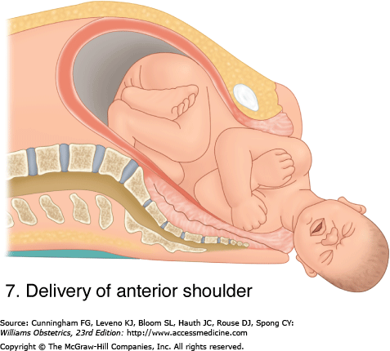
DELIVERY OF ANTERIOR SHOULDER

Slide 30
IMMEDIATE CARE OF THE NEWBORN
Baby is placed on a tray covered with clean dry linen
Tray is kept in-between the legs of the mother at a lower level than the uterus to facilitate gravitation of blood from placenta to infant
Air passage should be cleared
Apgar rating at 1 and 5 min is recorded

Slide 31
IMMEDIATE CARE OF THE NEWBORN
CLAMPING AND LIGATURE OF CORD
Cord is clamped by two kochers forceps proximal are being placed 2.5cm away from the navel
Cord is divided with scissor to prevent cord sepsis
Abnormality in the cord to be noted(single umbilical artery)

Slide 32
CORD
DELAYED CLAMPING
For 2-3 min or till cessation of cord pulsation facilitates the transfer of 80-100ml of blood from placenta to baby
EARLY CLAMPING
Is done in Rh incompatibility
Baby born to diabetic mother
Baby is wrapped in a dry warm towel and identification tape is tied both on the wrist of baby and mother

Slide 33
MANAGEMENT OF 3 STAGE
IS THE MOST CRUCIAL STAGE
Includes the delivery of placenta
Steps of management
Expectant management
Active management

Slide 34
THIRD STAGE
Expectant management
The placenta separation and its descent into the vagina are allowed to occur spontaneously
Placenta is separated within minutes following the birth of the baby
Watchful expectancy extended upto 15-20 min
As soon as the placenta passes through the introitus,it is grasped by hands and twisted round and round with gentle traction so that the membranes are stripped intact

Slide 35
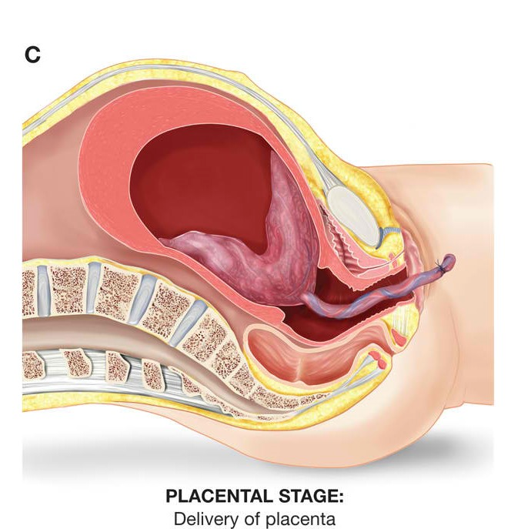
DELIVERY OF PLACENTA

Slide 36
ASSISTED EXPULSION
CONTROLLED CORD TRACTION(MODIFIED BRANDT-ANDREWS METHOD)
Palmar surface of left hand placed at the junction of upper and lower segment.body is pushed upwards and backwards,towards the umbilicus and with right hand steady traction is given
Procedure is done only when the uterus is hard and contracted

Slide 37
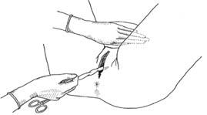
CONTROLLED CORD TRACTION

Slide 38
DELIVERY OF PLACENTA
FUNDUS PRESSURE
Fundus is pushed downward and backward after placing forefingers behind the fundus and thumb infront and pressure is given only when the uterus becomes hard
If the baby is premature this method is preferable as tensile strength of cord is much reduced

Slide 39
EXAMINATION OF PLACENTAL CORD AND MEMBRANES
Maternal surface is inspected for its completeness and anomalies
Vulva,vagina and perineum is inspected for injuries and to be repaired
The episiotomy wound is now sutured

Slide 40
ACTIVE MANAGEMENT OF 3 STAGE OF LABOUR
INJ.Oxytocin 10 units im/methergin 0.2mg I.M given 1min of delivery of baby
Controlled cord traction of placenta
Uterine massage
ONLY DISADVANTAGE
Increased incidence of manual removal of placenta

Slide 41
ACTIVE MANAGEMENT OF 3 STAGE OF LABOUR
To prevent PPH must be followed in patients
With anaemia
Grand multipara
Polyhydraminos
Twins
Previous history of PPH

Slide 42
FOURTH STAGE OF LABOUR
PR,BP,Tone of uterus and any abnormal vaginal bleeding are to be watched for 1 hr after delivery
when vitals are stable,uterus is well contracted,and no abnormal vaginal bleeding the patient is shifted to ward

Slide 43
THANK YOU

Slide 44
