Slide 1
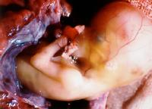
Ectopic pregnancy

Slide 2
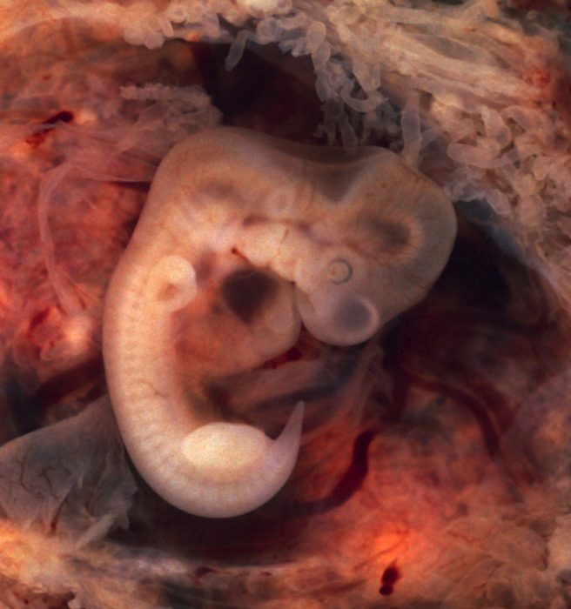
Defnition:
Implantation & development of a fertilized ovum outside the normal endometrial cavity
Leading cause of maternal morbidity & mortality.

Slide 3
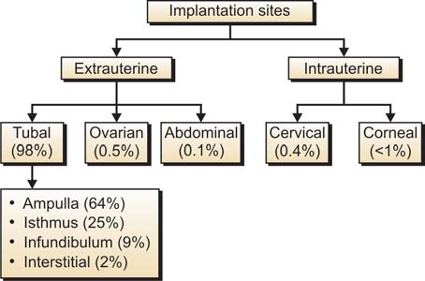
Sites of implantation

Slide 4
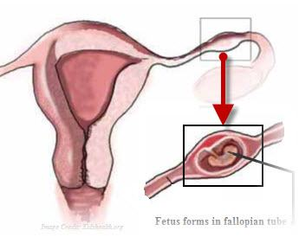
Tubal ectopic pregnancy
Incidence- 1 in 150-300.

Slide 5
Etiology
Congenital:
Tubal hypoplasia,
Tortuosity,
Congenital diverticuli,
Accessory ostia,
Partial stenosis

Slide 6
Etiology
Pelvic inflammatory disease
Assisted reproductive technology
Use of an IUCD, OCP(POP)
Tubal endometriosis
H/o prior ectopic pregnancy
H/o tubal reconstructive surgery
H/o tubal ligation
H/o previous induced/ septic abortion

Slide 7
Pathophysiology
Normal transport of the ovum to the uterine cavity takes about 3-4 days. The fertilized ovum normally gets implanted on the 6th to 7th day.
Factors that contribute to the transport are tubal contractility, ovarian harmones and the cilial action.
Abnormality in the tubal action or the tube causes ectopic gestation.

Slide 8
The changes that occur in the tube are:
Implantation of ovum in intercolumnar and intramuscular fashion
Minimal decidual reaction
Formation of pseudo capsularis
Erosion of blood vessels by chorionic villi
Distension and thinning of tubal wall.

Slide 9
Changes that occur in the uterus are:
The uterus undergoes early pregnancy changes. The isthmus and the cervix softens, the endometrium decidualizes. The endometrial glands show marked secretory and proliferative activity.

Slide 10
Fate of tubal preganacy:
Tubal abortion
Tubal rupture
Tubal perforation
Continuation of pregnancy

Slide 11
Clinical Features
SYMPTOMS
Ectopic pregnancy remains almost asymptomatic until it ruptures.
Classical triad:
Amenorrhoea – 6-8wks
Abdominal pain – lower abdomen, acute, colicky. Shoulder tip pain (25%)
Vaginal bleeding – slight/ continuous
Syncopal attack, vomiting

Slide 12
Clinical Features
SIGNS
GPE:
Blanched look
Pallor
Features of shock

Slide 13
P/A:
Tense
Tender
Uterus is usually not palpable
Shifting dullness +
P/V:
Vaginal mucosa - blanched white
Uterus – normal size/ slightly bulky, uterus floats as if in water.
Cervical motion tenderness +
Forniceal tenderness +

Slide 14
Unruptured Ectopic:
Symptoms:
Usual presentation is with delayed periods and uneasiness in the flanks.
Signs:
P/A: uterus will be smaller than the period of amenorrhoea
P/V: pulsatile, small, well circumscribed tender mass in one fornix separate from the uterus is felt

Slide 15
Chronic Ectopic
Symptoms:
Multiple attacks of self limiting abdominal pain with features of bladder irritation.
Signs:
GPE: pallor, high resting pulse, elevated temperature.
P/A: irregular tender mass with Cullen’s sign
P/V: reveals ill defined boggy tender mass in postero- lateral fornix and tenderness on movement of cervix

Slide 16
Differential diagnosis
Appendicitis
Salpingitis
Ruptured corpus luteum cyst, Chocolate cyst of ovary
Spontaneous abortion or threatened abortion
Ovarian torsion

Slide 17
Diagnosis
Investigations for diagnosing tubal ectopic:
Serial measurements of B-Hcg
Sr. Progesterone <5ng/ml
Ultrasonography – TVS
Uterine curettage
Culdocentesis
Laparoscopy
Laparotomy

Slide 18
TVS:
Absence of intrauterine pregnancy with a +UPT
Demonstration of the gestational sac with or without an alive embryo outside the uterus.
Adnexal mass easily seperated from the ovary
Fluid (echogenic) in the POD
Color Doppler: identify the placental shape – ring-of-fire pattern, enhanced blood flow pattern outside the uterine cavity.

Slide 19
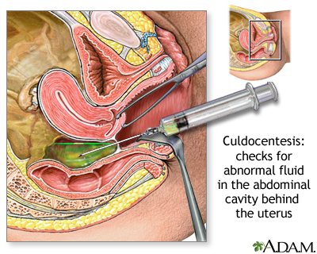
Uterine curettage:
Identification of decidua without chorionic villi.
Culdocentesis:
Using 18G lumbar puncture needle, with a fittes syringe, post.fornix is punctured to gain the access to POD. Aspiration of blood (non clotting) signifies ruptured ectopic pregnancy

Slide 20
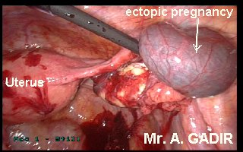
Treatment
Ruptured tubal ectopic
Resuscitation (anti-shock treatment)
Laparotomy:
Indications:
Hemodynamically unstable,
E/o rupture
salpingectomy

Slide 21
Unruptured tubal ectopic
Expectant
Conservative
Medical
Surgical

Slide 22
Expectant management:
Only observation is done hoping spontaneous resolution.
Indications:
Sr.β.hCG <1000IU/L & subsequent levels are falling
Gestational sac <4cm
No Fetal cardiac activity on TVS
No e/o bleeding or rupture in TVS

Slide 23
Conservative medical:
Advantages:
Reduction in operative morbidity
Reduction in hospital stay
Less risk of recurrence
Improved chance of subsequent intrauterine pregnancy

Slide 24
Pt must be hemodynamically stable
Sr.β.hCG <3000IU/L
Tubal diameter <4cm
No Fetal cardiac activity
No e/o intra abdominal hemorrhage
Drugs commonly used are: Methotrexate, KCL, prostaglandins (PGF2α), actinomycin, hyperosmolar glucose

Slide 25
Direct local- Methotrexate, KCl, PGF2α, hyper osmolar glucose can given directly into the tubal gestation with the help of laparoscope or ultrasound guidance.

Slide 26
Methotrexate(MTX) single dose:
50mg/m2 im
Monitor β.hCG on D4 &D7
When the decline >15% pt is followed up weekly until hCG<10mIU/ml
If decline is <15% - MTX 2nd dose is given on D7

Slide 27
MTX variable dose:
MTX-1mg/kg im on D1,3,5,7
Leucovorin-0.1mg/kg im on D2,4,6,8
Monitor β.hCG weekly until <5mIU/ml

Slide 28
Conservative surgery:
Linear salpingostomy
Linear salpingotomy
Segmental resection
Fimbrial expression (fimbrial pregnancy)
Salpingectomy

Slide 29
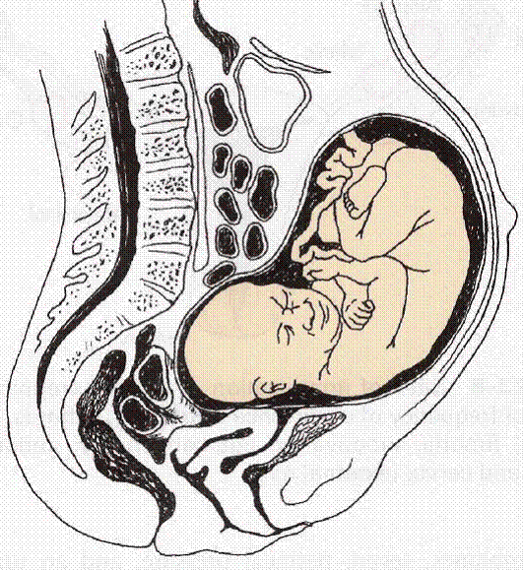

Slide 30
Abdominal pregnancy
Primary: primary implantation of the fertilised ovum on the pritoneum
So rare, that its existance is questionable.
Secondary: always secondary, primary sites being the tube, ovary, uterus

Slide 31
Studdiford criteria for primary abdominal pregnancy:
Both tubes & ovaries are normal without e/o recent injury
Absence of uteroperitoneal fistula
Presence of pregnancy related exclusively to the peritoneal surface & young enough to eliminate the possibility of secondary implantation following primary nidation in the tube.

Slide 32
Ovarian pregnancy
Spiegelberg’s criteria:
Fallopian tube must be intact on the affected side.
Gestational sac must occupy the ovary in depth. Not just superficially adherent.
GS should be attached to the uterus by ovarian ligament & to the pelvic wall by infundibulopelvic ligament.
On HPE:
Ovarian tissue must be recognisable on the GS
Chorionic tisue should be identifiable in the ovarian mass

Slide 33
Cervical pregnancy
Rubins criteria:
Enlarged cervix- equal to/larger than fundus
Products of conception confined to endocervix
Closed internal os
Partially opened external os
Uterine bleeding following amenorrhoea without cramping pain

Slide 34
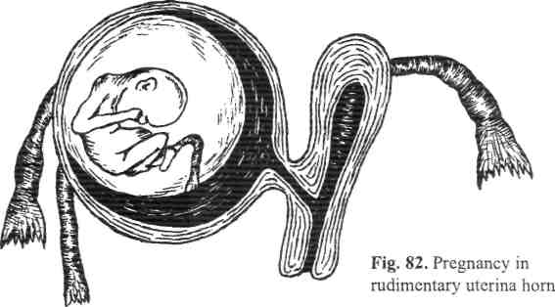
Cornual pregnancy
Pregnancy occuring in the rudimentary horn of the bicornuate uterus.

Slide 35
Heterotopic pregnancy
Intrauterine pregnancy coexistent with tubal/ cervical/ovarian pregnancy
Incidence-1 in 8000 pregnancies

Slide 36
Future Fertility following EP
Subsequent conception rate is ~ 60%
Incidence of recurrent EP is 15%
Other factors influencing include:
Age, parity, history of infertility, evidence of contralateral tubal disease, ruptured EP, IUCD use, salpingitis
No difference b/t laparoscopy vs laparotomy

Slide 37


