Slide 1

Development of female genital tract

Slide 2
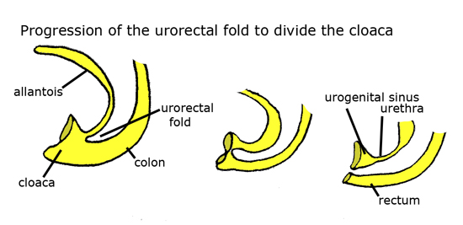
Development of External Genitalia
Site of origin: UROGENITAL SINUS
A longitudinal septum called Urorectal septum appears in the urogenital sinus

Slide 3
The urorectal septum contains a pair of paramesonephric ducts and a pair of mesonephric ducts.
The caudal end of the urogenital sinus is covered by cloacal membrane.
The urorectal septum grows caudally and meets the cloacal membrane.

Slide 4
The point where the urorectal septum meets the cloacal membrane develops into perineal body.
The part of the cloacal membrane in front of the perineal body is called urogenital membrane
The part behind is called anal membrane

Slide 5
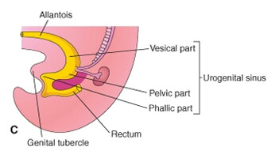
The dorsal part of endodermal cloaca differentiates into rectum and anal canal.
Ventral portion called urogenital sinus differentiates into 3parts:
Upper vesicourethral part
Middle pelvic part of urogenital sinus
The lower phallic part of urogenital sinus

Slide 6
Upper vesicourethral part:
Forms the mucous membrane of the bladder except the trigonal area.
Contributes the major part of female urethra.
Middle pelvic part of urogenital sinus:
Receives the united caudal end of the 2paramesonephric ducts in the midline. Derivatives of this part differentiates into epithelium of vagina, bartholins gland and hymen
The lower phallic part of urogenital sinus:
Contributes to vestibule of vagina

Slide 7
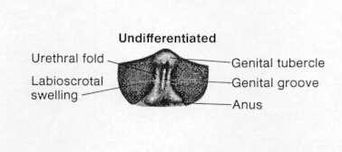
The genital tubercule forms a prominence at the tip of the cloacal membrane.
On either side of the ant.part of the cloacal membrane, a pair of genital folds appear and lateral to this, a pair of genital swellings appear.

Slide 8
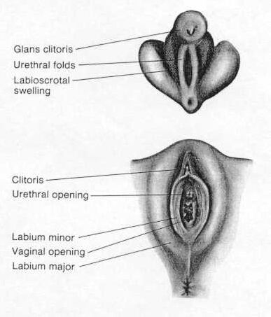
In the absence of androgens
Genital tubercle - clitoris
Genital folds – Labia minora
Genital swellings-Labia majora
The cloacal membrane breaks down to form anal and vaginal openings
Urethral groove develops anteriorly and later forms the urethra
Bartholin glands- outgrowth from the caudal part of urogenital sinus

Slide 9
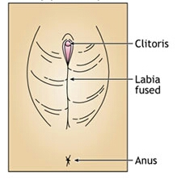
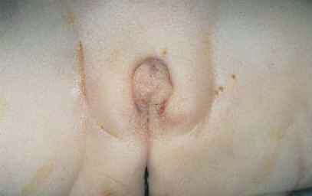
Anomalies of external genitalia
Clitoris: absent/ bifid/ enlarged/ may be double.
Labia minora: fusion
Labia majora: fusion/ hypoplastic/ hyperplastic

Slide 10
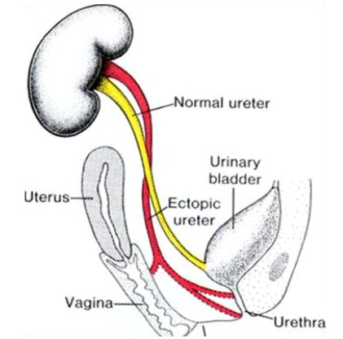
Urethra may open on the ant.wall of the vagina
Ectopic ureter : additional ureteric opening in the vestibule, close to the urethra or in the vagina

Slide 11
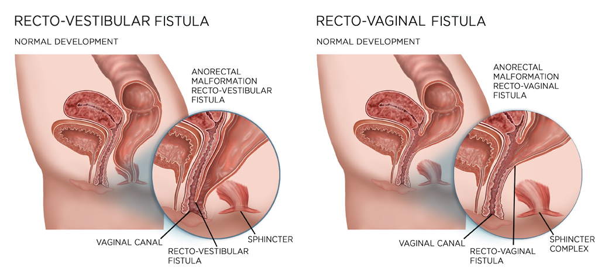
Vestibular anus: anal opening situated either close to the post. End of vestibule or in the vestibule.
Congenital rectovaginal fistula: anal opening situated in the vagina

Slide 12
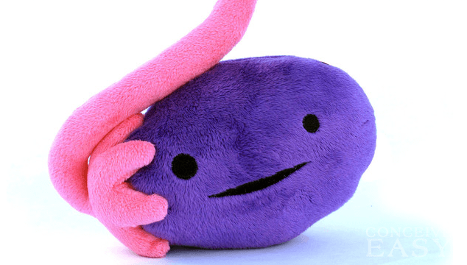
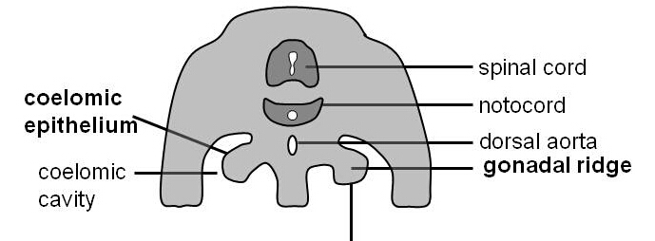
Development of Ovary
Ovary is formed on either side from the GONADAL RIDGE which is formed in a 5th WEEK EMBRYO.

Slide 13
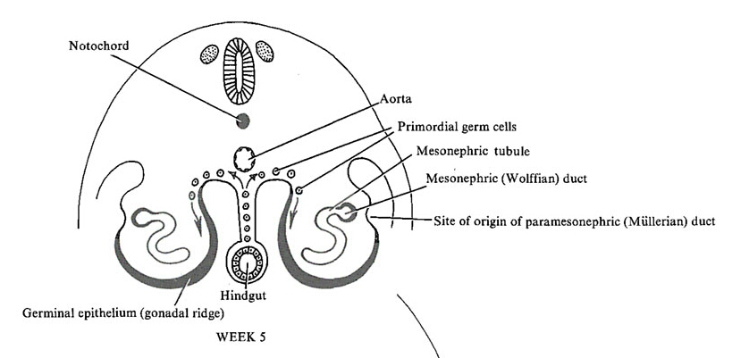
The coelomic epithelium on the medial side of the mesonephric ducts becomes thickened to form the gonadal ridges along with the condensation of the underlying mesenchyme

Slide 14
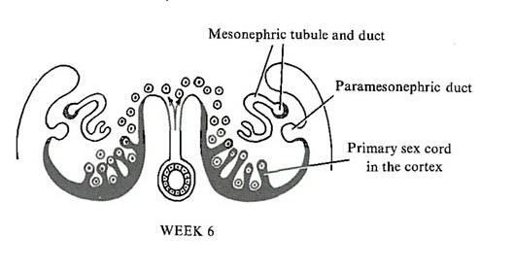
Sex cords or medullary cords proliferate from the germinate epithelium into the underlying mesoderm
The primordial germ cells (endodermal in origin) are formed in the yolk sac and migrate along the mesentry of hindgut into the gonadal ridges by 6th week.

Slide 15
The germ cells undergo a number of rapid mitotic divisions and differentiate into oogonia.
The oogonia reaches its maximum at 20th wk numbering about 7 million.
The mitotic division gradually ceases and majority enters the prophase of 1st meiotic division and are called PRIMARY OOCYTES.

Slide 16
The cells of the coelomic epithelium differentiate into pregranulosa cells.
The oocytes are surrounded by ring of pregranulosa cells and later by the granulosa cells to form primordial follicles by 20th wks of gestation.
They arrange themselves in the ovarian cortex, while the ovarian medulla consists of connective tissue.
At birth there is no more mitotic division and all the oogonia are replaced by primary oocytes. The estimated number at birth is about 2 million.

Slide 17
Descent of ovary
The ovary descends from the lumbar region to the true pelvis/pelvic brim during the seventh to ninth months
A gubernaculum forms and extends from the ovary to the labium majus. It gets attached to the developing uterus at its junction with the uterine tubes.

Slide 18
The gubernaculum that persists between the ovary and the uterus becomes the ovarian ligament.
The part between the uterus and labium majus becomes the round ligament of uterus.

Slide 19
Anomalies of Ovary
The ovary may be absent on one or both the sides.
Streak gonads/ gonadal dysgenesis
Ovaries may be duplicated.
Accessory ovary- division of ovary into 2
Supernumerary ovaries- ovaries may be found in the broadligament or elsewhwere

Slide 20
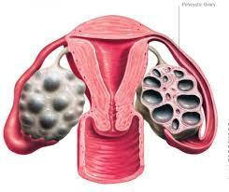
Ovarian cysts: developmental arrest of ovarian follicles
Stein Leventhal Syndrome: multiple small theca lutein cysts involve both the ovaries, mild hirsutism, deep voice, secondary amenorrhoea.

Slide 21
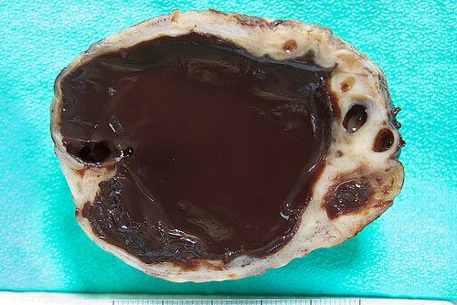
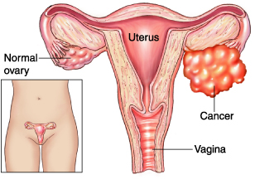
The ovary may descend into the inguinal canal or even into the labium majus.
Prolapse of ovaries
Chocolate cysts:
endometrial cysts in the ovary
Carcinoma of ovary

Slide 22
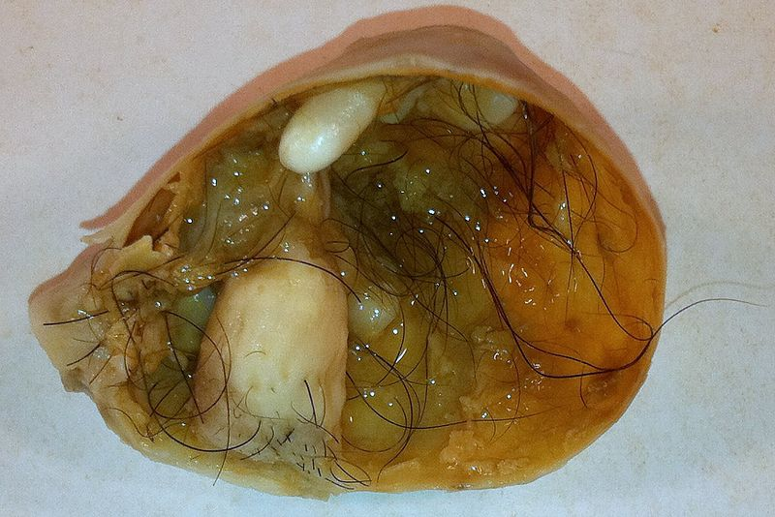
Adrenal or thyroid tissue may be present in the ovary. The ovary sometimes contain cells that are capable of differentiating into various tissues like bone, cartilage, hair etc., and the growth of these cell rests can give rise to a particular tumour called TERATOMA

Slide 23


