Slide 1
ENDOCRINOLOGICAL CHANGES IN PREGNANCY

Slide 2
ENDOCRINOLOGY IN PREGNANCY
INTRODUCTION
The synthesis and role of hormones in
pregnancy is a interplay between
the three major compartments of
pregnancy:
The fetus, the placenta, and the mother.

Slide 3
ENDOCRINOLOGY IN PREGNANCY
Some hormones are produced in the
nonpregnant state and up regulated in
pregnancy (Quantitative hormones),
Whereas others are largely unique to the
pregnant state (Qualitative hormones).

Slide 4
ENDOCRINOLOGY IN PREGNANCY
Hormones for maturation of graffian follicle, ovulation,maintenance of corpus luteum after fertilization.
Placental endocrinology.
Physiological alteration of endocrine glands (thyroid, pituitary, adrenal, parathyroid,&pancreas).
Endocrine control of labour.
Maintenance of lactation.

Slide 5
ENDOCRINOLOGY IN PREGNANCY
Maturation of graffian follicles& ovulation:
For GF maturation –mainly FSH & small portion of LH,oestrogen.
For ovulation FSH & LH surge.
After ovulation GF is changed to corpus luteum.

Slide 6
Maintenance of CL after fertilization
Maintenance of CL after fertilization:
If pregnancy occurs CL continues to produce progesterone for 12 weeks after which placenta takes over.
HCG Secreted by syncytiotrophoblast prevents corpus luteal demise(corpus luteal rescue)

Slide 7
CORPUS LUTEUM IN PREGNANCY
THE CORPUS LUTEUM
In pregnancy-hCG for rescuing the corpus luteum –
Synthesizes crucial hormones
Progesterone, estradiol, inhibin A,relaxin, and VEGF
Functions of these hormones :
Growth and development of the embryo
Inhibit spontaneous uterine activity
Suppress further folliculogenesis

Slide 8
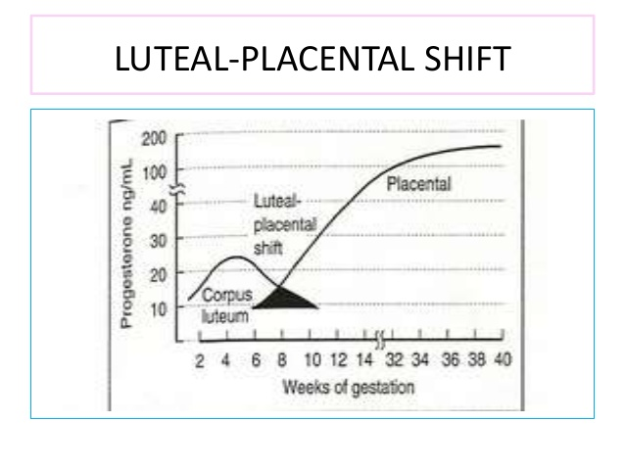

Slide 9
PLACENTAL HORMONES

Slide 10
HORMONES OF CORPUS LUTEUM AND PLACENTA
Progesterone
Estrogen
HCG
HPL
Pregnancy associated plasma protein A
Pregnancy specific B1glycoprotein
Placental protein 13
Relaxin

Slide 11
PROGESTERONE & ESTROGEN
From corpus luteum in early pregnancy and later from placenta
Estrogens are produced by placenta from 19 carbon androgen precursors
3major estrogen are
estriol
estradiol
estrone

Slide 12
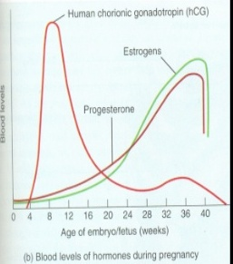

Slide 13
ACTION OF OESTROGEN AND PROGESTERONE
Maintenance of pregnancy:
Progesterone reduces muscle excitability by increasing ca binding thereby reducing free intracellular ca.
Oestrogen increase myometrial excitability
Growth, Vascularity and decidualisation of uterus : are increased
Onset of labour:
Near term, there is fall in progesterone level and an increase in oestrogen It induces myometrial excitability and stimulates prostaglandin synthesis and increased oxytocin recepors and the formation of gap junctions

Slide 14
ACTION OF OESTROGEN AND PROGESTERONE
• Lactation :
Oestrogen causing ductal changes and together effecting alveolar changes
Low levels of urinary oestriol late in pregnancy were previously used as a marker of fetal compromise
• Unconjugated oestriol is used as part of triple test to screen for “DOWN SYNDROME

Slide 15
HUMAN CHORIONIC GONADOTROPHIN

Slide 16
HUMAN CHORIONIC GONADOTROPHIN
Glycoprotein with high sialic acid content
Synthesized by the syncytiotrophoblast.
HCG is composed of α and b sub units.
Structural similarity with FSH, LH and TSH – identical α subunit
b subunit is specific
Half life of hCG is 24-36 hours
Doubling time of HCG is 1.4 to 2 days
HCG is called LH Surrogate because it acts on the LH receptors

Slide 17
HUMAN CHORIONIC GONADOTROPHIN
hCG is secreted by syncytiotrophoblast soon after implantation. It can be detected in maternal serum as early as 8 days post conception
• 100 IU/L – at the time of expected menses
• 100000 IU/L – 8-10 weeks then falls until 18-20wks.
• 10000-20000 IU/L- up to term
• High levels are seen in Hydatiform mole, Multiple pregnancies and Down syndrome

Slide 19
HUMAN CHORIONIC GONADOTROPHIN
ACTIONS:
1. It sustain corpus luteum prevents corpus luteal demise called corpus luteal rescue and there by maintains hormonal support to pregnancy 2. Stimulates the leydig cells of the male fetus to produce testosterone
3. Immunosuppressive action helps in maintenance of pregnancy
4. Promote relaxin secretion by corpus luteum
5. Stimulates maternal thyroid gland.

Slide 20
HUMAN CHORIONIC GONADOTROPHIN
CLINICAL APPLICATIONS :
1.Useful in diagnosis of pregnancy
2. In normal pregnancies there is usually an increase of at least 66% in 48 hours. 3.Doubling time is absent in:
ectopic pregnancy
failed gestation

Slide 21
HUMAN CHORIONIC GONADOTROPHIN
4. Follow-up of a molar pregnancy :
The average time taken for β hCG to reach normal values is about 8 weeks after evacuation . Persistently high or plateauing values could point to gestational trophoblastic neoplasia .
Screening of Down syndrome :
Fetuses with trisomy 21 have high hCG and hence it is an integral component of triplet test, quadruple test and first trimester screening for trisomy 21.

Slide 22
HUMAN PLACENTAL LACTOGEN

Slide 23
HUMAN PLACENTAL LACTOGEN
Human chorionic somatomammotrophin .
Polypeptide of 191 AA – single chain
Secreted by syncytiotrophoblast
Levels of hPL correlate exponentially with fetal and placental growth
Half life -15 minutes

Slide 24
HUMAN PLACENTAL LACTOGEN
HPL starts increasing by 3 wks & progressively increases up to 36 weeks and this rise much more in multiple pregnancies and big babies, making more prone to diabetes
Potent angiogenic hormone and may play a role in the formation of fetal vasculature.
Clinical significance:
HPL along with other placental hormones is responsible for diabetogenic state in pregnancy

Slide 25
PREGNANCY ASSOCIATED PLASMA PROTEIN A

Slide 26
PREGNANCY ASSOCIATED PLASMA PROTEIN A
Produced from syncytiotrophoblast
Concentration in maternal blood increases after 7 weeks of pregnancy.
Clinical Applications:
In the first trimester screening program for trisomy 21 along with B HCG
In prediction of preeclampsia in the first trimester along with uterine artery Doppler and placental growth factors

Slide 27
PREGNANCY ASSOCIATED PLASMA PROTEIN A
This protein appears as early as 3 days following fertilization in maternal blood and is being developed as attest for early detection and monitoring of pregnancy
• Immunomodulatory role in pregnancy

Slide 28
PLACENTAL PROTEIN 13

Slide 29
PLACENTAL PROTEIN 13
Produced by syncytiotrophoblast
Women with preeclampsia have a low concentration in first trimester.
It is being developed as a screening test for preeclampsia

Slide 30
RELAXIN

Slide 31
RELAXIN
Peptide hormone, produced almost exclusively by the corpus luteum (H2)
Small amount by placenta and decidua(H2)
Peaks at 8-12wks-approximately 1ng/ml-later declines at term
Action
cervical softening and in relaxation of pubic symphysis and in uterine quiescence

Slide 32
PREGNANCY SPECIFIC B 1 GLYCOPROTEIN

Slide 33
PREGNANCY SPECIFIC B 1 GLYCOPROTEIN
Synthesized by syncytiotrophoblast.
Appears in serum as early as 6 days post conception and has been used as a test for pregnancy
Potent immunosuppressor and prevents rejection of the fetus

Slide 34
EARLY PREGNANCY FACTOR

Slide 35
EARLY PREGNANCY FACTOR
A polypeptide
synthesized from activated platelets, maternal tissue and placenta
immunosupressive action

Slide 36
LEPTIN

Slide 37
LEPTIN
Is an anti obesity hormone
synthesized by cytotrophoblasts and syncytiotrophoblasts
helps in fetal development and growth

Slide 38
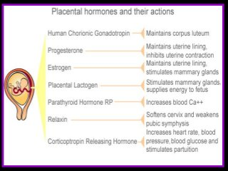

Slide 39
CHANGES IN ENDOCRINE GLANDS

Slide 40
CHANGES IN ENDOCRINE GLANDS
PITUTARY GLAND
THYROID GLAND
PARATHYROID GLAND
ADRENAL GLAND
PANCREAS

Slide 41
PITUITARY GLAND
Enlarges during pregnancy but this does not appear to be associated with pressure on the optic chiasma and visual problems.
Levels of almost ALL pituitary hormones are found to be rise in pregnancy
1. GH increases to a small extent and couples with HPL and makes
pregnancy a diabetogenic state.
2. Prolactin increases tremendously and this ensure lactation. Elevated oestrogen levels increase the amount of lactotrophs, there by elevating prolactin.

Slide 42
PITUITARY GLAND
3. TSH is augmented leading to hyperplasia of thyroid gland.
4. Pituitary gonadotrophins are low due to elevated oestrogen and progesterone level.
5. ADH and oxytocin – steadily increase in pregnancy.

Slide 43
SHEEHANS SYNDROME
Postpartum haemorrhage-hypotension-shock-blood supply to brain and pituitary compromised-anterior pituitary hypoxia-anterior pituitary necrosis
all anterior pituitary hormones become deficient(GH,TSH,ACTH,FSH&LH)
First manifestation is failure of lactation

Slide 44
SHEEHANS SYNDROME
secretions are affected in the following order
Prolactin
GH
FSH,LH
TSH
ACTH
Management:replacement of all anterior pituitary hormones

Slide 45
THYROID GLAND
In pregnancy, there is a state of relative iodine deficiency due to reduced reabsorption and increased excretion. The fall in plasma iodine results in the thyroid gland increasing its uptake from blood. If there is dietary insufficiency of iodine, the thyroid gland hypertrophies and this result in the physiological goiter of pregnancy.

Slide 46
THYROID GLAND
The synthesis of thyroid binding globulin is increased due to increase in oestrogen. Therefore total level of thyroxine T4 and triiodothyronine T3 are increased. However, levels of free T4 and T3 are less altered by pregnancy.
TSH level fall in the 1st trimester. This is because of the thyrotrophic action of hCG which cause an increase T4 level, which in turn suppresses the TSH level.

Slide 47
ADRENAL GLANDS
Anatomically:slight increase in size of zone fasiculata
Rise in serum cortisol 3 times more than the non pregnant value due to increase in half life, delayed clearance by the kidneys and resetting of HPA axis

Slide 48
ADRENAL GLANDS
Cortisol, aldosterone and deoxycorticosterone increase in pregnancy.
Androstenedione and testosterone levels are also increased and converted into oestradiol in the placenta by the action of placental aromatases.
Dehydroepiandrosterone sulfate levels are decreased because the hormone is used for oestrogen formation in the placenta.

Slide 49
PARATHYROID GLANDS
The parathyroid glands increase in size in pregnancy causing an increase in parathormone and calcitonin level .
Ca level decrease in pregnancy but ionized Ca which is the main trigger for parathormone , decreases only slightly.
This coupled with the increased GFR and increased fetal transfer of Ca, results in increased parathormone level.
Calcitonin antagonizes parathormone and vitamin D and its increased levels serve to preserve the maternal skeleton in times of severe Ca depletion as in pregnancy and lactation

Slide 50
PANCREAS
Pregnancy is a diabetogenic state.
Pregnancy is associated with hyperinsulinemia and insulin resistance.
There is accelerated fasting hypoglycemia, and prolonged postprandial hyperglycemia

Slide 51
ENDOCRINE CONTROL OF LABOUR

Slide 52
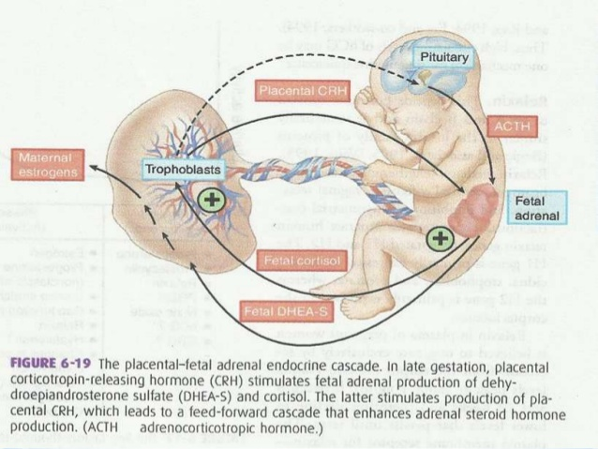

Slide 53
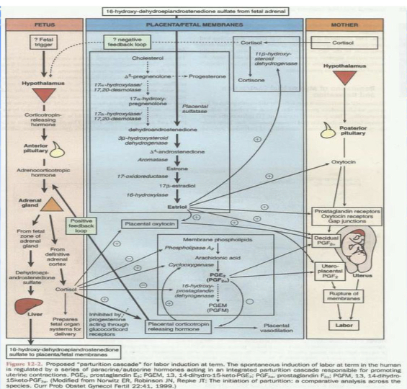

Slide 54
PHYSIOLOGY OF LACTATION

Slide 55
PHYSIOLOGY OF LACTATION
The physiological basis of lactation is divided into four phases:
1. Preparation of breasts (mammogenesis). 2. Synthesis and secretion from the breast alveoli
(lactogenesis).
3. Ejection of milk (galactokinesis).
4. Maintenance of lactation (galactopoiesis).

Slide 56
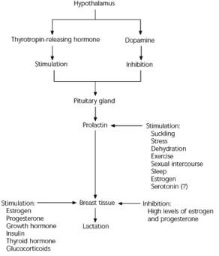

Slide 57
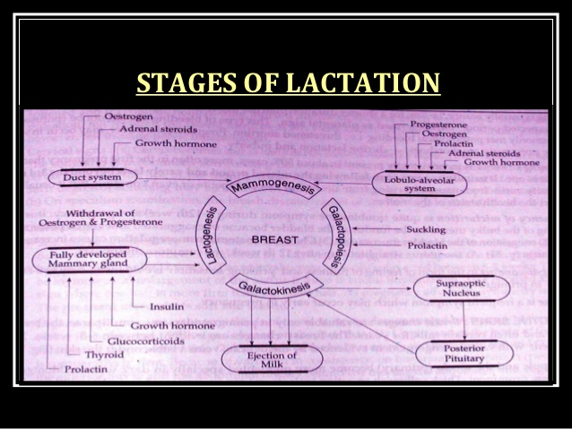

Slide 58
THANK YOU

Slide 59
PHYSIOLOGY OF LACTATION
Mammogenesis
■ Pregnancy is associated with a remarkable growth of both the ductal and lobuloalveolar systems.
■ An intact nerve supply is not essential for growth of the mammary glands during pregnancy.

Slide 60
PHYSIOLOGY OF LACTATION
Lactogenesis
■ Milk secretion actually starts on 3rd or 4th postpartum day.
■ Around this time, the breasts become engorged, tense, tender and feel warmth.
■ When the progesterone and estrogen are withdrawn following delivery, prolactin begins its milk secretory activity.

Slide 61
PHYSIOLOGY OF LACTATION
The secretory activity is enhanced directly or indirectly by growth hormone, thyroxine, glucocorticoids and insulin.
■ Prolactin stimulates mammary glandular ductal growth and epithelial cell proliferation and induces milk protein synthesis.

Slide 62
PHYSIOLOGY OF LACTATION
Stage 1:
■ Occurs by mid pregnancy.  Mammary gland becomes competent to secrete milk.
■ Lactose, total protein, and immunoglobulin concentrations increase within the secreted glandular fluid, whereas sodium and chloride concentrations decrease.
■ High circulating levels of progesterone and estrogen hold the secretion of milk in check

Slide 63
PHYSIOLOGY OF LACTATION
Stage 2 (day 2 or 3 to day 8 after birth):
■ Occurs around the time of delivery.
■ Onset of copious milk secretion.
■ Removal of the placenta is necessary for the initiation of milk secretion; however, the placenta does not inhibit established lactation control.

Slide 64
PHYSIOLOGY OF LACTATION
Work by Haslam and Shyamala reveals that progesterone receptors are lost in lactating mammary tissues, thus decreasing the inhibitory effect of circulating progesterone.
■ In addition, maternal secretion of insulin, growth hormone (GH), cortisol, and parathyroid hormone (PTH) facilitates the mobilization of nutrients and minerals that are required for lactation.
■ Endocrine control switches to autocrine

Slide 65
PHYSIOLOGY OF LACTATION
Galactokinesis
■ Discharge of milk from the mammary glands depends not only on the suction exerted by the baby during suckling but also on the contractile mechanism which expresses the milk from the alveoli into the ducts.

Slide 66
PHYSIOLOGY OF LACTATION
During suckling, a conditioned reflex is set up:
Ascending impulses from the nipple and areola
thoracic sensory (4, 5 and 6) afferent neural arc
paraventricular and supra optic nuclei of the hypothalamus
Oxytocin from the posterior pituitary produces contraction of the myoepithelial cells of the alveoli and the ducts containing milk. ("milk ejection" or "milk let down" reflex)
Milk is forced down into the ampulla of lactiferous ducts,
wherefrom it can be expressed by the mother or sucked by the baby.

Slide 67
PHYSIOLOGY OF LACTATION
Presence of the infant or the infant's cry can induce letdown without suckling.
■ A sensation of rise of pressure in the breasts by milk experienced by the mother at the beginning of the sucking is called "draught".
■ The milk ejection reflex is inhibited by factors such
as pain, breast engorgement or adverse psychic
condition.

Slide 68
PHYSIOLOGY OF LACTATION
Galactopoiesis
■ Prolactin appears to be the single most important galactopoietic hormone.
■ Continuous suckling is essential for removal of milk from glands, also release prolactin.
■ Secretion is the suppressed by disturbances.
continuous congestion process unless or emotional

