Slide 1

Fetal growth disorder

Slide 2
Screening options for growth restriction
CLINICAL
The maternal uterine fundus is objectively measured and charted during each antenatal visit.
sensitivity for detection of IUGR- 60-80%
Although this is a poor screening tool , accuracy of subsequent ultrasound prediction of IUGR is enhanced.

Slide 3
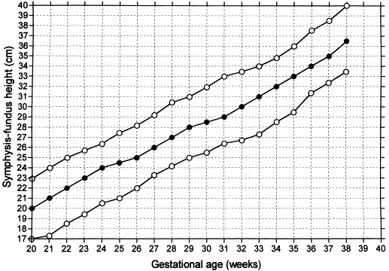
Gravidogram

Slide 4
Biochemical
Atleast four hormones measured in maternal sera early in 2nd trimester are associated with subsequent IUGR.
Estriol,humal placental lactogen,HCG, and α-fetoprotein.
Maternal alphafetoprotein- useful marker for abnormal placentation.
Single,unexplained elevated value- increases the risk of growth restriction 5-10 fold.

Slide 5
Uterine Artery Doppler
Uterine artery doppler reflects directly the involvement of trophoblastic invasion.
An early diastolic notch in uterine arteries at 12-14 weeks suggests delayed trophoblastic invasion.
Persistance of notching beyond 24 weeks –confirmatory.

Slide 6
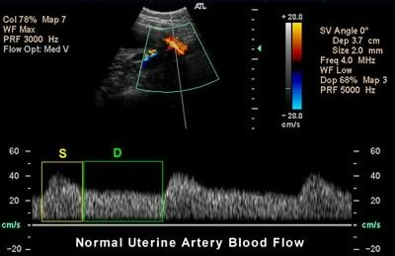

Slide 7
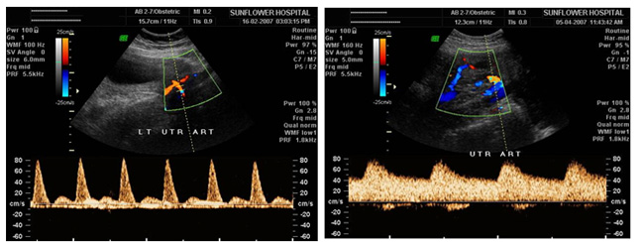
Early diastolic notch

Slide 8
Diagnosis
Serial Ultrasound is the most useful tool for the diagnosis of IUGR, to differentiate between symmetrical and asymmetrical and to monitor the fetal condition.
Fetal biometery:
Biparietal diameter: It is a poor tool for detection of IUGR.
Cranialgrowth delay as a result of insufficient nutritionis late.

Slide 9
Head circumference:
It is not subject to the same extrinsic variation as biparietal diameter.
Abdominal circumference:
Single best measurement for detection of IUGR because it is related to Liver size which is a reflection of fetal glycogen storage.
Its sensitivity is further enhanced by serial measurements obtained atleast 14 days apart.

Slide 10
Contd..
The most accurate abdominal circumference is the smallest value obtained at the level of the hepatic vein between the fetal respirations.
it is measured on transverse section at the level of bifurcation of main portal vein into right and left branch(boomerang appearance).

Slide 11
Contd..
If a table is based exclusively on healthy women delivering appropriate nourished neonate at term
-AC above 2.5 percentile is inconsistent with IUGR
If a table based on cross sectional population- 10th percentile is more appropriate.
Positive predictive value-50%
An increase in AC less than 10 mm in 14 days has a sensitivity-85% and specificity-74%

Slide 12
Trans cerebellar diameter
Upto 25 weeks measurement of TCD in cms equal to gestational week in weeks.
This measurement is relatively spared the effects of mild to moderate uteroplacental dysfunction.
Serial measurements have more predictive value than a single measurement.

Slide 13
Measurement ratios:
Various age independent morphometric ratios(HC/AC,FL/AC) have been used to detect IUGR.
The normal value of HC/AC decreases linearly from 16 to 40 weeks gestation.
An HC/AC >2 SD above the mean is predictive of IUGR.
FL/AC ratio normal value is 22 in second half of pregnancy.
FL/AC ratio above 23.5% is considered abnormal.

Slide 14
An abnormally elevated FL/AC or HC/AC ratio indicates asymmetrical growth and helps in differentiating a growth restricted fetus from a constitutionally small.

Slide 15
Sonographic estimate of fetal weight
Although an estimate of fetal weight doesnot routinely add to the abdominal circumference percentile for diagnosis
It adds a graphic image that is easy for both patient and referring physician to conceptualise.
Sensitivity-low
Positive predictive value of fetal weight estimate below 10th percentile is greater.

Slide 16
Placental morphology
Grannum et al developed a scoring system based on texture and architecture of placenta.
Grade 0 to grade III
Although placental changes are not specific to IUGR ,acceleration of placental maturation may occur with IUGR and Hypertensive disorders.

Slide 17
Grade 0- homogenous placenta without calcifiction.
I- random echogenic areas of calcification and an undulating pattern of chorionic plate.
II- comma shaped indentations in basal plate and calcification in basal layers.
III- distinct cotyledons are visualised,indentations are pronounced and there are echogenic fall out areas in the contyledons.

Slide 18
Amniotic fluid volume
Oligohydramnios may be a first incidental finding noticed in pregnancies with fetal growth restriction.
If this is noticed,complete USG assessment of fetal growth should be performed.
Because 96% of fetuses with fluid pockets less than 1 cm may be growth restricted.

Slide 19
Small fetal size – excess amniotic fluid volume suggests anuploidy or fetal infection.
Normal or decreased amniotic fluid is compatible with placental insufficiency.

Slide 20
Doppler ultrasonography
Doppler flow studies are an important adjunct to fetal biometry in identifying the IUGR fetus at risk of adverse outcomes.
The most widely used arterial indicies are pulsatility index, systolic to diastolic ratio, and resistance index.

Slide 21
These are calculated as follows
Pulsatility index(PI): peak systolic velocity-end diastolic velocity / average velocity during cardiac cycle.
Resistance index(RI): (peak systolic velocity-end diastolic velocity)/peak systolic velocity.
Systolic/diastolic ratio(S/D)=peak systolic velocity /end diastolic velocity.

Slide 22
Vessels examined: umbilical and middle cerebral arteries.
Normal pregnancy is characterised by a low resistance fetoplacental system with continous flow throughout the cardiac cycle.
When there is underperfusion of placenta, tertiary villi capillary bed is damaged resulting in increased placental resistance.

Slide 23
The temporal sequence of Doppler changes is as follows
Amniotic fluid index
Umbilical artery pulsatility index are the first to become abnormal followed by
Changes in MCA velocimetry
Aorta doppler study
Ductus venosus waveform and
Inferior vena cava Doppler

Slide 24
Umbilical artery Doppler
It reflects placental function and indicates degree of placental insufficiency.
High UA PI(above 95th percentile)
Placental insufficiency
Positive end diastolic flow ≥50%
Absent ≥ 70%
Reversed ≥90%

Slide 25
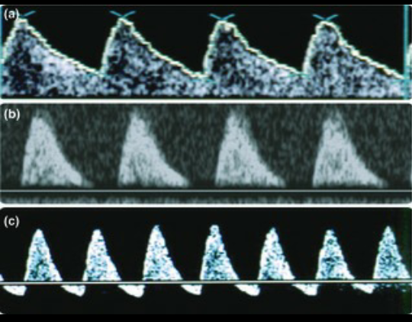
Umbilical artery Doppler

Slide 26
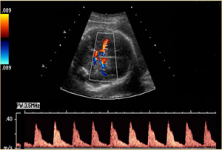
Middle cerebral artery
MCA and ductus venosus reflect how fetus is coping.
In normal fetus- relatively little flow during diastole.

Slide 27
Increased resistance to blood flow in the placenta results in redistribution of the cardiac output to favour cardiac and cerebral circulation.
Cerebral vasodilatation also known as “brain sparing effect” is a response of a fetus to chronic hypoxemia
Results in increase in diastolic flow and decrease in doppler indices.
Reduced MCA PI and MCA/UA PI ratio(cerebro- placental ratio)= early signs of cerebral hypoxemia.

Slide 28
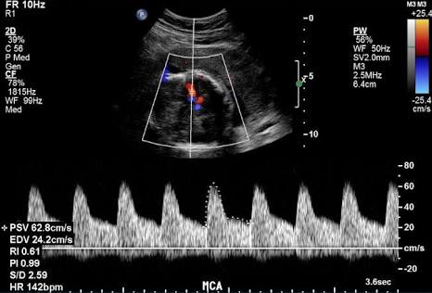
MCA-increased end diastolic flow

Slide 29
Contd…
An abnormal ratio (less than 1.0) – correlate with adverse neonatal outcome.
MCA doppler are most useful because of their high negative predictive value.

Slide 30
Ductus venous Doppler
DV shunts oxygenated blood from umblical vein into inferior venacava ,before it joins portalvein.
Normal fetus: flow in DV is forward ,moving towards the heart during the entire cardiac cycle.
It exhibits pulsatile triphasic waveform representing flow during systole(S wave), diastole (D) and atrial systole (a-wave)

Slide 31
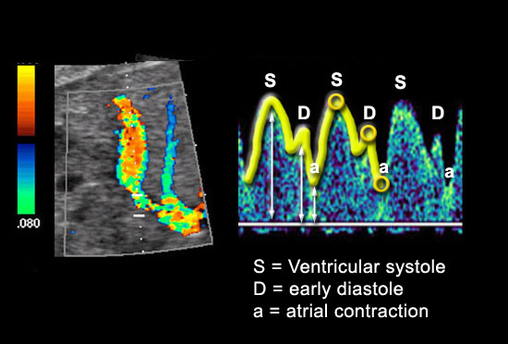

Slide 32
In response to hypoxia,
Dilatation of DV allows a larger proportion of umbilical venous flow to pass into the right atrium through the foramen ovale and into cerebral circulation .
Manifests by increase in pulsatility index for veins.
PIV= peak systolic velocity-atrial contraction velocity/average velocity during cardiac cycle.

Slide 33
Contd..
As hypoxia progresses to acidemia,
The phase of DV pulsation corresponding to atrial contraction become reversed.
DV used for
1. surviellance in SGA fetus with abnormal UA Doppler.
2.Decision of time to delivery in early onset SGA(<32-34 weeks)

Slide 34
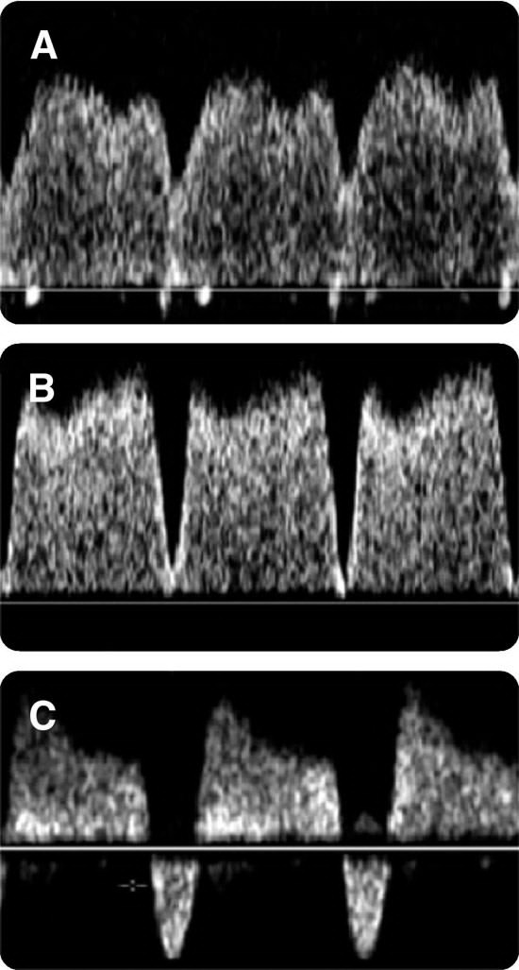

Slide 35
Diagnostic test likely diagnosis
AC<2.5 – 10th percentile
aneuploidy,viral infections
Anatomy survey & AFI
Normal anatomy/AFI or
Oligo
UA,MCA Doppler placental insufficiency
if both Normal
cerebroplacental ratio decreased ratio
If N- repeat examination after
14 days.

Slide 36
Management
Once the diagnosis of growth restriction is made ,next step is to determine the etiology of IUGR.
Maternal history: fever with rashes,smoking,use of illicit drugs& associated medical illness.
Clincal examination: Height,weight and blood pressure.

Slide 37
Laboratory investigations
Hb, blood sugar, renal functional test and serology for cytomegalovirus and toxoplasma.
Special investigations: thrombophilia(LAC,ACL,ANA) done in patients with suggestive history,karyotyping.
Fetal evaluation:
Usg- growth parameters,AFI,congenital anomaly and Doppler evaluation.

Slide 38
General management
Bed rest in left lateral position
To increase the uteroplacental flow.
Maternal nutritional supplementation with high caloric and protein diets,consumption of fish oil and micronutrients like zinc,folic acid, iron and calcium.

Slide 39
Maternal oxygen therapy
Maternal administration of 55% of oxygen at a rate of 8L/min round the clock.
Pharmacological therapy:
Aspirin in low dose(1-2mg/kg BW)
Acts by inactivating platelet cyclooxygenase and decreasing thromboxane.
Beta-mimetics act on beta 2 receptor and cause myometrial relaxation.

Slide 40
In conclusion there is no form of therapy currently available which can reverse IUGR and the only intervention possible in most case is delivery.
The optimum time of delivery is determined by gestational age,underlying etiology,possibilty of extrauterine survival and fetal condition.
Strict fetal surveillance is needed .

Slide 41
Progressive detoriation in fetal CVS and behavioural variables seen with declining metabolic status
Doppler :
abnormal UA (EDV decreased/absent/reversed)
Brain sparing- loss of brain sparing
Abnormal precordial veins
Heart
Redistribution of CO
Declining cardiac function
Av insufficiency

Slide 42
Biophysical profile
declining cardiac function
decrease in fetal activity
Loss of FH variation
Late deceleration
Acid base:
Decreased Po2
Decreased pH
Progressive multisystem failure

Slide 43
Suspected IUGR at ≥28 weeks
Abnormal umbilical A Doppler
Reduced Diastolic flow PI >+2SD-≤+3SD
Absent diastolic flow
Normal UA Doppler
Deliver at ≥38 weeks
Reduced diastolic flow PI>+3SD
Doppler once weekly
AFI once weekly
NST twice weekly or BPPweekly
Fetal growth every 3 weeks
Deliver ≥37 wks
Doppler and NST 2-3 times/week
Deliver at≥37 weeks
Admission
Steroids
NST 1-2/day
BPP daily
Doppler daily
Deliver≥34 weeks
Reversal of diastolic flow
Admission
Steroids
NST 2-4/day
Doppler daily
Deliver ≥32 wks

Slide 44
Mode of delivery
Fetus with significant IUGR should preferably delivered in well equipped centres which can provide intrapartum continuous fetal heart monitoring and expert neonatal care.
Mode of delivery depends on gestational age and evidence of acidemia.
Vaginal delivery- when no obstetric indication and the FHR pattern is normal.
Fetus with acidosis- Elective LSCS

Slide 45
Features of fetal acidosis:
Repetitive late decelerations
Poor biophysical profile
Reversal of end diastolic flow in umblical artery
Abnormal venous doppler
Abnormal blood gas analysis showing acidic pH oncordocentesis.

Slide 46
Fetal macrosomia
It is the result of excessive fetal growth which is opposite of fetal growth restriction.
Birth weight exceeding 4 kg or 90th percentile for a given gestational week.

Slide 47
Etiology and risk factors:
Large size of parents
Obesity
Diabetes- gestational or overt
Male fetus
Multiparity
Previous macrosomic baby
Post term
Racial and ethnic

Slide 48
Pathophysiology
It may result from optimal placentation and excess substrate availability or overstimulation of fetal insulin –insulin like growth factor-leptin axis.

Slide 49
Fetal and neonatal risk
Increased perinatal mortality
Intrapartum risks
Shoulder dystocia
Brachial plexus injury
Skeletal injuries
Meconium aspiration
Perinatal asphyxia
Unexplained IUD
Postpartum complications: RDS and hypoglycemia,SIDS.

Slide 50
Maternal risk
These are also related to neonatal birth weight
CPD
Prolonged labour
Caesarean rates.
PPH
Perineal tears
Diagnosis: clinical and USG

Slide 51
Management
Delivery route:
For EFW<4500g-vaginal deliver/VBAC
For EFW ≥ 4500g in diabetic – Elective LSCS
For EFW ≥ 5000g in non diabetic – Elective LSCS.

Slide 52


