Slide 1
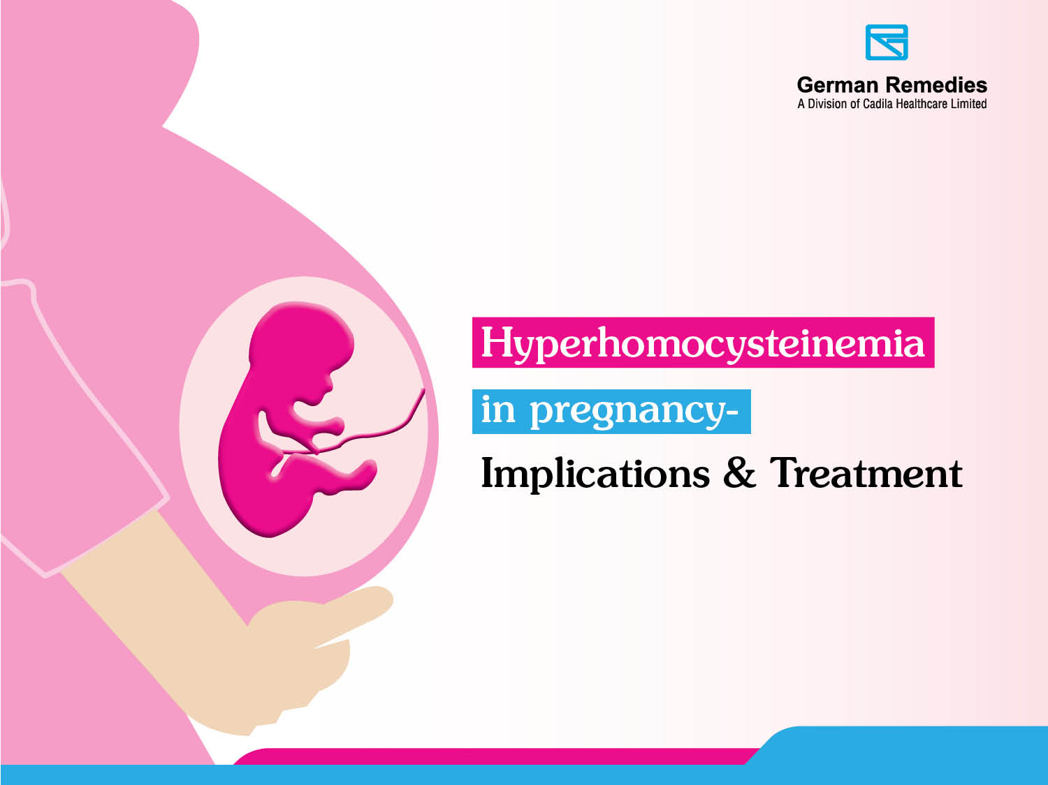

Slide 2


She is blessed !
A Women is blessed with a precious gift
‘Motherhood’

Slide 3
Cherishing Motherhood
Let us make her motherhood cherishable
But How ?

Slide 4
Optimum Nutrition
Optimum nutrition is
A Precious Gift to Cherish Motherhood

Slide 5
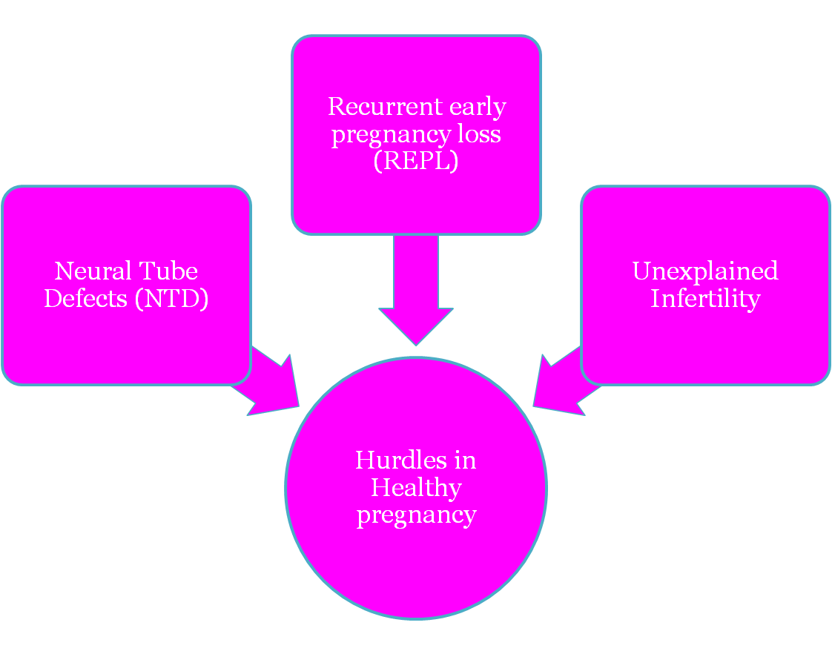
Hurdles for a healthy pregnancy

Slide 6
Prevalence of NTD/REPL in India
NTD in INDIA:
Bhide P et al.¹ in 2013 :
Overall birth prevalence of NTD’s in India =4.1 per 1000 births.
Live birth prevalence of NTD’s = 1.3 per 1000 births
Stillbirth prevalence of NTD’s = 1.7 per 1000 births
Prevalence of anencephaly=2.1 per 1000 births
Prevalence of spina bifida =1.9 per 1000 births.
REPL in India
REPL is found in 1–5% of couples desiring pregnancy and in 50% of total pregnancies it is a frequent obstetric complication.²
1. Bhide, P., Sagoo, G. S., Moorthie, S., Burton, H. and Kar, A. (2013), Systematic review of birth prevalence of neural tube defects in India. Birth Defects Research Part A: Clinical and Molecular Teratology, 97: 437–443. doi: 10.1002/bdra.23153.
2. Chakraborty P, Goswami SK, Rajani S, Sharma S, Kabir SN, et al. (2013) Recurrent Pregnancy Loss in Polycystic Ovary Syndrome: Role of Hyperhomocysteinemia and Insulin Resistance. PLoS ONE 8(5): e64446. doi:10.1371/journal.pone.0064446
Notes:
Bhide P et al.¹ in 2013 estimated the overall birth prevalence of neural tube defects in India as 4.1 per 1000 births.
The live birth and stillbirth prevalence of neural tube defects was 1.3 per 1000 births and 1.7 per 1000 births respectively.
Among the neural tube defects, the reported prevalence of anencephaly was highest at 2.1 per 1000 births followed by spina bifida at 1.9 per 1000 births.
*

Slide 7
Relationship between hyper-homocysteinemia
and pregnancy
Neural tube defects(NTD’s)
Recurrent early
pregnancy loss (REPL)
Unexplained Infertility
Hyperhomocysteinemia

Slide 8
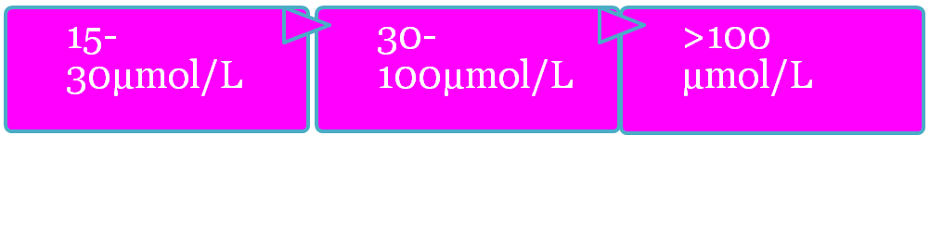
Hyperhomocysteinemia
Hyper-homocystenemia is characterised by an abnormally
high levels of homocysteine in the blood above 15μmol/L.
Mild
Moderate
Severe
Indian Scenario
In contrast to the west, Indian studies examining the prevalence of hyperhomocysteinemia have reported a much higher incidence of 52 to 84%.
The mean homocysteine levels too are high, varying from 19.5 to 23.2 μmol/L
Sainani G S, Talwalkar P G, Wadia R S et al. http://apiindia.org/pdf/medicine_update_2007/3.pdf

Slide 9
Etiology of Hyperhomocysteinemia
Vitamin deficiencies
Elevated levels of homocysteine result from deficiency of one of several enzymes involved in methionine metabolism, namely:
Ffolic acid,
Pyridoxin (vitamin B6)
Methylcobalamin (vitamin B12).
Indians have dietary deficiency of Vit B12, as majority of us are vegetarians and Vit B12 is present mainly in non-vegetarian food.
Indians also have a deficiency of folic acid, as most of us are habituated of eating cooked vegetables, which destroys folic acid.
Gupta S, Khanna A. Neural tube defect in pregnancy with hyperhomocysteinemia: a case report. Int J Reprod Contracept Obstet Gynecol. (2014);3(1): 266-267.
Notes:
*

Slide 10
Etiology of Hyperhomocysteinemia
2. Hereditary predisposition:
Mutation in this MTHFR gene is the most common factor for hyper-homocysteinemia.
The most common MTHFR mutation is called the MTHFR C677T mutation, or the “thermolabile” MTHFR mutation.
The MTHFR gene produces an enzyme, 5,10-methylene tetrahydrofolate reductase (MTHFR), that helps regulate homocysteine levels in the body.
1/3rd of normal Indian population have deficiency of enzyme MTHFR.
Gupta S, Khanna A. Neural tube defect in pregnancy with hyperhomocysteinemia: a case report. Int J Reprod Contracept Obstet Gynecol. (2014);3(1): 266-267.

Slide 11
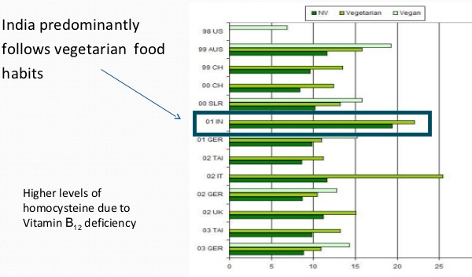
Hyperhomocysteinemia: Indian Scenario

Slide 12
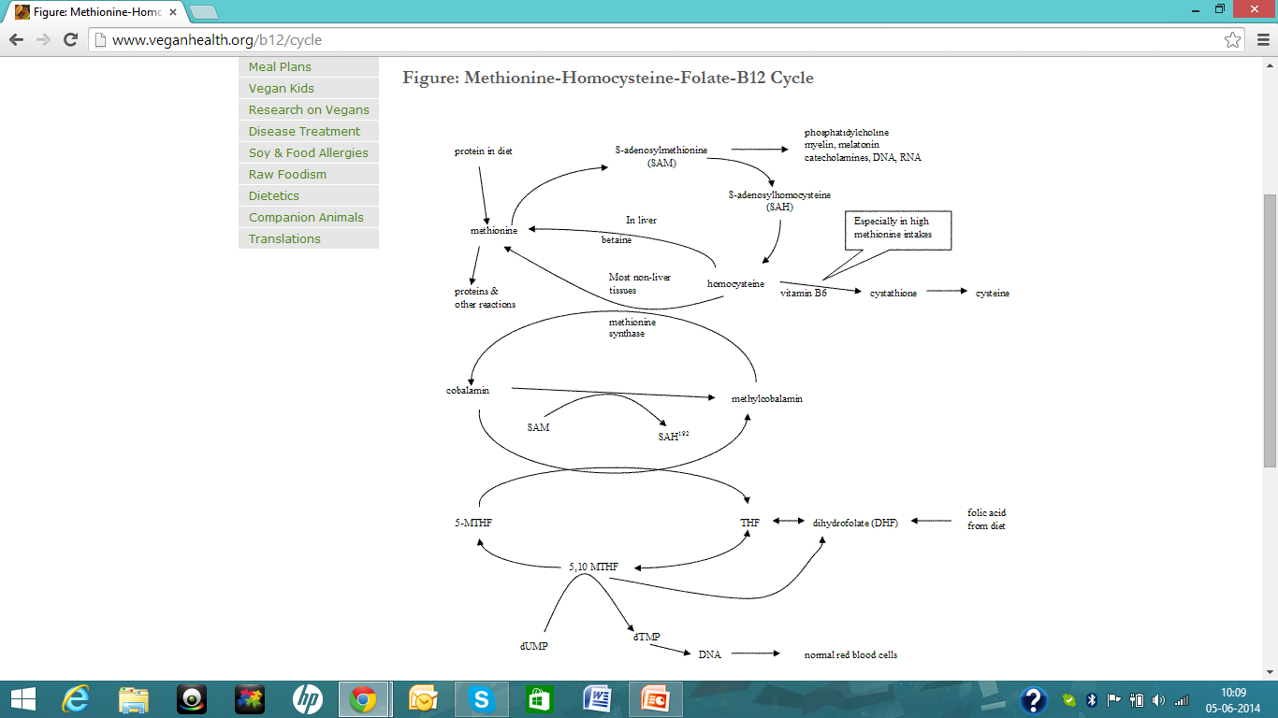
Methionine-Homocysteine-Folate-B12 Cycle
http://www.veganhealth.org/b12/cycle

Slide 13
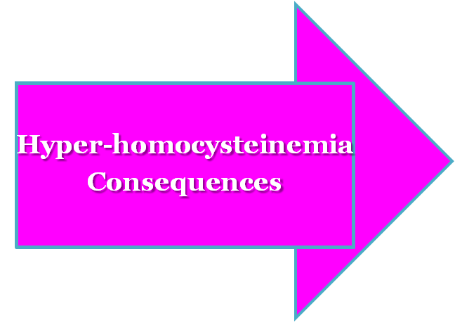
Hyperhomocysteinemia & Pregnancy complications
1st trimester complications
-NTD
- Congenital defects like cleft lip and cleft palate
- Spontaneous abortions
2nd & 3rd trimester complications
-Pre-eclampsia
-Abruptio-placenta
-Deep venous thrombosis
-IUGR
-IUFD
Khanna A. Neural tube defect in pregnancy with hyperhomocysteinemia: a case report. Int J Reprod Contracept Obstet Gynecol. (2014);3(1): 266-267.

Slide 14
Hyperhomocysteinemia and NTD
NTDs are the second most common severely disabling human congenital defects.¹
The association between hyperhomocysteinemia and NTD is the strongest.¹
Disorder of homocysteine metabolism has been suggested to be the basis for NTDs²
Homocysteine levels appeared to be75% higher in mothers with spina bifida affected offspring in a study by Van der et al.³
Alfarra H Y, Alfarra S R, Sadiq M F. Neural tube defects between folate metabolism and genetics. Indian J Hum Genet. 2011 Sep-Dec; 17(3): 126–131.
Steegers-Theunissen RP, Boers GH, Trijbels FJ, Eskes TK. Neural-tube defects and derangement of homocysteine metabolism. N Engl J Med. 1991;324:199–200.
Van der Put NM, Thomas CM, Eskes TK, Trijbels FJ, Steegers-Theunissen RP, Mariman EC, et al. Altered folate and vitamin B12 metabolism in families with spina bifida offspring. Q J Med. 1997;90:505–10.

Slide 15
Hyper-homocysteinemia and REPL
Elevated maternal plasma homocysteine levels have been associated with :
- Elevated risks of miscarriage ¹
- Placental abruption²
- Other pregnancy complications (e.g. pre-eclampsia) ³
- Spontaneous abortions⁴
Foetal growth retardation ¹
Nair R et al. in 2013 studied the genetic association between MTHFR polymorphism and recurrent pregnancy loss in north Indians.
They found that presence of rare allele “C” and heterozygous and rare homozygous genotypes significantly increased the risk of REPL.
Scholl TO, Johnson WG. Folic acid: influence on the outcome of pregnancy. Am J Clin Nutr. May 2000;71(5 Suppl):1295S-1303S
Boxmeer JC, Macklon NS, Lindemans J, et al. IVF outcomes are associated with biomarkers of the homocysteine pathway in monofollicular fluid. Hum Reprod. May 2009;24(5):1059-1066.
Nelen WL, Blom HJ, Steegers EA, et al.Homocysteine and folate levels as risk factors for recurrent early pregnancy loss. Obstet Gynecol. Apr 2000;95(4):519-524.
George L, Mills JL, Johansson AL, et al. Plasma folate levels and risk of spontaneous abortion. Jama. Oct 16 2002;288(15):1867-1873.
Nair R etal. MTHFR C677T Polymorphism and Recurrent Early Pregnancy Loss Risk in North Indian Population. Reproductive Sciences Feb2012 ;19(2):210-215.

Slide 16
Hyper-homocysteinemia and infertility
Treatment of Hyperhomocysteinemia is related to better embryo quality and chance of pregnancy¹
Reduced risk of ovulatory infertility has also been shown in one study²
Studies of infertile women have revealed that preconceptional folic acid supplementation:
Increases folate levels and
Decreases homocysteine levels in follicular fluid ³
1.Boxmeer JC, Macklon NS, Lindemans J, et al. IVF outcomes are associated with biomarkers of the homocysteine pathway in monofollicular fluid. Hum Reprod. May 2009;24(5):1059-1066.
2. Chavarro JE, Rich-Edwards JW, Rosner BA, Willett WC. Use of multivitamins, intake of B vitamins, and risk of ovulatory infertility. Fertil Steril. Mar 2008;89(3):668-676.
3..Boxmeer JC, Brouns RM, Lindemans J, et al. Preconception folic acid treatment affects the microenvironment of the maturing oocyte in humans. Fertil Steril. Jun 2008;89(6):1766-1770.

Slide 17
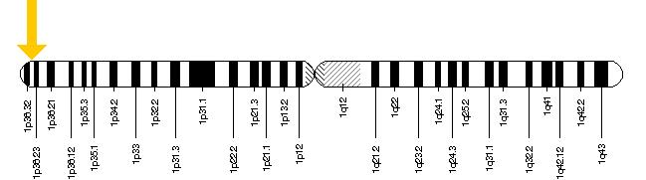
.
MTHFR Polymorphism
What is MTHFR gene?
The official name of this gene is “methylenetetrahydrofolate reductase (NAD(P)H).”
MTHFR is the gene's official symbol.
The MTHFR gene is located on the short (p) arm of chromosome 1 at position 36.3.a
http://ghr.nlm.nih.gov/gene/MTHFR

Slide 18

MTHFR Polymorphism
A Common polymorphism in the MTFHR gene
It replaces the nucleotide cytosine with the nucleotide thymine at position 677,written as 677C>T.
This variant, produces the most common ‘thermolabile’ form of MTHFR.
People with the thermolabile form have increased levels of homocysteine in their blood.
http://ghr.nlm.nih.gov/gene/MTHFR

Slide 19
MTHFR Polymorphism
What is the Normal Function of MTHFR gene?
The MTHFR gene provides instructions for making an enzyme called methylenetetrahydrofolate reductase.(MTHFR)
MTHFR plays an important role in processing amino acids,
Also important for a chemical reaction involving forms of the B-vitamin folate (also called folic acid or vitamin B9).
Also required for conversion of homocysteine to another amino acid, methionine.
http://ghr.nlm.nih.gov/gene/MTHFR

Slide 20
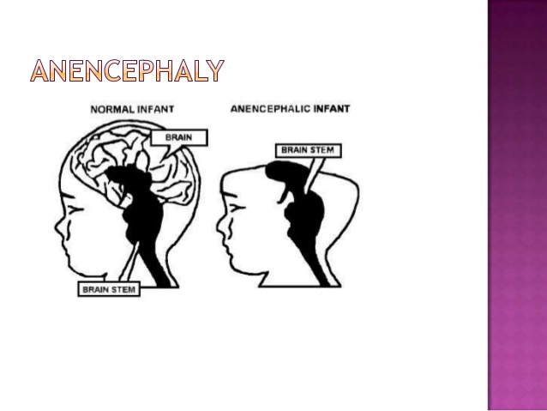
MTHFR Polymorphism
How changes in MTHFR gene are related to health conditions?
Homocystinuria -
Caused by mutations in the MTHFR gene
Anencephaly -
Associated with the MTHFR gene
Most common type of NTD due to polymorphisms in the MTHFR gene.
Notes:
At least 40 mutations in the MTHFR gene have been identified in people with homocystinuria.
Most of these mutations change single amino acids in MTHFR enzyme.
These changes impair the function of the enzyme, and some lead to its inactivation.
Anecephaly: Several variations (polymorphisms) in the MTHFR gene have been associated with an increased risk of neural tube defects (NTDs), a group of birth defects that occur during the development of the brain and spinal cord. Anencephaly is one of the most common types of neural tube defect. Affected individuals are missing large parts of the brain and have missing or incompletely formed skull bones.
*

Slide 21
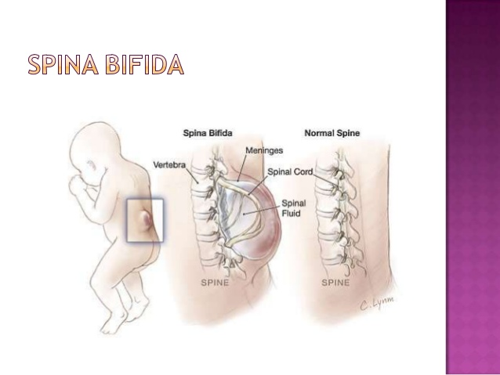
MTHFR Polymorphism
3. Spina bifida -
Associated with the MTHFR gene
Another common type of neural tube defect.
4. Other disorders-
Preeclampsia in pregnancy
Cleft lip and Palate
Spina Bifida
Notes:
Preeclampsia:Polymorphisms in the MTHFR is a risk factors for a variety of common conditions like high blood pressure during pregnancy (preeclampsia).
Cleft lip and Palate:
The 677C>T polymorphism in the MTHFR gene has also been suggested as a risk factor for cleft lip and palate.
*

Slide 22

MTHFR Polymorphism
Prevalence of MTHFR polymorphism
0 - 10%
10 - 20%
20 - 25%
25 - 30%
30 - 32%
32 - 34%
34 - 37%
37 - 41%
41 - 46%
The MTHFR C677T polymorphism distribution showing 1-25% of prevalence in
India specifically in north, south and western region.
(The population were marked by dots with gradient coloured for T allele frequency in population)
Yafei W, Lijun P, Jinfeng W et al. Is the prevalence of MTHFR C677T polymorphism associated with ultraviolet radiation in Eurasia? Journal of Human Genetics (2012), 1–7. doi:10.1038/jhg.2012.113

Slide 23
MTHFR Polymorphism
Studies on Indian Prevalence:
Anjeline T et al. ¹
Observed the MTHFR gene polymorphism among Tamilians.
Frequency of the C677T heterozygotes was 18.1%(13/72)
Kohli et al. ²
The prevalence of MTHFR C677T polymorphism in north Indian mothers with down syndrome was 28%.
Sheth JG et al. ³
A prevalence of 28% MTHFR C677T/T677T polymorphism in Gujrati mothers of babies with Down syndrome was seen.
1. Angeline T , Jeyaraj N, Granito S et al.Prevalence of MTHFR gene polymorphisms (C677T and A1298C) among Tamilians. Exp Mol Pathol. 2004 Oct;77(2):85-8.
2. Kohli U, Arora S, Kabra M et al. Prevalence of MTHFR C677T polymorphism in north Indian mothers having babies with Trisomy 21 Down syndrome. Down Syndr Res Pract (2008) ;12(2):133-7. doi: 10.3104/reports.2004.
3. Sheth JG, Sheth FJ. Gene polymorphism and folate metabolism: A maternal risk factor for Down syndrome. Indian Pediatrics. 2003;40:115-123.
Notes:
Anjeline T et al. observed the MTHFR gene polymorphism among Tamilians. Homozygosity for the MTHFR A1298C SNP was detected in 15.3% (11/72) of the individuals tested, and 47.2% (34/72) were heterozygous for this SNP. Homozygosity for the C677T MTHFR SNP was detected in 1.38%(1/72), and the frequency of the C677T heterozygotes was 18.1%(13/72)¹
Kohli et al. showed that the prevalence of MTHFR C677T polymorphism in north Indian mothers of babies with trisomy 21 Down syndrome was 28%.²
Another study by Sheth JG et al. showed a prevalence of 28% MTHFR C677T/T677T polymorphism in Gujrati mothers of babies with Down syndrome³.
*

Slide 24
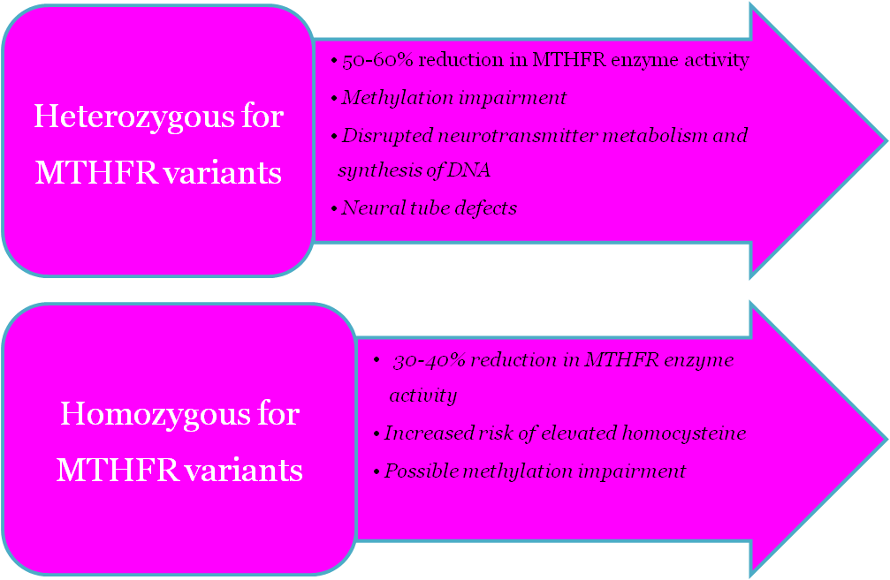
MTHFR Polymorphism
Consequences
http://www.mthfrheds.com/
Notes:
Heterozygous for MTHFR variants C677T (+/-) and A1298C (+/-), is called compound heterozygosity.
heterozygosity for both variants results in 50-60% reduction in MTHFR enzyme activity. Health implications include:
- Possible methylation impairment, including disrupted neurotransmitter metabolism and synthesis of DNA.
-Increased risk of autism, depression, schizophrenia, neural tube defects, cardiovascular disease, essential hypertension, venous thrombosis, diabetic retinopathy, osteoporosis, and cancers of the stomach
- Low levels of vitamins B2, B6, B12, and/or folate often determines the risk of these associated disorders.
homozygous for the A1298C variation (+/+), which results in 30-40% reduction in MTHFR enzyme activity. Health implications include:
· Slightly increased risk of elevated homocysteine,
· Possible methylation impairment, including disrupted neurotransmitter metabolism and
synthesis of DNA, carnitine and coenzyme Q10,
· Moderately increased risk of bipolar disorder, schizophrenia, and some cancers.
*

Slide 25
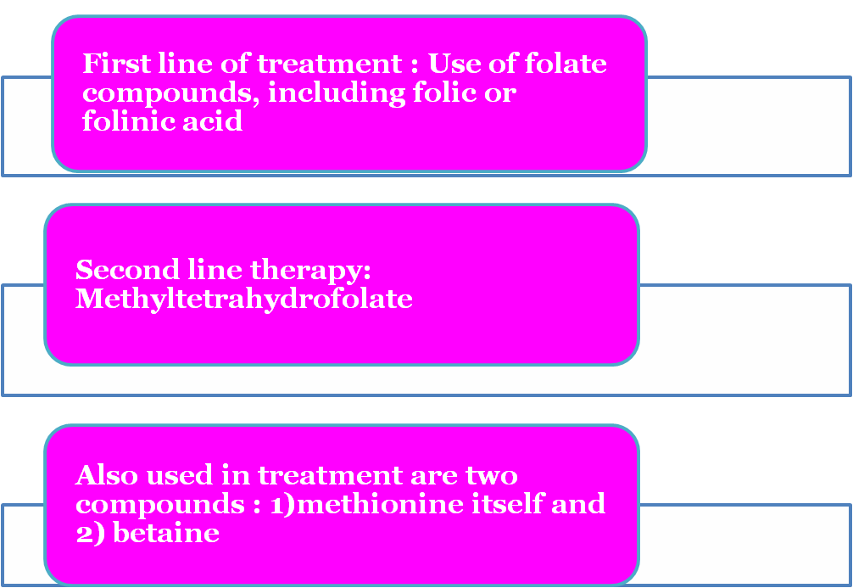
MTHFR Polymorphism
Treatment: Combination of therapies aimed at decreasing homocysteine levels and maximizing any residual enzyme activity.
Rosenblatt, D.S. & R. W. Erbe Methylenetetraydrofolate Reductase in Cultured Human cells. II. Genetic and Biochemical Studies of Methylenetetrahydrofolate Reductase Deficiency. Pediatric Research 11, 1141-1143 (1977).
Notes:
Treatment of severe MTHFR deficiency uses a combination of therapies aimed at decreasing homocysteine levels and maximizing any residual enzyme activity. The first line of treatment is the use of folate compounds, including folic or folinic acid
A second therapy included in treatment of the disorder is methyltetrahydrofolate, which is used to compensate for methylenetetrahydrofolate reductase’s inability to produce this product. Also used in treatment are two compounds aimed at compensating for the low methionine levels that result in MTHFR deficiency: 1) methionine itself, and 2) betaine, a substrate for betaine methyltransferase an enzyme that provides alternate route for conversion of homocysteine to methionine
*

Slide 26
L Methyl Folate
What is L-methylfolate?
L-methylfolate is the metabolically active form of folic acid.
A co-factor for homocysteine metabolism.
L-methylfolate is already broken down for those who lack the ability to break down folic Acid on their own.
There is a four-step process needed to break down Folic Acid into L-methylfolate.
Folic Acid Dihydrofolate Tetrahydrofolate >
5, 10 Methylene THF L-methylfolate
Jacobs A M, Cheng D. Management of Diabetic Small-Fiber Neuropathy With Combination L-Methylfolate, Methylcobalamin, and Pyridoxal 5-Phosphate. Rev NeurolDis 2011;8(1-2):39-47.
van Guldener C. Why is homocysteine elevated in renal failure and what can be expected from homocysteine-lowering? Nephrol Dial Transplant. 2006;21:1161-1166.

Slide 27
Advantages of L-methylfolate
Advantages of L-methylfolate over conventional forms
1. Novel form of folate more effective than folic acid.
Highly absorable form of folic acid.
A bio-active form
Benefits patients with MTHF genetic polymorphism.
Ready to use at cellular level.
Does not require enzymatic conversion, unlike folic acid.
7 times more bio-available than folic acid.
Less likely to mask a vit. B deficiency.
Better efficacy than folic acid in increasing RBC folate.
Jacobs A M, Cheng D. Management of Diabetic Small-Fiber Neuropathy With Combination L-Methylfolate, Methylcobalamin, and Pyridoxal 5-Phosphate. Rev NeurolDis 2011;8(1-2):39-47.
Venn BJ, Green TJ, Moser R, Mann JI. Comparison of the effect of low-dose supplementation with L-5-methyltetrahydrofolate or folic acidon plasma homocysteine: a randomized placebo-controlled study. Am J Clin Nutr. 2003;77:658-662.
Willems FF, Boers GH, Blom HJ, et al. Pharmacokinetic study on the utilisation of 5-methyltetrahydrofolate and folic acid in patients with coronary artery disease. Br J Pharmacol. 2004;141:825-830

Slide 28
Methyl Cobalamine
The coenzyme form of vitamin B12 is known as methylcobalamin or methyl B12.
Only form of vitamin B12 which can directly participate in homocysteine metabolism.
Advantages over conventional form:
Conversion to co-enzyme form of B12 is not required.
Methylcobalamin is the most highly reduced form of vitamin B12.
Therefore, it is a very potent anti-oxidant.
It puts less strain on our bodies' antioxidative capacity as it is in an already reduced metabolically active from.
http://www.health101.org/art_methylcobalamin.htm

Slide 29
Pyridoxal-5-phosphate
Pyridoxal-5-Phosphate, or P5P as it is commonly known, is the active form of vitamin B6.
Advantages over conventional form
Forms of B6 have to be converted by the liver to the active form the body needs – P5P.
Conversion is no longer necessary with direct supplementation of P5P.
Full benefits are available immediately after absorption.
http://www.terrytalksnutrition.com/weekly-articles/2012/04-27/the-life-saving-value-of-pyridoxal-5-phosphate-p5p-and-magnesium/

Slide 30
Role of L Methyl Folate, Methyl Cobalamine and Pyridoxal-5-phosphate
Role of L Methyl Folate, Methyl Cobalamine and Pyridoxal-5-phosphate supplementation in women with hyper homocysteinemia
L-methyl folate is an adequate, safe and efficient alternative to folic acid for increasing folate status.
It reduces the risk of having an NTD-affected pregnancy.

Slide 31
Role of L Methyl Folate, Methyl Cobalamine and Pyridoxal-5-phosphate
Clinical evidence:
Takimoto H et al. evaluated the folate status in pregnant women and their relation to fetal growth.
They measured changes in folate-related biomarkers including plasma homocysteine (tHcy), serum vitamin B(12) , and serum and RBC folate concentrations in each trimester.
Results:
Serum and RBC folate : declined significantly during gestation
Mean serum B(12) : significantly decreased
Plasma tHcy : increased from 5.1 in the 1st trimester to 5.9 micromol/l in the 3rd trimester
Plasma pyridoxal-5'-phosphate: markedly low
Conclusion: Higher plasma tHcy in the third trimester is a predictor of lower birth weight.
Takimoto H, Mito N, Umegaki K et al. Relationship between dietary folate intakes, maternal plasma total homocysteine and B-vitamins during pregnancy and fetal growth in Japan. Eur J Nutr. 2007 Aug;46(5):300-6. Epub 2007 Jul 11.

Slide 32
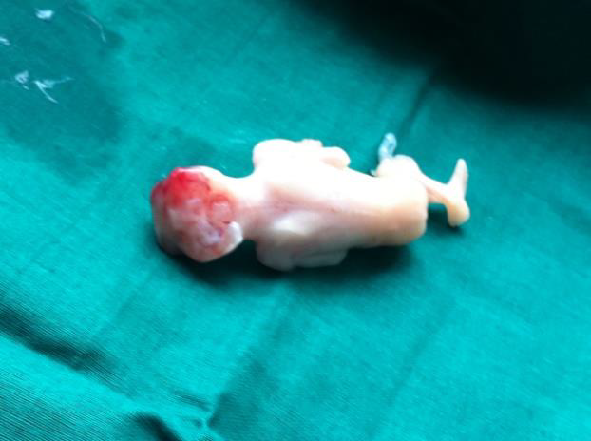
Clinical Evidence
Case report by Gupta S et al. in 2014:
Patient- Pregnant lady with hyper-homocysteinemia.
History- previous abortions due to spina bifida and anencephalic fetus
Treatment- combination of folate, vit B₁₂ and vit B₆ supplementation.
Follow up- her homocysteine levels were reduced from 44 to 13μmol/L and later delivered a healthy baby.
Anencephalic foetus
Gupta S, Khanna A. Neural tube defect in pregnancy with hyperhomocysteinemia: A case report. Int J Reprod Contracept Obstet Gynecol. (2014);3(1): 266-267.

Slide 33
Clinical Evidence
Trial by Lamers Y et al. in 2006
-A long-term intervention trial in 144 young women.
-Showed a higher efficacy of the biologically active folate form [6S]-5-MTHF than the equimolar amount of folic acid after 24 weeks of supplementation.
Results:
Increase in red blood cell and plasma folate over 24 weeks, was significantly greater in the group receiving 5-MTHF than in the groups receiving folic acid.
Conclusion:
5-MTHF is more effective than folic acid at increasing red blood cell folate concentrations in women of childbearing age.
Lamers Y, Prinz-Langenohl R, Bra¨mswig S et al. Red blood cell folate concentrations increase more after supplementation with [6S]-5-methyltetrahydrofolate than with folicacid in women of childbearing age. Am J Clin Nutr 2006;84:156–61.
Notes:
In red blood cell folate, the dimension of
increase over time was significantly greater in the group receiving
416 g [6S]-5-MTHF/d than in the groups receiving 400 g
folic acid/d or 208 g [6S]-5-MTHF/d (P 0.001 for both) and in the group receiving 400 g folic acid/d than in the group
receiving 208 g [6S]-5-MTHF/d (P 0.05).
*

Slide 34
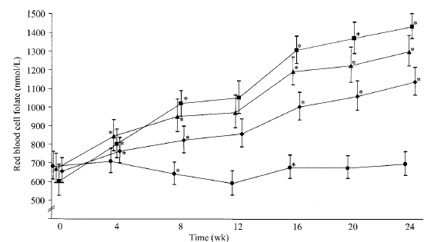
Results by Lamers Y et al.
Geometric mean red blood cell folate concentrations over time after 24 wk of supplementation with 400 g folic acid/d ,416g MTHF/d,208g MTHF/d and placebo.
(▲, n =34), 416 g [[6S]-5-MTHF)/d ; (■, n35), 208g [6S]-5-MTHF/d ; (◊, n33);or placebo
(•, n=34).

Slide 35
Advantages of L-MTHF over folic acid
and food folate

Slide 36
Conclusion
NTDs can be prevented by increasing maternal folate intake in the preconceptional period
Supplementation of the natural form, 5-methylTHF, is a better alternative to supplementation of FA.
Supplemental 5-methylTHF can effectively improve folate biomarkers in young women in early pregnancy in order to prevent NTDs
Women with polymorphisms in the folate cycle have higher requirements that cannot be achieved by increasing dietary folate intake.
A mean serum folate level of approximately 50 nmol/L can be achieved by supplementing with 400 μg of 5-methylTHF for 12 weeks.
Obeid R, Holzgreve W ,Pietrzik K. Is 5-methyltetrahydrofolate an alternative to folic acid for the prevention of neural tube defects? J. Perinat. Med. 2013; 41(5): 469–483

Slide 37


