Slide 1

URINARY INCONTINENCE

Slide 2
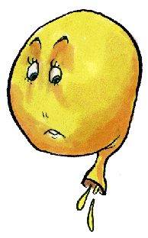
Definition
Involuntary loss of urine so as to
cause social/ hygienical
inconvenience for day to day activity.
The leakage should be objectively demonstrable.

Slide 3
CLASSIFICATION
Urethral
Genuine stress incontinence
Urge incontinence
Mixed
Overflow
Functional
Extra urethral
Congenital
Ectopic ureter
Acquired
Fistulae (vesical, ureteral)

Slide 4
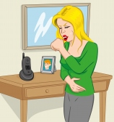
Genuine Stress Incontinence
Involuntary loss of urine with increased intra abdominal pressure in the absence of detrusor contraction.
THE BLADDER PRESSURE EXCEEDS THE URETHRAL PRESSURE, leakage occurs.
Most common type.

Slide 5
ETIOPATHOGENESIS
GSI is strictly an anatomic problem.
GSI occurs when there is urethral hypermobility due to damage to supports (or) intrinsic sphincter deficiency when urethra is damaged.

Slide 6
Risk Factors
Age
Pregnancy
Puerperium/Vaginal delivery
Multiparity
Menopause
Increased inta-abdominal pressure
Smoking
Obesity
Previous surgery

Slide 7
Symptoms
The only symptom is escape of urine with coughing, sneezing or laughing.
The loss of urine has got the following features:
Leakage of urine coincides with stress
No prior urge to void
Amount-small
Patient-fully aware of it
Micturition-normal

Slide 8
CLINICAL EVALUATION history:
Age
Obstetric history
Menopausal status
Urine leakage – provocative factors, duration, frequency, quantity
Past history: medications/ DM/ BA/ surgery
Personal history: constipation/smoking

Slide 9
Physical examination:
Ht/Wt/BMI
CVS/RS/CNS
P/A
L/E – excoriation of the vulva, prolapse
PELVIC EXAMINATION SHOULD BE DONE WITH THE FULL BLADDER
P/S – cystocele, urethrocele, senile vaginal changes, descent of cervix
P/V
Levator ani tone
Demonstration of incontinence

Slide 10

INVESTIGATIONS

Slide 11

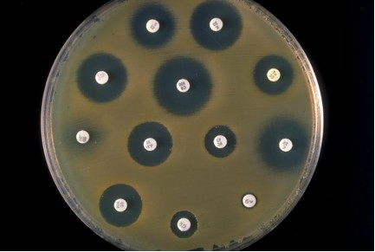
Routine URINE MICROSCOPY
Midstream urine for CULTURE AND SENSITIVITY
(to exclude UTI)

Slide 12
3.COTTON SWAB TEST (Q-TIP TEST)
A Q-tip cotton swab stick dipped in xylocaine jelly is placed in the urethra.
The pt is asked to strain/cough/valsalva manoeuvre.
Initially the swab will be parallel to the floor.
In patients with no GSI, the swab reach an angle not exceeding 10̊-15̊ above the horizontal.

Slide 13
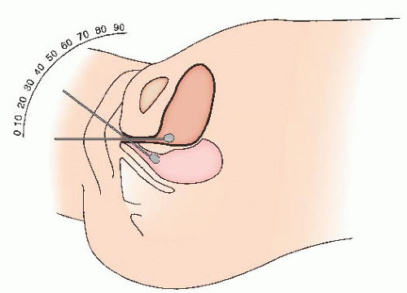
In positive cases, the angle increases by >30̊
Positive test indicates- bladder neck descent/ urethral hypermobility.

Slide 14
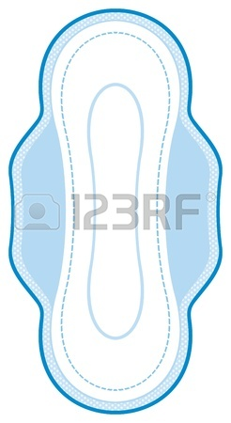
4.PAD TEST
Pt wears a preweighed sanitary pad.
Drinks 500ml water
15min – rest
30min – exercise – walking, climbing stairs
15min – provocative exercise – bending, jumping, coughing
After a period of 1hr, the pad is removed and weighed.
An increase in 1g is considered as positive test.

Slide 15

5.STRESS TEST
Pt is asked to void. She is then catheterized to determine the residual urine.
Thereafter, 250ml of warm saline is
instilled into the bladder.
Pt is then made to squat on a
preweighed absorbent pad & asked
to strain, cough.
Objectice evidence of leak is noted & grossly quantitated as mild/moderate/severe.

Slide 16
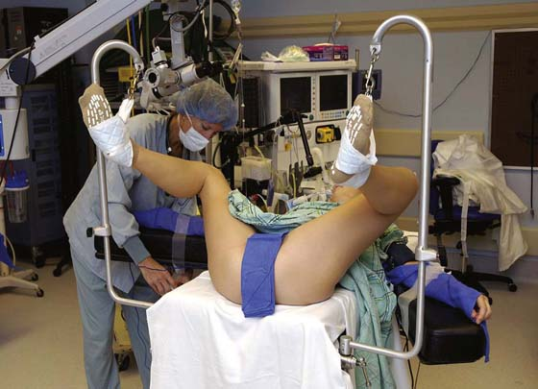
Pt is then placed in supine lithotomy position & asked to strain, cough for further evidence of stress incontinence.
The absorbent pad is weighed at the end of the test.
Wt gain of 2g or more is indicative of GSI.

Slide 17
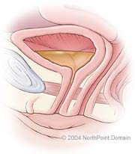
6.POST RESIDUAL URINE ASSESSMENT:
The woman is asked to void.
Catheter is inserted in the bladder
within the next 10min to measure
the remaining urine in the bladder.
Residual urine assessment by Ultrasonography is also fairly accurate.
NORMAL RESIDUAL VOLUME SHOULD BE <50ml.

Slide 18

7. VOIDING DIARY:
(FREQUENCY VOLUME CHART)
Pt is asked to record her:
Fluid intake
Output
Episodes of leaking in relation to time & activity.
Should be recorded at least for 3days
This gives an information about:
Daily urine output
No. Of voids during day and night
Bladder capacity

Slide 19
8.MARSHALL AND BONNEY’S TEST
In the MARSHALL test, the vagina in the region of bladder neck is infiltrated with local anaesthetic & the area is elevated with an allis clamp.
Failure to demonstrate leakage of urine is indicative of positive test.

Slide 20
In BONNEY’S test, 2fingers are placed in the vagina at the urethrovesical junction, on either side of the urethra & the baldder neck region is elevated.
On straining/coughing, absence of leakage of urine indicates a positive test.
Instead of fingers, hodge pessary may be used to elevate the bladder neck.

Slide 21
9.URODYNAMIC STUDY
If stress incontinence is the only symptom, there may not be any need for detailed urodynamic study.
INDICATIONS:
Associated with frequency, voiding difficulties, nocturia
Mixed symptomatology (GSI, OAB)
Associated neuropathy
Previous failed surgery

Slide 22
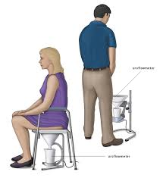
UROFLOWMETRY:
Non invasive test to rule out
voiding dysfunction.
The time period of total voiding is recorded by a stop watch & the amount of urine is estimated.
The normal flow rate is 15-25ml/sec.
The residual urine is estimated.

Slide 23
Low peak flow rate <15ml/sec, associated with prolonged voiding time, associated with increased detrusor pressure (>50cm H2O) indicates outflow obstruction.
If the flow rate drops <10ml/sec, it indicates atonic bladder, urethral obstruction - can be confirmed by cystometry.

Slide 24
In stress incontinence, urine flow rate is normal with nil or insignificant residual urine.
If uroflowmetry is normal, the next step is to do cystometry to exclude detrusor instability/ urge incontinence

Slide 25
CYSTOMETRY:
Measurements of pressures within the bladder and urethra during artificial filling of bladder with normal saline/CO2.
Helps to differentiate true stress incontinence/ detrusor instability/ urgency/ other types of incontinence.
Helpful in planning the correct treatment.

Slide 26
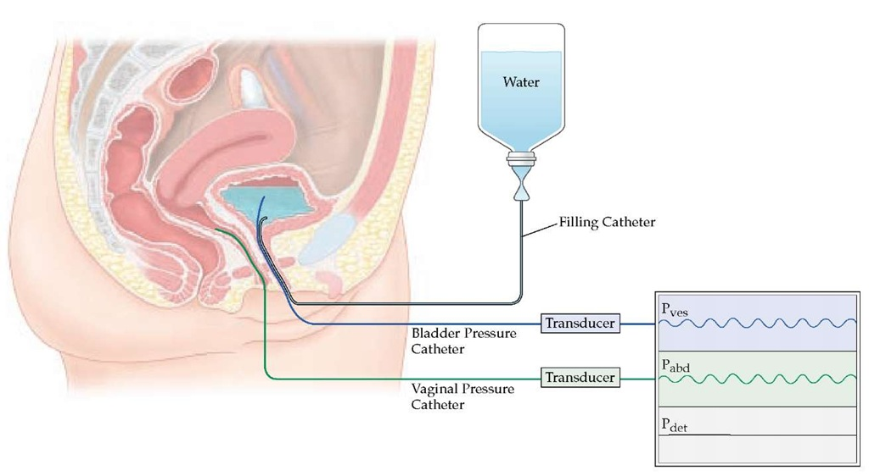
2 Pressure catheters with electronic microtip transducer are used.
One pressure catheter is introduced into the bladder to measure intravesical pressure (Pves). An additional catheter is placed in the bladder to fill it up.
Another rectal or vaginal pressure catheter is introduced to measure the intra-abdominal pressure(Pabd).
True detrusor pressure (Pdet) = Pves - Pabd

Slide 27
Technique:
Patient sits on the study coach.
Normal saline is infused inside the bladder through the filling catheter at the rate of 50–100ml/min.
Continuous recording of the volume infused and pressure changes are done.
Patient may be asked for standing, coughing or heel bouncing, for provocation.
During voiding, filling catheter is removed.
Total volume voided, urine flow rate and pressures- (Pabd, Pves and Pdet) are recorded.

Slide 28
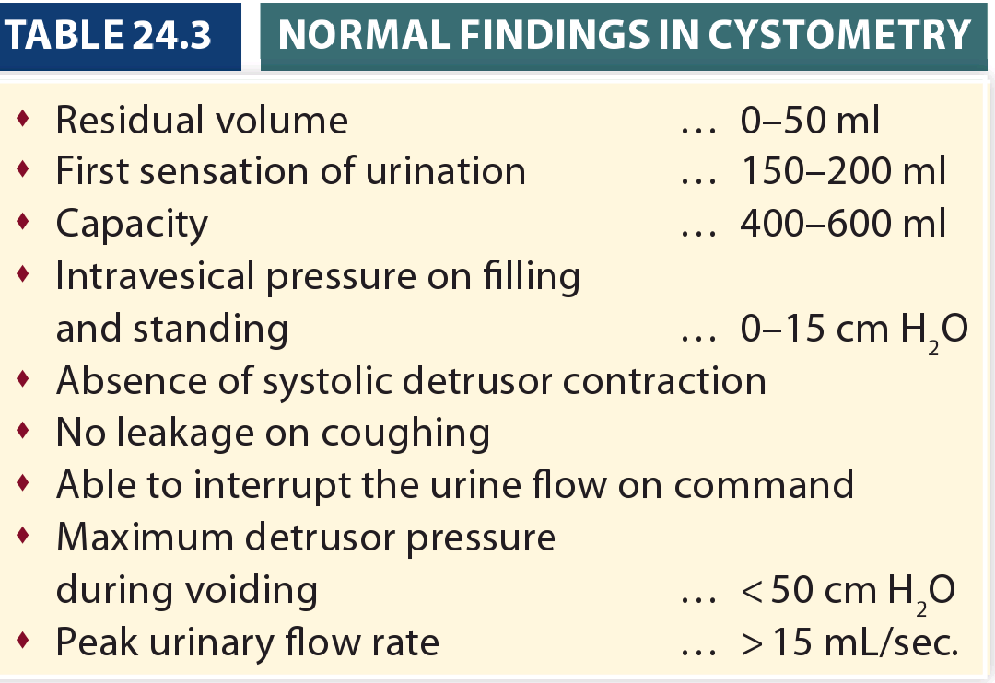

Slide 29
Urine leaks on coughing with no rise in detrusor pressure- GSI.
In GSI, cystometric evaluation is normal.
Values are abnormal in detrusor instability and urge incontinence.

Slide 30
MICTURITION CYSTOURETHOGRAPHY:
Normally, a continent woman demonstrates a well posterior UV angle of 100̊.
Loss of post.UV angle causes stress incontinence.

Slide 31
UROPROFILOMETRY:
GOLD STANDARD in the diagnosis of GSI.
In a continent woman, urethral pressure must be higher than the bladder pressure.

Slide 32
Technique:
Catheter having microtip pressure transducers is inserted into the bladder (filled with 250ml NS) & the catheter is slowly pulled down from the bladder along the urethra.
The transducer measures the intravesical and urethral pressure while it is pulled down.

Slide 33
Abnormalities:
Functional length of urethra <3cm
Peak urethral pressure decreases both in supine and erect position.
During strain, significant lowering of urethral closure pressure compared to intravesical pressure. (PATHOGNOMONIC of GSI)

Slide 34
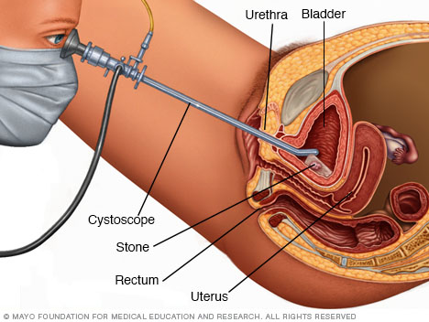
CYSTOSCOPY & URETHROSCOPY:
Perfomed only in selected cases.
Indications:
h/o hematuria
h/o frequency, urgency (to r/o reduced bladder capacity, interstitial cystitis)
Suspected neoplasm
Suspected fistula

Slide 35
VIDEOCYSTOURETHROGRAPHY:
Indications:
h/o previous failed surgery.
To exclude diverticula, sacculation.
To assess the anatomical relationship of bladder neck, bladder base and urethra.

Slide 36
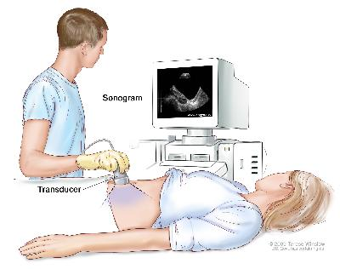
10.ULTRASOUND
To measure:
Bladder volume
Residual volume
Bladder wall thickness
(Thickness>6mm – detrusor instability)
TRANSVAGINAL ENDOSONOGRAPHY is widely used to assess the anatomy of bladder neck, urethra, bladder wall thickness

Slide 37
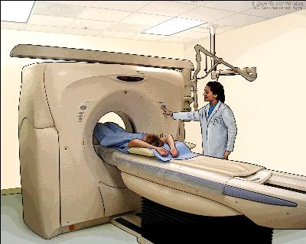
11.MRI
Helps in studying the defects in the pelvic floor muscles and the supporting fasciae.
12.CT UROGRAM
To ruleout congenital anomalies, calculi, fistulae.

Slide 38
Grades of GSI (clinical)
Grade i – incontinence with only severe stress
Grade ii – incontinence with moderate stress
Grade iii – incontinence with mild stress

Slide 39
Grades of GSI (surgical)
Type i – GSI due lo loss of posterior urethrovesical angle
Type ii – loss of posterior urethrovesical angle + urethral hypermobility
Type iii – intrinsic sphincter deficiency

Slide 40

TREATMENT
Depends on:
Clinical findings
Severity of incontinence
Presence of co.morbidities
Comprises of:
Conservative therapy
Surgical repair

Slide 41
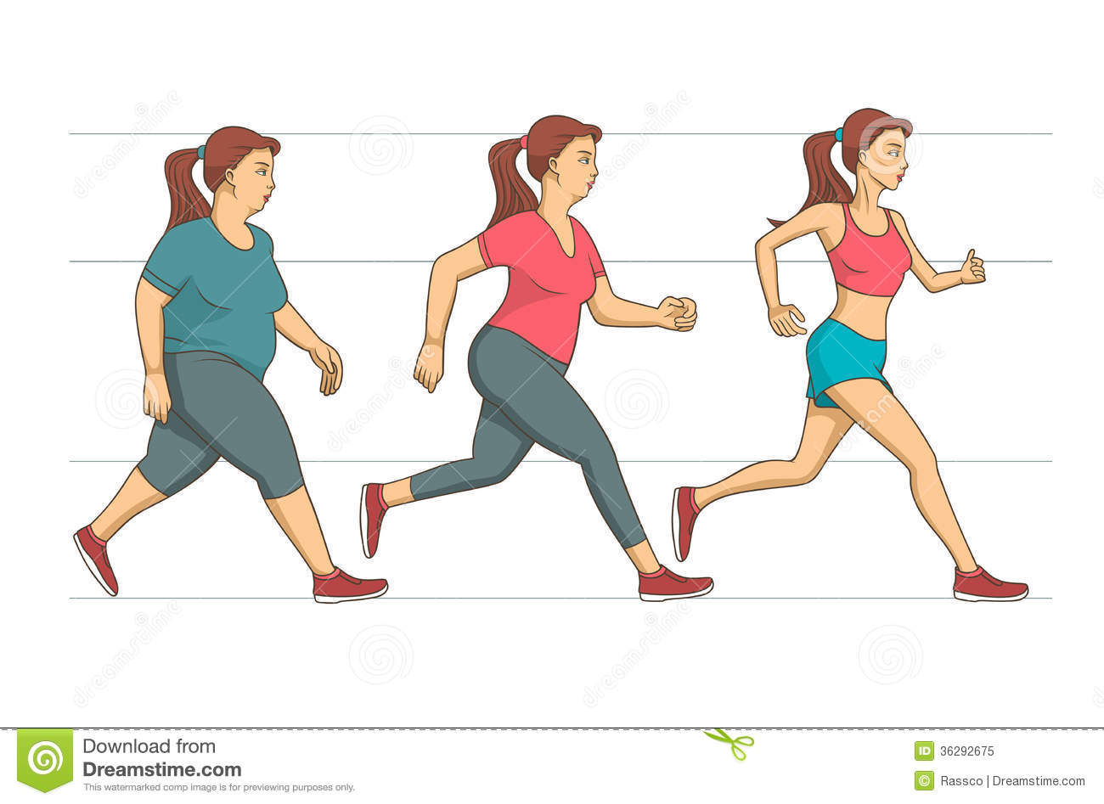


Conservative therapy
LIFE STYLE MODIFICATION:
Wt reduction
Cessation of smoking
Reduce caffeine intake

Slide 42
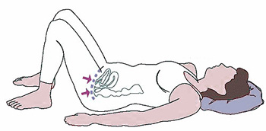
PHYSIOTHERAPY:
KEGEL’S EXERCISE- voluntary contraction of pelvic floor muscles, there by improves the resting tone of levator ani.
This should be done about 100times in a day.
It takes 8-12wks before any improvement is seen.

Slide 43
Pelvic floor exercises with or without electrical stimulation for 4months.
ELECTRICAL STIMULATION- if incontinence is caused by denervation of pudendal nerve.

Slide 44

MEDICATIONS:
α-adrenergic agents: Imipramine 10-25mg, BD
SSRIs: Duloxetine hydrochloride
Oestrogens: Oral/Vaginal cream in post menopausal
Increase the tone of the bladder neck and urethra.

Slide 45
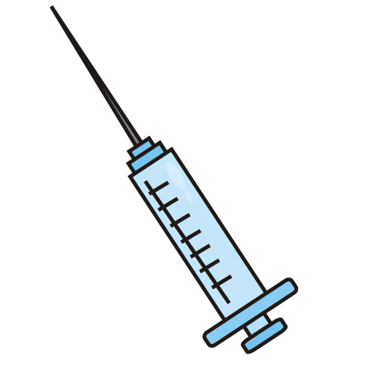
PERIURETHRAL INJECTION
GAX collagen (glutaraldehyde cross-
linked bovine collagen)
2.5ml is injected at 3 & 9 o’clock
positions into the submucosa of
proximal urethra near the bladder
base under cystoscopic vision.
effective in minor degree GSI.
It prevents premature bladder neck opening.

Slide 46
PARAURETHRAL IMPLANTS
Implants using Teflon increase the functional length of the urethra.

Slide 47
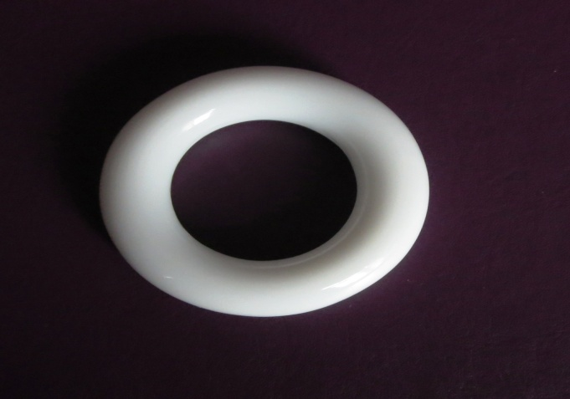
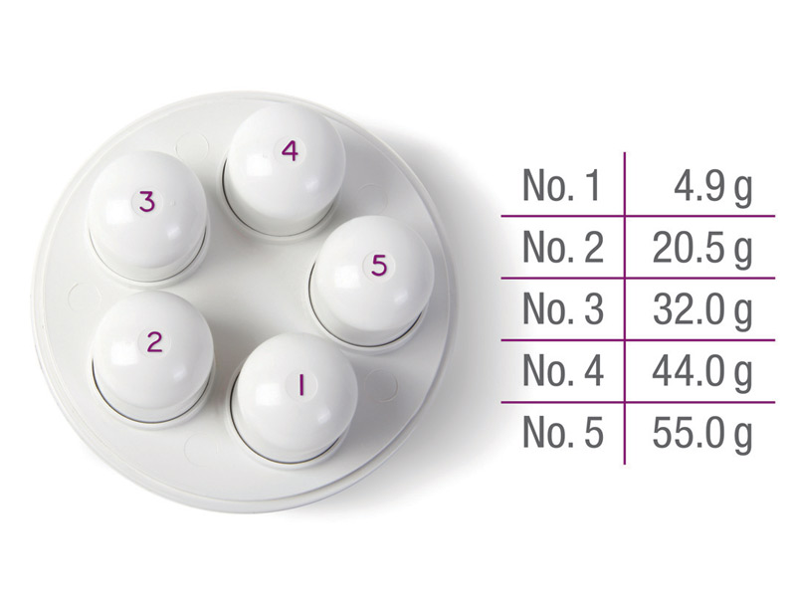
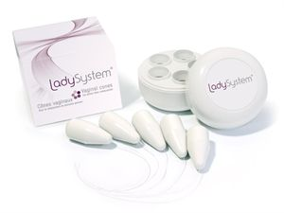
VAGINAL DEVICES:
Pessary
Bladder neck prosthesis
Silastic vaginal cone (20-100g)
supports the urethra & decrease the stress incontinence

Slide 48
INTRAURETHRAL DEVICES:
Inserted into the urethra and removed before voiding.

Slide 49

SURGICAL REPAIR Objectives and Principles
Restoration of normal anatomy to maintain bladder neck and proximal urethra as intra abdominal structures. So that it lies within the abdominal pressure zone.
Strengthening the supports of bladder neck and proximal urethra. This prevents the funnelling of vesicourethral junction in response to raised intravesical pressure.
To increase the functional urethral length.

Slide 50
Vaginal Procedures
Anterior colporrhaphy + kelly’s stitch
Retropubic midurethral tape procedures
TVT – Tension Free Vaginal Tape
TOT – Trans Obturator Tape

Slide 51
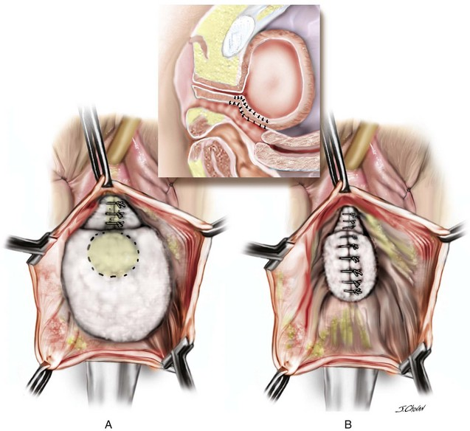
Anterior colporrhaphy + kelly’s stitch
Vesicovaginal fascia is plicated by a series of transverse stitches at the level of bladder neck with ‘0’ catgut/vicryl.
Results in elevation of bladder neck.

Slide 52
Advantages:
(i) simple procedure
(ii) less time is required
(iii) correction of co-existent cystocele
(iv) specially suited for women who are elderly and medically unfit for prolonged surgery
Disadvantage:
Long-term success rate is low (50–60%).

Slide 53
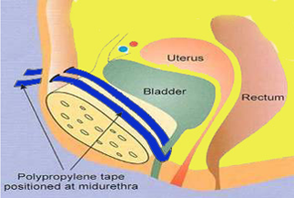
TVT
Polypropylene mesh is placed under midurethra, passed via the retropubic space and fixed to the anterior abdominal wall just above the pubic symphysis.
Tape is not sutured to any structure.
(tension-free).
Cystoscopy is done at the end of the procedure.

Slide 54
Advantages:
Less invasive
Operative time is short
Success rate is about 80–90% at 3 years
Complications:
Injury to bladder
Retropubic hematoma
Overactive bladder

Slide 55
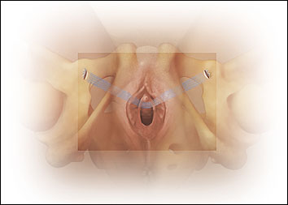
TOT
Polypropylene mesh tape is placed under the midurethra and passed through the obturator membrane & tape is fixed to the anteromedial aspect of the thigh.
No need to perform cystoscopy.

Slide 56
Advantages:
Less hospital stay
operation time is less.
Success rate is similar to that of TVT
Complications:
Post-operative delayed voiding
Urinary retention
Infection
Mesh erosion

Slide 57
Abdominal Procedures
Marshall-Marchetti-Krantz procedure
Burch colposuspension
Laparoscopic colposuspension

Slide 58
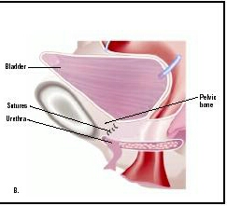
Marshall-Marchetti-Krantz (MMK) procedure
Through suprapubic approach, retropubic space is opened.
Paraurethral and paravesical endopelvic fascia at the level of bladder neck are stitched to the periosteum at the back of the symphysis pubis.

Slide 59
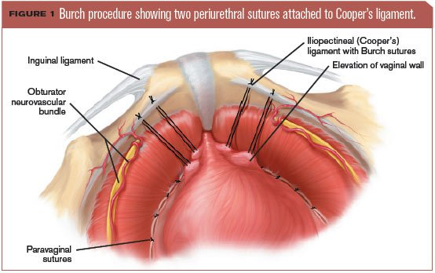
Burch colposuspension
Approach is through the retro pubic space.
Paravaginal tissue at the level of bladder neck or the lateral vaginal fornix is sutured to the iliopectineal ligament [Cooper’s ligament] with non absorbable sutures.
Gold standard for GSI.
Success rate-70-90%

Slide 60
Laparoscopic colposuspension
Same way as that of an open Burch colposuspension.
Success rate is similar to open method.
Needs experienced operator
More time consuming.

Slide 61
Complications of abd.procedures:
Hemorrhage during dissection of the space
Urethra and bladder neck injury
Osteitis pubis (MMK procedure)
Voiding difficulty
Detrusor instability
VVF
Failure and recurrence.

Slide 62
Combined procedures
Sling procedures
Endoscopic bladder suspension

Slide 63
Sling procedures
Combined approach, vaginal and abdominal (retropubic space) is made.
Sling is passed around the bladder neck and is fixed to rectus sheath under minimal tension to act as a hammock.
This works by compressing the urethra at the urethrovesical junction.
Success rate is 70 percent.

Slide 64
The materials used for sling are:
organic (autogenous)
rectus sheath (Aldridge procedure)
fascia lata
2. Inorganic
silastic
marlex
goretex

Slide 65
Disadvantages:
Voiding difficulties
Detrusor instability and
Sling erosion

Slide 66
Endoscopic bladder suspension
Bladder-neck region is dissected, through the vagina.
A small suprapubic incision is made.
Sutures are passed between vagina and anterior abdominal wall & the proximal urethra and the bladder neck are fixed to the rectus sheath.
Success rate – 50%

Slide 67
Salvage Procedures
Implantation of artificial sphincter
Urinary diversion

Slide 68
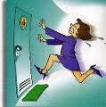
Urge Incontinence
Second common cause of urinary incontinence.
Involuntary loss of urine, accompanied by/ preceded by urgency.
2types:
Sensory urge incontinence
Motor urge incontinence

Slide 69
Sensory Urge Incontinence:
Unable to control the escape of urine once there is urge to void.
Motor Urge Incontinence: (OVER ACTIVE BLADDER/OAB)
Leakage of urine due to detrusor over activity during the filling phase while the patient tries to inhibit it.

Slide 70
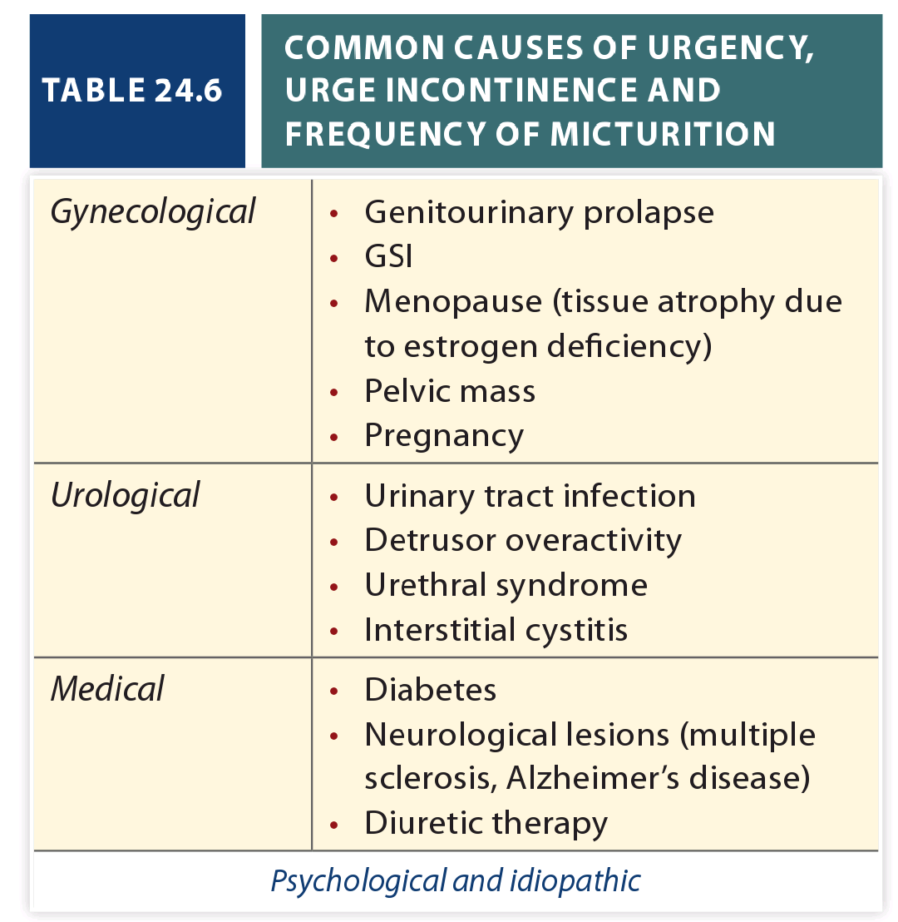

Slide 71
Clinical presentation
 | SENSORY URGE INCONTINENCE | MOTOR URGE INCONTINENCE (OAB)
Stress prior to leakage | Nil | Nil
Urge prior to leakage | Present | Present except in neurologic disease
Awareness | Present | Not present
Control of loss | Can control with adequate encouragement | Cannot control despite strong encouragement
Amount | Large | Large

Slide 72
Urodynamics
 | SENSORY URGE INCONTINENCE | MOTOR URGE INCONTINENCE (OAB)
Uro flowmetry | Normal | High in idiopathic group
Cystometry | Normal | Urge to pass urine is provoked at much lower bladder filling. Detrusor pressure is increased during filling.
Cystourethroscopy | oﬀending factor present | Diminished bladder capacity

Slide 73
Treatment
Psychotherapy
BLADDER DRILL – this involves voiding at scheduled times starting with 30-60min interval. If urge to void occurs earlier, distraction methods are used to control voiding.
The initial response is quite good but the failure rate is high.

Slide 74
Medications:
Oxybutynin
Hyoscyamine
Dicyclomine
Tolterodine
Trospium
Solifenacin
These drugs act through anticholinergic property & inhibit bladder contractility, increase bladder neck and urethral resistance.

Slide 75
INTRAVESICAL THERAPY:
Capsaicin, botulinum toxin, resiniferatoxin
SURGICAL TREATMENT:
Denervation
Detrusor myectomy
Augmentation cystoplasty
Urinary diversion

Slide 76
Mixed Incontinence
Have symptoms of both stress and urge incontinence.
Managed initially with medical treatment for detrusor overactivity.
If repeat urodynamic study reveals stress incontinence, surgical intervention is warranted.

Slide 77
Overflow Incontinence
Occurs as a result of prolonged and neglected retention.
Its mechanism is probably the over-distension of the bladder pulls open the internal sphincter.
There may be compensatory detrusor hypertrophy.

Slide 78
Causes:
Obstructive:
Stenosis following operations of urethrovaginal fistula or caruncle.
Urethral angulation in cases with big cystocele.
Bladder neck obstruction in postmenopausal women.
After sling operation for stress incontinence.
Cancer of the urethra, bladder neck, vulva, paraurethral cyst and tumor.

Slide 79
Non-obstructive:
BLADDER DETRUSOR MAY FAIL TO CONTRACT
Diseases—multiple sclerosis (detrusor sphincter dys synergia)
Parkinson’s disease
neuropathy.
Drugs—epidural anesthesia antidepressant, ganglion blockers.
Psychogenic—hysteria, fear, modesty or shyness.

Slide 80
Urodynamic findings:
Cystometry
Large capacity of the bladder
No rise of detrusor pressure during voiding.
Uroflowmetry
Low flow rate
Significant residual urine.

Slide 81
Treatment:
Surgical treatment of obstruction, if any, has to be done.
In cases of non-obstructive group, continuous catheter drainage is required. Intermittent clamping of the catheter is to be done prior to its removal.
Following removal of the catheter, the residual urine has to be measured. It should not be more than 100 ml, preferably 50 ml. If more than 100 ml, the continuous drainage is reinstituted.

Slide 82
Functional Incontinence
Unrelated to the physiological voiding mechanism.
Causes:
D - delirium
I - infection
A - atrophy
P - pharmacological
P - psychological
E - endocraniopathy
R - restricted mobility
S - stool impaction

Slide 83
Treatment of underlying cause.
Usage of incontinence pads
Fluid restriction 1L/day
Vaginal estrogen in post menopausal

Slide 84
Extra Urethral Incontinence
When the urine escapes through abnormal opening & not through the urethra.
Congenital - Ectopic ureter
Acquired - Fistulae (vesical, ureteral)

Slide 85

