Slide 1
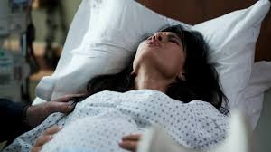

Genital Injuries.

Slide 2
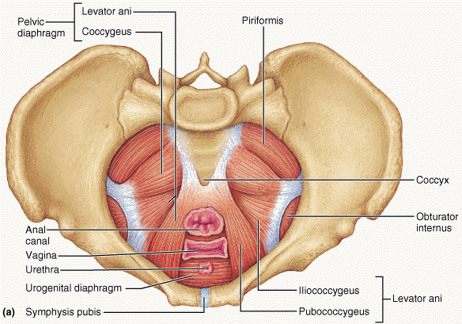
Anatomy of Perineum.
Pelvic Floor/Pelvic Diaphragm,
Perineum.

Slide 3
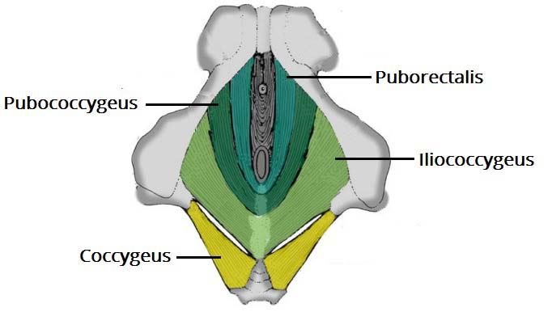
Pelvic Floor.
Pelvic Floor is a muscular partition which seperates the pelvic cavity from the anatomical perineum.
It consists of 3 sets of muscles on either side:
Pubococcygeus,
Iliococcygeus,
Ischiococcygeus
They are collectively called Levator Ani.

Slide 4
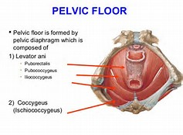
Upper surface:Concave and slopes downwards,backwards and medially covered by parietal fascia.
Inferior surface is convex and is covered by anal fascia.
The muscle with the covering fascia is called the Pelvic Diaphragm.

Slide 5
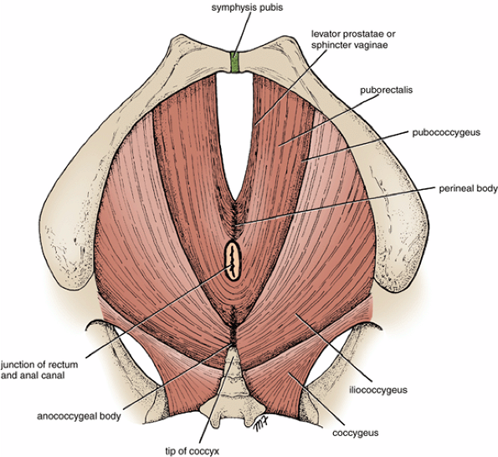
Origin
Back of the pubic rami, from the condensed fascia covering the obturator internus(White line)
From the inner surface of ischial spine

Slide 6
Insertion.
The fibres pass backwards and medially to be inserted in the midline from before backwards to
the vagina( lateral and posterior walls)
Perineal body,
anococcygeal raphae,
lateral borders of coccyx and
lower part of sacrum.

Slide 7
Pelvic cellular tissue.
Between the pelvic peritoneum and the upper surface of the levator ani which fill all the available spaces.
Contains
fatty & connective tissue,
Unstraited muscle fibres.
Condensation occurs near the cervicovaginal junction to form ligaments which extend from viscera to the pelvic organs from either side.

Slide 8
Functions.
To support the pelvic organs
Pubovaginalis which forms a “U” shaped sling which supports the vagina which inturn supports the other pelvic organs.(Bladder & Uterus).
To maintain intra abdominal pressure by reflexly responding to its changes.
Facilitates anterior internal rotation of the presenting part when it presses on the pelvic floor.
Puborectalis place an ancillary role to the action of the External anal sphincter.
Ischiococcygeus helps to stabilise the sacroiliac and sacrococcygeal joints.
To steady the perineal body.

Slide 9
During Pregnancy & Parturition.
Levator ani muscle undergo
hypertrophy,
Becomes less rigid,
More distensible.
Due to water retention,it swells up and sags down.
In second stage, the pubovaginalis and puborectalis relax and levator ani is drawn up over the advancing presenting part .

Slide 10
Failure of the levator ani to relax at crucial moment may lead to extensive damage to the pelvic structures.
The effect of such displacement is to elongate the birth canal which is composed of soft parts below the bony outlet.
The soft canal has got deep lateral and posterior walls and its axis is in continuation with the axis of the bony pelvis.

Slide 11
Perineum.
Anatomical Perineum:
Anatomically,the perineum is bounded
Above:Inferior surface of the pelvic floor,
Below:by the skin b/w the buttocks & thighs.
Laterally:
ischiopubic ramus,
Ischial tuberosities &sacrotuberous ligaments.
Posteriorly:by the coccyx.

Slide 12
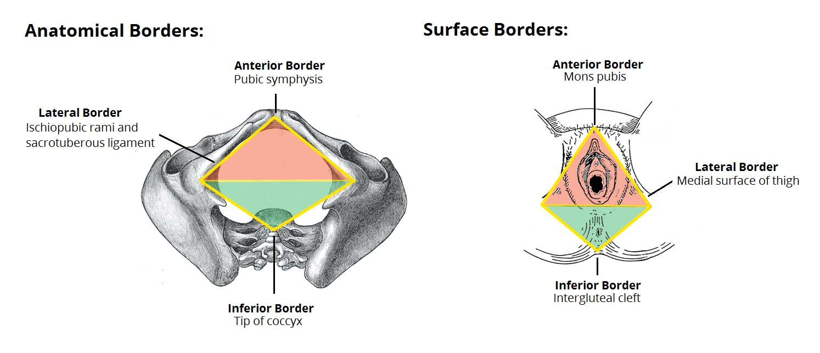

Slide 13
The diamond shaped space of the bony pevic outlet is divided into 2 triangular spaces with the common base formed by the free border of the urogenital diaphragam.
The anterior triangle is called the urogenital triangle.
Which fills up the gap of hiatus urogenitalis and is important from the obstetric point of view.
The posterior one is called the anal triangle.

Slide 14
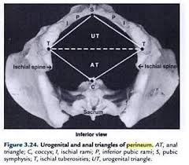
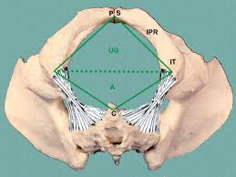
Triangle of perineum.

Slide 15
Urogenital Triangle.
It is pierced by the terminal part of the vagina & urethra.
2 compartments:
Superficial Pouch,
Deep Perineal Pouch.

Slide 16
Superficial Pouch.
Formed by the
Deep layer of the superficial perineal fascia(Colles fascia),
Inferior layer of the urogenital diaphragam(Perineal Membrane)
CONTENTS:
Superficial transverse perinei(Paired),
Bulbospongius-covering the bulb of vestibule,
Ischiocavernosus(Paired) covering the crura of the clitoris and the Bartholin’s gland.(Paired).

Slide 17
Structures in
Superficial pouch
Clitoris & crus
Bulb of vestibule
Vestibular glands

Slide 18
Deep perineal Pouch
Formed by the inferior and superior layer of the urogenital diaphragam.
Together called urogenital diaphragam/Triangular ligament.
Between the layers there is a potential space of about 1.25cm.
Contents:
Deep transverse Perinei(Paired),
Sphincter Urethrae membranacea

Slide 19
Urogenital diaphragm
Sphincter urethrae
Deep transverse peroneal muscles

Slide 20
Anal Triangle.
No obstetric significance.
Contains terminal part of the anal canal with
Sphicter ani externus,
Anococcygeal body,
Ischiorectal fossa,
Blood vessels,nerves & lymphatics.

Slide 21
Obstetric Perineum.
Perineal body,central point of the perineum.
The pyramidal shaped tissue where the pelvic floor and the perineal muscles and fascia meet in between the vagina and anal canal is called the Obstetric Perineum.
It measures about 4cmx4cm with the base covered by the perineal skin and the apex is pointed and is continuous with the rectovaginal septum.

Slide 22
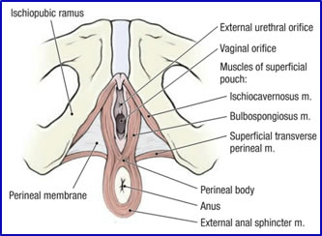

Slide 23
Musulofascial structures .
Fasciae:
2 layers of superficial fascia:
Superficial fatty liver and deep layer called Colles fascia.
Inferior and superior layer of the urogenital diaphragam.(Triangular ligament).

Slide 24
Muscles
Superficial and deep transverse perinei(Paired).
Bulbospongius,
Levator ani:
Pubococcygeus (Paired),situated at the junction of the upper two third and lower one third of the vagina.
Sphincter ani externus(few fibres).

Slide 25
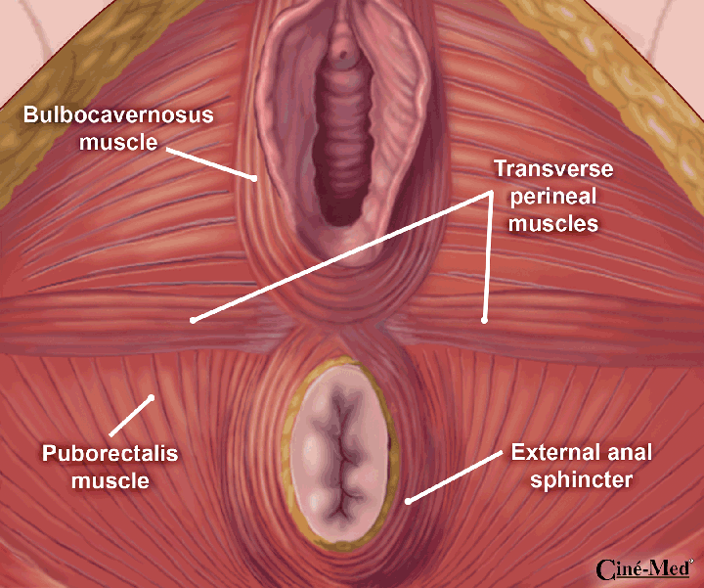

Slide 26
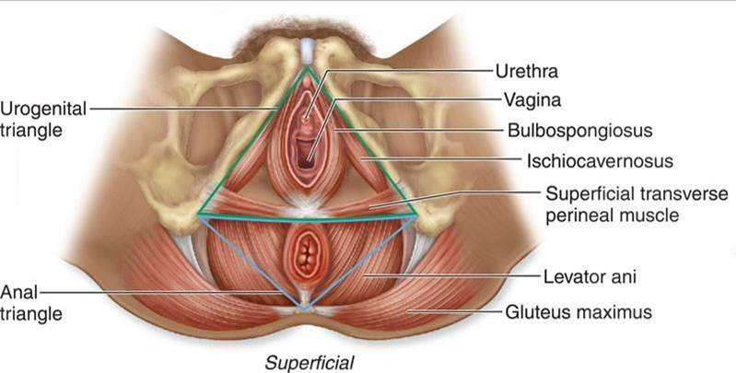

Slide 27
Importance.
Helps to support the levator ani which is placed above it.
By supporting the posterior vaginal wall, it indirectly supports the anterior vaginal wall,bladder and the uterus.
It is vulnerable to injury during childbirth.
Deliberate cutting of the structures during delivery is called Episiotomy.

Slide 28
Perineal Tears.
An intact perineum is one in which there is no tissue seperation at any site following a vaginal delivery.
During a vaginal delivery, the tissues of anterior perineum(Clitoris,Vestibule,Urethra,Labia majora,minor) are more vulnerable to trauma compared to posterior fourchette due to pressure of the fetal occipital bone when the head is extended during the course of normal labour.

Slide 29
When the fetal head is guarded avoiding extension(Ritgen’s manoeuvre) the head is pushed posteriorly,thereby increasing the trauma to the posterior perineum.
Gross injury(third & fourth degree) is invariably a result of mismanaged second stage of labor.
Overall risk is 1% of all vaginal deliveries.

Slide 30
Causes
Perineal injury results from
A) Overstreching,
B)Rapid streching of the perineum especially when the perineum is inelastic.
Elderly Primigravida,
Perineal Scar.

Slide 31
Classification of Perineal Tears.
Degrees | Type of Injury.
FIRST DEGREE | INJURY TO PERINEAL SKIN ONLY
SECOND DEGREE | INJURY TO PERINEUM INVOLVING PERINEAL MUSCLES BUT NOT INVOLVING THE ANAL SPHINCTER.
THIRD DEGREE | INJURY TO PERINEUM INVOLVING THE ANAL SPHINCTER COMPLEX.
III A | LESS THAN 50% OF EAS THICKNESS TORN
III B | MORE THA N 50% OF EAS THICKNESS TORN.
III C | BOTH EAS AND IAS TORN.
FOURTH DEGREE | INJURY TO PERINEUM INVOLVING THE ANAL SPHINCTER COMPLEX(EAS & IAS) AND ANAL EPITHELIUM.

Slide 32
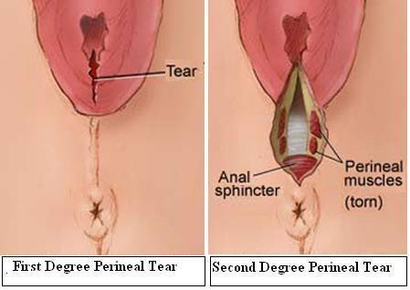
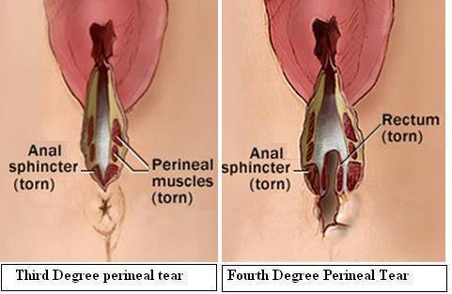
Types of injury.

Slide 33
RISK FACTORS.
Nulliparity,
Increased maternal age,
Asian race,
Low socioeconomic status,
Obesity(BMI>/30)
Prolonged second stage of labour(>120 min),
Primipara with short perineum,
Operative vaginal delivery(max risk with low forceps),

Slide 34
Outlet contraction with narrow pubic arch,
Shoulder dystocia,
Face to pubis delivery,
Scar in the perineum(perineorrhaphy,episiotomy),
Preciptate labour.
Midline episiotomy,
Persistent occiptoposterior position,
Birth weight >3.5kg.

Slide 35
Contrary to the popular belief,routine episiotomy is not warranted,as it does not prevent anal sphincter injury.
In fact,it shows to increase the risk of spontaneous lacerations in subsequent deliveries.
Women who had previous anal sphincter injuries are three times at risk for subsequent sphincter lacerations.

Slide 36
Complications.
Immediate short term complications:
Increased blood loss,
Need for suturing,
Perineal pain.
Protracted pain occurs in 20% cases, varying degree of functional impairment of sphincters
Wound infection can also occur.

Slide 37
Long term consequences.
Pelvic floor dysfunction lead to bowel,urinary and sexual function impairment.
Includes
Stress urinary incontinence,
Overactive bladder,
Anal incontinence &
Prolapse.

Slide 38
Prevention of Perineal Tears.
Identifying women at risk and avoidance of obstetric interventions,
Selective episotomy on case to case basis,
Warm compressions to the perineum,massage with a lubricant.
No touch technique(no intervention) until crowning of the fetal head,
Avoidance of Valsalva pushing,
Maintaining the women in left lateral position till active pushing.
Controlled head delivery.

Slide 39
Management
Recent tear should be repaired immediately following the delivery of the placenta.
Reduces the chances of infection and minimizes the blood loss.
In case of delay beyond 24 hrs the repair is to be withheld.
Antibiotics should be started to prevent infection,
The complete tear should be repaired after 3 months if delayed beyond 24 hrs.
If doubt regarding degree it is to classify higher degree rather than lower degree.

Slide 40
Identification of anal sphincter injury.
On visual examination, absence of normal puckering around the anterior aspect of the anus may give a clue.
Insert a finger into the rectum and ask the women to squeeze.
In case of damage to EAS ,deficiency of the sphincter can be felt on squeezing and the torn ends can be seen to retract backwards.
Epidural analgesia can affect the muscle power so bulk of the muscle should also be palpated between the finger and thumb.

Slide 41
Anal sphincter Injury.
Anal sphincter complex consists of
IAS,
EAS.
The internal anal sphincter is the lower most part of the circular smooth muscle layer of the rectum, and lies between the anal mucosa and the EAS
It contributes to 70% resting anal sphincter complex tone.
It is invariably tone in fourth degree tears,although occult disruption of the sphincter can occur even with an intact rectal mucosa.

Slide 42
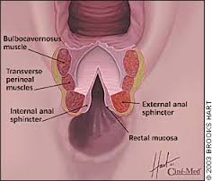

Slide 43
Incidence of 3rd and 4th degree tears varies between 0.6%-9.0% after vaginal deliveries where mediolateral episotomy is practised.
Endoanal USG :
Detects occult sphincter injuries/defects.
26.9%-Primiparous,
8.2%-Multiparous.
30% defects are symptomatic,
3.4% experience faecal incontinence without detectable anal sphincter defect.

Slide 44
Repair of complete perineal tear,
STEP I:
Patient in lithotomy position,
Antiseptic cleaning of the local area,
Repair may be done with
Local infiltration of 1% lignocaine hydrochloride(10-15ml)
Pudendal block,
Preferably under GA/Regional anaesthesia.

Slide 45
STEP II
Dissection is not required as in old complete perineal tear.
The rectal & anal mucosa is first sutured from above downwards.
No.3-0 vicryl or 3-0PDS,atraumatic needle, interuppted stiches with knots inside the lumen are used.
The rectal muscles including the pararectal fascia are then sutured by interrupted sutures using the same suture material

Slide 46
d) the torn ends of the sphicter ani externus(EAS) are then exposed by Allis’s tissue forceps.
The sphincter is reconstructed with a figure of eight stich,and it is supported by another layer of interrupted sutures.
For repair of EAS either an overlapping or end to end approximation method can be used
IAS repair is done by interrupted suture.

Slide 47
STEP III
Repair of perineal muscle is done by interrupted sutures using no.”O” PDS or dexon or vicryl.
Surgical knots are buried under the superficial muscles.

Slide 48
STEP IV
The vaginal wall and the perineal skin are apposed by interrupted sutures.
SUTURES:
For repair of EAS,monofilament sutures such as polydioxanone(PDS),/Polyglactin(Vicryl) can be used.
Repair of IAS is done with fine suture size such as 3-0 PDS and 2-0 vicryl as they cause less irritation & discomfort.

Slide 49
https://youtu.be/tOpqKzvcudk

Slide 50
Post operative care.
Broad spectrum antibiotics( IV Cefuroxime 1.5g,Metronidazole 400mg thrice daily for 5 to 7 days) to reduce wound infection & dehiscence due to anaerobic contamination of fecal matter.
A low residual diet consisting of milk, bread, biscuits, fish,sweets, etc; from third day onwards.
Lactulose 8 ml twice daily beginning on the second day and increasing the dose to 15 ml on third day is satisfactory regimen to soften the stool.

Slide 51
Women advised Physiotherapy & Pelvic Floor Exercises.
Review again in 6-12 weeks postpartrum.
In case of persistent incontinence of flatus and feces,endoanal USG and anorectal manometry is considered to detect any residual defects(20-30%)
Consultation with a colorectal surgeon may be needed..

Slide 52
Plan for Future delivery.
Patients should be counselled regarding the risk of developing anal incontinence or worsening of symptoms with subsequent vaginal delivery after anal sphincter repair.
Vaginal delivery may be allowed in selected case with or with out episiotomy.
Option of Caesarean section is given.
Women have symptoms / abnormal endoanal USG/manometry should be delivered by elective Cesarean section.

Slide 53
Cervix
Minor degree of cervical tear is invariable during first delivery & requires no treatment.
Extensive cervical tear is rare.
It is the commonest cause of traumatic postpartrum haemorrhage.
Left lateral tear is the commonest cause.

Slide 54
Causes.
Iatrogenic.
Rigid cervix.
Strong uterine contractions.
Detachement.

Slide 55
IATROGENIC.
Attempted forceps delivery or breech extraction through incompletely dilated cervix.
Manual dilatation of cervix to enhance the labour.
Induction of labour is associated with a 3 fold increase in cervical lacerations

Slide 56
Rigid cervix.
May be due to congential
More commonly following scar from previous operations:
Amputation,
Cervical cerclage,
Conization,
Presence of a lesion like Ca cervix.

Slide 57
Strong uterine contractions.
In
Preciptate labour(Short second stage of labour)
Cause rapid & forceful dilatation of cervix increasing risk for lacerations
Premature bearing down with an incompetely dilated cervix,
Extremely vascular cervix as in Placenta Previa.

Slide 58
Detachment.
Detachment of the cervix may be annular which involved the entire circumference of the cervix.
Occurs following Prolonged labour in Cervical dystocia.
Anterior lip when it is nipped between the head and the symphysis pubis in association with the sacral os.
Bleeding is minimal
Healing occurs through epithelisation.

Slide 59
Diagnosis.
Cervical tear may be suspected and excluded in any case of :
persistent bleeding in the presence of a well contracted uterus
The entire circumference of the cervix must be explored to identify the nature and extent of the cervical tear and to suture it appropriately.

Slide 60
Prerequisites are
A good light is essential.
The cervical suturing set must have long blade vaginal retractors for adequate exposure,
Sim’s posterior vaginal speculum,
3 sponge holders.

Slide 61
Exploration of the cervix.
The first sponge holder is applied on the anterior lip of cervix,
The second sponge holder is applied at 45 degree interval and the area between them is inspected.
The second and third sponge holders are advanced further along the circumference until the entire 360 degree of the cervix has been visualised.
Superficial tears, which are not bleeding ,need not to be sutured,but if the tear is deep and bleeding,suturing should be done.

Slide 62
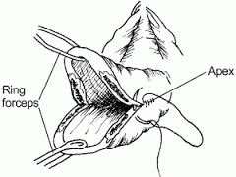

Slide 63
Method of suturing.
Repair done in lithotomy position.
The anterior & Posterior margins of the torn cervix are grasped by sponge holding forceps.
Instead of giving traction to the forceps, it is better to push down the fundus gently by assistant.

Slide 64
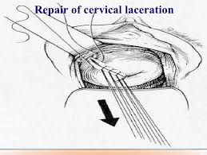

Slide 65
Cont;
The suturing must start above the apex of the tear in order to include all retracted blood vessels.
It is difficult to reach the apex of the tear, a stich is taken as high as possible and the sutures left long.
The suture is then given traction and the stich placed above the previous one.
The tear can be traced in this fashion till the apex is reached and a stich is placed above it.
Mattress suture is preferrable as it prevents rolling in of the edges.

Slide 66
Complications
Early:
Deep cervical tears involving the major vessels leads to severe PPH.
Broad ligament haematoma.
Pelvic cellulitis.
Late:
Ectropion,
Cervical Incompetence.

Slide 67
Vagina .
Isolated vaginal tears or lacerations without involvement of the perineum / cervix are not uncommon.
Seen in instrumental / Manipulative delivery.
Tears are extensive and often associated with brisk haemorrhage.

Slide 68
Treatment.
Tears associated with brisk haemorrhage require exploration under GA with a good light.
Tears are repaired by interrupted / continous sutures using chromic catgut No.”0”.
In extensive lacerations, in addition to sutures,haemostasis may be achieved by intravaginal plugging by roller gauze,soaked with glycerin and acriflavine.
The plug should be removed after 24 hrs.
Selective arterial embolization may be done if bleeding persists.

Slide 69
COLPORRHEXIS.
Rupture of the vault of the vagina is called Colporrhexis.
Primary,
Secondary.

Slide 70
Primary & Secondary.
PRIMARY:
Only the vault is involved.
It is said to be complete when the peritoneum is opened up.
SECONDARY:
Secondary when associated with cervical tear(Common)
Posterior fornix usually ruptures,however,cervical tear is usually associated with tear of the lateral fornix.

Slide 71
Pelvic hematoma.
Collection of blood anywhere in the area between the pelvic peritoneum and perineal skin is called Pelvic Hematoma.
ANATOMICAL TYPES:
Depending upon the location of the haematoma, whether below or above Levator ani,it is termed as:
Infralevator hematoma-Common,
Supralevator hematoma –Rare.

Slide 72
Infralevator Hematoma.
The commonest one is the Vulval Hematoma.
ETIOLOGY:
Improper hemostasis during repair of vaginal or perineal tears or episiotomy wound.
Failure to take precautions while suturing the apex of the tear.
Failure to obliterate the dead space while suturing the vaginal walls.
Rupture of Paravaginal venous plexus either spontaneously following instrumental delivery.

Slide 73
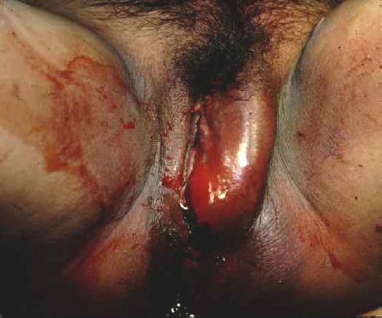

Slide 74
SYMPTOMS:
Persistent ,severe pain on the perineal region.
There may be rectal tenesmus or bearing down efforts when extension ocurs to the ischiorectal fossa.
There may be even retention of urine.

Slide 75
Signs
Variable degress of shock may be evident.
Local examination reveals a tense swelling at the vulva which become dusky and purple in colour and tender to touch.

Slide 76
Treatment.
A small hematoma <5 cm may be treated conservatively with cold compression.
Larger hematomas should be explored in the operation theatre under GA.
Simultaneously resuscitative measures are to be taken.
The blood clots are to be scooped out and the bleeding points are to be secured.
Usually,a generalised oozing surface is visible.

Slide 77
Contn;
The dead space is obliterated by deep mattress sutures and a closed suction drain may be kept in that place for 24 hrs.
A foley catheter is inserted till the tissue odema subsides.
Prophylactic antibiotic is to be administered.

Slide 78
Supralevator hematoma.
Causes:
Extension of cervical laceration or Primary colporrhexis(Vault rupture).
Lower uterine segment rupture.
Spontaneous rupture of paravaginal venous plexus adjacent to the vault.

Slide 79
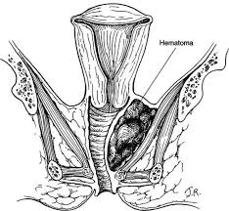

Slide 80
Diagnosis.
The diagnosis is usually late as pain is not of a conspicuous nature and also the vaginal bleeding.
Unexplained shock with features of internal hemorrhage following delivery raises the suspicion.
P/A: Swelling above the inguinal ligament pushing the uterus to contralateral side.

Slide 81
P/V:
occlusion of the vaginal canal by a bulge.
A boggy swelling felt through the fornix.
P/R:Corrobates the presence of the boggy mass.
USG:Exact localisation of the hematoma.

Slide 82
Management .
Usual treatment of shock is to be instituted.
Arrangement is made for laporotomy.
The anterior leaf of broad ligament peritoneum is incised and the blood clot is scooped out.
The bleeding points, if visible, are to be secured and ligated.
Randomized blind sutures shouldnot be placed to prevent ureteric damage.
If oozing continues, ligate anterior division of internal iliac artery.

Slide 83
Vulva.
Lacerations of the vulval skin posteriorly and the parauretheral tear on the inner aspect of the labia minora are the common sites.
Parauretheral tear may be associated with brisk haemorrhage.
It should be repaired by interrupted catgut sutures,
Preferably after introduction of a rubber catheter into the bladder to prevent injury of the urethera.

Slide 84


