Slide 1
INTRACYTOPLASMIC SPERM INJECTION

Slide 2
MAJOR ASSISTED REPRODUCTIVE TECHNOLOGIES (ART)
ART-It is the use of technology to assist human reproduction in the t/t of male and female infertility.
It includes-
In vitro fertilization and embryo transfer (IVF-ET)
Intracytoplasmic sperm injection (ICSI)
preimplantation of genetic councelling(PGD)
Gamete intra-fallopian transfer (GIFT)
Zygote intra-fallopian transfer (ZIFT)

Slide 3
History of ART:
1978- first successful birth using In Vitro Fertilization(U.K)
1984- first successful baby from frozen Embryo(Netherlands)
1985-1st GIFT baby(U.S.A)
1992-1st ICSI (Belgium)
1986-first successful birth using Zygote Intra Fallopian Transfer

Slide 4
History of ART in India
1978 october-Dr.Subhas Mukhopadhyay and his team-Birth of Durga.
1982-1986-Kolkata-Dr.B.N.Chakravorty,Dr.S.Ghosh Dastidar-Birth of Imran.
1983-1986-bombay-dr.I.Hinduja,dr.Anandkumar-birth of Harsha.
1992-kolkata-1st GIFT baby-Dr.S.Ghosh Dastidar,Dr.K.Ghosh Dastidar.
1995-Mumbai-ICSI baby –Dr.Firuza Paarikh

Slide 5
INDICATIONS OF ART
1.TUBAL PATHOLOGY-
In case of impaired tubal function but no occlusion is present or following tubal surgery,IVF is method of choice after an infertility duration of 2yr or longer depending of female age.
2.UNEXPLAINED INFERTILITY-
IVF is indicated if the duration is 3yr or longer.
Woman is older than 36yr.
3. MALE INFERTILITY-
Total motile sperm count <1million T/T of choice is ICSI.
TMC>1 & less than 10 million & infertility duration is 2yrs or longer,IVF is the choice.
TMC>10 million-As unexplained infertility.

Slide 6
4.ENDOMETRIOSIS-
severe type can be treated as tubal pathology.
5.CERVICAL FACTOR-
After an infertility duration of 2yrs t/t is IVF.
6.HORMONAL DISTURBANCES-
Anovulatory cycle abnormalities are an indication of IVF

Slide 7
SEX LINKED DISEASES
In ceratin diseases only the male offspring is affected.In such diseases it is possible to transfer the embryos of the unaffected sex.This will completely eliminate the risk of transmission of the disease.This is possible by using the technique of pre-implantation genetic diagnosis.

Slide 8
UTERINE PROBLEMS
problems of uterus and uterine lining that can cause or contribute to reproductive problems such as infertility or recurrent miscarriage-
Uterine polyps
Uterine fibroids
Intrauterine adhesions
Congenital uterine anomaly
Luteal phase defect
Thin endometrial lining

Slide 9
IMMUNOLOGICAL FACTOR
Immunological infertility is treated by IVF.Here the sperms are not exposed to the antisperm antibody found in the female reproductive tract, there is a definite role of the IVF-ET in the immunological infertility.

Slide 10
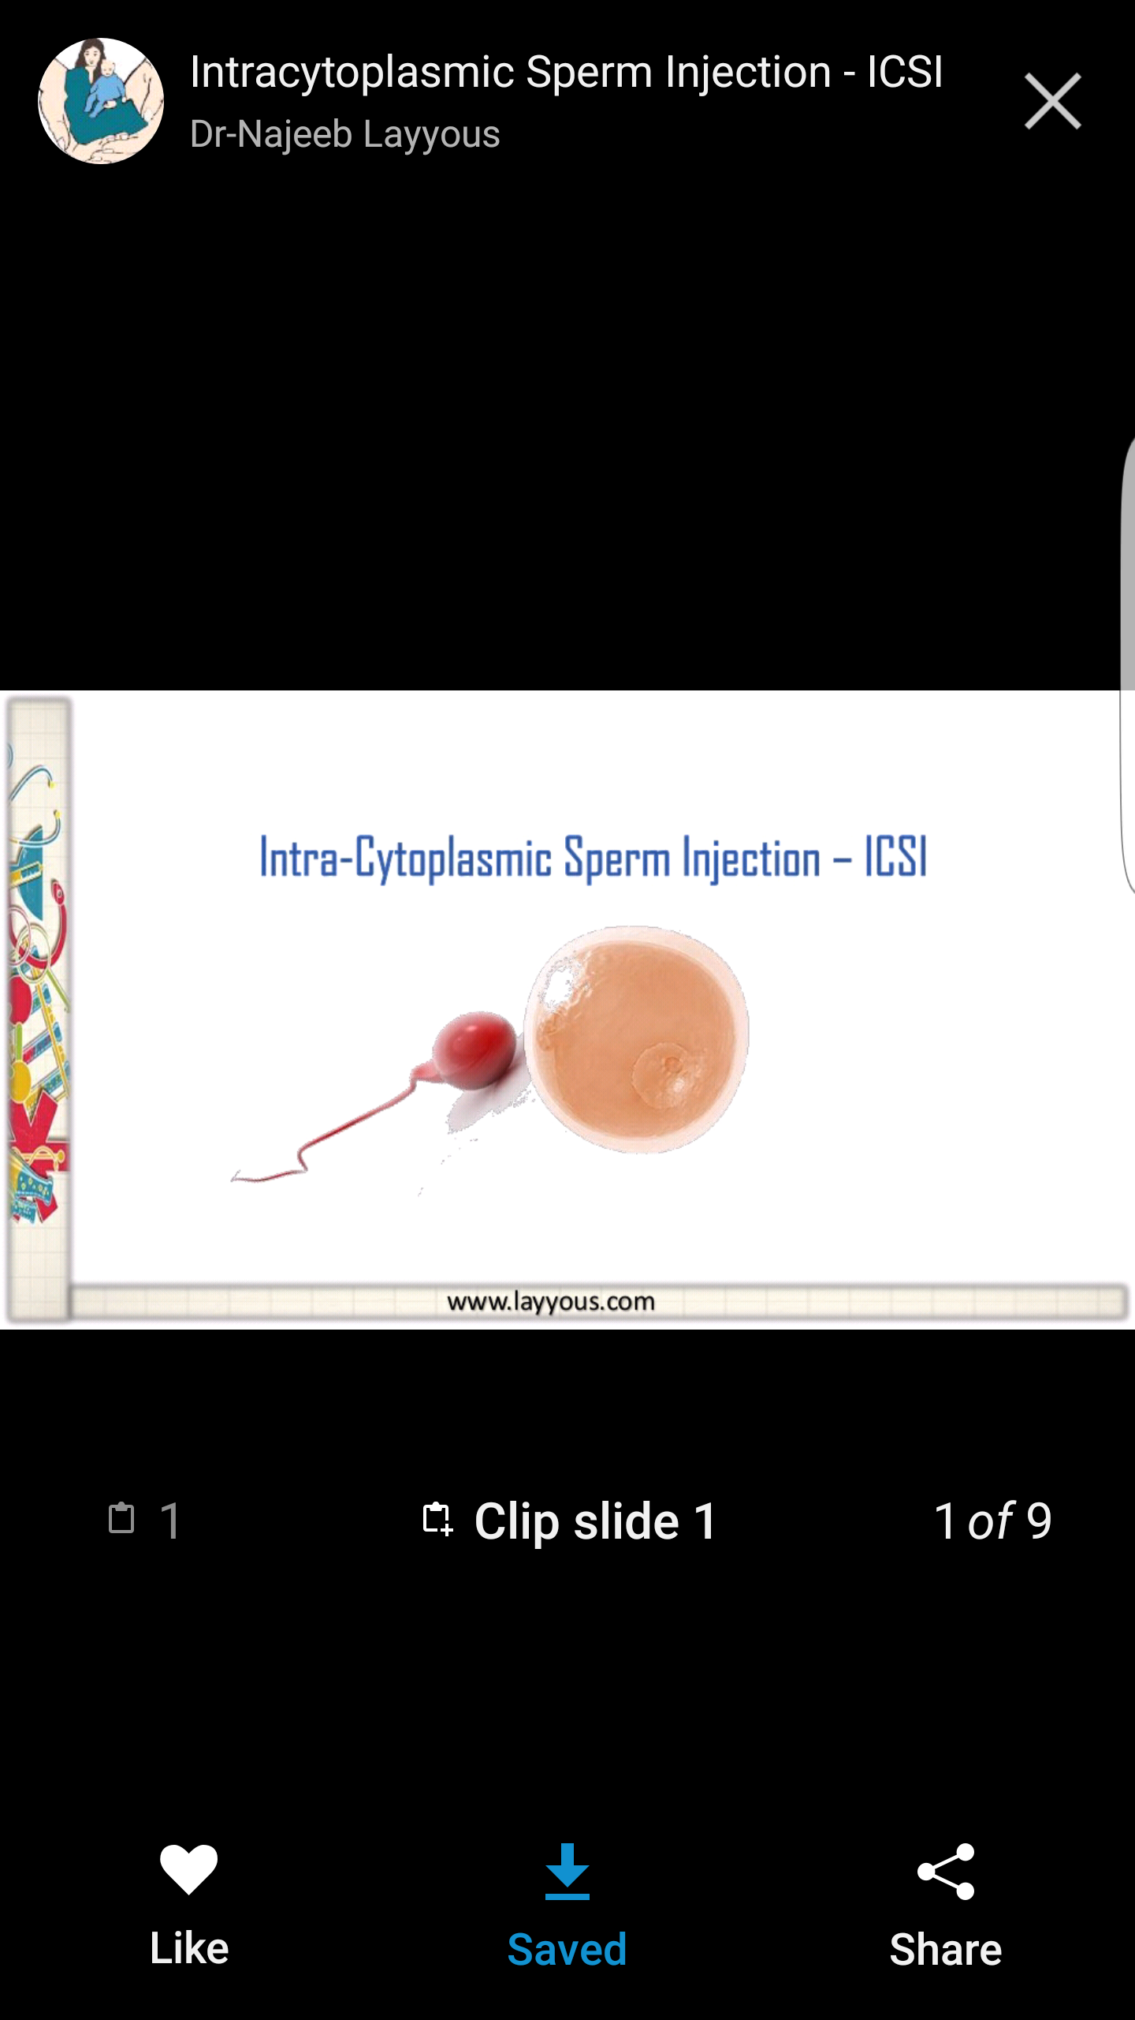

Slide 11
INTRACYTOPLASMIC SPERM INJECTION:
Intracytoplasmic Sperm Injection (ICSI) is a micromanipulation procedure in which a single sperm is injected directly into an egg to attempt fertilization, used with male infertility or couples with prior IVF fertilization failure. (ASRM)
In 1992 Palermo et al announced 1st live human birth by ICSI

Slide 12
Indication
Male factor infertility
Presence of antisperm antibodies
Cryopreserved sperm
Severe oligospermia,asthenospermia,Teratospermia.(RCOG 2014)
Obstructive azoospermia .(RCOG 2014)
Congenital absence of vas deference
Aquired vasal block
Ejaculatory duct obstruction
Young syndrome
Failure retrieve sperm from epididymis
Testicular failure-germ cell aplasia
Tubular sclerosis
Retrograde ejaculation
Reduce the risk of HIV transmission from sero+ve male to sero –ve female.
For patients with previous failed or poor fertilization with conventional IVF.(RCOG 2014)

Slide 13
Female factor infertility (ASRM and SART 2012)
Low number of oocytes
Oocyte abnormality(like thick zona)
Repeated failure of fertilisation following IVF
Preimplantation genetic diagnosis
Fertilisation after in vitro maturation
Fertilisation of cryopreserved oocytes

Slide 14
Procedure
Sperm is recovered from the ejaculate or retrieved by TESA or MESA or PESA
Oocte is recovered by ovulation stimulation , oocyte retrival by TVOR after 36hrs after HCG stimulation
Denudation of corona cumulus complex is essential before ICSI, enzyme hyalorunidase is used for this
Denuded oocytes observed under inverted microscope for presence and absence of geminal vesicle and polar body
All the oocytes with 1st polar body is selected for ICSI.
Single sperm is immobilized by PVP and drawn in to pipette

Slide 15
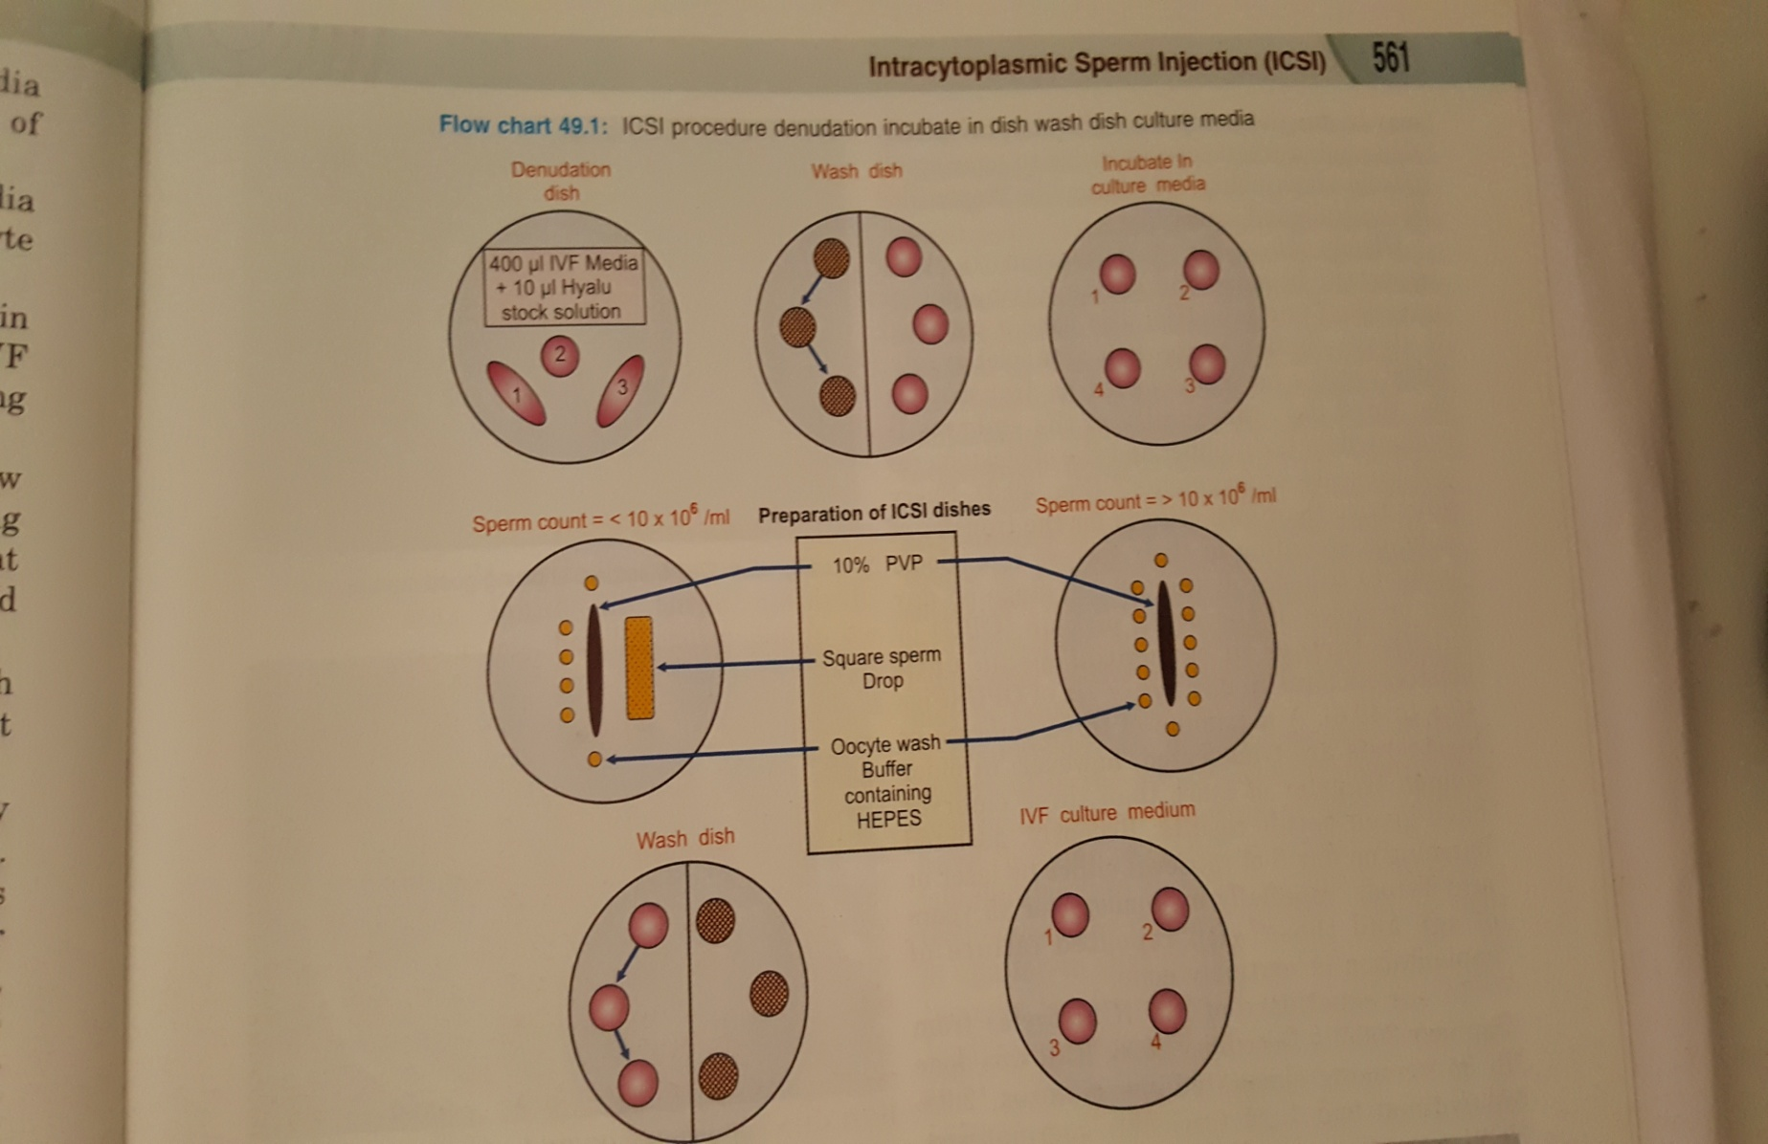

Slide 16
Vicious solution of PVP facilitates sperm handling and prevent sperm cells from sticking to pippette injection
Polar body at 6/12o’ clock position
Oocyte is stabilized by microtools
Oocyte entered 3 o’clock
Pipette pierce zona and oolemma
After this oocytes are washed four times in the culture medium and kept in incubator
This procedure is carried out under a high quality inverted microscope at 400x using nikon modulation contrast optics.

Slide 17
Evaluation
Around 12-17 hours after injection oocytes are analysed –integrity of cytoplasm, number and size of pronuclei.
After 24 hours –first day of cleavage, number and size of blastomere recorded for each embryo
At 72 hours after those with good morphology are tranferred to uterine cavity
Number of embryos depends on maternal age, embryo quality and availability.(Gardners)

Slide 18
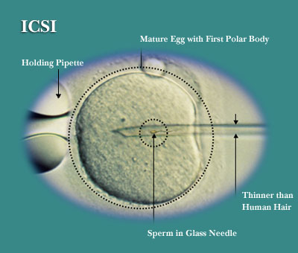

Slide 19
Disadvantage:
Faulty techniques
Expensive and require more technical expertise
ICSI generated embryo’s may fragment or less likely to bastulate. Because the second meiotic spindle varies in position and is not always located beneath the first polar body.
ICSI may cause damage to the meiotic spindle.Therefore polarizing optical system that visualize meiotic spindle reduces the risk.

Slide 20
Intracytoplasmic morphologically-selected sperm injection (IMSI)(ASRM)
it is developed in 2004 by Benjamin Baartov of Bar Ilan University, Israel - and is believed by some experts to be the most effective treatment to date for male factor infertility.
IMSI differs from ICSI, during IMSI, the embryologist carrying out the procedure uses an extremely high-powered microscope to select the sperm cells with the best morphological quality to be injected into the eggs
The technique involves selecting the best quality sperm cell from a sample provided by the male partner, and injecting them directly into the eggs retrieved from the female partner,
thereby increasing the probability that these sperm cells will fertilize the eggs.

Slide 21
Vanderwalmen et al :assumed that for specific morphological malformations the presence of large vacuoles in the sperm nuclei indicates more serious damage to the nuclear DNA content and organisation than size and shape impairment.

Slide 22
ASRM and SART Guidelines for ICSI
It is a safe and effective therapy for the treatment of male factor infertility
It can increase fertilisation rates when lower than expected or failed fertilisation has previously occured with conventional inseminisation
ICSI for unexplained infertilty doesnot improve clinical outcome
ICSI for low oocyte yield and advanced maternal age doesnot improve maternal outcome
It improves fertilisation rates in a subsequent cycles following total failed fertilisation in a prior IVF/Conventional inseminisation cycle
It is benefit for patients undergoing IVF with PGD in vitro matured oocytes, and previously cryopreserved oocytes
ICSI for routine use may decrease the incidence of unexpected failed fertilisation how ever the ratio is 1:30

Slide 23
Time lapse imaging - Embyoscope
Time lapse imaging: it is the study of cell movement in understanding the dynamic nature of the cells.
It is usefull to understand morphological events and physiological importance of fertlisation during early stage of embyonic development.
Advantages:
In contrast to the daily analysis and routinely performed in IVF lab , it saves the time and offers availabilty of 24 hours continous observation
It improves the effectiveness of IVF cycles reducing cost and increasing the ability to identify embyos with higher variability.
It includes closer monitoring of morphological events such as formation and reabsorption of fragments
Initiation of compaction
Appearance of blastocoele cavity
It prevents incorrect interpretation f confusing large fragment with a cell. Missing multi nucleation , catogorising zygote as a pronucleate.

Slide 24
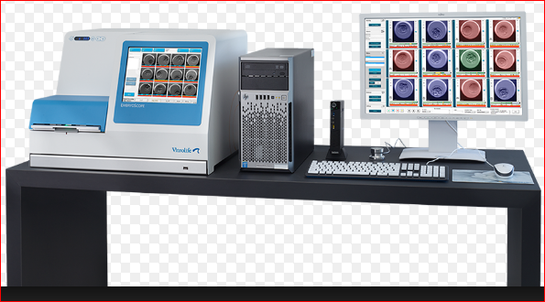
EmbryoScope: it is a new type of special incubator that has a inbuilt camera, capable of taking pictures of your embryo several times an hour. These pictures are then combined to create a time-lapse video showing the embryo's development at every vital stage, for our embryology team to assess.

Slide 25
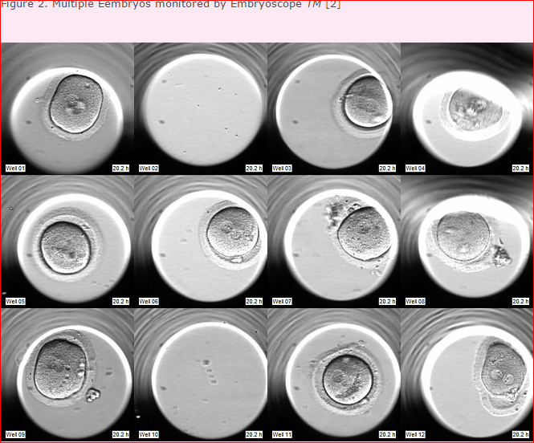
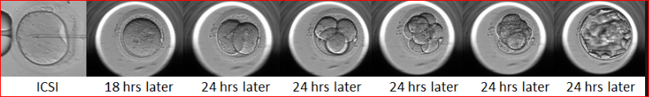

Slide 26
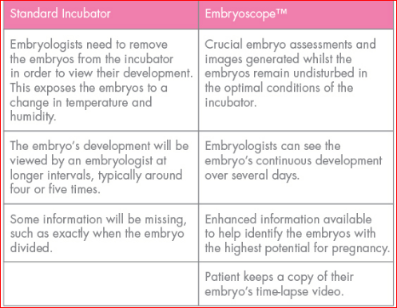

Slide 27
ART Bill 2010
An act to provide for a national framework for the accreditations, regulation and supervision of ART clinics, for prevention of misuse of ART, for safe and ethical practice of ART services and for matters connected therewith .
ART clinics shall ensure that patients, donors of gametes and surrogate mothers Act that they have been medically tested for diseases, like sexually transmitted and all other communicable diseases which may endanger the health of the parents, or any one of them, surrogate or child.
ART clinics shall provide professional counselling to patients or individuals about all the implications and chances of success of ART procedures in the clinic and in India and internationally, also inform patients and individuals of the advantages, disadvantages and cost of the procedures, their medical side effects, risks including the risk of multiple pregnancy, the possibility of adoption,

Slide 28
No ART clinic shall obtain or use sperm or oocyte donated by a relative or known friend of either of the parties seeking ART treatment or procedures.
No ART procedure shall be performed on a woman below 21 years of age, and any contravention of this stipulation shall amount to an offence punishable under this Act.
All ART clinics shall issue to the infertile couple / individual a discharge certificate stating details of the ARTprocedure performed on the couple / individual.
Only a registered ART bank shall be authorised to advertise for, procure or provide semen, oocyte donor or surrogate mother.
The consent of any of the parties obtained under this section may be withdrawn at any time before the embryos or the gametes are transferred to the concerned woman’s uterus.

Slide 29
No woman should be treated with gametes or embryos derived from the gametes of more than one man or woman during any one treatment cycle.
An ART clinic shall never mix semen from two individuals before use.
Pre-implantation Genetic Diagnosis shall be used only to screen the embryo for known, pre-existing, heritable or genetic diseases or as specified by the Registration Authority.
No ART clinic shall offer to provide a couple with a child of a pre-determined sex.
An ART bank shall not supply the sperm of a single donor for use more than seventy five times.
No woman shall donate oocytes more than six times in her life, with not less than a three-month interval between the oocyte pick-ups

Slide 30
No ART bank shall divulge the name, identity or address of any sperm or oocyte donor to any person or ART clinic except in pursuance of an order or decree of a court of competent jurisdiction.
Subject to the provisions of this Act and the rules and regulations made thereunder, ART shall be available to all persons including single persons, married couples and unmarried couples with informed consent from both the parties.
A child may, upon reaching the age of 18, ask for any information, excluding personal identification, relating to the donor or surrogate mother

Slide 31
The surrogate mother may also receive monetary compensation from the couple or individual, as the case may be, for agreeing to act as such surrogate.
A surrogate mother shall relinquish all parental rights over the child.
No woman less than <21 years of age and >35 years shall be eligible to act as a surrogate mother under this Act. Provided that no woman shall act as a surrogate for >5 successful live births in her life, including her own children
The birth certificate issued in respect of a baby born through surrogacy shall bear the name(s) of individual / individuals who commissioned the surrogacy, as parents.

Slide 32
References
Gardners-text book of ART
Kamini rao –infertility manual
ASRM – recent guidelines
Eshre –recent guidelines
ART bill 2015 of India
Speroffs textbook of gynaecology
Novaks textbook of gynaecology
Textbook on infertility management by Mehroo Hansotia

Slide 33
Finally ICSI is
IMPRESSIVE
COMPLETE
SOLUTION to
INFERTILITY

Slide 34
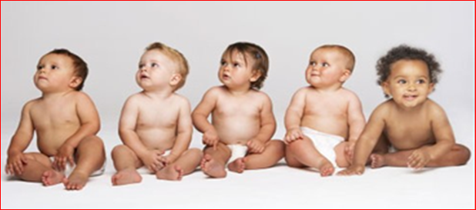
Thank you

