Slide 1
INTRAPARTUM FETAL MONITORING

Slide 2
OBJECTIVE
Screen for hypoxia or acidosis.
Identify the fetus at risk of an adverse outcome.
Enable obstetrician to intervene appropriately.
Prevent neurological damage, avoid morbidity or death due to hypoxia.

Slide 3
INDICATIONS-MEDICAL
Chronic hypertension
Diabetes
Cardiac disease
Chronic renal disease
Vascular disease
Asthma
Epilepsy
Substance abuse

Slide 4
OBSTETRIC INDICATION
Pre – eclampsia
Cholestasis of pregnancy
Rh isoimmunisation
Multiple pregnancy
IUGR
Oligohydraminos
PPROM
Previous stillbirth
Decreased fetal movement
Post term

Slide 5
CARDIOTOCOGRAPH(CTG )
CTG is a continuous Electronic recording of Fetal heart rate & uterine contractions over a desired length of time
Two channel chart
FHR on upper channel
Frequency, duration, & amplitude of uterine contraction on lower channel

Slide 6
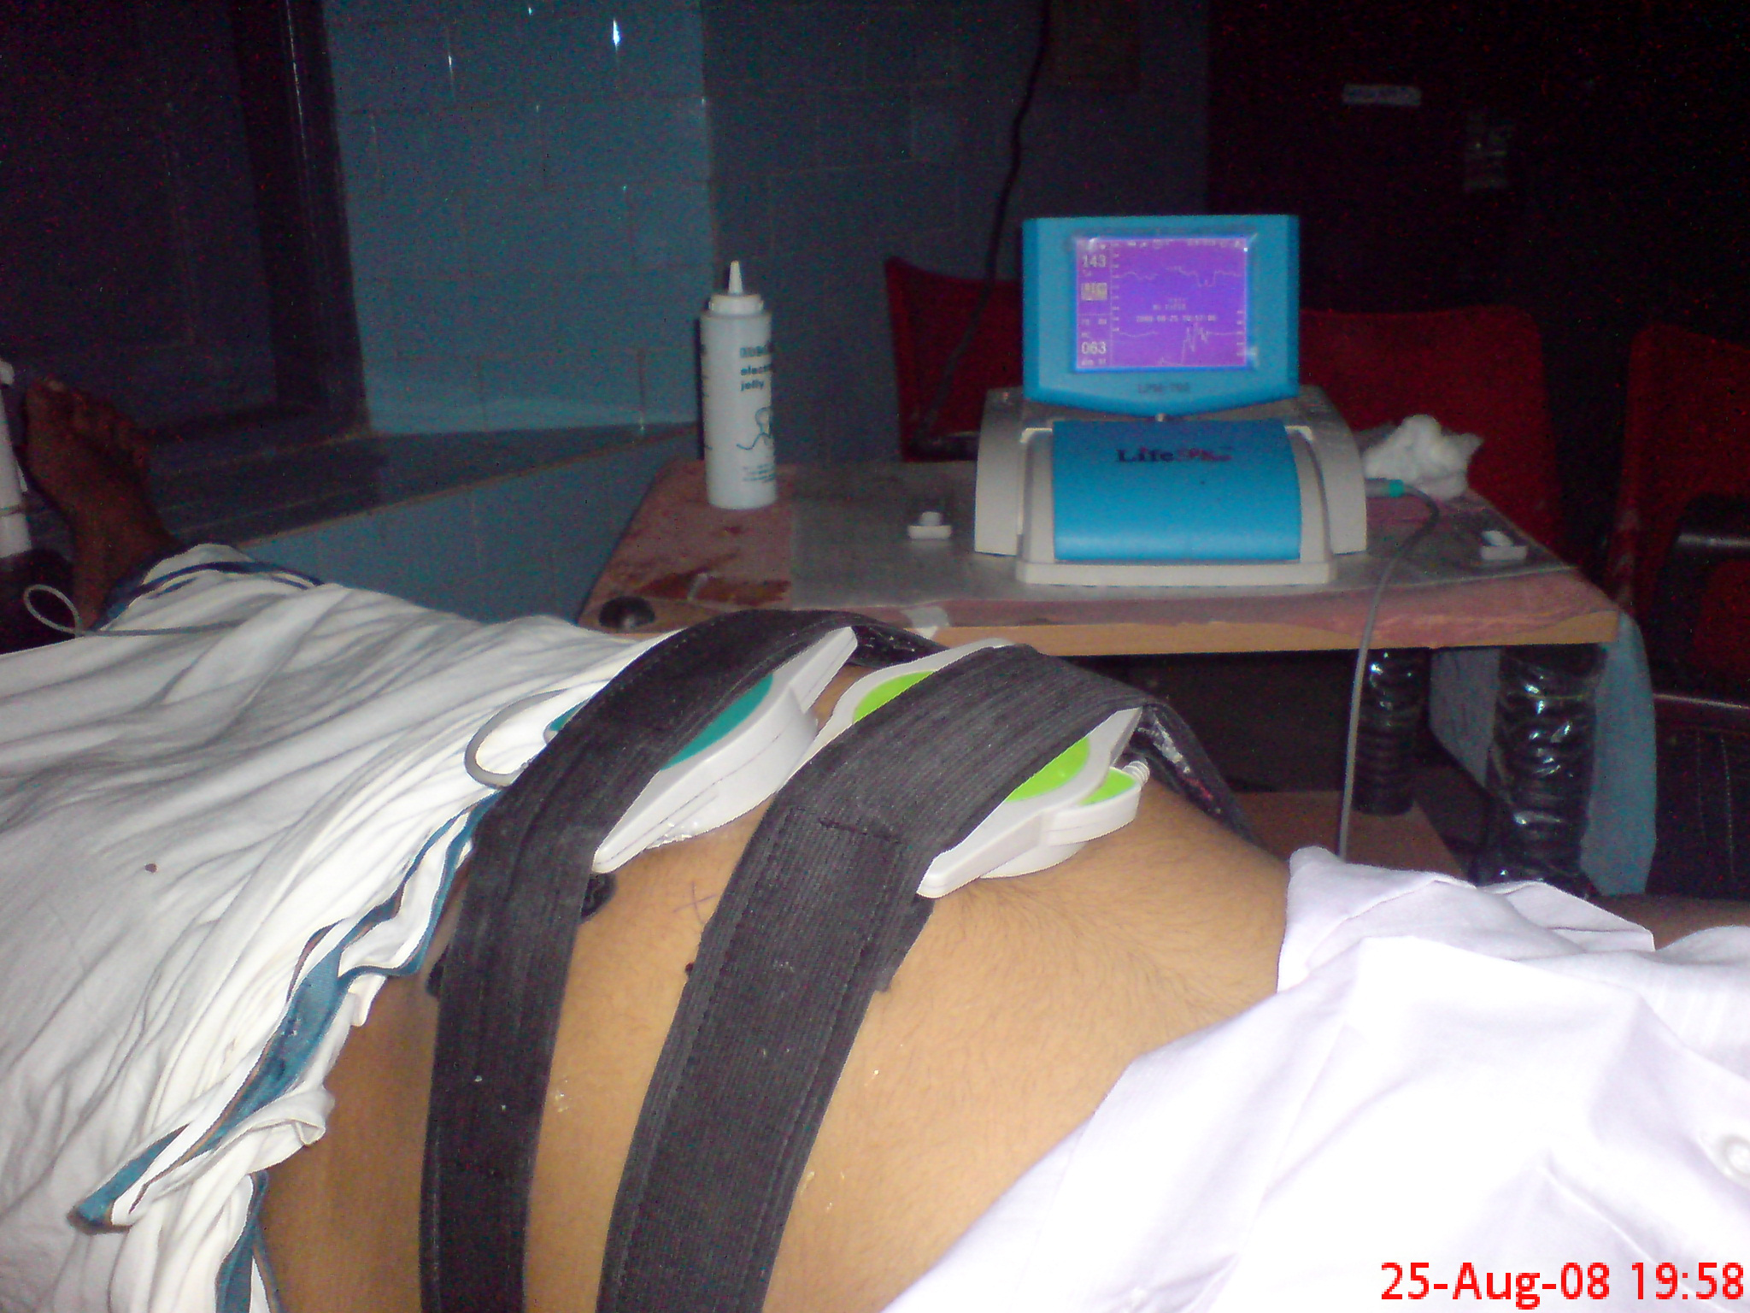

Slide 7
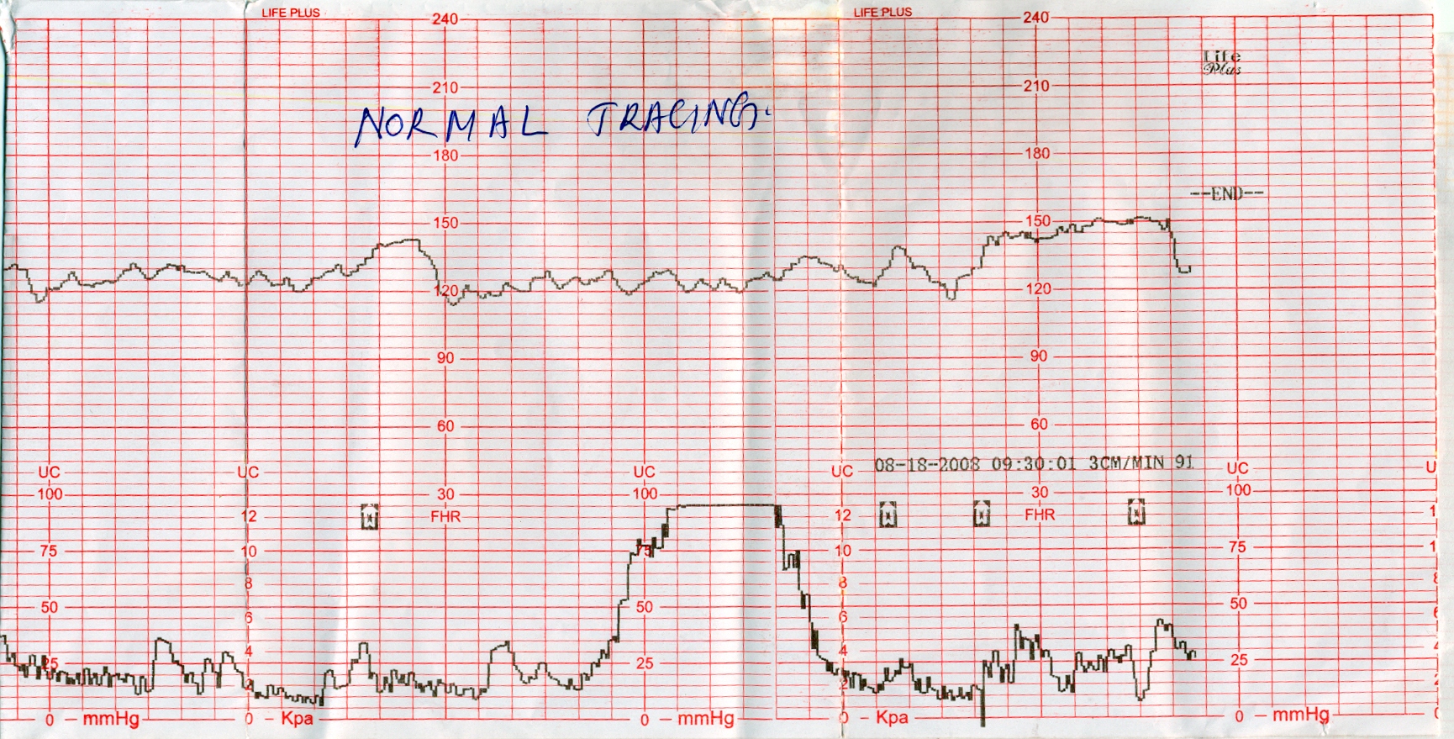
Normal CTG
HR between 110-160 bpm
Baseline variability of 5-25 bpm
2 accelerations ( increase in FHR by 15 bpm lasting for 15 secs) or more in 20 mts

Slide 8
BASELINE HEART RATE
Mean FHR, when it is stable excluding accelerations and decelerations, determined over a period of 5-10min and expressed in bpm.

Slide 9
ABNORMALITIES in BASE LINE HR
Baseline tachycardia >160 bpm
Moderate 160 -179 bpm
Severe >180 bpm
1. Maternal- pyrexia, Dehydration, bleeding – hypovolemia, hyperthyroidism
2. Physiological in preterm fetus due to immaturity of para symp system, Fetal hyperthyroidism, anemia, heart failure, tachyarrhythmias
3.Drugs like betamimetics, vagolytic drugs, nifidipine, hydralazine
4.Epidural analgesia

Slide 10
BRADYCARDIA
FHR < 110bpm
Moderate – 100 – 109bpm
Severe - < 100bpm

Slide 11
Causes:
Maternal
supine hypotension
post -term
drugs – beta blockers
connective tissue disorder
chronic hypoxia
uterine hyperstimulation
cord prolapse, placental abruption
scar dehisence, rupture uterus

Slide 12
BASE LINE VARIABILITY
The minor fluctuations in baseline fetal heart rate occuring at 3-5cycles/min
Beat to beat variability

Slide 13
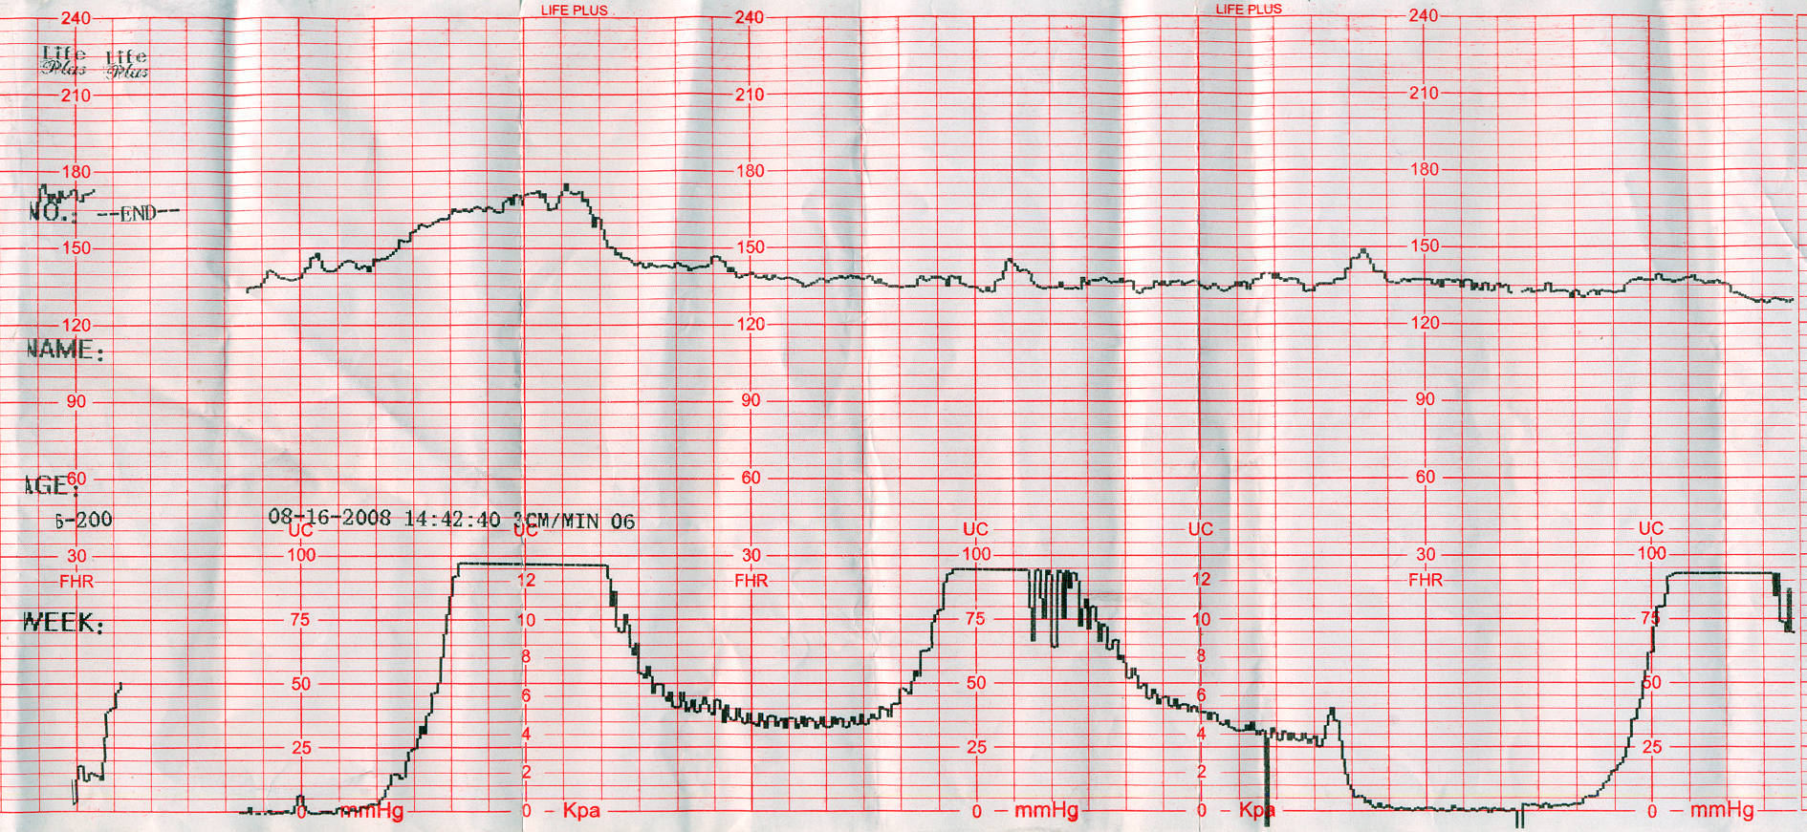
REDUCED BASE LINE VARIABILITY
Quiet sleep
Fetal acidosis
Analgesic drugs
Narcotics
Opiods
reduced beat to beat variability

Slide 14
INCREASED BASELINE VARIABILITY
Variability more than 25 beats/min is called saltatory pattern
Wandering Baseline:-baseline rate is unsteady 120-160. Neurologically abnormal fetus

Slide 15
ACCELERATIONS
A transient increase in FHR >15 beats
lasting > 15 sec
Accelerations are absent during fetal sleep and its presence rule out fetal acidosis

Slide 16
TYPES OF DECELERATIONS
Early decelerations- head compression
Late decelerations- Fetal hypoxia
Hypercarbia Acidosis
Variable decelerations – in cord compression
prolonged decelerations

Slide 17
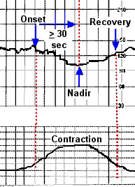
Early deceleration
Shallow, symmetric, uniform , U shaped.
Begin early in contraction, nadir coincident with peak of contraction.
Return to baseline by the time contraction is over.
< 30-40 bpm below baseline.

Slide 18
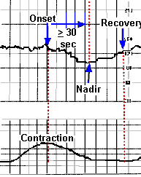
Late deceleration
Periodic slowing of heart rate from mid to end of contraction.
Nadir > 20 sec after the peak of the contraction.
Ending - after the contraction.
Uteroplacental insufficiency & fetal hypoxia.

Slide 19
Late deceleration
Excessive uterine contraction
Epidural anaesthesia
Collagen vascular disease
Diabetes mellitus
Severe maternal anemia
Postmaturity
Maternal hypertension
Chronic fetal anemia
Abruptio placenta
Maternal hypotension

Slide 20
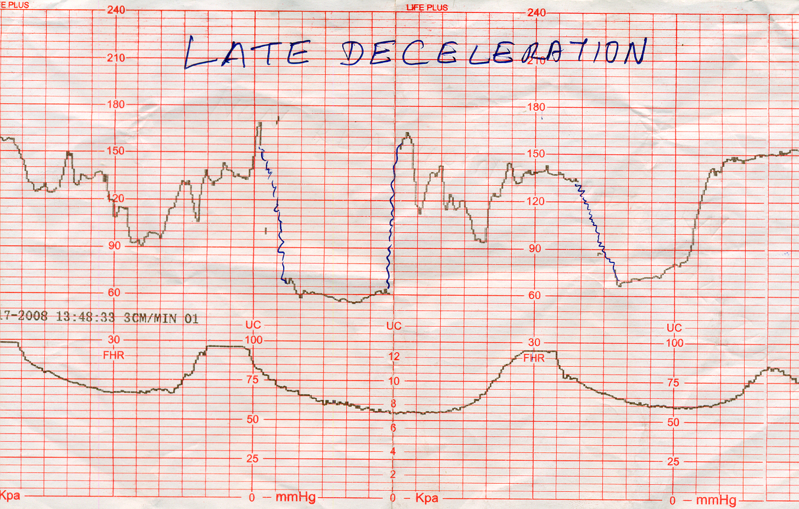
Variable deceleration
Variable in size ,depth, duration & timing in relation to contraction
Onset to nadir <30 secs
Rapid onset and recovery
Duration limited to 2 mts

Slide 21
Variable deceleration
Causes:
Umbilical cord entangled
True knot
Cord around the neck
Cord prolapse

Slide 22
Prolonged deceleration
Drop in FHR < 80 bpm for < 3min as suspicious, and >3min as abnormal
Causes:
Abruption
Cord prolapse
Scar rupture

Slide 23
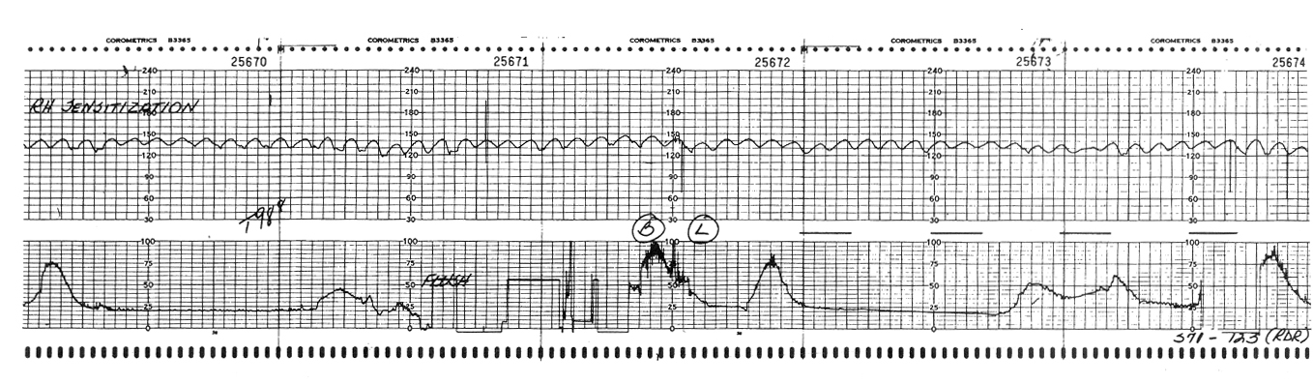
SINUSOIDAL FHR
Stable baseline of 120-160 with regular sine wave like oscillations
Amplitude of 5-15beats/min
Fixed or absent short-term variability
Absence of accelerations

Slide 24
SINUSOIDAL FHR
Strongly associated with fetal hypoxia
Severe fetal anemia-D-isoimmunisation
Fetomaternal haemorrhage
Erythroblastosis fetalis
Narcotis

Slide 25
Categorising CTG based on NICE 2007
Category | Baseline | Beat to beat variability | Acceleration | Deceleration
Reassuring | 110- 160 | 5-25 bpm | 2, each,15 bpm for 15 sec | nil
Non Reassuring | 100-109 160-180 | <5 bpmfor 40-90 mts | No acceleration | Typical variable deceleration in > 50% contractions> 90 mts, Single prolonged dec up to 3 mts
Abnormal | <100, >180 Sinusoidal pattern>10 mts | <5 bpmfor >90 mts | No acceleration | Atypical variable dec In> 50% contrac or Late decelerations,both over 30mts . Prolonged dec >3mts

Slide 26
CTG Classification (NICE )
Category | Defenition
Normal | All 4 parameters fall into Reassuring category
Suspicious | 1 feature is nonreassuring Others reassuring
Pathological | 2 or more nonreassuring 1 or more abnormal

Slide 27
Fetal Blood Sampling
FETAL SCALP Ph
Gold standard for the diagnosis of intrapartum fetal distress
It is an invasive procedure, requiring ruptured membranes & sufficiently dilated cervix (min 3cm)

Slide 28
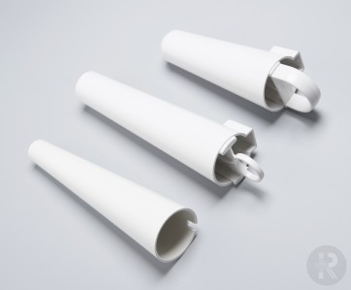
Procedure:
Performed in left lateral position.
Through a vaginal amnioscope, a capillary blood sample is taken from a small incision on the fetal scalp.
Liquor should be excluded from the sample.

Slide 29
pH SAMPLING RESULTS
Normal-≥7.25
Boderline-7.21-7.24
Abnormal-≤7.20
≥ 7.25 Repeat the FBS in 1 hour if the cardiotocography (CTG) abnormality persists, or sooner if required.
7.21 – 7.24 Repeat the FBS in 30 minutes time, or consider delivery if a significant fall has occurred since the previous sample.
≤ 7.2 Delivery is indicated.

Slide 30
Limitations:
Procedure and technical difficulties in collecting blood.
On an average, the procedure takes 18min, and therefore cannot be used in cases of acute fetal compromise.
Analysis can be compromised by air bubbles or clots in the blood sample.
Measurements may be inaccurate in the presence of mod-severe degrees of fetal scalp edema.
Result is valid only for a short period of time depending on the CTG pattern

Slide 31
FBS should be avoided in bleeding disorders- hemophilia A, women with maternal viral infections such as HIV, hepatitis B, herpes simplex.

Slide 32
FETAL SCALP LACTATE
Maternal and fetal lactate concentrations increase with the duration of active bearing down.
Fetal lactate increases by 1mmol/L for every 30min of maternal pushing.
Cutt-off value: 4.8mmol/L

Slide 33
Lactate result ACTION
< 4.2 mmol/L - Normal.
Repeat FBS in 1 hour if the cardiotocography (CTG) abnormality persists, or sooner if required
4.2 – 4.8 mmol/L - Pre-acidaemia.
Repeat the FBS in 30 minutes time, or consider delivery if a significant rise has occurred since the previous sample.
4.8 mmol/L - Acidaemia.
Delivery is indicated

Slide 34
Advantages of fetal scalp lactate over fetal scalp pH:
Much smaller quantity of blood is sufficient (5μl).
Takes less time.
Caput formation does not significantly alter the correlation between values.

Slide 35
Fetal ECG
ST segment analysis :
Provides continuous information on the ability of fetal heart muscle to the stress of labour.
ELEVATION of ST segment & T wave- identifies fetal heart muscle responding to hypoxia
DEPRESSION of ST segment – indicates that heart is not fully able to respond
PR interval:
As the fetal heart slows, PR interval lengthens/ vice versa.

Slide 36
Near Infra Red Spectroscopy (NIRS)
Measurement of change in concentration of oxy/deoxy hemoglobin.
Detects the change in cerebral blood volume and tissue oxygenation
Non invasive method for assessing placental oxygen dynamics

Slide 37
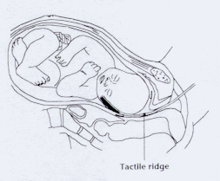
Fetal Pulse Oximetry
Measures fetal oxygen saturation (FSpO2) of hemoglobin by analysing the absorption patterns of red and near infra red light.
Reduces the cesarean section rate for non-reassuring CTG features.
Normal fetal range: 30-70%.

Slide 38
Doppler
In normal pregnancy s/d ratio, PI & RI ratio decreases as the gestational age advances
UMBILICAL ARTERY:
Indicates perfusion of fetoplacental unit.
S/D ratio is <3.5 -30 weeks
<3 -40weeks
increased resistance seen in IUGR, pre eclampsia, placental pathology

Slide 39
MIDDLE CEREBRAL ARTERY:
Normal MCA shows high resistance flow with continuous flow in systole and diastole at 28-32 wks .
PI- typically greater than 1.45 before term, falling to 1.0 by term.
With hypoxia, brain sparing effect occurs
Increases in diastolic velocity
Decrease in s/d, PI

Slide 40


