Slide 1
GESTATIONAL TROPHOBLASTIC DISEASE

Slide 2
Gestational tropoblastic disease encompasses a spectrum of tumours and tumour like conditions characterised by proliferation of placental tissue, either villous or tropoblastic.

Slide 3
Classification of gestational trophoblastic disease
Hydatidiform (vesicular )mole (Complete and Partial]
Invasive mole
Choriocarcinoma
Placental-site trophoblastic tumor

Slide 4


Slide 5
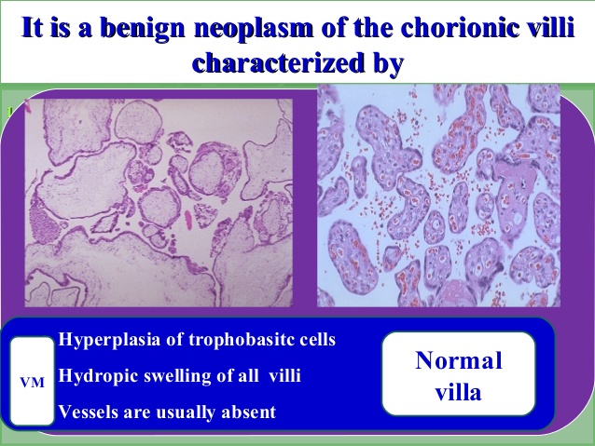

Slide 6
Epidemiology& Risk Factors
Risk Factors:
Age: <20y (2fold) , > 40y(10 fold) & >50y (50% V.mole)
Prior Molar Pregnancy
Second molar: 1% - Third molar : 20%!
Diet:↑ in low fat;low Vit. A or carotene diet (complete mole)
Contraception :COC double the incidence
Previous spontaneous abortion: double the incidence

Slide 7
KARYOTYPE
Most complete hydatidiform moles are diploid with a 46,XX karyotype, but rare examples are triploid or tetraploid; all the chromosome complements are paternally derived.
In the diploid complete mole, both X chromosomes result from duplication of a haploid sperm pronucleus in an empty ovum that has lost its maternal chromosomal haploid set.
Approximately 3 to 13 percent of complete moles have a 46,XY chromosome complement, presumably as a result of dispermy, in which an empty ovum is fertilized by two sperm pronuclei, one with an X and the other with a Y chromosome.
The embryo or fetus is absent in the complete mole.

Slide 8
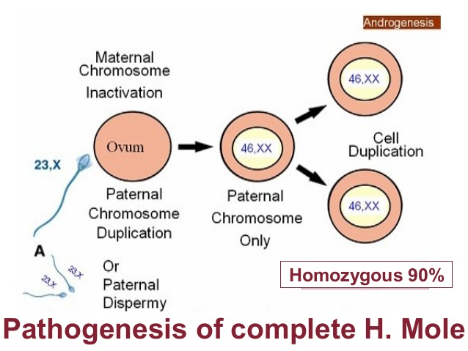

Slide 9
MORPHOLOGY
Microscopically Enlarged, edematous villi and abnormal trophoblastic proliferation that diffusely involve the entire villi
No fetal tissue, RBCs or amnion are produced
Macroscopically, these microscopic changes transform thechorionic villi into clusters of vesicles with variable dimensions “ like bunch of grapes"No fetal or embryonic tissue are produced.Uterine enlargement in excess of gestational age .
Theca-lutein cyst associated in 30%.

Slide 10
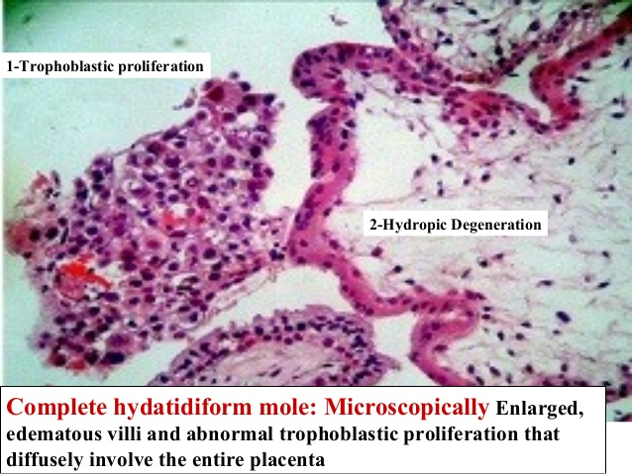

Slide 11
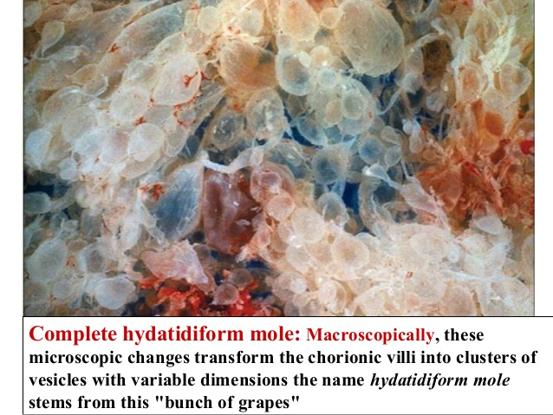

Slide 12
KARYOTYPE OF PARTIAL MOLE
These abnormal conceptuses result from the fertilization of an egg by two sperms
Partial moles have a triploid karyotype and evidence of an embryo or fetus.
When triploidy is present in a partial mole, the chromosomal complement is XXY in 70 percent of the cases, XXX in 27 percent, and XYY in 3 percent.
They have an increased risk of persistant molar disease.

Slide 13
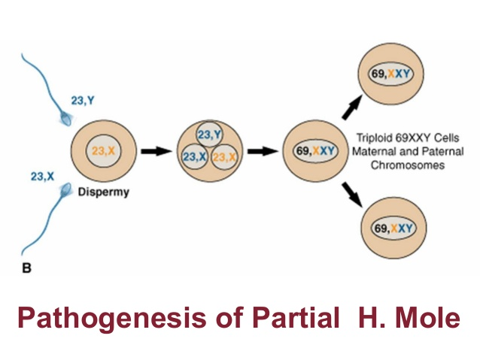

Slide 14
MORPHOLOGY
Microscopically:
The enlarged, edematous villi and abnormal trophoblastic proliferation are slight and focal and does not involve the entire villi.
There is a scalloping of chorionic villi
Fetal or embryonic or fetal RBCs present.
Macroscopically:
The molar pattern does not involve the entire placenta.
Uterine enlargement in excess of gestational age is uncommon.
Theca-lutein cysts are rare.

Slide 15
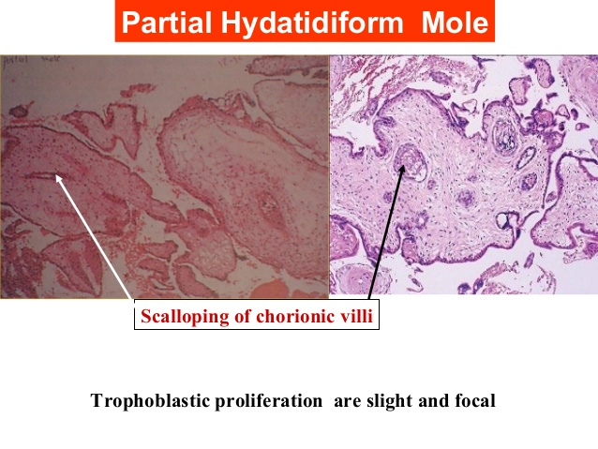

Slide 16
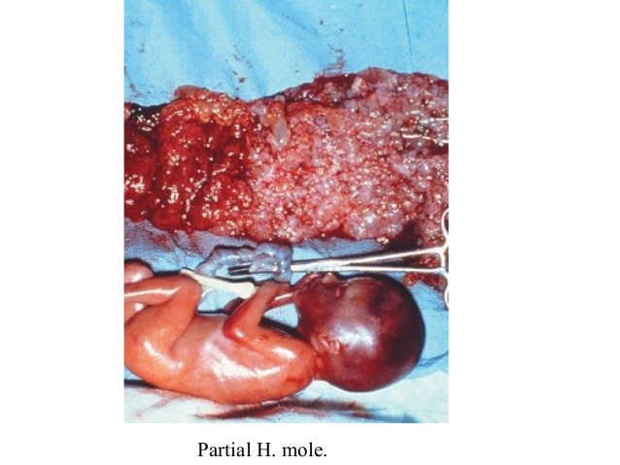

Slide 17
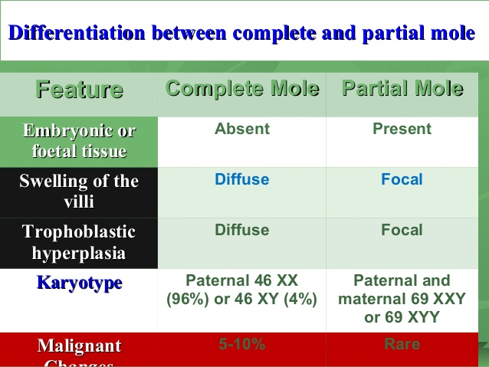

Slide 18
The classic features are
Irregular vaginal bleeding
Hyperemesis due to high hcg levels
Excessive uterine enlargement
Early failed pregnancy.
Clinicians should check a urine pregnancy test in women presenting with such symptoms. Some women will present early with passage of molar tissue
Rarer presentations include:
Hyperthyroidism
Early onset pre-eclampsia
Abdominal distension due to theca lutein cysts
Very rarely
Acute respiratory failure
Neurological symptoms such as seizures (? metastatic disease).

Slide 19
Most moles are successfully treated by curettage.
The pts are monitored for 6 months to 1year to ensure hcg levels decrease.
Continous elevation of hcg may indicate persistent or invasive mole.
2.5% of complete moles give rise to gestational chorocarcinoma.

Slide 20
INVASIVE MOLE
It is a trophoblastic tumour with penetration of the myometrium by the chorionic villi.
It is locally malignant and may invade the parametrial tissue and blood vessels.
The tumour is clinically manifested by vaginal bleeding and irregular uterine enlargement.
There is persistently elevated HCG.
The tumour responds well to chemotherapy but may result in uterine enlargement.

Slide 21
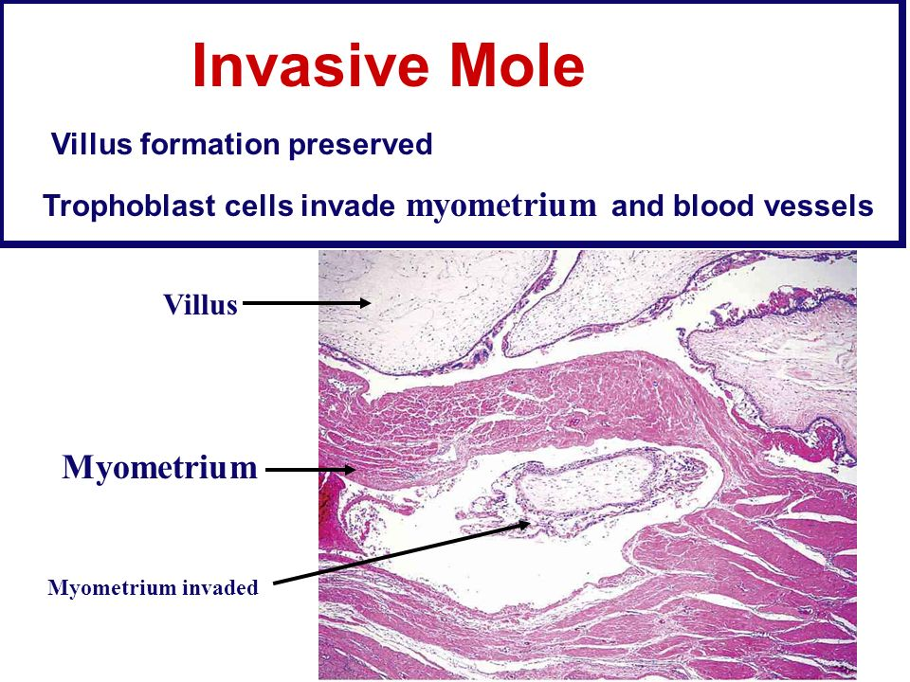

Slide 22
Choriocarcinoma
• Epithelial malignant neoplasm of trophoblastic cells derived from any form of previously normal or abnormal pregnancy.
• They are rapidly invasive, widely metastsizing malignant neoplasm.
• BUT, reponds to chemotherapy well.

Slide 23
Incidence : Uncommon. 1 in 20K to 30K pregnancies.
50% occur in hydatidiform moles
25% occur in previous abortions
22% occur in normal pregnancies
Rest occur in ectopic pregancies & teratomas

Slide 24
Gross
• The typical gross appearance of choriocarcinoma is that of a circumscribed hemorrhagic mass, due to its rapid proliferation combined with blood vessel invasion.
• The tumors vary from pinpoint-sized lesions to large destructive masses. The central portion of the lesion is typically hemorrhagic and necrotic, with only a thin rim of viable tumor at the periphery.

Slide 25
Microscopy
• No chorionic villi
• The classic histologic pattern of choriocarcinoma is dimorphic or biphasic, indicating an alternating arrangement of cytotrophoblast and syncytiotrophoblast or intermediate trophoblast and syncytiotrophoblast.
• Atypical mitotic activity
• Spread: Blood, permeation through lymphatics
• Mets: Lung, brain, bones and Liver.

Slide 26
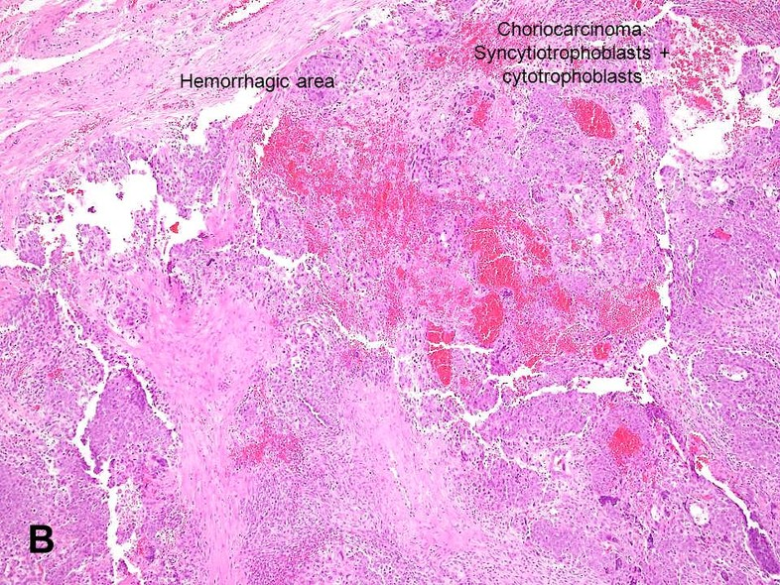

Slide 27
STAGING
Stage 1
This is the earliest stage of GTD when the tumour is only in the uterus.
Stage 2
This is when the tumour has spread outside the uterus to genital areas nearby, such as the vagina or ovary. It has not spread outside the pelvis.
Stage 3
The GTD has spread to the lungs and may or may not be in the local area around the womb.
Stage 4
The abnormal cells have spread (metastasised) to other parts of the body, such as the liver or brain.

Slide 28
CLINICAL FEATURES
US may show small masses in the uterus
Irregular spotting (bloody, brown and offensive)
• Mets may be found by chest x-ray
• ß-HCG level are elevated enormously
• Wide spread mets are common (Lungs 50%, vagina 30%)

Slide 29
Treatment: Depends on type & stage of tumor. Options: evacuation, surgery, chemo (MTX, actinomycin – 100% cure rate)
Non-gestational choriocarcinomas are much more resistant to CHEMOTHERAPY

Slide 30
PLACENTAL SITE TROPHOBLASTIC TUMOUR [PSTT]
THEY COMPRISE OF LESS THAN 2 PERCENT OF TROPOBLASTIC NEOPLASMS.
THEY ARE NEOPLASTIC PROLIFERATION OF EXTRAVILLOUS TROPOBLASTS ALSO CALLED INTERMEDIATE TROPOBLAST.
THESE INTERMEDIATE TROPOBLAST ARE FOUND IN NON VILLOUS SITES SUCH AS IMPLANTATION SITE,PLACENTAL MEMBRANES.

Slide 31
PSTT PRESENTS AS A UTERINE MASS ACOMPANIED BY ABNORMAL UTERINE BLEEDING OR AMEORRHOEA AND MODERATELY ELEVATED HCG.
HISTOLOGICALLY PSTT IS COMPOSED OF MALIGNANT TROPOBLASTIC CELLS DIFFUSELY INFILTRATING ENDOMYOMETRIUM.
PATIENTS WITH LOCALISED DISEASE HAVE EXCELLENT PROGNOSIS WHILE 10-15% DIE OF DISSEMINATED DISEASE.

Slide 32
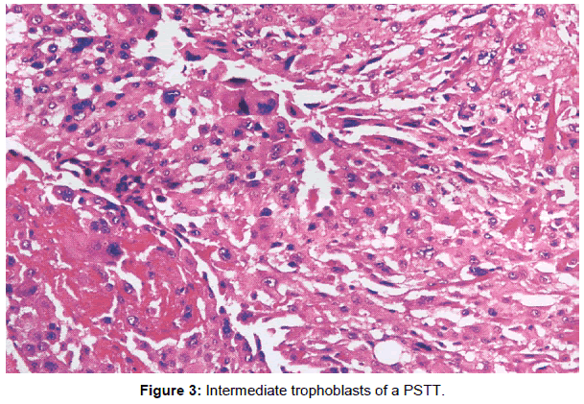

Slide 33
THANK YOU

