Slide 1
Ovarian Neoplasms

Slide 2
Ovarian Neoplasms- Introduction
Common neoplasms.
80% are benign – young (20-45)
20% are Malignant - older (>40)
6% of all cancers in women.
50% deaths due to late detection.

Slide 3
Risk Factors
Null parity
Gonadal Dysgenesis
Family History
Ovarian cancer genes
  BRCA1 (17q12) & BRCA2(13q12)
  (Cancer suppressor, Breast & ovary)

Slide 4
Classification
Surface epithelial – 65-70%
stromal – 15-20%
Germ cell tumors – 5-10%
Metastatic tumors – 5%

Slide 5
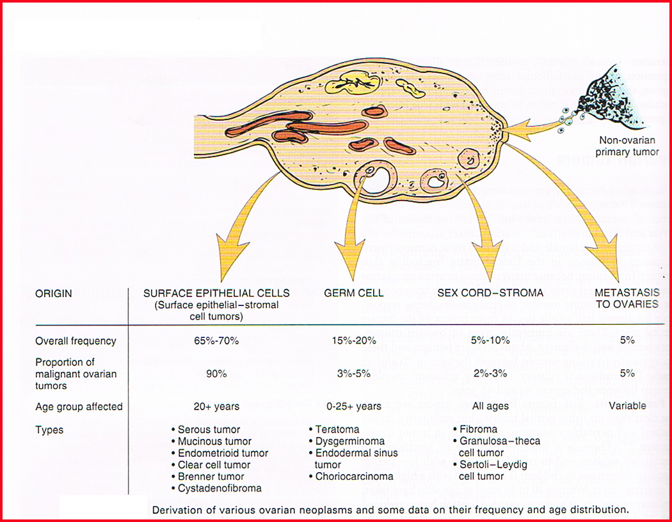

Slide 6
Surface Epithelial tumors:
Coelomic mesothelium.
Most common primary neoplasms
90% of malignant tumors of ovary
Morphologically
  Cystic – Cystadenomas
  Solid/cystic – Cystadenofibromas
  Solid - adenofibromas

Slide 7
Surface Epithelial tumors
Serous (tubal)
Mucinous (endocx & intestinal)
Endometrioid
Transitional cell - Brenners.
Clear cell

Slide 8
Surface Epithelial tumors
all types can be benign, borderline , or malignant, depending upon;
Benign ; - gross: mostly cystic - microscopic; fine papillae, single layer covering (no stratification), no nuclear atypia, no stromal invasion)
Borderline ; - gross; cystic / solid foci - microscopic; papillary complexity, stratification, nuclear atypia, no stromal invasion
Malignant ; - gross; mostly solid & hemorrhage / necrosis
- microscopic; papillary complexity, stratification, nuclear atypia, stromal invasion

Slide 9
Serous Tumors:
Frequently bilateral (30-66%).
75% benign/bord., 25% malignant.
One unilocular cysts, papillary/less solid- benign/borderline
Tall columnar ciliated epithelium.
Papillary, solid, hemorrhage, necrosis or adhesions – malignancy.
Extension to peritoneum – bad prognosis.

Slide 10
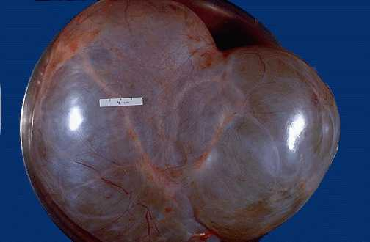
Serous Cystadenoma

Slide 11
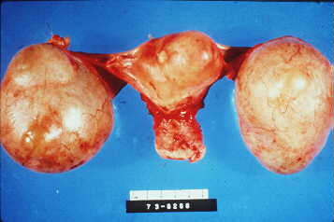
Bilateral cystadenoma

Slide 12
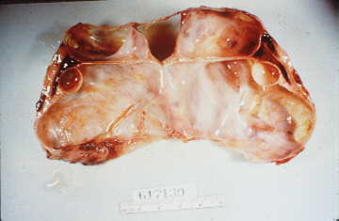
Serous Cystadenoma:

Slide 13
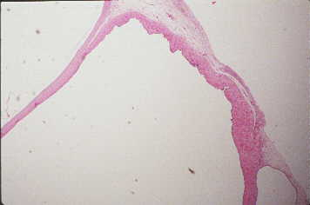
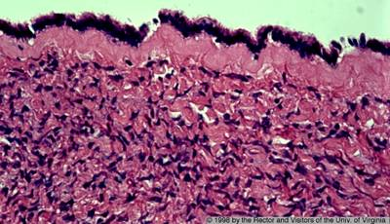
Serous Cystadenoma
single layer of columnar ciliated
Fine papillae

Slide 14
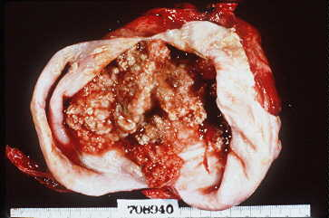
Papillary serous cystadenoma (solid/cystic)-borderline

Slide 15
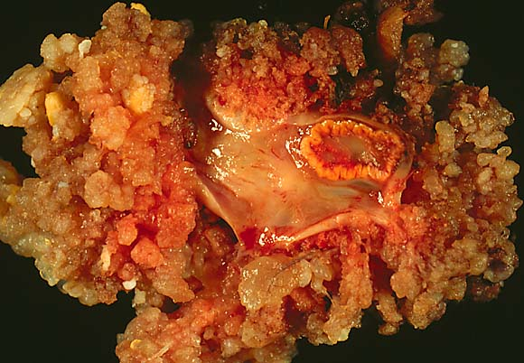
Papillary cystadenoma (bor)

Slide 16
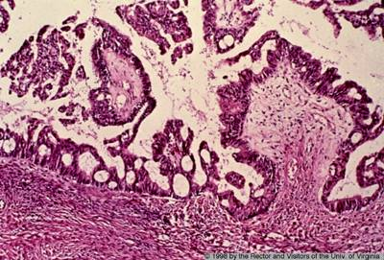
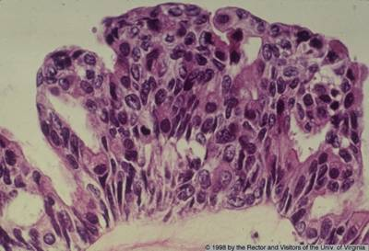
Papillary cystadenoma (bor)
Papillary complexity
Nuclear stratification& atypia
No stromal invasion

Slide 17
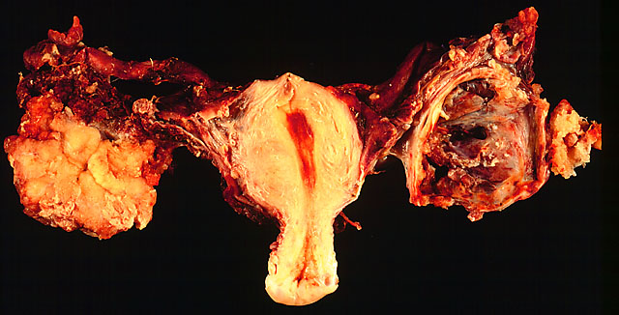
Serous cystadeno Ca – bilateral

Slide 18
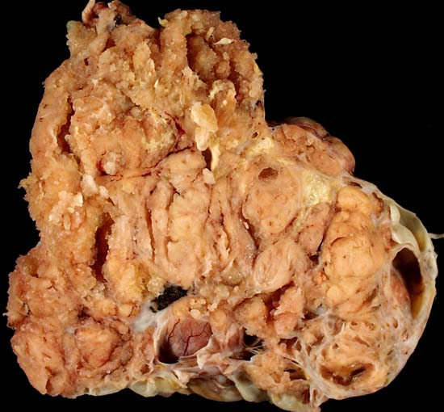
Serous cystadeno Carcinoma

Slide 19
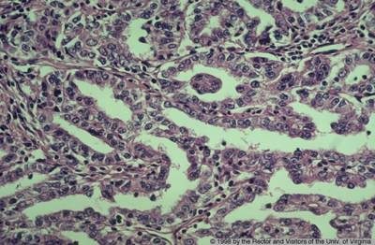
Serous cystadenocarcinoma
Papillary complexity
Nuclear stratification& atypia
stromal invasion
Psammoma bodies

Slide 20
Mucinous Tumors:
Less common 25%, very large.
Rarely malignant - 15%.
Multiloculated, many small cysts.
Rarely bilateral – 5-20%.
Tall columnar, apical mucin.
Pseudomyxoma peritonei.

Slide 21
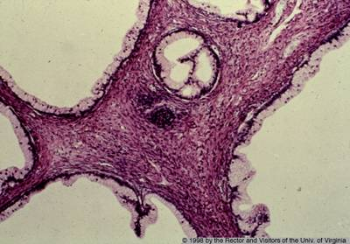
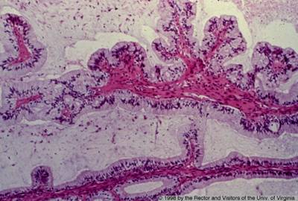
Mucinous cystadenoma
Multilocular cyst lined by single layer of columnar cells with basally placed nuclei and apical mucin.

Slide 22
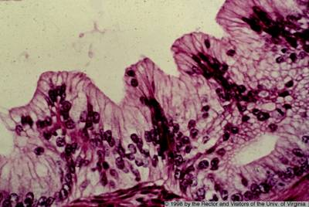
Mucinous cystadenoma-borderline
Papillary complexity
Nuclear stratification& atypia
No stromal invasion

Slide 23
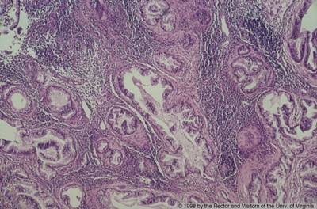
Mucinous cystadenocarcinoma
Papillary complexity
Nuclear stratification& atypia
stromal invasion

Slide 24
Endometrioid tumors
most are unilateral (40% are bilateral)
cells look like endometrium even though they are coming from the coelum of the ovary.
almost all are malignant
about 20% of all ovarian tumors
many are associated with endometrial cancer (30%)
patient may have concurrent endometriosis

Slide 25
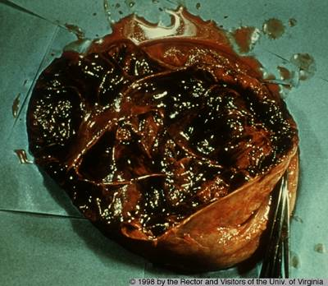
Endometrioid tumors
Solid / cyst filled by hemorrhage & necrosis

Slide 26
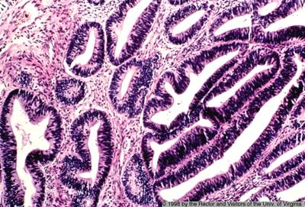
Endometrioid adenocarcinoma
stromal invasion by irregular malignant endometrial glands

Slide 27
Clinical course of coelomic surface epithelial tumors
  low abdominal pain
  abdominal enlargement
  GI tract complaints
  urinary tract complaints
  malignant ones produce ascites
  serosal surfaces are seeded with cancer in metastasis
  grow slowly and get very large

Slide 28
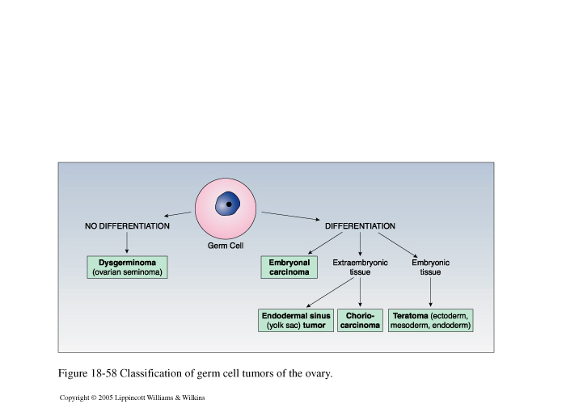
Germ cell tumor- classification

Slide 29
Germ cell Tumors
Teratoma –
  Benign cystic (dermoid cysts)
  Solid immature
  Monodermal – struma ovarii, carcinoid
Dysgerminoma
Yolk sac tumor (Endodermal sinus tumor )
Choricarcinoma
Mixed germ cell tumor

Slide 30
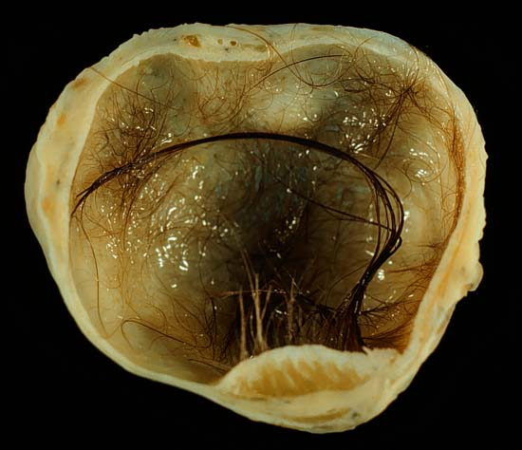
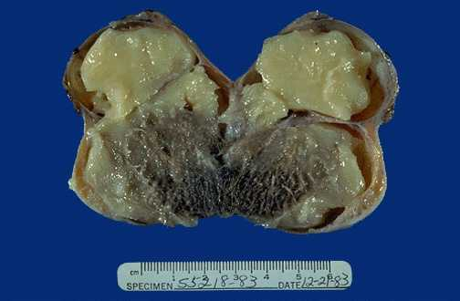
Cystic Teratoma (Dermoid Cyst)

Slide 31
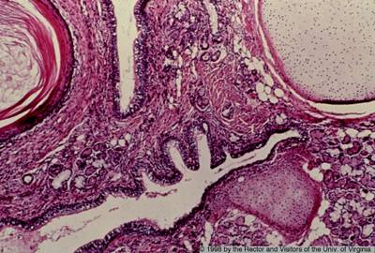
Dermoid Cyst

Slide 32
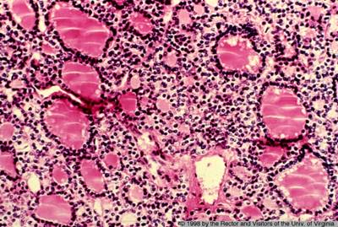
Monodermal teratomas
Struma ovarii:
composed entirely of mature thyroid tissue

Slide 33
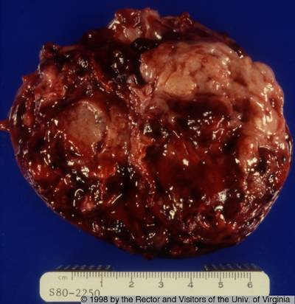
Immature Teratoma
Solid/ necrosis &hemorrhage

Slide 34
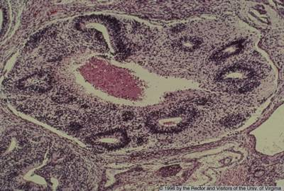
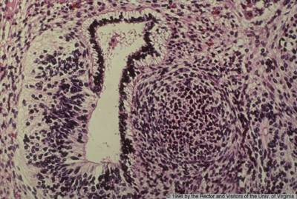
Immature Teratoma
primitive neuroepithelium with multiple neural tubes

Slide 35
Dysgerminoma
The ovarian counterpart of the testicular seminoma
2% of all ovarian malignancies
Most common malignant germ cell tumor
Affects primarily younger females with the majority in the second and third decades.
It is the most frequently encountered ovarian malignancy in pregnancy
An excellent prognosis. Highly radiosensitive .

Slide 36
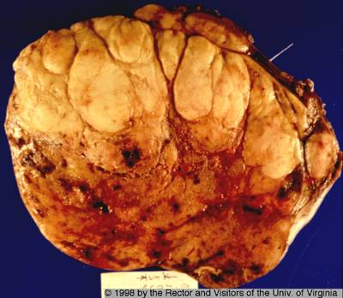
Dysgerminoma
Solid/ lobulated mass with foci of hemorrhage

Slide 37
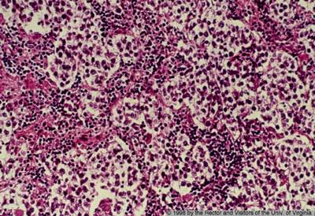
Dysgerminoma
sheets of monotonous rounded cells with pale cytoplasm and central nuclei

Slide 38
Endodermal sinus tumor (Yolk sac carcinoma)
Tumor is a highly malignant and clinically aggressive neoplasm
Most frequently in children and young females
20% of malignant germ cell tumors.
fatal within 2 years of diagnosis

Slide 39
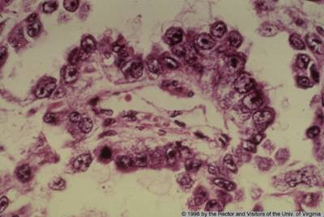
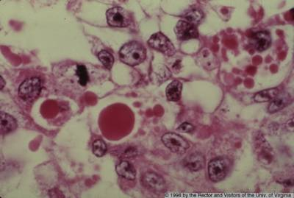
Endodermal sinus tumor (Yolk sac carcinoma)
Schiller-Duval body
BV

Slide 40
Sex Cord - Stromal Tumors
Granulosa-cell tumor
Thecoma
Fibroma
Sertoli-Leydig cell tumors

Slide 41
Granulosa Cell Tumor
Hormonally active tumor
The most common estrogenic ovarian neoplasm.
The adult form occurs mainly in postmenopausal women, associated with endometrial hyperplasia and carcinoma
The juvenile type occurs in the first two decades, cause precocious sexual development.

Slide 42
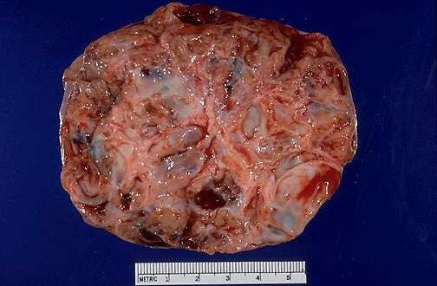
Granulosa Cell Tumor
Solid with hemorrhage

Slide 43
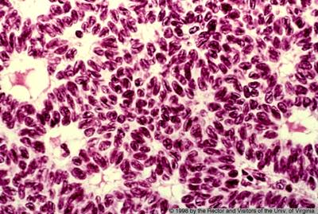
Granulosa Cell Tumor
Sheets of granulosa cells containing spaces lined by the cells to give a follicle-like appearance (Call-Exner bodies).

Slide 44
Thecoma
Functional tumors producing estrogen
It occur in postmenopausal women
Endometrial hyperplasia or carcinoma may develop

Slide 45
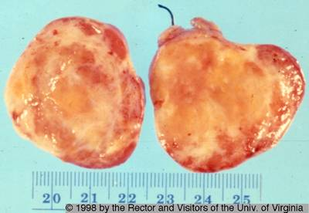
Thecoma
Solid tumor with variegated yellow - orange appearance.

Slide 46
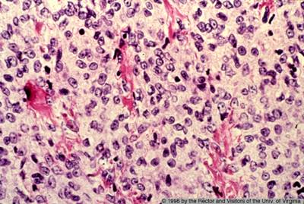
Thecoma
sheets of round to oval cells with pale cytoplasm containing lipid.

Slide 47
Sertoli-Leydig cell tumors
1% of ovarian neoplasms
It occur predominantly in young women.
Commonly androgenic, cause defeminization of women manifested as breast atrophy, amenorrhea, and loss of hair and hip fat , to virilization with hirsutism

Slide 48
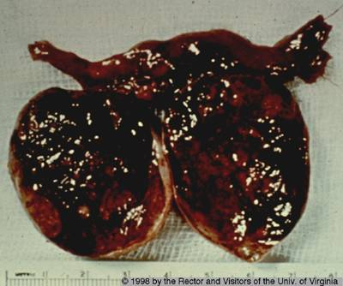
Sertoli-Leydig cell tumors
solid & hemorrhage

Slide 49
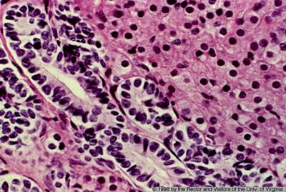
Sertoli-Leydig cell tumors
Tubules lined by Sertoli cells and sheet of Leydig cells

Slide 50
Metastases to ovary
About 3% of malignant tumors in the ovary are metastatic
The most common primary site is the breast followed by the large intestine, stomach, and other genital tract organs.

Slide 51
Krukenberg tumor
It is applied to the uniform enlargement of the ovaries (usually bilaterally) due to diffuse infiltration of the ovarian stroma by metastatic signet-ring cell carcinoma .
The commonest primary site is the stomach followed by the colon.

Slide 52
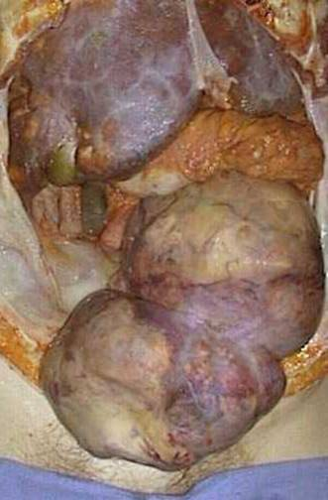
Krukenberg Tumor

Slide 53
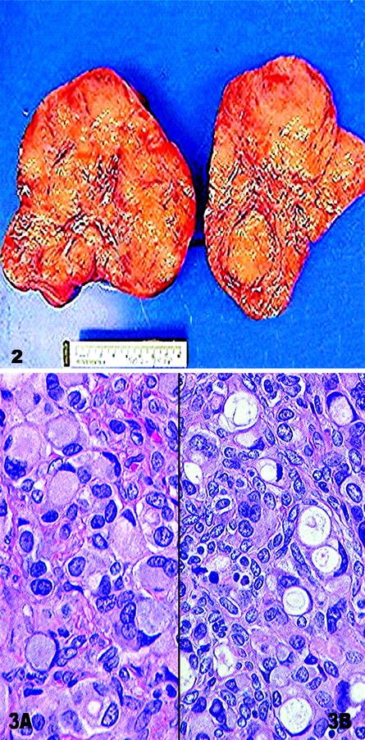
Krukenberg Tumor
Ovarian infiltration with signet ring cell

Slide 54
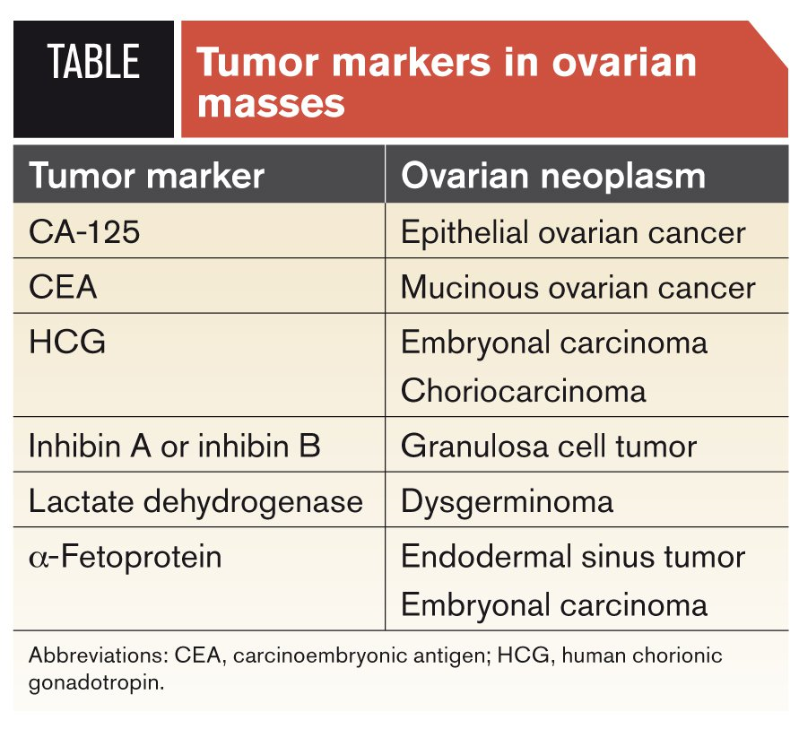

Slide 55
Thankyou for your patience

