Slide 1
PHYSIOLOGY OF OVULATION

Slide 2
Female Reproductive Cycles
Starts at puberty.
Continues throughout the reproductive period.
Monthly female reproductive cycles involves activities of hypothalamus, pituitary gland, ovaries, uterus, uterine tubes, vagina and mammary glands.

Slide 3
Female Reproductive Cycles
These are the monthly rhythmic changes in the ovary and uterus.
These cycles occur approximately every 28 days.
They include:
The “OVARIAN” cycle
The “UTERINE” cycle

Slide 4
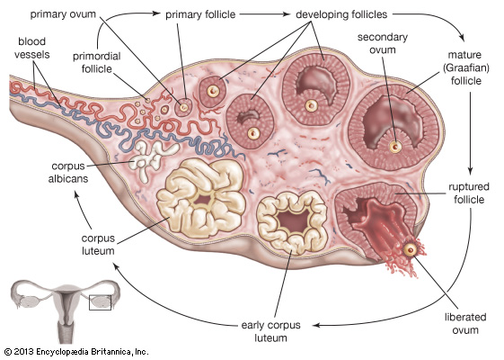
OVARIAN CYCLE
FOLLICULAR PHASE: The development and maturation of a follicle
OVULATION
LUTEAL PHASE: Formation of corpus luteum and its degeneration

Slide 5
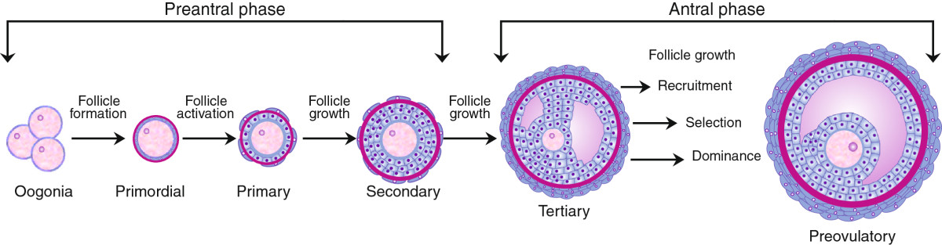
1.Follicular phase:
The development and maturation of a follicle.

Slide 6


Stages of follicular development:
PRIMORDIAL FOLLICLE:
Consists of a oocyte surrounded by a layer of flattened follicular epithelial cells.
PRIMARY/EARLY PREANTRAL FOLLICLE:
A hyaline membrane called zona pellucida is formed around the ovum.
The granulosa cells increase in number, become cuboidal and arrange themselves in a pseudostratified layer

Slide 7
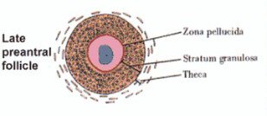
SECONDARY/LATE PREANTRAL FOLLICLE:
With increase in FSH levels , the oocyte grows further & granulosa cells increase in number.
The stroma surrounding the follicle differentiates into theca interna and theca externa.

Slide 8
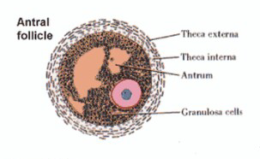
TERTIARY/ ANTRAL FOLLICLE:
Fluid collects in the follicle between the granulosa cells and thus is called antrum.
Of the recruited follicles in a given cycle, only 4-5 follicles attain this stage.

Slide 9
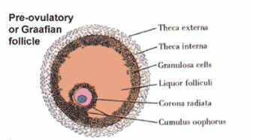
GRAFFIAN FOLLICLE:
The antral fluid (liquor folliculi) increases, contains oestrogen.
Follicle grows to a size of more than 1.5cm
The granulosa cells surrounding the oocyte have a radial arrangement and form the corona radiata.
Cumulus Oophorus:
The oocyte is pushed aside of the follicle & surrounded by a mass of follicular cells.
It projects into the antrum.
The ovum remains in meiotic arrest until 36hrs before ovulation..

Slide 10
2.OVULATION
The process of release of an oocyte from the graffian follicle.
It is quickly picked up by the tubal fimbria.
Occurs on Day14 in a 28 day menstrual cycle.
The process is triggered by midcycle LH surge.
The rupture of the graffian follicle occurs because of the contraction of micromuscle present over the theca externa brought by prostaglandins secreted under the influence of LH

Slide 11
LH surge causes:
Completion of meiosis of ovum
Ovulation
Development of corpus luteum

Slide 12
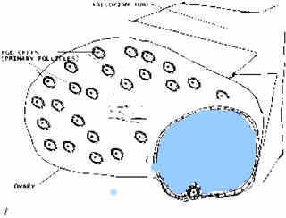
The oocyte completes the first meiotic division with extrusion of the first polar body which is pushed to the perivitelline space.
The dominant follicle, shortly before ovulation reaches the surface of the ovary producing swelling or a bulge on Ovarian surface.
The cumulus becomes detached from the wall, so that the ovum with the surrounding cells (corona radiata) floats freely in the liquor folliculi.

Slide 13
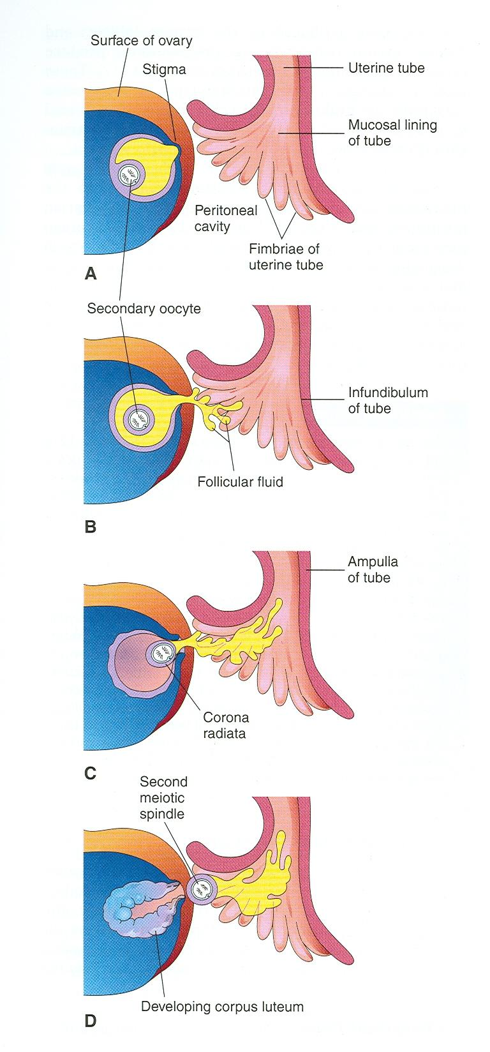
The follicular wall near the ovarian surface becomes thinner. The stigma develops as a conical projection which penetrates the outer surface layer of the ovary and persists for a while (30–120 seconds) as a thin membrane

Slide 14
The stigma ruptures and the cumulus escapes out of the follicle by a slow oozing process, taking about 60–120 seconds along with varying amount of follicular fluid.
The stigma is soon closed by a plug of plasma.

Slide 15
3.LUTEAL PHASE
The period extends from formation of corpus luteum to the onset of menses or luteolysis.
Usually 14days in length.

Slide 16
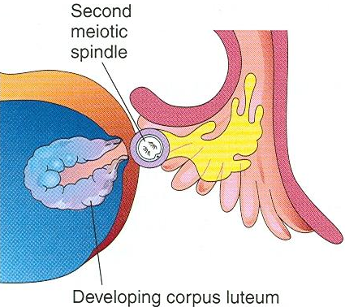
Formatiom of Corpus Luteum:
After ovulation the walls of the ovarian follicle and theca folliculi collapse and thrown into folds called Corpus Luteum

Slide 17
LUTEINISATION:
The granulosa cells and theca cells become yellow due to deposition of lipids and lutein pigment.
The cells bloat up and increase in size with pale staining cytoplasm.
At the same time, the corpus luteum becomes vascularised from the theca interna layer.

Slide 18
The corpus luteum reaches maximum maturity by 22nd day of normal menstrual cycle, when it attains the size of 2cm or more.
It secretes Progesterone, Inhibin A and little estrogen.
High levels of progesterone which is the characteristic of luteal phase, prepares the endometrium for implantation.

Slide 19
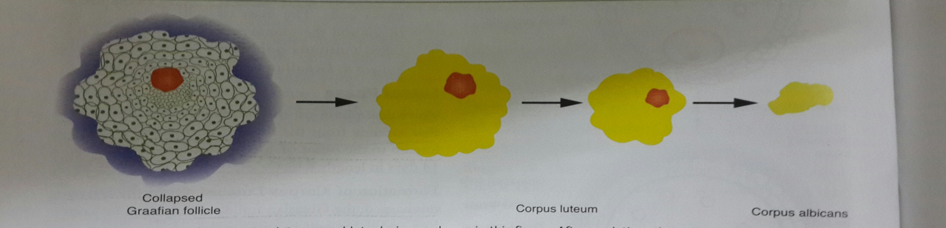
If fertilization does not occur corpus luteum of menstruation -----› corpus albicans
Luteolysis takes place.
Blood supply to corpus luteum decreases
Hormone production ceases
Hyaline degeneration of granulosa cells
Cells become fibrotic
and the resulting structure is called corpus albicans.

Slide 20
If fertilization occurs corpus luteum of pregnancy
If the oocyte is fertilized the Corpus Luteum enlarges & remains active till the placenta takes over the hormone production at 10-12wks.
hcG secreted by trophoblasts prevents luteolysis.

Slide 21
Ovulation Symptoms:
Light spotting
Slight cramping or pain on one side of the pelvis
Abdominal bloating
Breast tenderness
Increased libido

Slide 22
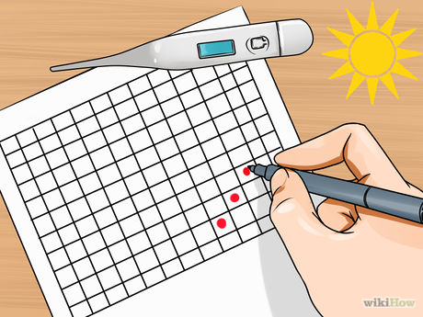
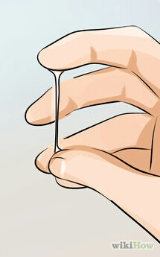
Signs:
BBT:
Temperature reduces by 1/2̊ F.
Spinnbarkeit phenomenon/ Thread test for oestrogen activity:
Cervical mucous at the time of ovulation is thin and profuse and has the property of great elasticity and will withstand stretching up to 10cm.

Slide 23
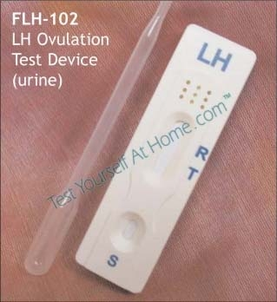
Tests for Ovulation
Urinary LH:
Ovulation occurs 36hrs after LH surge. Serial measurement of urinary LH starting 3-4 days prior to the predicted LH surge is used to predict ovulation.
LH>40mIU/ml is considered to indicate a surge.

Slide 24
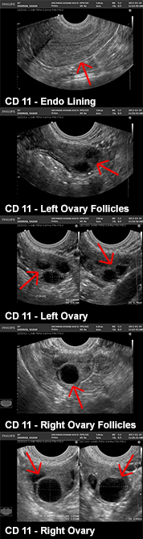
Ultrasonography:
Serial sonographic examination of the ovaries is used to visualise the development of the dominant follicle and its subsequent collapse after ovulation.

Slide 25
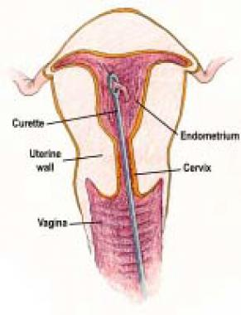
Endometrial biopsy:
Should be performed preferably 1 or 2days before the onset of menstruation.
Secretory changes prove that the cycle has been ovulatory

Slide 26
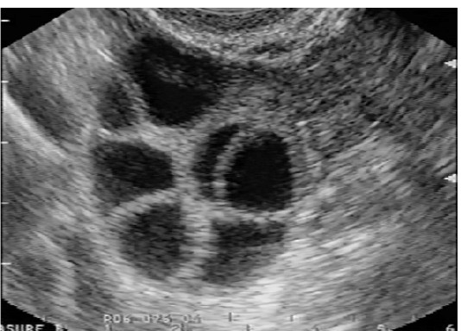
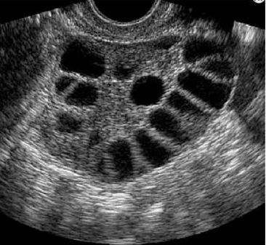
APPLIED PHYSIOLOGY
Multiple ovulation resulting in multiple pregnancy.
Anovulation
10% cases of infertility
PCOS
AUB-O
Luteinized unruptured follicle

Slide 27


