Slide 1
MICROBIOLOGY OF PEURPERAL SEPSIS

Slide 2
INTRODUCTION
Puerperal fever: “The oral temperature is higher than 100.4F(38⁰C) in more than 2 occasions at least 24 hours apart following the 1st 24 hours after delivery for 10 days”
Puerperal sepsis: infection of the genital tract occuring as a complication of delivery.
Puerperal sepsis occurs in 1-8% of vaginal delivery .
Risk of sepsis increases by 5 to 10 times higher in caesarean delivery

Slide 3
Postpartum uterine infection has been called variously endometritis , endomyometritis and endoparametritis
Preferred term: metritis with pelvic cellulitis-because infection does not only involve the decidua but also the myometrium and parametrial tissues.

Slide 4
Vaginal flora
Doderlein’s bacillus
Yeast like fungus mostly candida albicans
Staphylococcus aureus
Streptococcus
E.coli
Bacteriodes
Clostridium Welchii
These organism remain dormant and harmless during normal delivery conducted in aseptic position.

Slide 5
PRE DISPOSING FACTORS
The pathogenicity of the vaginal flora may be influenced by certain factors
The cervicovaginal mucous membrane is damaged even in normal delivery .
The uterine surface, specially the placental site, is converted into an open wound by the cleavage of the decidua during the third stage of labour .
The blood clots present at the placental site are excellent media for the growth of the bacteria.

Slide 6
Antepartum factors
Malnutrition and anemia
Preterm labour
Prelabour rupture of the membranes
Chronic debilitating illness
Prolonged rupture of membrane > 18 hours.

Slide 7
Intrapartum factors
Caesarean delivery
Repeated vaginal examinations
PROM(> 18 hours)
Dehydration and keto-acidosis during labour
Traumatic operative delivery
Hemorrhage—antepartum or postpartum
Retained bits of placental tissue or membranes
Placenta praevia

Slide 8
Previous bacterial colonization if the lower genitaltract with certain microorganisms like:
-Group B streptococcus
-Chlamydia trachomatis
-Mycoplasma hominis
-Ureaplasma urealyticum
-Gardnerella vaginalis

Slide 9
 | RISK FOR METRITIS
Low risk women without complications | 1 -2 %
High risk women due to membrane rupture , prolonged labour , and multiple cervical exams | 5 – 6 %
Women with intrapartum chorioamnionitis | 13 %

Slide 10
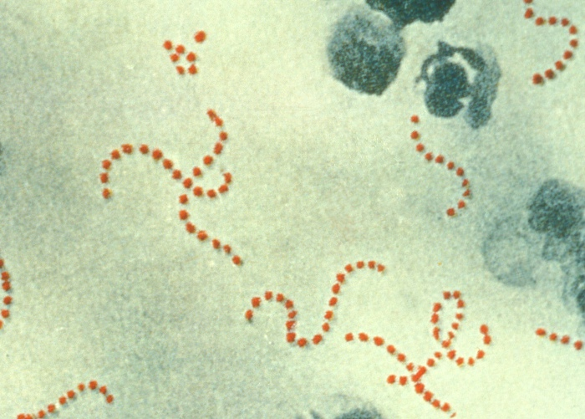
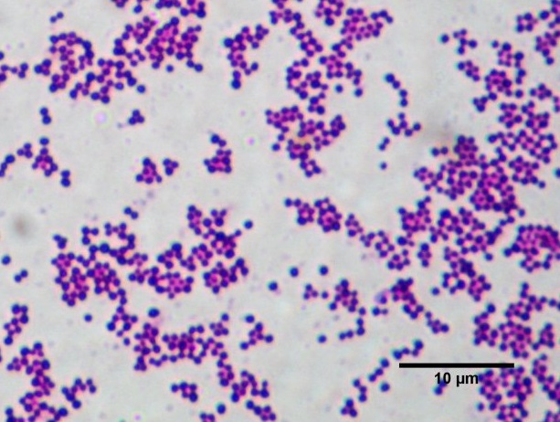
Common Pathogens
Infections are polymicrobial which promotes bacterial synergy.
Other factors that promote virulence are hematomas and devitalized tissue.

Slide 11
Causative organisms
Aerobic
Streptococcus hemolyticus Group A (GAS)
Toxic Shock syndrome, necrotising fascitis in episiotomy or caesarean section wound
Streptococcus hemolyticus Group B (GBS)
Septicemia, respiratory disease and meningitis

Slide 12
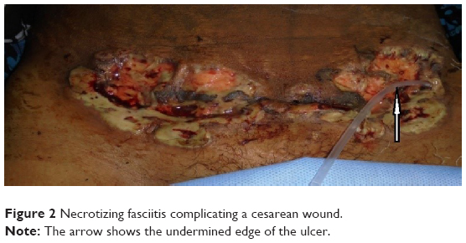

Slide 13

Other aerobic bacteria
staphylococcus aureus
staphylococcal epidermidis
E. coli
Klebsiella
proteus
Pseudomonas
Chlamydia.

Slide 14
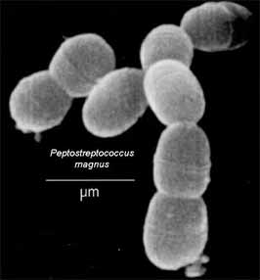
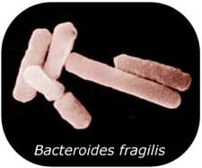
Anaerobic
Streptococcus
Peptococcus
Bacteroides (fragilis, bivius, fusobacteria, mobiluncus)
clostridia

Slide 15
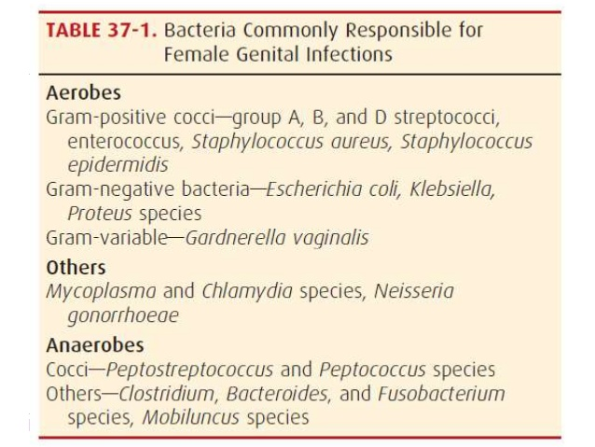

Slide 16
Mode of infection
Endogenous : Organisms are present in the genital tract before delivery .Anaerobic streptococcus is the predominant pathogen
Autogenous : Organisms present elsewhere (skin, throat) in the body and migrate to the genital organs by blood stream.
Exogenous : Infection is contracted from sources outside the patient (from hospital or attendants)

Slide 17
Pathogenesis
•Endometrium (placental implantation site), cervical lacerated wound, vaginal wound or perineal lacerated wound favorable sites for bacterial growth and multiplication
•Devitalized tissue, blood clots, foreign body (retained cotton swabs), and surgical trauma favors polymicrobial growth, proliferation and spread of infection
•Ultimately leads to metritis, parametritis and/or cellulitis.

Slide 18
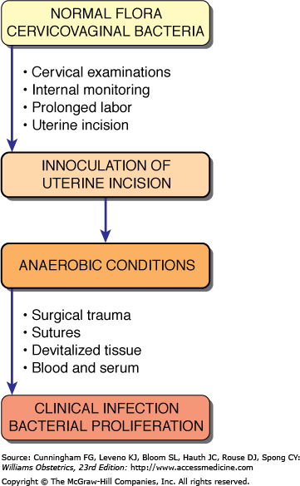

Slide 19
Clinical features
Local infection
Uterine infection
Spreading infection

Slide 20
Local infection
Slight rise of temperature
generalized malaise or headache
Local wound becomes red and swollen
Pus may form which leads to disruption of the wound
When severe (acute), there is high rise of temperature with chills and rigor.

Slide 21
Uterine infection
Mild
Rise in temperature and pulse rate
Lochial discharge becomes offensive and copious
Uterus is subinvoluted and tender
Severe
Onset is acute with high rise of temperature, often with chills and rigor
Pulse rate is rapid, out of proportion to temperature ▪
Lochia may be scanty and odourless
Uterus may be sub involuted, tender and softer.
There may be associated wound infection (perineum, vagina or the cervix).

Slide 22
Spreading infection
Parametritis
Pelvic peritonitis
Pelvic abscess
General peritonitis
Thrombophebitis
Septicemia

Slide 23
Parametritis
Onset : 7–10th day of puerperium
Constant pelvic pain
Tenderness on either sides on the hypogastrium

Slide 24
Pelvic peritonitis
Pyrexia with increase in pulse rate
Lower abdominal pain and tenderness
Muscle guard may be absent
Vaginal examination :tenderness on the fornix and with the movement of the cervix

Slide 25
General peritonitis
High fever with a rapid pulse
Vomiting
Generalised abdominal pain
Looks very ill and dehydrated
Abdomen tender and distended
Rebound tenderness often present
Septicemia
High rise of temperature usually associated with rigor
Blood culture positive
Symptoms and signs of metastatic infection in the lungs, meninges or joints may appear.

Slide 26
Investigations
To locate the site of infection
To identify the organisms
To assess the severity of the disease
History
Antenatal, intranatal and postnatal history of any high risk factor for anaemia, PROM or prolonged labour.

Slide 27
Clinical examination
General, physical and systemic examinations
Abdominal and pelvic examinations : involution of genital organs and locate the specific site of infection
Legs :thrombophlebitis or thrombosis

Slide 28
Investigations Cont…
High vaginal and endo cervical swabs for culture in aerobic and anaerobic media and sensitivity test to antibiotics.
Clean catch mid-stream urine analysis and culture plus sensitivity test
Blood : TC, DC, Hb estimation, platelet count
Thick blood film malarial parasites
Blood culture : if fever +chills/rigors

Slide 29
Pelvic USG
To detect any bits of conception within the uterus
To locate any abscess within the pelvis
To collect samples from pelvis for C/S
For color flow Doppler studies (venous thrombosis)
Chest X-ray
If suspected pulmonary Koch’s lesion
Any lung pathology like collapse or atelectasis
Blood urea and electrolytes
if any renal failure has occured or laparotomy is needed

Slide 30
Prophylaxis
Antenatal
Improvement of nutritional status (to raise Hb level)of the pregnant woman
Eradication of septic focus(skin ,throat, tonsils)in the body

Slide 31
Intranatal
Full surgical asepsis during delivery
Screening for group-B streptococcus in high risk patient
Prophylactic use of antibiotic at time of caesarean section (reduced incidence of wound infection, endometritis, UTIs)
Immediate infusion of 1 gram ceftriaxone after cord clamping and 2nd dose after 8 hours

Slide 32
Post-partum prophylaxis
Aseptic precaution for at least 1 week following delivery until the open wounds in the uterus, perineum and vagina are healed up
Too many visitors are restricted ▪
Sterilized sanitary pads are to be used
Infected mothers and babies in isolated room

Slide 33
General care
Isolation of the patient :When hemolytic streptococcus obtained in culture
Adequate fluid and calorie by I.V infusion
Correction of anaemia by oral iron or blood transfusion as per need
An indwelling catheter : To relieve urinary retention d/t pelvic abscess
Record urinary output
Maintenance of chart : Pulse , RR, Temperature, lochial discharge, fluid intake and output

Slide 34
Treatment
Mild metritis following vaginal delivery:
outpatient treatment with an oral antimicrobial agent is usually sufficient.
Moderate to severe infections:
intravenous therapy with a broad-spectrum antimicrobial regimen is indicated
Improvement follows in 48 to 72 hours in nearly 90% of women treated with one of several regimens.

Slide 35
Persistent fever after 48 to 72 hours mandates a careful search for causes of refractory pelvic infection including:-
Parametrial phlegmon —an area of intense cellulitis
Abdominal incisional or pelvic abscess
Infected hematoma
Septic pelvic thrombophlebitis
Antimicrobial-resistant bacteria
Patient may be discharged home after she has been afebrile for at least 24 hours and further oral antimicrobial therapy is NOT needed

Slide 36
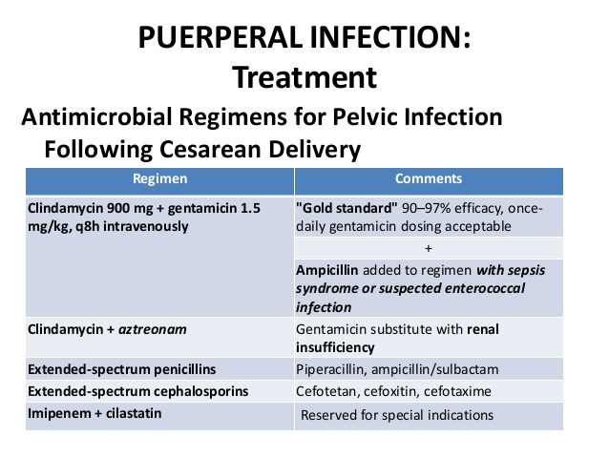

Slide 37
Antibiotics
Empirical antibiotics
Gentamycin (2mg/kg i.v loading dose followed by 1.5 mg/kg i.v every 8 hrs and clindamycin 900 mg i.v every 8 hrs started).
2. Metronidazole 500mg i.v TDS ( for anaerobes)
3. Treat until infection is controlled for at least 7-10days

Slide 38
Antibiotic regimen
Severe sepsis :
combination of either piperacillin -tazobactam or carbapenem plus clindamycin (broadest range of antimicrobial coverage)
MRSA infection : vancomycin or teicoplanin

Slide 39
Perineal wound
Stitches are removed to facilitate drainage of pus & relieve pain.
Cleaned with sitz bath
dressed with antiseptic ointment or powder
Secondary suture after control of infection
Retained uterine products
Surgical evacuation if diameter more than 3 cm
Antibiotic coverage for 24 hrs to avoid septicemia.
If septic pelvic thrombophlebitis : IV heparin for 7-10 days

Slide 40
Pelvic abscess
Drained by colpotomy under USG guidance
Wound dehiscence
Dehiscence of episiotomy or abdominal wound following cesarean section
Scrubbing the wound twice daily
Debridement of all necrotic tissue
Closing wound with secondary suture
Appropriate antibiotic after culture and sensitivity

Slide 41
Laparotomy
Peritonitis
maintenance of electrolyte balance by IV fluids with appropriate antibiotic therapy Unresponsive peritonitis
Pus drainage may be effective
Hysterectomy indicated if rupture or perforation, presence of multiple abscess, gangrenous uterus or gas gangrene infection
Ruptured tubo-ovarian abscess should be removed

Slide 42
THANK YOU

