Slide 1
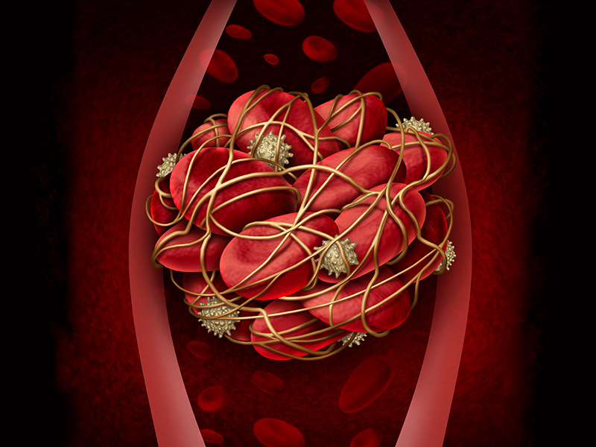
THROMBOEMBOLISM in PREGNANCY

Slide 2
Normal intravascular coagulation include 3 systems:
Coagulation system
Coagulation inhibitory system
Fibrinolytic system

Slide 3
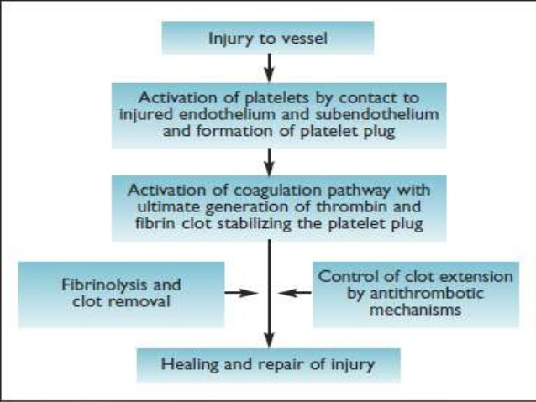

Slide 4
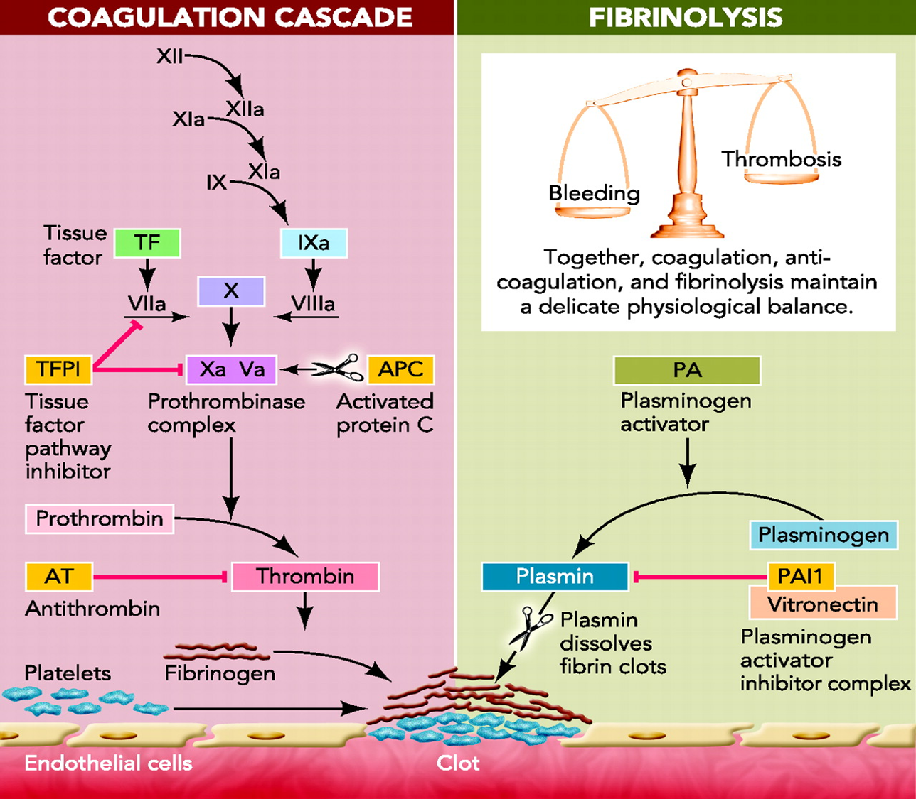

Slide 5
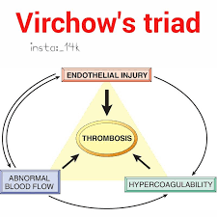
Risk factors for venous thrombosis
(Virchow’s triad)
Vascular stasis
Hypercoagulability of blood
Vascular endothelial trauma

Slide 6
PATHOPHYSIOLOGY
During pregnancy-
Hypercoagulability:
increase in coagulation factors –I, VII, VIII, X,vWF
Increase in plasminogen activator inhibitor 1 and 2
Decrease in protein S
Venous stasis:
increase during pregnancy due to compression of inferior venacava and iliac veins by gravid uterus.
Increased venous distensibility (progesterone effect)and decreased venous tone.
Endothelial injury: vascular damage at delivery

Slide 7
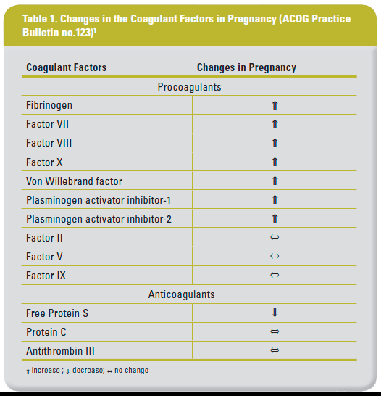

Slide 8
VENOUS THROMBOEMBOLISM
Leading direct cause of maternal death throughout pregnancy.
1 in 1,000 in pregnancy or postpartum.
Pregnant and postpartum women are approximately 4 to 5 times more likely to develop VTE than nonpregnant women.
Frequency of VTE is as much as 5 times greater postpartum than for the antepartum period.

Slide 9
Obstetrical risk factors:
Cesarean delivery
Diabetes
Hemorrhage and anemia
Hyperemesis
Immobility
Multifetal gestation
Multiparity>3
Preeclampsia
Puerperal infection

Slide 10
GENERAL CAUSES
Age 35 yrs or older
Cancer
Connective tissue disease
Dehydration
Immobility-long distance travel
Infection
Myeloproliferative disease
Nephrotic syndrome
Obesity(BMI>30)
Oral contraceptive use
Orthopedic surgery
Paraplegia
Prior thromboembolism
Sickle cell disease
Smoking
Thrombophilia

Slide 11
Thromboembolism in Pregnancy
Superficial Thrombophlebitis
Deep Vein Thrombosis.
Pulmonary Embolism.
Thrombophilias

Slide 12
Superficial Thrombophlebitis
Clinical Features:
Swelling and tenderness of the involved extremity.
On physical examination, there is erythema, tenderness, warmth, and a palpable cord over the course of the involved superficial veins.
Treatment:
Bed rest, pain medications, and local application of heat are often sufficient treatment.
There is no need for anticoagulants, but anti-inflammatory agents may be considered.

Slide 13
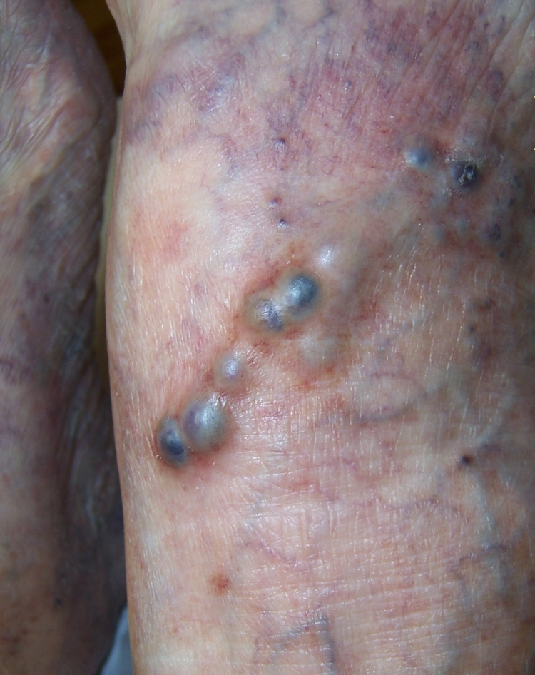

Slide 14
DEEP VEIN THROMBOSIS
During pregnancy, most venous thrombosis are confined to deep veins of lower extremity.
70% - in iliofemoral veins without involvement of calf veins.
50% of cases are asymptomatic.
DVT -more common – left leg > right leg [compression of left iliac vein by right iliac artery]

Slide 15
Clinical Features
Symptoms
Abrupt in onset,
Pain and odema of leg and thigh.
Dull ache, tingling, tightness, especially when walking.
Signs:
Asymmetric leg edema (difference in circumference between the affected and normal leg >2cm) is significant.
Homan’S sign: Pain in the calf in association with dorsiflexion of the foot

Slide 16
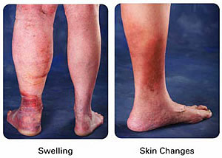

Slide 17
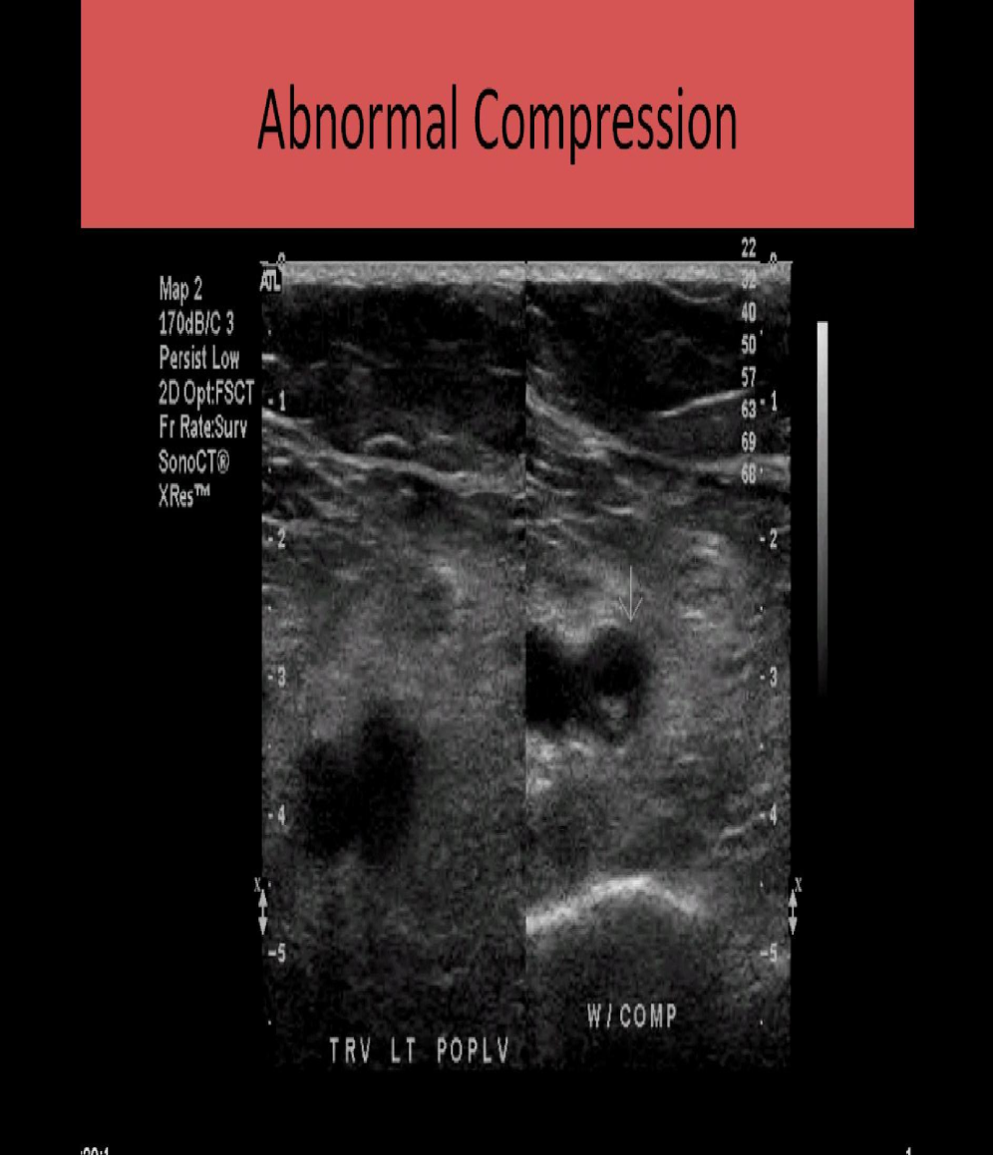
INVESTIGATIONS
COMPRESSION ULTRASONOGRAPHY
Initial diagnostic test.
First line test to detect DVT.
PRINCIPLE – based on noncompressibility and typical echoarchitecture of thrombosed vein.
Negative single complete compression USG may safely exclude diagnosis of DVT in pregnant women.

Slide 18
MRI:
Found superior to ultrasonography and equivalent to contrast venography.
Useful more in iliofemoral and pelvic vein thrombosis.
Sensitivity and specificity is 100%.
Venography :
Injecting nonionic water soluble radiopaque dye to note filling defect in venous lumen.
Gold standard test to exclude DVT.
restricted - risk of fetal radiation exposure(3mGY) and contrast allergy.

Slide 19
D -dimer screening tests
Excellent negative predictive value but less specificity.
D-dimer serum levels increase with gestational age along with substantively elevated plasma fibrinogen concentrations.
Also elevated - placental abruption, preeclampsia, multiple pregnancies, cesarean section, major postpartum hemorrhage.
Therefore , their use during pregnancy is uncertain , but negative D-dimer test should be considered reassuring.

Slide 20
D-dimer values(micg/ml)
Non pregnant –0.22-0.74
1st trimester – 0.05-0.95
2nd trimester- 0.32-1.29
3rd trmester- 0.13-1.7

Slide 21
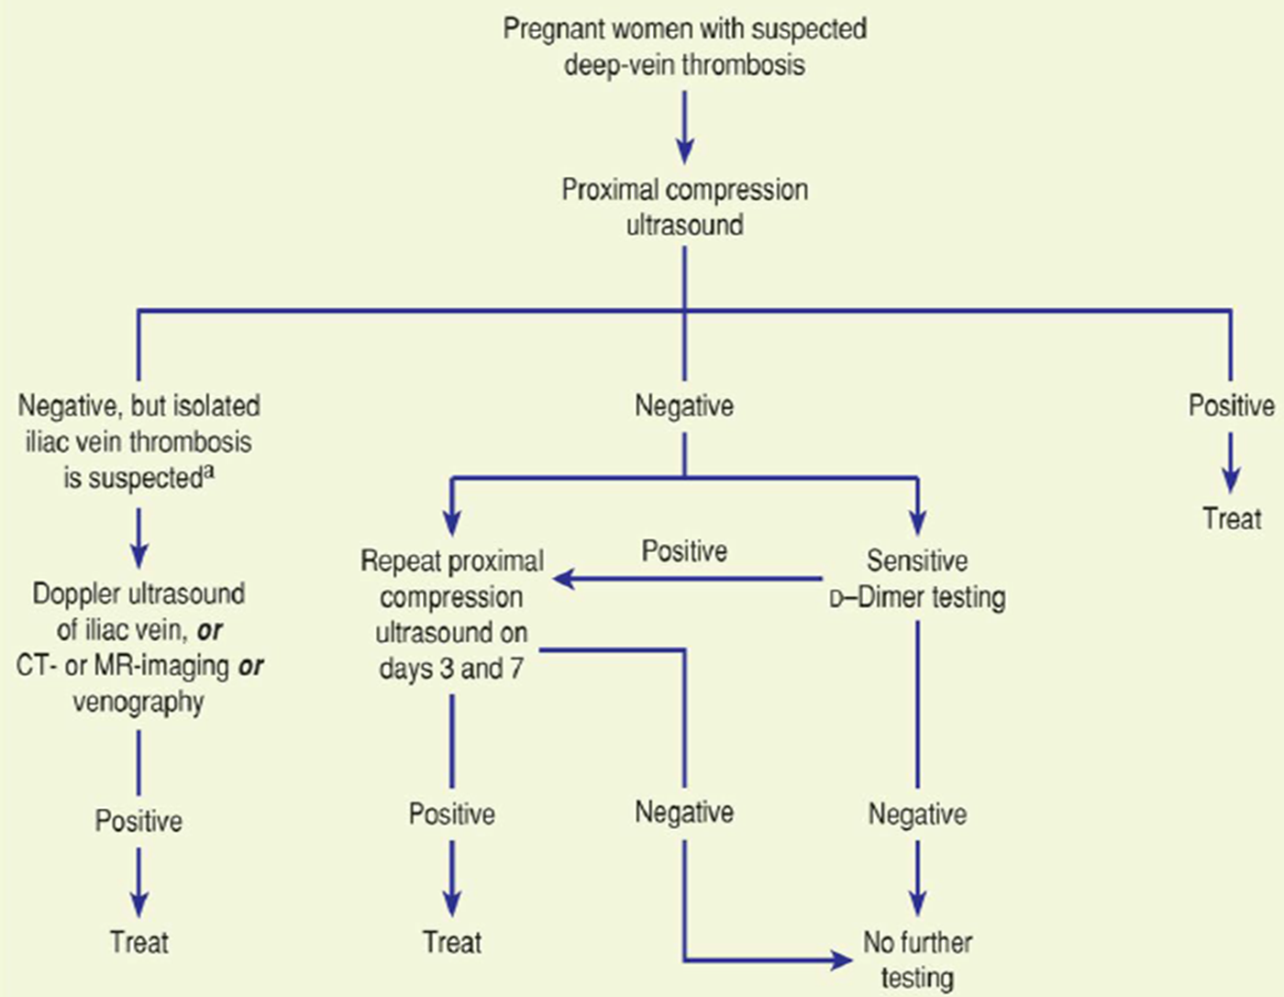

Slide 22
PULMONARY EMBOLISM
Incidence: 1 in 7000 pregnacies
Clinical Features:
Symptoms: - Dyspnoea,
- chest pain,
- Cough,
- Palpitations,
- Hemoptysis
Signs: º Tachypnea,
º Tachycardia,
º Pleural friction rub,
º Pulmonary rales,
º Signs of right ventricular failure.

Slide 23
DIAGNOSIS
Ecg: right axis deviation, T- wave inversion, non specific ST changes(S1Q3T3)
Chest x ray(<.01mSv): diminshed intravascularmarkings,atelectasis,
effusion. Exclude other causes like pneumonia,collapse, pneumothorax
Arterial blood gas analysis: PO2 > 85mm of hg on room air is reassuring but does not rule out PE.
D-dimer: A negative D-dimer value may rule out the diagnosis of PE

Slide 24
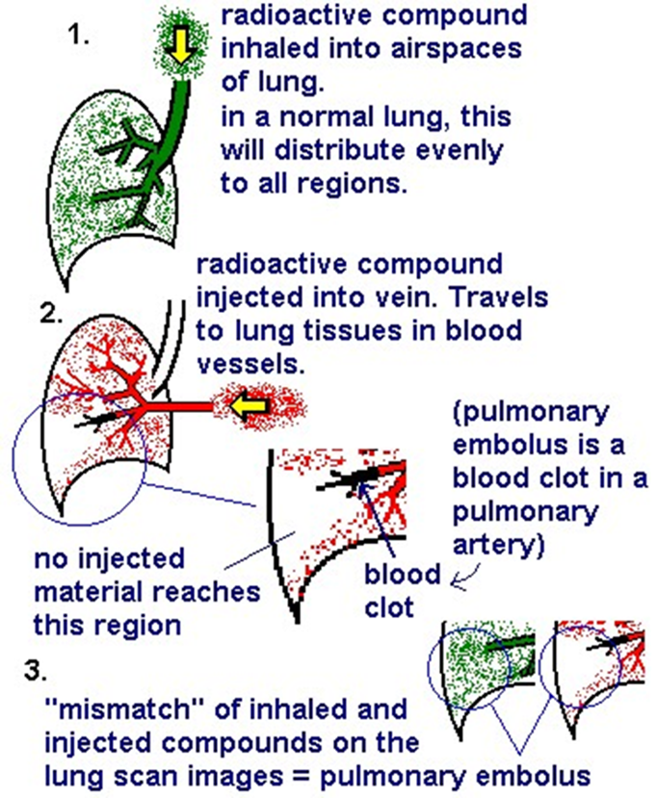
Perfusion scan:
Intravenous administration of technetium 99 macroaggregated albumin – abnormal areas of perfusion
Inhalation of xenon 133/technitium 99m – abnormal areas of ventilation.
Better negative predictive value.

Slide 25
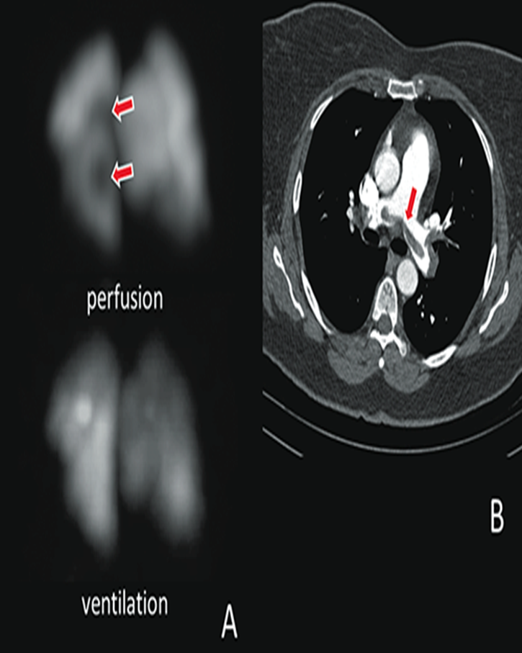
CTPA:
Initial diagnostic test when chest X ray is abnormal

Slide 26
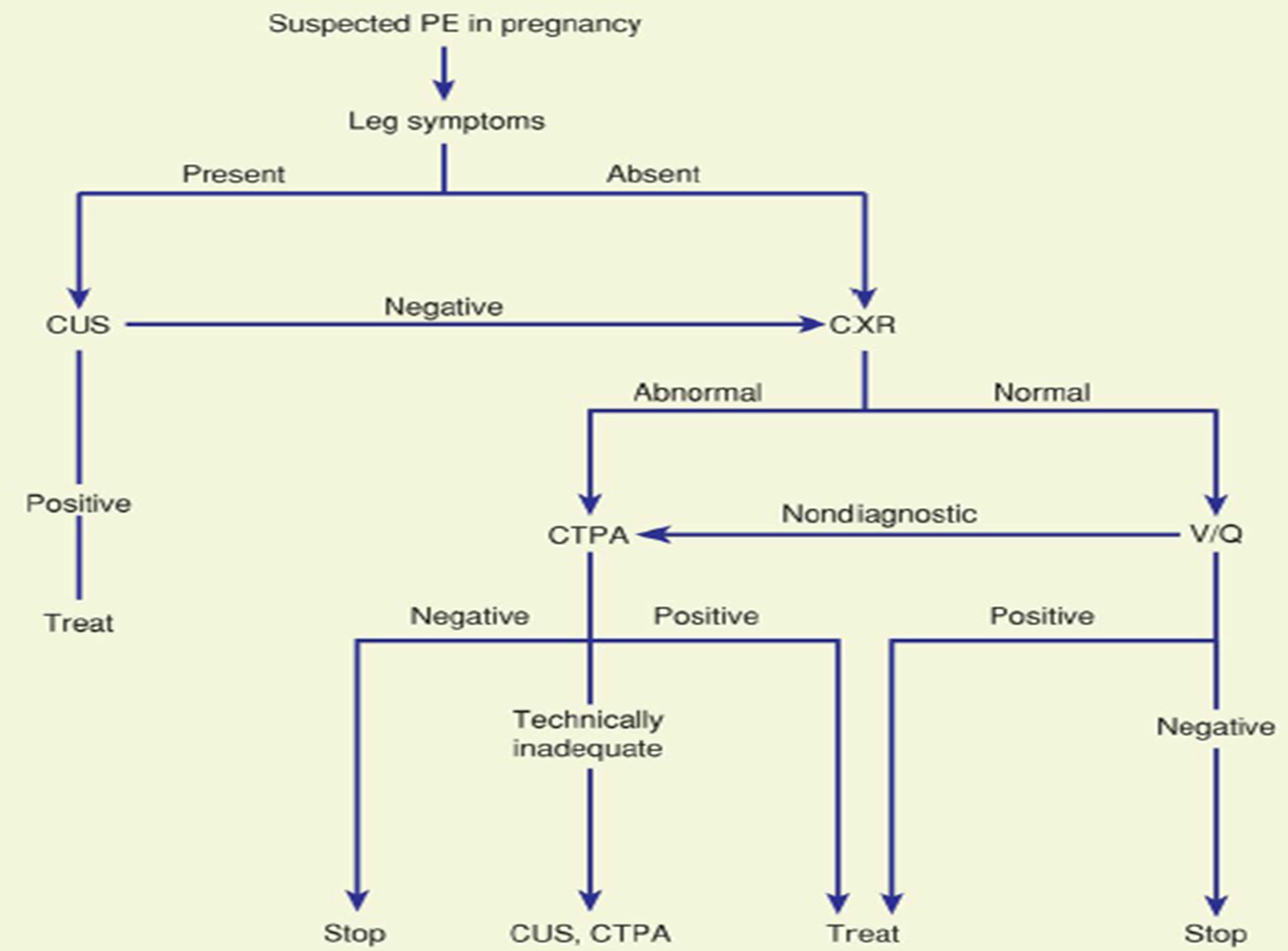

Slide 27
PHARMACOLOGICAL AGENTS FOR ANTI THROMBOTIC THERAPY

Slide 28
LOW MOLECULAR WEIGHT HEPARIN
The anticoagulant effect is exerted by inhibiting factor Xa > thrombin.
They have better bio availability ,long half life, dose independent clearance and decreased interference with platelets.
Therefore they are preferred over UFH in pregnancy both for therapeutic and prophylactic anticoagulation.

Slide 29
Doses of LMWH are based on weight. For thromboprophylaxis the booking or most recent weight can be used to guide dosing
Doses of LMWH should be reduced in women with renal impairment.
LMWH is safe in breastfeeding.
Monitoring of anti-Xa activity for patients on LMWH for treatment of acute VTE in pregnancy or postpartum is not necessary except in women at extremes of body weight (<50 kg and ≥90 kg) or with other complicating factors (eg, renal impairment or recurrent VTE).
Routine platelet count monitoring is not necessary

Slide 30
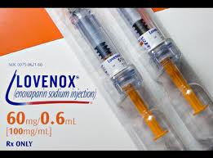
Commonly used LMWH includes
1.Enoxaparin
2.Dalteparin
3.Tinzaparin

Slide 31
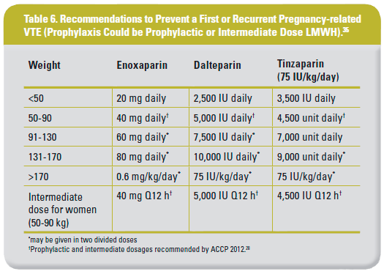

Slide 32
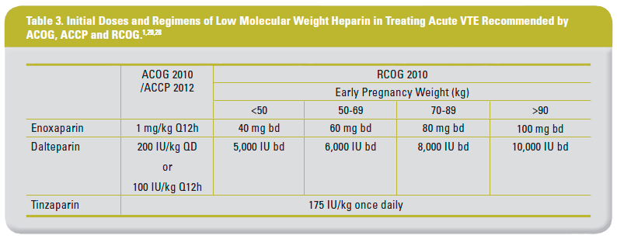

Slide 33
Contraindications/cautions to LMWH use
Known bleeding disorder (e.g. haemophilia, von Willebrand’s disease or acquired coagulopathy)
Active antenatal or postpartum bleeding
Women considered at increased risk of major haemorrhage
Thrombocytopenia
Acute stroke in previous 4 weeks (haemorrhagic or ischaemic)
Severe renal disease (glomerular filtration rate [GFR] < 30 ml/minute )
Severe liver disease
Uncontrolled hypertension (blood pressure > 200 mmHg systolic or > 120 mmHg diastolic)

Slide 34
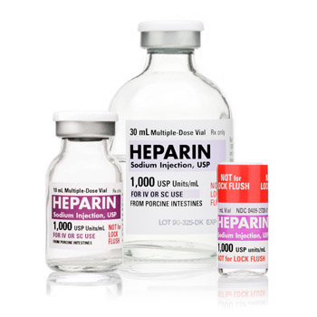
UNFRACTIONATED HEPARIN
It acts by inactivating factors IIa and Xa and affects the aPTT.
No teratogenic risk.
Maternal risks- hemorrhage, heparin induced thrombocytopenia and osteoporosis
Used in
VTE close to term
Post operative patients with
risk of haemorrhage
Massive PE with cardiovascular
collapse

Slide 35
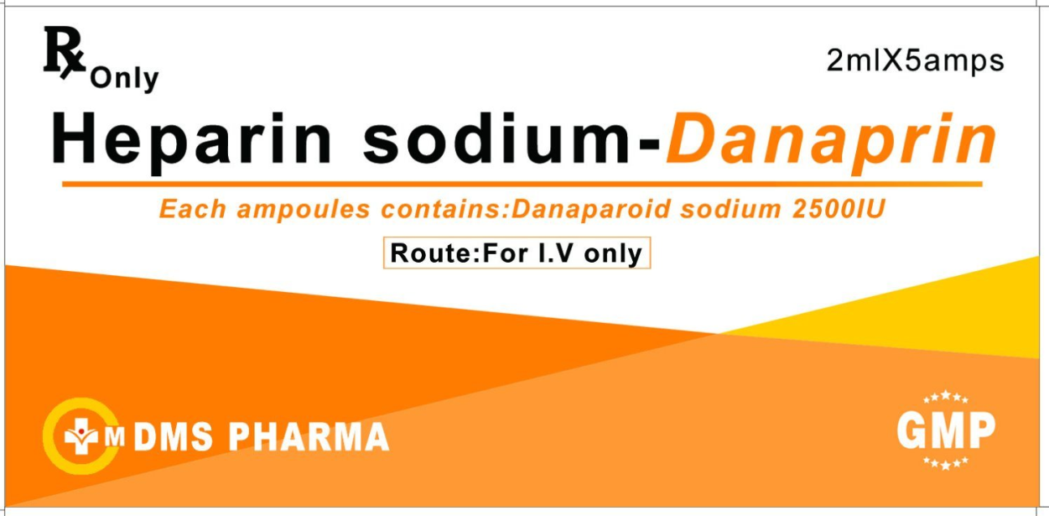
Danaparoid
Danaparoid is a heparinoid that is mostly used in patients intolerant of heparin, either because of HIT or a skin allergy to heparins
There were no adverse fetal outcomes attributed to danaparoid.
Danaparoid seems reasonable to use in pregnancy when there is a requirement for anticoagulant prophylaxis or treatment and heparins cannot be used.

Slide 36
The half-life of danaparoid is long (24 hours) and regional anaesthesia should be avoided in women receiving it for thromboprophylaxis.
Although direct evidence is limited, it seems likely that breastfeeding would be safe while on danaparoid since little if any appears in breast milk and oral absorption is unlikely

Slide 37
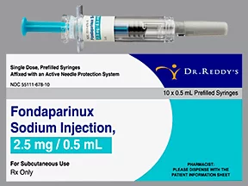
Fondaparinux
Fondaparinux should be reserved for women intolerant of heparin compounds.
Fondaparinux is a synthetic pentasaccharide that acts through inhibition of factor Xa .
No placental passage of fondaparinux was found.
No adverse effects were observed in the newborns.

Slide 38
It is unknown whether fondaparinux is excreted in breast milk but oral absorption seems unlikely.
The half-life of fondaparinux is long (18 hours) and 36–42 hours should pass following the previous dose before it becomes acceptable to consider regional anaesthesia.
Thus, although experience is limited, it seems likely that fondaparinux would be a reasonable alternative when there is a need for anticoagulant prophylaxis or treatment in pregnancy and heparins cannot be used.

Slide 39
Warfarin Vit K antagonist
Warfarin use in pregnancy is restricted to the few situations where heparin is considered unsuitable, e.g. some women with mechanical heart valves.
Women receiving long-term anticoagulation with warfarin can be converted from LMWH to warfarin postpartum when the risk of haemorrhage is reduced, usually 5–7 days after delivery .
Warfarin is safe in breastfeeding.
Warfarin crosses the placenta leading to a characteristic warfarin embryopathy (hypoplasia of nasal bridge, congenital heart defects, ventriculomegaly, agenesis of the corpus callosum, stippled epiphyses) in approximately 5% of fetuses exposed between 6 and 12 weeks of gestation.

Slide 40
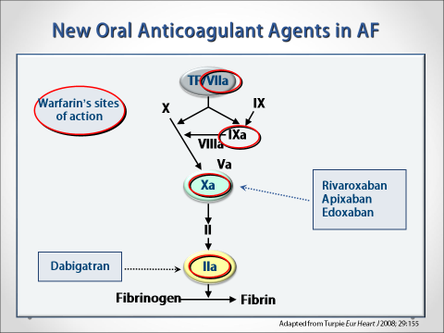
There are no reports on the use of the non-vitamin K antagonist oral anticoagulants (NOACs, previously called new or novel oral anticoagulants, e.g. rivaroxaban, apixaban, betrixaban and dabigatran) in pregnancy or the puerperium and as they are likely to cross the placenta and have potential direct fetal effects, they should therefore be avoided in the antenatal period.

Slide 41
Dextran
Dextran should be avoided antenatally and intrapartum because of the risk of anaphylactoid reaction.
Although dextran may reduce the risk of postoperative DVT outside pregnancy, the evidence is weak, it is less effective than LMWH and it appears to increase the risk of bleeding.
Anaphylaxis to dextran has been associated with uterine hypertonus, fetal distress, fetal neurological abnormalities and death.

Slide 42
GREEN TOP GUIDELINES FOR THROMBOPROPHYLAXIS AND ACUTE MANAGEMENT OF THROMBOEMBOLISM

Slide 43
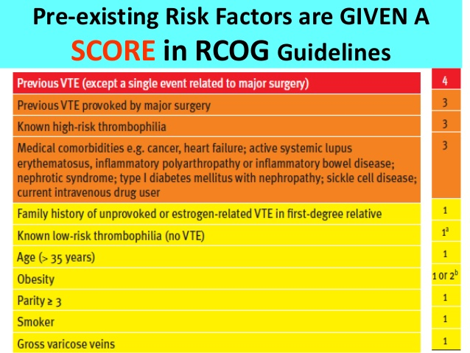

Slide 44
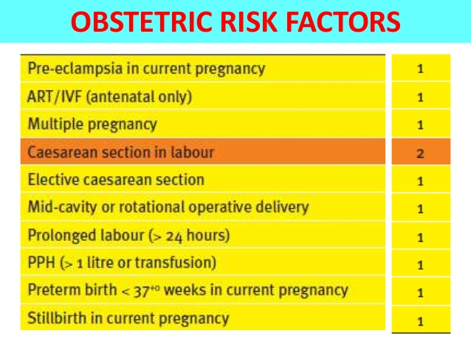

Slide 45
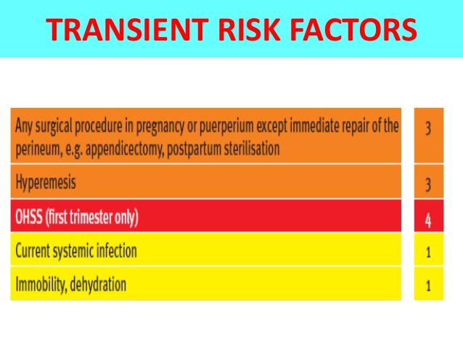

Slide 46
TOTAL SCORE | ANTENATAL THROMBO PROPHYLAXIS | POSTNATAL THROMBO PROPHYLAXIS
≥ 4 | from the first trimester | for 6 weeks
3 | from 28 weeks | for 6 weeks
2 | - | at least 10 days
If admitted to hospital antenatally consider thromboprophylaxis.
If prolonged admission (≥ 3 days) or readmission to hospital within the puerperium consider thromboprophylaxis.

Slide 47
Previous VTE or thrombophilia
Two well-recognised significant risk factors for VTE in pregnancy, identifiable before pregnancy, are thrombophilia and previous VTE.
Heritable thrombophilia is found in 20– 50% of pregnancy-related VTE.

Slide 48
How should women with previous VTE be managed in pregnancy?
Women with previous VTE should be offered prepregnancy counselling and a prospective management plan for thromboprophylaxis in pregnancy made.
Women with previous VTE (except those with a single previous VTE related to major surgery and no other risk factors) should be offered thromboprophylaxis with LMWH throughout the antenatal period.
Women with previous VTE have an increased risk of recurrence in pregnancy.
All women with prior VTE should receive postpartum prophylaxis.

Slide 49
Thrombophilia-associated VTE
Heritable thrombophilia
Women with previous VTE associated with antithrombin deficiency (who will often be on long-term oral anticoagulation) should be offered thromboprophylaxis with higher dose LMWH (either 50%, 75% or full treatment dose) antenatally and for 6 weeks postpartum or until returned to oral anticoagulant therapy after delivery.
If anti-Xa levels are measured, a 4-hour peak levels of 0.5–1.0 IU/ml aimed for.

Slide 50
Other heritable thrombophilic defects are lower risk and can be managed with standard doses of thromboprophylaxis.
Risks of recurrent VTE appear higher for those with a family history and deficiencies of the naturally occurring anticoagulants, particularly type 1 antithrombin deficiency (both activity and antigen reduced), than for those with heterozygous V Leiden mutation.
Antithrombin replacement around the time of delivery has been suggested and might be considered in individual cases.

Slide 51
Acquired thrombophilia
Women with VTE associated with the antiphospholipid syndrome (APS)[lupus anticoagulant and/or anticardiolipin and/or β2-glycoprotein 1 antibodies] should be offered thromboprophylaxis with higher dose LMWH (either 50%, 75% or full treatment dose) antenatally and for 6 weeks postpartum or until returned to oral anticoagulant therapy after delivery.
Women with antiphospholipid syndrome (APS) and previous VTE are at high risk of recurrent VTE in pregnancy.

Slide 52
Asymptomatic heritable thrombophilia
How should women with asymptomatic thrombophilia be treated?
Women with asymptomatic antithrombin, protein C or S deficiency or those with more than one thrombophilic defect (including homozygous factor V Leiden, homozygous prothrombin gene mutation and compound heterozygotes) should be given antenatal prophylaxis.
They should be recommended for six weeks’ postnatal prophylaxis even in the absence of additional risk factors. Heterozygosity for factor V Leiden or prothrombin gene mutation or antiphospholipid antibodies are considered as risk factors for thrombosis in asymptomatic women.

Slide 53
Family history itself in the absence of an identifiable thrombophilic tendency is associated with an increased risk of VTE.
Women should be stratified according to both the level of risk associated with their thrombophilia and the presence or absence of a family history or other risk factors.
When LMWH is used for thromboprophylaxis in pregnancy in women with asymptomatic thrombophilias, standard doses can be used, with the exception of antithrombin deficiency where intermediate doses may be required.

Slide 54
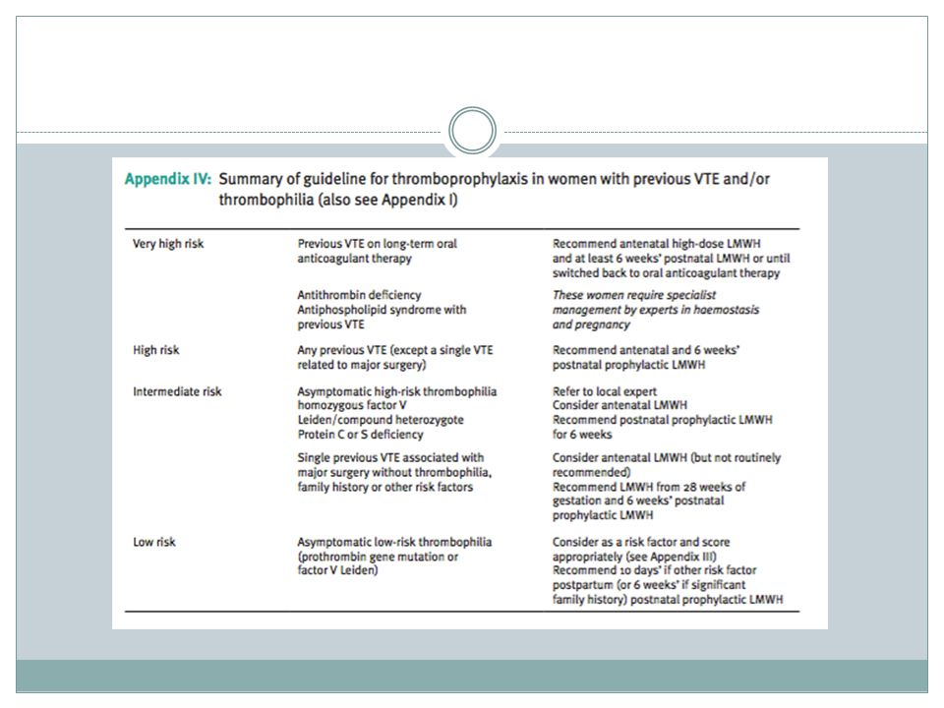

Slide 55
Thromboprophylaxis during labour and delivery
When should thromboprophylaxis be interrupted for delivery?
Women receiving antenatal LMWH should be advised that if they have any vaginal bleeding or once labour begins they should not inject any further LMWH.
Regional techniques should be avoided if possible until at least 12 hours after the previous prophylactic dose of LMWH.
LMWH should not be given for 4 hours after use of spinal anaesthesia or after the epidural catheter has been removed .

Slide 56
Women receiving antenatal LMWH having an elective caesarean section should receive a thromboprophylactic dose of LMWH on the day prior to delivery and, on the day of delivery, any morning dose should be omitted and the operation performed that morning.
The first thromboprophylactic dose of LMWH should be given as soon as possible after delivery provided there is no postpartum haemorrhage and regional analgesia has not been used.

Slide 57
If LMWH precludes regional techniques (in, for example, the woman who presents in spontaneous labour within 12 hours of taking a LMWH dose), alternative analgesia such as opiate-based intravenous patient-controlled analgesia can be offered.

Slide 58
Caesarean section and VTE
What is the magnitude of risk of VTE after caesarean section?
All women who have had caesarean sections should be considered for thromboprophylaxis with LMWH for 10 days after delivery apart from those having an elective caesarean section.
Most women who suffer a VTE after caesarean section have other risk factors including twin pregnancy, obesity, severe pre-eclampsia, reoperation, immobilisation and placenta praevia.

Slide 59
Caesarean section is a risk factor for death from PE.
Women delivered by elective caesarean section have at least double the postpartum risk of VTE compared with vaginal birth.
The risk of postpartum VTE after an emergency caesarean section is twice that after an elective caesarean section and four times that after a vaginal delivery.

Slide 60
Are specific surgical measures required for anticoagulated patients undergoing delivery by caesarean section?
In patients receiving therapeutic doses of LMWH, wound drains (abdominal and rectus sheath) should be considered at caesarean section and the skin incision should be closed with interrupted sutures to allow drainage of any haematoma.

Slide 61
How is acute VTE diagnosed in pregnancy?
Any woman with symptoms and/or signs suggestive of VTE should have objective testing performed expeditiously and treatment with low-molecular-weight heparin (LMWH) given until the diagnosis is excluded by objective testing, unless treatment is strongly contraindicated.
Individual hospitals should have an agreed protocol for the objective diagnosis of suspected VTE during pregnancy.
This may recommend the involvement of obstetricians, radiologists, physicians and haematologists.

Slide 62
If DVT remains untreated, 15–24% of these patients will develop PE.
PE during pregnancy may be fatal in almost 15% of patients, and in 66% of these, death will occur within 30 minutes of the embolic event.

Slide 63
What investigations are needed for the diagnosis of an acute DVT?
Compression duplex ultrasound should be undertaken where there is clinical suspicion of DVT.
If ultrasound is negative and there is a low level of clinical suspicion, anticoagulant treatment can be discontinued.
If ultrasound is negative and a high level of clinical suspicion exists, anticoagulant treatment should be discontinued but the ultrasound should be repeated on days 3 and 7.

Slide 64
If ultrasound confirms the diagnosis of DVT, anticoagulant treatment should be continued.
If repeat testing is negative, no further treatment is required; if repeat testing confirms the presence of DVT, anticoagulant treatment should be recommenced and continued.

Slide 65
What investigations are needed for the diagnosis of an acute PE?
Women presenting with symptoms and signs of an acute PE should have an electrocardiogram (ECG) and a chest X-ray (CXR) performed.
In women with suspected PE who also have symptoms and signs of DVT, compression duplex ultrasound should be performed.
If compression ultrasonography confirms the presence of DVT, no further investigation is necessary and treatment for VTE should continue.

Slide 66
In women with suspected PE without symptoms and signs of DVT, a ventilation/perfusion (V/Q) lung scan or a computerised tomography pulmonary angiogram (CTPA) should be performed.
When the chest X-ray is abnormal and there is a clinical suspicion of PE, CTPA should be performed in preference to a V/Q scan.
Anticoagulant treatment should be continued until PE is definitively excluded.

Slide 67
The choice of technique for definitive diagnosis (V/Q scan or CTPA) will depend on local availability, and individual hospitals should have an agreed protocol for the objective diagnosis of suspected PE during pregnancy.
CTPA has potential advantages over V/Q imaging including: CTPA is more readily available, delivers a low radiation dose to the fetus and can identify other pathology including pneumonia (5–7%), pulmonary oedema (2–6%) and rarely aortic dissection.

Slide 68
While CTPA is associated with a low risk of radiation for the fetus there is an increased risk of maternal breast cancer.
It would be prudent to recommend that lung perfusion scans should be considered the investigation of first choice for young women, especially if there is a family history of breast cancer or the patient has had a previous chest CT scan.

Slide 69
How should massive life-threatening PE in pregnancy and the puerperium be managed?
Collapsed, shocked women who are pregnant or in the puerperium should be assessed by a team of experienced clinicians and obstetrician.
Women should be managed on an individual basis regarding: intravenous unfractionated heparin, thrombolytic therapy or thoracotomy and surgical embolectomy.
Management should involve a multidisciplinary team including senior physicians, obstetricians and radiologists.

Slide 70
Intravenous unfractionated heparin is the preferred, initial treatment in massive PE with cardiovascular compromise.
An urgent portable echocardiogram or CTPA within 1 hour of presentation should be arranged.
If massive PE is confirmed, or in extreme circumstances prior to confirmation, immediate thrombolysis should be considered.

Slide 71
Maternal resuscitation should commence following the principles of ABC and if cardiac arrest occurs, cardiopulmonary resuscitation should be performed with the woman in a left lateral tilt.
A perimortem caesarean section should be performed by 5 minutes if resuscitation is unsuccessful and the pregnancy is more than 20 weeks.

Slide 72
Regimen for the administration of intravenous unfractionated heparin is:
Loading dose of 80 units/kg, followed by a continuous intravenous infusion of 18 units/kg/hour .
If a patient has received thrombolysis , the loading dose of heparin should be omitted and an infusion started at 18 units/kg/hour.
It is mandatory to measure activated partial thromboplastin time (APTT) level 4–6 hours after the loading dose, 6 hours after any dose change and then at least daily when in the therapeutic range.
The therapeutic target APTT ratio is usually 1.5–2.5 times the average laboratory control value.
The infusion rate should be adjusted according to the APTT.

Slide 73
Additional therapies
Should graduated elastic compression stockings be employed in the acute management of VTE in pregnancy?
In the initial management of DVT, the leg should be elevated and a graduated elastic compression stocking applied to reduce oedema.
Mobilisation with graduated elastic compression stockings should be encouraged.

Slide 74
What is the role of inferior vena cava filters in the management of VTE in pregnancy?
Placement of a temporary inferior vena cava (IVC) filter in obstetric practice is indicated when recurrent thromboembolism occurs despite adequate anticoagulation, or when anticoagulation is contraindicated.
The long-term safety of IVC filters is uncertain and the main complications associated with vena cava filters are migration, an increased risk of lower limb DVT and caval thrombosis and, rarely, infection.

Slide 75
Prevention of post-thrombotic syndrome
What measures can be employed to prevent the development of post-thrombotic syndrome?
Women should be advised that prolonged use of LMWH (more than 12 weeks) is associated with a significantly lower chance of developing post-thrombotic syndrome.
Following a DVT, graduated elastic compression stockings should be worn on the affected leg to reduce pain and swelling.

Slide 76
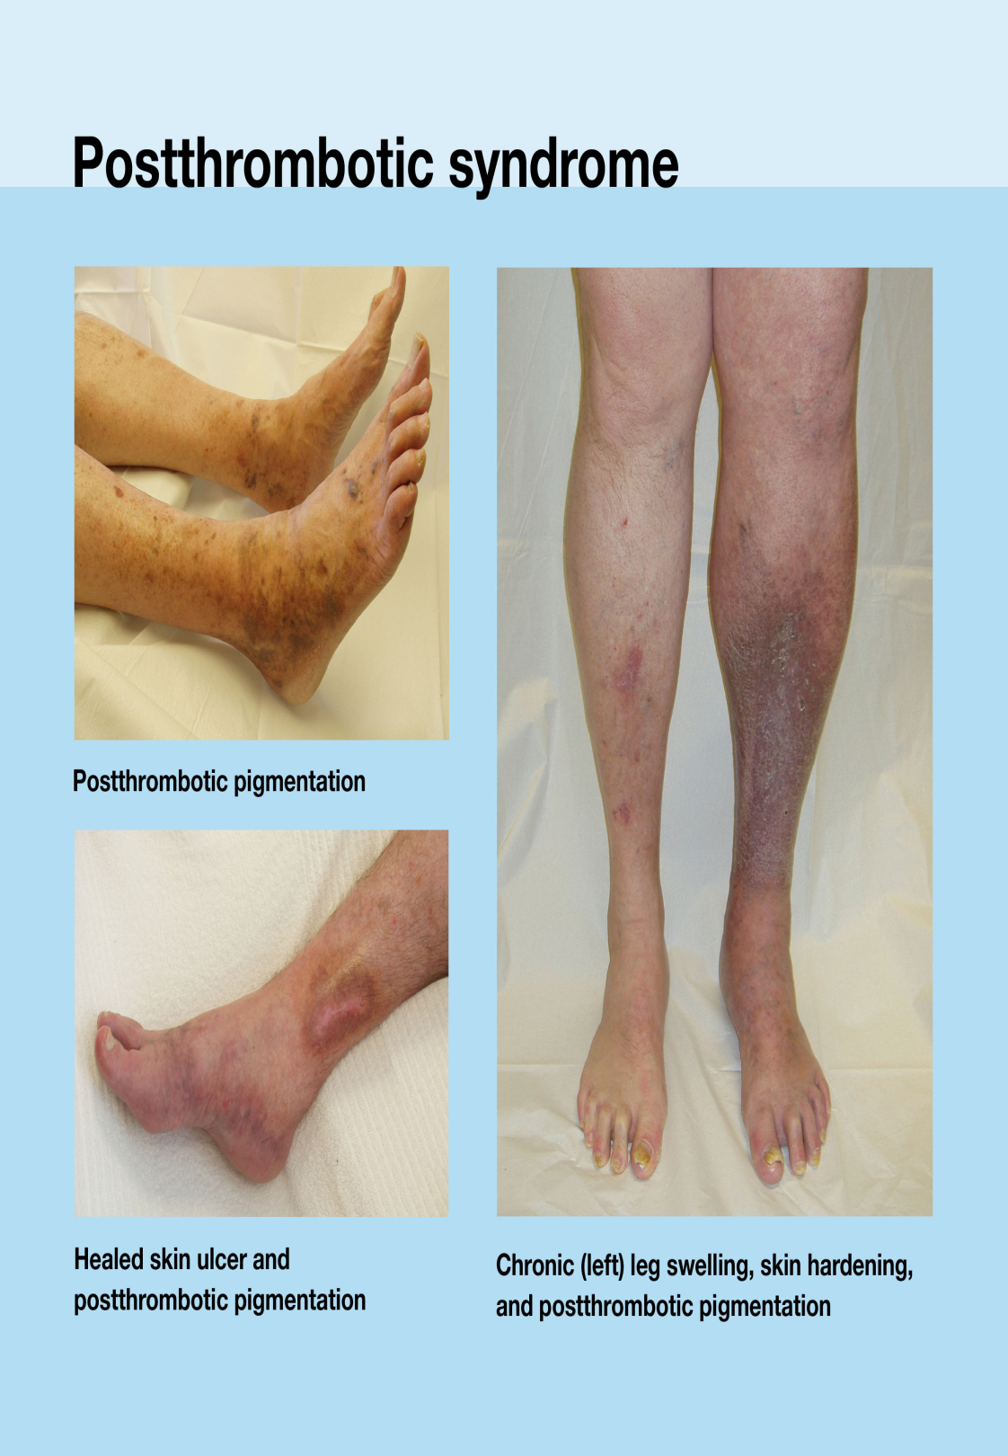
The post-thrombotic syndrome (PTS) is characterised by chronic persistent leg swelling, pain, a feeling of heaviness, dependant cyanosis, telangiectasis, chronic pigmentation, eczema, associated varicose veins and in the most severe cases, venous ulceration

Slide 77
Postnatal clinic review
Thrombophilia testing should be performed once anticoagulant therapy has been discontinued only if it is considered that the results would influence the woman’s future management.
At the postnatal review, an assessment should be made of post-thrombotic venous damage and advice should be given on the need for thromboprophylaxis in any future pregnancy and at other times of increased risk .

Slide 78
How should a woman with a history of VTE who requires contraception be treated?
Avoid combined oral contraceptives, as they may increase the risk of recurrent VTE.
First choice contraceptives are effective non-hormonal preparations, such as the copper intrauterine device.
If non-hormonal contraceptive options are discussed and found unsuitable, we would recommend a levonorgestrel intrauterine device in women who wish to continue contraceptive use after a first VTE.
Another option would be the progestogen only pill, as studies show no increased risk of recurrent or primary VTE in its users.

Slide 79
