Slide 1
COMPLIATION AND MANAEMENT OF UNSAFE EAR

Slide 2
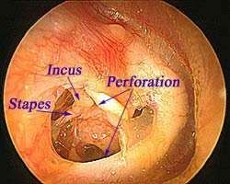
INTRODUCTION OF CSOM
Long-standing infection of a part or whole of the middle ear cleft characterized
  By ear discharge
  A permanent perforation.

Slide 3
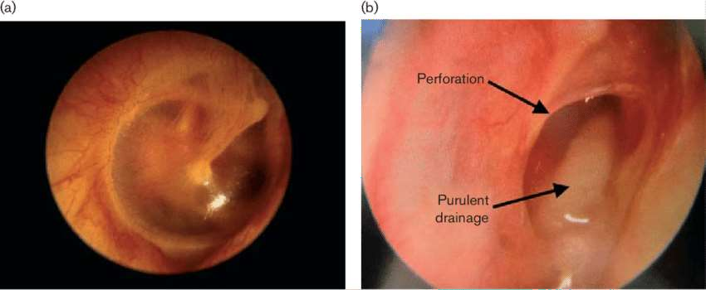

Slide 4
TYPES OF CSOM
1. Tubotympanic. Also called the safe or benign type; it
Involves anteroinferior part of middle ear cleft,
i.E. Eustachian tube and mesotympanum
Associated with a central perforation.
There is no risk of serious complications.
2. Atticoantral. Also called unsafe or dangerous type; it
Involves posterosuperior part of the cleft (I.E. Attic, antrum and mastoid)
Associated with an attic or a marginal perforation.
The disease is often associated with a bone eroding process such as cholesteatoma, granulations or osteitis.
Risk of complications is high in this variety.

Slide 5
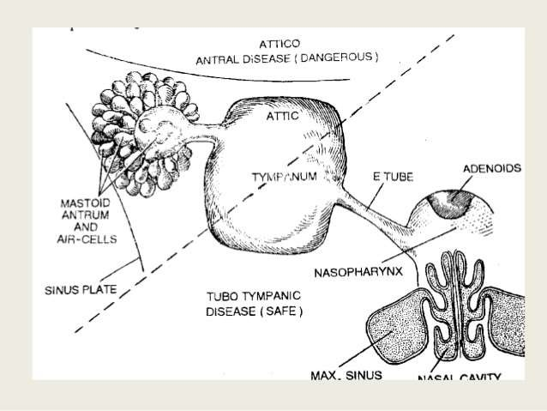

Slide 6
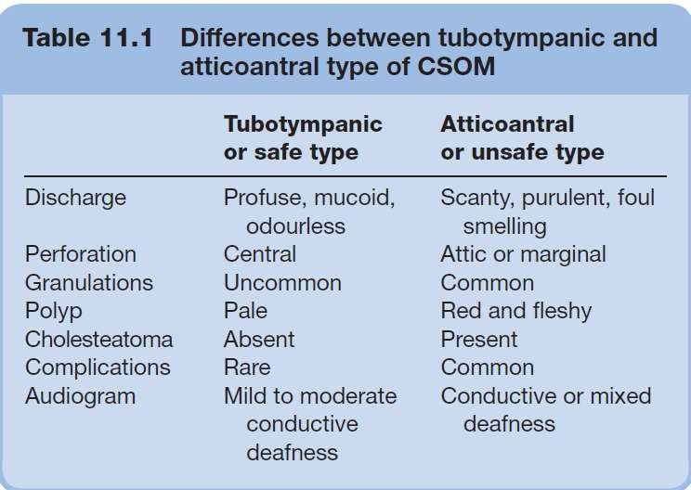

Slide 7
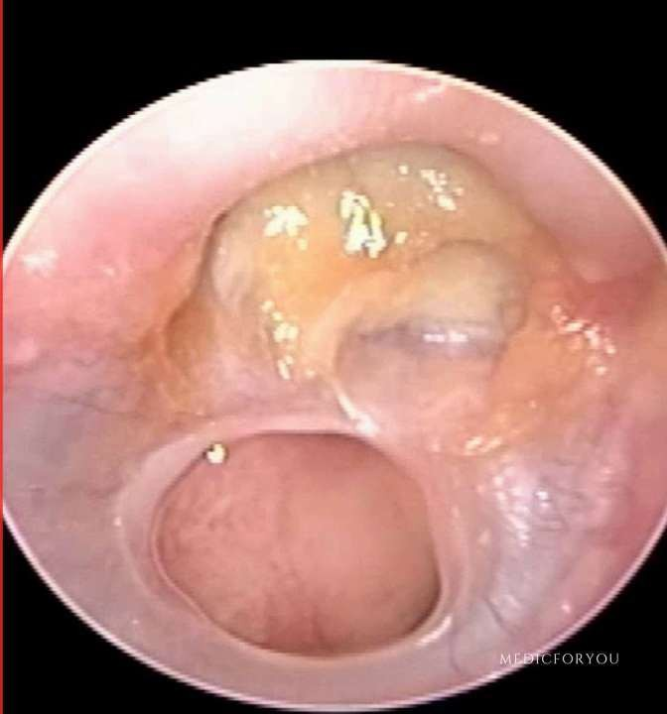
ATTICOANTRAL TYPE

Slide 8
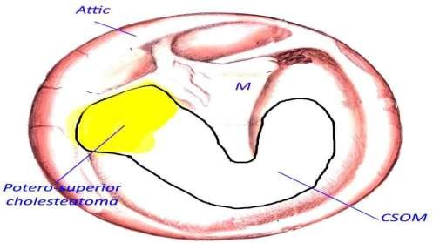
INTRODUCTION
It involves postero-superior part of middle ear cleft
Associated with cholesteatoma (bone eroding properties)
unsafe or dangerous type.

Slide 9
AETIOLOGY
Aetiology of atticoantral disease is same as of cholesteatoma and has been discussed earlier.
It is seen in sclerotic mastoid.

Slide 10
PATHOLOGY
Cholesteatoma.
Osteitis and granulation tissue.
Ossicular necrosis (cholesteatoma hearer)
Cholesterol granuloma.

Slide 11
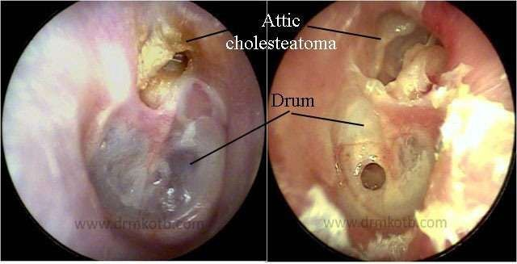

Slide 12
BACTERIOLOGY
Pus culture in both types of aerobic and anaerobic CSOM
Common aerobic organisms
  Pseudomonas aeruginosa,
  Proteus,
  Escherichia coli
  Staphylococcus aureus,
Anaerobes include Bacteroides fragilis and anaerobic Streptococci.

Slide 13
SYMPTOMS
Ear discharge.
Usually scanty, but always foul-smelling due to bone destruction
Hearing loss.
Hearing is normal when ossicular chain is intact or when cholesteatoma, having destroyed the ossicles, bridges the gap caused by destroyed ossicles (cholesteatoma hearer).
Bleeding.
From granulations or the polyp when cleaning the ear.

Slide 14
SIGN
Perforation.
It is either attic or postero-superior marginal type.
Retraction pocket.
An invagination of tympanic membrane is seen in the attic or posterosuperior area of pars tensa.
There are four stages of tympanic membrane retraction.
Cholesteatoma.

Slide 15
Stage I
Tympanic membrane is retracted but does not contact the incus.
Stage II
Tympanic membrane is retracted deep and contacts the incus.
Middle ear mucosa is not affected.

Slide 16
Stage III
Also called middle ear atelectasis.
Tympanic membrane comes to lie on the promontory and ossicles.
Middle ear space is totally or partially obliterated but middle ear mucosa is intact.
Stage IV
Also called adhesive otitis media.
Tympanic membrane is very thin and wraps the promontory and ossicles.
There is no middle ear space
Mucosal lining of the middle ear is absent and tympanic membrane gets adherent to the promontory.

Slide 17
INVESTIGATIONS
Examination under microscope
Tuning fork tests and audiogram.
X-ray mastoids/CT scan temporal bone.
Culture and sensitivity of ear discharge.

Slide 18
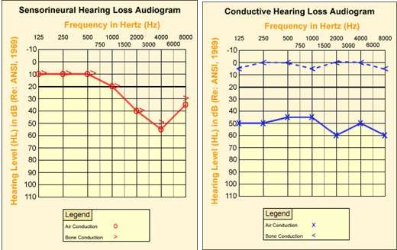

Slide 19
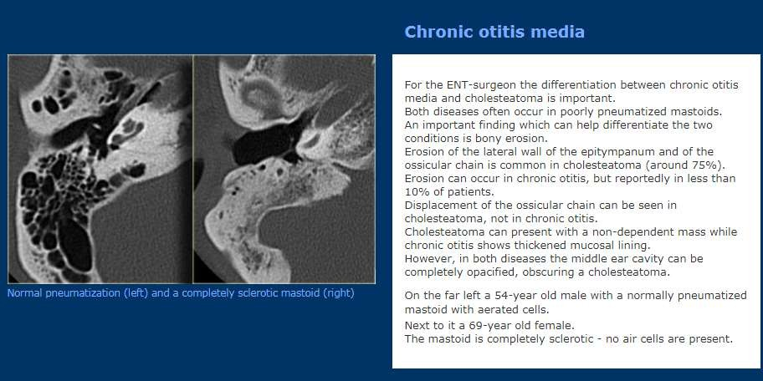

Slide 20
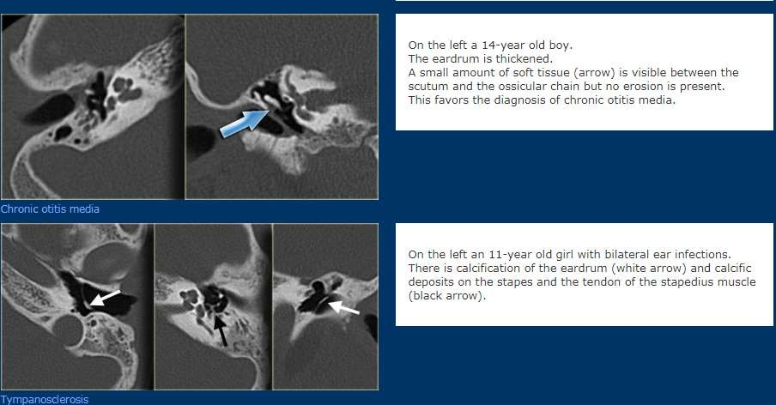

Slide 21
FEATURES INDICATING COMPLICATIONS IN CSOM
Pain
Vertigo
Persistent headache.
Facial weakness indicates erosion of facial canal.
A listless child refusing to take feeds and easily going to
sleep (extradural abscess).
Fever, nausea and vomiting (intracranial infection).
Irritability and neck rigidity (meningitis).
Diplopia (Gradenigo syndrome) petrositis.
Ataxia (labyrinthitis or cerebellar abscess).
Abscess round the ear (mastoiditis).

Slide 22
TREATMENT
1. Surgical
Canal wall down procedures
Canal wall up procedures.
Reconstructive surgery. Hearing can be restored by myringoplasty or tympanoplasty.
Conservative treatment.

Slide 23
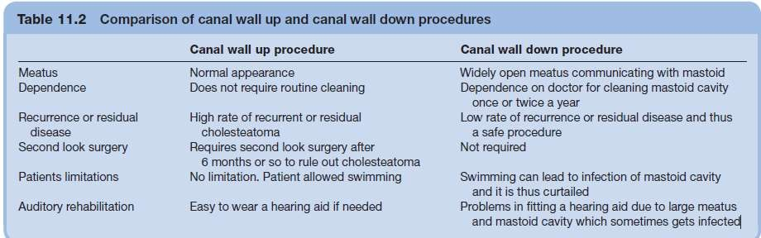

Slide 24
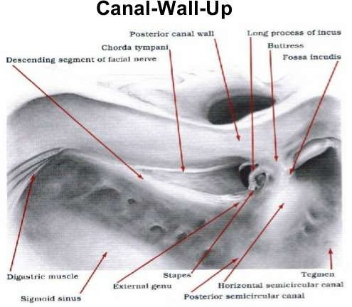

Slide 25
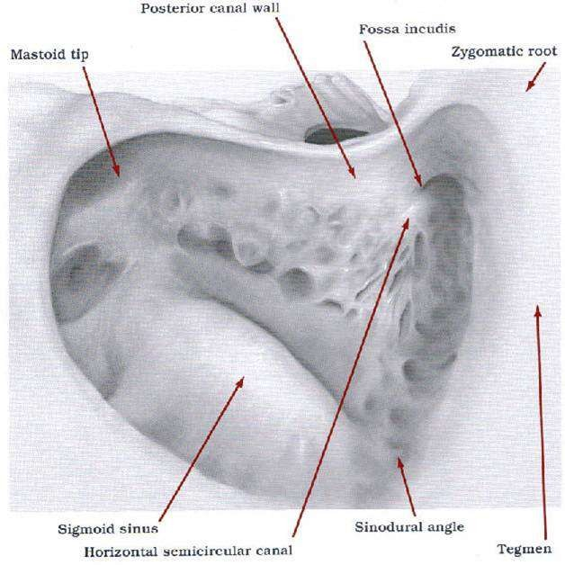

Slide 26
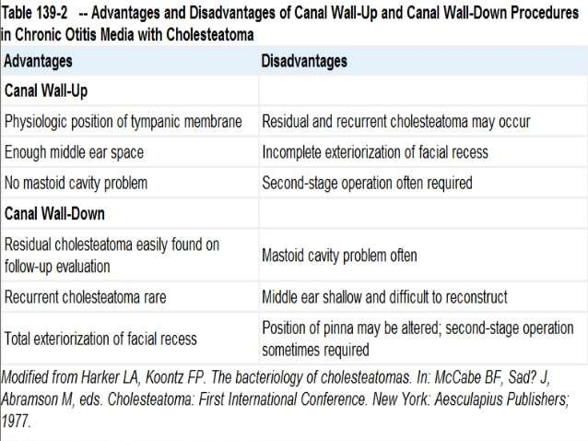

Slide 27
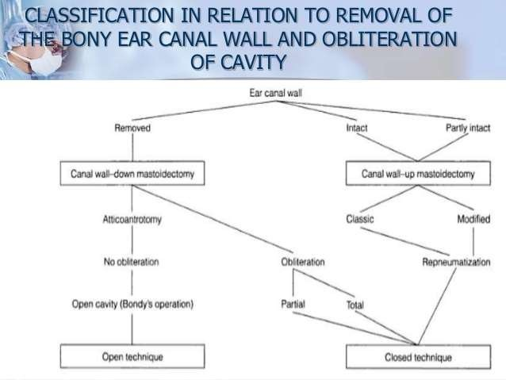

Slide 28
CHOLESTEATOMA

Slide 29
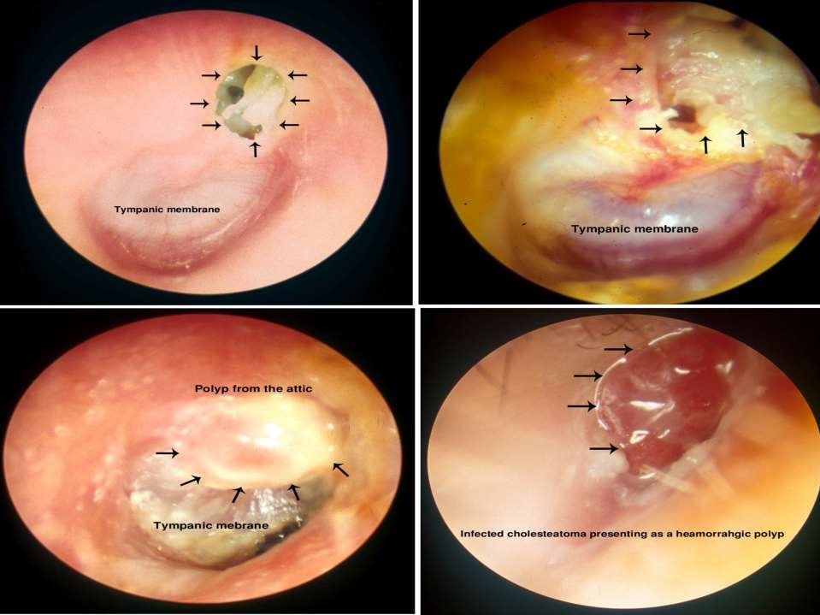

Slide 30
INTRODUCTION
Normally, middle ear cleft is lined by different types of epithelium in different regions
It is the presence of keratinizing squamous epithelium in the middle ear or mastoid.
“Skin in the wrong place.”
Essentially, cholesteatoma consists of two parts:
  the matrix, which is made up of keratinizing squamous epithelium resting on a thin stroma of fibrous tissues and
  a central white mass, consisting of keratin debris produced by the matrix .
Also been named epidermosis or keratoma.

Slide 31
ORIGIN
Presence of congenital cell rests.
Invagination of tympanic membrane from the attic or posterosuperior part of pars tensa in the form of retraction pockets (Wittmaack’s theory).
Basal cell hyperplasia (Ruedi’s theory).
Epithelial invasion (Habermann’s theory).
Metaplasia (Sade’s theory).

Slide 32
CLASSIFICATION OF CHOLESTEATOMA
The cholesteatoma is classified into:
Congenital
Acquired, primary
Acquired, secondary

Slide 33
1. CONGENITAL CHOLESTEATOMA.
It arises from the embryonic epidermal cell rests
3 important sites:
  Middle ear
  Petrous apex
  And the cerebellopontine angle
Presents as a white mass behind an intact tympanic membrane and causes conductive hearing loss.
It may sometimes be discovered on routine examination of children or at the time of myringotomy.
It may also spontaneously rupture
Present with a discharging ear indistinguishable from a case of chronic suppurative otitis media.

Slide 34
2. PRIMARY ACQUIRED CHOLESTEATOMA
No history of previous otitis media or a pre- existing perforation.
Theories on its genesis are:
  invagination of pars flaccida.
  basal cell hyperplasia.
  squamous metaplasia.

Slide 35
3. SECONDARY ACQUIRED CHOLESTEATOMA
Already a pre-existing perforation in pars tensa.
This is often associated with posterosuperior marginal perforation or sometimes large central perforation.
Theories on its genesis
  migration of squamous epithelium.
  Keratinizing squamous metaplasia

Slide 36
EXPANSION OF CHOLESTEATOMA AND DESTRUCTION OF BONE
It invades the surrounding structures, first the path of least resistance, and then by enzymatic bone destruction.
An attic cholesteatoma may extend
  Backwards into the aditus, antrum and mastoid;
  Downwards into the mesotympanum;
  Medially, it may surround the incus and/or head of malleus.
  Cause destruction of ear ossicles,
  Erosion of bony labyrinth,
  Canal of facial nerve,
  Sinus plate or tegmen tympani
Attributed to various enzymes such as
  Collagenase,
  Acid phosphatase and proteolytic enzymes,
Liberated by osteoclasts and mononuclear inflammatory cells,
Seen in association with cholesteatoma.

Slide 37
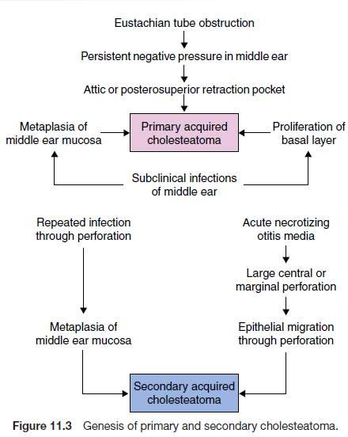

Slide 38
COMPLICATIONS

Slide 39
FACTORS INFLUENCING DEVELOPMENT OF COMPLICATIONS
Age.
Poor socioeconomic group.
  overcrowding,
  poor health education
  poor personal hygiene,
  limited access to healthcare play an important part.
Virulence of organisms.

Slide 40
Cont.
Immune-compromised host.
Preformed pathways.
– Infection can easily travel beyond the middle ear cleft if preformed pathways exist,
Cholesteatoma.

Slide 41
PATHWAYS OF SPREAD OF INFECTION
Direct bone erosion
Venous thrombophlebitis.
Preformed pathways
  Congenital dehiscences, e.g. in bony facial canal, floor of middle ear over the jugular bulb.
  Patent sutures, e.g. petrosquamous suture.
  Previous skull fractures. The fracture sites heal only by fibrous scar which permits infection.
  Surgical defects, e.g. stapedectomy, fenestration and mastoidectomy with exposure of dura.
  Oval and round windows.
  Infection from labyrinth can travel along internal acoustic meatus, aqueducts of the vestibule and that of the cochlea to the meninges.

Slide 42
CLASSIFICATION
A. INTRATEMPORAL (WITHIN THE CONFINES OF TEMPORAL BONE) | B. INTRACRANIAL
Mastoiditis Petrositis Facial paralysis Labyrinthitis | Extradural abscess Subdural abscess Meningitis Brain abscess Lateral sinus thrombophlebitis Otitic hydrocephalus

Slide 43
SEQUELAE OF OTITIS MEDIA
Perforation of tympanic membrane
Ossicular erosion
Atelectasis and adhesive otitis media
Tympanosclerosis
Cholesteatoma formation
Conductive hearing loss due to ossicular erosion or fixation
Sensorineural hearing loss
Speech impairment
Learning disabilities

Slide 44


