Slide 1
CYSTIC LESION OF NOSE AND PNS

Slide 2
CLASSIFICATION
Odontogenic
1)dental cyst(radicular cyst/periodontal cyst)
2)dentigerous cyst(follicular cyst)
Non-odontogenic cyst
1)nasolabial cyst (naso alveolar cyst)
2)lateral alveolar cyst
3)median alveolar cyst
4)median palatine cyst
5)nasopalatine duct cyst

Slide 3
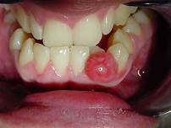
DENTAL CYST
Most common
Develops from apex of an erupted tooth in response to pulpal necrosis secondary to infection of the periapical epithelium as in dental caries

Slide 4
PATHOENESIS
Continued inflammatory stimulation leads to proliferation of epithelial cells from rests of Malassez. Cyst lining is formed as the epithelial cells proliferate. The cellular debris collected within the lumen creates an osmotic gradient as a result of which fluid accumulates within the cyst. This gradually increases the size of the cyst as the fluid volume increases causing bone expansion. The contents of the cyst will be fluid or semisolid with epithelial debri, cholesterol crystals and foreign body giant cells.

Slide 5
CLINICAL FEATURES AND DIAGNOSIS
Common In middle age and always associated with normally erupted tooth but chronically infected or carious tooth
Swelling around the erupted tooth
It is usually painless unless infected
Egg shell crack can be elicited if the bone becomes thin and fluctuation will be positive if the bone is completely destroyed
Xray of PNS a cirvular radiolucent area is seen in relation to the root of affected tooth. Margin of the cyst may be sclerosed

Slide 6
TREATMENT
Enucleated of the cyst and extraction of the infected tooth. It has a tendency to recur if incompletely removed

Slide 7
DENTIGEROUS CYSTS
2ND most common among ondontogenic cyst.
Associated with non erupted permanent tooth
The swelling consist of a cyst containing a tooth,most commonly an upper or lower third molar

Slide 8
PATHOGENESIS
The epithelium is derived from reduced enamel epithelium
The development of cyst occurs due to fluid collection between the remnants of enamel organ and contiguous tooth crown.
The cyst may continue to grow due to osmotic gradient and can reach very large size

Slide 9
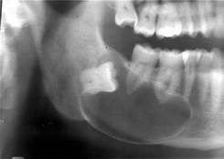
CLINICAL FEATURES AND DIAGNOSIS
More common in 2nd and 3rd decade
M>F
Most common location – Mandibular third molar> Maxillary third molar > Mandibular second premolar
Painless progressive swelling. Painful if it is secondarily infected
Egg shell crackling can be elicited
Xray :- well defined radiolucency around the crown of the unerupted tooth, soap bubble appearance can be seen

Slide 10
TREATMENT
Enucleation of the cyst with removal of the involved tooth

Slide 11
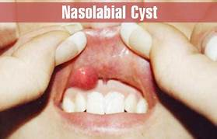
NASOLABIAL CYST
It is a non odontogenic developmental cyst that develops from the soft tissue in the mucobuccal area of the nasal ala.

Slide 12
ETIOLOGY
Origin of the cyst is from the epithelium entrapped at the fusion of the globular ,lateral nasal and maxillary processes

Slide 13
CLINICAL FEATURES AND DIAGNOSIS
More common in adults 4^{th -} 6th decade
F>M
Unilateral
Starts as painless progressively enlarging swelling in the lateral aspect of the upper lip. It may elevate the nasal vestibule and obliterate the nasolabial fold
Nasal obstruction
d/d are odontogenic development cysts, minor salivary gland neoplasms inclusion cysts and sebaceous cyst

Slide 14
TREATMENT
Surgical exision of transoral approach.
Recurrence is rare.

Slide 15
THANK YOU.

