Slide 1
ACUTE AND CHRONIC INFLAMMATIONS OF LARYNX

Slide 2
ACUTE LARYNGITIS
AETIOLOGY: Secondary to inflammation of nose, throat, paranasal sinuses
Air born infection by adenovirus, influenza→ leads to secondary bacterial infection by damaging mucosa
Most common organisms are moraxella catarrhalis, streptococcus pneumoniae, haemophilus influenzae
Unfavorable climate, physical, psychological strain are predisposing factors

Slide 3
ACUTE LARYNGITIS - PATHOLOGY
Mucosal inflammation→ extravasation of fluid
Infiltration of neutrophils/ lymphocytes/ plasma cells
Muscles, joints, perichondrium affected
Epithelial exfoliation, necrosis occurs
In some instance fibrosis results with mucosal loss leading to chronic laryngitis

Slide 4
ACUTE LARYNGITIS - SYMPTOMS
Hoarseness of voice
Discomfort
Pain
Instant paroxysmal cough
General cold
Dryness of throat
Malaise
fever

Slide 5
ACUTE LARYNGITIS - SIGNS
Erythema and edema of epiglottis, aryepiglottic folds, arytenoids and ventricular bands
Vocal cords appear normal in early stages
In later stages congestion and swelling increases, vocal cords become red and swollen
Sticky secretions are seen between cords and interarytenoid region
Submucosal hemorrhages may be seen in the vocal cords

Slide 6
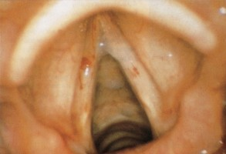
ACUTE LARYNGITIS (SIMPLE)

Slide 7
ACUTE LARYNGITIS - TREATMENT
Vocal rest
Avoid smoking and alcohol
Steam inhalation with tincture benzoin
Cough sedatives (codeine)
Antibiotics (broad spectrum penicillin)
Analgesics
steroids

Slide 8
ACUTE FIBRINOUS LARYNGITIS
Laryngotrachoebronchitis involving the entire respiratory system
Age: 6 months-7 years
Super infections following influenza by hemolytic streptococcus

Slide 9
ACUTE FIBRINOUS LARYNGITIS- PATHOLOGY
Affects entire respiratory tract
The loose areolar tissue in the subglottic region swells up and causes respiratory obstruction and stridor
This coupled with thick tenacious secretions and crusts may completely occlude the airway

Slide 10
ACUTE FIBRINOUS LARYNGITIS- SIGNS AND
SYMPTOMS
Hoarseness
Croupy cough
39- 40 degree temperature
Common cold
Difficulty to breath
Inspiratory stridor
Increased muscular energy consumption
Increased CO2 retention leads to metabolic respiratory acidosis, paralysis of respiratory regulation centers
CYNOSIS may be present

Slide 11
ACUTE FIBRINOUS LARYNGITIS- INVESTIGATIONS
Blood gas analysis
3mm flexible endoscopic examination
Chest X-ray

Slide 12
ACUTE FIBRINOUS LARYNGITIS- TREATMENT
Hospitalization: isolated room
Treatment with moist air
Antibiotics-Broad spectrum penicillins→ amoxicillin 50mg/kg
Mucolytics: oral or aerosol
Nasogastric feeding
Hydration
Steroids ?
Intubation / tracheostomy
Ventilator support may be required

Slide 13
SUBGLOTTIC LARYNGITIS (PSEUDOCROUP)
Common in young children- 3 years of age
Caused by influenza virus
Signs and symptoms: subglottic edema (+) croup, stridor, no fever
Treatment : voice rest, steroids, tracheostomy may be needed

Slide 14
ACUTE EPIGLOTTITIS (SUPRAGLOTTITIS)
Etiology :
Common in children between 2-7 years
Incidence 1:17000
3. In adult 1:100000
4. Caused by h. influenza type B
•

Slide 15
ACUTE EPIGLOTTITIS- CLINICAL FEATURES
Onset : abrupt / rapid progressive
Sore throat
Dysphagia in adults
Dyspnoea and stridor in children
Tripod sign
Drooling of saliva
Fever 40 degree Celsius

Slide 16
ACUTE EPIGLOTTITIS- CLINICAL FEATURES
Epiglottis appears like a rounded swollen mass
Tongue depression and indirect laryngoscopy may cause fatal laryngeal spasm so it is avoided
Lateral soft tissue x ray shows swollen epiglottis (thumb sign)

Slide 17
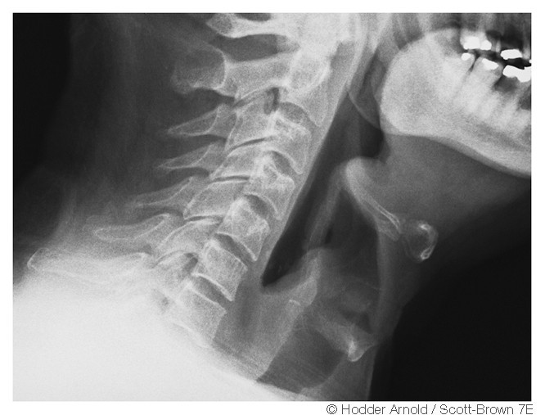

Slide 18
ACUTE EPIGLOTTITIS- TREATMENT
Hospitalization
Antibiotics
Fluids
Steroids
Humidification
Intubation / tracheostomy
Assisted respiration

Slide 19
Simple laryngitis
Subglottic laryngitis
1-4 yrs
Laryngotracheo bronchitis
epiglottitis
Age
Any
1-8 yrs
3-6 yrs
Onset
gradual
rapid
gradual
Rapid
Etiology
virus
Viral ?
bacterial
bacterial
temperature
<39
<38
<38
>39
Voice
hoarse
harsh
hoarse
Normal
Posture
Indifferen restless t
supportive supportive
lying
Sitting
treatment
Antibiotics/int ubation
yes
Antibiotics/int ubation
yes
monitoring no no

Slide 20
OEDEMA OF THE LARYNX
Oedema of mucosa can accompany any inflammatory reaction therefore not a specific disease but rather a sign
Solitary reaction to different types of stimuli like exogenous or unknown / trauma, infection, tobacco, radiation

Slide 21
OEDEMA OF THE LARYNX- ETIOLOGY
Infection: acute epiglottitis, croup, tuberculosis, syphilis
From neighboring structures: quinsy, retro and parapharyngeal abscess, Ludwig's angina
Trauma: tongue, larynx, floor of mouth burns (physical, chemical), Foreign bodies, post endoscopy
Neoplasms: larynx, tongue, pharynx
Allergy
Angioneurotic oedema
Radiation
Systemic diseases: nephritis, cardiac failure, myxedema

Slide 22
REINKE’S OEDEMA
Named after German anatomist
Reinke’s space bound between superior and inferior arcuate lines which is filled with loose areolar tissue

Slide 23
REINKE’S OEDEMA
Etiology
Precisely not known
Allergy, infection, local irritants like tobacco
Common in men age 30-60 yrs Clinical features
On IDL examination : vocal cord red swollen, slightly translucent, mucosa shows polypoidal changes
Hoarseness stridor cough present

Slide 24
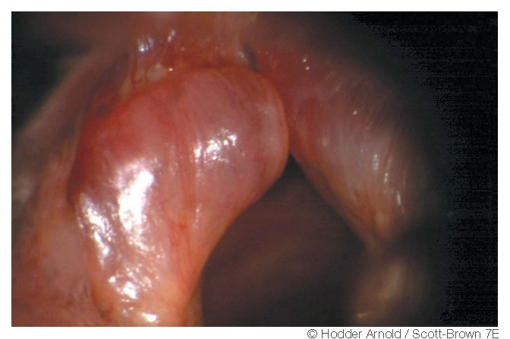
REINKE’S OEDEMA

Slide 25
REINKE’S OEDEMA- TREATMENT
Rehabilitation
Microlaryngeal stripping: mucosa on both sides incised sagittally not up to anterior commissure
Voice rest and speech therapy

Slide 26
ANGIONEUROTIC OEDEMA
May be allergic, non allergic OR hereditary and non hereditary
Recurrent attacks of local swelling in various parts of the body: face, larynx, limbs, buttocks
Death occurs because of the edema of the larynx
Colic, nausea, vomiting

Slide 27
ANGIONEUROTIC OEDEMA
Allergic: food, medicines, inhaled allergens (ACE inhibitors used in treatment of essential hypertension)
Hereditary Angioneurotic edema: described by Sir William Osler (1888)
➢Serum deficiency of C1 esterase inhibitor protein thus inhibiting compliment activation, kinin formation and fibrinolysis
➢Triad of symptoms: abdominal pain, peripheral non pitting oedema, laryngeal oedema

Slide 28
ANGIONEUROTIC OEDEMA- TREATMENT
36000 units of C1 INH
Recurrent attacks : use fibrinolytic inhibitors like epsilon amino caprioc acid, tranexamic acid or methyl testosterone derivative ( danazol)→ these drugs stimulate C1 INH production

Slide 29
LARYNGEAL PERICHONDRITIS
Inflammation of perichondrium covering laryngeal cartilages
Etiology: blood borne infections, typhus, typhoid and radiotherapy

Slide 30
RELAPSING POLYCHONDRITIS
Autoimmune disease- collagen vascular disease
Rheumatoid arthritis, SLE, ankylosing spondylitis
Can effect recurrently pinna, nasal cartilages, larynx and trachea
Treatment: corticosteroids

Slide 31
CHRONIC LARYNGITIS
•
Diffuse inflammatory condition symmetrically involving whole larynx
Aetiology
Incomplete resolution of acute laryngitis and its recurrent attacks
Chronic infection in paranasal sinuses, teeth, tonsils and chest
Occupational factors→ miners, gold/ironsmiths, chemical industries
Smoking, alcohol
Chronic lung disease
Vocal abuse
•

Slide 32
CHRONIC LARYNGITIS- CLINICAL FEATURES
Hoarseness of voice→ easily tired becoming aphonic
Constant hawking, dryness, compelled to clear throat
Discomfort in throat
Dry irritating cough Signs
Hyperemia of vocal cords : dull, red and round
Viscid mucosa in vocal cord and interarytenoid region

Slide 33
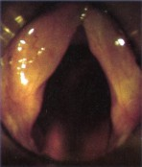
CHRONIC LARYNGITIS

Slide 34
CHRONIC LARYNGITIS- TREATMENT
Elimination of upper and lower respiratory infections
Avoid irritating factors
Voice rest
Speech therapy
Steam inhalation
Supportive measures

Slide 35
CHRONIC HYPERTROPHIC(HYPERPLASTIC) LARYNGITIS
•
•
May be symmetrical diffuse process or localized
Dysphonia plica ventricularis, vocal cord nodules, vocal cord polyps, Reinke's oedema, contact ulcers
Pathology
Starts in Glottic region, later extends to supra and subglottic region
Mucosa, submucosa, mucosal glands, intrinsic muscles and joints affected
Initially hyperemia, oedema, cellular infiltration to submucosa
Epithelium changes to squamous type (from pseudostratified ciliated )
Vocal cord epithelium becomes hyperplasic Mucosal gland hypertrophy later may atrophy dryness
•
•
•
•
•
•

Slide 36
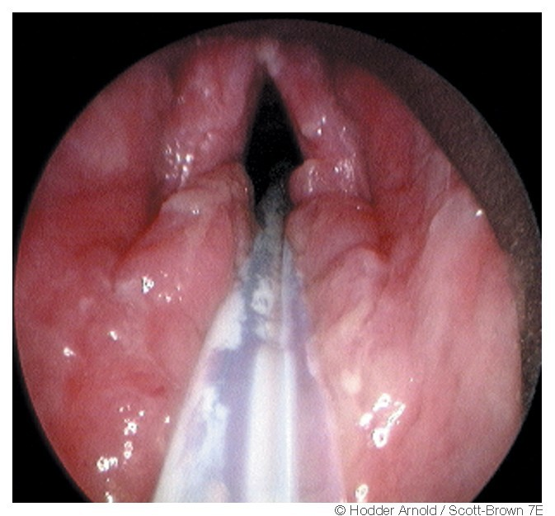
CHRONIC HYPERTROPHIC(HYPERPLASTIC) LARYNGITIS

Slide 37
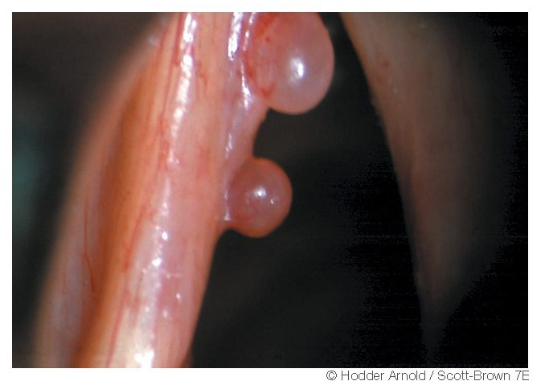
VOCAL CORD POLYPS

Slide 38
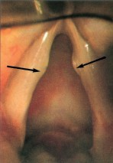
VOCAL NODULE

