Slide 1


Slide 2
◻ Darwin’s tubercle : an inherited cond. Presence as a small elevation in post-sup part of helix.
◻ Wildermuth’s ear : Prominence of antihelix and under-development of helix & assoc. with CHL & SNHL.
◻ Mozart’s Ear : an dominant inheritance presencs as fusion of helix and antihelix.

Slide 3
◻ Congenital Abnormalities of Auricle :
Anotia
Microtia
Synotia
Melotia
Bat ears : Abnormal protrusion of auricle , disappered spontanously in first year of life.
Lop Ear : Crux anhihelics is poorly formed
Cup Ear : Antihelix is undeveloped

Slide 4
◻ Pre – Auricular Sinus :
Faulty fusion of 1st & 2nd arch
Opening :
Anterior border of ascending limb of helix
Line extending b/w tragal notch & angle of mouth
Pinna (or) Lobule
Extend upto the level of tympanic ring.
C/F : Asymptomatic , If infected – chr.discharge ,
recc.abscess & calculus
Treatment : Excision ( careful for facial nerve)

Slide 5
◻ Collaural Fistula
Tract : Line joining the angle of mandible &
Sterno-clavicular joint
Outer opening : Ant border of SCM
Inner opening : Bony Cartilagenous junction of EAC C/F : Discharge fistula , Abscess , Ear discharge ,
Gran.tissue in EAC
Treatment : Excision of fistula

Slide 6
◻ Cicatrical Stenosis & Acquired Atresia of EAC
Aetiology : Following external trauma , mastoid surgery , blunting following a lateral graft technique , keloid , COE, burns , radiation , neoplasms
Treatment : Surgical Removal of fibrous tissue & Reconstruction of canal

Slide 7
◻ Cystic swelling in upper half of the anterior aspect of the auricle.
◻ Formed within degenerate cartilage as a cystic space that has no lining but contains straw coloured fluid.
◻ Oral Prednisolone ( 4 week period ) – fluid was absorbed and the intra-cartilaginous fibrosis and granulation was prevented.
◻ Insertion of drainage tube into the pseudocyst thro a guide needle which was left in place for 5 days with pressure dressing.

Slide 8
◻ Caused by an extravasation of blood b/w the cartilage and the perichondrium producing a soft doughy swelling of the pinna
◻ If untreated , blood clot becomes organised and the ear remains permanently thickened – Cauliflower Ear
◻ Aspiration with wide bore needle
◻ Incision (along the margin of helix) & Evacuation of clot

Slide 9

◻ Infection of superficial layer of skin by staphylococci.
◻ Involve the whole auricle doesnot extend the EAC
◻ Reddish – purple vesicles filled with serum – later bursts to exude - dries to form semi-adherent amber crusts.
◻ Bathing with warm sterile saline.
◻ Topical Antibiotic Ointment

Slide 10

◻ Due to streptococcal infection of the skin producing a raised red oedematous eruption with a characterically well – defined edge.
◻ Auricle – red & swollen
◻ Assoc with fever and rapid pulse
◻ Antibiotic theraphy

Slide 11
◻ Infection or inflammation of perichondrium / cartilage of Auricle & EAC
◻ Classification :
Erysipelas of External ear ( Inf. of overlying skin)
Cellulitis of External ear (Inf. of soft tissue )
Perichondritis ( Inf. Involving perichondrium)
Chondritis ( Inf. Involving cartilage )

Slide 12
◻ Result of trauma to auricle
Laceration of auricle , Surgery to ext.ear , frostbite , burns , chemical injury , inf. of hematoma of pinna , high piercing of auricle for insertion of ear rings.
◻ May be spontaneous (overt diabetes)
◻ Org : Pseudomonas Aeruginosa , Staph. Aureus

Slide 13
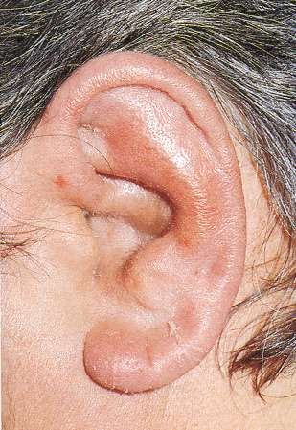
SIGNS & SYMPTOMS
◻ Pain over auricle and deep in
canal
◻ Pruritus
◻ Induration
◻ Edema
◻ Advanced cases
Crusting & weeping
Involvement of soft tissues

Slide 14
◻ TREATMENT :
Topical & oral antibiotics
Discharge (or) Abscess – Drainage
Sub-perichondrial Abscess – I & D & Irrigating with 1.5 % acetic acid & garamycin
◻ PREVENTION :
By careful ear piercings away from cartilaginous pinna.
Avoid Surgery in and around ear – to prevent from trauma
Hematoma of auricle to drain properly.
Meticulous management of burn injuries with prophylatic antibodies against gram neg. bacteria.
Removal of eschars and crusts.

Slide 15

◻ Acute localized infection of single hair follicle.
◻ Lateral 1/3 of posterosuperior canal
◻ Obstructed apopilosebaceous unit
◻ Pathogen: S. aureus

Slide 16
SYMPTOMS :
◻ Localized pain
◻ Ear blockage
◻ Exudates a scanty sero-sanguinous discharge
◻ Pinna & tragus – tender on palpation
◻ Pruritus
◻ Hearing loss (if lesion occludes canal)

Slide 17
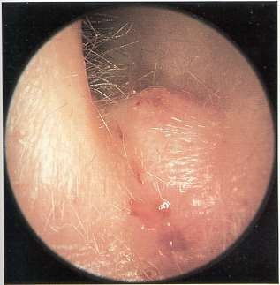
SIGNS :
◻ Edema
◻ Erythema
◻ Tenderness
◻ Occasional fluctuance
DD : Ac.mastoiditis

Slide 18
TREATMENT :
◻ Local heat
◻ Analgesics
◻ Oral & systemic anti-staphylococcal antibiotics
◻ Topical ( antibiotics, Hygroscopic Dehydrating agents)
◻ Incision and drainage reserved for localized abscess
◻ IV antibiotics for soft tissue extension
◻ For recurrent : Eradication theraphy with nasal mupirocin , oral flucloxacillin (14 days)

Slide 19

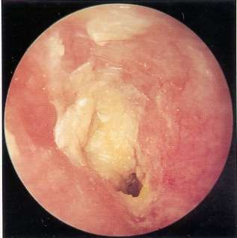
◻ Fungal infection of EAC skin
◻ Common in hot , humid climates & is often secondary to prolonged use of topical Antibiotics.
◻ Most common organisms: Aspergillus and Candida
◻ Occur bcoz the protective lipid/acid balance of the ear is lost.

Slide 20
SYMPTOMS :
◻ Often indistinguishable from bacterial OE
◻ Pruritus deep within the ear
◻ Dull pain
◻ Hearing loss (obstructive)
◻ Tinnitus

Slide 21
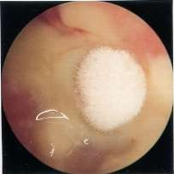
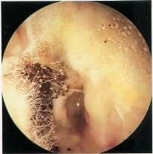
◻ Canal erythema
◻ Mild edema
◻ White, grey ,green , yellow or black fungal debris
( wet newspaper)

Slide 22
TREATMENT
◻ Thorough aural toilet & removal of debris
◻ Topical antifungals
◻ Resistant otomycosis – Exclude fungal inf. anywhere including Athelete’s foot .

Slide 23

◻ Gen. cond of skin of the EAC that is charac. by General edema & Erythema assoc. with itchy discomfort and usually a ear discharge.
◻ Predisposing factors :
Anatomical ( narrow / obstructed ear canal) , Dermatological ( Eczema , Sebhorrhoeic dermatitis ) Allergic ( Atopy , Non–atopy , Exposure to top.med) Physiological ( Humid environment , Imm.comp) Traumatic ( Skin maceration , ear probing , rad.theraphy ) Microbiological ( P.aeruginosa , Active COM , Fungi )

Slide 24
◻ Edema of stratum corneum and plugging of apopilosebaceous unit
◻ Symptoms: pruritus and sense of fullness
◻ Signs: mild edema
◻ Starts the itch/scratch cycle

Slide 25
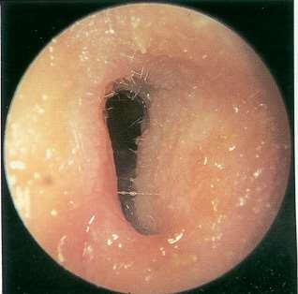
◻ Progressive infection
◻ Symptoms
Pain
Increased pruritus
◻ Signs
Erythema
Increasing edema
Canal debris, discharge

Slide 26
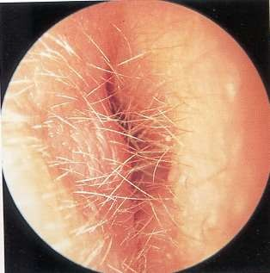
◻ Severe pain, worse with ear movement
◻ Signs
Lumen obliteration
Purulent otorrhea
Involvement of periauricular soft tissue

Slide 27

◻ Most common pathogens: P. aeruginosa and S. aureus
Frequent canal cleaning ( Microscopic Toilet )
Topical Medications ( IG pack )
Pain control ( NSAIDS )
Instructions for prevention ( avoidance of water pentration into ear – cotton wool with petroleum jelly , custom made ear moulds , nonprene head bandage)
Aqua-Ear (or) Ear Calm , Blow driers - will remove the water

Slide 28
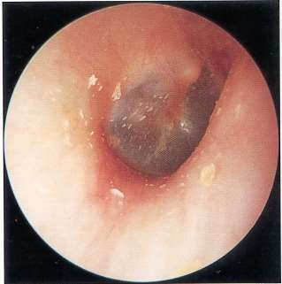
◻ Unrelenting pruritus
◻ Mild discomfort
◻ Dryness of canal skin
◻ Hypertrophied skin
◻ Mucopurulent otorrhea
(occasional)

Slide 29

◻ Similar to that of AOE
◻ Topical antibiotics, frequent cleanings
◻ Topical Steroids
◻ Surgical intervention
Failure of medical treatment
To enlarge and resurface the EAC

Slide 30
◻ Localized chronic inflammation of pars tensa with granulation tissue with possible involvement of EAC
◻ Toynbee described in 1860
◻ Causes : High temp , swimming , lack of hygeine , local
irritants , foreign body , bacterial & fungal infections
◻ Sequela of primary acute myringitis, previous OE, perforation of TM
◻ Common organisms: Pseudomonas, Proteus, Staph.aureus & Candida albicans

Slide 31
◻ Myringitis Externa Granulosa :
Has granulation on lateral surface of drum & medial part of the ear canal skin
◻ Granular Myringitis :
Involves only the ear drum

Slide 32
◻ PATHOLOGY :
Odematous granulation tissue with capillaries and diffuse infiltration of chronic inflammatory cells

Slide 33
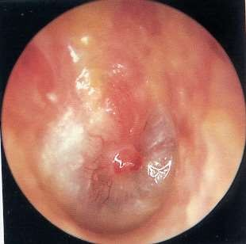
SIGNS & SYMPTOMS :
◻ Foul smelling discharge from one ear
◻ Often asymptomatic
◻ Slight irritation or fullness
◻ No hearing loss or significant pain
◻ TM obscured by pus
◻ Posterio-superior granulations
◻ No TM perforations

Slide 34
◻ Careful and frequent debridement
◻ Specific Anti-microbial drops or powder with or without steroids for 2 weeks
◻ Removal of granulation by physical methods
◻ Appln of caustic agents – Chromic acid , 0.5 % formalin , silver nitrate
◻ Laser evaporation of granulation

Slide 35
◻ Myringitis Bullosa Hemorrhagica – finding of vesicles in the superficial layer of TM
◻ Viral infection ( Influenza ) , Mycoplasma pnuemoniae
◻ Confined b/w outer epithelium & lamina propria of tympanic membrane
◻ Primarily involves younger children

Slide 36
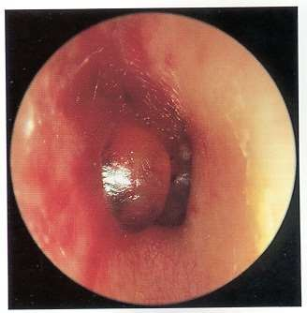
◻ Inflammation limited to TM & nearby canal
◻ Multiple reddened, inflamed blebs
◻ Hemorrhagic vesicles

Slide 37
◻ Sudden , unilateral throbbiong pain
◻ Blood stained discahrge
◻ Hearing loss
◻ Otoscopy : Serous (or) sero-sanginous discharge blisters in TM & med. part of Ear canal

Slide 38
◻ Self-limiting
◻ Analgesics
◻ Topical antibiotics to prevent secondary infection

Slide 39
◻ Benign NOE : is the clinical cond. of idiopathic necrosis of a localised area of the bone of the tympanic ring , with secondary inflammation of the overlying soft tissue and skin.
◻ Causative organism : Staph.aureus ,
◻ TM is suspectible to osteonecrosis because of its relatively poor vascular supply
◻ Repeated local trauma – ear bud abuse , pricking of ear , use
of hearing aids.

Slide 40
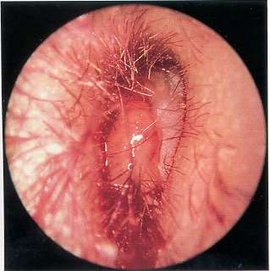
◻ Poorly controlled diabetic with h/o OE
◻ Deep-seated aural pain
◻ Chronic otorrhea
◻ Aural fullness
◻ Pruritis
◻ Hearing loss

Slide 41
◻ Small area of deficient skin and soft tissue in EAC revealing a segment of necrotic bone.
◻ Purulent secretions
◻ Occluded canal and obscured TM
◻ Cranial nerve involvement

Slide 42
◻ Pus swab
◻ CT Scan – extent of bone necrosis
◻ Brush cytology & Biopsy – to exclude neoplasm
◻ Audiometry
◻ Chronic granulomatous cond like Syphillis & TB should be excluded.

Slide 43
◻ Intravenous antibiotics for at least 4 weeks – with serial gallium scans monthly
◻ Local canal debridement until healed
◻ Pain control
◻ Use of topical agents controversial
◻ Hyperbaric oxygen – necrosis beyond tymp.plate
◻ Surgical debridement

Slide 44
◻ Localised necrosis – involves only tympanic plate and leads to
spontaneous sequestration of bone
◻ Diffuse necrosis – more adjacent neuro-vascular structures assoc. with more morbidity & lethal seq.
◻ Limited to tympanic ring - small area of bare bone may appear on meatal floor , assoc. with pain & irritation , scanty discharge.
◻ Conservative management
◻ Removal of remaining dead bone of the tympanic ring and reconstitute the soft tissue of the meatus with a graft.

Slide 45
◻ A very severe dangerous cellulitis and inflammation of the external auditory canal and skull base ( temporal bone )
◻ Caused by psuedomonas organism.
◻ Majority of these patients are elderly diabetics
◻ Males
◻ Spread of this disease occurs through the fissures of Santorini and osteo cartilagenous junction.

Slide 46
PATHOLOGY
◻ Immunity is reduced in patients with :
Diabetis mellitus
Blood cancer
HIV infections
Patients on anticancer drugs

Slide 47
CLINICAL FEATURES :
◻ history of trivial trauma to the ear often by ear buds
◻ pain and swelling involving the EAC often severe, throbbing and worse during nights.
◻ scanty and foul smelling discahrge (When the discharge is foul smelling it indicates the onset of osteomyelitis )

Slide 48
C / F :
◻ Granulation tissue at the bony cartilagenous junction.
◻ Ear drum is normal.
◻ EAC skin is soggy and edematous.
◻ Cranial nerve palsies are common when the disease affects the skull base.
◻ The facial nerve is the most common nerve affected.
◻ Intracranial complications like meningitis and brain abscess.

Slide 49
◻ TREATMENT
◻ MEDICAL:
Carbenicillin, Pipercillin, Ticarcillin can be used.
Third and forth generation cephalosporins can be used.
Ciprofloxacillin in doses of 1.5 g - 2.5 g /day in divided doses can be administered for a period of 2 weeks.
Gentamycin can also be administered parenterally in doses of 80 mg iv two times a day in adults.
Local antibiotic ear drops
CONTROL OF DIABETES

Slide 50
SURGERY :
◻ Extensive surgical procedures have failed miserably to cure this condition.
◻ Drainage of subperiosteal abscess, removal of necrotic tissue and sequestrated bone
◻ Wound debridement in advanced cases.

Slide 51
◻ Herpes zoster oticus (HZ oticus) is a viral infection of the inner, middle, and external ear.
◻ HZ oticus manifests as severe otalgia and associated cutaneous vesicular eruption, usually of the external canal and pinna.
◻ When associated with facial paralysis, the infection is called Ramsay Hunt syndrome

Slide 52
◻ Pathophysiology
Reactivation of the varicella-zoster virus (VZV) along the distribution of the sensory nerves innervating the ear, which usually includes the geniculate ganglion, is responsible for HZ oticus.

Slide 53
◻ Severe otalgia ( burning blisters in and around the ear, on the face, in the mouth, and/or on the tongue)
◻ Vertigo, nausea, vomiting
◻ Hearing loss, hyperacusis, tinnitus
◻ Eye pain, lacrimation
◻ In patients with Ramsay Hunt syndrome, vesicles may appear before, during, or after facial palsy

Slide 54
◻ Vesicular exanthem - External auditory canal, concha, and pinna , post-auricular skin .
◻ Associated findings
Dysgeusia (alteration in taste)
Inability to fully close the ipsilateral eye

Slide 55
◻ Corneal protection
◻ Oral steroid taper (10 to 14 days)
◻ Antivirals

Slide 56
◻ Keratotic mass of desquamating squamous epithelium in bony portion of EAC
◻ Aetiology :
Faulty migration of squamous epithelial cells from surface of TM and the adjacent canal – accumulation of squ.epithelial cells and debris end mixed with cerumen
◻ Pearlly white & glistening
◻ Pain – erosion of osseus meatus
◻ CHL & Otorrohea

Slide 57
◻ Tm – intact
◻ Gram (-)ve infection – treated topically
◻ Irritation of efferent vagal nerve endings in the bronchi produces a reflex secretion of wax
◻ Assoc with Yellow Nail Syndrome ( yellow nails , lymphodema & plueral effusion )
◻ Treatment :
Removal of Kerototic mass
Refractory cases – canaloplasty

Slide 58

◻ Mixture of two glands – Ceruminous & Pilo-sabeceous together with squ.epithelium , dust , forign debris
◻ Outer 2/3 rd of EAC lined by cuboidal and columnar epithelium
◻ Secretion – Exocrine & apocrine Functions
◻ Stimulation of adrenergic receptors – myoepithelial cells contract – expel liquid content into EAC

Slide 59
◻ Wet phenotype
Caucasians & Negroes
Moist , honey coloured
◻ Dry phenotype
Mangaloid races
Grey , granular & brittle
◻ C/F
Deafness , tinnitus , Reflex cough , Ear ache , Fullness & Vertigo

Slide 60
◻ Treatment
Ceruminolytics (paradichlorobenzene)
Syringing
Suction (or) Hooking
◻ Syringing – Not in Perf. TM , Middle Ear Diseases , Previous ear surgeries.

Slide 61
◻ Insects – first killed by instilling oil in EAC and then by syringing
◻ Small Objects – Syringing with water
◻ Vegetable Objects – Syringing with alchohol (or) removal by small forceps.
◻ Large Objects - Using Microscopic control , by small forceps or blunt hook
◻ Spherical objects – Cyanoacrylate adhesive (superglue) applied to blind end of cotton swab

Slide 62
◻ Buttton batteries – may spontaneously leak alkaline electrolyte solution on exposure to moisture – liquefication necrosis – removed in urgency
◻ Otolaryngeal Complication :
LMN Palsy
Nasal Septal Perforation
◻ Large FB – Expose the meatus thro’ post- auricular incision , drilling the bone from the canal wall

Slide 63

◻ Lipoma – post-auricular sulcus
◻ Papilloma
Viral Papilloma - outer meatus
Removal – curetting under L.A / laser
Diffuse Papilloma
Typical papilliferous apperance
Extend to deep meatus & obscure TM
Remove permanently but recur

Slide 64
◻ Adenoma
Sebaceous Adenoma
Arise from sabeceous gland of meatus.
Smooth , painless skin covered swelling in outer EAC
Local Excision
Ceruminoma ( Hidradenoma)
Arise from modified apocrine sweat gland
Smooth innervated polypoidal swelling in outer EAC
Blocking sensation
Wide Excision

Slide 65
◻ Indurated ulcer with everted margins
◻ Biopsy under L.A
◻ Regional L.N involvement
◻ Small leisions - Local Excision
◻ Large leisions – Excision with external beam radiation
◻ Advanced Cases – Radical ressection of ear including Parotidectomy , neck dissection & mastoidectomy

Slide 66
◻ Results from prolifertion of basal epithelium
◻ Seen in tragus , border of helix , meatal entrance
◻ Later cases – whole auricle is involved , with underlying bone and parotid gland involvement.
◻ First a flat painless slightly raised leision followed by the development of rolled edge with penetrating ulcer – bleeds readily
◻ Treatment – Wide Excision
◻ Advanced Stages – Wide Excision & radiotheraphy

Slide 67
◻ Nodular pigmented leision which tends to enlarge rapidly and eventually to ulcerate
◻ Regional L.N Involement & Diatant metastasis
◻ Local Disease – Excision & Skin Graft
◻ Large Tumours – Wedge (or) Wide Excision
Radical excision involves complete excision of pinna & and dissection of regional L.N
Prognosis is poor

Slide 68
THANK YOU

