Slide 1
DISEASES OF EXTERNAL NOSE AND VESTIBULE

Slide 2
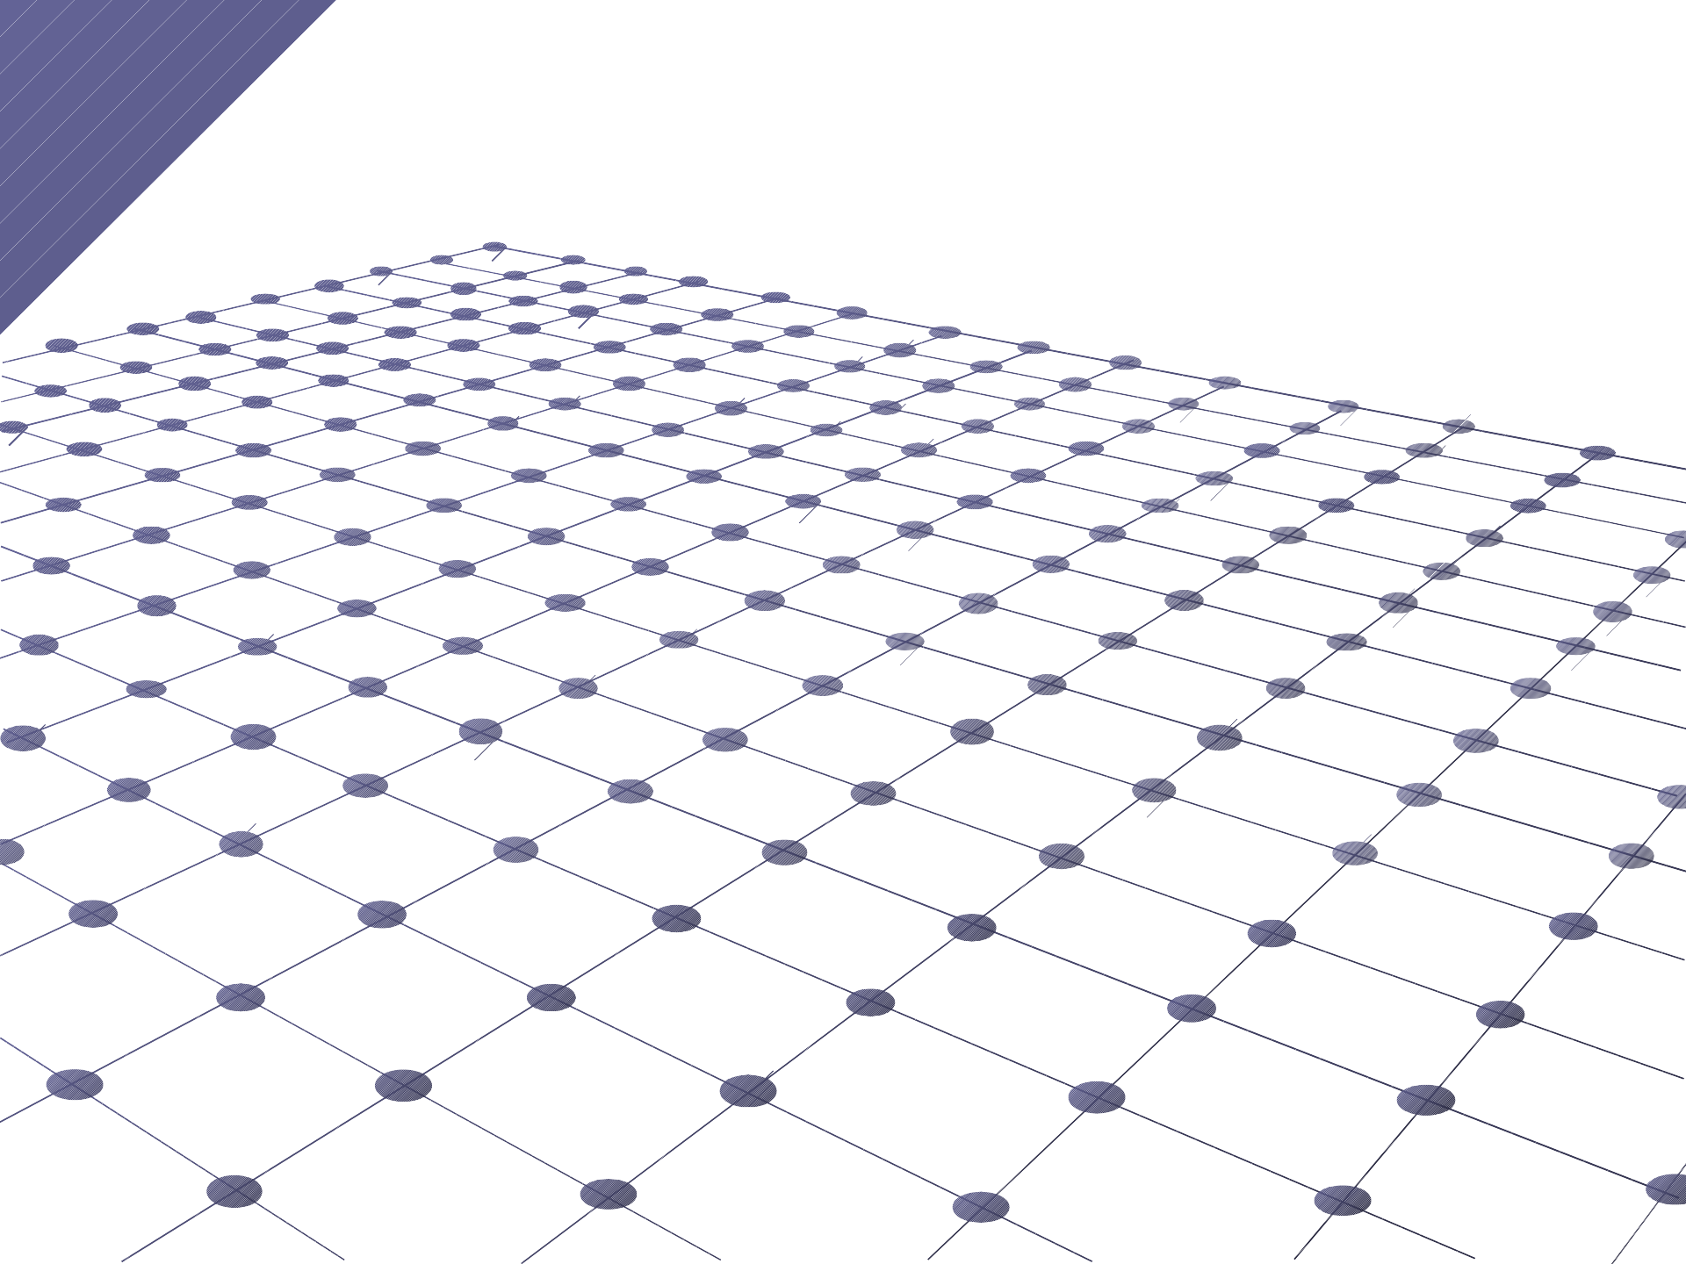
Diseases of external nose and vestibule
Nasal deformities:
1. Saddle nose: depressed nasal dorsum may involve bony, cartilagenous or both components of nasal dorsum.
Etiology:
a} nasal trauma causing depressed fractures(most common) b} excessive removal of septum in SMR.
c} destruction of septal cartilage by haematoma or abscess, or syphilis, tuberculosis or leprosy.
Treatment: augmentation rhinoplasty by filling the dorsum with cartilage
,bone or synthetic implant.
- if destruction is only cartilagenous cartilage is taken from nasal septum or auricle and laid in single or multiple layers.
-if involves both bone and cartilage cancellous bone from iliac crest is taken.
-autografts are preferred over allografts.
-synthetic implants used are silicone or teflon (likely to be extruded)

Slide 3
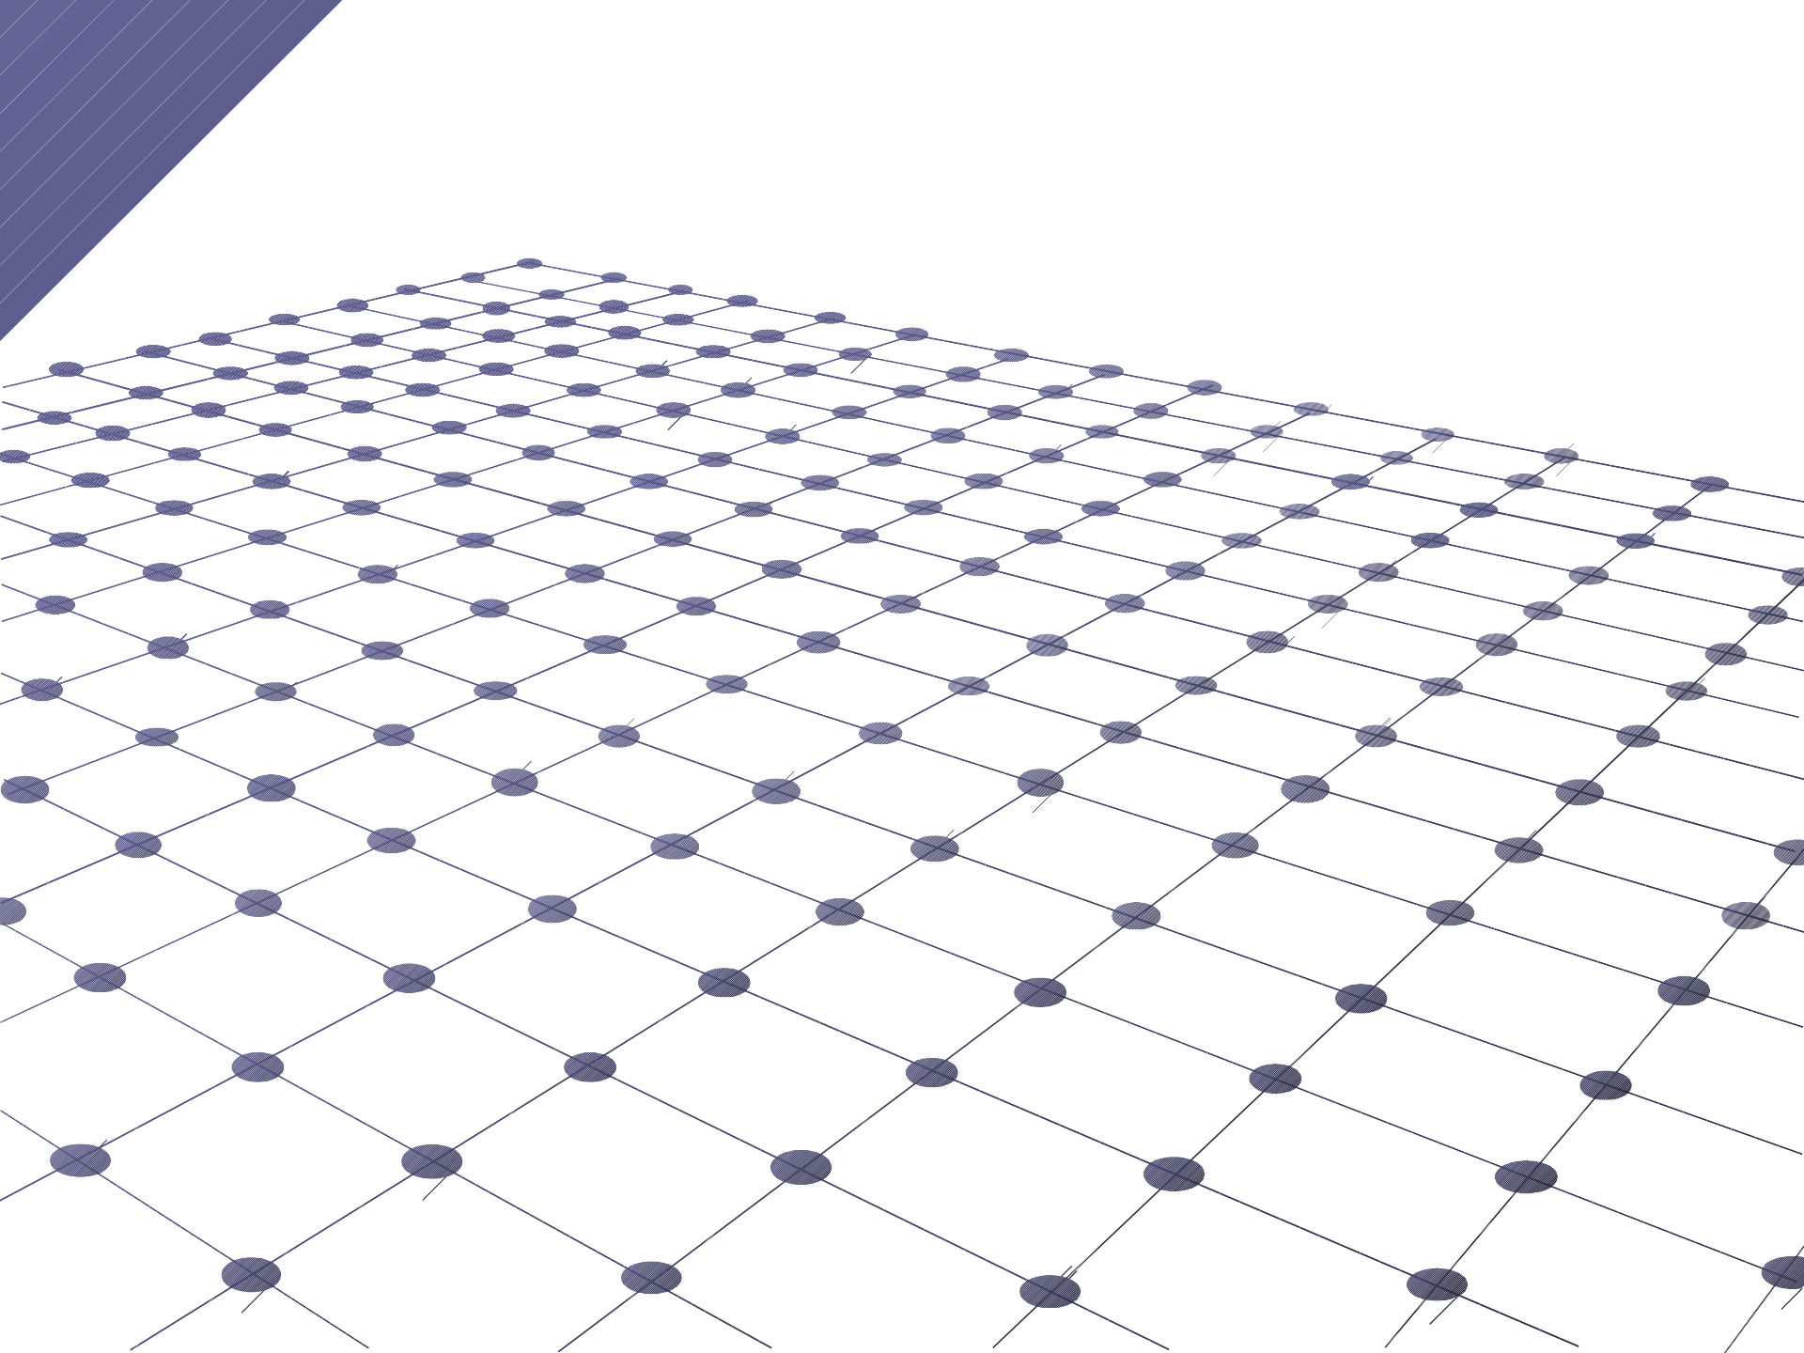
Diseases of external nose and vestibule
Hump nose-this may involve the bone
or cartilage or both. corrected by reduction rhinoplasty
Crooked nose-midline of dorsum from frontonasal angle to tip is curved in a C or S shape.
Deviated nose-midline is straight but deviated to one side.
-usually these deformities are traumatic in origin (birth, neonatal or childhood) .With growth of nose these are identified.
- corrected by rhinoplasty or septorhinoplasty.

Slide 4
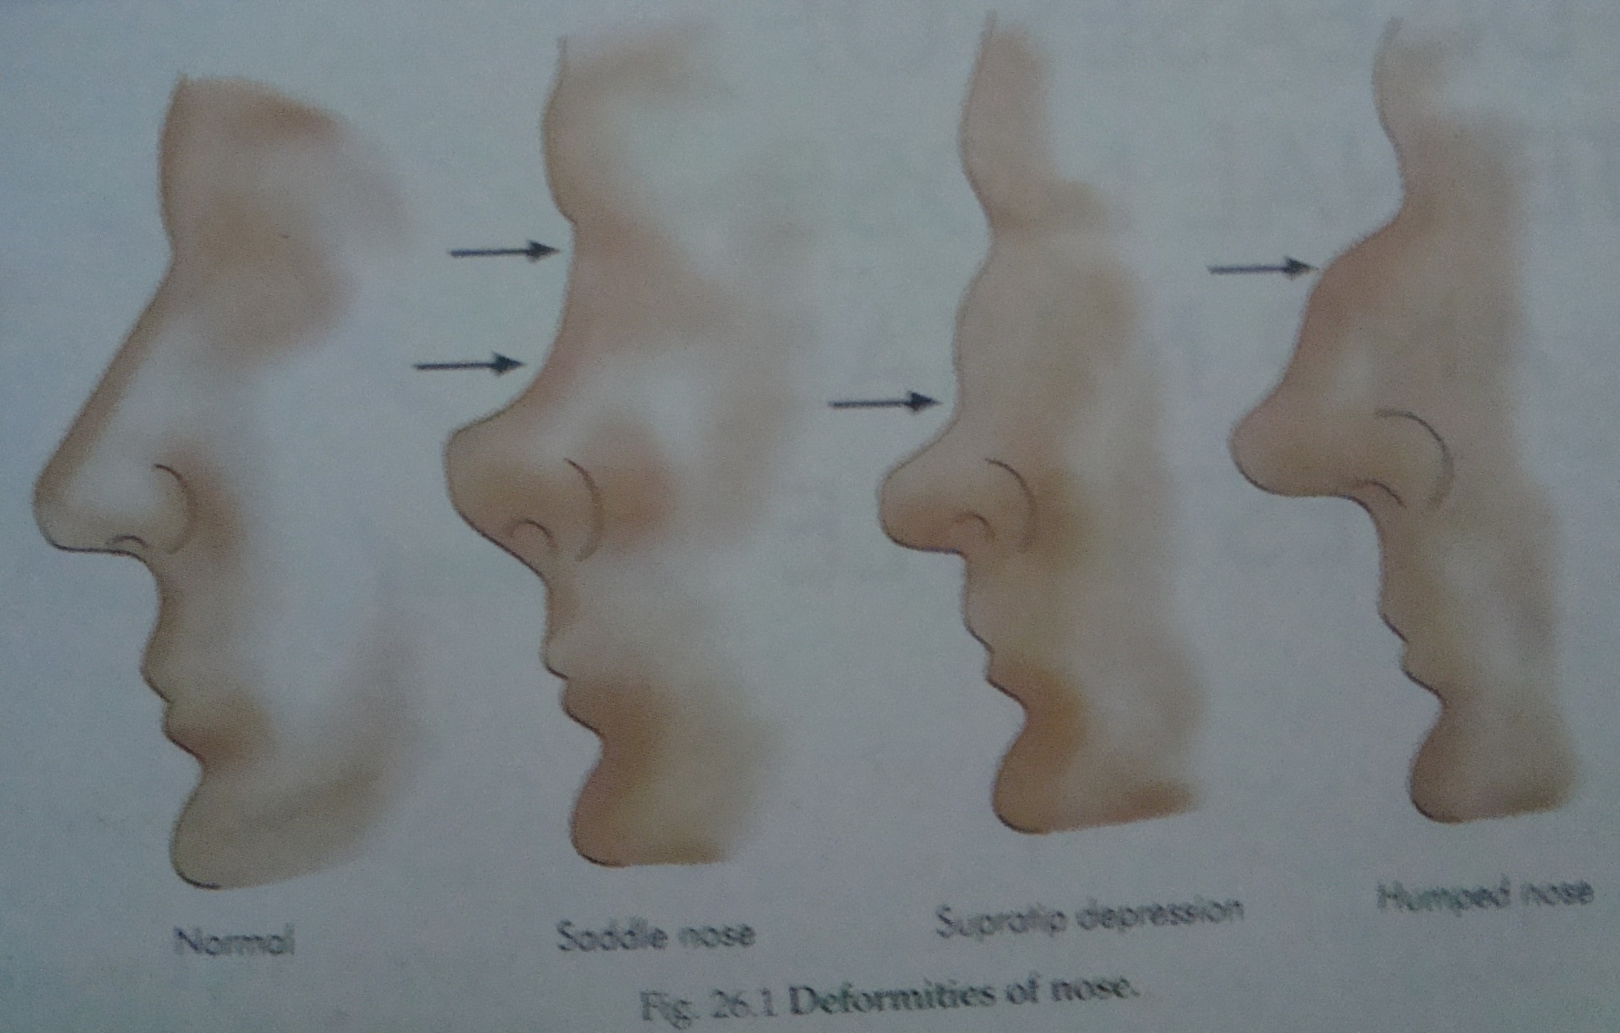
Nasal deformities

Slide 5
Diseases of external nose and vestibule
Meningoencephalocele or encephalocoele:
It is the herniation of brain tissue with meninges through a congenital bony defect.
types: a} nasofrontal-subcutaneous pulsatile swelling in the midline at the root of nose.
b} nasoethmoid - swelling at side of nose.
c} naso-orbital-on the antero medial aspect of
orbit.
Swellings show cough impulse and may be reducible.
Treatment: neurosurgical-severing the stalk from brain and repairing the bony defect.

Slide 6
Diseases of external nose and vestibule
Glioma:
It is a nipped off portion of encephalocele during embryonic development.
60%-extranasal-firm subcutaneous swelling on the bridge, side of nose or inner canthus.
30%-intranasal,10%-both
extranasal gliomas are encapsulated and can be easily removed by external nasal approach.

Slide 7
Diseases of external nose and vestibule
Benign tumors:
Rhinophyma (potato tumour)-it is a slow growing benign tumour due to hypertrophy of the sebaceous glands of the tip of nose.
-seen in long standing cases of acne rosacea.
-patient comes for unsightly appearance of tumour, obstruction in breathing and vision due to large of tumour.
-presents as pink, lobulated mass over the nose with superficial vascular dilations.
-mostly affect men past middle age.
-treatment consists of paring the bulk of the tumour with sharp knife or CO2 laser and the area allowed to re- epithelialise. sometimes completely excised and skin grafting is done.
-other benign tumours are Papilloma (warts), haemangioma, pimented naevus, seborrhoeic keratosis, neurofibroma.

Slide 8
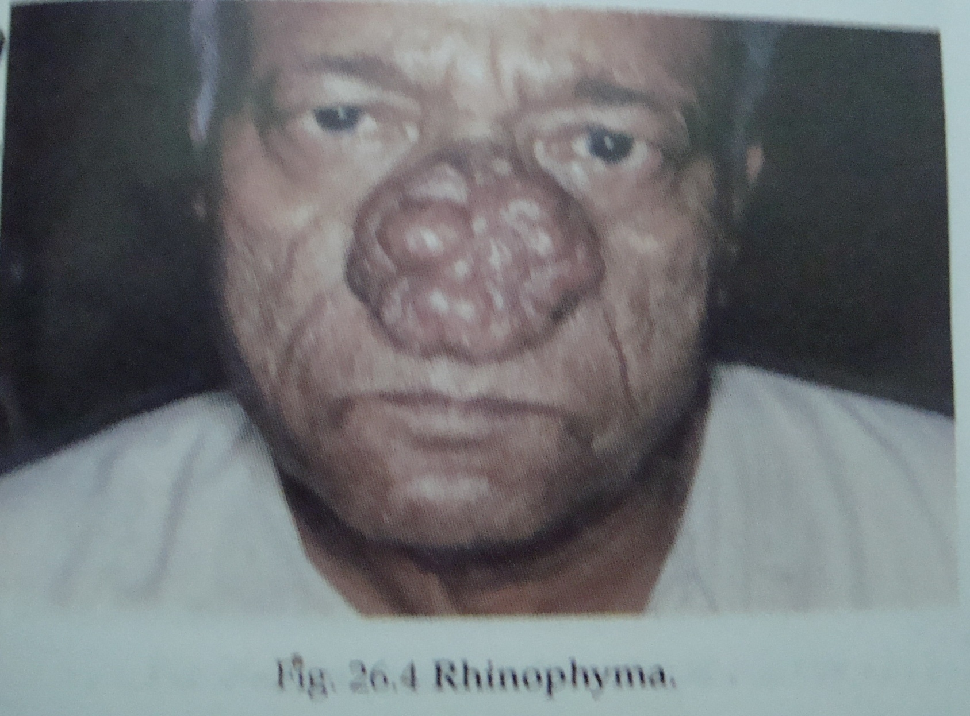
Rhinophyma

Slide 9
Diseases of external nose and
vestibule
Malignant tumours:Basal cell carcinoma (rodent ulcer):
-Most common malignant tumour of the skin of nose(87%).
-affects males and females equally in the age group of 40-60.
-common sites: tip and the ala.
-may present as a cyst or papulo-pearly nodule or an ulcer with rolled edges.
-very slow growing and remains confined to skin for a long time. underlying bone and cartilage may get invaded. nodal metastasis extremely rare.
-treatment-depends on size,location and depth .early lesions can be cured with cryosurgery, irradiation or surgical excision with 3-5mm margin. Recurrent lesions, extensive or with involvement of bone or cartilage are excised and surgical defect closed by local or distant flaps or prosthesis.
-Other malignant tumors are-squamous cell carcinoma, melanoma.

Slide 10
Diseases of external nose and vestibule
Furuncle (boil): -acute infection of hair follicle by staphylococcus aureus.
-trauma from nose picking, plucking nasal vibrissae are predisposing factors.
-lesion is small but extremely painful and tender. inflammation may spread to skin of nasal tip and dorsum which may become red and swollen. Fever, malaise and head ache may be present. furuncle may rupture spontaneously in vestibule.
-special significance as it lies in the dangerous area of face which drains into inferior orbital veins and cavernous sinuses.
-treatment-warm compress, analgesics, topical and systemic antibiotics. if fluctuation is seen incision and drainage is done. furuncle should not be squeezed or prematurely incised because of danger of cavernous sinus Thrombophlebitis.
-complications- cellulitis of face and upper lip, septal abscess, cavernous sinus Thrombophlebitis.

Slide 11

Diseases of external nose and vestibule
Vestibulitis: it is a diffuse dermatitis of nasal vestibule.
-causative organism- staph aureus
-predisposing factors-nose picking, plucking of nasal vibrissae, nasal discharge due to any cause coupled with trauma due to handkerchief.
-acute form-vestibular skin is red, swollen and tender, crusts and scales cover an area of skin erosion or excoriation. upper lip may also be involved.
-chronic form- induration of vestibular skin with painful fissures and crusting.
-treatment-removal of crusts with hydrogen peroxide and application of antibiotic steroid cream. chronic fissure can be cauterized with silver nitrate.

