Slide 1
Facial trauma

Slide 2
Facial trauma, also called maxillofacial trauma, is any physical trauma to the face.
Injuries of face may involve
Soft tissues
Bones or
Both
Causes:
Automobile accidents
Sports
Personal accidents
Assaults and fights

Slide 3
Signs and symptoms
Pain
Swelling
Epistaxis
Loss of function
Changes in the shape of facial structures
Disfigurement
Eye injuries

Slide 4
GENERAL MANAGEMENT
Airway maintenance
Control hemorrhage
Treat associated injuries of head, chest, neck, abdomen, cervical
spine, pelvis & limbs
Wound debridement, bandaging and suturing of open wounds, administration of ice, antibiotics and painkillers
Treatment of maxillo-facial bone injury

Slide 5
Soft tissue injury
Facial lacerations
Avulsions
Bruises
Burns and cold injuries
Parotid gland and duct injury
Facial nerve injury

Slide 6
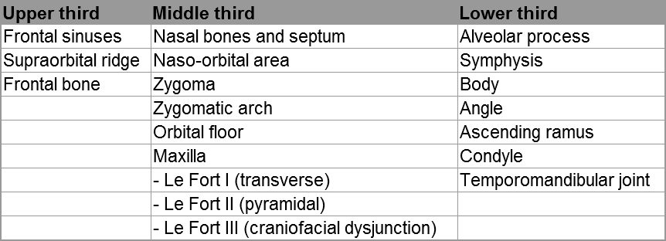
Fractures of the face

Slide 7
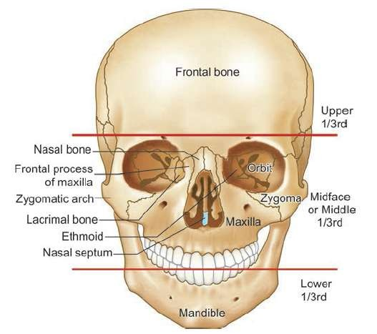

Slide 8
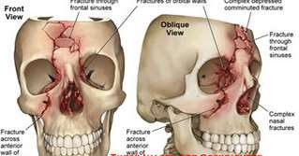
A. FRACTURES OF UPPER THIRD OF FACE
a)Frontal Sinus
Anterior wall fractures
Posterior wall fractures.
Injury to nasofrontal duct

Slide 9
b)Supraorbital Ridge
periorbital ecchymosis
flattening of the eyebrow
Proptosis
Downward displacement of eye
Fragment of bone-pushed into the orbit and get impacted
Treatment
open reduction-brow or transverse skin line incision of the forehead

Slide 10
c)Fractures of Frontal Bone
depressed or linear, with or without separation
often extend into the orbit
associated with brain injury and cerebral oedema
require neurosurgical consultation

Slide 11
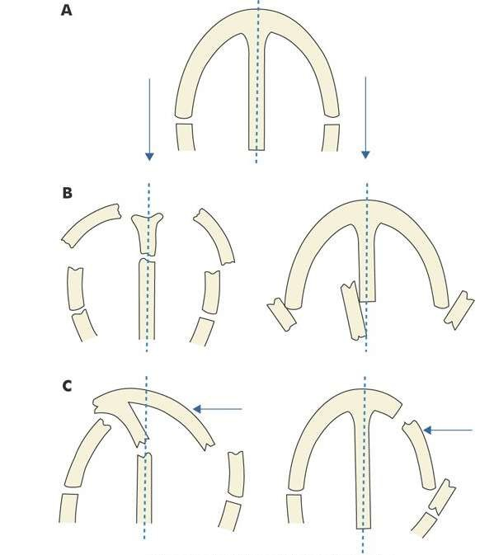
B. FRACTURES OF MIDDLE THIRD OF FACE
a)Nasal Bones and Septum
most common because of the projection of nose on the face.
Magnitude of force will determine the depth of injury
Types
Depressed
Angulated

Slide 12
Clinical Features
Swelling of nose
Periorbital ecchymosis.
Tenderness.
Nasal deformity
Crepitus and mobility of fractured fragments.
Epistaxis.
Nasal obstruction.
Lacerations of the nasal skin

Slide 13
Diagnosis
Physical examination
X-rays -Waters' view, right and left lateral views and occlusal view
Treatment
Simple fractures -no treatment
others may require closed or open reduction
reduction by closed methods-before the appearance of edema or after it has subsided

Slide 14
Closed reduction
Depressed fractures -a straight blunt elevator guided by external digital manipulation
displaced nasal bridge -firm digital pressure in the opposite direction.
Impacted fragments-disimpaction with Walsham or Asche's forceps before realignment.
Septal fractures are also reduced by Asche's forceps
Septal haematoma-must be drained
Unstable fractures require intranasal packing and external splintage.

Slide 15
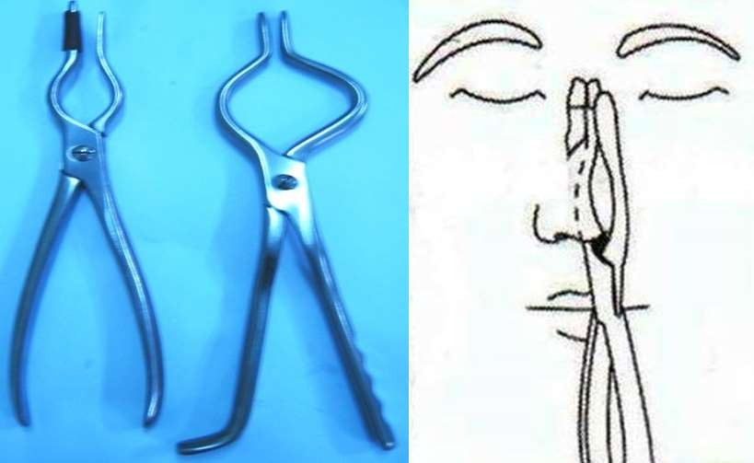
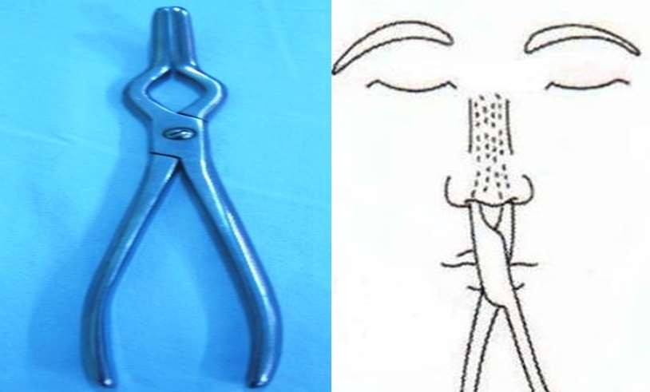
Left Walsham Forceps
Asch Forceps

Slide 16
Open reduction
Early open reduction -rarely required
Certain septal injuries can be better reduced by open methods
Healed nasal deformities -corrected by rhinoplasty or septorhinoplasty

Slide 17
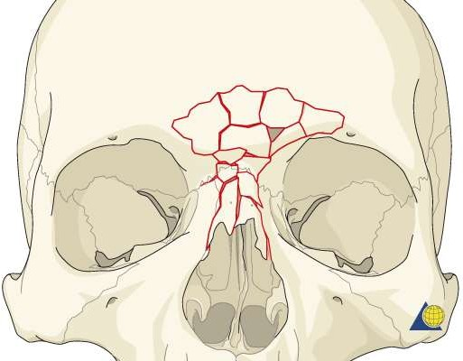
b)Naso-orbital Fractures
Impact over the nasion fractures nasal bones and displaces them posteriorly
Perpendicular plate of ethmoid, ethmoidal air cells and medial orbital wall
Other-cribriform plate, frontal sinus, frontonasal duct, extraocular muscles, eyeball and the lacrimal apparatus.
Medial canthal ligament may be avulsed.

Slide 18
Clinical Features
Telecanthus
Pug nose
Periorbital ecchymosis.
Orbital haematoma
CSF leakage
Displacement of eyeball
Diagnosis
Various facial x-rays films -assess the extent of fracture and injury to other facial bones
CT scans

Slide 19
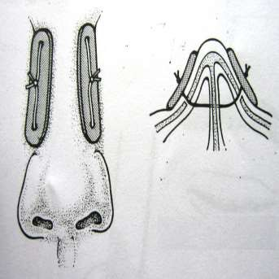
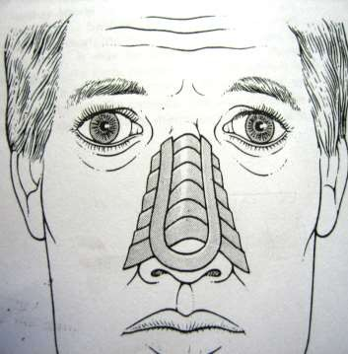
Treatment
Closed reduction
Uncomplicated cases-reduced with Asche's forceps and stabilized by a wire passed through fractured bony fragments and septum and tied over the lead plates.
Intranasal packing & splinting for 10 days
Open reduction
cases with extensive comminution of nasal and orbital bones & injuries to lacrimal apparatus, medial canthal ligaments, frontal sinus
H-type incision -extended to the eyebrows if access to frontal sinuses is also required.
Nasal bones & Medial orbital walls are reduced under vision and bridge height is achieved
Medial canthal ligament-restored.
Intranasal packing -restore the contour
•

Slide 20
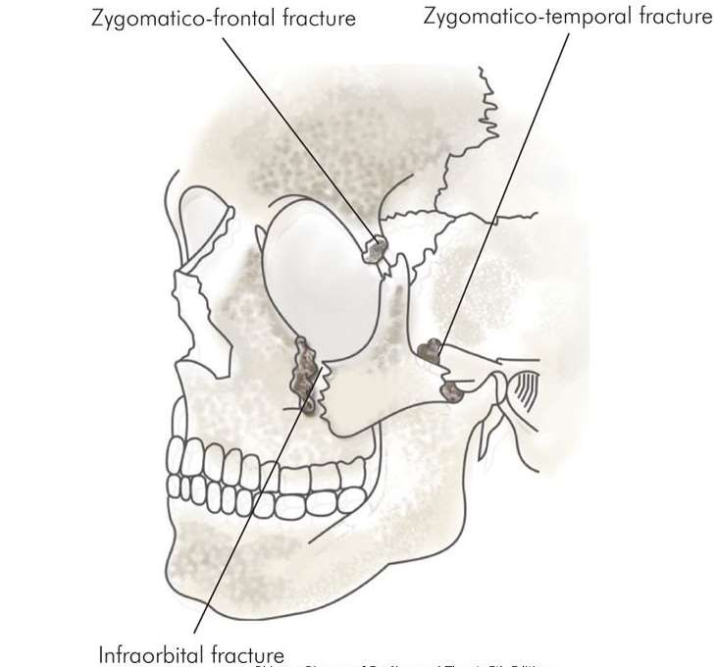
c)Fractures of Zygoma (Tripod Fracture)
Zygoma is the second most fractured bone
cause is direct trauma
Zygoma is separated at its three processes
Orbital contents may herniate into the maxillary sinus

Slide 21
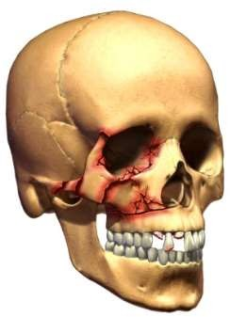
Clinical Features
Flattening of malar prominence.
Step-deformity of infraorbital margin.
Anaesthesia in the distribution of infraorbital nerve.
Trismus, due to depression of zygoma on the underlying coronoid process.
Oblique palpebral fissure
Restricted ocular movements
Periorbital emphysema

Slide 22
Diagnosis
Physical examination
Waters' or exaggerated Waters' view
CT scan of the orbital wall

Slide 23
Treatment
Open reduction and internal wire fixation gives best results
Wire fixation is done at frontozygomatic suture and infraorbital margin
Transantral approach -less favourable,antrum is exposed as in Caldwell-Luc operation,
Blood is aspirated, fracture reduced and then stabilised by a pack in the antrum.
Fractures of orbital floor can also be reduced
Antral pack is removed in about 10 days

Slide 24
Fracture of zygomatic arch

Slide 25
Generally breaks into two fragments
Three fracture lines, one at each end and third in the centre of arch

Slide 26
Clinical features
Depression in the area of zygomatic arch
Local pain
Limitation of movement of mandible

Slide 27
Diagnosis
X- ray submentovertical view of skull
Waters view is also taken

Slide 28
Treatment
A vertical incision is made in the hair bearing area above or in front of the ear, cutting through temporal fascia.
An elevator is passed deep to temporal fascia and carried under the depressed bony fragments which are then reduced.
Fixation is usually not required

Slide 29
Fractures of orbital floor
Fractures of orbital floor occurs generally in zygomatic and Le Fort II maxillary fractures
Isolated fractures of orbital floor occurs in blow out fractures
Orbital contents may herniate into the antrum

Slide 30
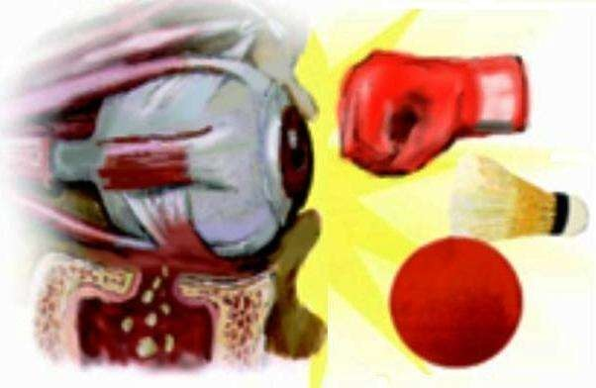

Slide 31
Clinical features
Ecchymosis of lid, conjunctiva and sclera
Enophthalmos with inferior displacement of eyeball
Diplopia
Hypo aesthesia or anaesthesia of cheek and upper lip incase infraorbital nerve is involved

Slide 32
Diagnosis
X-ray waters’ view
Convex opacity bulging into the antrum from above (tear-drop opacity)
CT scan
Entrapment of inferior rectus and inferior oblique muscles is diagnosed by asking the patient to look up and down

Slide 33
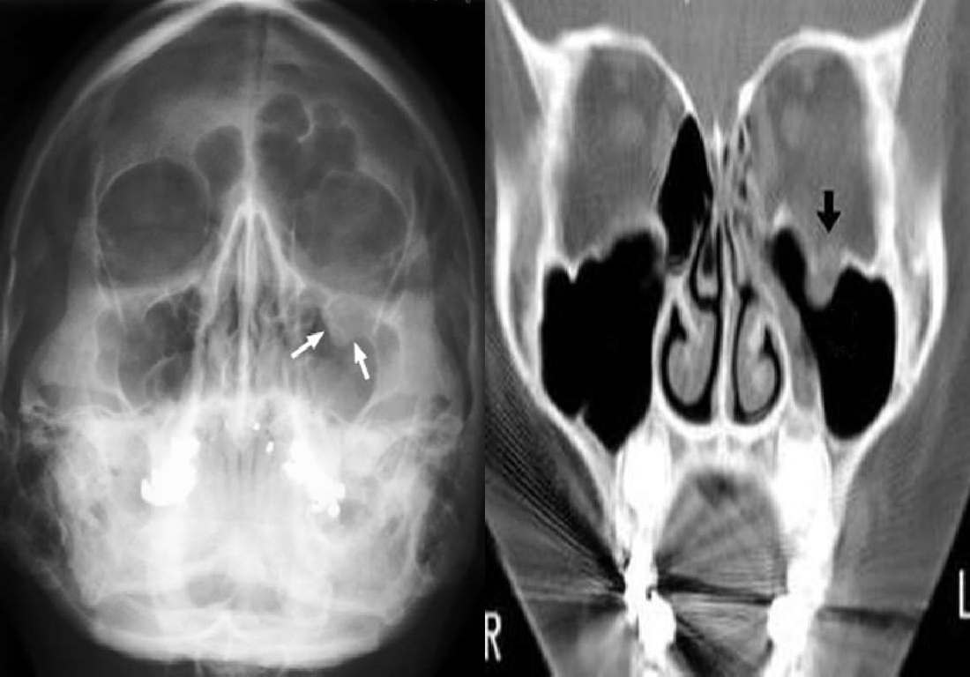

Slide 34
Treatment
Indications for surgery
Enphthalmos and persistent diplopia due to entrapment of muscle
Reduction is done by finger passed into the antrum through a transantral approach
Pack can be kept in the antrum to support the fragments
Infra orbital approach through a skin crease of the lower lid can also be used either alone or in combination with transantral approach

Slide 35
Fracture repaired by bone graft from the iliac crest, nasal septum or the anterior wall of the antrum
Silicon or teflon sheets also can be used for reconstruction of orbital floor

Slide 36
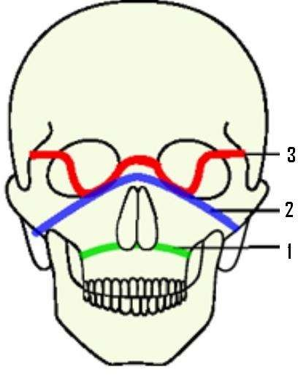
Fractures of maxilla
They are classified into three types as
Le Fort I ( transverse)
Le Fort II (pyramidal)
Le Fort III (craniofacial dysjunction)

Slide 37
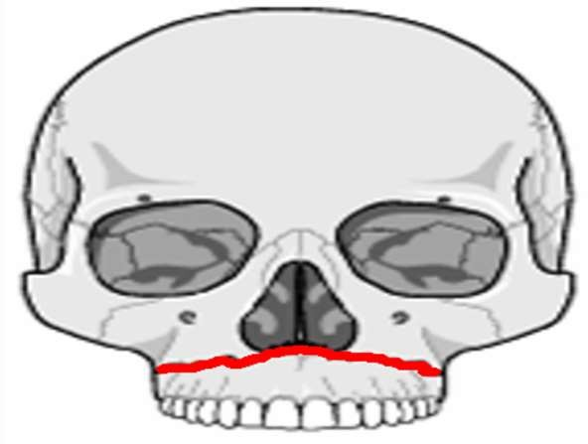
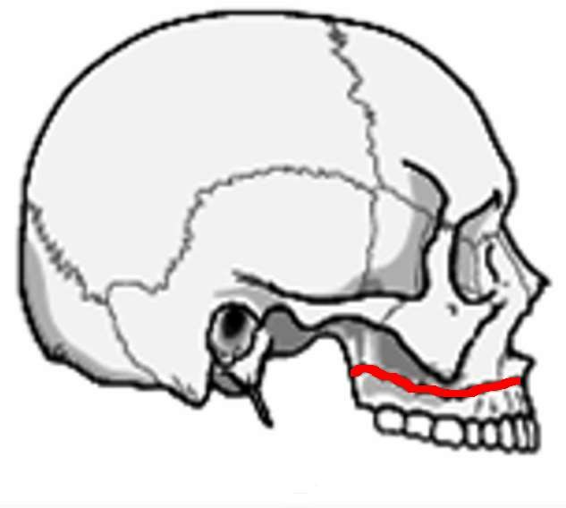
Le Fort I (transverse)
Fracture runs above and parallel to the palate
It crosses lower part of nasal septum, maxillary antral and the pterygoid plates

Slide 38
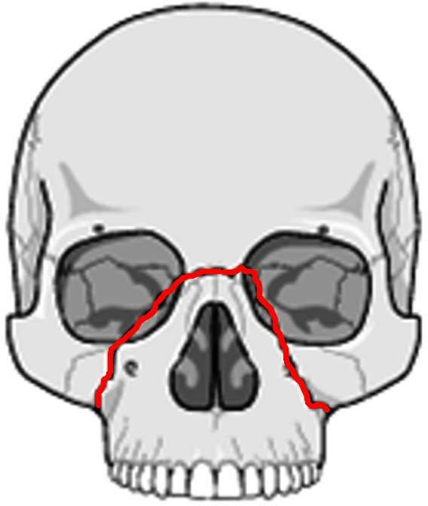
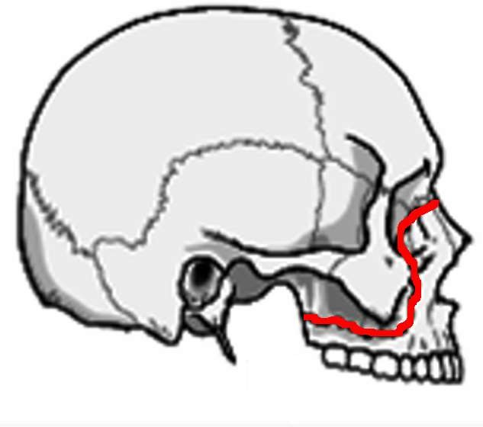
Le Fort II (pyramidal)
Fractures passes through the root of nose, lacrimal bone, floor of orbit, upper part of maxillary sinus and pterygoid plates

Slide 39
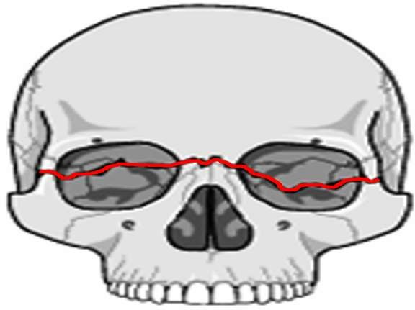
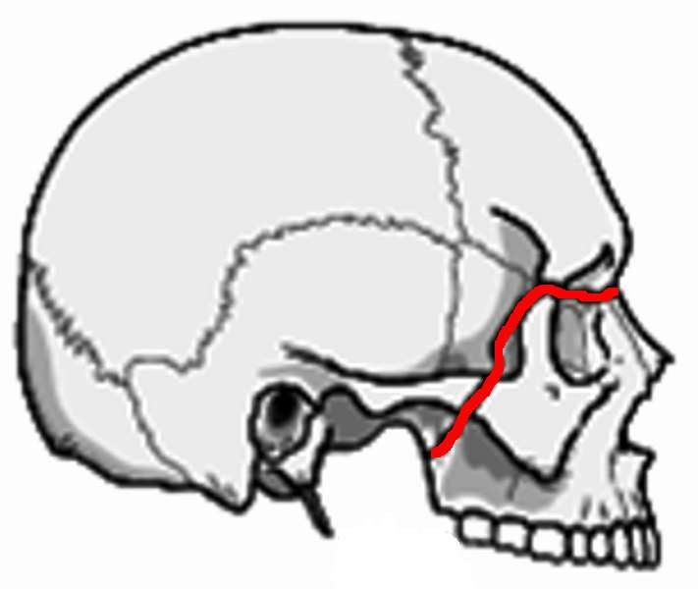
Le Fort III (craniofacial dysjunction)
There is complete seperation of facial bones from the cranial bones.
Fracture lines passes through root of nose, ethmofrontal junction, superior orbital fissure, lateral wall of orbit, frontozygomatic and temporozygomatic sutures and the upper part of pterygoid plates.

Slide 40
Clinical features
Malocclusion of teeth with anterior open bite
Elongation of mid face
Mobility in the maxilla
CSF rhinorrhea

Slide 41
Diagnosis
X-ray waters’ view, posteroanterior view, lateral view
CT scans

Slide 42
Treatment
Restore the airway and stop severe haemorrhage from maxillary artery
Fixation of maxillary fractures is done by
Interdental wiring
Intermaxillary wiring using arch bars
Open reduction and interosseous wiring
Wire slings from frontal bone, zygoma or infraorbital rim to the teeth or arch bars

Slide 43
C. Fractures of Lower third
Fractures of mandible

Slide 44
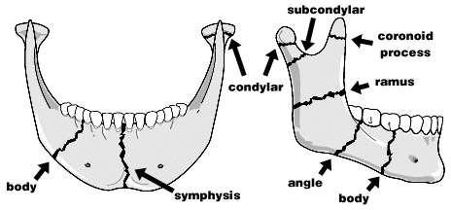
Fractures of mandible
Fractures of mandible have been classified according to their location

Slide 45
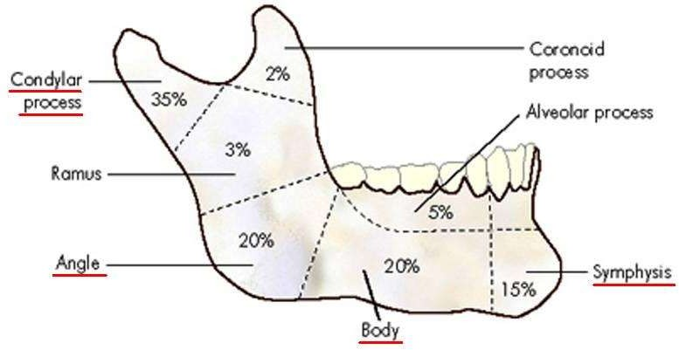
Frequency of fracture

Slide 46
Most of the mandible fractures are the result of direct trauma however, condylar fractures are caused by indirect trauma to the chin or opposite side of the body of mandible
Displacement of mandibular fractures is determined by
The pull of muscles attached to the fragments
Direction of fracture line
Level of fracture

Slide 47
Clinical features
Pain and Trismus
Malocclusion of teeth
Ecchymosis of oral mucosa
Tenderness at site of fracture
Crepitus at site of fracture

Slide 48
Diagnosis
X-ray PA view of skull (for condyle)
Right and left oblique views of mandible

Slide 49
Treatment
Fracture reduction
Closed methods (Inter-maxillary fixation):
Inter-dental wiring
Arch bars and rubber bands Open methods:
Inter-osseous wiring
Lag screws
Compression plates & screws

Slide 50
Immobilization of mandible beyond 3 weeks in condylar fractures can cause ankylosis of temporomandibular joints
Therefore inermaxillary wires are removed and jaw exercises started

Slide 51
Thank you

