Slide 1
Hearing loss , deafness and mutism

Slide 2
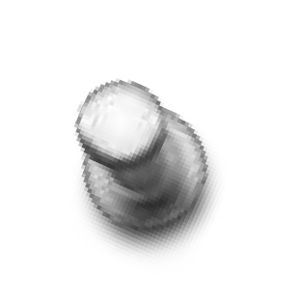
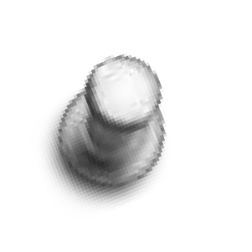

WHO-DEFINATION
Hearing impairment :refers to complete or partial loss of the ability to hear from one or both ears. The level of impairment can be mild, moderate, severe or profound;
Deafness : refers to the complete loss of ability to hear from one or both ears.

Slide 3
Types of hearing loss
Conductive hearing loss
Sensory neuronal hearing loss
Syndromic--hearing loss in association with other medical problems e.g pendred syndrome with associated thyroid dysfunction.
Nonsyndromic--hearing loss without associated medical problems.

Slide 4
Quantification of hearing loss
The severity of a hearing impairment is ranked according to the loudness (measured in decibels (dB)) a sound must be before being detected by an individual. Hearing impairment may be ranked as mild, moderate, severe or profound as defined below:
Mild:
– for children: between 20 and 40 dB
Moderate: between 41 and 55 dB
Moderately severe: between 56 and 70 dB
Severe: between 71 and 90 dB
Profound: 90 dB or greater
Hearing sensitivity varies according to the frequency of sounds. To take this into account, hearing sensitivity can be measured for a range of frequencies and plotted on an audiogram.

Slide 5
Classification of deafness
O Clinical
O Educational
O Sociological

Slide 6
O Educational
O Grade I- obtain benefit from education provided in ordinary school
O Grade II-requires special educational
arrangements
O Grade III- educational methods are required for deaf children without naturally acquired speech.

Slide 7
CONGENITAL HEARING IMPAIRMENT
CONDUCTIVE
O Exostosis
O Microtia
O Absence of pinna
O Congenital cholesteatoma
O EAC atresia with/without ossicular fixation : Treacher Collins, Klippel Fiel, Alport’s, Goldenhar, Mohr’s
O Associated eye disorders: Cryptophtalmus, Duane’s
O Associated renal disorders:
Nephrosis, Taylor’s syn.
SENSORINEURAL
O Michael’s aplasia
O Mondini dysplasia
O Scheibe dysplasia
O Bing – Siebenmann dysplasia
O Alexander dysplasia
O Enlarged vestibular aqueduct
O Semicircular canal malformations

Slide 8
The Deaf Child
Inner ear abnormalities
Sheibes dysplasia-dysplasia in cochlea and vestibule.
Alexanders dysplasia-affects only the basal turn of membranous cochlea,only high frequencies are affected.
Bing-siebmann dysplasia-complete abscence of membranous labyrinth.

Slide 9
Michel aplasia-complete abscence of bony and membranous labyrinth
Modinis dysplasia-only basal coil is present or cochlea is 1.5 turns.

Slide 10
Maternal factors
Infections-TORCHES
To-toxoplasmosis
R-rubella
C-cytomegalovirus
H-herpes 1 and 2
S-syphyllis

Slide 11
Drugs during pregnancy
Streptomycin,gentamycin,tobramycin cross placental barrier and damage cochlea
Radiation
Nutriotional deficiency
Diabetes
Thyroid deficiency
Alcoholism-Foetal alcohol syndrome (FAS

Slide 12
Perinatal causes
Anoxia
Prematurity and low birth weight
Birth injuries
Neonatal jaundice
Neonatal meningitis
Sepsis
Ototoxic drugs-antibiotics,anti-inflamatory

Slide 13
Post-natal causes
Genetic causes.
Non-genetic-viral infections(mumps measles,varicella)
Secretory otitis media- Secretory otitis media is an accumulation of fluid in the middle ear.
Trauma e.g fractures of temporal bone
Noise induced deafness

Slide 14
Investigations.
Anamnesis
Screening procedures-used to test high risk infants.(arousal test)
Behaviour observation audiometry-moros reflex,chochlea palpebral reflex,cessation reflex.
Distraction techniques.

Slide 15
ASSESSING THE DEAF CHILD
O The objectives are :
O To ascertain whether the child has any deafness or not
O If deafness is present, whether unilateral or bilateral
O To document the degree of functional impairment
for each ear
O To establish a topographical localisation of the lesion
O To establish an etiological diagnosis
O To establish management protocols

Slide 16
NEONATAL HEARING SCREENING
O Performed as soon as soon as child is born
O Two types-

Slide 17
Universal Newborn hearing Screening.
O With in 48hrs of birth.
O 100% specificity
O Evoked otoacoustic emission (EOAE)
INTERPRETATION-
pass infant- needs no further testing.
Refer infant- needs diagnostic hearing evaluation . Electrochocleography ,BERA ASSR.

Slide 18
O However even if passed EOAE test
O Behavioural observation audiometry suggested at 8th, 12th , 24th, 36th months if born out of high risk pregnancy

Slide 19
Clinical test
O Neonates –reflexes (0 to 4mnths )
O Auropalpebral reflex
O Startle reflex
O arousal reflex

Slide 20
O (5-6months) –Distraction techniques child turns head to locate source of sound.
sound of approximately 50dB ,if speech then 25dB.
O Free field Audiometry- 2 calibrated loudspeaker in a sound- treated room and finding out whether the child is turning its head to the direction of loudspeaker.

Slide 21
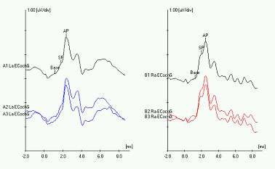
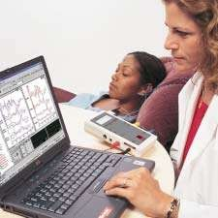
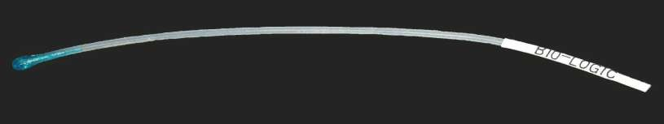
Objective tests

Slide 22
Electrocochleography-recording electrode is placed as close as practical to the cochlea this test measures electrical activity of the inner ear in response to stimulus by sound.

Slide 23
Acoustic reflex
Acoustic reflexes measure the stapedius and tensor tympani reflex generated eardrum movement in response to intense sound.
A typical setup to measure the acoustic (stapedius) reflex is a tympanometer having a method of delivering both a sound to either ear as well as measuring the admittance of the tympanic membrane. Reflexes may be elicited at 500, 1000 and 2000 hz, using 110 db HL. The amplitude of the reflex, latency, and timing (sustained or rapidly decaying) can be quantified. Typical reflex latencies in normal subjects are 107 msec, ranging from 40-180(Bosatra and Russolo, 1976). Normally the reflex does

Slide 24
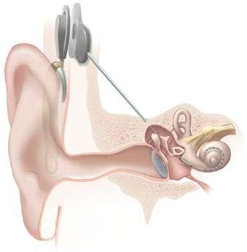
management
Parental guidance
Hearing aids
Development of speech and language-sign language,lip reading
Cochlear implants

