Slide 1
Hypopharyngeal
Pouch and Stylalgia
2017/12/25

Slide 2
Hypopharyngeal pouch
Synonyms
  Posterior pharyngeal diverticulum
  Zenker’s diverticulum
  Pharyngo-oesophageal pouch
  Retropharyngeal pouch

Slide 3
Definition
Acquired
caused by mucosa
pulsion
diverticulum
protrusion of pre-existing
posterior
through
weakness between thyropharyngeus
and cricopharyngeus component of

Slide 4
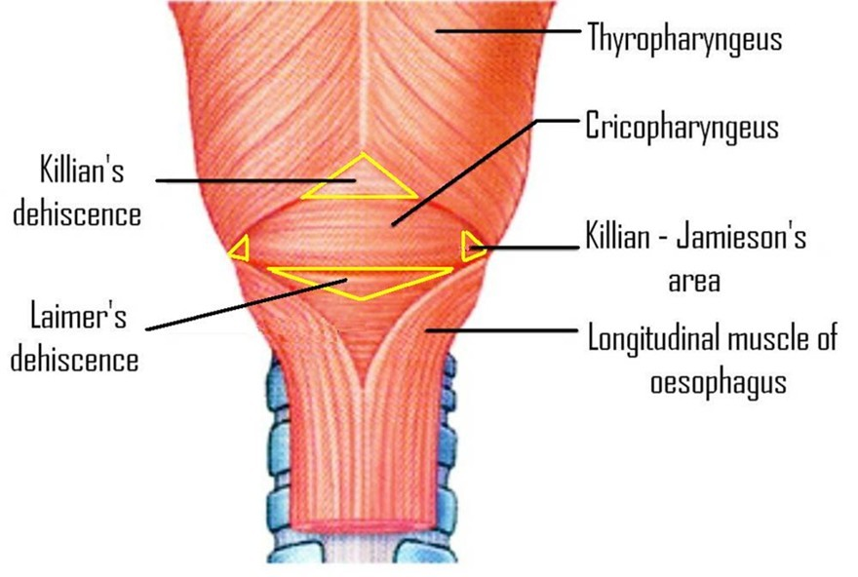
Weak areas between the muscles

Slide 5
Etiology

Slide 6
Tonic spasm of cricopharyngeal sphincter (Negus)
Lack of inhibition to cricopharyngeus (Dohlmann)
Neuromuscular in-coordination between thyropharyn geus and cricopharyngeus (Korkis)
Second swallow against closed cricopharynx( Wilson)

Slide 7
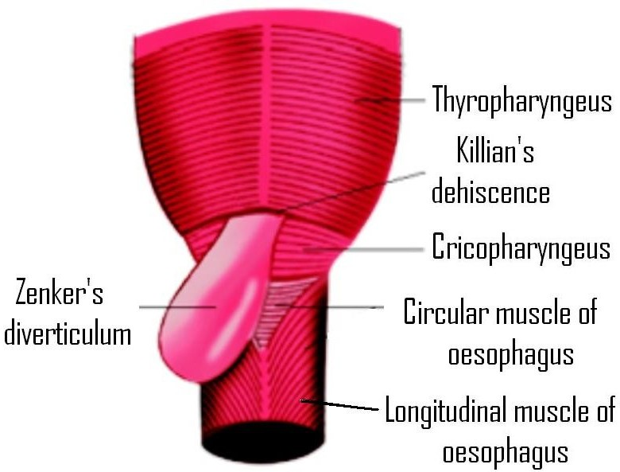
Origin of Zenker’s diverticulum

Slide 8
Clinical Features

Slide 9
Sensation of food sticking in throat and dysphagia: entrapment of food in pouch
Foul taste, bad odor, nocturnal coughing, choking : regurgitation of entrapped food
Hoarseness : spillage laryngitis or sac pressure on RLN
Weight loss due to malnutrition
Compressible neck swelling on left side that reduces with a gurgling sound

Slide 10
Complications
Aspiration of sac contents into lungs
Bleeding from sac mucosa
Absolute esophageal obstruction
Fistula formation into trachea or major blood vessels
Squamous cell carcinoma within

Slide 11
Investigations
Chest X-ray: may show sac and air
- fluid level
Barium swallow
Barium swallow with video- fluoroscopy
Rigid Esophagoscopy
Flexible Endoscopic Evaluation of

Slide 12
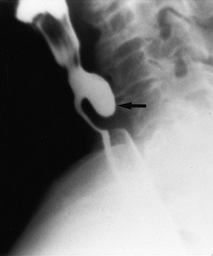
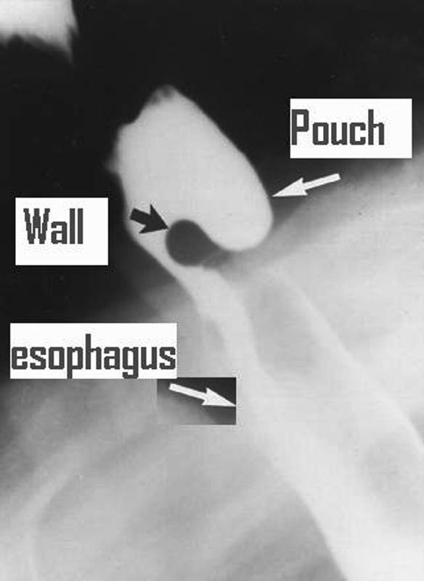
Barium swallow

Slide 13
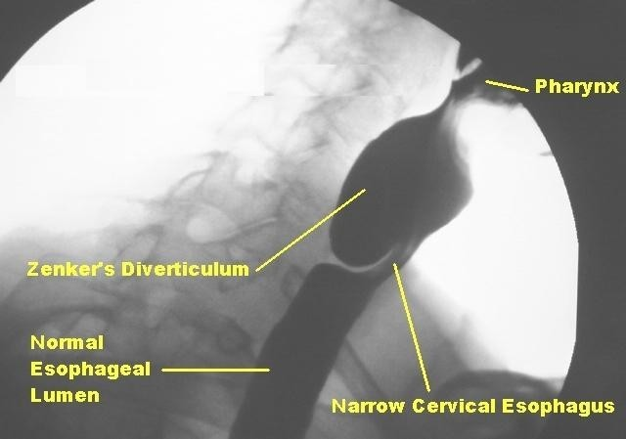
Barium swallow with Videofluroscopy

Slide 14
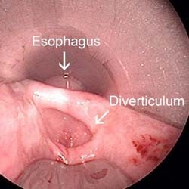
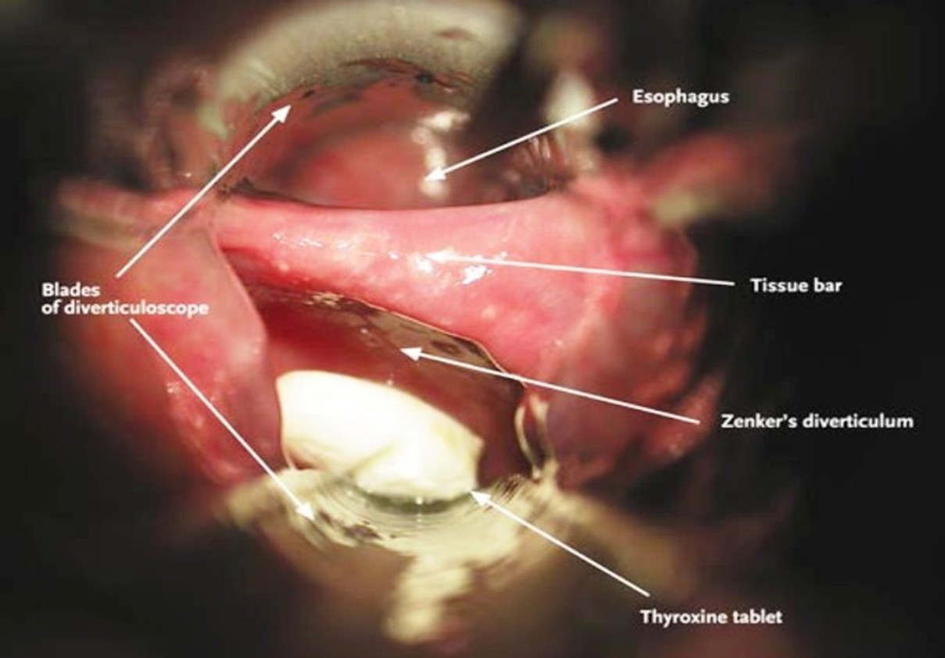
Rigid Esophagoscopy

Slide 15
Staging ( Lahey system)
Stage I:
  Small mucosal protrusion
Stage II:
  Definite sac present, but hypo-pharynx and esophagus are in line
Stage III:
  Hypopharynx is in line with pouch and esophagus pushed anteriorly

Slide 16
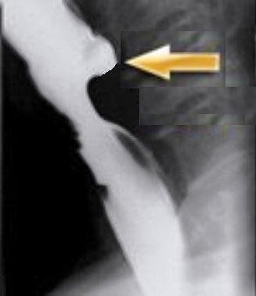
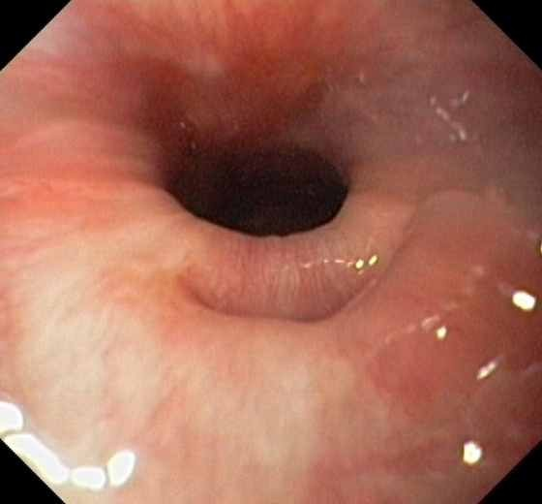
Stage 1

Slide 17
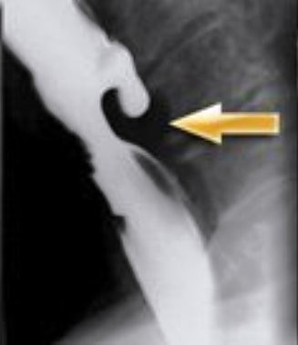
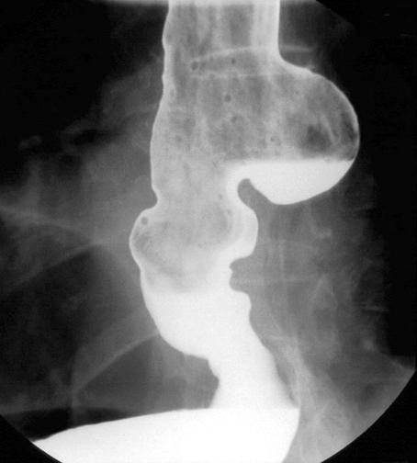
Stage 2

Slide 18
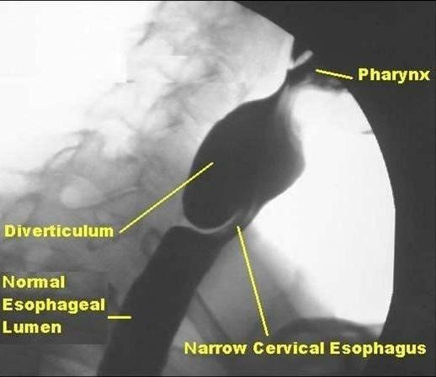
Stage 3

Slide 19
Advantages/disadvantages of
endoscopic vs. external surgery
External Endoscopic
Longer procedure Short procedure and anaesthetic time
Longer hospital stay (typically 5–7 Short hospital stay (1–2 days) with oral days) with nasogastric feeds for 5 days intake within 24 hours
Higher complication rate Lower complication rate
Specimen available for histological assessment to exclude carcinoma
No histological assessment of pouch
Long term results of stapling awaited, although good results reported with laser
Revision surgery straightforward
Proved long term satisfactory results
Revision surgery can be difficult

Slide 20
Surgical Treatment
Cricopharyngeal myotomy and combinations
Diverticulum invagination (Keyart)
Diverticulopexy: Sippy-Bevan
External or open Diverticulectomy: Wheeler
Rigid Endoscopic Diverticulotomy : Cautery (Dohlman), Laser , Stapler

Slide 21
Treatment Protocol
Small sac (< 2cm)
  Cricopharyngeal (CP) myotomy + invagination
Large sac (2-6 cm)
  Open Diverticulectomy with CP myotomy
  Endoscopic Diverticulotomy with CP myotomy

Slide 22
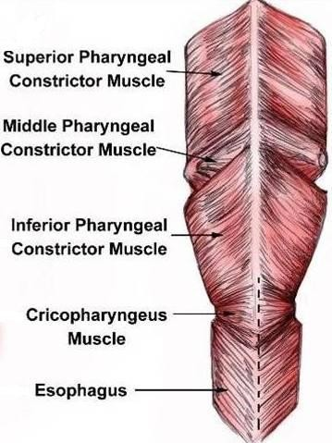
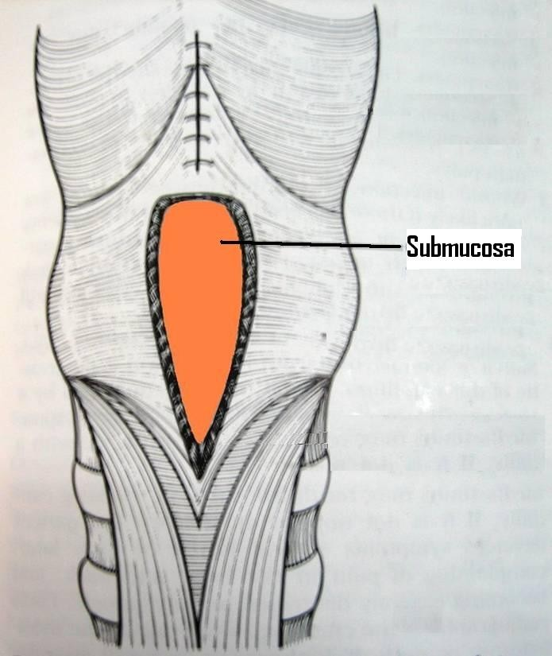
Cricopharyngeal myotomy

Slide 23
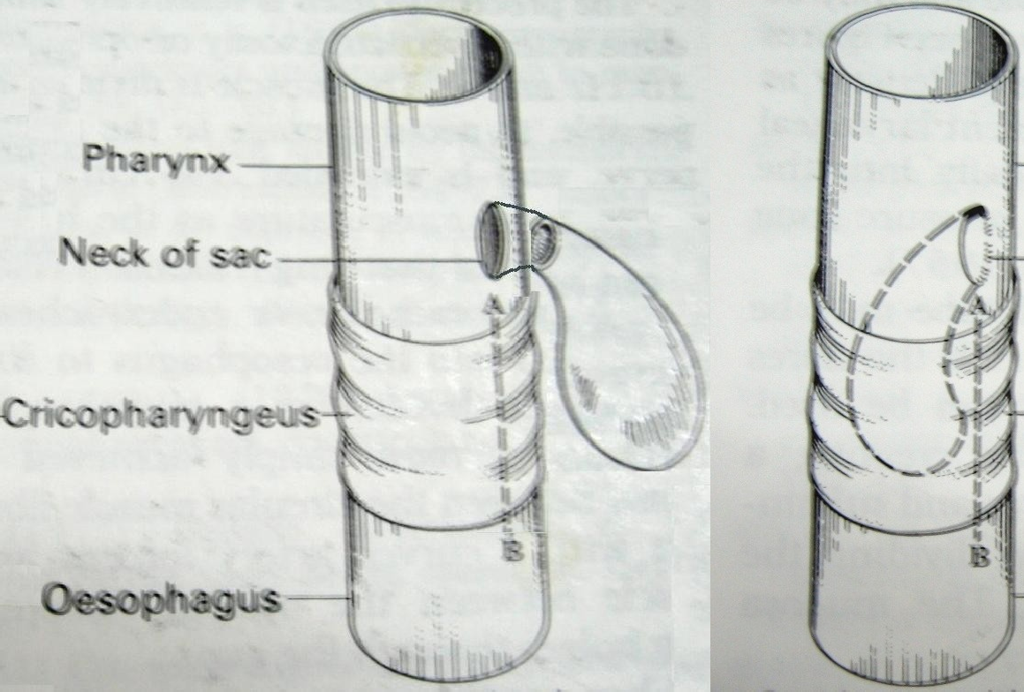
Diverticulum invagination
Diverticulum pushed
into
hypopharyngeal lumen and muscle and adjacent tissues are oversewn
CP myotomy is usually performed

Slide 24
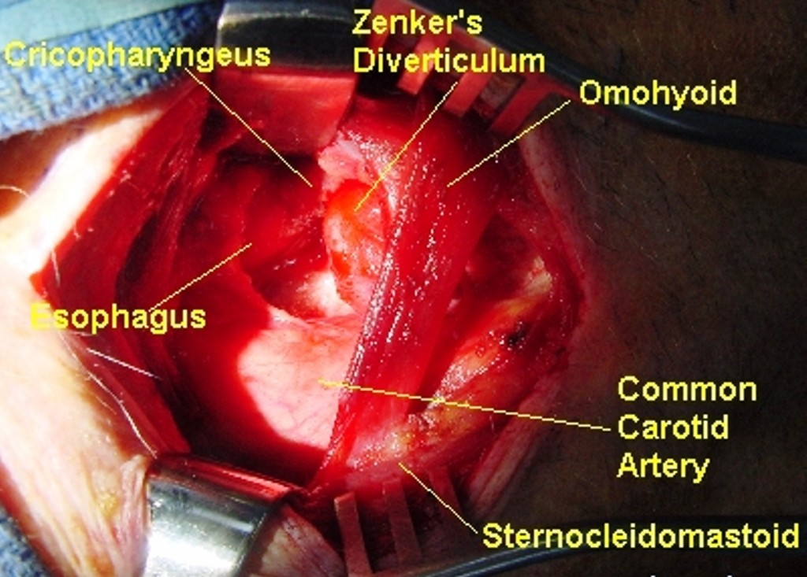
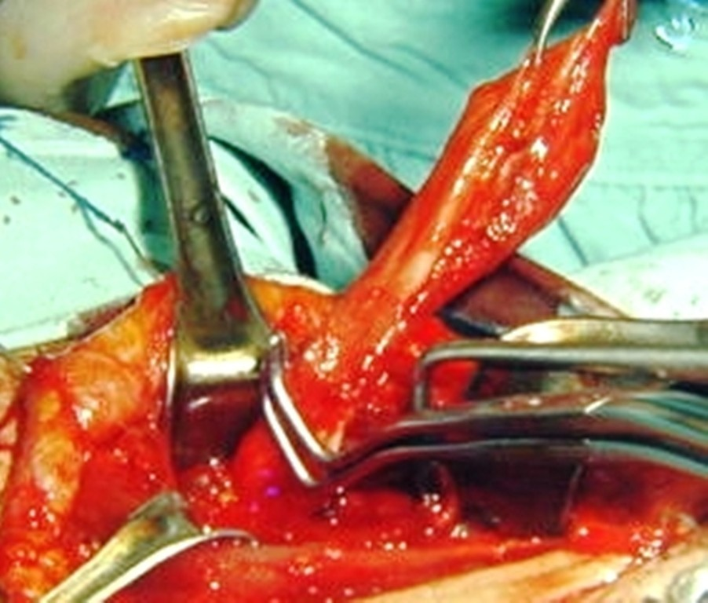
Diverticulectomy
External

Slide 25
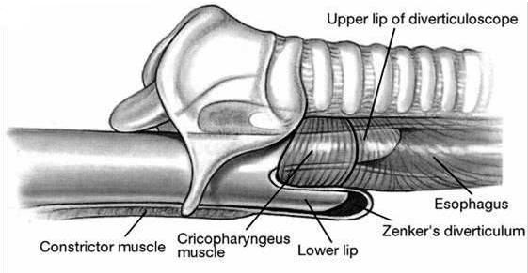
Endoscopic Diverticulotomy
Diverticuloscope advanced so its upper lip is within esophagus & lower lip is within
diverticulum

Slide 26
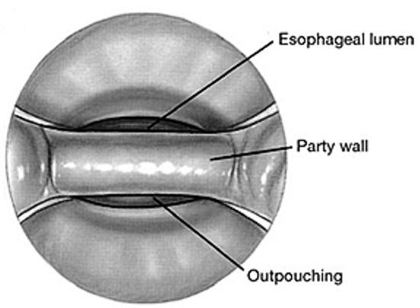
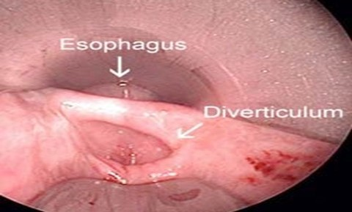
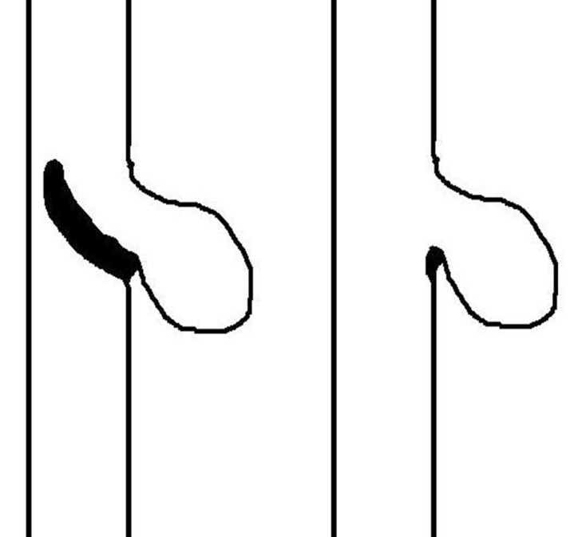
Cautery, laser, or stapling device used to
divide common party wall between pouch & esophagus

Slide 27
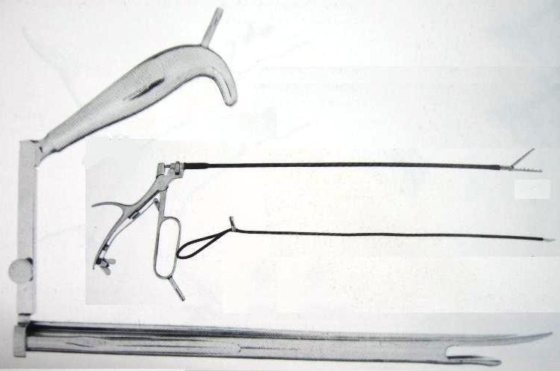

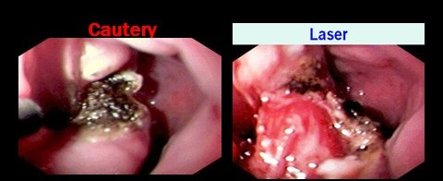
Dohlman’s Procedure

Slide 28
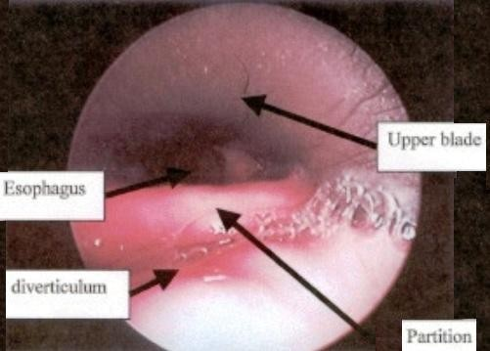
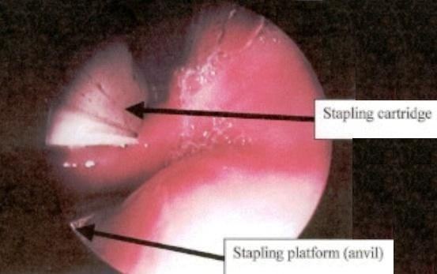
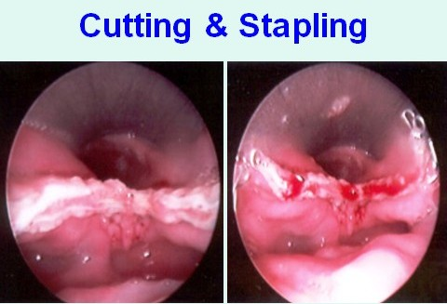
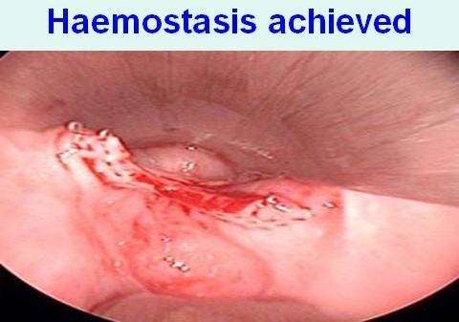
Endoscopic Stapler

Slide 29
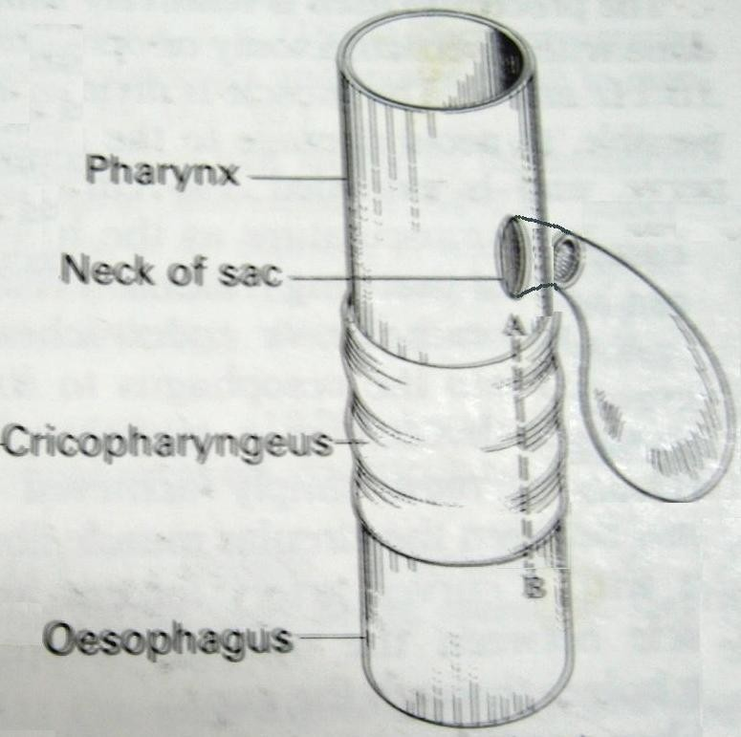
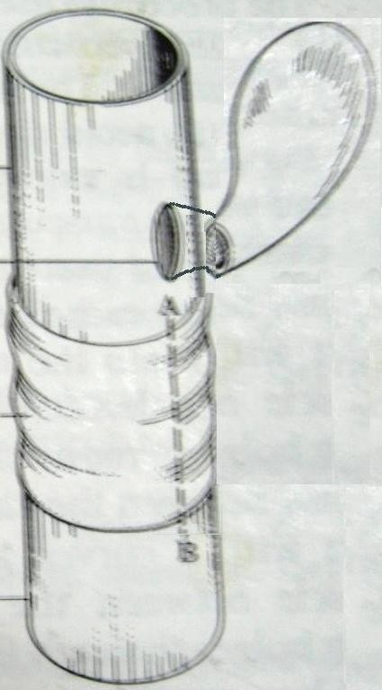
Diverticulopexy
Sac mobilized & its sternocleido-mastoid
fundus muscle
fixed to in a
superior, non-dependent position
CP myotomy is also performed

Slide 30
Complications of surgery
Bleeding & hematoma formation
Esophageal or diverticulum perforation
Infection: mediastinitis & pneumonitis
Esophageal stricture
Recurrence
Recurrent Laryngeal Nerve paralysis
Pharyngo -cutaneous fistula

Slide 31
Stylalgia
(Eagle Syndrome)

Slide 32
Introduction
Normal length of styloid process is 20–25 mm
Length >30 mm in radiography is considered an elongated styloid process
5-10% pts with elongated styloid process have pain
Increased angulation of styloid process both anteriorly and medially, can also

Slide 33
Types
Classical
– Occurs several tonsillectomy
years
after
Presents as pharyngeal foreign body sensation , dysphagia ,dull pharyngeal pain on swallowing, rotation of neck or protrusion of tongue ,referred otalgia
Due to scar tissue in tonsillar fossa

Slide 34
Carotid Artery Syndrome
  Sequale of head or neck trauma
  Carotid artery compression by styloid process
    Leads to carotidynia, headache & dizziness
External carotid artery involvement
  Neck pain that radiates to mandible, palate & nose
eye,
ear,
– Internal carotid artery involvement

Slide 35
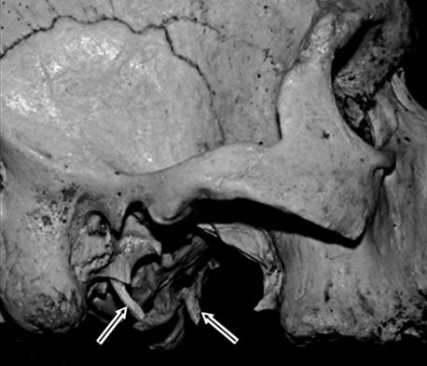
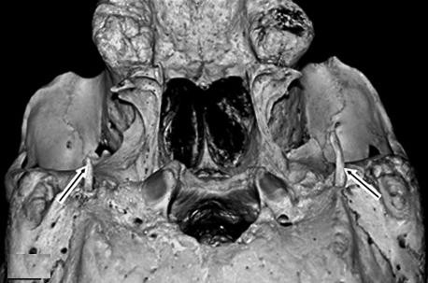
Normal Styloid Process

Slide 36
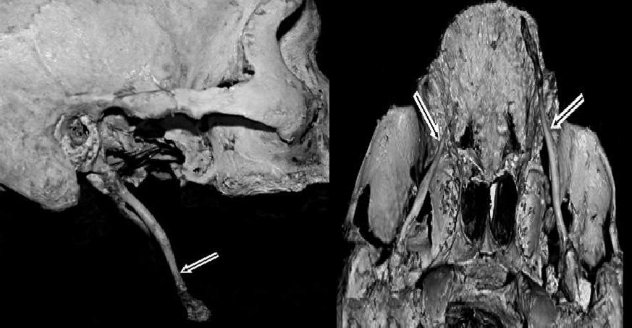
Elongated Styloid Process

Slide 37
Theories for ossification
Reactive hyperplasia
– Trauma → | ossification | of
fibrocartilaginous | remnants | in
stylohyoid ligament
Reactive metaplasia
  Abnormal post-traumatic healing
    calcification of stylohyoid ligament
Loss of elasticity of stylohyoid ligament

Slide 38
Theories for pain
Irritation of glossopharyngeal nerve
Irritation of sympathetic nerve plexus around internal carotid artery
Inflammation of stylohyoid ligament
Stretching of overlying pharyngeal mucosa

Slide 39
Diagnosis
Digital palpation of styloid process in tonsillar fossa elicits similar pain
Relief of pain with injection of 2%
Xylocaine solution into tonsillar fossa
X-ray neck lateral view
Ortho-pan-tomogram (O.P.G.)
Coronal C.T. scan skull
3-D reconstruction of C.T. scan skull

Slide 40
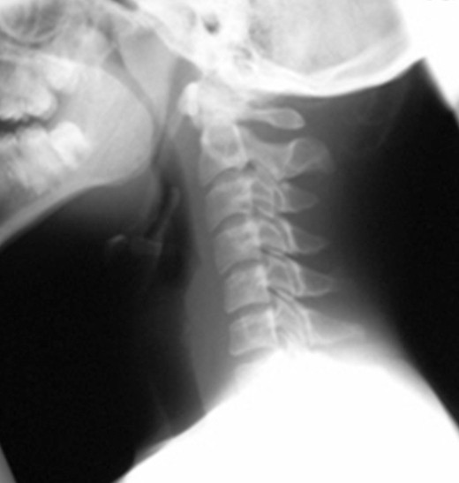
X-ray neck lateral view for Styloid process

Slide 41
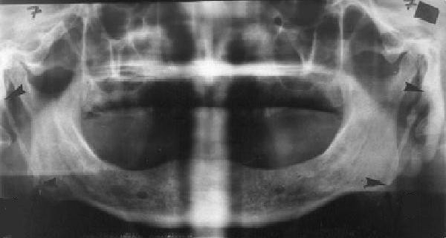
Ortho- Pantomogram

Slide 42
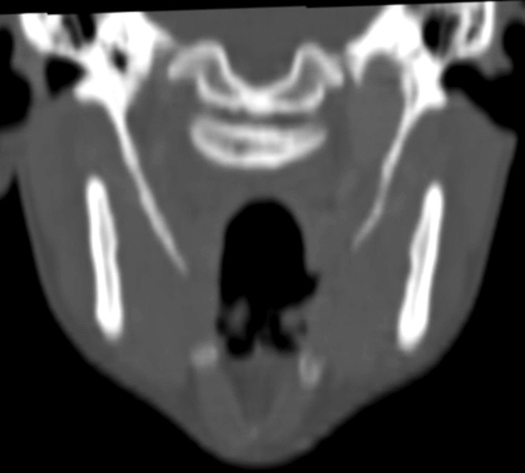
Coronal C.T. scan

Slide 43
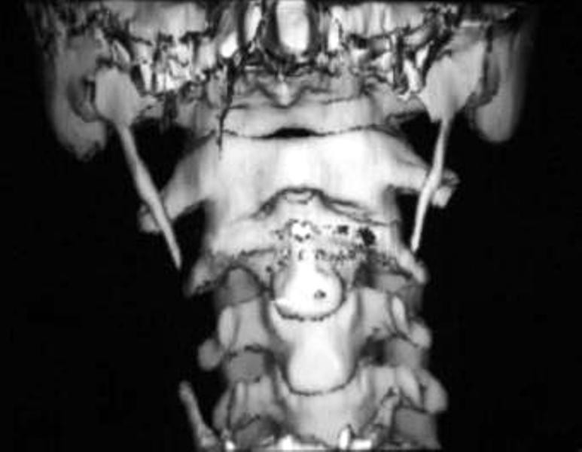
Coronal 3-D C.T. scan

Slide 44
Medical Treatment
Oral analgesics
Injection of steroid + 2% Lignocaine into tonsillar fossa
Carbamazepine: 100 – 200 mg T.I.D.
Operative intervention reserved for
  Failed medical management for 3 months
  Severe & rapidly progressive

Slide 45
Styloid Process Excision
Intra-oral route
  Via tonsillar fossa
  No external scarring
  Poor visibility due to difficult access
  High risk of damage to internal carotid artery
  Iatrogenic glossopharyngeal nerve injury

Slide 46
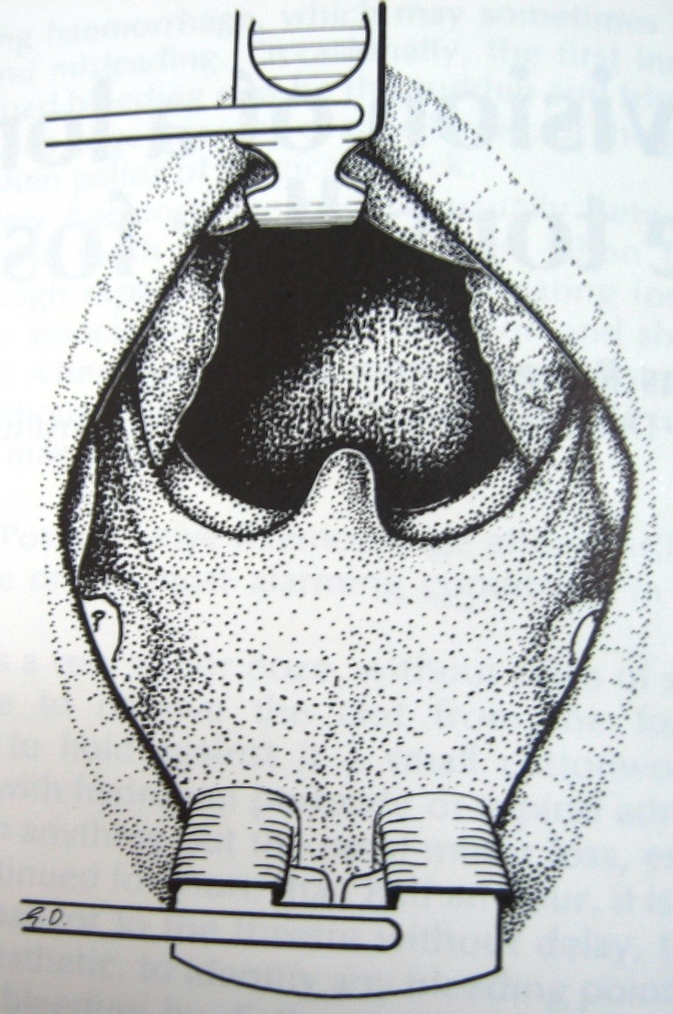
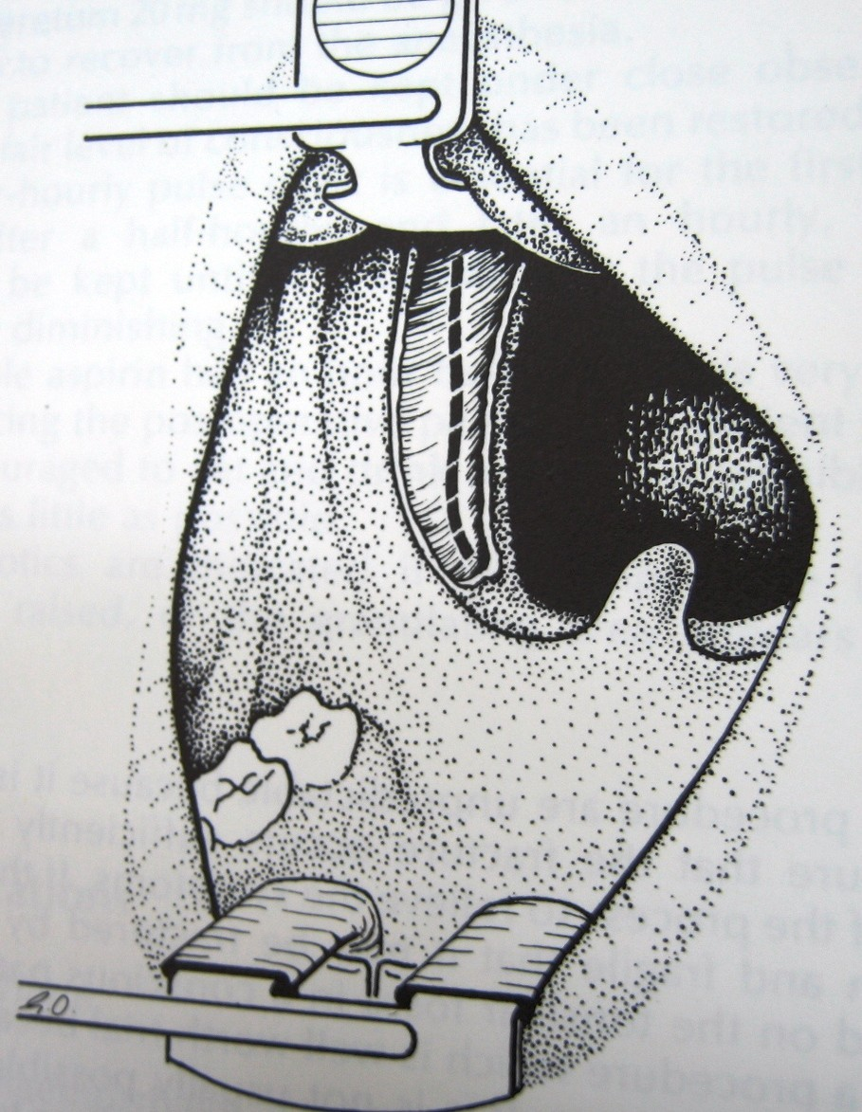
Tonsillectomy and fossa incision

Slide 47
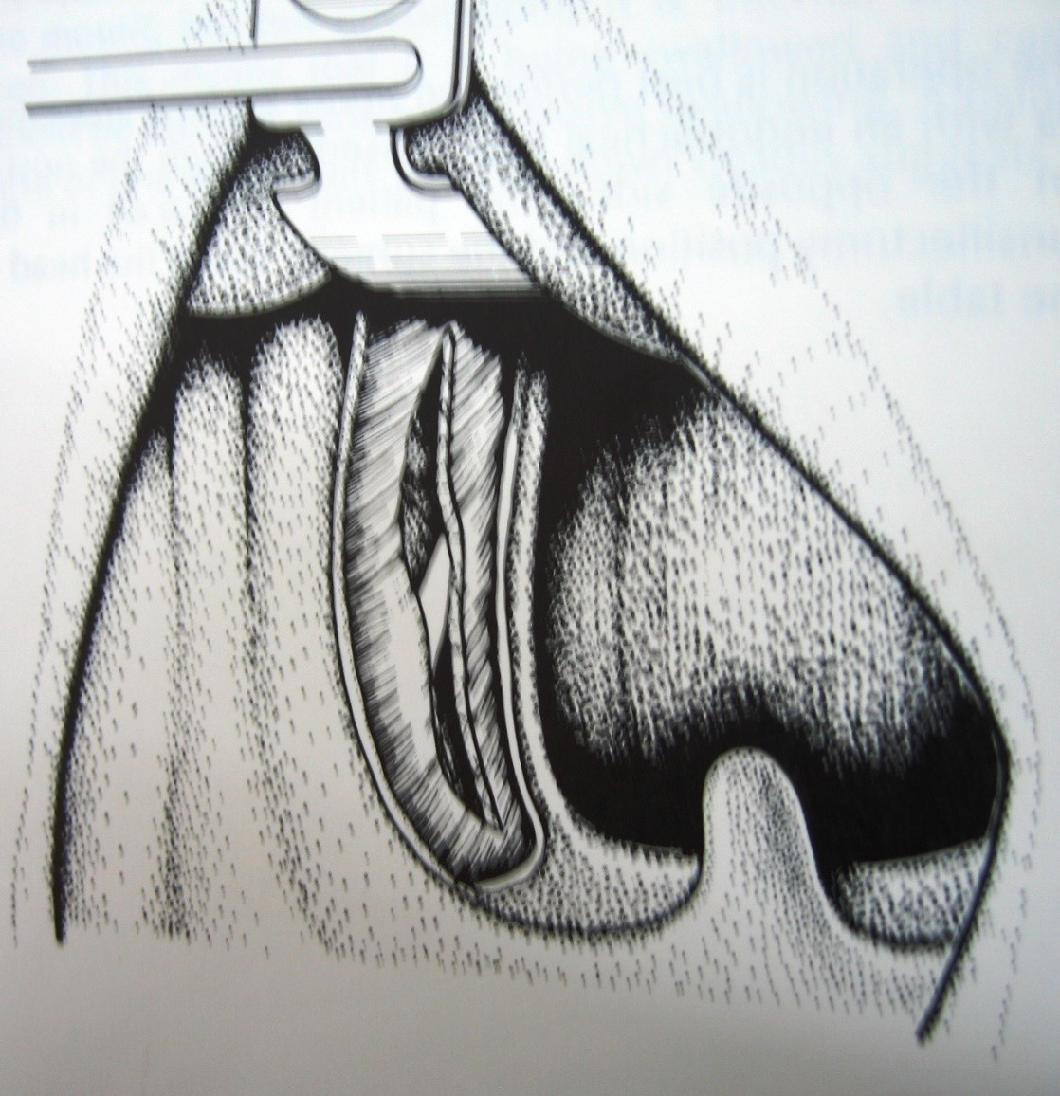
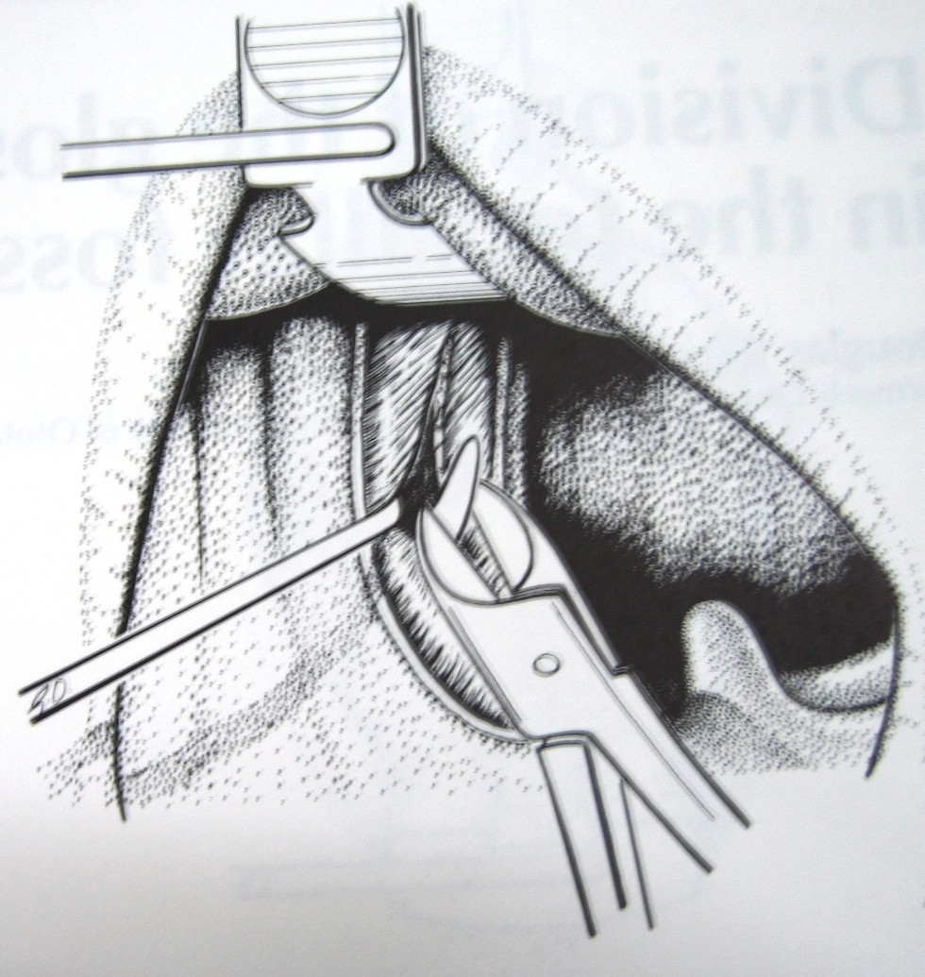
Styloidectomy

Slide 48
Tonsillectomy done and
process palpated
styloid
Incision made in tonsillar fossa just
over the tip
Styloid attachments elevated till its base with periosteal elevator
Styloid process broken near its base with bone nibbler, avoiding injury to

Slide 49
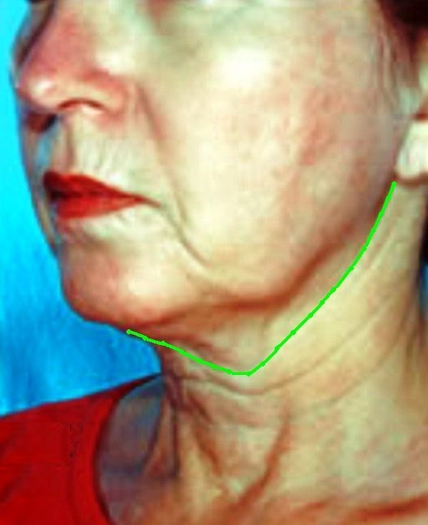
Extra- oral route
Incision extends from
mastoid along
process
the
sternocleidomastoid
to the level of hyoid then across neck up
to midline of chin
– External
scar

