Slide 2
Defined as simple, edematous, non-neoplatic, hypertrophied mucosa of paranasal sinuses and nasal cavity.
2 main types:
  Ethmoidal Polypi
  Antrochoanal Polyp
They can also be presenting features of fungal sinusitis and sino-nasal malignancy

Slide 3
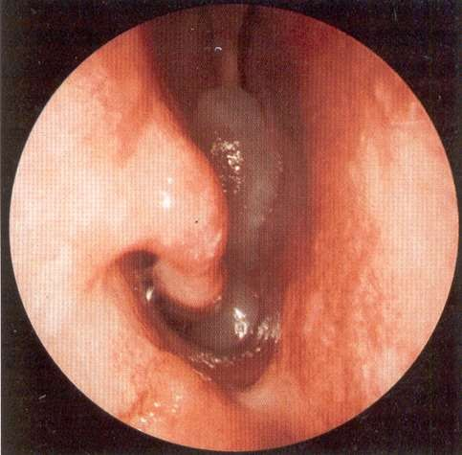

Slide 4
PATHOGENESIS OF NASAL POLYPS
There are 3 main factors involved:
The mucosal reactions at the Cellular level
Relatively poorly developed blood supply of the ethmoid sinuses
The complex anatomy of the ethmoid labyrinth

Slide 5
THEORIES OF PATHOGENESIS
Bernoulli Phenomenon
Bernoulli’s theorem postulates that, when gases or fluids pass through a constricted area, a negative pressure may develop in the vicinity of constriction. The lowered pressure leads to an increased formation of tissue fluid and subsequent Polyp formation.
Polysaccharide Changes
An alteration in the polysaccharides of ground substances has been
postulated by Jackson and Arihood.
Vasomotor imbalance
This is implied because of the majority of cases are not atopic and
no obvious allergen can be found.

Slide 6
4. Infection
Non-capsulated haemophilus influenzae.
Allergy
This has been implicated because of three factor:
  Histological picture where 90% or more of nasal polyps have an Eosinophilia
  Association with asthma
  Finally, the nasal findings which may mimic allergic symptoms and signs.

Slide 7
PROETZ THEORY:
Disease could be due to faulty development of the maxillary sinus ostium.
Hypertrophic mucosa of maxillary antrum sprouts out through this enlarged maxillary sinus ostium to get into the nasal cavity.
The growth of the polyp is due to
impediment to the venous return from the polyp at the level of the maxillary sinus ostium.

Slide 8
Samter’s triad
NARE syndrome
Kartagener syndrome
Young’s syndrome

Slide 9
CLINICAL FEATURES
Symptoms :
Nasal obstruction
Sneezing and running nose.
Partial loss of the sense of smell and alterations in taste are common complaints.
Hawking and cough may be present due to post nasal drip.
Although not frequent, pain does occur in patients with polyps and is usually over the bridge of nose, forehead and cheeks.
Epistaxis infrequent, occurs when squamous metaplasia takes place.

Slide 10
SIGNS
Patients have a distinctive hypo nasal voice.
Mouth Breathing.
Greyish pale glistening polypoidal mass can be seen through anterior rhinoscopy. It is insensitive and doesn’t bleed on touch. It is soft and mobile and can be probe all around except laterally.
Pale grey colour is due to poor blood supply but, in the presence of repeated trauma and inflammation, they may become reddened. The insensitivity is due to poor nerve supply.
Posterior Rhinoscopy : A Smooth Greyish Polypoidal mass occupying the choana – AC polyp.
A severe Eosinophilia may change the colour of the mucus from white to yellow or greenish yellow colour and was called allergic pus.

Slide 11
Hypertrophic inferior turbinates
JNA
Meningoencephalocele
Rhinosporidiosis
Inverted Papilloma
Granulomatous disease
Malignant tumour of nose.

Slide 12
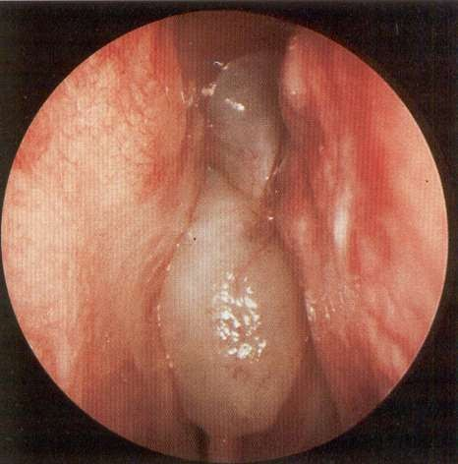

Slide 13
AC Polyp
Ethmoidal Polyps
Common in Children and adolescents
Arises from maxillary antrum
Usually Singale, Unilateral , 3 components – (Antral, Choanal, Nasal)
Extends backward due to wide choana, gravity, aircurrent, Ciliary movement , Accessory ostium is more posteriorly placed.
Recurrence less common
Common in middle age and elderly male.
Arises from anterior, middle and posterior group of ethmoids.
Usually, multiple, bilateral.
Extends forward
Common, about 20 - 40%
In long standing cases, there may be expansion or broadening of external nose, known as frog- face deformity

Slide 14
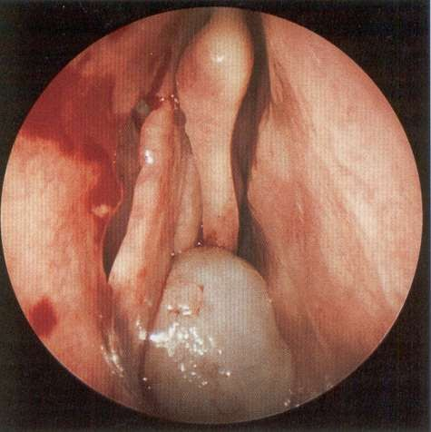
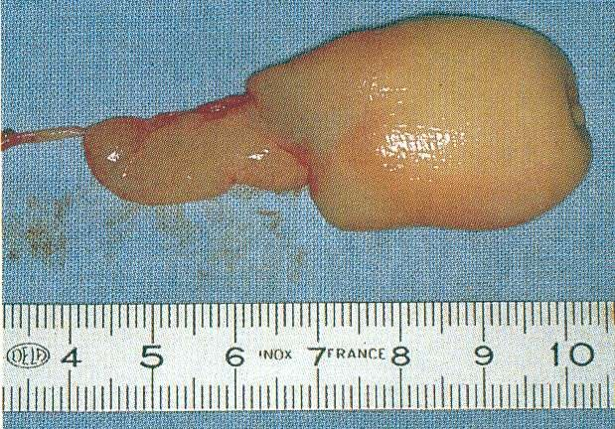

Slide 15
INVESTIGATIONS
Haematological
TC, DC, Hb%, ESR
Absolute eosinophil count
X-ray PNS
CT Scan PNS (Coronal and Axial views)
DNE

Slide 16
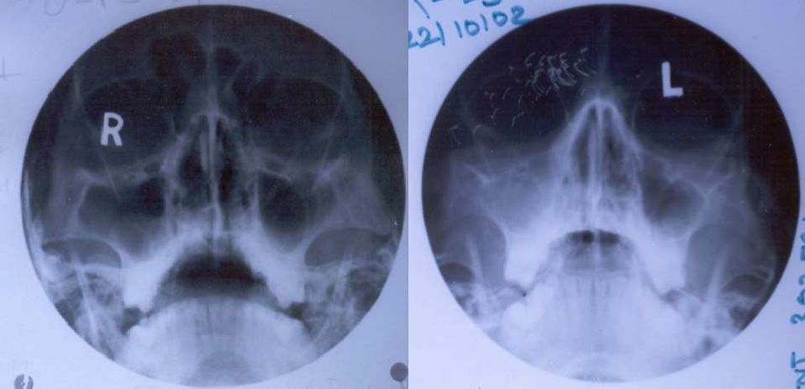

Slide 17
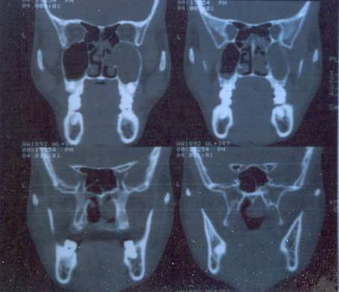

Slide 18
SURGERY FOR AC POLYP
Simple removal of the polyp by nasal Krause’s or Glegg’s snare or forceps
Caldwell- luc operation
Endoscopic assisted polypectomy

Slide 19
SURGERY FOR ETHMOIDAL POLYPS
MEDICAL MANAGEMENT
Antihistamines & Intranasal steroid sprays.
SURGICAL MANAGEMENT
Internal Ethmoidectomy
External Ethmoidectomy
Transantral Ethmoidectomy
Endoscopic assisted polypectomy followed by nasal steroids spray
more recurrence
more recurrence
– less recurrence

Slide 20
In most cases etiology is unknown
Polyps are associated with asthma, aspirin sensitivity, cystic fibrosis.
Symptomatic nasal polyps occur in 2% pts.
Osteomeatal complex is most common site.
Unilateral polyps should always be regarded with suspicion and HPE is needed to rule out malignancy

Slide 21



