Slide 1

Neck Space Infections

Slide 2
Parotid abcess
Ludwig’s angina
Peritonsillar abcess
Retropharyngeal abcess
Acute retropharyngeal abcess
Chronic retropharyngeal abcess
Parapharyngeal abcess

Slide 3

 It is suppuration of parotid space
 Deep cervical fascia splits into two layers
,superficial and deep.
 It enclose the parotid gland and its associated structures
 Parotid space lies deep to the superficial fascia

Slide 4
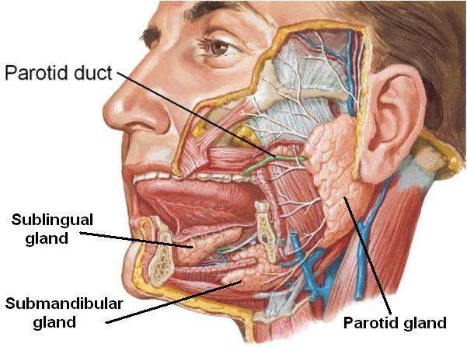

Slide 5
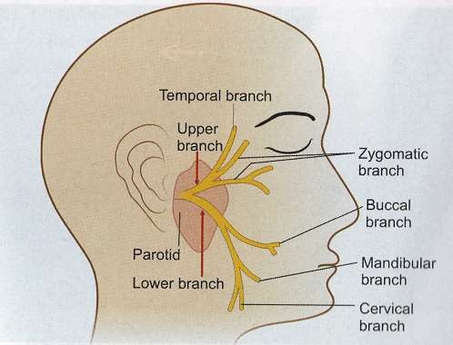
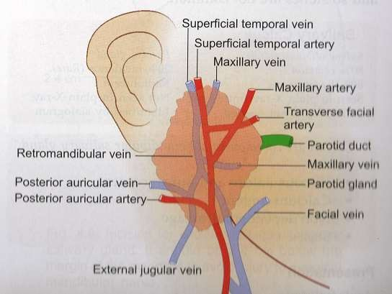
 Parotid space include :parotid gland ,parotid lymph node, facial nerve , external carotid artery and retromandibular vein

Slide 6

 Dehydration –particularly in post surgical cases and debilitated patients with stasis of salivary flow is the predisposing cause
 Infection from the oral cavity travels via the stenson’s duct to invade the parotid gland .
 Multiple small abcesses may form in the parenchyma ,they may then coalesce to form a single abscess

Slide 7

 Staphylococcus – most common
 Streptococci
 Anaerobic organisms
 Rarely gram negative organisms have been cultured

Slide 8

 Swelling
 Redness
 Induration
 Tenderness in the parotid area and at the angle of mandible
 Opening of the stenson’s duct becomes congested and may exude pus on pressure

Slide 9
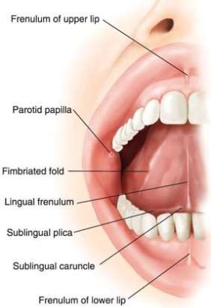

Slide 10

 USG
 CT
 Aspiration of pus can be done for culture and sensitivity

Slide 11

 Correct dehydration
 Improve oral hygiene
 Promote salivary flow
 Intravenous antibiotics
 Surgical drainage under local or general anaesthesia is carried out by a preauricular incision .

Slide 12
 It is the infection of submandibular space.
 Submandibular space lies between mucous membrane of the floor of mouth and tongue on one side and superficial layer of deep cervical fascia extenting between the hyoid bone and mandible on the other.

Slide 13
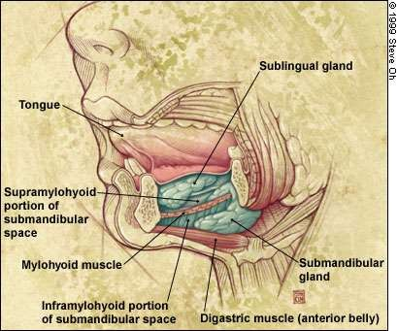

Slide 14
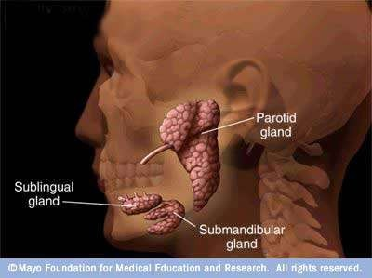

Slide 15
 Divided into two compartments by the mylohyoid muscle.
Sublingual compartment (above the mylohyoid)
Submaxillary and submental compartment (below the mylohyoid).
- around the posterior border of mylohyoid muscle the two compartments are continuous.

Slide 17

1) Dental infection: accounts for 80% of cases.
Premolar lies above the attachment of mylohyoid
cause sublingual space infection Molar teeth extent up or below the mylohyoid line
cause submaxillary space infection

Slide 18
2) Submandibular sialadenitis 3) injuries of oral mucosa
4) fracture of mandible

Slide 19
 mixed infection involving both aerobes and anaerobes are common
 Alpha haemolytic streptococci staphylococci
bacteroides groups are common.
 Rarely haemophilus influenzae Escherichia coli Pseudomonas are seen.

Slide 20
 Difficulty in swallowing (dysphagia) with varying degree of trismus.
 When infection is localised to sublingual space
,structures in the floor of the mouth are swollen and tongue seems to pushed up and back.
 When infection spreads to submaxillary space, submental and submandibular regions become swollen and tender,and impart woody hard feel.

Slide 21
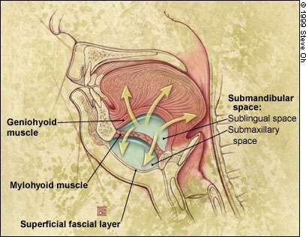

Slide 22
 Tongue is progressively pushed upwards and backwards threatening the airway .
 Laryngeal edema may appear.

Slide 23

Systemic antibiotics
Incision and drainage of abcess a)intraoral-sublingual b)external-submaxillary
Tracheostomy if airway is endangered

Slide 24

Spread of infection to parapharyngeal and retropharyngeal spaces and then to the mediastinum
Airway obstruction due to laryngeal oedema or swelling and pushing back of the tongue .
Septicaemia 4)Aspiration pneumonia

Slide 25
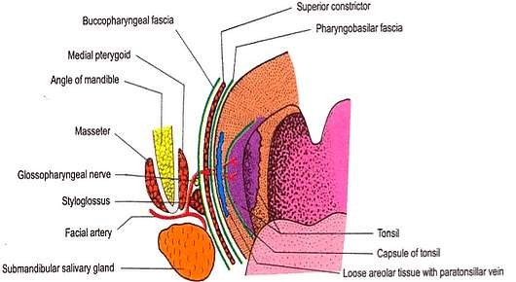
 Collection of pus in the peritonsillar space.
 Space lies between the capsule of tonsil and the superior constrictor muscle .

Slide 26
 Usually follows acute tonsillitis though it may arise without previous history of sore throat .
 First one of the crypts, crypta magna ,get infected and sealed off
forms an intratonsillar abscess
which then bursts through the tonsillar capsule to set up peritonsillitis and then abscess

Slide 27
 Pus culture shows growth of streptococcus pyogenes ,S.aureus or anaerobic organism .
 More often the growth is mixed with both aerobic and anaerobic organism.

Slide 28
 Mostly affects adults than children .
 Usually unilateral occasionally bilateral abscess are recorded .
 c/f divided into general and local .

Slide 29
 GENERAL: occur due to septicaemia Include : Fever(up to 104 degree F)
Chills and rigor General malaise Body aches Headache Nausea and Constipation

Slide 30
 LOCAL:
Severe throat pain.usually unilateral.
Odynophagia
(Hot potato voice) muffled and thick speech
Foul breath due to sepsis in the oral cavity and poor hygiene
Ipsilateral ear ache
Trismus

Slide 31

The tonsil, pillar and soft palate on the involved side are congested and swollen .
tonsil may not appear enlarged as it is buried in the oedematous pillars
Uvula is swollen and edematous and pushed to opposite side
Bulging of the soft palate and anterior pillar above the tonsil

Slide 32
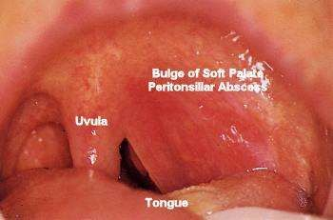
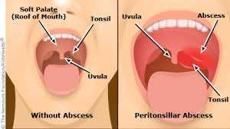

Slide 33
Mucopus may be seen covering the tonsillar region.
Cervical lymphadenopathy is commonly seen. This involves jugulodigastric lymph node.
Torticollis. Pt keeps the neck tilted to the side of abscess.

Slide 34
Hospitalization
Intravenous fluids to compact dehydration.
Antibiotics to cover both aerobic and anaerobic organisms.
Analgesic
Oral hygiene

Slide 35
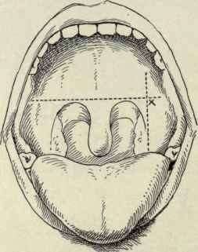
 If frank abscess has formed incision and drainage will be required

Slide 36
 Interval tonsillectomy: tonsils are removed 4-6 weeks following attack of quinsy.
 Abscess or hot tonsillectomy: it has the risk of rupture of the abscess during anaesthesia and excessive bleeding at the time of operation.

Slide 37
 Rare with modern therapy
parapharyngeal abscess
Oedema of larynx .tracheostomy may be required
Septicaemia
Pneumonitis or lung abscess
Jugular vein thrombosis
Spontaneous haemorrage from carotid artery or jugular vein

Slide 38
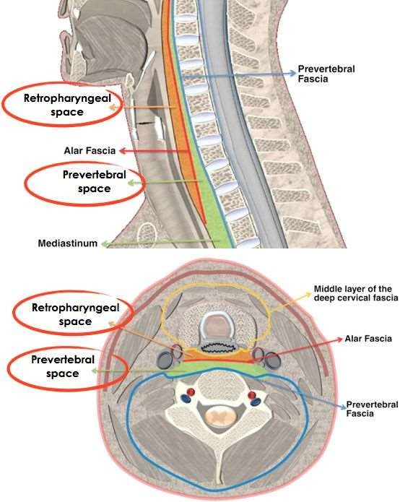

Slide 39
 Commonly seen in children below 3years.
 It is the result of suppuration of retro pharyngeal lymph node secondary to infection in the adenoid
,nasopharynx, posterior nasal sinuses or nasal cavity.

Slide 40
 In adults it may result from penetration injury of posterior pharyngeal wall or cervical oesophagus.
Rarely pus from acute mastoiditis tracks along the undersurface of petrous bone to present as retropharyngeal abscess

Slide 41

 Dysphagia and difficulty in breathing are the prominent symptoms.
 Stridor and croupy cough may be present.
 Torticollis
 Bulge in the posterior pharyngeal wall.
radiogragh of soft tissue lateral view of the neck shows widening of prevertebral shadow and possibly even the presence of gas.

Slide 42

 Incision and drainage
 Systemic antibiotics
 Tracheostomy

Slide 43
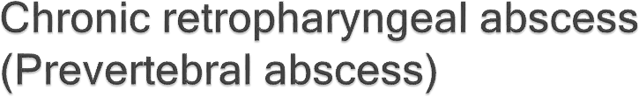
Aetiology:
 It is tubercular in nature
 Tubercular caries of cervical spine(presents centrally)
 Tubercular infection of retropharyngeal lymphnode secondary to tuberculosis of deep cervical nodes.(limited to oneside of midline)

Slide 44

 Discomfort in throat
 Dysphagia not marked
 Posterior pharyngeal wall shows a fluctuant swelling centrally or on one side of midline
 Neck may show tubercular lymph node

Slide 45
 Incision and drainage:
can be done through a vertical incision along the anterior border of sternomastoid (for low abcess)
or along its posterior border (for high abscess)
 Antitubercular therapy

Slide 46
Aetiology:
Pharynx: acute and chronic infection of tonsil and adenoid,bursting of peritonsillar abscess
Teeth: usually from the lower last molar tooth 3)Ear: Bezold abscess and petrositis
4)Other spaces: infections of parotid, retropharyngeal and submaxillary spaces

Slide 47
5) External trauma: penetrating injuries of neck, injection of local anaesthetic for tonsillectomy
or mandibular nerve block

Slide 48
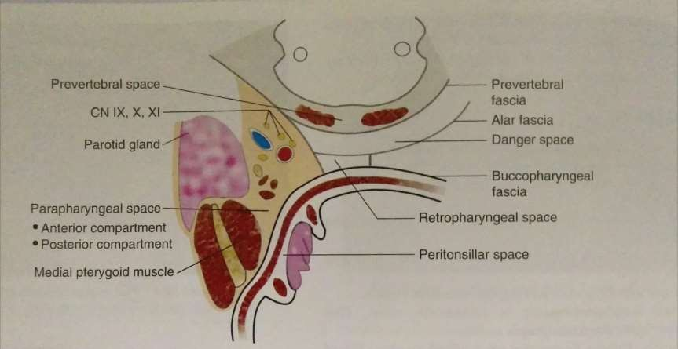

Slide 49
 Depends on the compartment involved
 Styloid process and the muscles attached to it divide the parapharyngeal space into anterior and posterior compartment
 Anterior compartment is related to tonsillar fossa medially and medial pterygoid muscle laterally

Slide 50
 Anterior compartment produce a triad of symptoms
prolapse of tonsil and tonsillar fossa
Trismus
External swelling behind the angle of jaw

Slide 51
 Posterior compartment is related to posterior part of lateral pharyngeal wall medially and parotid gland laterally
 Through the posterior compartement pass the carotid artery,jugular vein, lXth ,Xth,Xlth,Xllth cranial nerves and sympathetic trunk.also contains upper deep cervical nodes
 It communicates with retropharyngeal, submandibular, parotid,carotid and visceral

Slide 52
 Posterior compartment involvement produce
bulge of pharynx behind the posterior pillar
Paralysis of CN lX,X,Xl and Xll and sympathetic chain and sympathetic chain
Swelling of parotid region
 minimal trismus or tonsillar prolapse

Slide 53
 Fever
 Odynophagia
 Sore throat
 torticollis
 signs of toxaemia are common to both compartment

Slide 54

 Systemic antibiotics
 Drainage of abscess

Slide 55
1)Acute odema of larynx with respiratory obstruction 2)Thrombophlebitis of jugular vein with septecaemia 3)Spread of infection to retropharyngeal space 4)Spread of infection to mediastinum along the
carotid space
5)Carotid blow out with massive haemorrhage.

Slide 56


