Slide 1
OBSTRUCTIVE SLEEP APNOEA

Slide 2
SLEEP APNOEA
No breathing at all
there is no movement of air at the level of nose and mouth

Slide 3
Types
Obstructive: There is collapse of the upper airway resulting in cessation of air flow. Other facotrs may be obstructive conditions of nose nasopharynx, oral cavity and oropharynx, base of tongue or larynx
Central: airways are patent but brain gails to signal the muscle to breath.
Mixed: It is combination of both types

Slide 4
Pathophysiology of OSA
Apnoea during sleep causes hypoxia and retention of carbon dioxide which leads to pulmonary constriction leafing to congestive heart failure, bradycardia and cardiac hypoxia leading to left heart failure and cardiac arrhythmias sometimes leading to sudden death.
During sleep apneoa there are frequent arousals which cause sleep fragmentation daytime sleepiness and other manigestations

Slide 5
Physiology of Sleep
A normal healthy adult sleeps for 7-8 hours. Sleep ocucrs in two phases: non REM (non rolling eye movement) and REM (rolling eye movement). THe 2 phases ovvur in semiregular cycles, each cycle lasting for 90-120minutes.

Slide 6
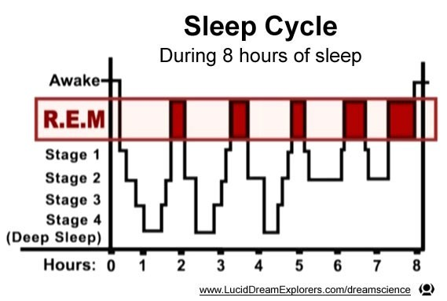

Slide 7
Non REM sleep 75-80%
Stage | Events | EEG
I (2-5%) | Transition from wakefulness to sleep Muscle tone is less Person can easily be aroused from sleep | EEG shows decrease of alpha and increase in theta waves.
II (45-55%) | Decrease in muscle tone | Sleep spindles or K complexes
III (3-8%) | Deep sleep | delta waves
IV (10-15%) | Deep, most restful sleep | delta waves

Slide 8
REM Sleep
Forms 20-25% of total sleep characterised by rapid eye movements, increased autonomic activity with erratic cardiac and respiratory movements, Dreaming occurs in this stage but muscular activity is decreased so that dreaming is not enacted.

Slide 9
NREM vs
REM
•
•
•
75-80%
No eye rolling
Less autonomic activity gives slow heart rate low BP slow and steady respiration
Minimal brain activity Less muscular activity
EEG passes from alpha to delta waves from stage I to IV
No dreaming
•
•
20-25%
Rapid conjugate eye movements
Increased autonomic activity with fluctuations in BP, heart rate and respiration
Brain is active Decreased muscular activity. Snoring and OSA occur in this stage
Mixed frequency low voltage waves with occasional burst of saw tooth waves
Dream
•
•
•
•
•
•
•
•

Slide 10
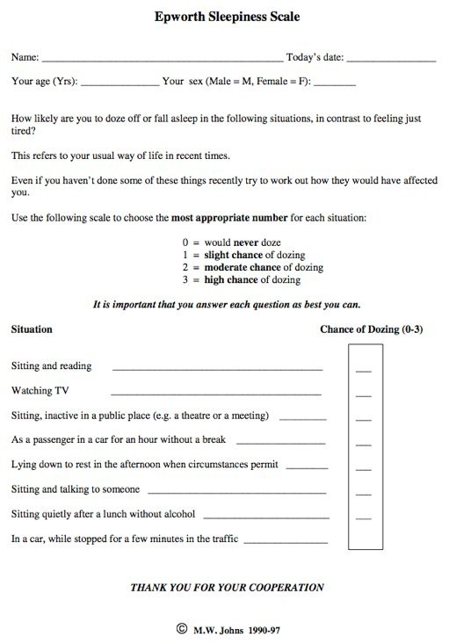

Slide 11
Consequences of Obstructive Sleep Apnoea
Congestive heart failure / cor pulmonale
Polycythemia and hypertension
Atrial and centricular arrhythmias and left heart failure
Attacks of angina
Snoring spouse
Loss of memory
Decreaed libido
traffic accidents

Slide 12
Grading
0-15
15-30
30

Slide 13
Clinical Evaluation
Patient;s bed partner goves more reliable information than the patient himself because latter does not know what happened duringsleep
History should include snoring during sleep restless disturbed sleep -Epworth Sleep Scale
fatigue, irritable, morning headaches, memory loss and impotence.
Also one should eliit history of body position during sleep, use of alcohol, sedatives and affeine intake, mouth breathing and history of menopause or having hormonal replacement theray

Slide 14
Physical Examination
Body mass index
Collar size - neck circumference at the level of criothryroid membrane is measured
collar size should not exceed 42cm in males and 37.5cm in females
Complete head and neck examination: look for to sillar hypertrophy, retogtnathia macroglossia, elongated soft palate and uvula, base of tongue tumours, septal deviation, nasal polyps, turbinate hypertrophy and nasal valve collapse. Also examine nasopharynx and larynx

Slide 15
Systemic examination is done to look for hypertension congestive heart failure, pedal edema, truncal obesity and any sign of hypothyroidism
Cephalometric radiograph anomalies and tongue base obstruction
Polysomnography: gold standard

Slide 16
Polysomnography
•
•
•
•
EEG: electroencephalogram to look for nonREM ECG: HR and rhythm
EOM: electro-oculogram- for rolling eye movement
EMG: electromyography recorded from submental and tibialis anterior muscle
Pulse oximetry : to assess oxygen satyratuin of blood to know lowest SaO2 during sleep
Nasal and oral airflow: for episodes apnea and hypopnoea
Sleep position: helps to know whether apnoea/ hypopnoea, episodes occur in supine or lateral recumbent position.
Blood pressure
Oesophageal pressure: not done in all laboratories , negative esophageal pressure helps to know degree of breathing efforts made by the patients
•
•
•
•
•

Slide 17
Split Night Polysomnography
In this study, the first part of night is used in usual polysomnography while the second part of night is used in titration of pressure (CPAP). It is not recommended because episodes of sleep apnoea occur more often in the second hald of night and are thus missed.
Titration of pressures for CPAP should ideally be done on a second night
Polysomnography can differentiate between primary snoring, pure OSA and central sleep apnoea

Slide 18
Treatment (Non-surgical)
Change in lifestyle
Those with mild disease and minimal symptoms can be treated with weight loss and dietary changes bt those with cor pulmonale as a result of severe OSA may require permanent tracheostomy
Use of alcohol in the eveining aggraates OSA. Sedatives/ hypnotics taken at night also have the same effect.
Smoking should be avoided
Reduction of weight is avoided

Slide 19
Positional therapy
sleep on the side as supine position may cause obstructiv apnoea. A rubber ball can be fixed to the back of shirt to prevent adoptong supine position
Intraoral devices
alter the position og mandible or tongue to open the airway ad relive snoring and sleep apnoea. Manfible advancement device (MAD) keeps the mandible forward while tongue retaining device (TRD) keeps tongue in anterior position during sleep. They help improve or abolish snoring. MAD is also useful in retrognatic patients

Slide 20
Continuous Positive Airway Pressure
Provides pneumatic splint to airway and increases its calibre. Optimum airway pressure for deice to open the airway is determined during sleep study and is usually kept at 5-20cmH20
About 40% of patients fing the use of CPAP device cumbersome and difficult to carry with them when travelling and thus stop using it when CPAP is not tolerated, a BiPAP (bilevel positive airway pressure) device is used. It delivers positive pressure at two fixed levels- a higher inspiratory and a lower expiratory pressure. Now an autotitrating PAP is also available which continuously adjusts the pressure. Their advantage are same as those of CPAP.
•

Slide 21
Surgery
It is indicated for failed or non compliant medical therapy
Permanent tracheostomy is the gold standard of treatment but it is not accepted socially and ha complication of its own.
It is usually not a preferrd option by patients
Surgical procedures used in OSA include

Slide 22
Nasal Surgery
Primary or aggravating factor of OSA
septoplasty to correct DNS, removal of nasal polyps and reduction of turbinate size jelp to relieve nasal obstructuction
Sometimes nasal surgery is also indicated for efficient use of CPAP

Slide 23
Oropharyngeal surgery
Uvulopalatoplasty (UPP) is the most common prorcedure performed for snoring and OSA. It s 80% effective in snoring but OSA is relieved only in terms of because of another site becoming acive in the cause of abstruction (base oftongue)
UPP can be laser or radiofrequency assisted.

