Slide 1

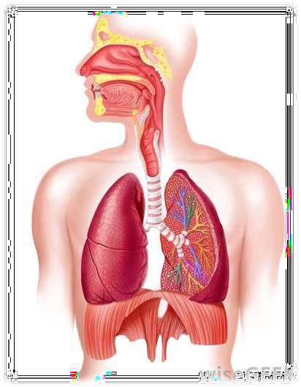
AIRWAY FOREIGN BODY

Slide 2

EPIDIMIOLOGY
 Most airway foreign body aspirations occur in children younger than 15 years.
 Children aged 1-3 years are the most susceptible.

Slide 3
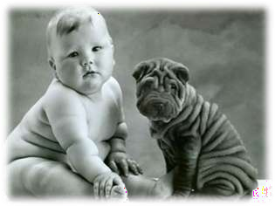
ETIOLOGY
Young children are susceptible because:
 They lack molars for proper grinding of food.
 They tend to be running or playing at the time of aspiration.
 They tend to put objects in their mouth
more frequently.
 They lack coordination of swallowing and glottic closure.

Slide 4
PATHOPHYSIOLOGY
 Food items are aspirated most commonly;
 Peanuts are the most frequently aspirated
food
 After foreign body aspiration occurs, the foreign body can settle into 3 anatomic sites, the larynx, trachea, or bronchus.

Slide 5

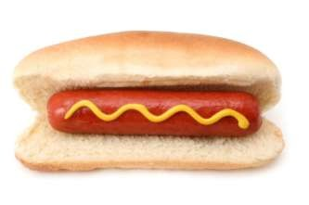
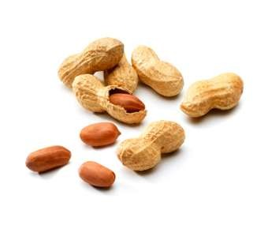
HIGH RISK ITEMS
 Hard Food
 Hot Dog
 Peanut
 Grapes
 Beans
 Seeds

Slide 6
STAGES/PHASES OF FOREIGN BODY ASPIRATION
 Initial phase - Choking and
gasping, coughing, or airway obstruction at the time of aspiration
 Asymptomatic phase - Subsequent lodging of the object with relaxation of reflexes that often results in a reduction or cessation of symptoms, lasting hours to weeks
 Complications phase - Foreign body producing erosion or obstruction leading to pneumonia, atelectasis, or abscess

Slide 7
FOREIGN BODY IN THE NOSE
 Symptoms:
Difficulty breathing through the affected nostril.
Feeling of something in the nose
Foul-smelling
Bloody nasal discharge
Irritability, particularly in infants
Irritation or pain in the nose

Slide 8
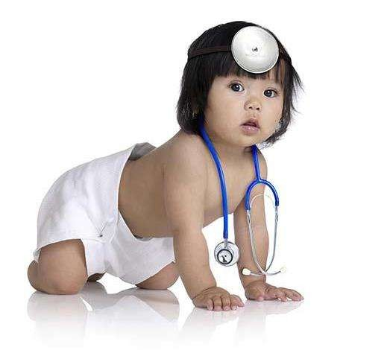
DIAGNOSIS
 Patient history
 Rhinoscopy
 Radiograph

Slide 9
METHOD OF REMOVAL
Give anaesthesia – general or local
Visualization
Removal

Slide 10

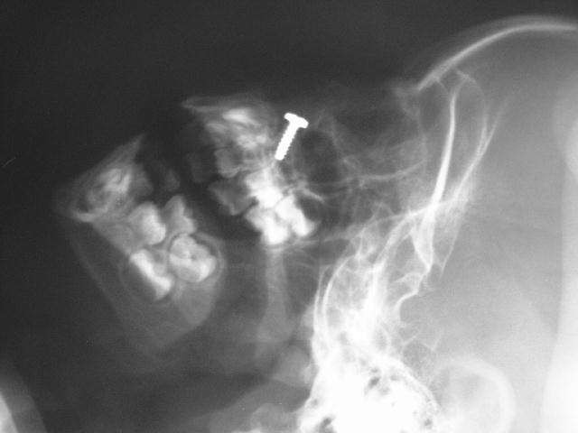
 2 year-old boy inserted a screw in his left nostril. The lateral film of the skull shows the metallic foreign body.

Slide 11
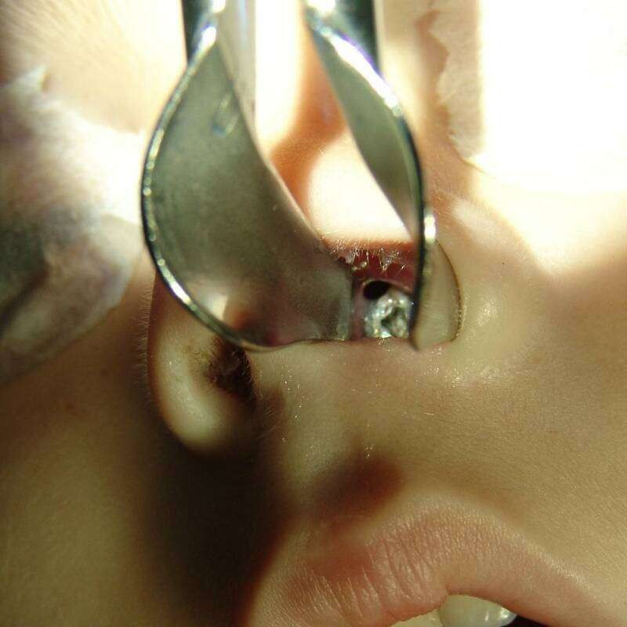
 The screw was removed from the patient's left nostril under general anaesthesia.

Slide 12
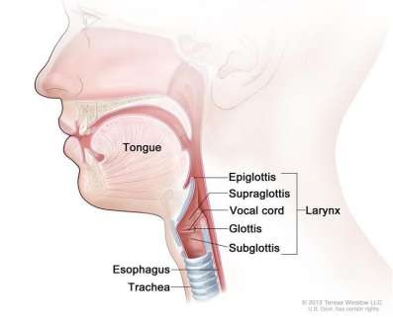
FOREIGN BODY IN THE LARYNX
 Laryngeal foreign bodies usually cause complete or partial airway obstruction.

Slide 13
LARYNGEAL FOREIGN BODY SYMPTOMS
 Croup(laryngotracheobronchitis)
 Stridor(abnormal, high-pitched, musical
breathing sound)
 Cough
 Hoarseness
 Dyspnoea
 Odynophagia(painful swallowing)
 Aphonia

Slide 14
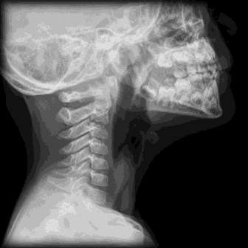
DIAGNOSIS
 Roentgenographic or fluoroscopic
examination.

Slide 15
MANAGEMENT
 Heimlich manoeuvre
 Tracheotomy
 Laryngoscopy

Slide 16
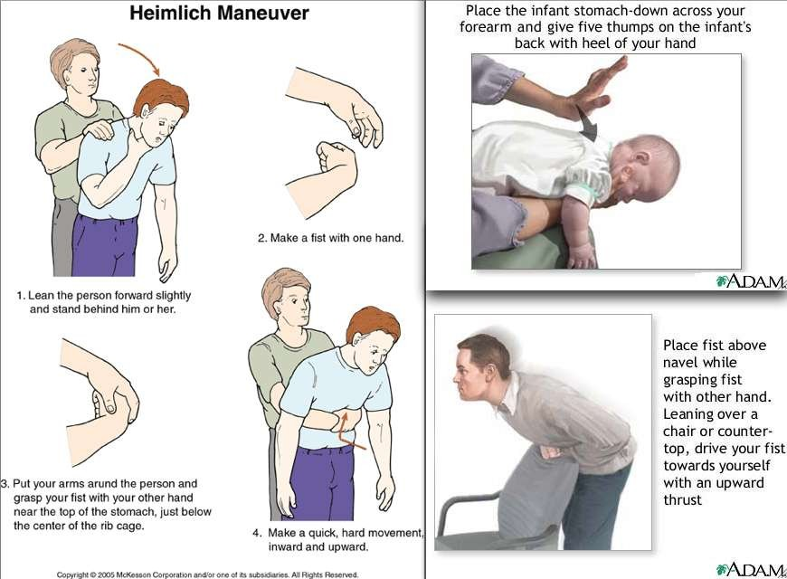

Slide 17
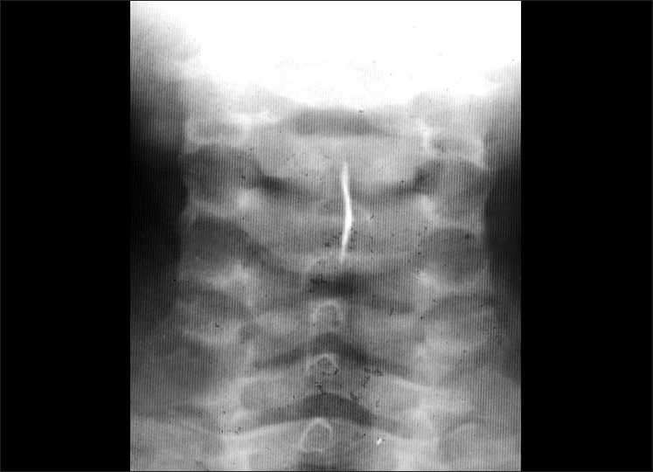

Slide 18
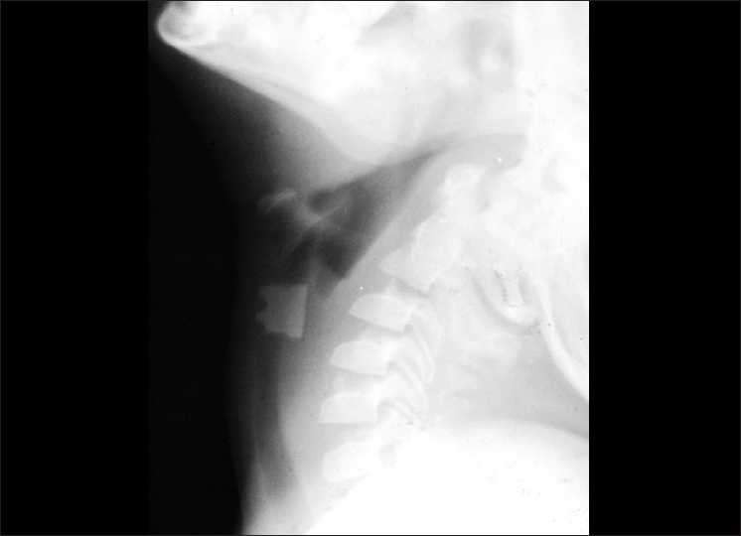

Slide 19
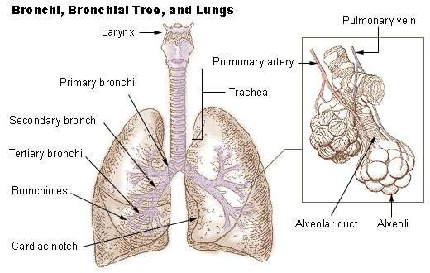
TRACHEOBRONCHIAL TREE FOREIGN BODY
 The main symptoms are
episodes of coughing,
intermittent or continuous dyspnoea with cyanosis, pain, and intermittent hoarseness.

Slide 20
SITE
 This depends on the size and shape of the foreign body.
 The most common site is the right main bronchus because of its straighter angle of origin from the trachea.

Slide 21
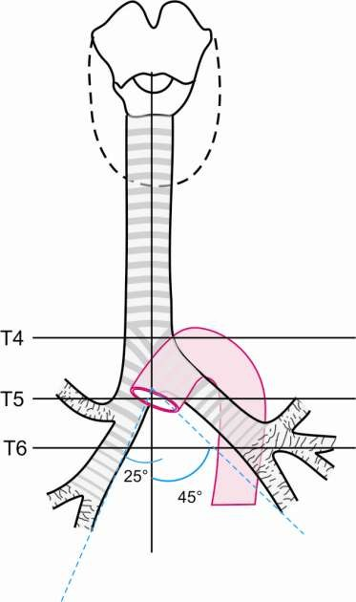

Slide 22
SITE
 If the foreign body is retained for a longer period the following occur depending on the type of foreign body and duration:
accumulation of secretions;
tracheitis or bronchitis with edema,
swelling, and granulations;
bleeding and bloodstained secretions;
inspiratory and expiratory valvular stenoses;
partial obstruction of the lower airway or emphysema;
atelectasis or overinflation of the poststenotic part of the lung.

Slide 23
DIAGNOSIS
 Roentgenographic or fluoroscopic examination.

Slide 24
TREATMENT
 Bronchoscopy(under general anesthesia)

Slide 25


