Slide 1
ANATOMY OF PARANASAL SINUSES

Slide 2
DEFINITION Air containing cavities in certain bones of the skull.
Paranasal sinuses are four on each side:
*ANTERIOR GROUP
Maxillary sinus
Frontal sinus
Anterior ethmoidal sinus
*POSTERIOR GROUP
Posterior ethmoidal sinus
Sphenoid sinus
Notes:
DEFINITION
Air containing cavities in certain bones of the skull.
They are four on each side:
Anterior group :
*Maxillary
*Frontal
*Ethmoidal

Slide 3
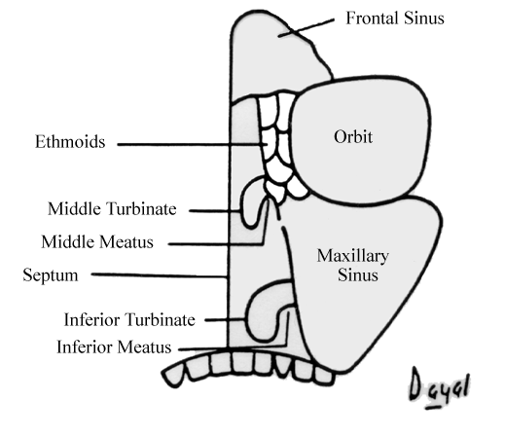

Slide 4
FUNCTIONS :
Warms up inspired air.
Resonance of voice.
Temperature buffer.
Decreases weight of bone.
Sinus mucosa acts as the donor site for reconstructive surgery.
Increases olfactory area.
Acts as shock absorber.
Secrets mucus.
Contributes to facial growth.

Slide 5
MAXILLARY SINUS
Antrum of Highmore
Largest Paranasal sinus
Occupies body of maxilla
Pyramidal in shape
Base- lateral wall of nose
Apex- Laterally to zygomatic process.
Dimensions :
Antero-Posterior : 3-4cm
Transeversely : 2.5cm
Height : 3.3cm

Slide 6
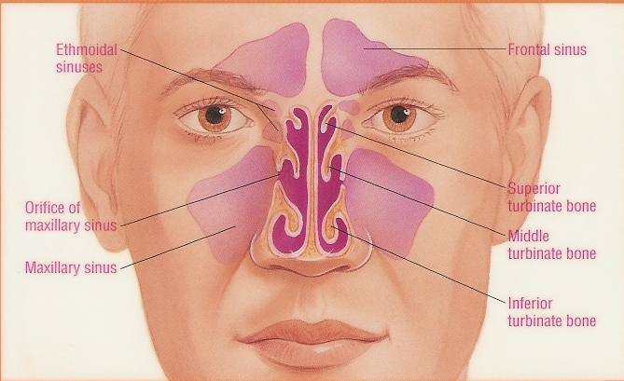

Slide 7
RELATIONS
*ANTERIOR WALL
Anterior wall of maxilla
* POSTERIOR WALL
Infra temporal & pterygopalatine fossae
* MEDIAL WALL
Middle and inferior meatuses
* FLOOR
Alveolar and palatine process of maxilla
* ROOF
Floor of the orbit

Slide 8
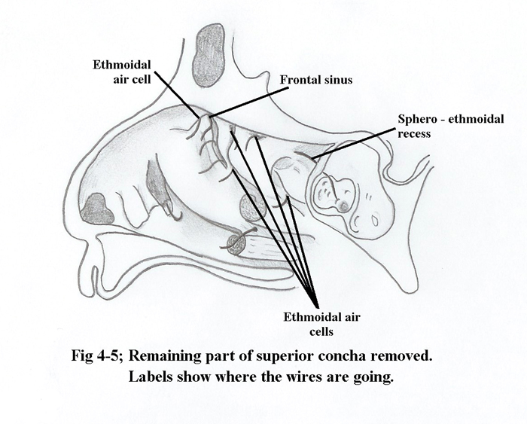

Slide 9
BLOOD SUPPLY :
Facial artery
Infraorbital artery
Greater palatine artery
Sphenopalatine artery
NERVE SUPPLY :
Greater palatine nerve.
Posterior lateral nasal nerves
Superior alveolar nerve
Parasympathetics from sphenopalatine ganglion

Slide 10
FRONTAL SINUS
SITE
Present between the inner and outer tables of the frontal bones,above and below to the supra orbital margins.
It may be absent on one or both sides
Dimensions :
Height 28mm
Width 24mm
Depth 20mm

Slide 11
RELATIONS
*ANTERIOR WALL
Skin over fore head
*POSTERIOR WALL
Meninges and frontal lobe of the brain
*INFERIOR WALL
Orbit and its contents
*FLOOR
Opening of the frontal sinus which leads to middle meatus

Slide 12
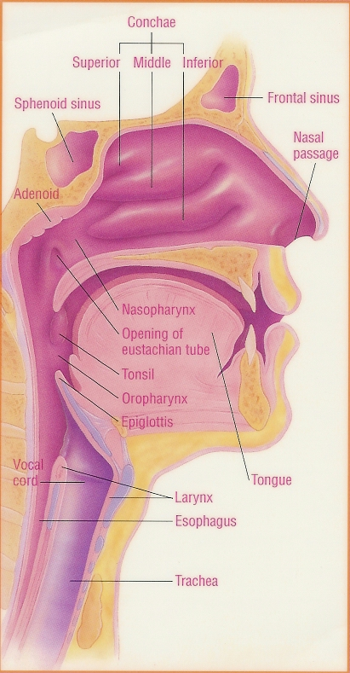

Slide 13
DRAINAGE
Frontal recess – 55%
Above Infundibulum-30%
Into Infundibulum-15%
Above bulla ethmoidalis- 1%

Slide 14
BLOOD SUPPLY :
Supraorbital artery
Supratrochlear artery
VENOUS DRAINAGE :
Superior ophthalmic veins
Anterior facial veins to EJV
NERVE SUPPLY :
Supraorbital nerves
Supratrochlear nerves

Slide 15
ETHMOIDAL SINUS
ETHMOIDAL AIR CELLS
SITE
Lateral mass of ethmoidal bone. Occupies the space between upper one third of lateral nasal wall and the medial wall of orbit
TYPES..
** Anterior ethmoidal cell
opens into middle meatus
** Posterior ethmoidal cell
opens into superior meatus and sphenoethmoidal recess

Slide 16
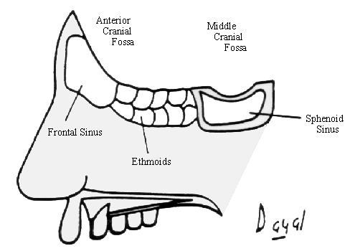

Slide 17
RELATIONS
ROOF
Anterior cranial fossa lateral to cribriform plate
Meninges of the brain
LATERAL WALL
Orbit

Slide 19
BLOOD SUPPLY :
Anterior ethmoidal artery
Posterior ethmoidal artery
Sphenoidal artery
VENOUS DRAINAGE :
Nasal veins
Anterior ethmoidal veins
Posterior ethmoidal veins
NERVE SUPPLY :
Anterior ethmoidal nerve
Posterior ethmoidal nerve

Slide 20
SPHENOID SINUS
Occupies the body of sphenoid
The two , right and left sinuses are rarely symmetrically and are separated by thin bony septum
Ostium of sphenoid is situated in the upper part of its anterior wall and drains into sphenoethmoidal recess
Word meaning of sphenoid is wedge shaped.
Dimensions :
Length – 23mm
Width – 17mm
Height – 20mm
Capacity : 0.5 to 30ml

Slide 21
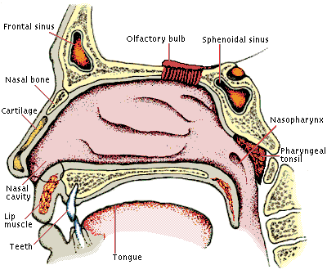

Slide 22
RELATIONS
*ANTERIOR PART
** ROOF
Olfactory tract,optic chiasma & frontal lobe
** LATERAL WALL
Optic nerve,ICA & Maxillary nerve
*POSTERIOR PART
** ROOF
Pituitary gland in Sella Turcica
**LATERAL WALL
Cavernous sinus,ICA,Cranial nerves

Slide 23
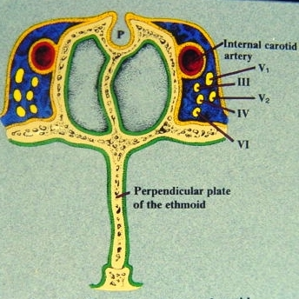

Slide 24
BLOOD SUPPLY :
Posterior ethmoidal artery
Sphenopalatine artery
NERVE SUPPLY :
1st & 2nd division of trigeminal nerve.

Slide 25


